Slide 1
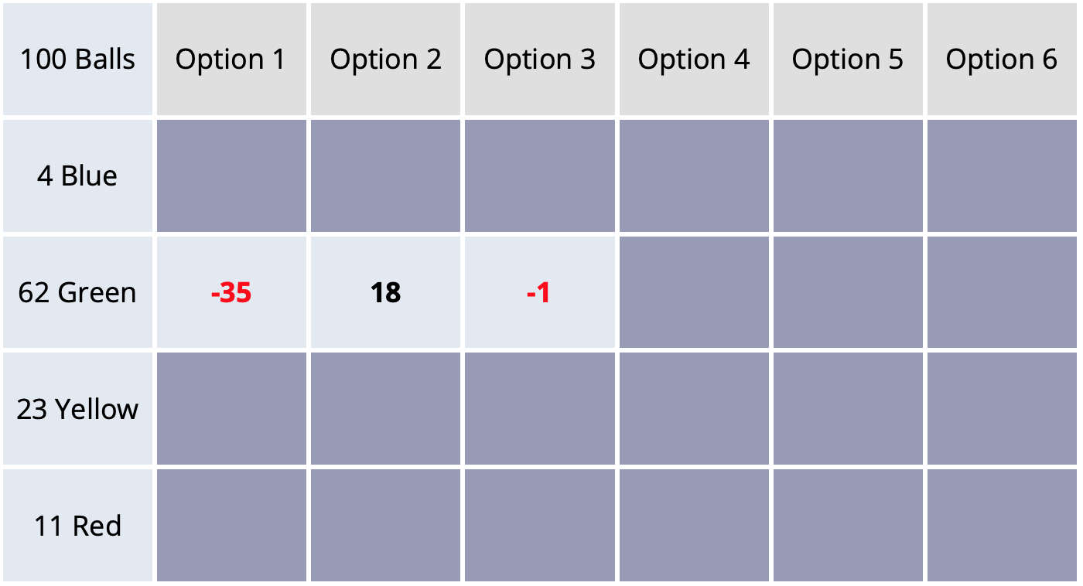
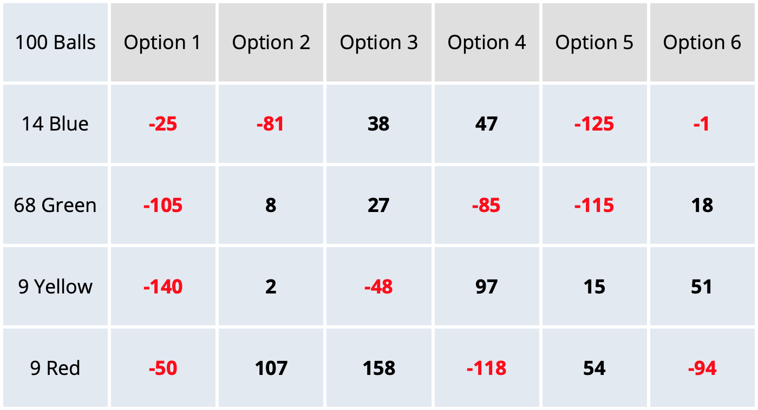








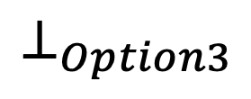


cost incurred for
reward received
each computation
from gamble
belief entails mean and variance for each option
$$r_{meta}$$
$$r_{meta}$$
$$r$$
state resultant
from gamble
$$b_{0}$$
$$b_{1}$$
$$b_{4}$$
$$s_{⊥}$$
You win 107 points!
. . .
$$⊥_{Option3}$$
$$c_{0}$$
$$c_{1}$$
computation made
by clicking on a cell
deliberation terminated and gamble selected

