Slide 1
Virtual Machine Introspection
Observation or Interference?
Kara Nance and Brian Hay University of Alaska, Fairbanks
Matt Bishop University of California, Davis
報告人：倪丞頤

Slide 2
Abstract
Virtualization becomes increasingly mainstream
Virtual machine introspection techniques and tools are evolving to monitor VM behavior
Notes:
VMI 技術已經逐漸監測 VM 行為

Slide 3
Agenda
Virtualization or Not
Virtualization Overview
Type of VM manager
Memory Mapping
VMI Classifications
VIX (Virtual Introspection for Xen)

Slide 4
Without Virtualization
One machine, one operating system, one application
  To close one application to open another
  Often to spend more time waiting than doing as a result
The advent of many applications lets users run multiple programs

Slide 5
Virtualization
Lets users have“one machine, multiple operating systems, multiple applications”
Switch between them at will
Lets developers easily test their programs on multiple OSs
Enterprise users more effectively utilize hardware through server consolidation
Also useful to computer users in general
Provides some security benefit
Notes:
商業使用者能更有效的利用硬體
更一般性的計算使用者行為

Slide 6
VMI
Virtual Machine Introspection
Techniques and tools to monitor VM behavior
Inspect a VM from the outside to assess what's happening on the inside
Possible for security tools
  Virus scanners
  Intrusion detection systems
Observe and respond to VM events from a "safe" location outside the monitored machine
Notes:
由外檢查 VM 內部的事件
在監測的機器外的 “安全” 處觀察和回應 VM 事件

Slide 7
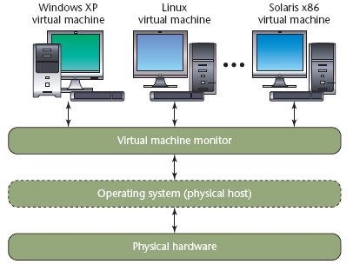
Virtualization Overview

Slide 8
Virtualization Overview
A Virtualized environment
VM monitor provides the interface between each VM and the underlying physical hardware
OS layer (Physical host) is optional

Slide 9
Type 1 of VM managers
VMM runs directly on the physical hardware
Eliminating an abstraction layer
Often improving efficiency as a result
VMware ESX, Xen, and Microsoft Hyper-V
Notes:
忽略抽象層 (OS)
改善效能

Slide 10
Type 2 of VM managers
VMM uses an OS as an interface to the physical hardware
Rely on the underlying OS to provide hardware interaction and device drivers
Often have a wider range of physical hardware components
VMware Workstation, QEMU, KVM, Parallels, and Virtual PC/Server
Notes:
依賴基本的 OS 提供和硬體的互動以及 Driver
有較寬鬆的硬體元件（限制？）

Slide 11
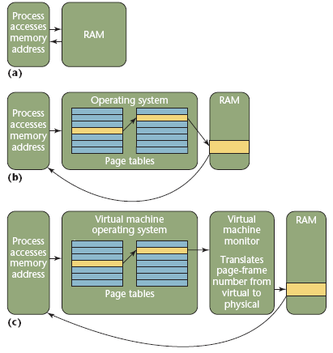
Memory Mapping

Slide 12
Memory Mapping
A process perspective
  Request results in direct access to the memory address
The OS layer has an active role in providing memory location access
  Access the page table to map the logical memory address to a physical memory address
Notes:
OS 層扮演了記憶體位址存取的腳色

Slide 13
Memory Mapping (VM)
VMM provides an abstraction layer between
  Each VM OS's memory management
  The underlying physical hardware
VMM translates the VM-requested page frame number into a page frame number for the physical hardware
Gives the VM access to that page

Slide 14
VMM Memory Accesses
VMM accesses memory pages assigned to each VM directly by
  VMM's active involvement in this process
  Its elevated privileges
Without the VM actually requesting the page
Can also make those pages accessible to other VMs
Notes:
VMM 能根據 1. VMM 活動的影響 2. 提升的權限 來存取 Assign 給每個 VM 的記憶體

Slide 15
VMI Classifications
Interfere with a threat / Simply monitor it
  Distinction between reading and writing
How much know about the guest OS
  The knowledge of context and environment
Ability to replay events
  Whether analysis must be performed in real time or at some later time

Slide 16
Threat Monitoring/Interfering
Only monitor subject behavior
  Livewire
  Monitor a system can only detect and report problems
Interfere with subject behavior
  LycosID, μDenali
  Can actually respond to a detected threat
  Might terminate the relevant processes or VM
  Might reduce the resources available to the VM (starve the attacker)
Notes:
能實際的回應偵測到的威脅
可能終結相關的程式或 VM

Slide 17
Livewire
An early host-based intrusion detection system
Monitors VMs to gather information and detect attacks
Merely reports it rather than interfering

Slide 18
LycosID
Uses crossview validation techniques to compare running processes
Patches running code to enable reliable identification of hidden processes

Slide 19
Manitou
A VMI designed to detect malware
Compares known instruction-page hashes with memory-page hashes at runtime
The instruction-page is corrupted and nonexecutable for no match
Notes:
設計來偵測惡意軟體
執行期的比較 instruction-page 和 memory-page
在不符合下將該 instruction-page 認定為邪惡且不可執行的

Slide 20
μDenali
Acts as a switch for network requests to a set of VMs
Can force a VM reboot
Notes:
充當一群 VM 的網路 Switch

Slide 21
Semantic Awareness
Account for different guest OS
provide information that is more detailed
Parse kernel memory to build a process table map
Unaware VMI simply see memory as bits
Notes:
對不同 OS 的描述

Slide 22
Semantic Awareness (Lares)
Gives each VM an internal "hook"
  Activate an external monitoring control upon execution
Monitor can interrupt execution and pass control to a security mechanism
  The hook is injected into the VM OS
  Hypervisor write-protects both the hook and the transfers control
  Triggers at a meaningful system execution point
Notes:
增加額外的監測控制
將 Hook 引入 VM 的 OS

Slide 23
Semantically Unaware (AntFarm)
Monitor the VM's memory management unit
Can construct the virtual-to-physical memory mapping
Infer information about the machine's processes and OS
Notes:
推測 machine 的程序和 OS 的資訊

Slide 24
IntroVirt
Attempt to bridge the "semantic gap" between
  The VMI application
  The target VM
Using functionality on the target VM itself to lend context to the acquired data
Notes:
利用目標 VM 的功能將 Context 轉成獲得的資料

Slide 25
Event Replay
Ability to replay, or log events on a VM is useful
  Debugging OSs
  Replaying compromises
VM must record enough information to reconstruct interesting portions
The penalty is to record extra information
Notes:
缺點是需要記錄額外的資訊

Slide 26
ReVirt
An example of a logging VMI
Serves as the basis for time-traveling VMs that allow replay from any previous VM state

Slide 27
Livewire & μDenali
Logless
Analyze the current system state as it executes

Slide 28
VMI Classifications
Interfere with a threat / Simply monitor it
  Distinction between reading and writing
How much know about the guest OS
  The knowledge of context and environment
Ability to replay events
  Whether analysis must be performed in real time or at some later time

Slide 29
Take advantage of the VM's inability
Terminate-and-stayresident computer virus
  Loads before the antivirus
  TSR can alter the intercept vectors
VM's malware can't alter VMM routines
Digital forensic applications
  Shut down the machine
  Take an image of the disk
  Lose important RAM information
The contents of memory and disk are available by reading from a process external to the VM

Slide 30
Implementation
In at least two system locations
  Embed the VMI application in the VMM itself
    Modify the VMM code
    VMI application highly dependent on the VMM version
  Place the VMI application outside the VMM

Slide 31
Place the VMI application
The option we chose using Xen
Place in the privileged Dom0 VM
Interact through a stable API
Reduce the application's ability to perform inline processing (requests in real time)
Notes:
透過固定的 API 來互動
降低程式提供即時處理的能力

Slide 32
VIX
Virtual Introspection for Xen
Xen is open source
Under active development
Supported in several leading Linux distributions

Slide 33
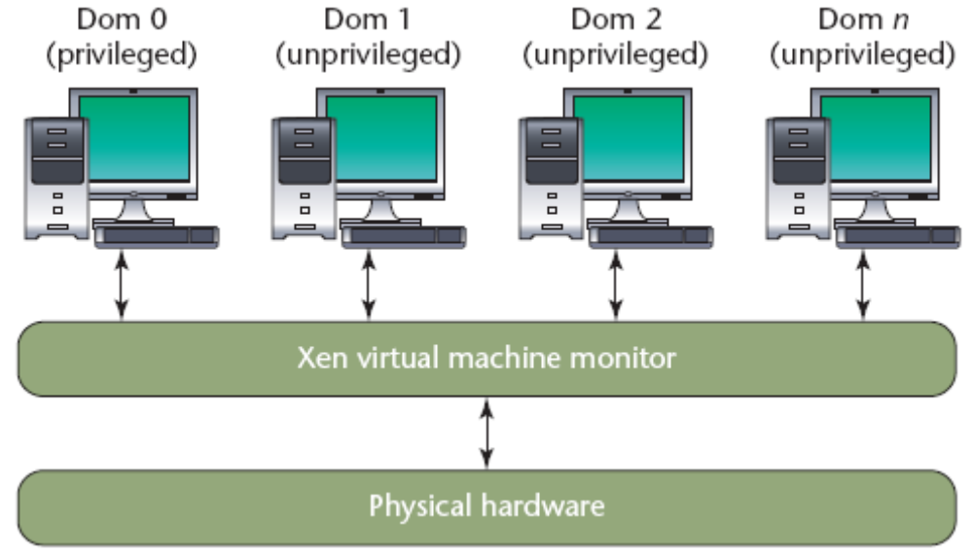
Xen overview

Slide 34
Xen overview
Runs directly on the physical hardware
Special management domain is called Dom0 to provide a management interface
The VMM gives Dom0 system access to a control library
  create, destroy, start, pause, stop, and allocate resources to VMs from Dom0
Provides drivers for the host’s physical hardware
Can also request that memory pages allocated to unprivileged VMs

Slide 35
How VIX works
Pauses operation of the target VM
Maps some of its memory into the Dom0
Acquires and decodes the memory pages
Resumes operation of the target VM
Reference task_struct data structures
  process ID, process name, memory map, and execution time
Traverses the list of task_structs
Notes:
獲得並解譯 Memory Page

Slide 36
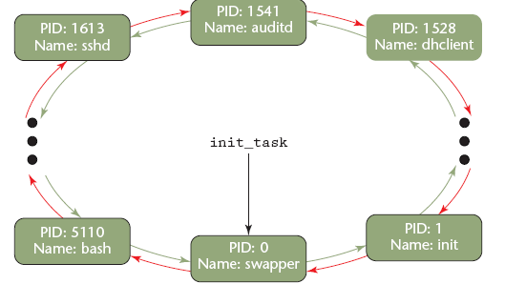
List of task_structs

Slide 37
List of task_structs
Linux stores this list as a circular double-linked list
Each kernel version has an associated memory address for the first process

Slide 38
Memory Map
Application requests a memory address (process's address space)
OS transparently translates the address into a page frame
The introspection program traverse between
  The VM page frame
  The underlying physical host's page frames

Slide 39
VMI Functionality
Not depend on any VM OS functionality for information
VIX application
  vix-ps, vix-netstat, vix-lsof, vix-pstrings, vix-lsmod, vix-pmap, and vix-top
vix-ps
  Traverse the entire task list
  Output as the ps command

Slide 40
Important Outstanding Question
Whether we can detect monitoring of the target VM — and if so, under what conditions and to what extent
Notes:
是否能得知目標 VM 的監測

Slide 41
Detecting VM Monitoring
Monitors the VM during the brief periods of not scheduled for execution
Only reads data from the VM memory space
However, the attacker might be able to detect VMI by ancillary information
Detecting VM monitoring remains an open question
Notes:
攻擊方可能利用額外資訊得知 VMI 存在

Slide 42
A Second Issue
Whether it’s possible for unprivileged VMs to compromise the VMM and gain elevated access levels to the underlying physical host
Developers generally implement VMM as software
There might be bugs that leave the VMM vulnerable
Notes:
非特權的 VM 連累 VMM 和取得存取物理主機的權限

Slide 43
Hopes
Developers will carefully craft VMMs with a view to simplicity, reliability, and sound security engineering practices
VMM development will let us apply VMI as reliable and unbiased reporters of VM activity
Notes:
開發者能以小心的手法開發 VMM，附帶有簡單、可信賴和安全的方式
1. 以可信賴；和 2. 公平的回報 VM 活動；來應用 VMI

Slide 44
Need for research
The interaction between
  The virtualized host
  The underlying virtual or physical hardware
The VM's internal state, including OS and process data structures
Notes:
需要在研究的：
物理的硬體和虛擬主機間的互動
VM 內部的狀態

