Slide 1
Micro-array Analysis
PCA based probe selection
F. Commo, PhD student

Slide 2
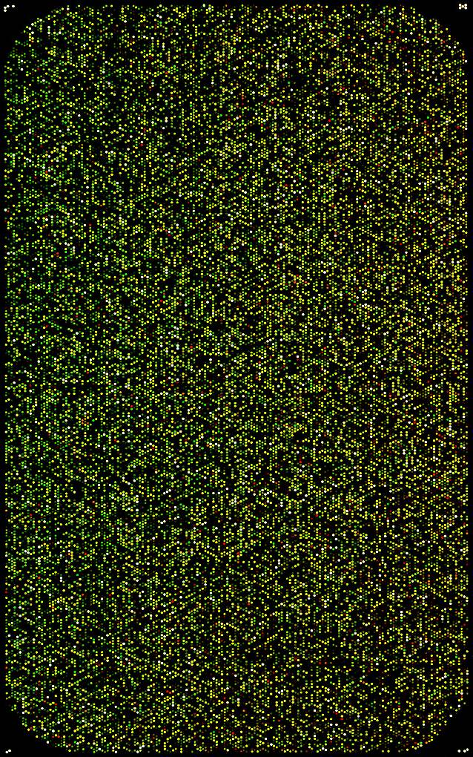
Problem:
Size of data
Full microarray = Information + background
Prefiltering may be arbitrary: intensities, quantiles,..
Post-filtering may be arbitrary: p-value, foldchange,…
How to reduce the size of data?
How to find probes which may be informatives?
Informative probes
Non informative probes

Slide 3
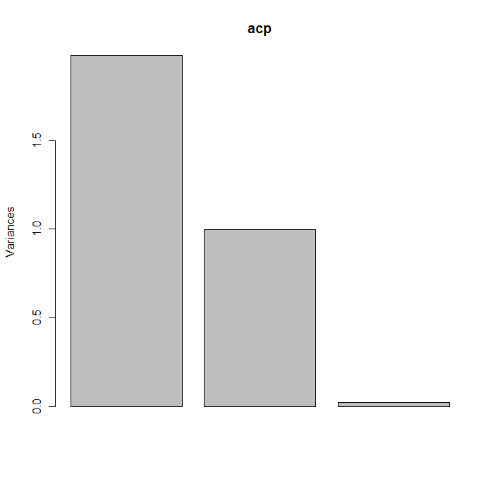
How PCA could help?
A 2 groups (A, B) example, described by 3 variables (x, y, z), with
X_{A} ≠ X_{B} Y_{A} ~ Y_{B} Z_{A} ≠ Z_{B}
 | Importance of components
 | PC1 | PC2 | PC3
Std.deviation | 1.407 | 0.9992 | 0.14522
Prop. Variance | 0.6602 | 0.3328 | 0.00703
Cumulative prop. | 0.6602 | 0.993 | 1
 | PC1 | PC2 | PC3
x | 0.707 | -0.029 | -0.707
y | 0.041 | 0.999 | -0.001
z | -0.707 | 0.028 | -0.707

Slide 4
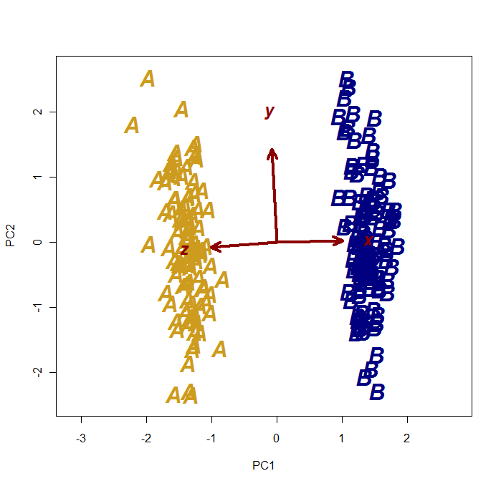
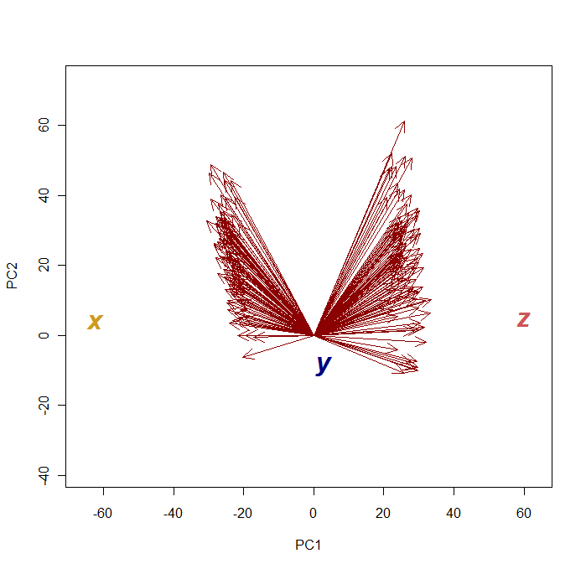
How PCA could help?
Observations Vs. variables
Variables Vs. Observations

Slide 5
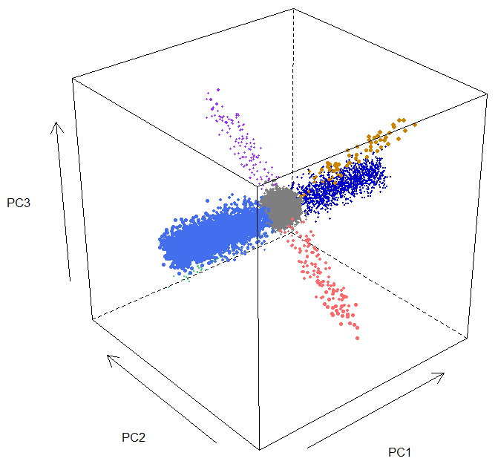
GE simulation (Log2Ratio matrix)
3D visualization of the PCA :
Probes are observations
Samples are variables
Group specific
Virtual GE matrix: 44K, 100 samples
3 groups (G1, G2, G3)
common probes (all groups)
‘normal’ : Log2Ratio ~0
overexpressed : Log2Ratio >> 0
lowerexpressed : Log2Ratio << 0
Group-spécific probes (n_{s} ~ 400)
  Higher or lower in grp1 only
  Higher or lower in grp3 only
Unchanged

Slide 6
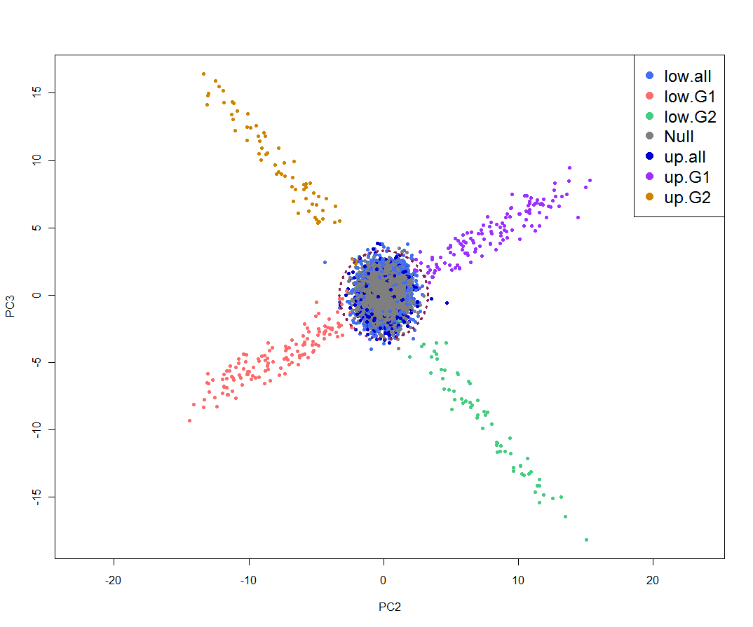
GE simulation (Log2Ratio matrix)
PC2/PC3 projection
Common probes
PC3
Group-spécific probes
PC2

Slide 7
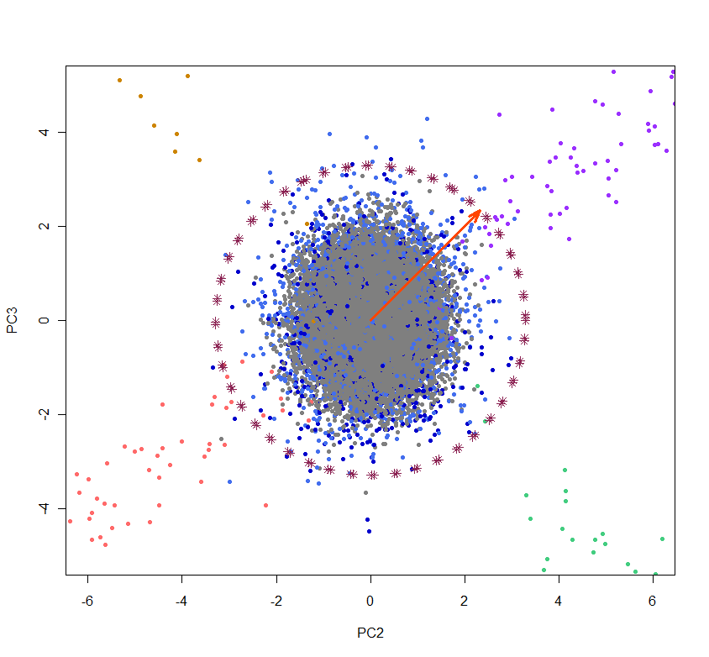
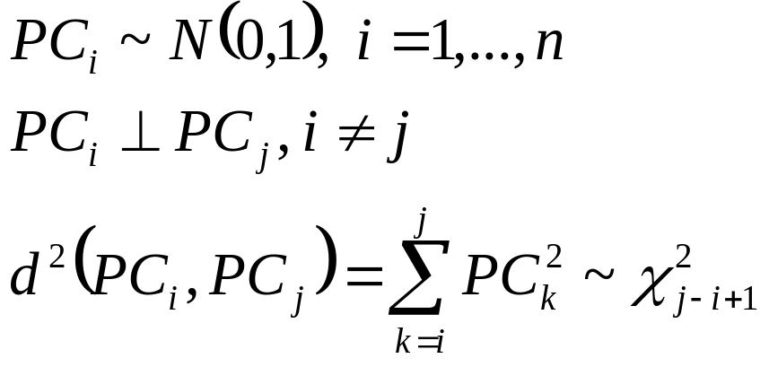
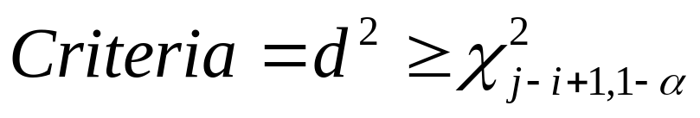
n samples, p probes.
After scaling the M_{(p,n)} rotation Matrix :

Slide 8
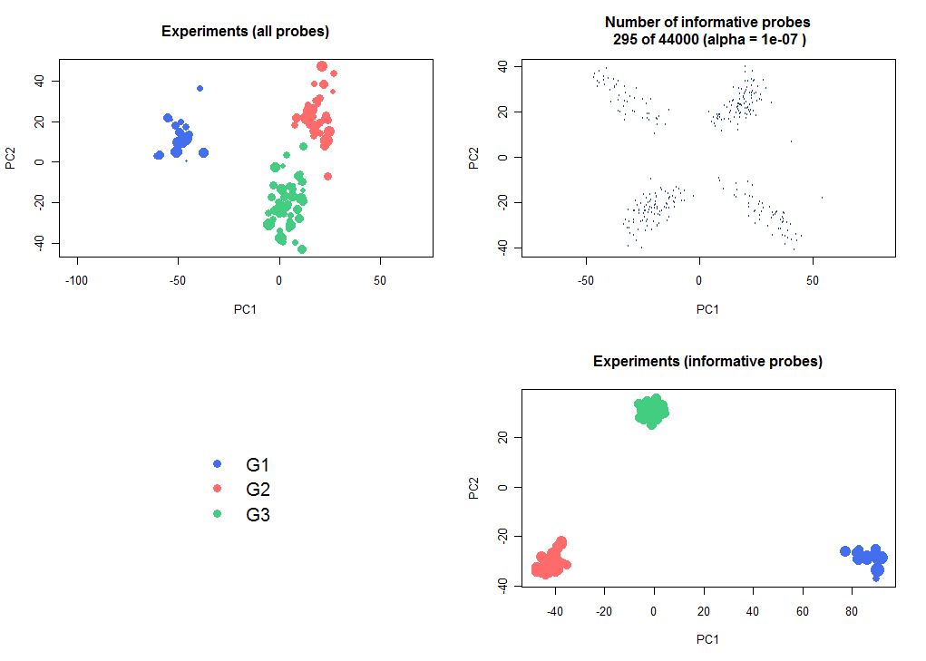
400 ‘differentially expressed’ probes had been initially generated.
325 were really different, due to the added bg.
295 of 325 have been found by PCA selection.

Slide 9
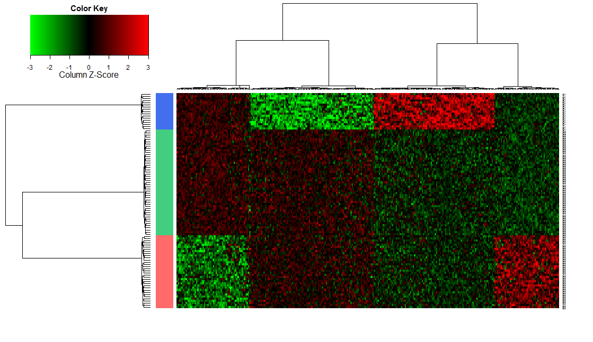
GE simulation (Log2Ratio matrix)

Slide 10
Subjectivity (and uncertainty) still remains !
How to be sure that PC2/PC3 is the best choice on a real dataset ?
How to estimate the best alpha value ?
Let’s have a look on a true dataset : Kim’s Lung GE dataset.

Slide 11
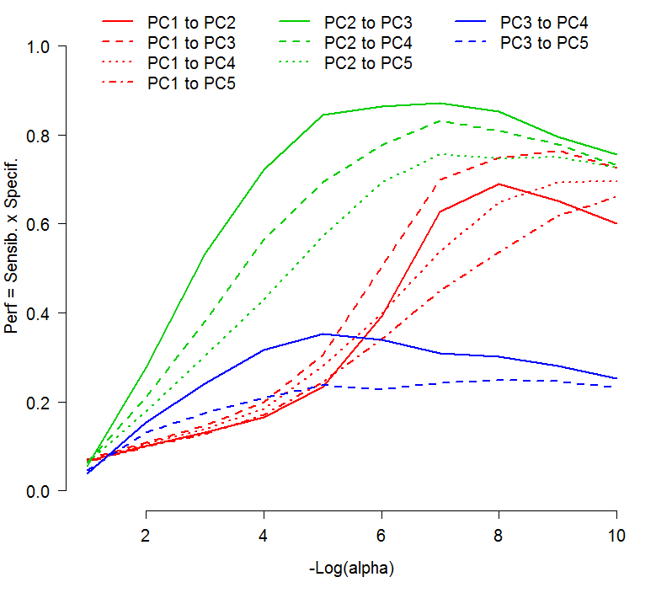
Performances according to axes & alpha
Performance measurement confirms that considering PC2 & PC3 is the most relevant.

Slide 12


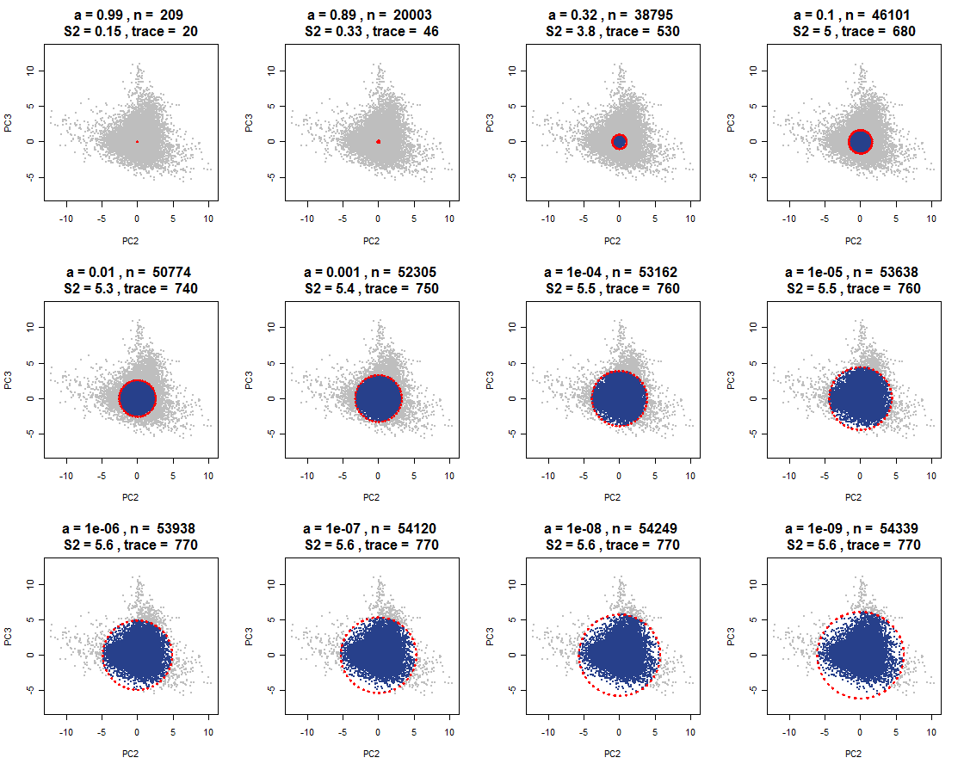
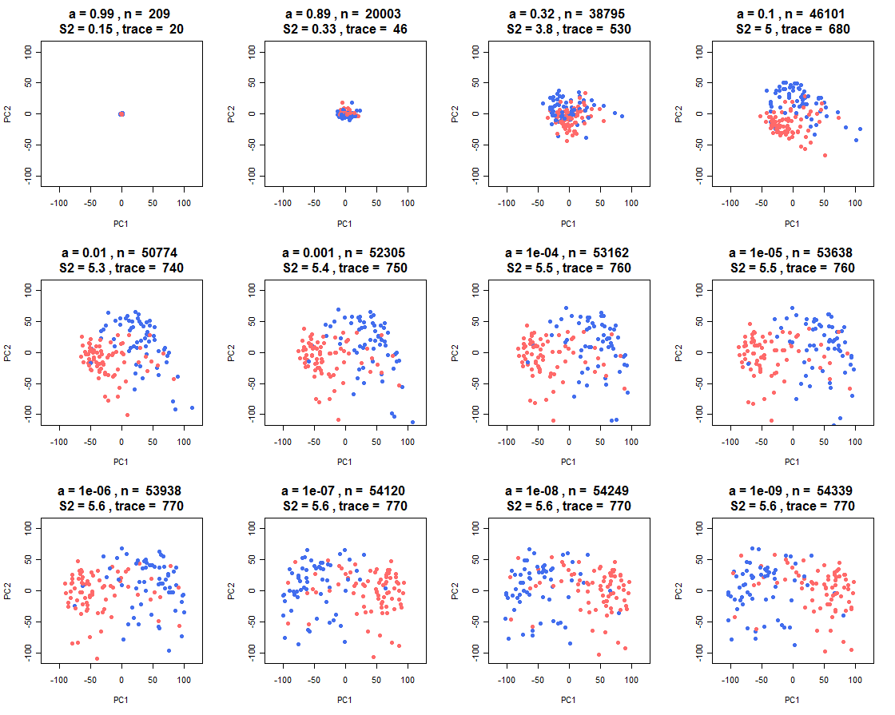
Estimating the best alpha
Probes selection
Effect on sample segregation

Slide 13
Estimating the best alpha
Probes selection
Effect on sample segregation

Slide 14
Estimating the best alpha
Probes selection
Effect on sample segregation

Slide 15
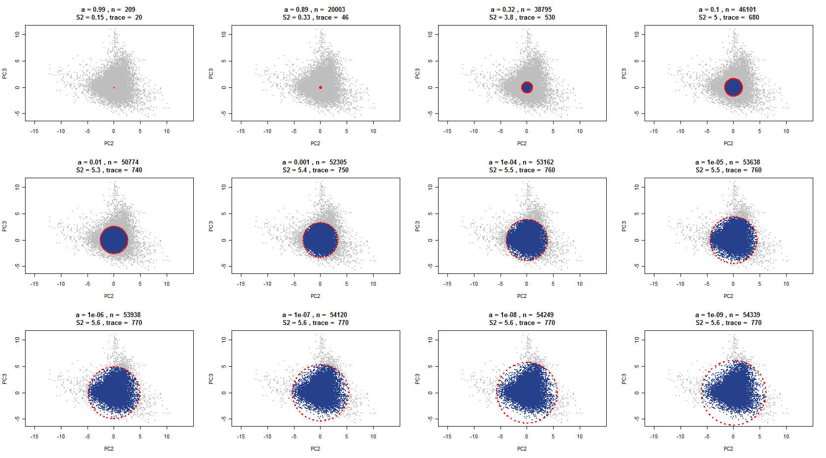
Estimating the best alpha

Slide 16
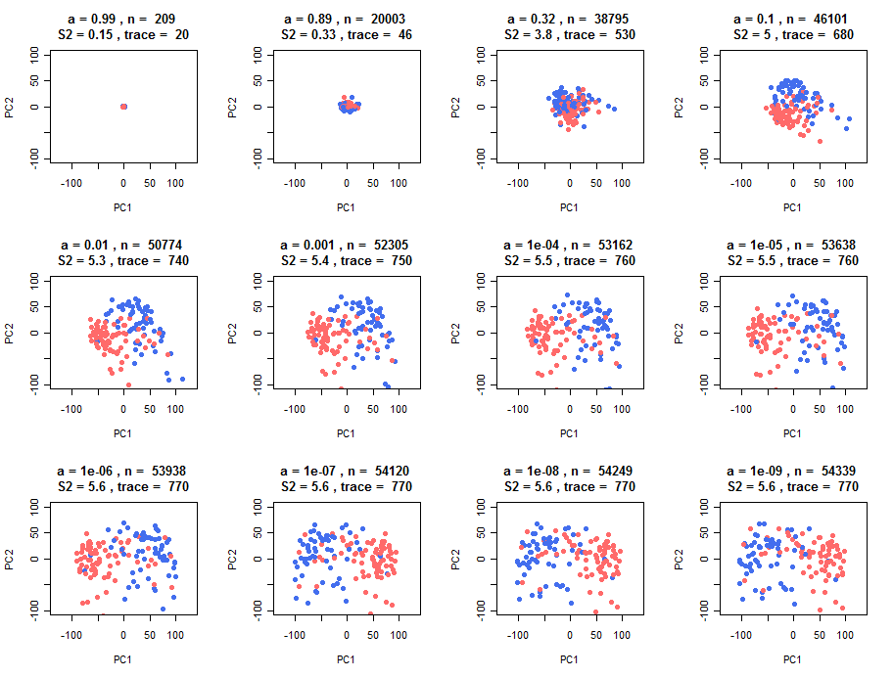
Estimating the best alpha

Slide 17
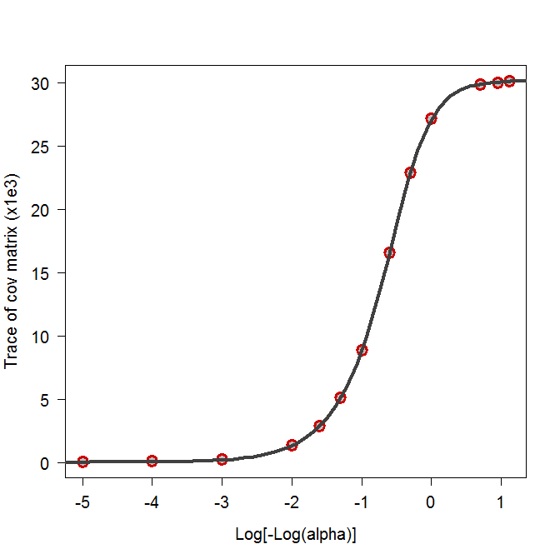
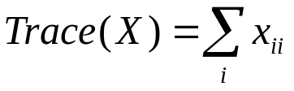
Estimating the best alpha
5pl regression: trace = f(alpha)
Modeling the Trace of covariance matrix as a function of alpha.
What threshold ?
A possible choice is the proportion of max of benefit.

Slide 18
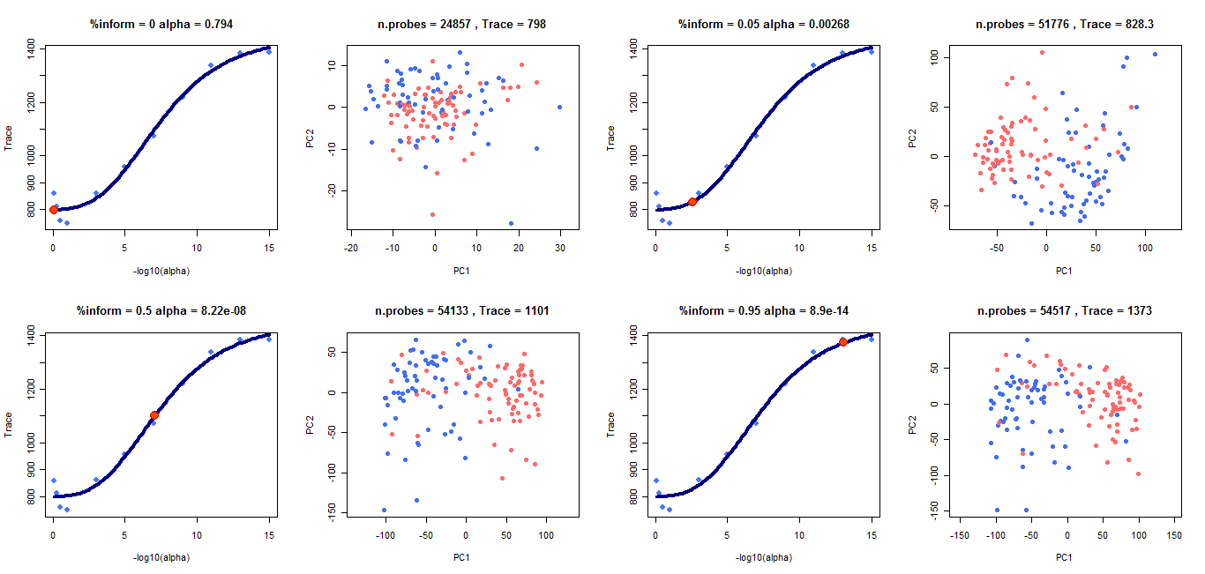
Benefit on the sample segregation by expanding the probe selection.

Slide 19
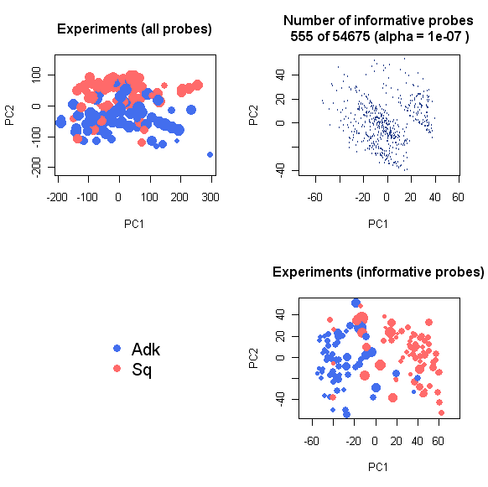
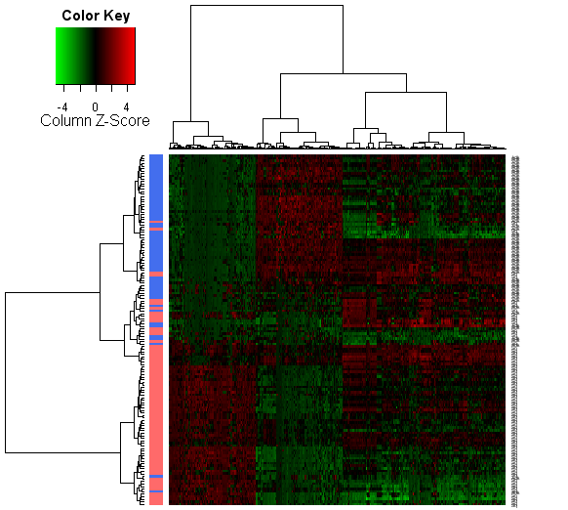
Lung dataset (Kim)

Slide 20
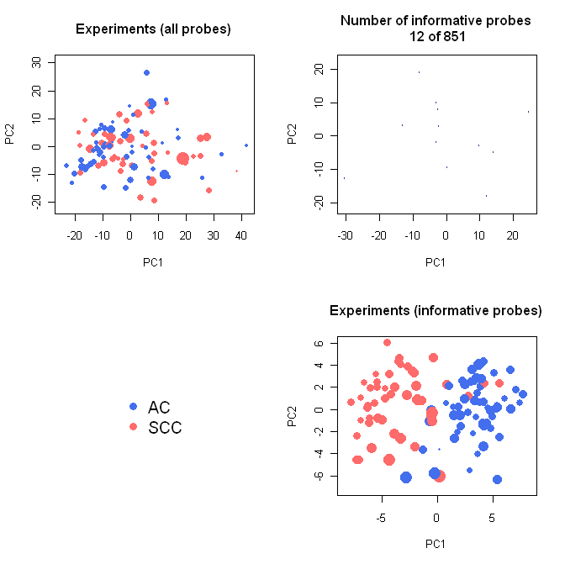
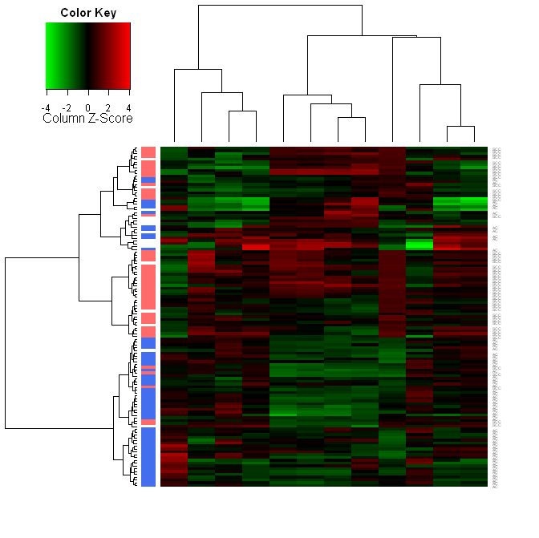
Lung miRs dataset (Chemores)

Slide 21
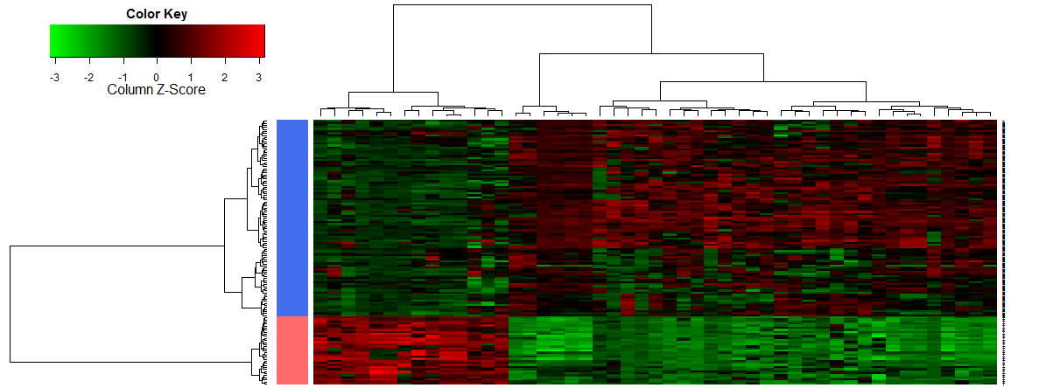
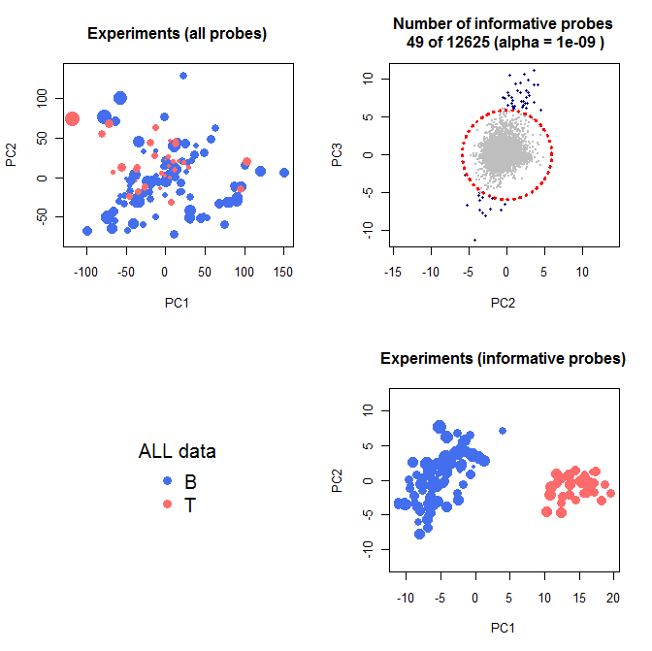
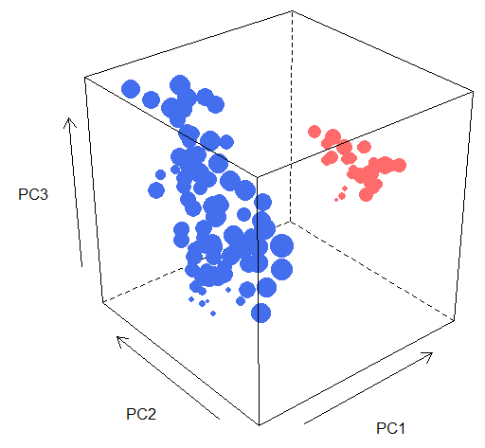
Leucemia B Vs. T Chiaretti et al., 2004

Slide 22
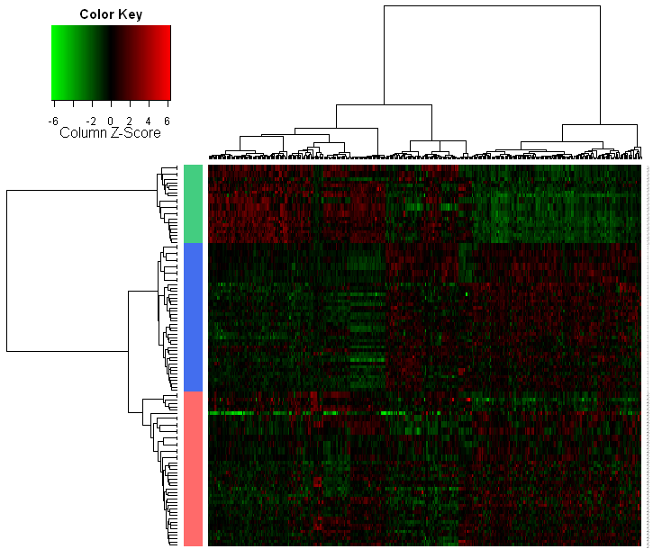
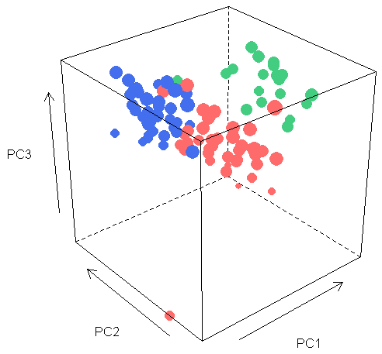
Van’t Veer: breast metastatsis (5 years)

Slide 23
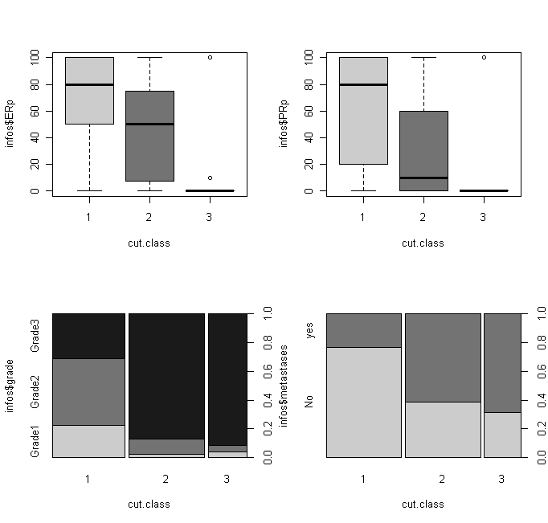
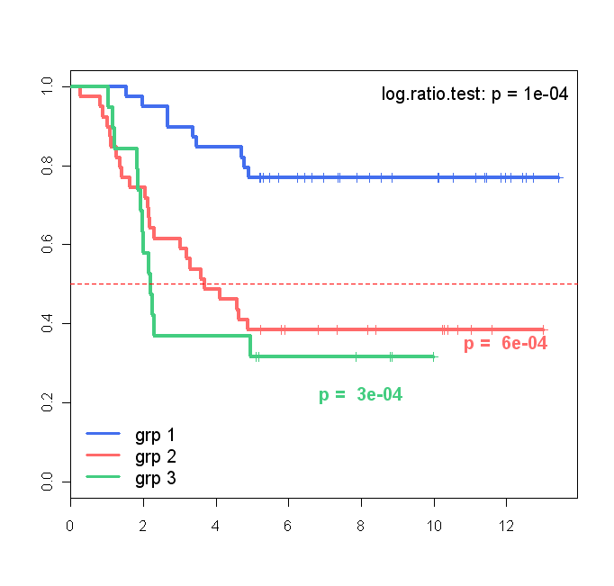
Van’t Veer: breast metastatsis (5 years)
ER
PR
Metastasis
Grade
Metastasis
years

Slide 24
Advantages:
No a priori information is required.
No subjective criterion.
Simultaneous identification of the samples structure & information.
2 possible ways to use this filtering method:
Low stringency: suppression of non informative probes.
High stringency: selection of highly discriminative probes.
To do :
exhaustive Bibliography
Compare with ‘standard’ methods.
…

