Slide 1
Micro-array Analysis
PCA-based probe selection
F. Commo, PhD student

Slide 2
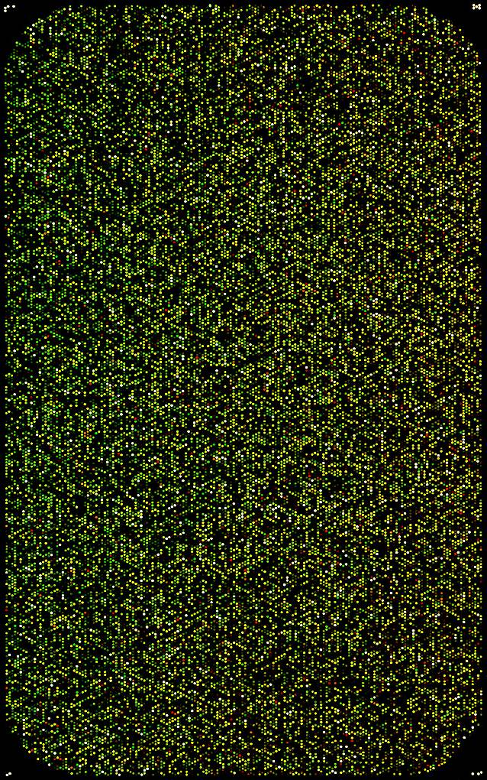
Problem:
Size of data
Full microarray = Information + background
Prefiltering may be arbitrary: intensities, quantiles,..
Post-filtering may be arbitrary: p-value, foldchange,…
How to reduce the size of data?
How to find probes which may be informatives?
Informative probes
Non informative probes

Slide 3
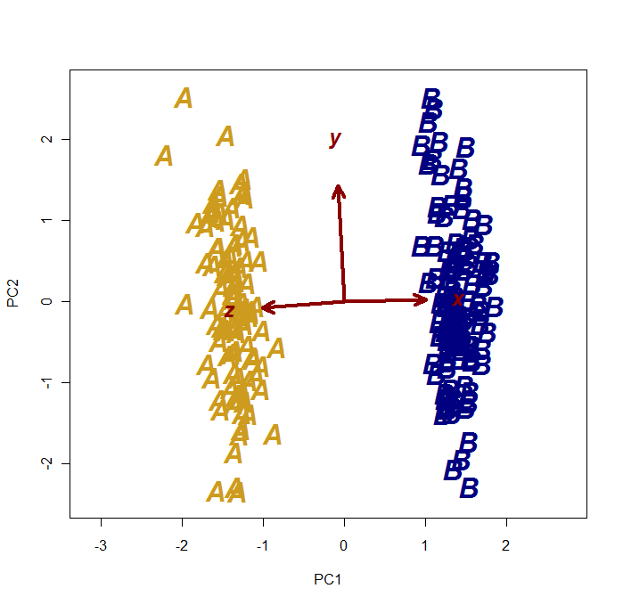
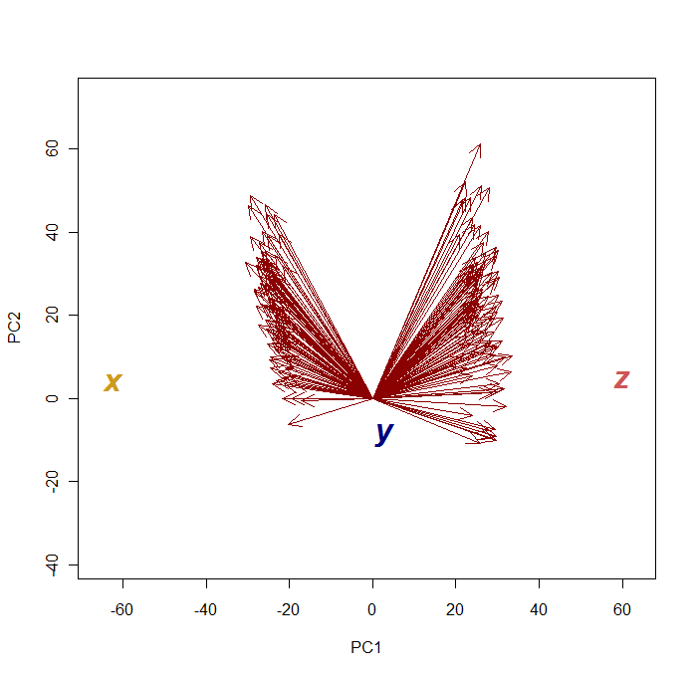
How PCA could help?
A 2 groups (A, B) example, described by 3 covariates (x, y, z), with
X_{A} ≠ X_{B} Y_{A} ~ Y_{B} Z_{A} ≠ Z_{B}
Observations Vs. variables
Variables Vs. Observations
Y appears close to (0, 0)

Slide 4
GE simulation (Log2Ratio matrix)
Virtual GE matrix: 44K, 100 samples assigned to 3 groups (G1, G2, G3)
common probes (all groups): ‘normal’ Log2Ratio ~ 0
overexpressed Log2Ratio >> 0
lowerexpressed Log2Ratio << 0
Group-specific probes (n_{spe} ~ 400) Higher or lower in grp1 only
Higher or lower in grp3 only
PCA on eset matrix
- Probes are ‘observations’
- Samples are ‘covariates’

Slide 5
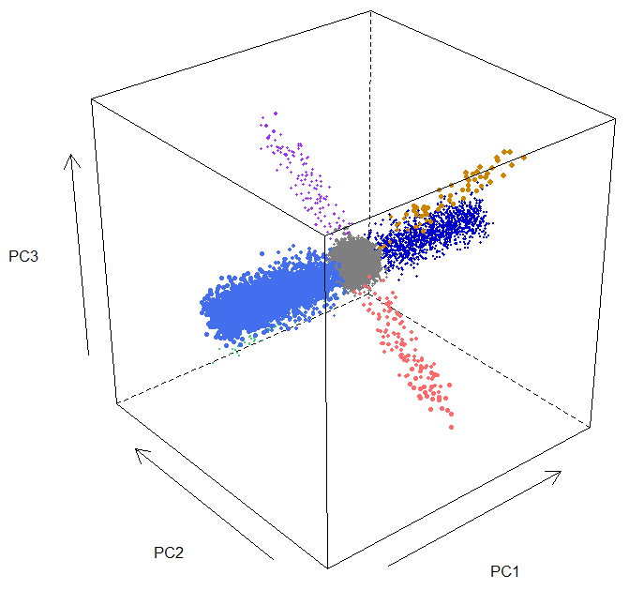
GE simulation (Log2Ratio matrix)
3D visualization of the PCA :
Group specific
Common probes

Slide 6
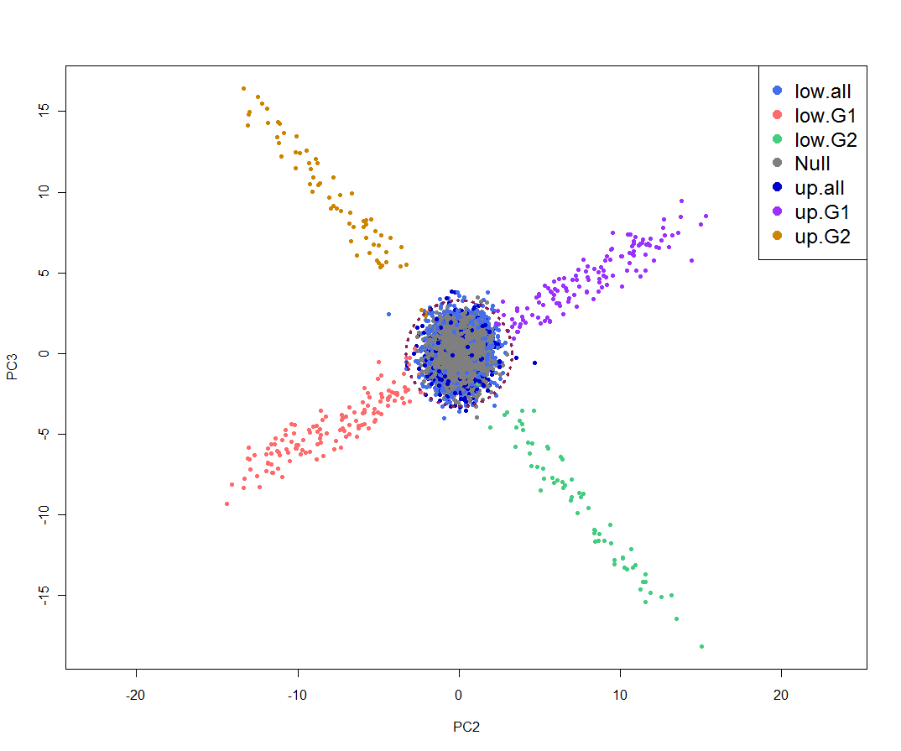
GE simulation (Log2Ratio matrix)
PC2/PC3 projection
Common probes
PC3
Group-specific probes
PC2

Slide 7
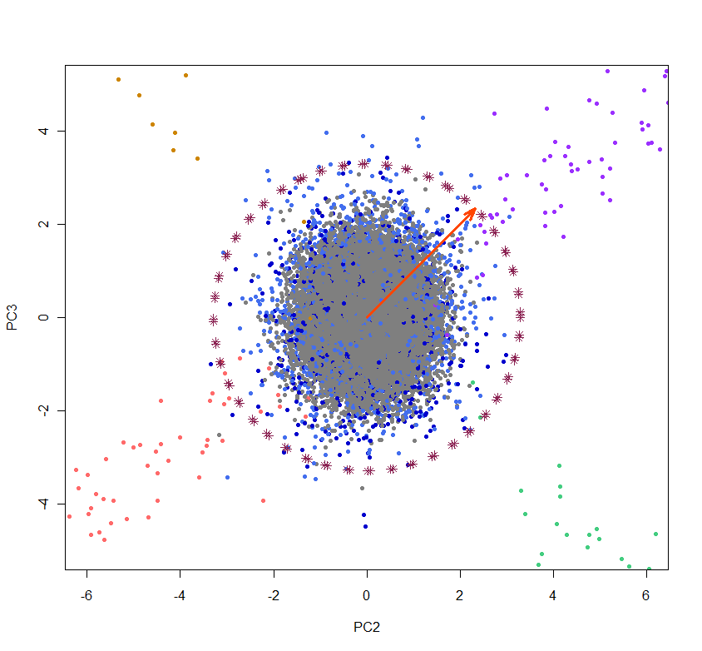
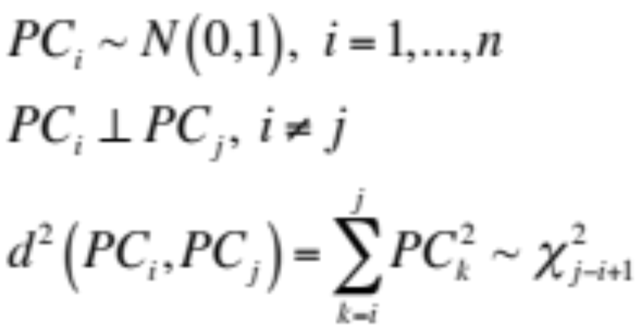
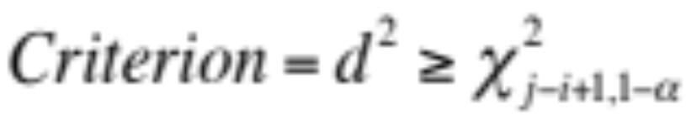
GE simulation (Log2Ratio matrix)
Selecting a raduis to define probes which are closed to Zero at 95% of conf. (or more)
n samples, p probes.
After scaling the M_{(p,n)} rotation Matrix :

Slide 8
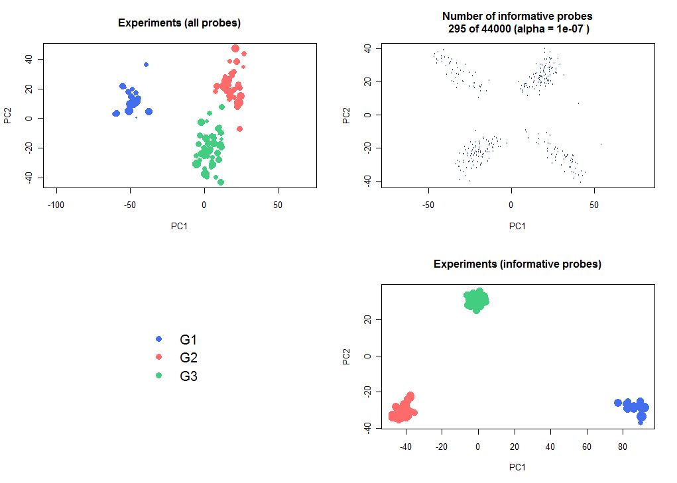

GE simulation (Log2Ratio matrix)
Results:
400 ‘differentially expressed’ probes had been initially generated.
325 were really different, due to the added bg.
295 of 325 have been found by PCA selection.

Slide 9
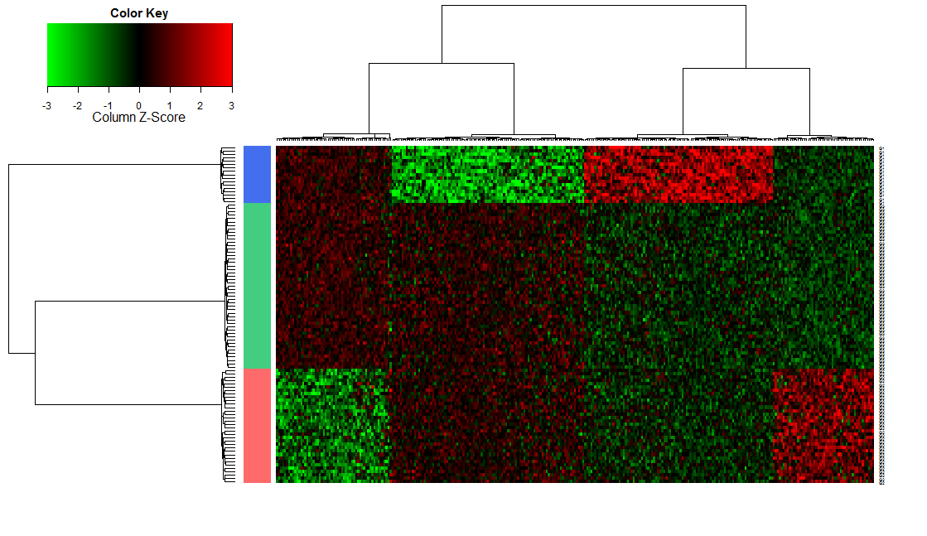
GE simulation (Log2Ratio matrix)

Slide 10
Problem
Subjectivity (and uncertainty) still remains !
How to be sure that PC2/PC3 is the best choice ?
How to estimate the best radius/alpha (confidence) ?

Slide 11
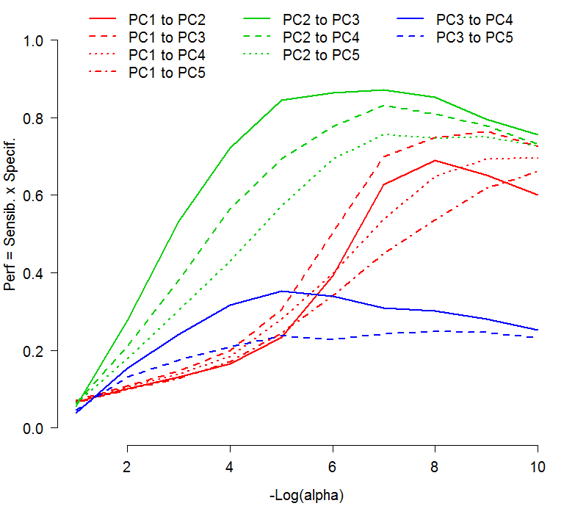
Performances according to axes & alpha
Performance measurement confirms that considering PC2 & PC3 is the most relevant.

Slide 12
Subjectivity (and uncertainty) still remains !
How to be sure that PC2/PC3 is the best choice on a real dataset ?
How to estimate the best radius/alpha (confidence) ?
➔ What happens on a true data set : Lung – Kim series ?

Slide 13


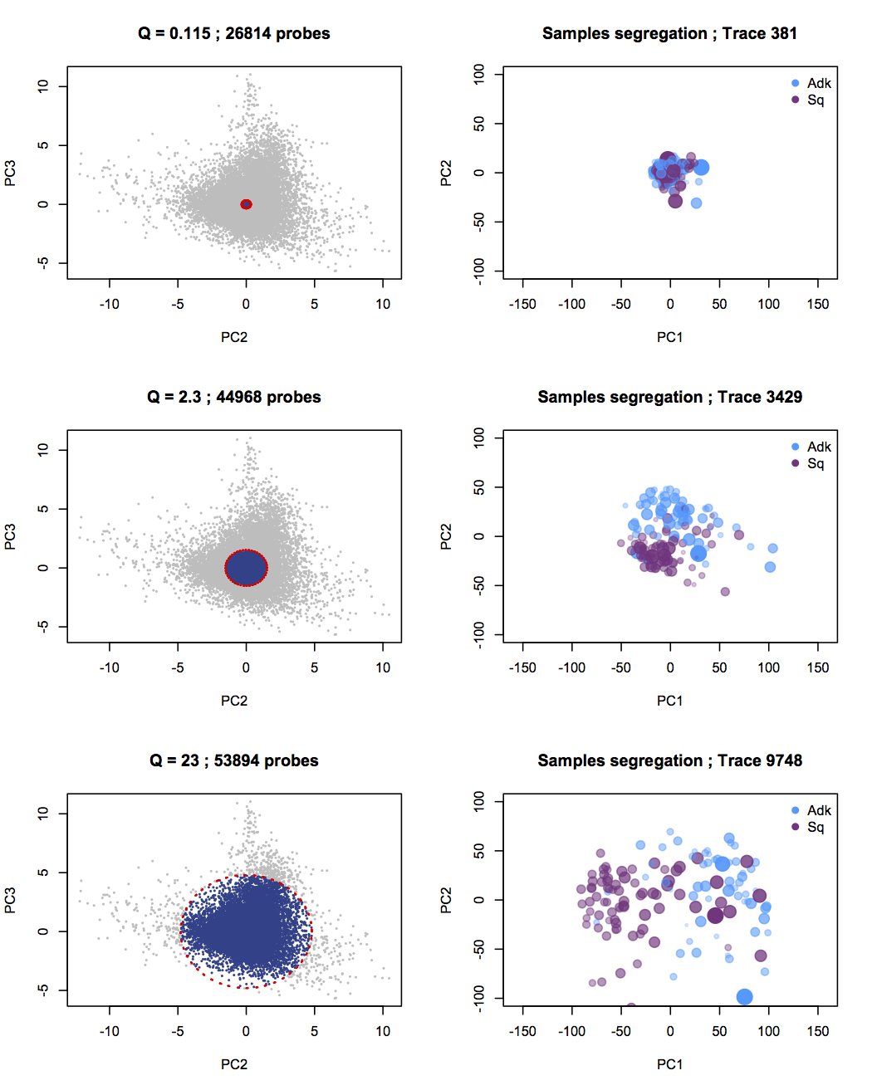
Estimating the best alpha
Probes selection
Effect on sample segregation

Slide 14
Estimating the best alpha
Probes selection
Effect on sample segregation

Slide 15
Estimating the best alpha
Probes selection
Effect on sample segregation

Slide 16
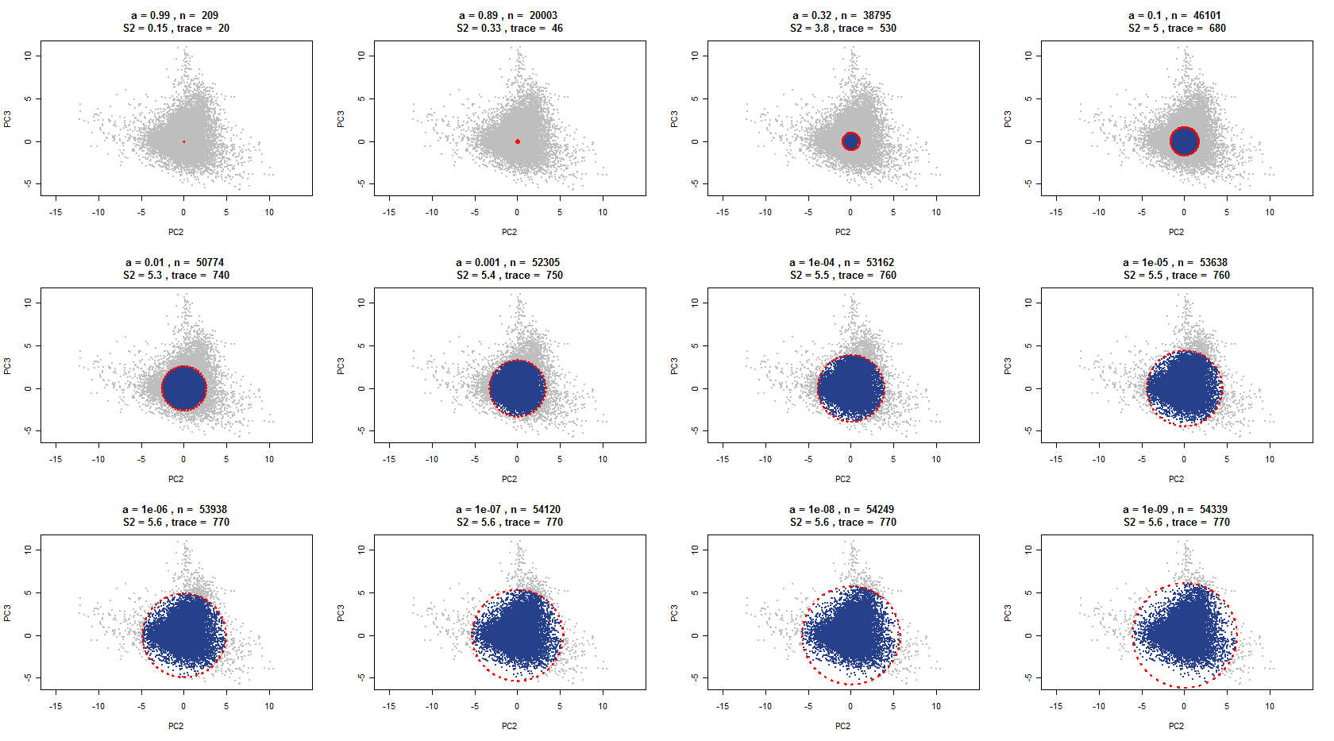
Estimating the best alpha

Slide 17
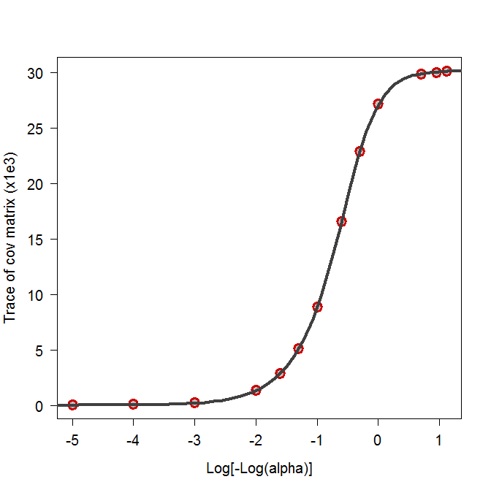
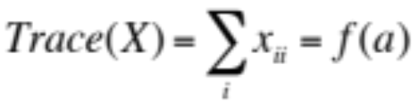
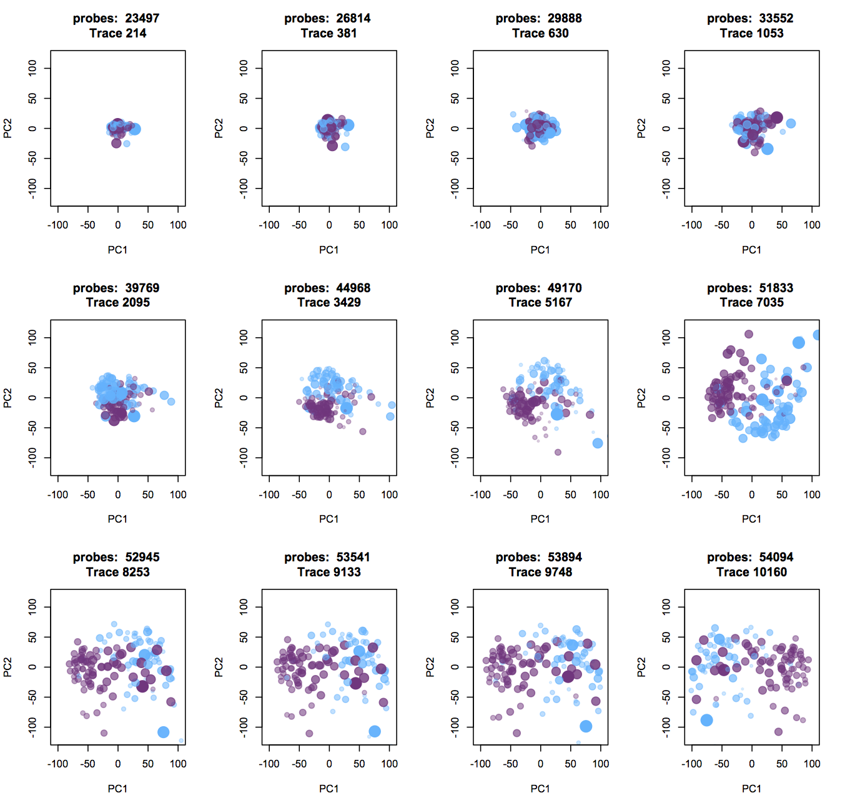
Estimating the best alpha
Modeling the Trace of covariance matrix as a function of alpha.
5pl regression: trace = f(alpha)
Max benefits
No benefits
What threshold ?
A possible choice is the proportion of max of benefit.

Slide 18
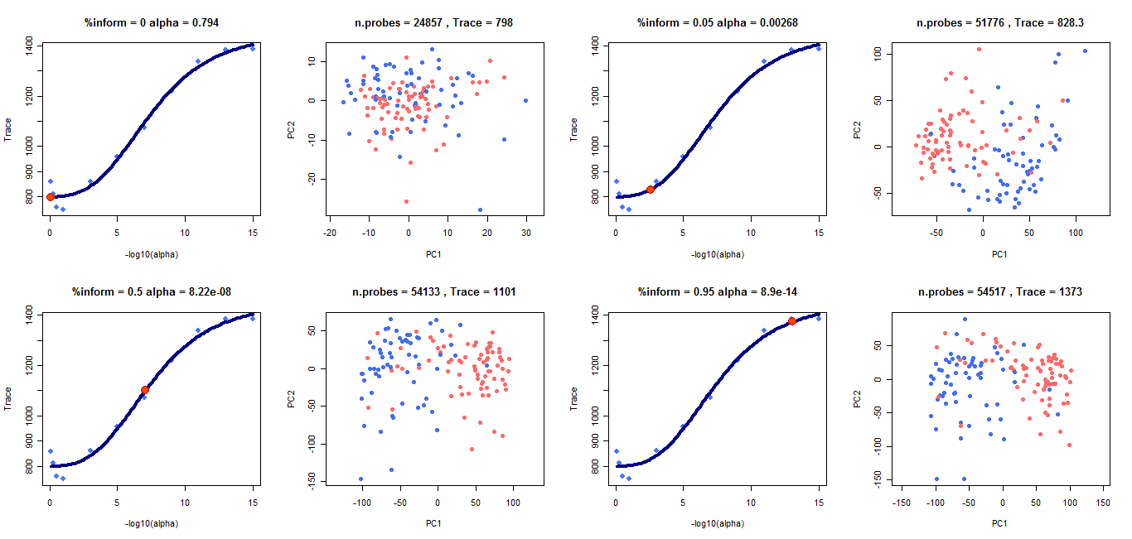
Benefit on the sample segregation by expanding the probe selection.

Slide 19
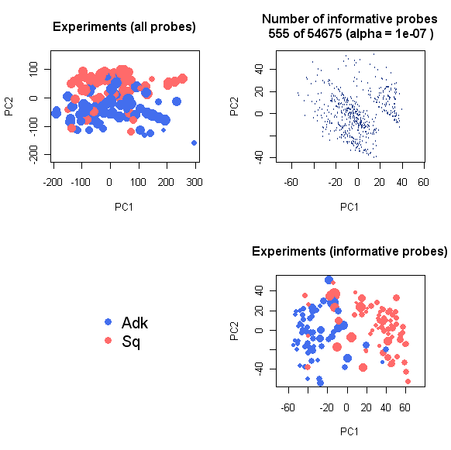
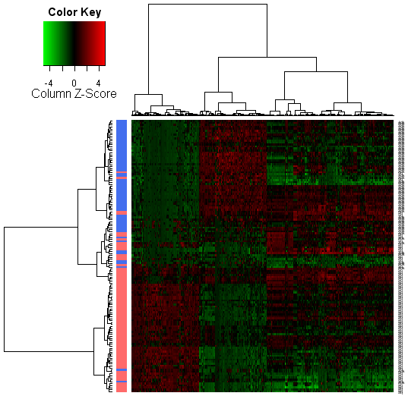
Lung dataset (Kim)

Slide 20
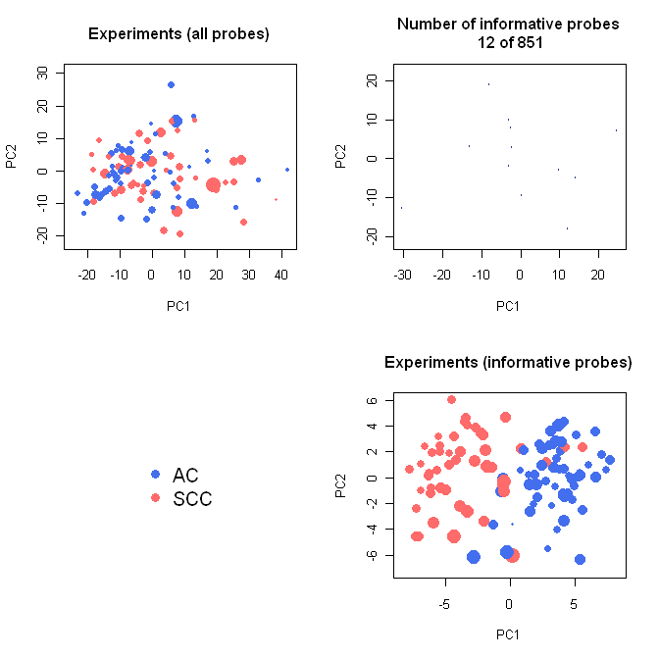
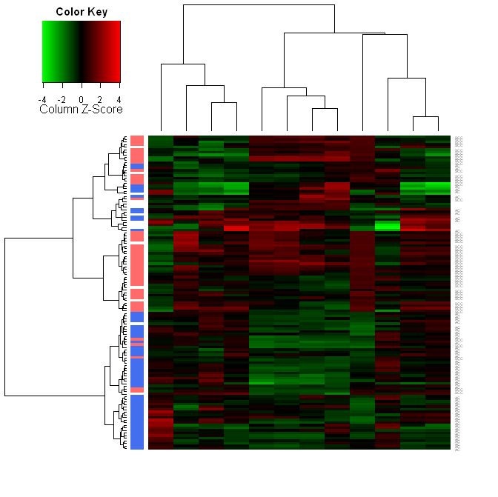
Lung miRs dataset (Chemores)

Slide 21
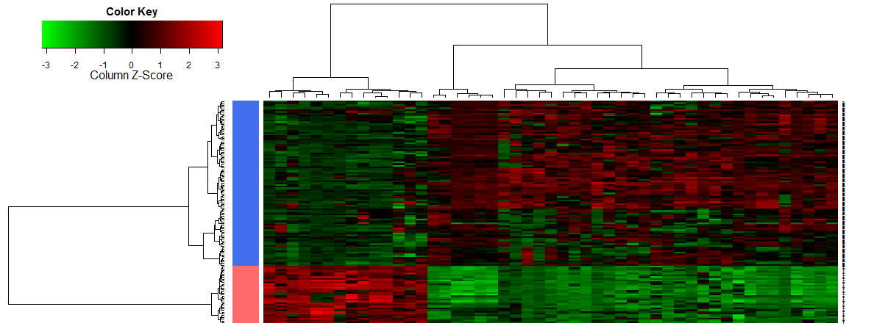
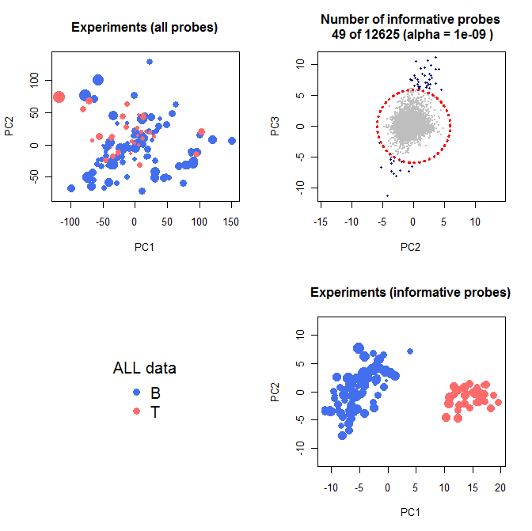
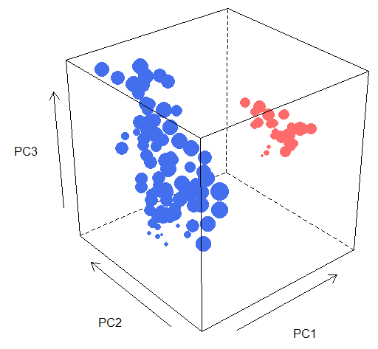
Leucemia B Vs. T Chiaretti et al., 2004

Slide 22
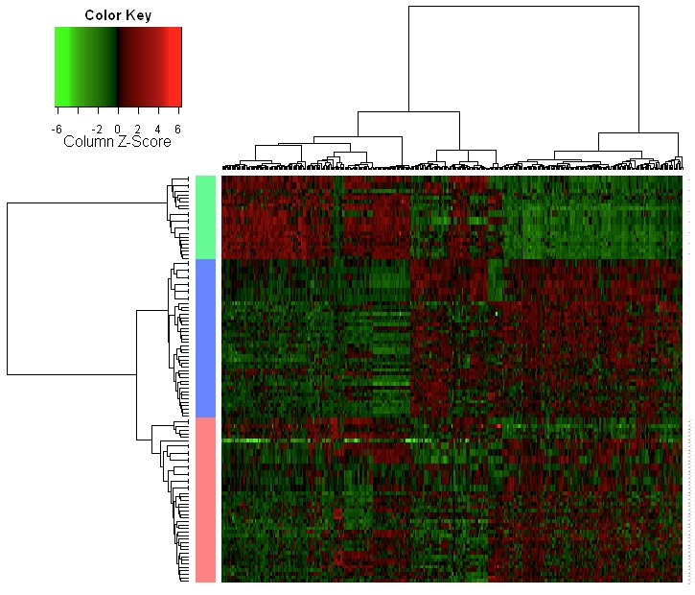
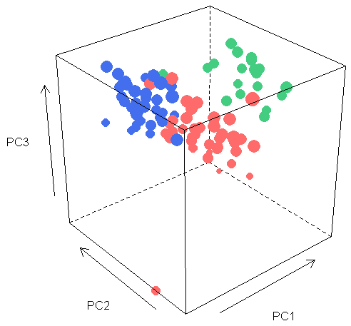
Van’t Veer: breast metastatsis (5 years)

Slide 23
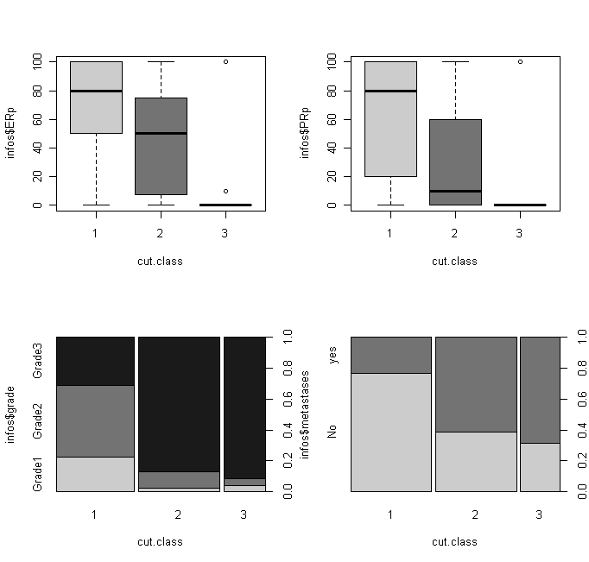
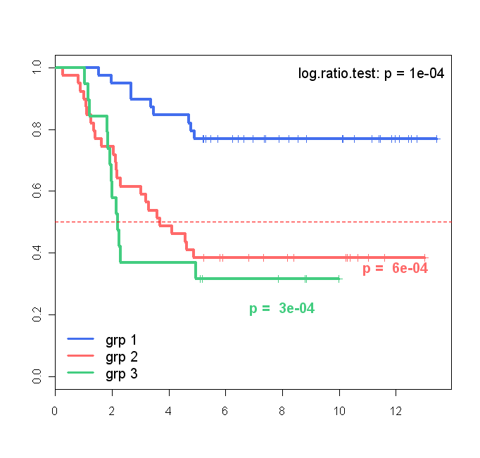
Van’t Veer: breast metastasis (5 years)
ER
PR
Metastasis
Grade
Metastasis
years

Slide 24
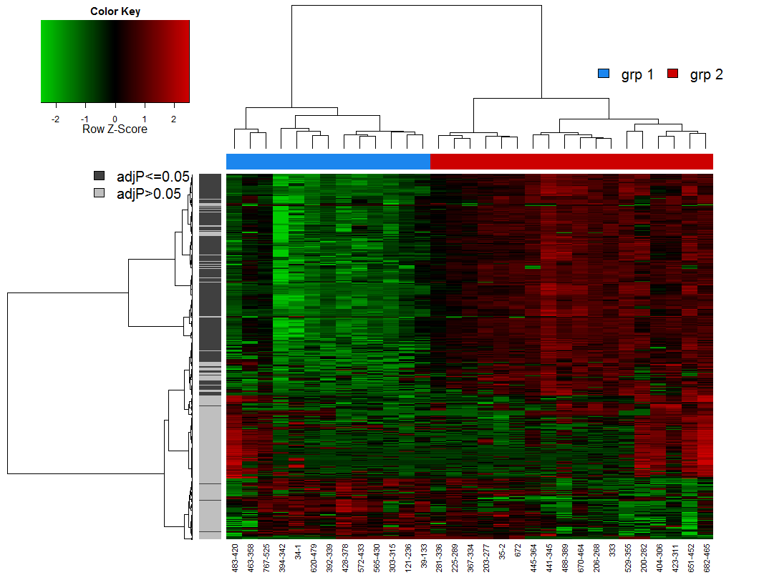
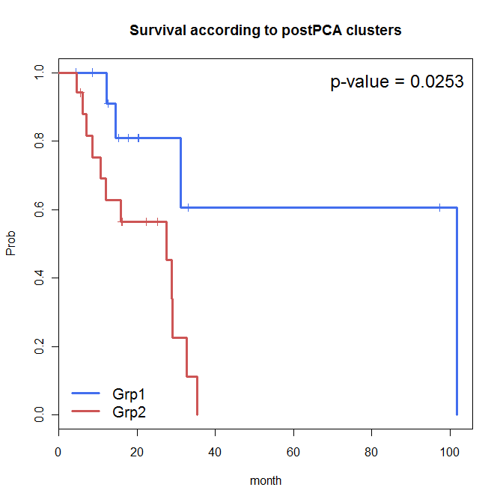
Unpublished bone marrow GE (IGR)

Slide 25
Unpublished bone marrow GE (IGR)

Slide 26
Advantages:
No a priori information is required.
No subjective criterion (hummmf).
Simultaneous identification of the samples structure & information (if groups exist).
2 possible ways to use this filtering method:
Low stringency: suppression of non informative probes.
High stringency: selection of highly discriminant probes (if groups exist).
To do:
Exhaustive bibliography.
Compare with ‘standard’ methods (how?).
Other ideas ?

