Slide 1



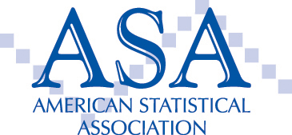


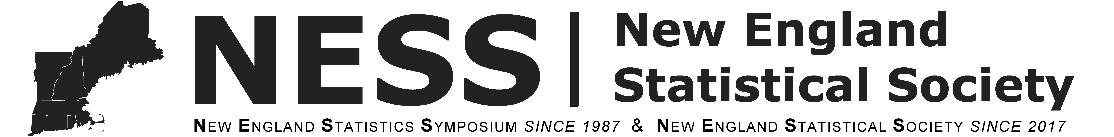
Connecticut College
Bentley University
Trinity College
University of Connecticut
Wesleyan University
Yale University
QAC 2018

