Slide 1

PREDICTION OF COLLISION RISKS FOR SPACE OBJECTS USING A NEURAL NETWORK
Applied Machine Learning for Engineers
Project Presentation of Frederik Dall‘Omo, Leo Paul and Lukas Wallner

Slide 2
Introduction
Former ESA challenge
Same dataset, same goal: risk estimation with ML
Our way to go:
Data processing
Feature selection
Building the model
Evaluation
Notes:
2019
Prepare data
Evaluate the results

Slide 3
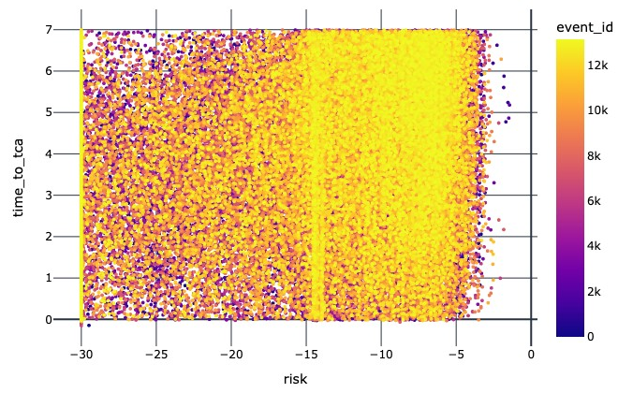
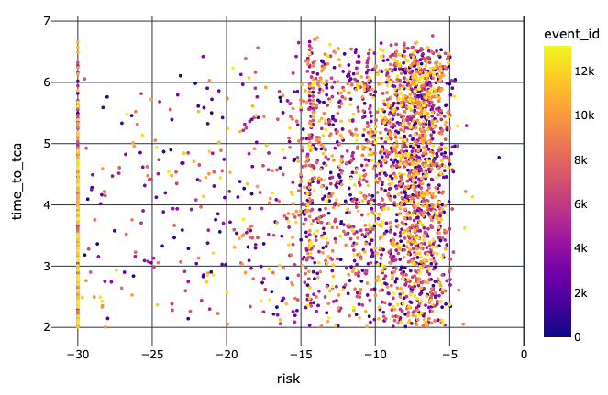
Data processing
Conjunction Data Message (CDM) with 103 features
162634 CDMs (real data)
13154 events (potential collision between a satellite and a space object)
Filtering the useful data
Handling of NaN values?
Drop
Impute using k-nearest-neighbour
Scaling

Slide 4
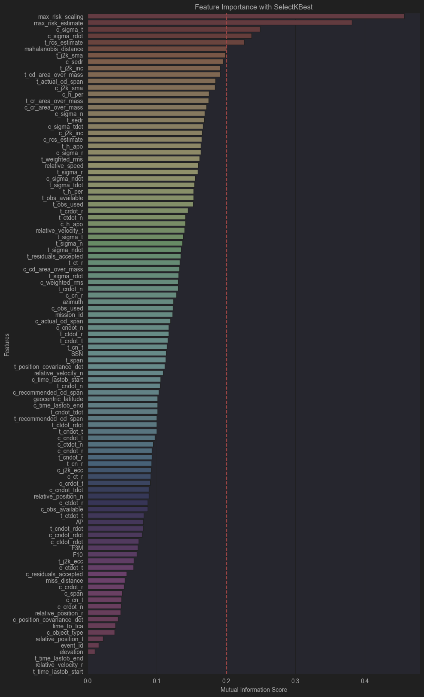
Feature Selection
Univariate Selection (SelectKBest)
Feature Importance with ExtraTreesRegressor
Correlation Matrix
Quantum-Classical Hybrid Solver
16 features seleceted

Slide 5
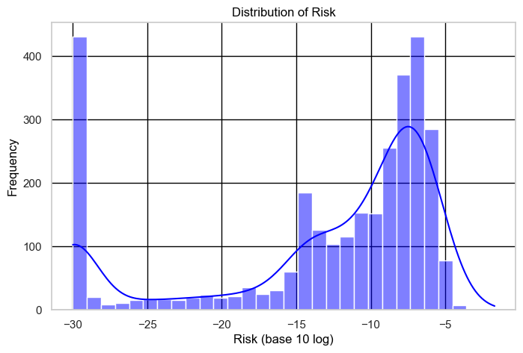
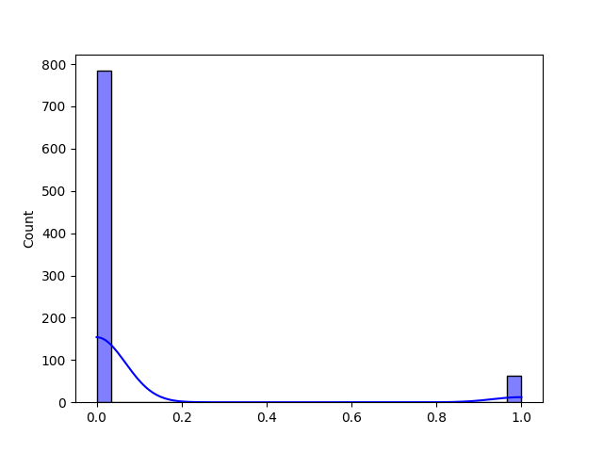
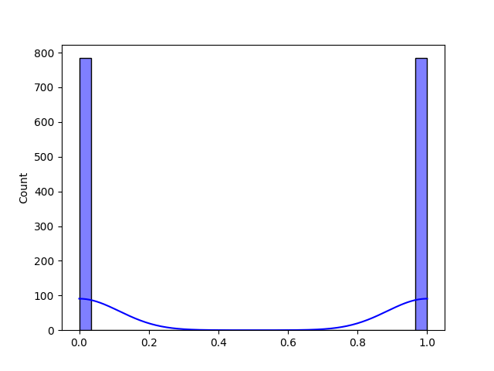
Building the model
Splitting into test, training and evaluation data
High risk events are of greater interest than low risk events
Bad risk distribution
Using SMOTE (Synthetic Minority Oversampling Technique) on the training set

Slide 6
Building the model
Feedforward neural network
One Input Layer – 128 neurons with ReLU activation
One Hidden Layer – 64 neurons with ReLU activation
Output Layer – sigmoid activation function
Stochastic Gradient descent (SGD) with momentum
Learning rate of 0.01
Momentum of 0.9
binary cross-entropy loss function
Iterative updates of the parameter
Batch-size 64

Slide 7
Evaluation
Model priority: avoid false negatives
F-Beta score with β=2 → weight on recall
F₂-Score with all 103 features: 0.688
F₂-Score with less features: 0.3
F₂-Score with selected best 16 features: 0.736
Notes:
Curse of Dimensonality (N^2=10000 CDM ~3000)

Slide 8
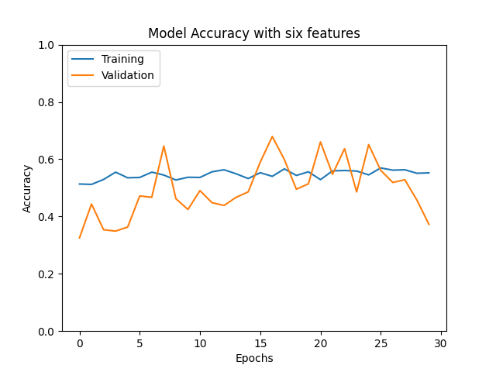
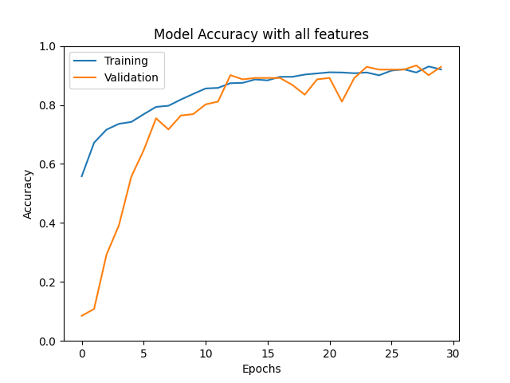
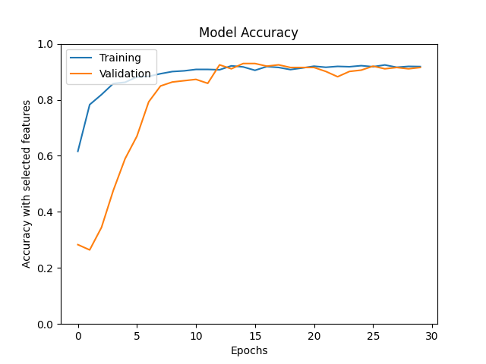
Evaluation
Notes:
ACC=(TP+TN)/(P+N); PRECISION=TP/PP; RECALL=TP/P

Slide 9
Conclusion
Model with high F-beta score generated
Promises improvement with more data
Model could be tested further with TCA < 2
Deep understanding of the problem required

Slide 10
SPACE FOR QUESTIONS
Thank You!

