Slide 1
CueCode
SEAN BAKER
ANDREW BAUSAS
FREDDIE BOATENG
KOBE FRANSSEN
BRYAN HAWICKHORST
JOHN HICKS
DIYA PATEL
CHASE WALLACE
Team Red CS410W project

Slide 2
Elevator Pitch
CueCode lets a Web application generate API calls from natural language with minutes of development time. “I booked an appointment for Patricia Davis for Thursday at 2pm” can become an API call to your appointment booking backend with little additional programming effort. A good API specification and a few key questions are all the model needs to start generating API requests. This allows rapid development of natural language processing features typical of those created during the Generative AI boom, without having to take humans or business rules out of the loop. CueCode can add AI features to your app without any backend code changes or specialized NLP or large language model (LLM) skills. CueCode is made by developers, for developers - as seen in CueCode’s easy-to-use client libraries.

Slide 3
Table of Contents
Team Bios
Table of Contents
Elevator Pitch
The Societal Problem
Solution
Development Tools (not in scope for iteration 1)
Major Functional Components (not in scope for iteration 1)
References
Appendix

Slide 4
Team Bios
SEAN BAKER
ANDREW BAUSAS
FREDDIE BOATENG
KOBE FRANSSEN
BRYAN HAWICKHORST
JOHN HICKS
DIYA PATEL
CHASE WALLACE

Slide 5
The Societal Problem
User interfaces don’t speak the user’s language
Turning bulk unstructured data into structured data is difficult
Humans are kept out of the loop in current AI agent based systems
To develop human-in-the-loop natural language to API systems, it would take:
Specialized skills
Extensive backend programming changes
One-off development per application
=> A lot of money

Slide 6
2.1 Problem Statement
To solve the above problems, we must commoditize LLM development for existing Web apps. However, there are no frameworks/tools that leverage OpenAPI or GraphQL specifications, the two most common ways to describe API capabilities.
Notes:
Microsoft published a paper; Zafin came close. But there is not a product that makes this easy.

Slide 7
2.2 Problem Characteristics
Problems with current NLP/LLM processing for creating API calls:
Hand decision-making to the LLM
removing human checks
business logic
One-off, defined per application
Lack a clearly defined concept of entity relationships
Require awareness of prompt engineering and other more complex AI techniques
=> Heavy development effort

Slide 8
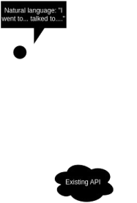
2.3 Current Process Flow
Encode API structure
Build Python classes [9]
Verify output is in JSON format
Tools exist for verifying a JSON format and even that LLM output matches a JSON schema. (LangChain [9], Guidance AI [6])
(This alone does not make an NLP-to-API engine.)
Tell the LLM about the API structure
One-shot prompt is common
Could not find examples of encoding API information in the vector store.
Tie it all together with backend programming
Make your application aware of LLM API call suggestions

Slide 9
3 Solution
We aim to build client libraries for web app developers that interface with CueCode’s servers, which will deploy LLMs to convert natural language to structured API calls.

Slide 10
3.1 Solution Statement
What that means:
Developers will be able to use existing API specifications, which is CueCode makes understandable by LLMs, to define the structure of their API calls.
For example, if a client service representative were to provide input to an application using CueCode in natural language, “I called Patricia Davis and rescheduled her appointment from August 1st to August 16th.” The application can then use CueCode’s libraries, which have been configured using documentation about the structure of their data, to generate the following JSON:
{"request":{"reschedule":{"last": "Davis", "first":"Patricia", "from":{"month":8, "day":1,"year":2024}, "to":{"month":8, "day":1,"year":2024}}}}
Which would then be converted into the appropriate API call to change the appointment date in their database, or prompt the user for additional information.

Slide 11
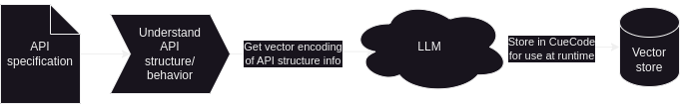
3.2 Solution Process Flow (training time)
Training time:
Upload API specification
Answer a few questions
CueCode stores the structure and requirements for your API in a vector store to aid the LLM in generating responses at runtime

Slide 12
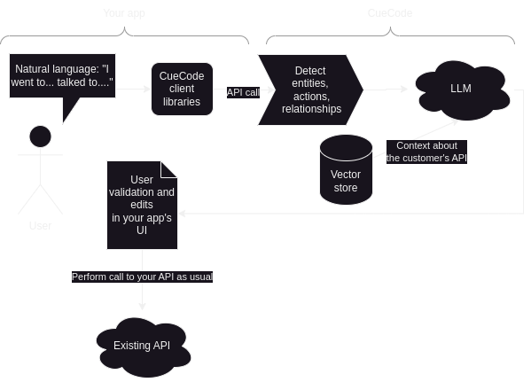
3.2 Solution Process Flow (runtime)
Use CueCode in your app:
Integrate text processing via CueCode libraries
At runtime, let CueCode figure out the structured data contained in the text
Use CueCode’s extracted structured data. e.g.:
Show suggestions to the user
Perform API calls in a batch job
Validate through business rules
Whatever your use case requires

Slide 13
3.3 What it Will Do
Will implement NLP capabilities to enable and understand natural language
Will offer a user friendly interface (API) that developers can use
Will enable quick iteration and prototyping by allowing developers to test and refine how their applications respond to the natural language inputs.
Will provide tools for customizing NLP models to fit specific domains/industries ensuring better performance for unique use cases.
Will include documentation and support resources to help developers implement and troubleshoot various systems effectively.
Will reduce the time and financial investment typically required for implementing NLP, making it affordable for smaller teams and startups
Will use API specifications, enabling context-aware replies that complement the distinct functionality and data structure of each application.
Will allow for real time analysis and response generation, enhancing user experience through immediate feedback and interactions.

Slide 14
3.4 What it Will Not Do
Will not replace human judgment when interpreting language in terms of making subjective decisions beyond its programming.
Will not act as an AI agent
Will not be perfect, misinterpretations could occur with certain slang, ambiguous phrasing or idioms.
Will not be able to handle complex conversations.
Will struggle with dialogues conversations that require deeper understanding.
Will not have ready to use applications pre installed, developers will need to build their own solutions and install any necessary software/applications they need.
Will not automatically make API calls on users' behalf; requests must first have human permission before being fulfilled.
Will not have programming tutorials, developers will need to possess knowledge of programming to utilize CueCode effectively.
Will not ensure data privacy, users must manage and secure their data to the best of their abilities.

Slide 15
3.5 Competition Matrix
✔- Full Implementation
✔ - Partial Implementation
Feature | CueCode | OpenAI Functions | Google Natural Language API | Spacy.io | LangChain | GenKit
Entity recognition | ✔ |  | ✔ | ✔ |  | ✔
Plug and Play | ✔ |  |  |  | ✔ | ✔
LLM suggests action | ✔ | ✔ |  |  | ✔
Retrieval Augmented Generation | ✔ | ✔ |  |  | ✔ | ✔
Requires no LLM Experience | ✔ |  | ✔ | ✔

Slide 16
4 Development Tools
Not in scope for Feasibility iteration 1

Slide 17
5 Major Functional Components
Not in scope for Feasibility iteration 1

Slide 18
5.1 Major Functional Components Diagram
Not in scope for Feasibility iteration 1

Slide 19
6 Risks
Not in scope for Feasibility iteration 1 E.g., what if we find we need to store application data in the vector store, not just the API schema, to get CueCode to work at all? That would change the way we market it and the tooling we would need to create for our developer customers.

Slide 20
7 References
[1]
“Against LLM maximalism · Explosion.” Accessed: Sep. 10, 2024. [Online]. Available: https://explosion.ai/blog/explosion.ai
[2]
E. at Zafin, “Bridging the Gap: Exploring use of Natural Language to interact with Complex Systems,” Engineering at Zafin. Accessed: Sep. 10, 2024. [Online]. Available: https://medium.com/engineering-zafin/bridging-the-gap-exploring-using-natural-language-to-interact-with-complex-systems-11c1b056cc19
[3]
Y. Su, A. H. Awadallah, M. Khabsa, P. Pantel, M. Gamon, and M. Encarnacion, “Building Natural Language Interfaces to Web APIs,” in Proceedings of the 2017 ACM on Conference on Information and Knowledge Management, Singapore Singapore: ACM, Nov. 2017, pp. 177–186. doi: 10.1145/3132847.3133009.
[4]
“Firebase Genkit.” Accessed: Sep. 14, 2024. [Online]. Available: https://firebase.google.com/docs/genkit

Slide 21
7 References
[5]
“Function Calling.” Accessed: Sep. 14, 2024. [Online]. Available: https://platform.openai.com/docs/guides/function-calling
[6]
guidance-ai/guidance. (Sep. 25, 2024). Jupyter Notebook. guidance-ai. Accessed: Sep. 25, 2024. [Online]. Available: https://github.com/guidance-ai/guidance
[7]
“OpenAPI Specification - Version 3.1.0 | Swagger.” Accessed: Sep. 10, 2024. [Online]. Available: https://swagger.io/specification/
[8]
OpenAPITools/openapi-generator. (Sep. 10, 2024). Java. OpenAPI Tools. Accessed: Sep. 10, 2024. [Online]. Available: https://github.com/OpenAPITools/openapi-generator

Slide 22
7 References
[9]
“Tool/function calling | LangChain.” Accessed: Sep. 14, 2024. [Online]. Available: https://python.langchain.com/v0.1/docs/modules/model_io/chat/function_calling/
[10]
“What Is NLP (Natural Language Processing)? | IBM.” Accessed: Sep. 10, 2024. [Online]. Available: https://www.ibm.com/topics/natural-language-processing
[11]
“Cloud Natural Language,” Google Cloud. Accessed: Sep. 26, 2024. [Online]. Available: https://cloud.google.com/natural-language

Slide 23
8 Appendix

Slide 24
8.1 Real World Product vs Prototype Table
Not in scope for Feasibility iteration 1.
That said, we will likely implement CueCode for OpenAPI specs but not GraphQL specs.

