Slide 1
Weekly notes
6-7-2019

Slide 2
Contents
Community detection with gephi and nltk word2vec
Pattern detections

Slide 3

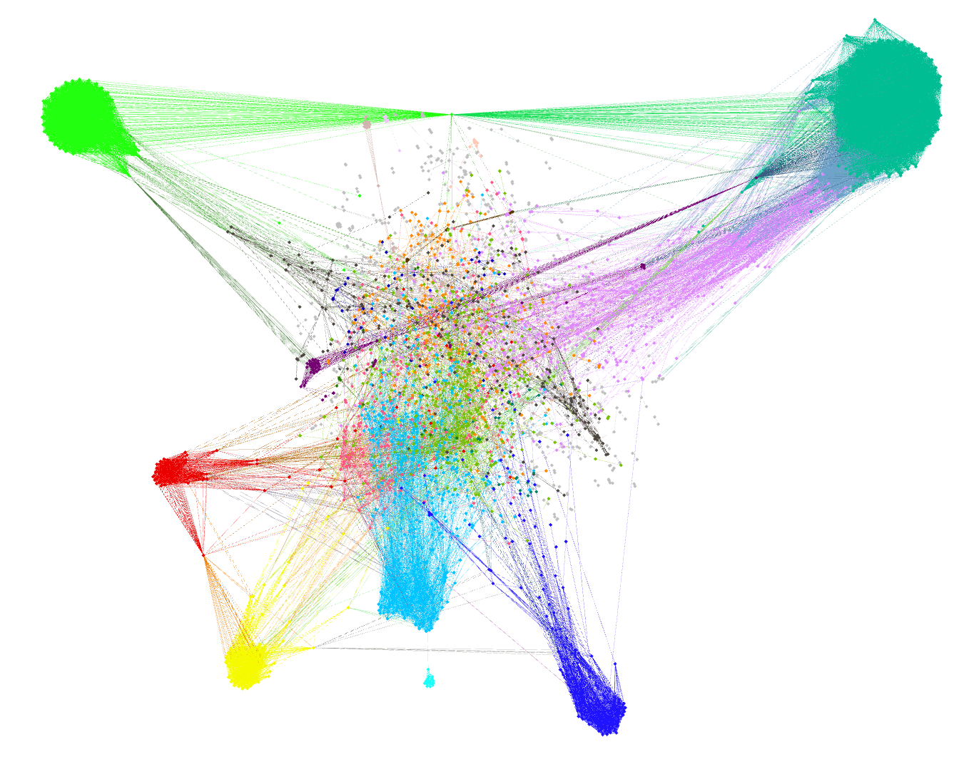
Gephi 3539 nodes/8223 sentences 34722 edges

Slide 4
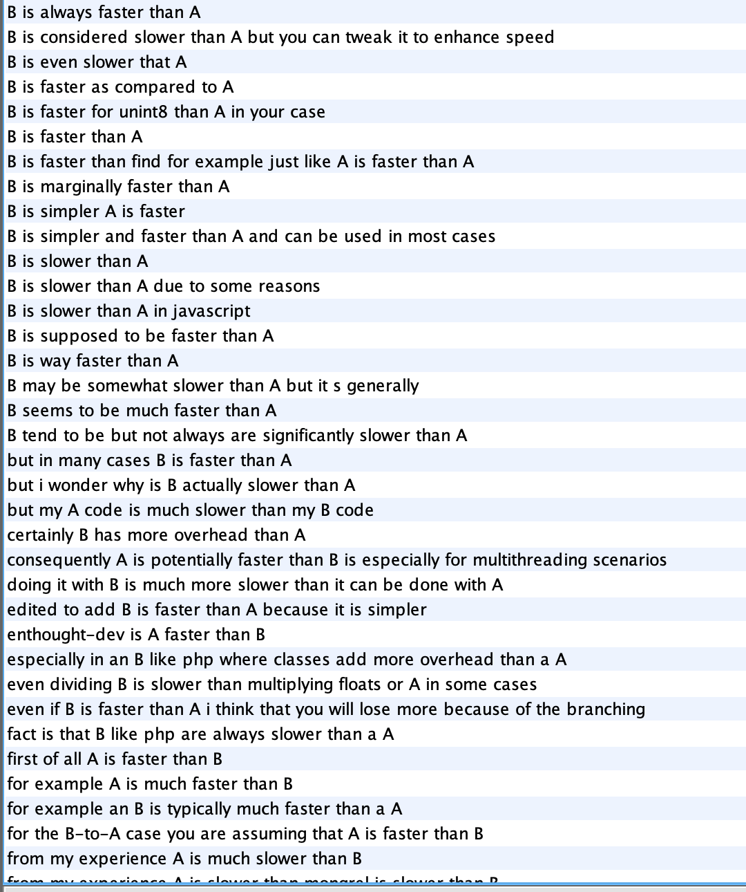
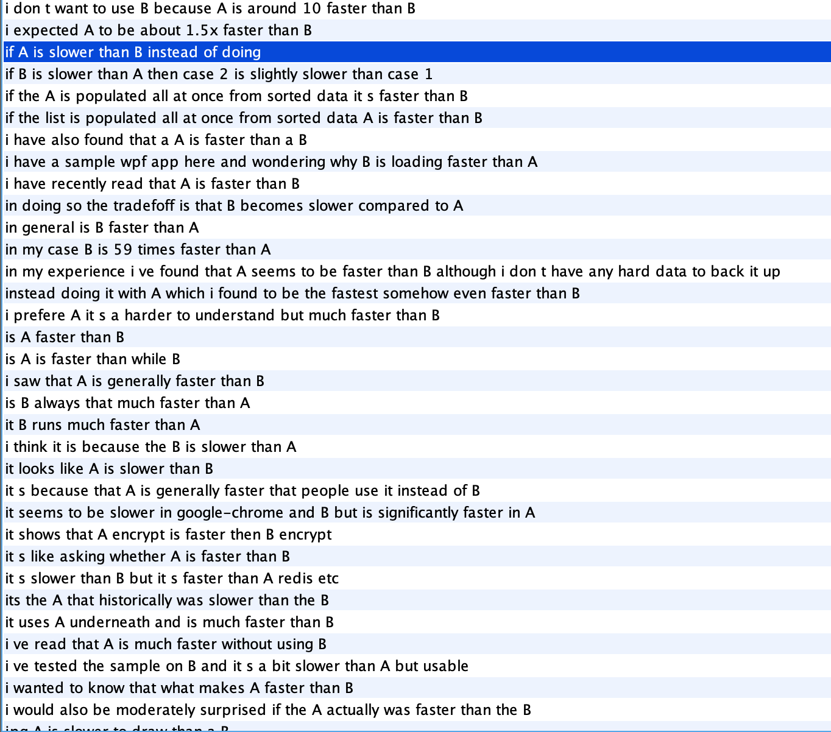
Class 12 slower, faster, speed

Slide 5
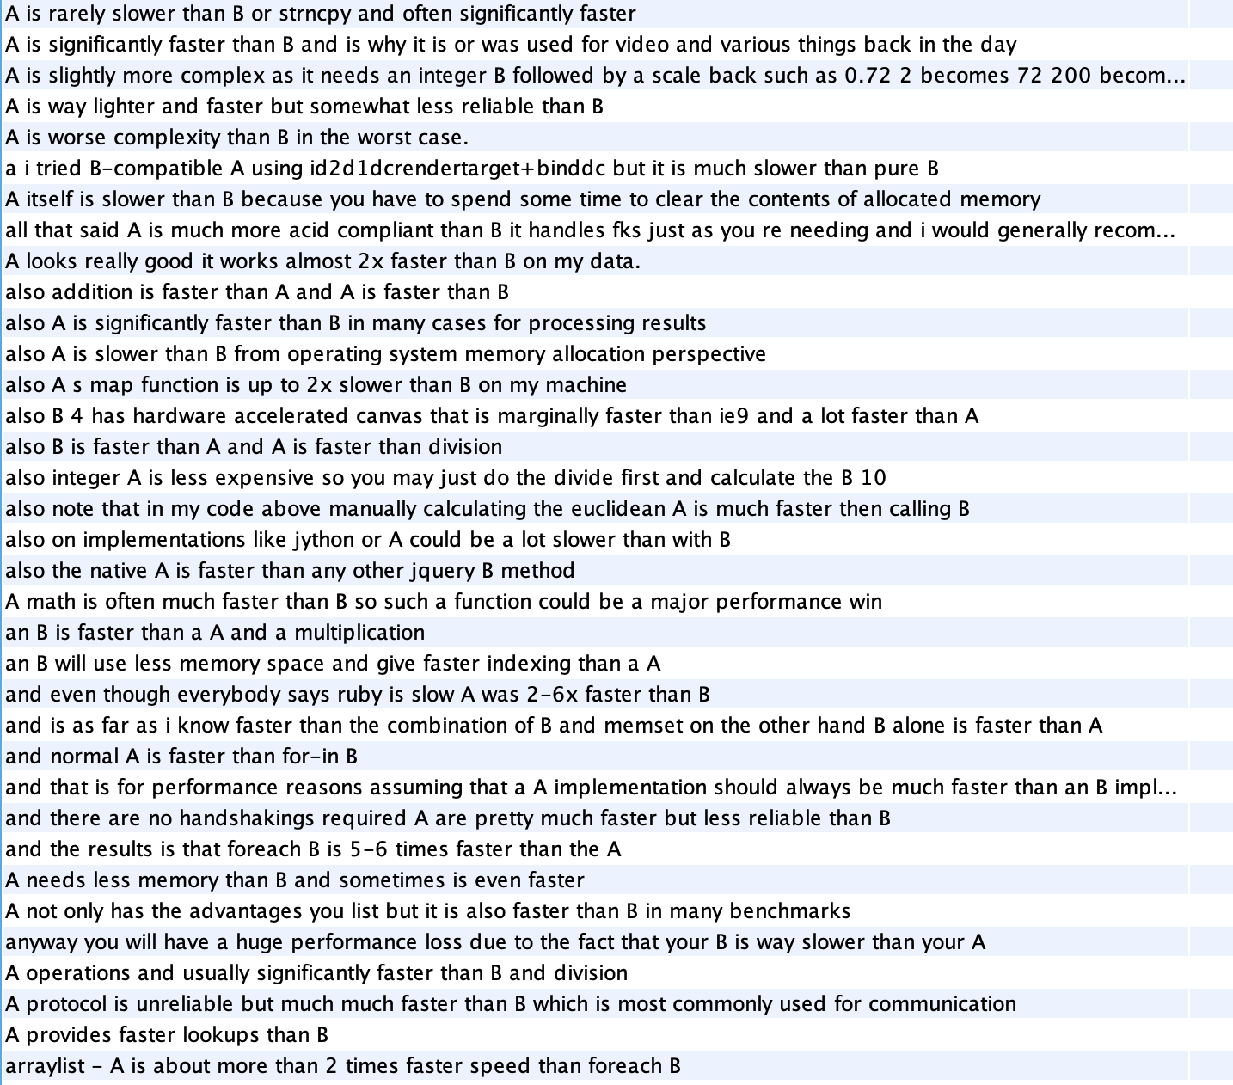
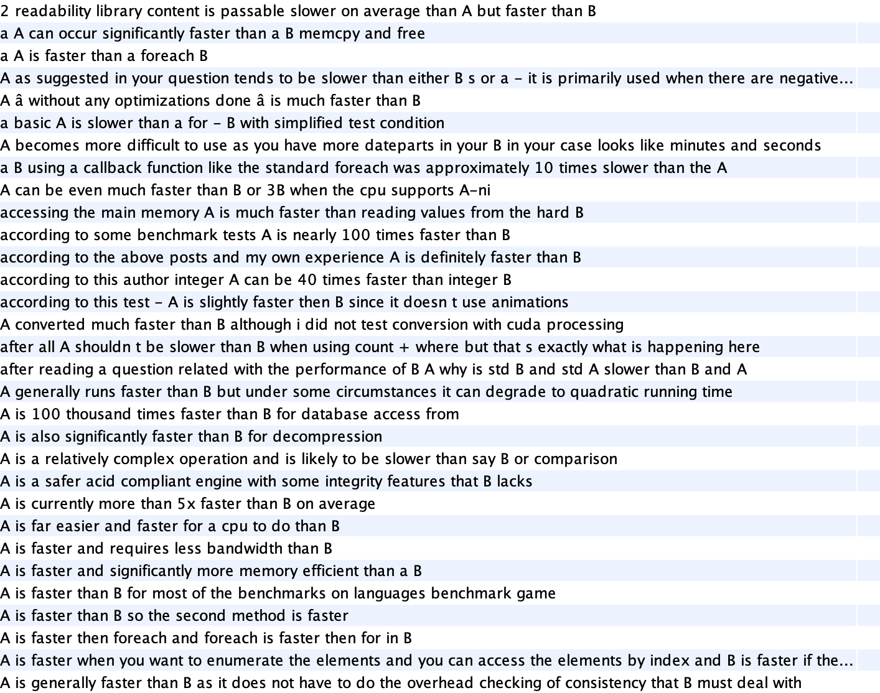
Class 104 somehow faster, slower

Slide 6
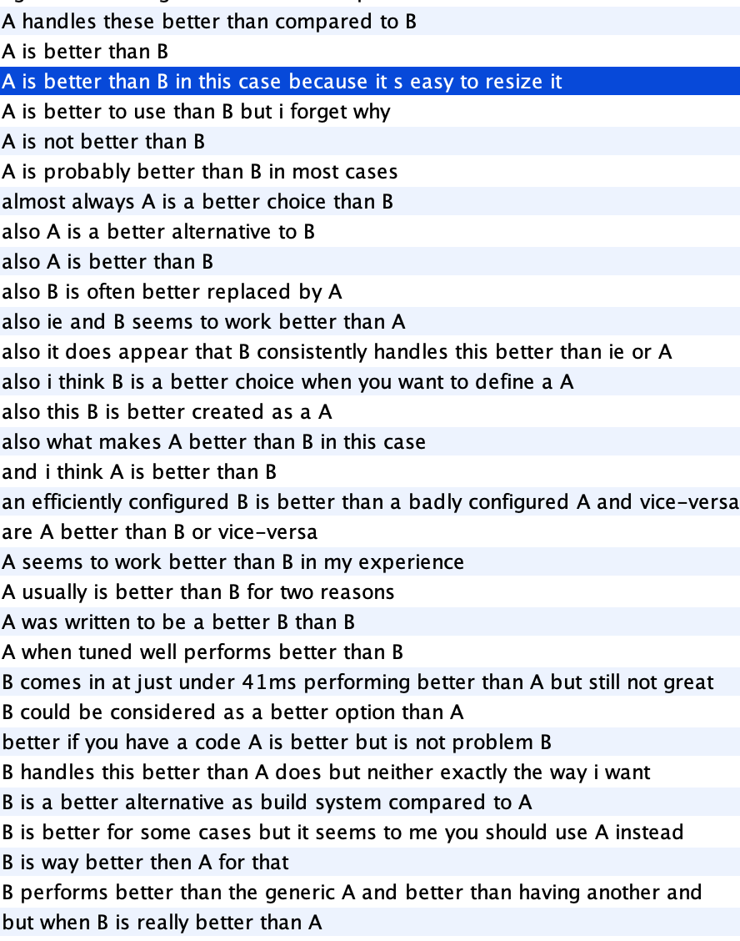
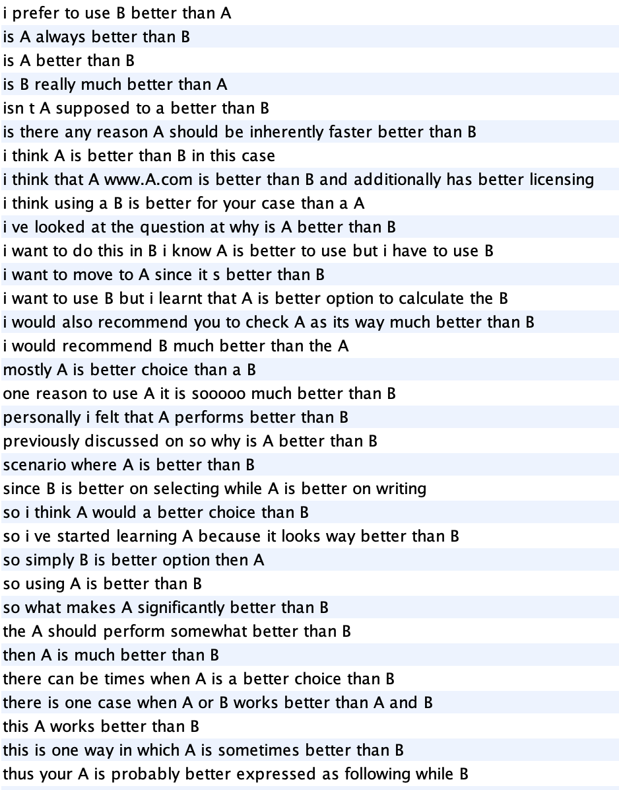
Class 49 better

Slide 7
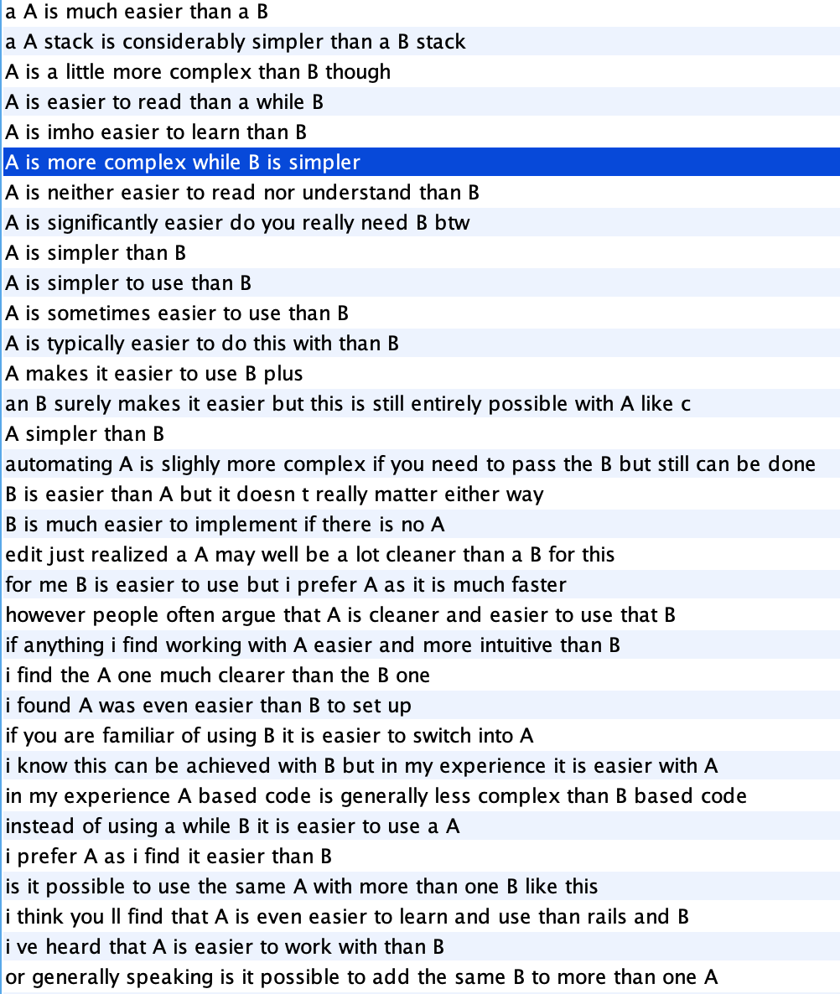

Class 50 simple, easier

Slide 8
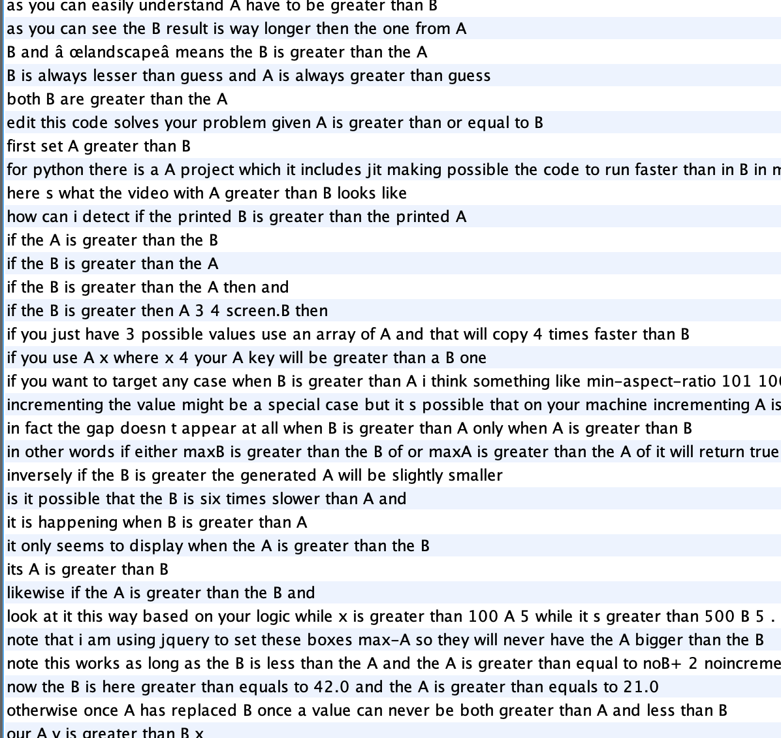
Class 25 greater than (value)

Slide 9
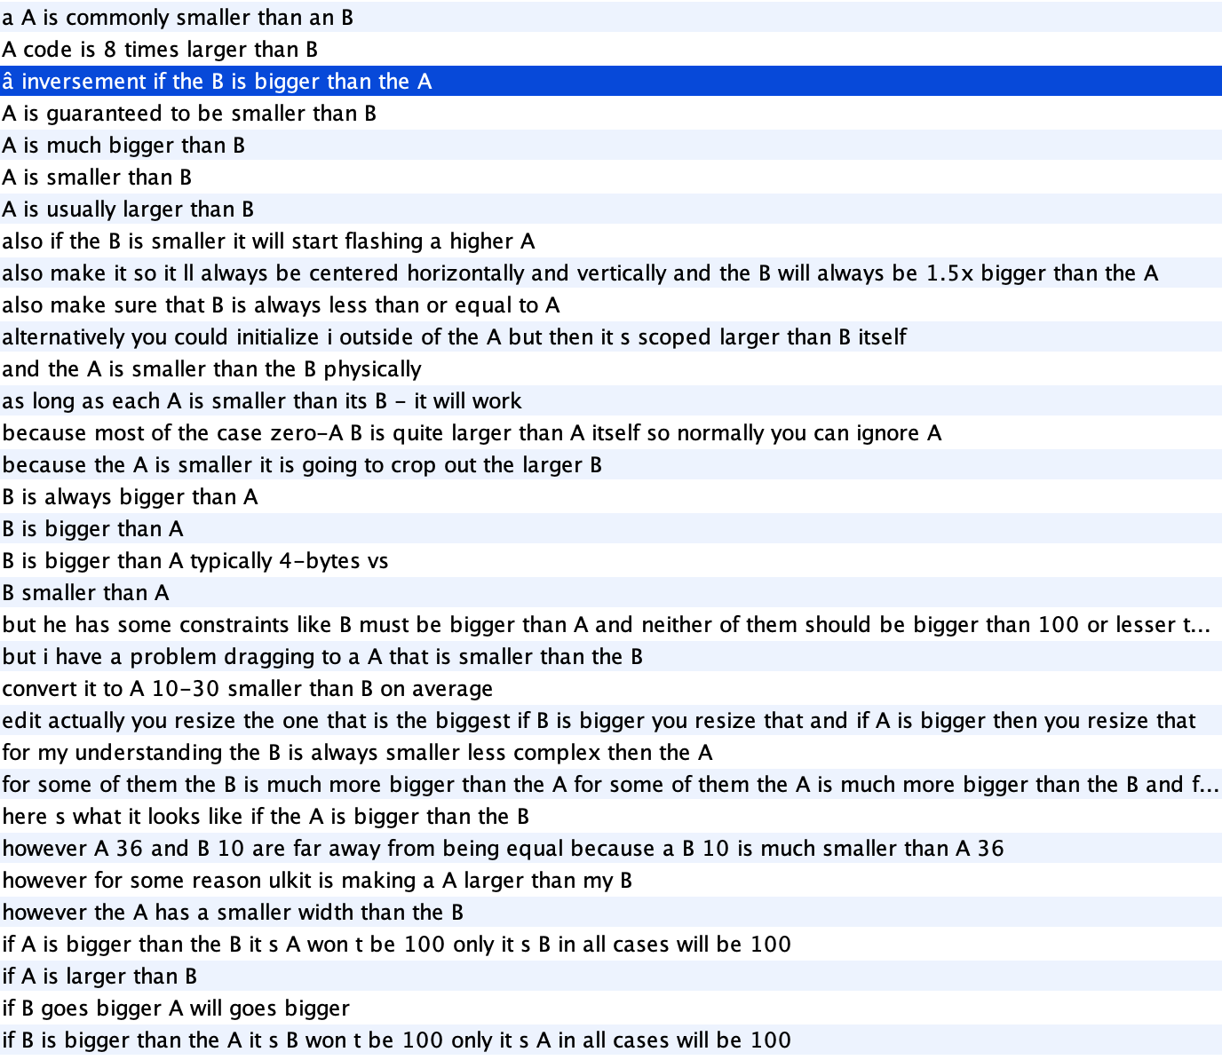
Class 14 larger, bigger than

Slide 10

Class 122 larger, bigger than (image, web attribute)

Slide 11
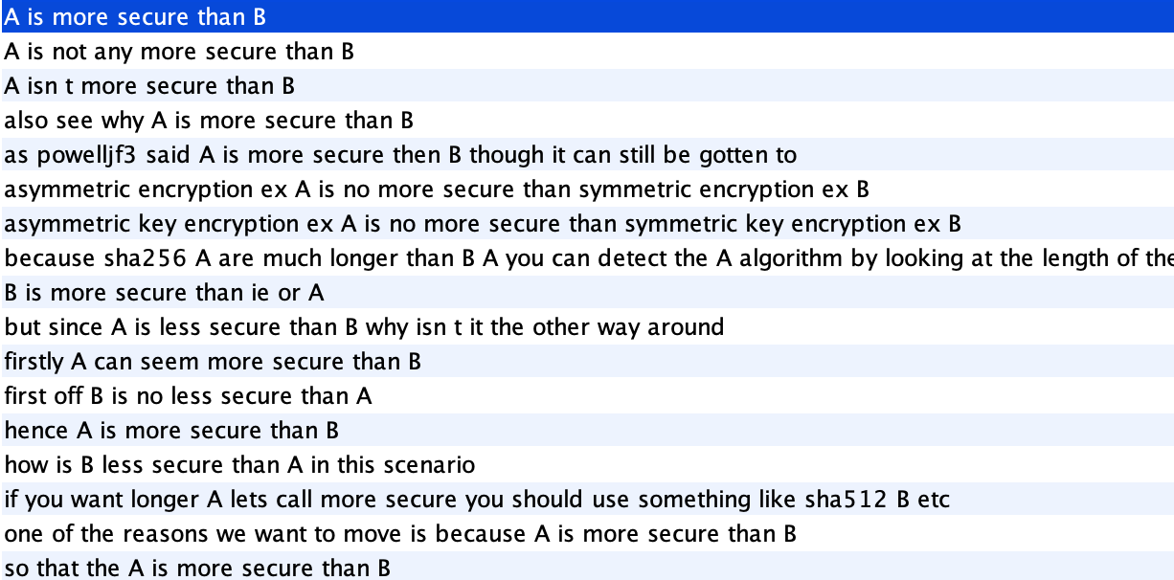
Class 122 secure

Slide 12
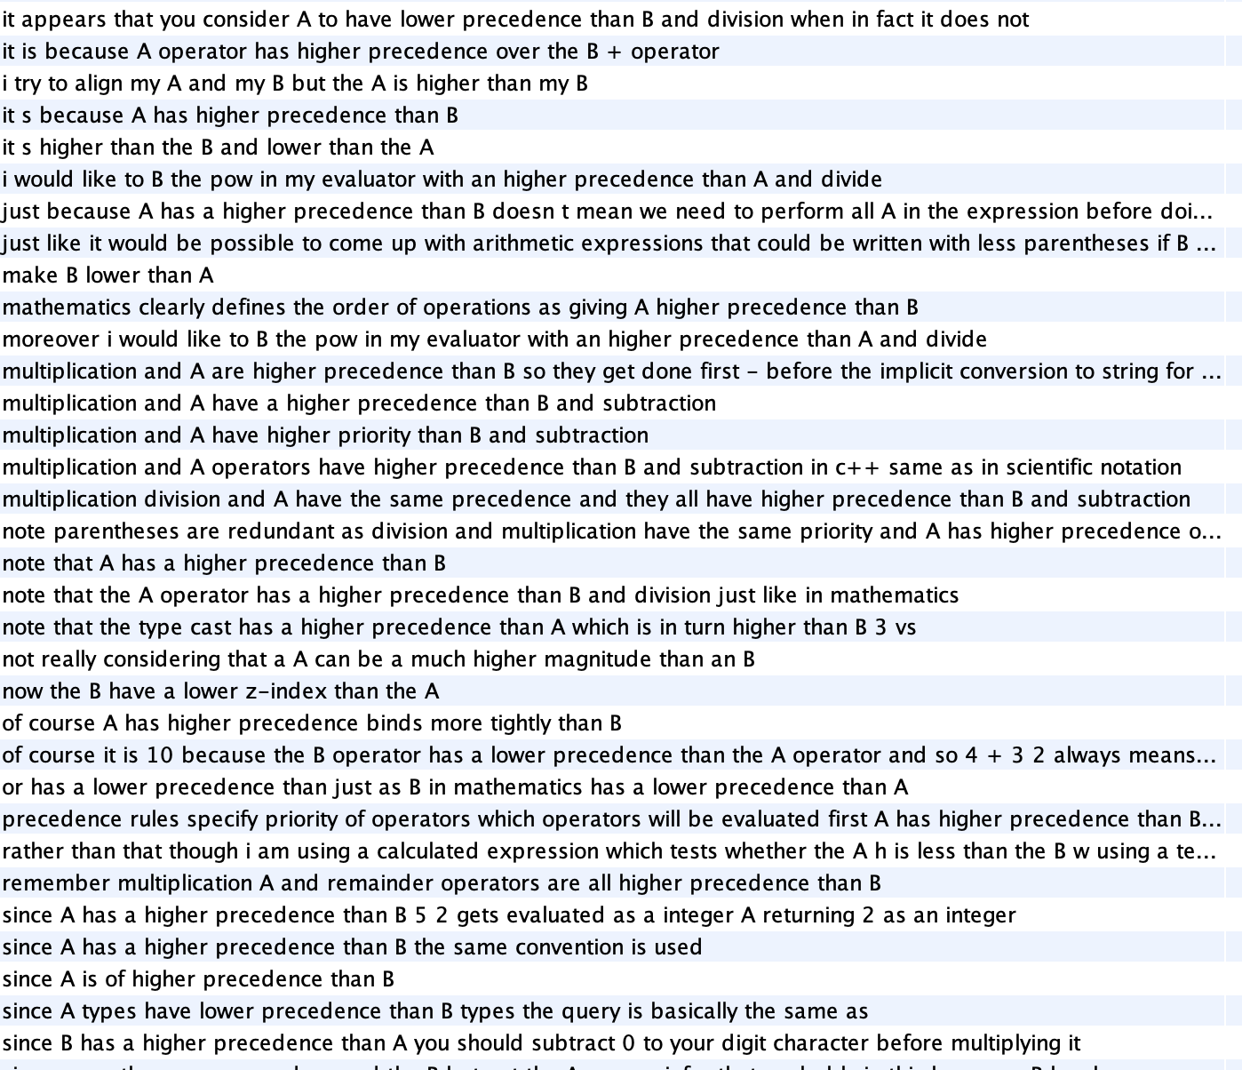
Class 122 high, low precedence/level

Slide 13
Mixed classes
Old, new versions
Expensive
Common, useful
Efficient
Memory
Better for doing detailed things
Wider

Slide 14
Patterns
549 matched pattern sentences from id 0 to 500000(343209 posts).
Pattern 0: 33
Pattern 1: 231
Pattern 3: 158
Pattern 4: 23
Pattern 5: 280
Pattern 6: 23
Pattern 7: 5
Pattern 8: 7

Slide 15
Patterns
Pattern 0: Tech VBZ/VBD JJR
perforce svn
i use perforce right now and for some reason i like svn better
perforce definitely gives me a better indication that there s going to be merge conflicts and even has built-in tools to help me resolve the merges
Postgresql mysql
of course the picture is not so simple innodb tables on mysql have a very different performance behaviour at the load levels where postgresql s better locks overtake mysql s other parts of your platform could be the bottlenecks
postgresql does comply better with standards so it can be easier to replace later
lxml libxml2
also libxml2 has more features
lxml is mostly api compatible with xml.etree.elementtree

Slide 16
Patterns
division addition
since most processors can do an addition comparison or multiplication in a single cycle those are all counted as one flop
but division always takes longer
quicksort mergesort
i could imagine that by directly accessing the memory using c for example one can improve the performance of quicksort more than it is possible with mergesort
another reason is that mergesort needs more memory because it s hard to implement it as an in-place sort

Slide 17
Patterns
Pattern 1: Tech VBZ/VBD JJ
phpunit simpletest
phpunit is run from the linux command line by default though there are http interfaces available for it
simpletest is web-based by nature and is much easier to get up and running imo
mockito jmock
i ve had good success using mockito
when i tried learning about jmock and easymock i found the learning curve to be a bit steep though maybe that s just me
Bazaar git
git is fastest but all three are fast enough
bazaar is the most flexible it has transparent read-write support for svn repositories and cares a lot about the user experience

Slide 18
Patterns
postgresql mysql
postgresql has the basic of sql and a lot more so if your mysql do not use fancy mysql stuff you will be ok
google-chrome safari
google-chrome is full featured browser
so you should be asking for webkit rendering engine google-chrome use developed by safari s guys control

Slide 19
Patterns
Pattern 3: Tech VBZ/VBD RB
cvs svn
the two approaches are more or less the same idea but svn was specifically designed to fix long standing flaws in cvs so in theory at least svn will always be the better choice
robocopy xcopy
you get note xcopy is now deprecated please use robocopy
junit testng
we didn t want people to feel uncomfortable writing tests while getting to know testng because we wanted them to keep writing a lot of tests
also junit is pretty much the de-facto standard in the java world
phpunit simpletest
simpletest also ships with a very simple html gui which is quite easy to extend if you want to
as far as i know phpunit does not include a html gui but there are gui s available to download such as cool

Slide 20
Patterns
google-chrome firefox
google-chrome does support the netscape plugin api but that is for displaying certain kinds of content
you seem to be after a extention api really firefox is the only major browser to encourage and support third party extentions to browsing capability that aren t simply new toolbars nothing in the developer documentation points to a browser enhancing api - google seem to want to keep a tight reign on the look and feel of the application

Slide 21
Patterns
Pattern 4: NN IN TECH VBZ RB
vmware virtualbox
one feature of vmware i really like is the ability to snapshot the system
firefox safari
afaik there is no difference on the part of browsers as both firefox and ie will incorrectly cache the response from a url with a querystring in the same way they cache the response from a url without a querystring
in the case of safari it respects the spec and doesn t cache urls with querystrings
bazaar svn
hm the most popular is easily svn which an old-fashioned centralized system but it s a bit of a pain to set up imo
requires special software on the server. i personally am quite fond of bazaar which is distributed and a server repository only requires ftp access and nothing else on the server

Slide 22
Patterns
Pattern 5: TECH VBP/VBZ NN
mbunit nunit
nunit does have a litter bit better tool support though
i am using resharper to run mbunit tests
pascal delphi
i spent six years in delphi and loved it to bits
the main strength for me of c# over object pascal is the syntax - it s much cleaner
umbraco dotnetnuke
umbraco gets my vote as a good cms that comes close to joomla in maturity and out of the box functionality
i m not that fond of dotnetnuke but it s been at least a year since i ran it thru its paces

Slide 23
Patterns
allegro sdl
for allegro there is collegro
for sdl there is sdl_collide.h or sdl-collide
cairngorm puremvc
in short cairngorm is the visualbasic of flex it works but will teach you a lot of bad habits
puremvc isn t so bad it just isn t a very good fit for writing flex applications
postgresql mysql
these databases are very different - mysql is speed and simplicity postgresql is robustness and concurrency
it will be easier for you to learn postgresql it is not that hard

Slide 24
Patterns
Pattern 6: JJR CIN TECH
bazaar git
mercurial and bazaar resemble themselves very much on the surface
they both provide basic distributed version control as in offline commit and merging multiple branches are both written in python and are both slower than git
postgresql mysql
for any application that wants to use an open source database the hands-down answer is postgresql
it s a lot more enterprise-ready than mysql not to mention that it follows the sql standard a lot better
prng random
normally seeding a new state takes quite while for a serious prng and making new ones each time won t really help mucha
nice solution for seeding is to use this random.org they supply random numbers generated from the atmospheric noise for free

Slide 25
Patterns
Pattern 7: RB/RBR JJ CIN TECH
ubuntu linux
ubuntu is getting closer but there are still numerous things with linux that will keep the grandmothers of the world from using it
phpunit simpletest
phpunit seems to have a bigger userbase which may count as an argument for switching
i m quite happy with simpletest though

Slide 26
Problems
Too many not pairs in the current system
Pattern 6 needs some modification(to be more strict)
There are still some A and B / A or B

