Slide 1
Biliv-Augmenta Employee Attrition Analysis
Insights and Recommendations
Presented by: Frederick Kaakoye
Date: 9th November 2024

Slide 2
Introduction
Objective: Understand and reduce employee attrition at Biliv-Augmenta.
Scope: Analysis of demographics, performance, and attrition trends using Power BI.

Slide 3
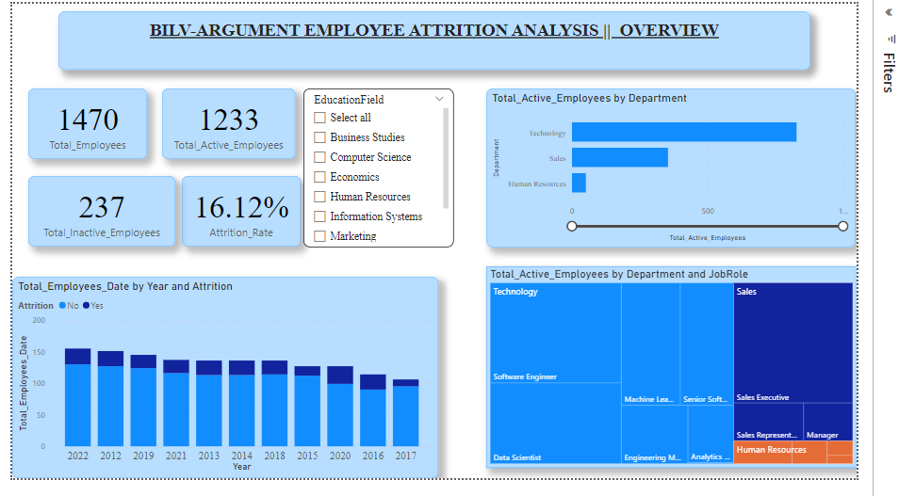
Overview of Attrition Metrics
Key Metrics
Total Employees
Active vs. Inactive Employees
Attrition Rate
Visual: KPI Cards displaying each metric

Slide 4
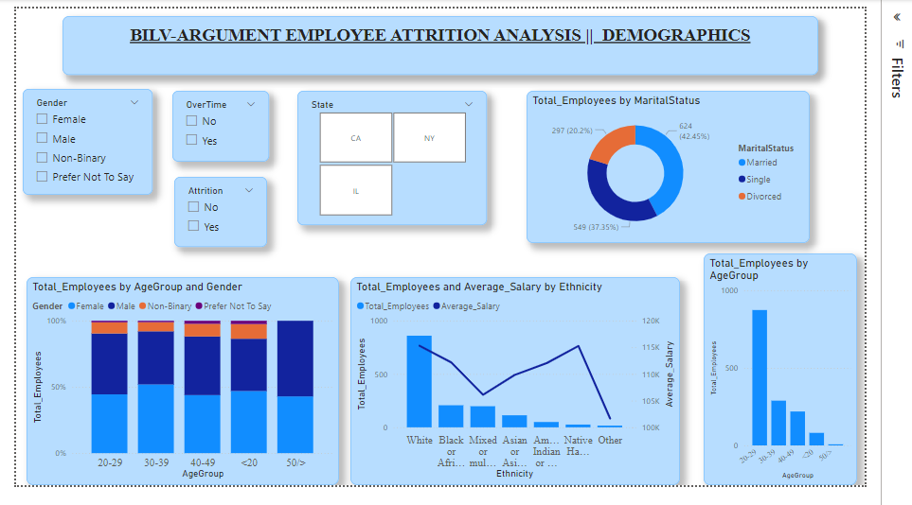
Demographics Analysis
Key Findings
Higher attrition in younger employees (<2 years tenure).
Gender disparities in attrition rates.
Marital status correlation with retention.
Visuals: Stacked Column and Donut Charts.

Slide 5
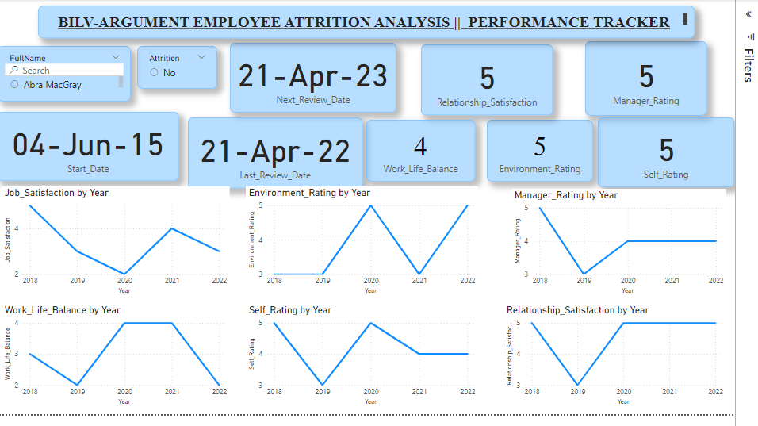
Performance Tracker Insights
Key Findings
Regular review cycles correlate with lower attrition.
Low self and manager ratings linked to higher turnover.
Career development opportunities matter.
Visuals: Line Graph, Bar Chart.

Slide 6
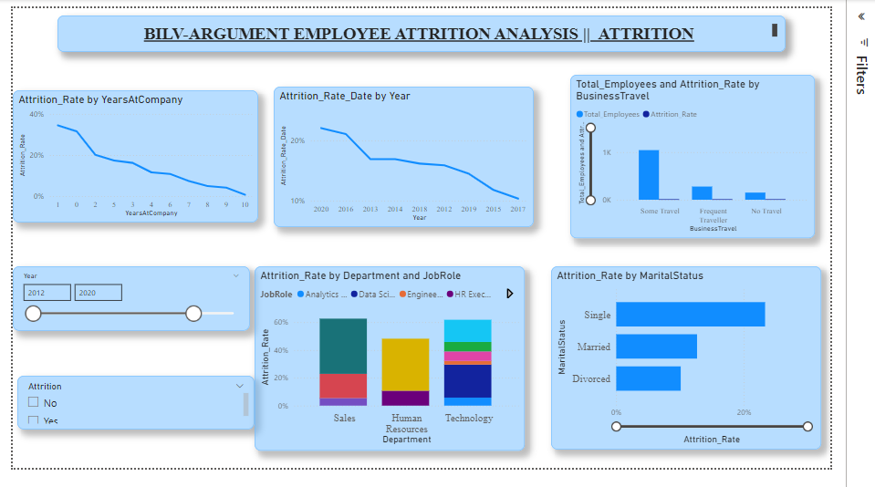
Attrition Trends Over Time
Insight: Annual attrition rates and identified spikes.
Visual: Line Chart showing Attrition Rate by Year.

Slide 7

Attrition Drivers
Primary Drivers
Limited career advancement.
Workload stress and overtime.
Compensation dissatisfaction

Slide 8
Departmental and Role-Based Trends
Key Findings
High attrition in specific departments (e.g., roles requiring extensive travel).
Correlation between tenure in role and turnover.

Slide 9
Compensation and Benefits Analysis
Key Findings
Higher average salaries linked to lower attrition.
Impact of salary hikes and stock options on retention..

Slide 10
Work-Life Balance and Overtime Impact
Key Findings
High overtime correlates with increased turnover.
Work-life balance satisfaction influences retention

Slide 11

Recommendations
Strategies to Reduce Attrition
Enhance career development programs.
Improve compensation and benefits packages.
Implement flexible work arrangements.
Strengthen managerial support and regular feedback mechanisms.

Slide 12
Action Plan
Short-Term Actions
Schedule regular performance reviews.
Conduct salary benchmarking.
Long-Term Actions
Develop clear career progression paths.
Introduce wellness and work-life balance initiatives.

Slide 13

Conclusion
Summary of Insights
Recap key findings and their implications.
Next Steps
Outline immediate actions and future analysis.

Slide 14
Thank You
Thank you for your attention!
Contact Information:
Frederick Kaakoye
| Email: frederickkaakoye@gmail.com
| LinkedIn: https://www.linkedin.com/in/frederick-kaakoye-98ab16243/

