Slide 1
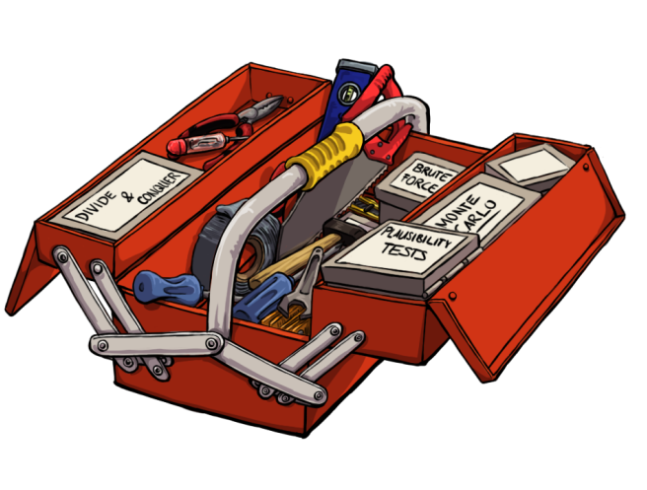
Problem solver‘s tool box
Analogies
Bottom up vs. Top down
Brute Force Simulation
Definitions
Divide and conquer
Examples
Exchange of „given“ and „looked for“
Formula Symbols and Equations
Interim values
Invariants
Monte Carlo Simulation
Plausibility tests
Repetitions (->loops)
Search the world
Notes:
We already mentioned the brute force method, but now I want to step into the details.
And I would like to show you, how I used the brute force method very early in my career for a gear milling machine.

Slide 2
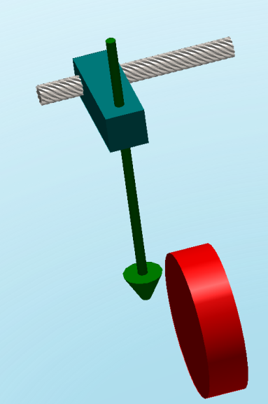
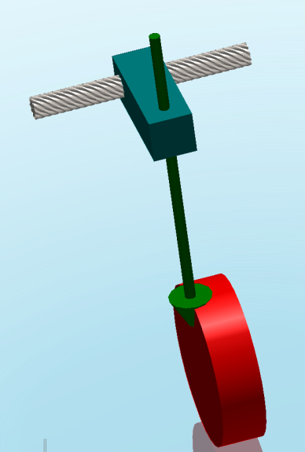
Axle having a trapezoidal thread
Feed motion
Rotating form cutter
Blank to make a spur gear
Notes:
This example is about a gear milling machine.
The red cylinder is a blank to become a spur-gear.
There is a rotating form cutter going through the blank to remove the tooth gaps. For simplicity the drive of the form cutter and the bearing of the form cutter is not shown.
The feed motion is realized via a rotating axle having a trapezoidal thread.
Each feed travel produces one tooth gap.
Between milling one tooth gap and milling the next tooth gap, the blank has to be turned according to the gap distance. This is not shown.
Having done all tooth gaps, the result is a spur-toothed gear.
If you want to produce a skewed-toothed gear, you have to turn the blank while milling.

Slide 3
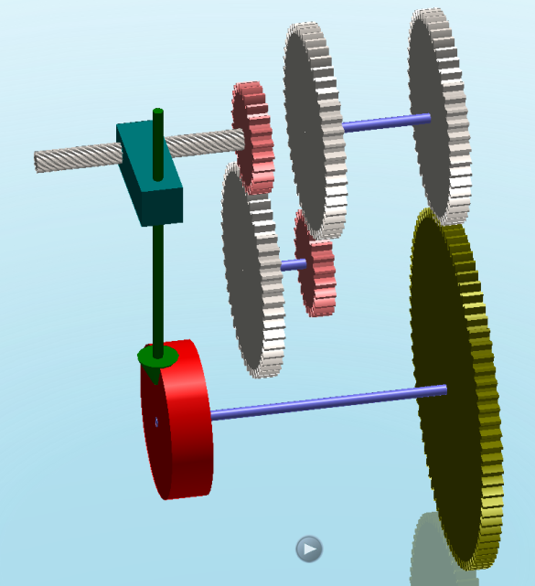
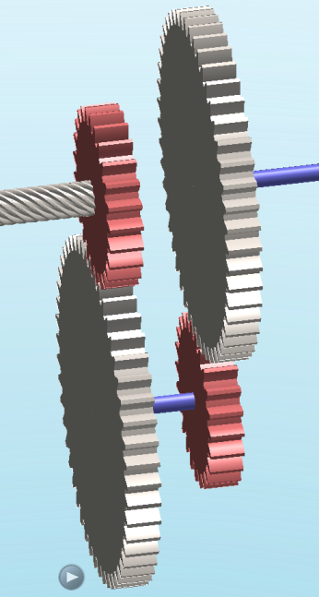
n1
n4
n2
n3
Notes:
Here you see a schematic gearing system to turn the red blanket during milling in order to make a skew toothed gearing.
In order to adust the skew angle, there is a gear box with gears 1 to 4 which can be changed.
In order to adjust the skew angle, the right gear ratio n4/n1 has to be realized.

Slide 4
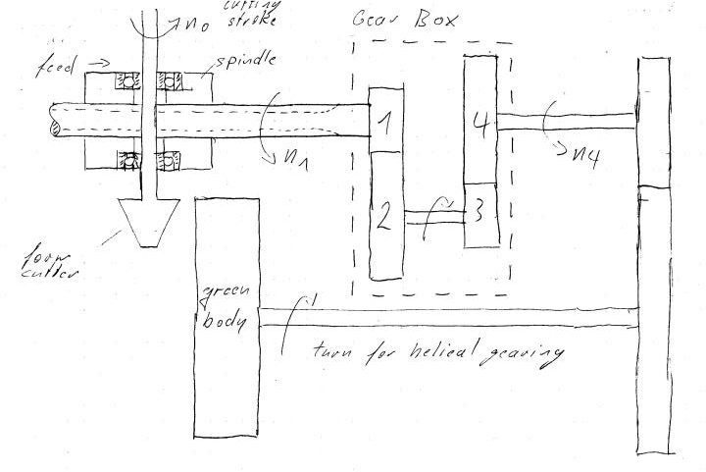
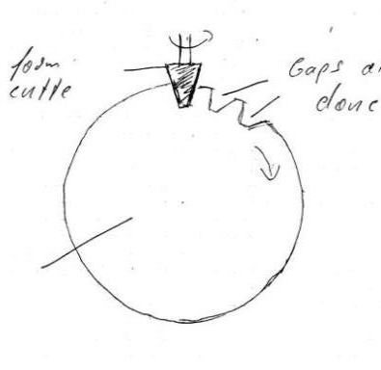

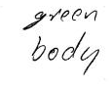
Notes:
Remember chapter 3, when Karin talked about brain storming? This was my first sketch for the gear milling machine.

Slide 5
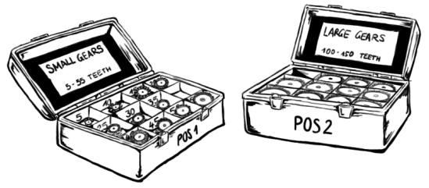

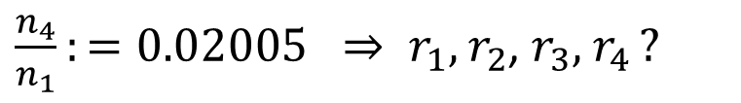
Problem solver‘s toolbox -Brute Force Simulation
r1=5, 10, 15,…55
r2=100, 105, 110…150
r3=5, 10, 15,…55
r4=100, 105, 110…150
n1
n4
n2
n3
$\frac{n_{4}}{n_{1}}:=0.02005 ⇒ r_{1},$ $r_{2}$, $r_{3},$ $r_{4 }?$
Notes:
Now how can we adjust the gear ratio?
Assume we have 4 different boxes, each containing wheels for one position in the gear box:
For the first wheel position we can pick a wheel with a radius from 5 to 55 in steps of 5.
For the second position we choose from 100 to 150 - again with steps of 5.
The third wheel’s radius ranges again from 5 to 55.
And the last wheel can be taken from 100 to 150.
This makes 11 different wheels for each wheel position.
Now the task for brute force is:
Find a combination that best realizes a gear ratio of 0.02005!

Slide 6
Problem solver‘s tool box
Analogies
Bottom up vs. Top down
Brute Force Simulation
Definitions
Divide and conquer
Examples
Exchange of „given“ and „looked for“
Formula Symbols and Equations
Interim values
Invariants
Monte Carlo Simulation
Plausibility tests
Repetitions (->loops)
Search the world
Notes:
Although we want to demonstrate Brute Force, it is not forbidden to use also the Divide and conquer tool.

Slide 7
Problem solver‘s toolbox -Brute Force Simulation
n1
n4
Mr. Jones should generate all possible combinations of r1,r2,r3,r4
Mr. Smith should find out how to calculate the gear ratio as a function of r1,r2,r3,r4
Mr. Miller will memorize the best combination Mr. Jones generated and Mr. Smith evaluated.
n2
n3
Notes:
So one approach to partition the work could be:
Mr. Jones should generate all possible combinations of r1,r2,r3,r4
Mr. Smith should find out how to calculate the gear ratio as a function of r1,r2,r3,r4
Mr. Miller will memorize the best combination Mr. Jones generated and Mr. Smith evaluated.

Slide 8
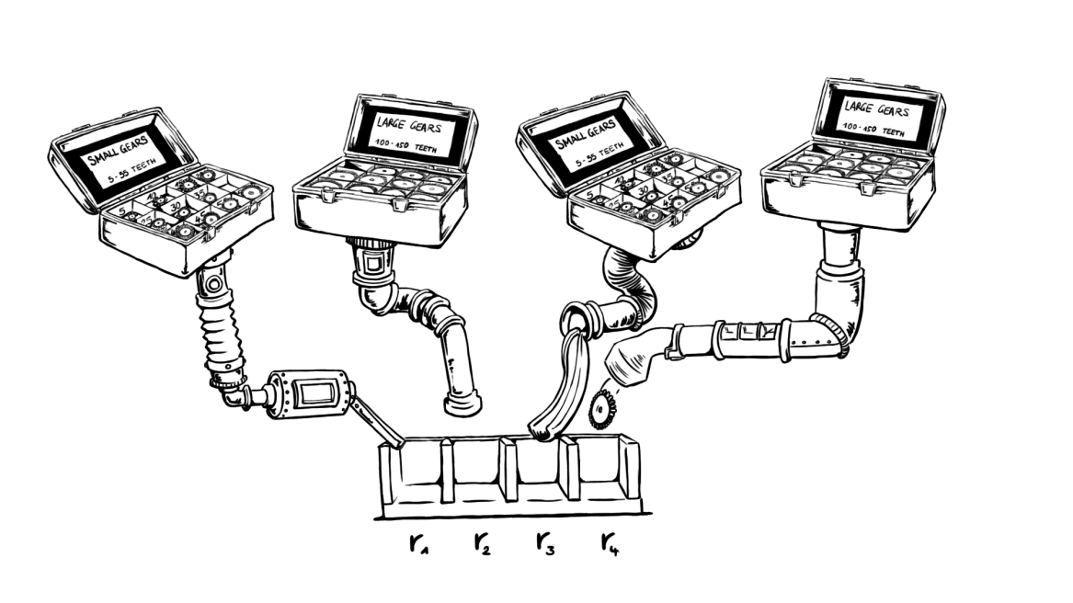
Jones generates combinations
Notes:
How jones creates the combinations will be shown live in Matlab.

Slide 9

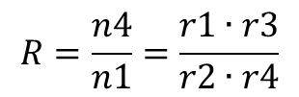



Smith calculates the gear ratios
$$v1=v2 \\ v3=v4$$
n1
n4
$$ω2=ω3$$
$$\frac{n4}{n1}=\frac{ω4}{ω1}=\frac{v4/r4}{v1/r1}=\frac{v3/r4}{v1/r1}=\frac{(v2∙\frac{r3}{r2})/r4}{v1/r1}$$
n2
n3
$$R=\frac{n4}{n1}=\frac{r1∙r3}{r2∙r4}$$
$$RD≔0.02$$
Notes:
Now we have to leave Matlab for a short time, because before Smith can start his Matlab work, he has to do some calculations on a piece of paper.
Here are his thoughts on how to calculate the gear ratio of a combination.
What is a gear tooth system good for?
Avoid slippage, thus the translational velocities of gear 1 and gear 2 are identical. The same is true for gear 3 and gear 4.
Gear wheel 2 and Gear wheel 3 or on the same shaft, therefor they have the same angular velocity:
From that after some basic steps we get the final Gear ratio R
In the matlab code, the desired Gear ratio is denoted as RD. And first we start with RD=0.02.

Slide 10
% jones should do the combinations
clc
combi=[];
for r1=5:5:55
for r2=100:5:150
for r3=5:5:55
for r4=100:5:150
combi=[combi;r1,r2,r3,r4];
end
end
end
end
%smith calculates the Gear Ratios R=r1*r3/r2/r4
R=combi(:,1).*combi(:,3)./combi(:,2)./combi(:,4);
Rd=0.02;
%miller pick up some combinations
rows=R==Rd;
bestcombi=combi(rows,:);
Rd=0.02005;
Notes:
This is our first working code as it was just developed in matlab. It works very well to find combinations with a Gear Ratio of 0.02 or if I change the value of RD for any Gear Ratio which is possible without an error. But as we have a limited choice of gear wheels, not all Gear Ratios can be realized without an error.
If we change RD for example to 0.02005, there is no combination matching this value, thus our bestcombi array is empty.
Because of the small difference R=0.02 might still work, but asking for a perfect match by the line rows=error==RD, we do not get the closest match.

Slide 11
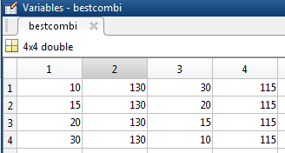
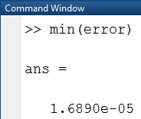
% jones should do the combinations
clc
combi=[];
for r1=5:5:55
for r2=100:5:150
for r3=5:5:55
for r4=100:5:150
combi=[combi;r1,r2,r3,r4];
end
end
end
end
%smith calculates the Gear Ratios R=r1*r3/r2/r4
R=combi(:,1).*combi(:,3)./combi(:,2)./combi(:,4);
Rd=0.02005;
error=abs(R-Rd);
%miller pick up some combinations
rows=error==min(error);
bestcombi=combi(rows,:);
Notes:
Here is an approach to overcome this problem.
Now Smith calculates the error
of each of his combinations.
Miller then picks the combinations with the smallest error instead of the combinations with error 0. Thus we always get suggestions.
In this example we still get 4 combinations with an error as small as 1.something times 10 to the power of -5.

Slide 12
% jones should do the combinations
clc
combi=[];
for r1=5:5:55
for r2=100:5:150
for r3=5:5:55
for r4=100:5:150
combi=[combi;r1,r2,r3,r4];
end
end
end
end
%smith calculates the Gear Ratios R=r1*r3/r2/r4
R=combi(:,1).*combi(:,3)./combi(:,2)./combi(:,4);
Rd=0.02005;
error=abs(R-Rd);
%miller pick up some combinations
rows=error==min(error);
bestcombi=combi(rows,:);
Notes:
The version we have right now, has the advantage, that it is easy to understand as we only have a few lines of code. But style-wise it resembles a mixture of two programming paradigms within matlab:
Use loops and nothing special
Use special functions for matrices.
As matlab (remember the full name matrix laboratory ) is specialized in Matrix operations, it’s full elegance and beauty only shows up if you use matrix functions.
On the other side, a lot of people are no native matlab programmers, they started their career in C or Java-programming. These people like to have it in a more close to C-style. So let‘s look on two more style-consistent solutions.

Slide 13
% jones should do the combinations
r1=5:5:55;
r2=100:5:150;
r3=5:5:55;
r4=100:5:150;
combi=allcomb(r1,r2,r3,r4);
%smith calculates the Gear Ratios R=r1*r3/r2/r4
R=combi(:,1).*combi(:,3)./combi(:,2)./combi(:,4);
Rd=0.02005;
error=abs(R-Rd);
%miller pick up some combinations
rows=error==min(error);
bestcombi=combi(rows,:);
Notes:
This version does not use a loop at all, but employs the function allcomb to produce all possible combinations. This function is not part of matlab, but can be found within matlab central, where matlab-wizzards from all over the world add useful functions that are not included in the official matlab releases.

Slide 14
%Jones
combi=zeros(11^4,4);
CombiNr=1;
for r1=5:5:55
for r2=100:5:150
for r3=5:5:55
for r4=100:5:150
combi(CombiNr,1)=r1;
combi(CombiNr,2)=r2;
combi(CombiNr,3)=r3;
combi(CombiNr,4)=r4;
CombiNr=CombiNr+1;
end
end
end
end
%Smith
Rd=0.02;
error=zeros(11^4,1);
for i=1:11^4
R(i)=combi(i,1)*combi(i,3)/combi(i,2)/combi(i,4);
error(i)=abs(Rd-R(i));
end
%Miller
errorbest=1E100; % just an unreasonable big number
for i=1:11^4
if error(i)<=errorbest
errorbest=error(i);
r1best=combi(i,1);
r2best=combi(i,2);
r3best=combi(i,3);
r4best=combi(i,4);
end
end
Notes:
This version only uses loops.
There are two changes to the work of Jones: The size of combi is pre-calculated by the command combi=zeros(11^4,4). So for the rest to the program, the size of combi is fixed.
Second change is, we only write element wise to combi so we need four commands, where we had only one vectorial command. And the index CombiNr is to be increased with every loop step.
The work of smith is now also done in a loop. The array error is dimensioned and defined with the zeros command. For every value of error we take a loop step.
And also Miller works through a loop now. Here we loose something, as Miller will only report the last good combination in the variables r1 best to r4 best, while in the matrix version, we had all the good combinations.
It‘s nice, that Jones, Smith and Miller are separated in the code. But it loops several times over the same array combi.

Slide 15
errorbest=1E100;
Rd=0.02;
for r1=5:5:55
for r2=100:5:150
for r3=5:5:55
for r4=100:5:150
R=r1*r3/r2/r4;
error=abs(Rd-R);
if error<=errorbest
errorbest=error;
r1best=r1;
r2best=r2;
r3best=r3;
r4best=r4;
end
end
end
end
end
Notes:
This version only uses one loop and no array at all.

Slide 16
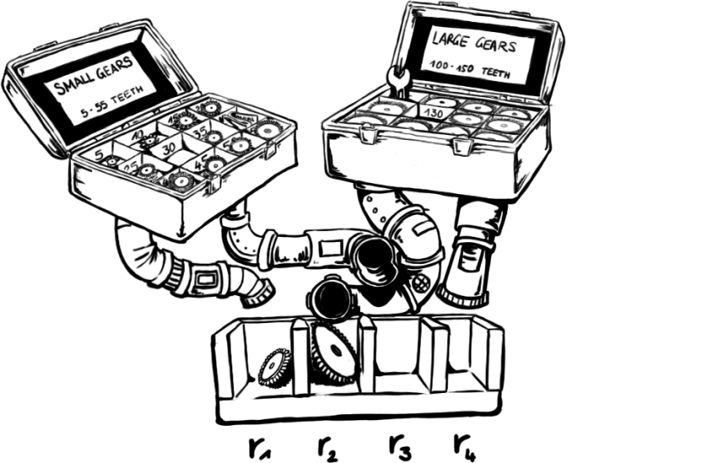
Controller cuts on boxes
Notes:
Now the controller of your company says: it is not possible to deliver four different boxes with each machine. Just two boxes have to suffice. First think about whether this makes sense. Then change the code to meet this new requirement.

Slide 17
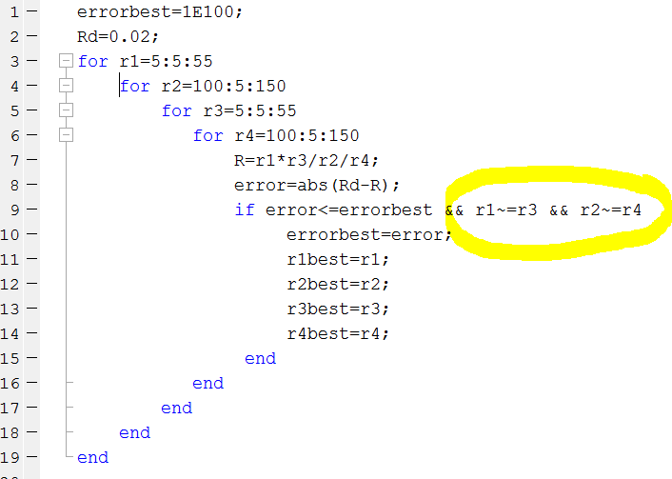
Notes:
The highlighted part of the code is added. All combinations are generated, but only those that satisfy the condition r1 being different form r3 and r2 being different from r4 are used.
It is quite common, that you do not have a good scheme to come up only with those combinations, that are interesting. Therefor you generate all and filter out the misfits.

Slide 18

Shafts of Gear1 and Gear4 in a line
n1
n4
$$r1+r2=r3+r4$$
n2
n3
Notes:
So far, we accepted combinations with different locations of shaft 4. Assuming shaft 1 fix, the relative location of shaft 4 would be r1+r2-r3-r4. Now this relative position shall be zero Thus: r1+r2=r3+r4
Note that we still allow shaft 2 or shaft 3 respectively to move.

Slide 19
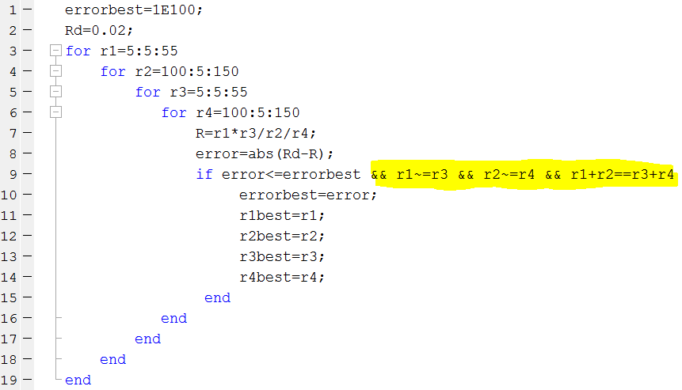
Notes:
In the highlighted region of the code the condition r1+r2==r3+r4 is added.

Slide 20

n1
n4
Finally all shaft positions shall be fixed:
$$r1+r2=r3+r4=d$$
What is a good value for d?
Change the matlab code accordingly!
d=155
n2
n3

Slide 21
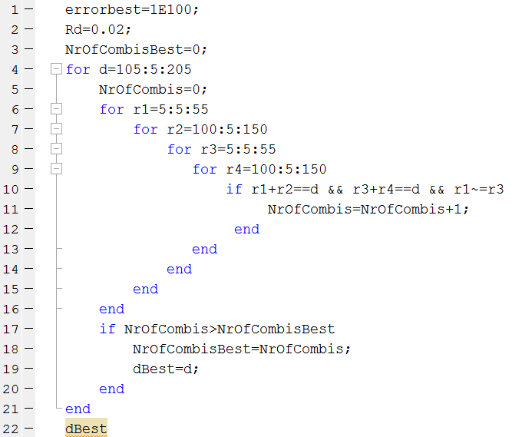
Notes:
The ideal distance for the axis is that one, which maximizes the number of possible combinations. So finding the optimal axis distance is a brute force problem by itself. Variable NrOfCombis counts for each distance d, how many valid combinations are possible. The first two conditions in line 10 refer to the right distance of the gears, the last one reflects , that each gear size is available only once. You could add a condition r2<>r4, but that one is logically included from the other 3 conditions.

Slide 22
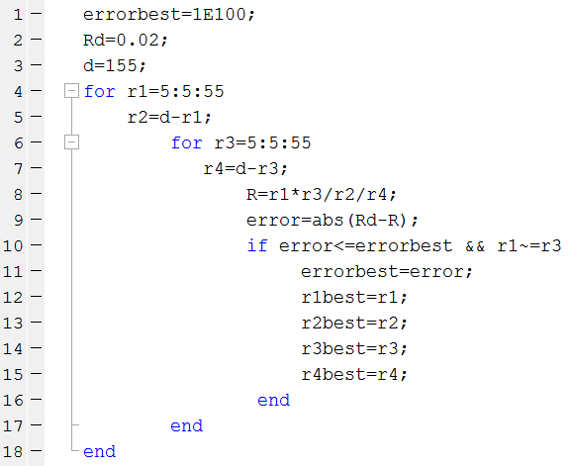
Notes:
With the fixed distance d, r2 is determined by d and r1; as well as r4 is determined by d and r3. Thus we only need two loops.

Slide 23
% jones should do the combinations
r1=5:5:55;
r2=100:5:150;
r3=5:5:55;
r4=100:5:150;
combi=allcomb(r1,r2,r3,r4);
%smith calculates the Gear Ratios R=r1*r3/r2/r4
R=combi(:,1).*combi(:,3)./combi(:,2)./combi(:,4);
Rd=0.02005;
error=abs(R-Rd);
%miller pick up some combinations
rows=error==min(error);
bestcombi=combi(rows,:);
Notes:
The function allcomb was taken from matlab central

Slide 24
% jones should do the combinations
r1=5:5:55;
r2=100:5:150;
r3=5:5:55;
r4=100:5:150;
combi=combinations(r1,r2,r3,r4);
%smith calculates the Gear Ratios R=r1*r3/r2/r4
R=combi.r1 .* combi.r2 ./combi.r3 ./ combi.r4;
Rd=0.02005;
error=abs(R-Rd);
%miller pick up some combinations
rows=error==min(error);
bestcombi=combi(rows,:);
Notes:
The function combinations is available since matlab version 2023a

Slide 25
Review Brute force problems mean you have to make the right choice.
For every variable you can choose, there will be one loop in the code.
You need a function to judge one alternative versus another (error in our example) More on these functions will follow in the chapter Least Squares.
In our example the steps of the loops were already given by the problem (gears in steps of 5).
Most of the time the steps (and the start and stop values) of the loops are not given by the problem. For an optimal solution the steps should be small, for a fast program, the steps should be large.
Therefor the step size is often a trade off.
In the gearbox example, the existence of each gear was given, while the value had to be chosen. Let‘s look at another example, where the existence has to be decided on, while the value is fixed in the first place and will be changed later on.

Slide 26
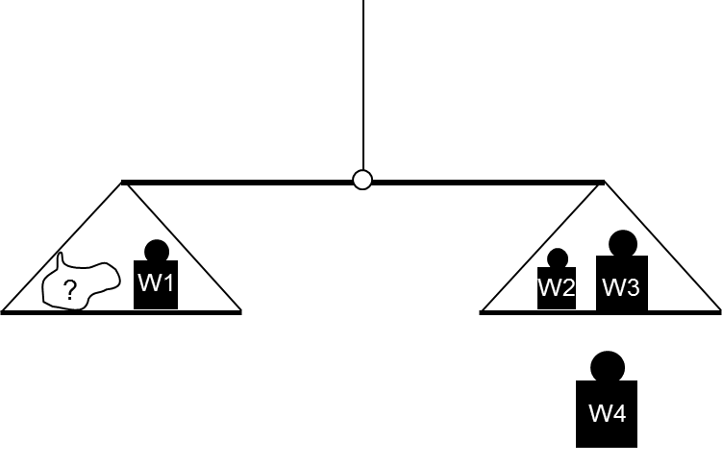
P=-1
P=1
To measure this
W ?
P=0
Where to place these
P1=-1, P2=1, P3=1 and P4=0
Notes:
An unknown weight W
has to be determined
using a beam balance.
The weight W is an integer multiply of 1 kg and is smaller or equal Wmax.
You can choose 4 reference weights to make this possible.
According to Divide and conquer the solution is subdivided in two steps: Step1
Learn How to decide whether a certain weight can be determined with a given set of W1 to W4.
Step2
Use step one to find a set of W1 to W4 suitable to measure all weights smaller equal Wmax.
For the first step:
The unknown Weight W is always placed on the left scale pan. The weights W1 to W4 can either be placed on the left pan (coded by Position P= -1)
or on the right pan (coded by P=1)
or may not be used at all (coded by P=0).
So in the picture P1=-1, P2=1, P3=1 and P4=0.

Slide 27

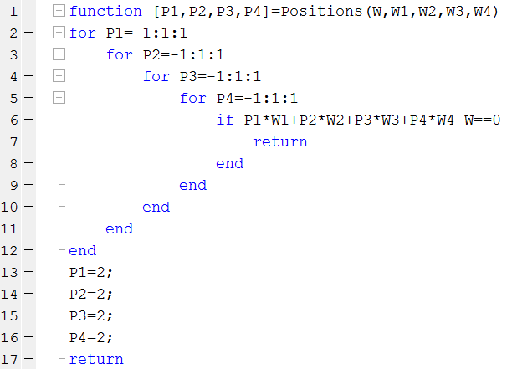
Notes:
The weight W and the Weights W1 to W4 are passed to the function Positions as arguments.
The four for loops try all possible weighting configurations for the 4 Weights W1 to W4.
In line 6 we check if both pans balance.
If yes, we stop the function (keyword return) the return values are the current values of P1 to P4. If no working weighting combination is found, we return the impossible positions 2 which stands for no success.

Slide 28
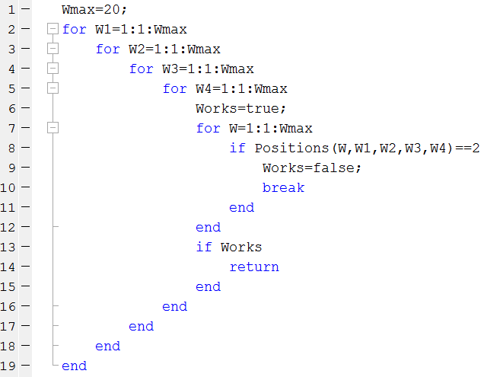
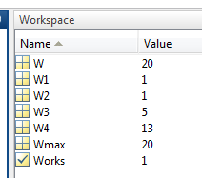
Notes:
Now all possible combinations of weights W1 to W4 are tried (lines 2 to 5) . If a combination fails to measure one of the weights (test in line 8), the next combination is tried (break command in line 10).
If a combination worked (condition Works in line 13) then the program is finished. Otherwise the program ends, when all combinations are tried without success. In this case Works has the value false.

Slide 29
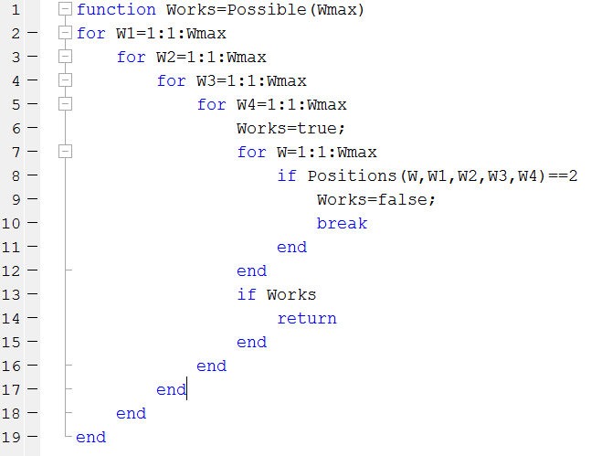
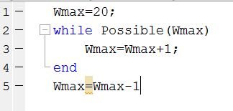
Result: Wmax=40
Positions(W,W1,W2,W3,W4)==2 is a short cut to
[P1, P2, P3, P4 ]=Positions(W,W1,W2,W3,W4);
P1==2;
Notes:
As the last extension of this problem, let’s determine the biggest maximum weight, that is possible with 4 weights. Our old program is turned into a function. A new one looks for the maximum weight. This version may take some time (on my machine 90 s). If you want to stop the execution you can hit “control c”. Some details on the code:
We increase Wmax after we find a possible weight set. This means we recognize 40 works then increase to 41 and find that 41 does not work. So the last working Wmax is Wmax leaving the loop minus 1.
Positions==2 is a shortcut to assigning the output of the function to an array holding P1 to P4 and then asking for any of these positions whether it is 2 (which means impossible)

Slide 30
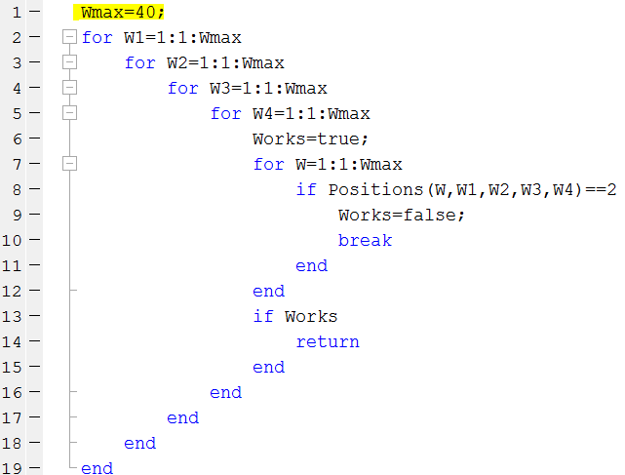
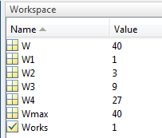
Notes:
For simplicity, the code for wmax did not include an output of the final weight set. The final weight set can be seen running the previous code with Wmax=40.

