Slide 1
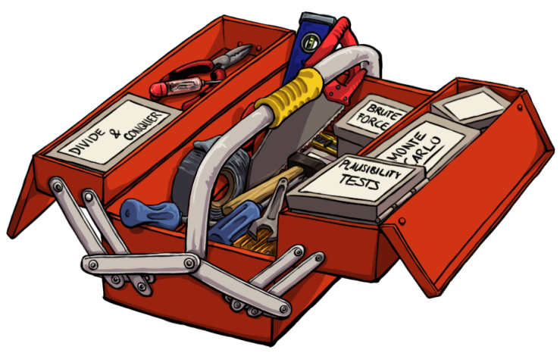
Problem solver‘s tool box
Analogies
Bottom up vs. Top down
Brute Force Simulation
Definitions
Divide and conquer
Examples
Exchange of „given“ and „looked for“
Formula Symbols and Equations
Interim values
Invariants
Monte Carlo Simulation
Plausibility tests
Repetitions (->loops)
Search the world
“Brute force problems mean you have to make the right choice.
For every variable you can choose, there will be one loop in the code.
You need a function to judge one alternative versus another (error in our example) More on these functions will follow.”
Notes:
Change history:Slide 1 added Slide 6 inner derivation added
Slide 13 changed x to p
Slide 14 changed x to p
In the brute force chapter we stated:
„Brute force problems mean you have to make the right choice.
For every variable you can choose, there will be one loop in the code.
You need a function to judge one alternative versus another (error in our example) More on these functions will follow.” And here it comes the follow up starting with a simple example.

Slide 2
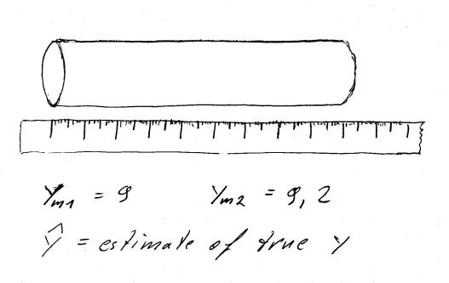
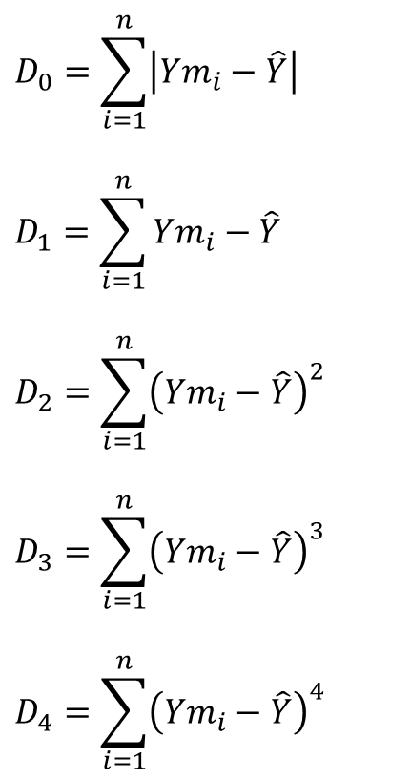
$$D_{0}=\sum_{i=1}^{n}{\left|{Ym}_{i}−\hat{Y}\right|}$$
$$D_{1}=\sum_{i=1}^{n}{{Ym}_{i}−\hat{Y}}$$
$$D_{2}=\sum_{i=1}^{n}{{\left({Ym}_{i}−\hat{Y}\right)}^{2}}$$
$$D_{3}=\sum_{i=1}^{n}{{\left({Ym}_{i}−\hat{Y}\right)}^{3}}$$
$$D_{4}=\sum_{i=1}^{n}{{\left({Ym}_{i}−\hat{Y}\right)}^{4}}$$
Notes:
Let us assume someone had the task to determine the length of a part. The true length of the part is called y. Several measurements ymi are taken. Based on these measurements an estimate y^ of the true length is calculated. Now, how comfortable can you feel with the estimate? Obviously, if all the measurements give the same reading and this very value is reported as Y^, there is no reason to doubt the estimate.
If the measurements vary a lot, or if the estimate is far off the measured values, the estimated value may be doubted.
As we will see soon, it is useful to have a meaningful number to express such a doubt.
Lets look at some candidate formulas to calculate such a doubt: All these doubt functions calculate to zero if all measurement values and the estimated value are identical. But when do these doubt functions differ?

Slide 3

ym1=9;
ym2=9.2;
y_caret=8.5:0.05:9.7;
D0=abs(ym1-y_caret)+abs(ym2-y_caret);
D1=(ym1-y_caret)+(ym2-y_caret);
D2=(ym1-y_caret).^2+(ym2-y_caret).^2;
D3=(ym1-y_caret).^3+(ym2-y_caret).^3;
D4=(ym1-y_caret).^4+(ym2-y_caret).^4;
D5=(ym1-y_caret).^5+(ym2-y_caret).^5;
plot(y_caret,D0,y_caret,D1,'.',y_caret,D2,y_caret,D3,y_caret,D4,y_caret,D5)
legend('D0','D1','D2','D3','D4','D5');
xlabel('estimated value');
ylabel('Doubtfunction');
$$D_{0}=\sum_{i=1}^{n}{\left|{Ym}_{i}−\hat{Y}\right|}$$
$$D_{1}=\sum_{i=1}^{n}{{Ym}_{i}−\hat{Y}}$$
$$D_{2}=\sum_{i=1}^{n}{{\left({Ym}_{i}−\hat{Y}\right)}^{2}}$$
$$D_{3}=\sum_{i=1}^{n}{{\left({Ym}_{i}−\hat{Y}\right)}^{3}}$$
$$D_{4}=\sum_{i=1}^{n}{{\left({Ym}_{i}−\hat{Y}\right)}^{4}}$$
Notes:
Here is a little example with two measurement values 9 and 9.2. I’m interested in how the doubt functions look like over a range of estimated values from 8.5 to 9.7.
The code is straight forward. You only have to note, that y^ is a vector, thus some of the following calculations have to be done element wise. So we have some point operators.

Slide 4
Notes:
Here are the doubt functions over the estimated value y caret.
D0 is not bad, as it says the best estimates are between the two measured values ym1 and ym2. But between these values, D0 is constant. Thus in the area we are most interested in, this doubt function doesn’t help us at all.
D1, D3 and D5 are bad Doubt-functions, as the doubt is the smaller the bigger the estimated value is. This does not make any sense.
D2 and D4 are good functions, as the minimal doubt is at the average value 9.1.
This can be seen better in a zoomed view. Now let’s focus on the difference between D2 and D4.

Slide 5
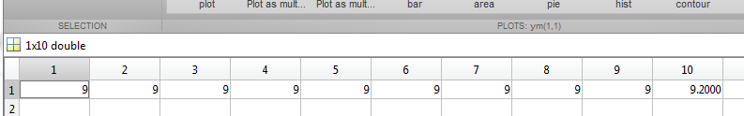
for i=1:9
ym(i)=9;
end
ym(10)=9.2
y_caret=8.95:0.005:9.25;
D2=y_caret*0
D4=y_caret*0;
for i=1:10
D2=D2+(ym(i)-y_caret).^2;
D4=D4+(ym(i)-y_caret).^4;
end
plot(y_caret,D2,y_caret,D4*15)
legend('D2','D4*15');
Notes:
As we’ve seen no differences with respect to the location of the minimum while having two measured values, now let us look at 10 values. Nine of the ten values are 9, the tenth value is 9.2.
D2 and D4 are calculatedand plotted for this data set.
Note that for better comparison D4 is scaled by a factor 15. This does not change the position of the minimum. We can see that the “outlier” 9.2 influences the minimum stronger, if we use D4.
This is a hint, that it might make more sense to use D2. And this is how far we come in this course to justify D2. Assuming the measurement errors having a normal distribution, statisticians can show, that D2 leads to a y caret having the highest likelihood to meet the true value y.
By the way, if you do not remember a normal distribution, revisit the chapter of Georg.

Slide 6

Least Squares: Calculating an estimate from N-Measured Values
$$\frac{{dD}_{2}}{d\hat{Y}}=\frac{d}{d\hat{Y}}\sum_{i=1}^{n}{{\left({Ym}_{i}−\hat{Y}\right)}^{2 }}=0$$
$$Derivation and Summation are linear Operations, theire order can be changed$$
$$\frac{{dD}_{2}}{d\hat{Y}}=\sum_{i=1}^{n}{{\frac{d}{d\hat{Y}}\left({Ym}_{i}−\hat{Y}\right)}^{2 }}=0$$
$$Inner and outer derivation$$
$$\sum_{i=1}^{n}{2{\left({Ym}_{i}−\hat{Y}\right)∙\left(−1\right)}^{ }}=0$$
$$Solve for \hat{Y }$$
$$\hat{Y}=\frac{1}{n}\sum_{i=1}^{n}{{{Ym}_{i}}^{ }}=\overline{Ym}$$
Notes:
Minimizing D2 is also called the least Squares Approach, as the Square of the errors between the measured values and the estimated value is minimized. So what value would we actually estimate, if we follow the Least Squares approach?
After some basic calculations, we find that our estimate would be the average value of the measured values. This makes sense.
Now let’s look at an example, where we do not know the right solution in advance by intuition .

Slide 7
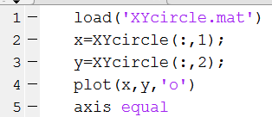
Notes:
There is a cloud of points given in the file XYcircle.mat. You see a code snippet to import this file to matlab, assign the x and y values and plot the points.
The axis equal command is very useful, it scales the axis in a way, that a circle is a true circle and not an ellipse.

Slide 8
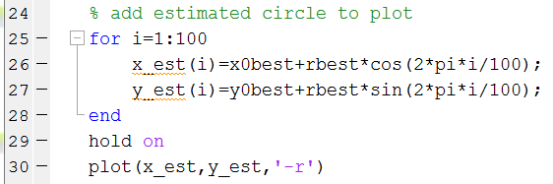
Notes:
Now our task is to find a circle with origin xobest, yobest and radius rbest in a way, that it is the best fit to the cloud of points. The code snippet shows how to add the circle once it’s parameters are known.

Slide 9
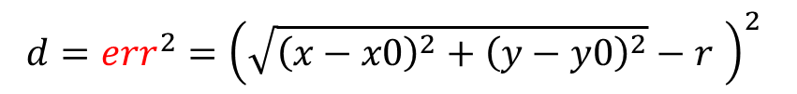

x0
r
y0
$$err=\sqrt{{\left(x−x0\right)}^{2}+{\left(y−y0\right)}^{2}}−r$$
$$d={err}^{2}={\left(\sqrt{{\left(x−x0\right)}^{2}+{\left(y−y0\right)}^{2}}−r \right)}^{2}$$
Notes:
We want to find a circle, that matches to the cloud of points.
Any circle is determined by it‘ center (x0, y0) and it‘s radius r.
The doubt or error associated with each point is given by the formulas as shown.

Slide 10
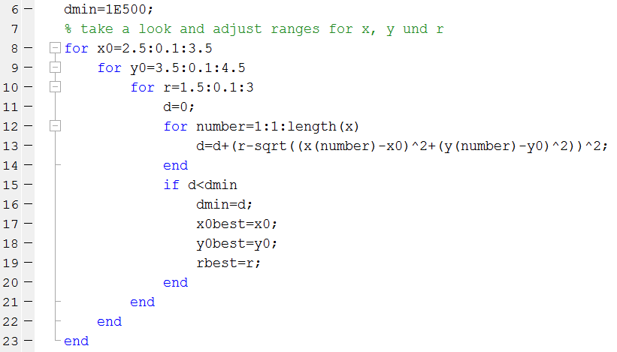
Notes:
Now here is the code to find the best circle i.e. the set of x0best, y0best, rbest that minimizes the sum of squares of the errors.

Slide 11
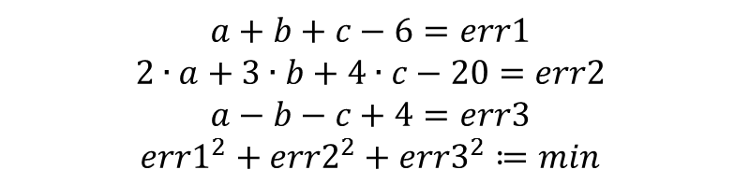
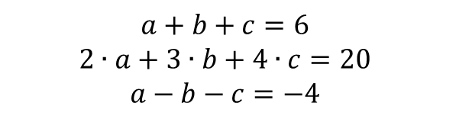
dmin=1E200; %just very big…
for a=-10:1:10
for b=-10:1:10
for c=-10:1:10
err1=a+b+c-6;
err2=2*a+3*b+4*c-20;
err3=a-b-c+4;
d=err1^2+err2^2+err3^2;
if d<dmin
dmin=d;
abest=a;
bbest=b;
cbest=c;
end
end
end
end
$$a+b+c=6$$
$$2∙a+3∙b+4∙c=20$$
$$a−b−c=−4$$
$$a+b+c−6=err1$$
$$2∙a+3∙b+4∙c−20=err2$$
$$a−b−c+4=err3$$
$$err1^{2}+err2^{2}+err3^{2}≔min$$
Notes:
The least square approach can also be used to solve a system on n equations with n unknowns.
The errors are the differences between the right hand side and the left hand side of the equations.
If the system can be solved, the least square approach leads to the exact solution (of cause limited to the resolution of the steps in the loop.)
The three loops make a 3-d grid. If the exact solution is one of the grid knots, we find it. If the exact solution is not on the grid knots, we are off be maybe one loop step.

Slide 12

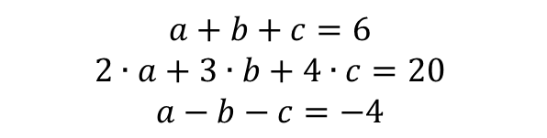
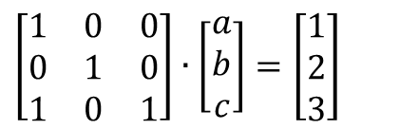
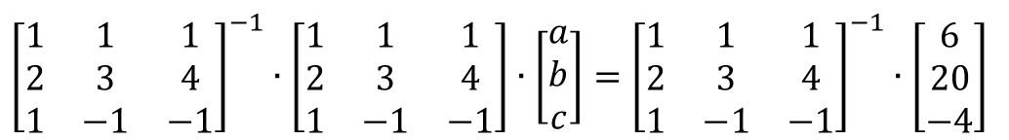


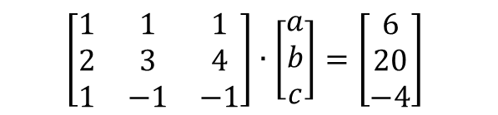

$$a+b+c=6$$
$$2∙a+3∙b+4∙c=20$$
$$a−b−c=−4$$
$$\left[\begin{matrix}1 & 1 & 1 \\ 2 & 3 & 4 \\ 1 & −1 & −1\end{matrix}\right]∙\left[\begin{matrix}a \\ b \\ c\end{matrix}\right]=\left[\begin{matrix}6 \\ 20 \\ −4\end{matrix}\right]$$
$$A∙p=y$$
$${\left[\begin{matrix}1 & 1 & 1 \\ 2 & 3 & 4 \\ 1 & −1 & −1\end{matrix}\right]}^{−1}∙\left[\begin{matrix}1 & 1 & 1 \\ 2 & 3 & 4 \\ 1 & −1 & −1\end{matrix}\right]∙\left[\begin{matrix}a \\ b \\ c\end{matrix}\right]={\left[\begin{matrix}1 & 1 & 1 \\ 2 & 3 & 4 \\ 1 & −1 & −1\end{matrix}\right]}^{−1}∙\left[\begin{matrix}6 \\ 20 \\ −4\end{matrix}\right]$$
$$A^{−1}∙A∙p=A^{−1}∙y$$
$$\left[\begin{matrix}0.5 & 0 & 0.5 \\ 3 & −1 & −1 \\ −2.5 & 1 & 0.5\end{matrix}\right]∙\left[\begin{matrix}1 & 1 & 1 \\ 2 & 3 & 4 \\ 1 & −1 & −1\end{matrix}\right]∙\left[\begin{matrix}a \\ b \\ c\end{matrix}\right]=\left[\begin{matrix}0.5 & 0 & 0.5 \\ 3 & −1 & −1 \\ −2.5 & 1 & 0.5\end{matrix}\right]∙\left[\begin{matrix}6 \\ 20 \\ −4\end{matrix}\right]$$
$$\left[\begin{matrix}1 & 0 & 0 \\ 0 & 1 & 0 \\ 1 & 0 & 1\end{matrix}\right]∙\left[\begin{matrix}a \\ b \\ c\end{matrix}\right]=\left[\begin{matrix}1 \\ 2 \\ 3\end{matrix}\right]$$
$$p=A^{−1}∙y$$
$$p=A\backslash y$$
Notes:
A system of equations can also be solved
by writing it as a matrix equation.
The matrix equation can be solved employing the inverse of a matrix
or by Gaussian elimination. Please note the back slash operator is different form the slash operator. It stands for solving a matrix equation it is not a divide sign.

Slide 13
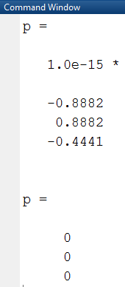
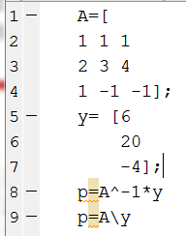
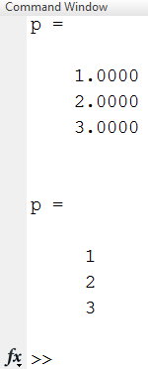
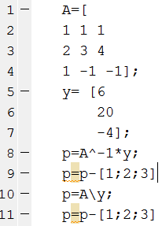
Notes:
This is the matlab code to solve the system of equations.
The first output shows decimal digits. This indicates, that the solution is not exactly 1, 2, 3.
The exact solution (1,2,3) is given by the last output produced by line 9. This shows, that the Gaussian elimination performs better (numerically in matlab) than the solution employing the inverse function.
This is emphasized by subtracting the exact solution from the numerical one.
Employing matrix inversion we see a (small) error.
Gaussian elimination shows no error at all.

Slide 14
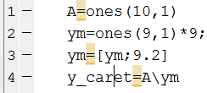
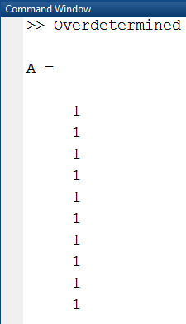
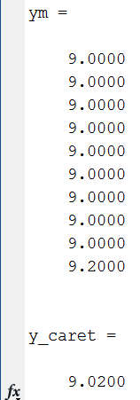



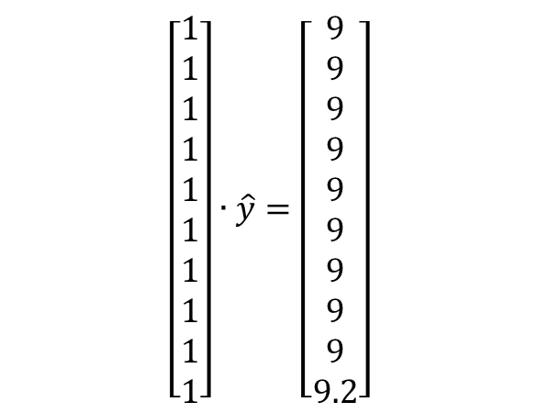

$$A∙\hat{y}=ym$$
$$\left[\begin{matrix}1 \\ 1 \\ 1 \\ 1 \\ 1 \\ 1 \\ 1 \\ 1 \\ 1 \\ 1\end{matrix}\right]∙\hat{y}=\left[\begin{matrix}9 \\ 9 \\ 9 \\ 9 \\ 9 \\ 9 \\ 9 \\ 9 \\ 9 \\ 9.2\end{matrix}\right]$$
$$\hat{y}={\left(A^{T}∙A\right)}^{−1}∙\left(A^{T}∙ym \right)$$
$\hat{y}=A\backslash$ym
Notes:
To come back to the problem this chapter began with, let’s look on several measurement values ym all belonging to one true value y.
This can be written as a matrix equation as well, with A being a matrix with only one column, as there is only one unknown y^.
This system is highly over determined, as there are 10 measured values (10 rows in A and ym) for only one unknown.
For over determined systems, most of the times there is no clean Matrix solution.
A solution in terms of LS can be calculated, the formula looks like this:
But in matlab we still can use the backslash operator, even if we do not truly solve a system, but only solve implying least square.
The result itself is the value we expected as the minimum of D2 as shown in the plot (slide4) or calculated as the average of the measured values.

Slide 15
Example: fitting a polynomial: Build in functions
load PolyMeasure; %load the matlab workspace PolyMeasure
plot(x,ym,'o'); %plot the measured data
p=polyfit(x,ym,3); %calculate the coefficients of y=p1*x^3+p2*x^2+p3*x+p4
y=polyval(p,x); %evaluate the values of the polynomial
hold on; %next plot is added to the last one
plot(x,y,'r'); %plot fitted data...
xlabel('X-Values')
ylabel('Y-Values')
legend('Data Points', 'Fitted Polynom')
Notes:
In the file PolyMeasure we have Data Point in x and y coordinates. And now we want to fit a polynomial to these points. As this task is very common, matlab offers the specialized functions polyfit and polyval to do this job.
Here is the code loading the workspace, estimating the parameters p, evaluating the polynomial and plotting the result.

Slide 16
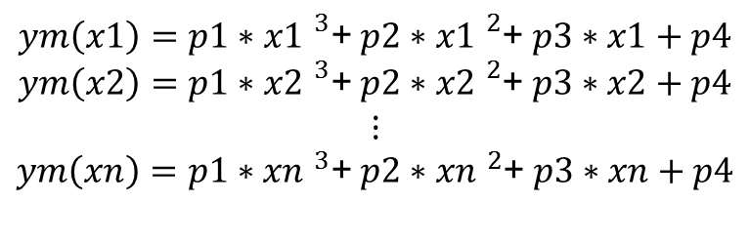
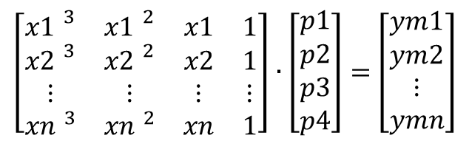
Example: fitting a polynomial: Matrix approach
load PolyMeasure; %load the matlab workspace PolyMeasure
plot(x,ym,'o'); %plot the measured data
A=[x.^3,x.^2,x,ones(length(x),1)] %construct matrix A for A*p=ym
p=A\ym %solve for coefficient vector p
y=A*p %use p to calculate y of fitted polynomial
hold on; %next plot is added to the last one
plot(x,y,'r','LineWidth',2); %plot fitted data...
xlabel('X-Values')
ylabel('Y-Values')
legend('Data Points', 'Fitted Polynomial')
$ym\left(x1\right)=p1∗{x1 }^{3}$+ $p2∗{x1 }^{2}$+ $p3∗x1+p4$
$ym\left(x2\right)=p1∗{x2 }^{3}$+ $p2∗{x2 }^{2}$+ $p3∗x2+p4$
$$⋮$$
$ym\left(xn\right)=p1∗{xn }^{3}$+ $p2∗{xn }^{2}$+ $p3∗xn+p4$
.
A
p
=
ym
$\left[\begin{matrix}{x1 }^{3} & {x1 }^{2} & x1 & 1 \\ {x2 }^{3} & {x2 }^{2} & x2 & 1 \\ ⋮ & ⋮ & ⋮ & ⋮ \\ {xn }^{3} & {xn }^{2} & xn & 1\end{matrix}\right]∙\left[\begin{matrix}p1 \\ p2 \\ p3 \\ p4\end{matrix}\right]=$ $\left[\begin{matrix}ym1 \\ ym2 \\ ⋮ \\ ymn\end{matrix}\right]$
Notes:
Now let‘s neglect the special functions polyfit and polyval and focus on the basics. Each Datapoint yields one equation ym(xi) as a function of xi and the unknown parameters p1 to p4.
This set of scalar equations can be turned to a matrix equation, just by moving the coefficients of the unknown p‘s into a matrix. Note the forth column of the matrix. There we collected the kind of invisible factors 1 before the p4‘s.
Thus we have an equation of form A times p is equal to ym with the for elements of p as the unknowns.
To solve this equation, we carefully have to assemble the matrix A in matlab. Please look up the ones and the length commands in the online help, if you have problems to understand the third line.
In the fourth line, the Gaussian elimination to solve the equation is performed. And in the fifth line the fitted values y are calculated.

Slide 17
A = 1.0e+03 *
0.0010 0.0010 0.0010 0.0010
0.0017 0.0014 0.0012 0.0010
0.0027 0.0020 0.0014 0.0010
0.0041 0.0026 0.0016 0.0010
0.0058 0.0032 0.0018 0.0010
0.0080 0.0040 0.0020 0.0010
0.0106 0.0048 0.0022 0.0010
0.0138 0.0058 0.0024 0.0010
0.0176 0.0068 0.0026 0.0010
0.0220 0.0078 0.0028 0.0010
0.0270 0.0090 0.0030 0.0010
0.0328 0.0102 0.0032 0.0010
0.0393 0.0116 0.0034 0.0010
0.0467 0.0130 0.0036 0.0010
0.0549 0.0144 0.0038 0.0010
0.0640 0.0160 0.0040 0.0010
0.0741 0.0176 0.0042 0.0010
0.0852 0.0194 0.0044 0.0010
0.0973 0.0212 0.0046 0.0010
0.1106 0.0230 0.0048 0.0010
0.1250 0.0250 0.0050 0.0010
0.1406 0.0270 0.0052 0.0010
0.1575 0.0292 0.0054 0.0010
0.1756 0.0314 0.0056 0.0010
0.1951 0.0336 0.0058 0.0010
0.2160 0.0360 0.0060 0.0010
0.2383 0.0384 0.0062 0.0010
0.2621 0.0410 0.0064 0.0010
0.2875 0.0436 0.0066 0.0010
0.3144 0.0462 0.0068 0.0010
0.3430 0.0490 0.0070 0.0010
0.3732 0.0518 0.0072 0.0010
0.4052 0.0548 0.0074 0.0010
0.4390 0.0578 0.0076 0.0010
0.4746 0.0608 0.0078 0.0010
0.5120 0.0640 0.0080 0.0010
0.5514 0.0672 0.0082 0.0010
0.5927 0.0706 0.0084 0.0010
0.6361 0.0740 0.0086 0.0010
0.6815 0.0774 0.0088 0.0010
0.7290 0.0810 0.0090 0.0010
0.7787 0.0846 0.0092 0.0010
0.8306 0.0884 0.0094 0.0010
0.8847 0.0922 0.0096 0.0010
0.9412 0.0960 0.0098 0.0010
1.0000 0.1000 0.0100 0.0010
ym =
8.6768
11.4998
5.9390
9.3376
7.3949
10.7480
12.9496
8.9605
14.8694
18.1159
17.3615
27.5228
17.9980
19.7259
17.2450
33.3524
36.1730
34.7173
43.1396
43.3569
47.9540
51.4063
57.6726
60.9115
79.5791
65.3667
67.8141
77.6054
84.4125
94.6384
103.2577
110.6769
122.5315
130.2215
140.8865
155.2913
162.2089
159.8045
165.1464
192.3241
190.1218
211.5914
223.8742
247.7630
249.7123
261.4634
p =
0.2062
0.4556
0.6564
6.1696
Notes:
Don‘t ruin your eyes trying to read all these numbers. I just wanted to give you a glance of what are the dimensions of the variables.

Slide 18
Example: fitting a polynomial: Brute Force approach
dmin=1E200;
for p1=0:0.5:1
for p2=0:0.5:10
for p3=0:0.5:10
for p4=0:0.5:10
d=0;
for i=1:length(x)
d=d+(p1*x(i)^3+p2*x(i)^2+p3*x(i)+p4-ym(i))^2;
end
if d<dmin
dmin=d;
p1best=p1;
p2best=p2;
p3best=p3;
p4best=p4;
end
end
end
end
end
Notes:
This is the brute force code for the same problem. With brute force you have to take care on the step sizes. If the step sizes are to small, the code consumes to much time. If the step size is to large, the accuracy is poor as you can see at the red line produced by a step size of 0.5.

Slide 19
Matrix versus Brute Force
The Matrix approach only works, if the problem is linear with respect to the unknown p‘s.
If so, use matrix calculation, as you do not have to care about the step size.
If the problem is not linear i.e. you can not write it as A*p=y, use brute force. But be aware of the step size dilemma!
Trust Regions
LSQ only gives you the estimate of the unknown p‘s but no hint on the accuracies and uncertainties of this estimate. Confidence levels may be concluded from statistics or may come from Monte Carlo sensitivity analysis.

Slide 20
Outlook and further reading
So far, we looked upon the Least Square method as a special doubt function to be used in a brute force approach.
Basically the selection of a doubt function (in Least Squares the D2) and the minimizing of the doubt function are two separate independent steps. You can use another doubt function together with Brute force (the more measurement values you have the closer are the results obtained with different doubt functions). Or you can use another approach to minimize the sum of squares but brute force, like matrix calculations e.g.. Look for gradient methods in textbooks or give the lsqlin and lsqnonlin functions of the optimization toolbox a try.

Slide 21

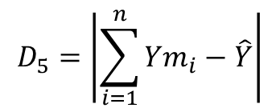
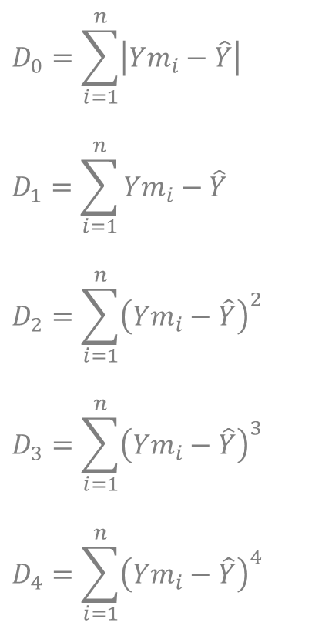
Food for thought
$$D_{0}=\sum_{i=1}^{n}{\left|{Ym}_{i}−\hat{Y}\right|}$$
$$D_{1}=\sum_{i=1}^{n}{{Ym}_{i}−\hat{Y}}$$
$$D_{2}=\sum_{i=1}^{n}{{\left({Ym}_{i}−\hat{Y}\right)}^{2}}$$
$$D_{3}=\sum_{i=1}^{n}{{\left({Ym}_{i}−\hat{Y}\right)}^{3}}$$
$$D_{4}=\sum_{i=1}^{n}{{\left({Ym}_{i}−\hat{Y}\right)}^{4}}$$
$$D_{5}=\left|\sum_{i=1}^{n}{{Ym}_{i}−\hat{Y}}\right|$$
$$D_{6}=max\left(\left|{Ym}_{1}−\hat{Y}\right|,\left|{Ym}_{2}−\hat{Y}\right|,…,\left|{Ym}_{n}−\hat{Y}\right|\right)$$
Notes:
Here are some other candidates as doubt functions. Think along line of thought we went so far. How would these doubt functions match?
Think about examples, where they would not match.

Slide 22
ym1=9;
ym2=9.2;
y_caret=8.5:0.02:9.7;
D6=max([abs(ym1-y_caret);abs(ym2-y_caret)],[],1);
D5=abs((ym1-caret)+(ym2-caret));
D2=(ym1-caret).^2+(ym2-caret).^2;
Notes:
This code calculates D5 and D6 for the two point measurement example.

Slide 23
Notes:
Both D5 and D6 would work for the two point measurement example.

Slide 24
for i=1:9
ym(i)=9;
end
ym(10)=9.2;
y_caret=8.90:0.005:9.25;
D2=y_caret*0;% Vector with size y_caret and all values zero
M=zeros(10,length(y_caret));
for i=1:10
D2=D2+(ym(i)-y_caret).^2;
M(i,:)=ym(i)-y_caret;
end
D5=abs(sum(M,1));
D6=max(abs(M),[],1);
plot(y_caret,D2,y_caret,D5,y_caret,D6);
Notes:
Some code for the 10 point measurement example is given here.

Slide 25
Notes:
D6 is ruled out, as it does not react on the repetitions of values 9.0.

Slide 26
a=1;
x=-9:3:9;
ym=a*x.^3;
plot(x,ym,'o','MarkerSize',20)
a_caret=0.95:0.0001:1.05;
y_caret=zeros(length(x),length(a_caret));
for i=1 : length(a_caret)
err(:,i)=a_caret(i)*x.^3-ym;
end
D2=sum(err.^2,1);
D5=abs(sum(err,1));
plot(a_caret,D2,a_caret,D5);
Notes:
This is an example to finally rule out D5.
Fancy you have to estimate the a in y=a*X^3 as the minimum of a doubt function. Even without an m-code, you could conclude from symmetry, that the sum of errors for any a will always be zero.
Anyway here is also m-code to generate a plot.

Slide 27
Notes:
As D5 does not depend on y^, it is of no use.

