Slide 1


Problem solver‘s tool box
Analogies
Bottom up vs. Top down
Brute Force Simulation
Definitions
Divide and conquer
Examples
Exchange of „given“ and „looked for“
Formula Symbols and Equations
Interim values
Invariants
Monte Carlo Simulation
Plausibility tests
Repetitions (->loops)
Search the world
Notes:
In the first chapter, we already had a look at the monte carlo method.
Now it’s a good time to dig into the details.

Slide 2
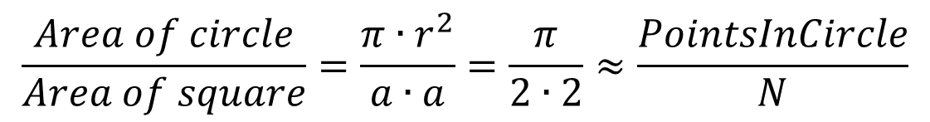
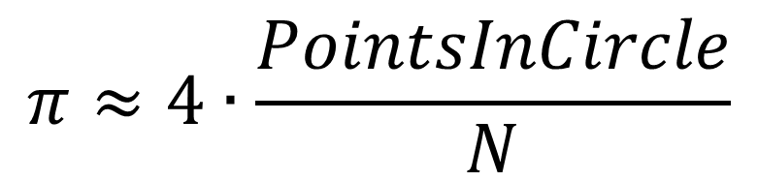
Problem solver‘s toolbox -Monte Carlo Simulations
N Blue points rain randomly into the square of size 2x2.
$$\frac{Area of circle}{Area of square}=\frac{π∙r^{2}}{a∙a}=\frac{π}{2∙2}≈\frac{PointsInCircle}{N}$$
$$π≈4∙\frac{PointsInCircle}{N}$$
Notes:
First the deterministic problem to find a numerical value for pi is solved.
We generate random values for points within a square of 2 by 2 with centerpoint (0,0).
The x-coordinates and the y-coordinates are independent results of a uniform distributed random experiment.
They range from -1 to 1.
In the square let‘s look on a circle with center point (0,0) and radius 1.
The area of the circle and the area of the square have approximately the same ratio as the number of points in the circle to the number of points in the square.
Thus we obtain a simple equation for PI.

Slide 3
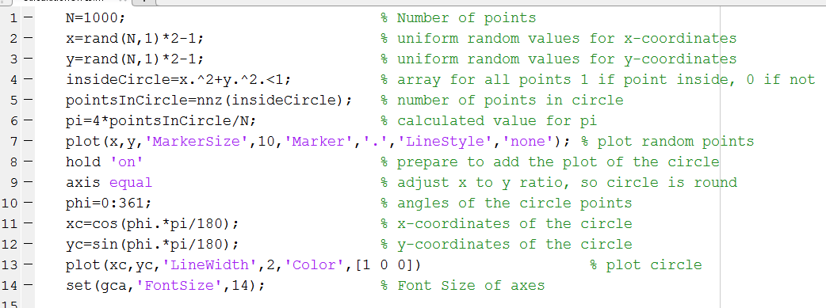
Problem solver‘s toolbox -Monte Carlo Simulations
Notes:
This is an easy code in matlab calculating pi…
and visualizing the method. It is straight forward, but somewhat specialized in matlab.
Especially Line 2-5 make use of vectoring. Some people with a classical C-programming background are not so familiar with vectoring. Therefor I also present a more classical variant.

Slide 4
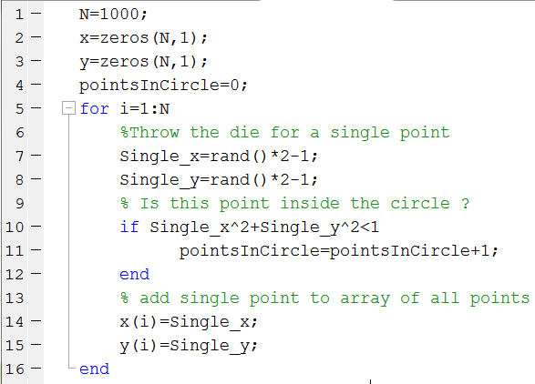
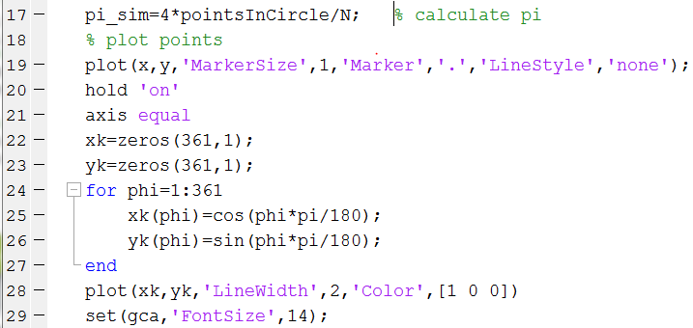
Problem solver‘s toolbox -Monte Carlo Simulations
Notes:
It is not possible in matlab to declare an empty array.
But the typical combination, declaration and definition of an array can be done by the zeros command.

Slide 5
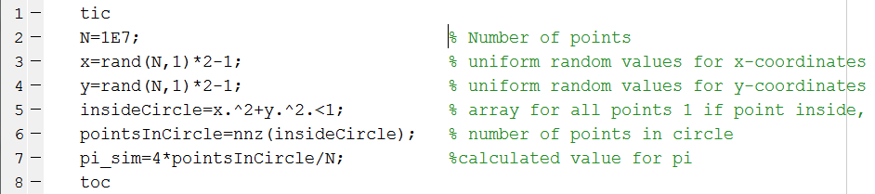
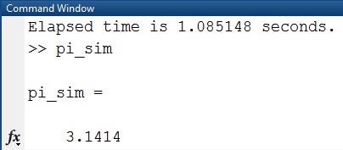
Problem solver‘s toolbox > Monte Carlo Simulations > pushing it to the edge
Notes:
For really big amounts of points, the plot is not very useful. Therefor only the pi-calculating part is done.

Slide 6
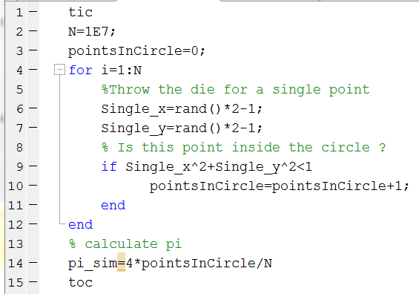
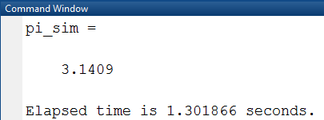
Problem solver‘s toolbox > Monte Carlo Simulations > pushing it to the edge
Notes:
Comparing C-style to vectoring style, the vectoring style is a little bit faster.

Slide 7
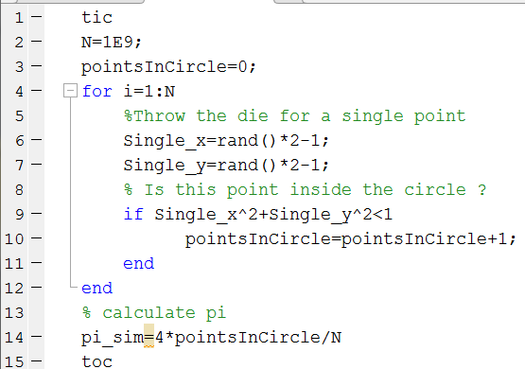
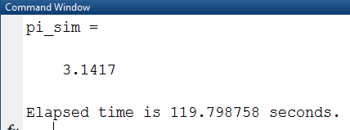
Problem solver‘s toolbox > Monte Carlo Simulations > pushing it to the edge
Notes:
But when stepping to even more points, the vectoring approach can cause out of memory errors, as very big arrays have to be generated. N=1E9 worked for the C-style code only on my machine.

Slide 8
Problem solver‘s toolbox > Monte Carlo Simulations > pushing it to the edge
The simulation size N (number of times you throw the die) in Monte Carlo Simulations has a similar trade off behavior as the step size in the brute force methods. Some rules of thumb to make the right choice:
If the simulation is well done, the results will scatter without bias around the true value.
For a big N, the CPU-time consumed is approximately proportional to N.
For a big N the standard deviations of the results falls with the square root of N.
Thus if you increase the simulation time by a factor 100, you decrease the standard deviation only by a factor 10.

Slide 9
Problem solver‘s toolbox -Monte Carlo Simulations
Gary Foshee’s “boy born on a Tuesday”
“I have two children. One is a boy born on a Tuesday. What is the probability I have two boys?”
Simulate 10 million families. Let all families have 2 children. Throw the die on their sex and the weekday of their birth. The probability is the number of families with two boys and one boy born on a Tuesday divided by the number of families with one boy born on a Tuesday.
To simplify coding, boys are encoded as 1, girls are encoded as 2, Weekdays start Monday as 1 through Tuesday as 2 to Sunday as 7.
Notes:
Now to Gary Foshee‘s famous „boy born on a Tuesday problem“ “I have two children. One is a boy born on a Tuesday. What is the probability I have two boys?”
Do you think the Tuesday is important information?
We‘ll see by employing the monte carlo method
And we try to do it like this:

Slide 10
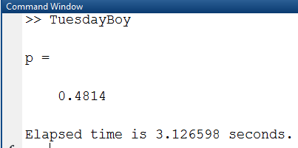
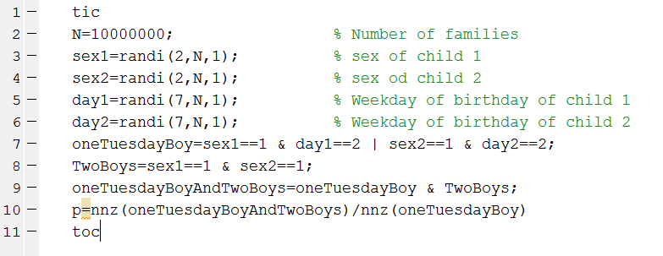
Problem solver‘s toolbox -Monte Carlo Simulations
“I have two children. One is a boy born on a Tuesday. What is the probability I have two boys?”
Notes:
The first and the last line of this code are used to measure the cpu-time for the program.
In line two the number of families is “hard coded” , this means the user of the program is not asked a number, but the number is written into the code.
Randi in lines 3-6 is the random number generator for discrete uniform distributions.
Note the bitwise logical operators | and & in line 7 and 8. You might have tried .|| or .&& which might give the same result if they were defined within matlab. The bitwise | & and == operators have arrays as operands and arrays as results. If the conditions are met, the corresponding array element is 1 otherwise it is 0.
nnz then just counts the ones.
Note that the solution 0.48 clearly shows that the Tuesday-Information is important (strange point is , Wednesday would work as well, the day just has to be fixed). Without the Tuesday, the probability of two boys would be only one third.

