Slide 1
Getting the most out of cloud service logs
INF-2202
Tor Kreutzer & Jan-Ove Karlberg tokreutz/jakarl@microsoft.com

Slide 2
Outline
Short recap of Azure Data Lake
Uploaders
Compliance and scrubbers
Correlating requests
Schemas, flexibility, and performance

Slide 3

Azure Data Lake Recap
Cold path for telemetry
Stores log data
Stores metrics
Has very long retention times (months/years)
Some latency on data entry
Unable to serve low latency queries
Notes:
Remember from last lecture that we operate with Hot, Warm, and Cold path. Azure Data Lake corresponds to the storage and computation platform for Microsofts cold path, and that is also how you will use it for the mandatory exercises. Recall that we use the cold path to store both logs and metrics. This means that pretty much all the telemetry we collect end up here. The key trait, in addition to analytics capabilities is the long retention times: We can store data for months and even years when not in raw format. The con is that we are unable to do low latency queries, as we can with the hot and warm path, and that there is some delay on data entry

Slide 4
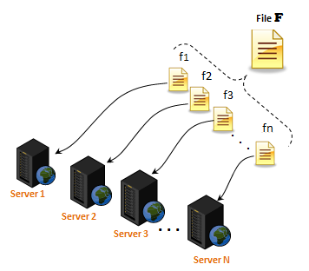
Azure Data Lake Recap
Is the “one stop shop” for data
Cloud-Scale File System
Large available compute resources
Machine Learning and Analytics
Uniform APIs for managing and querying data
https://en.wikipedia.org/wiki/Distributed_file_system_for_cloud
Notes:
So, for us in Microsoft Cosmos/Azure Data Lake is the one stop shop for data and analytics. It provides us with a cloud scale file system; we can operate with the concept of multi terabyte files even though they are stored over countless machines and even more parts. It also gives us access to large compute resources, often with data locality, which allows us to do rather expensive things within reasonable time. For a developer, the main pro is that we are given a uniform set of APIs and management tools for working with all these data across multiple geographies, data centers, and data sources.

Slide 5
Uploaders
A piece of software that uploads files
Non-centralized
Scalability
Notes:
Why do we need uploaders? To explain this it might be useful to do a quick recap of our problem domain. Because we have so incredibly many machines, centralizing the management of the logs and how these are uploaded will be hard to scale. This is made even harder by the fact that since so many machines are involved, some are constantly failing or inaccessible. Instead, we push this responsibility to the edge – the machines doing the actual logging, while ADL storage simply receives these (with some validation), and stores them. The code doing the uploading on each machine is called a uploader.

Slide 6
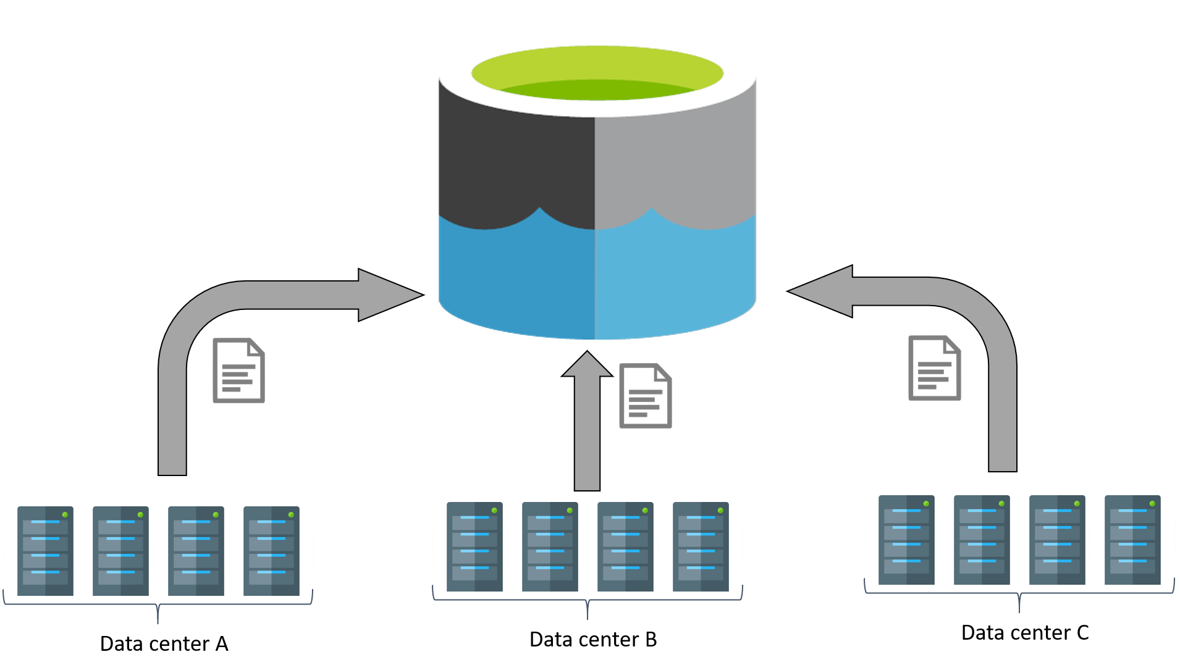
Why Uploaders?
Recap of log problem domain
100 000’s of machines
Heterogenous
Some are failing continuously
Some key properties:
Code should run on heterogenous platforms
Choice of language, dependent libraries, etc.
Code should handle temporary failures
Restarts, crashes, network failures, etc.
Notes:
Because of the heterogeneity of the edge machines, we need to take some considerations when designing an uploader framework. For example, the language should preferably run on multiple OS’s. We also need to ensure availability of any libraries we depend on. As mentioned before, we need to take failures into consideration. This means retrying in case ADL is down/unreachable, and using some sort of persistent watermarking scheme to know how far we have gotten. This will help us recover if a machine goes down for maintenance or crashes.

Slide 7
Uploaders - Considerations
Should support additional operations
Compliance issues (We’ll get back to this later)
Cost management (aggregation, i.e. joining columns)
Management
Pipe to specific file or DB for debug etc.
Notes:
There are some further considerations that should be taken into account. For instance, we know that there are some operations that one might want to do to logs. For example, there are certain compliance/privacy issues that must be attended to very often.

Slide 8
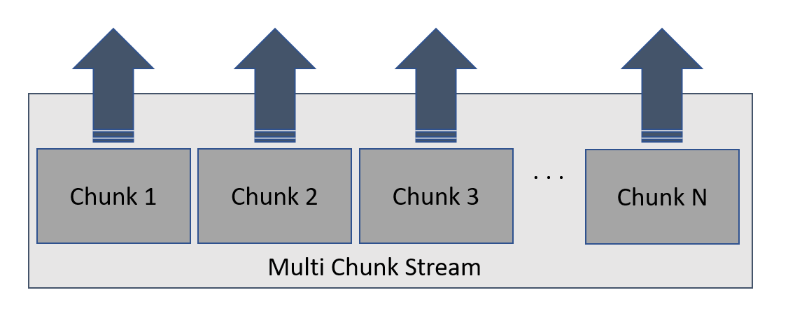
Uploaders - Details
Chunking
Upload data periodically: size, time, both
Chunk size tradeoff – What happens if replica fails
While building a chunk
While uploading a chunk
Chunk generation
Chunk summary
Sequence numbers
Notes:
As we have mentioned previously, ADL gives us the stream abstraction, allowing us to reason about peta-scale files. However, it is clear that we these don’t originate from a single machine. Also, since these streams “continue forever” it makes sense to have the uploaders work on pieces of data that support this mode of operation. That piece is a chunk, or “part” of a file/stream. A stream is just a collection of such pieces, one after another. These chunks are uploaded one at a time. The policy – or rules – governing when these chunks are uploaded can differ. For example, it can be based on size, a max age, or a combination of the two. There is also a tradeoff with chunk size, and how this impact recovery actions. To order the chunks, one commonly uses a sequence number, and it is also possible to use some chunk summary scheme where one keeps some metadata that might be useful.

Slide 9

Uploaders and compliance
Should not put sensitive data in ADL
But logs might contain that locally for debug reasons
Logs should be anonymous
Logs should support GDPR
User can choose to have his/hers data deleted (exercise 3)
Logs should support Auditing
So operators/actors must be traceable
Notes:
As a rule of thumb, one should never put sensitive data into cold storage in raw form. However, sometimes there is no helping some sensitive data be stored locally for debugging/auditing purposes. This means that some operations must be performed in order to ensure that the logs are “made anonymous” before they enter ADL. This must be done in such as way that traceability, e.g. for GDPR and auditing is maintained.

Slide 10

Log Scrubbers

Slide 11
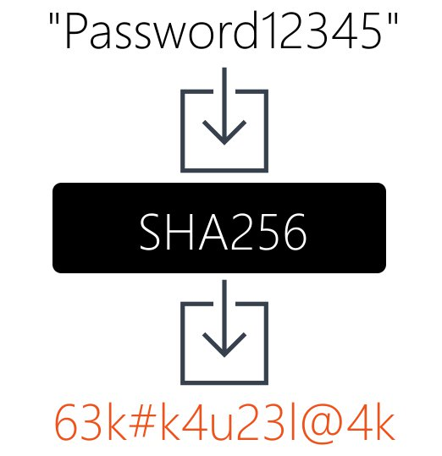
Log Scrubbers
Pluggable as “uploader operation”
Preserving anonymity and traceability
Hashing of user/customer ids
Need cryptographically strong hash
Governed by certifications
Notes:
These operations are handled by a scrubber, which is commonly run as a “operation” within the uploader framework. We cant just take all sensitive data and replace it with random garbage either, as we need to be able to locate data in case of desired deletion, and for auditing reasons. For reasons of certifications and CPU power, we cant just use any hash. As of now, SHA1 is not considered safe for long term storage, and SHA2 is preferred. We will probably have to upgrade within the foreseeable future.

Slide 12
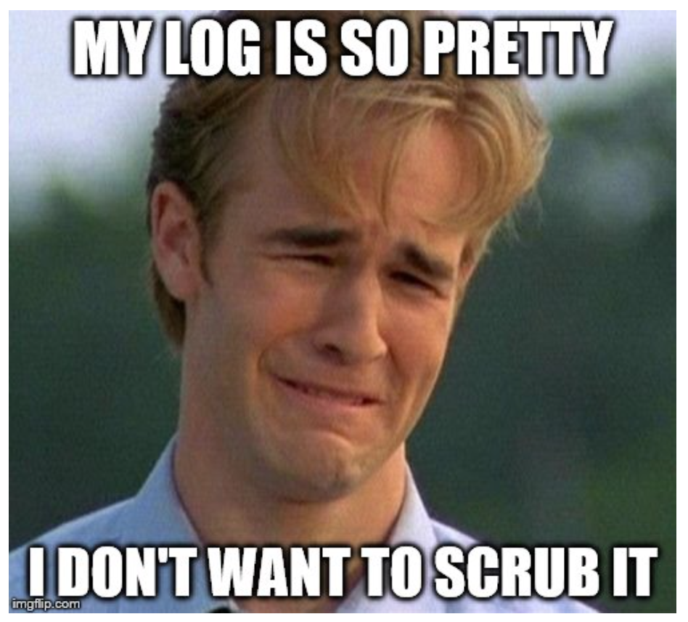
Log Scrubbers
Preserving security
Encryption
Sufficiently strong
Managing keys
Notes:
In addition to provide anonymity by hashing users ids or other information that can be used to potentially identify a person or customer, a scrubber can provide security. This might be relevant if one for whatever reason have to put something sensitive in cold storage – for example for the sake of debugging some specific issue for a specific customer (this happens!). The key points here are that we make sure to have sufficiently strong encryption – we need to ensure that we meet all certifications. Actually, which encryption implementations can make a difference (only native is compliant)). We also need to adhere to very strict schemes for managing encryption keys, and their versions.

Slide 13
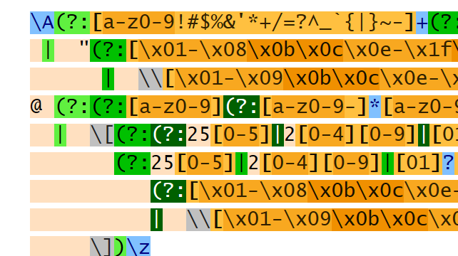
Log Scrubbers
Data detection
Need means for figuring out what to do with what data
Annotations
Manual in configuration system
Manual in log statements
Automatic
Safety net
Potentially expensive
http://www.regular-expressions.info/email.html
Notes:
The final topic for scrubbers is how we detect that something needs to be done. There are multiple possibilities here, for example the use of annotations. If we know that a given column will need to be scrubbed, it is typically possible to do this with configurations. If only a parts of a log message needs scrubbing, it is common to use manual annotations. This is probably the thing that is most commented on in code reviews. Sometimes it is also possible to do automated scrubbing. Sadly, this is somewhat error prone and potentially expensive wrt. CPU consumption.

Slide 14
Annotations
Manual in log statements
“Userid: <PII>{0}</PII> failed to access file: <PII>{1}</PII>”
Somewhat expensive – must parse the strings
Need to remember to do add annotations
Manual in config
Schema = Time:TimeStamp, EventId:Int, UserName:String:PII, …
More efficient – More on schemas later!

Slide 15
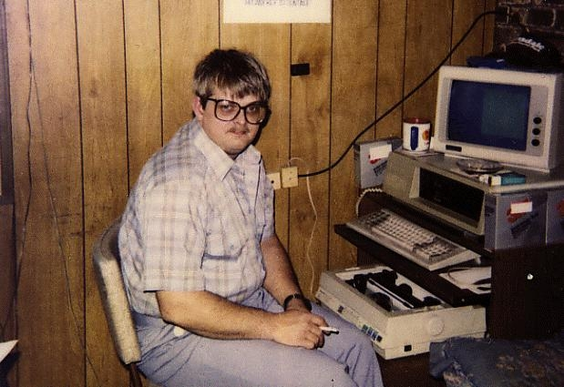
Code examples
Hashing vs. Encryption
Storage overhead
CPU cost
A simplified Log Scrubber
Simplistic interfaces
Use of manual annotations

Slide 16
Questions?

Slide 17

Overview
Schemas
Types of schema
Best practices
Examples
Correlations
How to use them
Examples

Slide 18
Schema Types
Hard
Soft
Hybrid
Not necessarily to be confused with relational database schemas

Slide 19

Hard Schemas
Fixed “columns”
Fixed data types
Compact
Performant
Not very flexible
Migrations
Example: Metrics
Common schema for metrics
MetricId : int32
Value : uint64

Slide 20
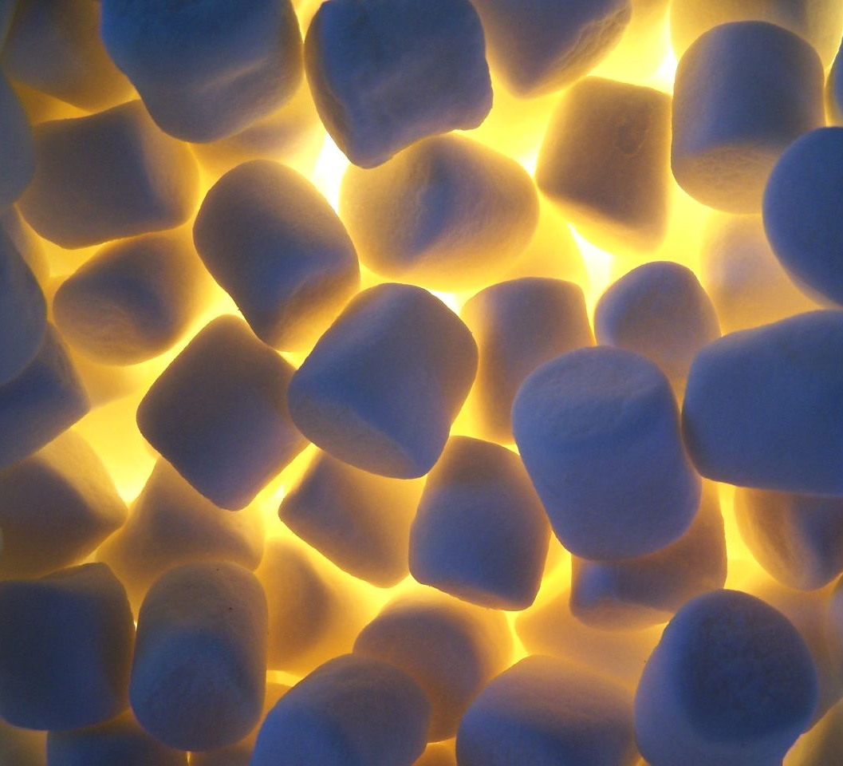
Soft Schemas
Fixed Format
E.g. xml, json, etc.
Arbitrary “fields”
Flexible
Verbose
Not very performant
Example: REST response values
{
result : [
“all”,
“the”,
“things”
]
}

Slide 21
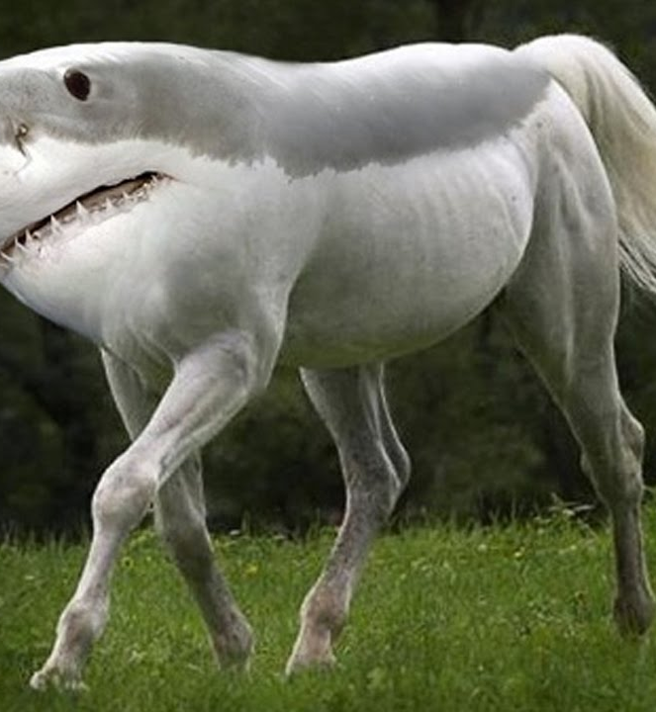
Hybrid Schemas
Some fixed columns
Some formatted columns
E.g. xml, json, etc.
Pragmatic
Performance where needed
Flexibility where required
Example: Service Logs
Example schema for logs
Timestamp : datetime
EventId : uint64
TenantId : guid
Properties : string

Slide 22
Hybrid Schemas cont.
Example Values
Timestamp | EventId | TenantId | Properties
7:34 AM 10/17/2017 | 12 | A4FF7C47-C46E-4B58-B0E6-3B7C249069AE | { “status” : 200, “message” : “OK” }
7:34 AM 10/17/2012 | 1 | C27F9BA1-8A9A-4EC1-B901-EE1959032B82 | { “status” : 418, “message” : “I’m a teapot” }

Slide 23

Hybrid Schemas cont.
Hard part
For the things that will always be present
timestamp, machineName, region, etc.
For the things that will be aggregated
Durations, eventIds, etc.
Soft part
For the things that may or may not be there
Special messages, stack traces for exceptions, etc.

Slide 24
Hybrid Schemas cont.
File modifiers log
Date,Region,TenantName,Filename,FirstAccess,LastAccess
Fixed columns
Hard
ModifyingUsers
Dynamic content
Fixed format
Soft

Slide 25
Schema Tradeoffs
Flexibility vs. performance
Compatibility
How the data is consumed
Storage and size
Indexing/clustering
Make sure it is consumed!
Do not log for the sake of logging

Slide 26
Schema Tradeoffs
Use different schemas for different jobs
Performance telemetry
Hard schemas
Metrics
Debug logs
Hard parts for file name, eventIds, etc.
Soft verbose parts for metadata that may help in debugging
Error logs
Hard parts for exception name
Soft parts for additional metadata specific to a certain exception

Slide 27
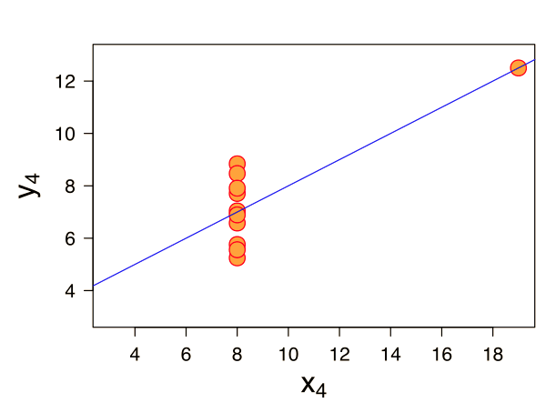
Correlation
What, Why, and How

Slide 28
Correlation Recap
Coupling of events
Represented as an identifier
Usually Guids
Usually part of log message schema
Hard or soft. It depends.

Slide 29
Creating correlation ids
Just do it
Any unique identifier will do
For some definition of unique
Example c#: var id = Guid.NewGuid();

Slide 30
Passing Correlation Ids
Just do it
Functional parameters
HTTP Headers
Context objects

Slide 31
Correlation Examples from MS
ETW
Windows’ build in event framework
Hard schema
But as previously shown, strings can contain their own soft schema
Thread static variable contains Correlation
Called ActivityId and RelatedActivityId

Slide 32
Correlation Examples from MS
QoS (Measurement of successes vs. expected and unexpected failures)
Typical schema (Hybrid)
Timestamp : datetime
Scenario : string
CorrelationId : guid
Operation : enum (start, success, expected failure, unexpected failure)
Properties : string

Slide 33
Questions?

