Slide 1

SMPC for Decentralized Distributed Systems
Frederic Klein – Final Talk

Slide 2
Overview
Motivation
Gamification
Secure Multi-Party Computation
Hygiene Games
Design
SPAN on Android
Distributed system: coordinator election, clock synchronization, database consistency
Decentralized system: decentralized SMPC, distributed database
Evaluation
Simulation
Android Integration (demonstration)
Discussion
Outlook

Slide 3
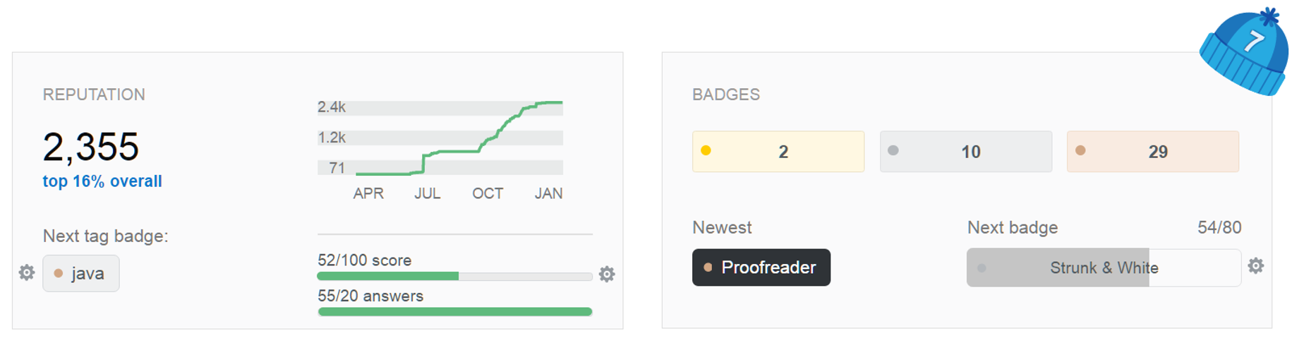
Gamification
Generate intrinsic motivation
Among other motivators: competition and social comparison
Examples
Stackoverflow, Amazon, runtastic, etc.

Slide 4

Privacy Concerns
Sensitive data
Sharing might result in disadvantage
Example: Hygiene Games
Gamification approach for hand-hygiene compliance
Targeting health-care professionals
High privacy demands
Independent from Internet access
Notes:
Examples: employees don’t want to be tracked to detailed
HAIS: 4.1 million infections per year in the EU, a quarter preventable

Slide 5
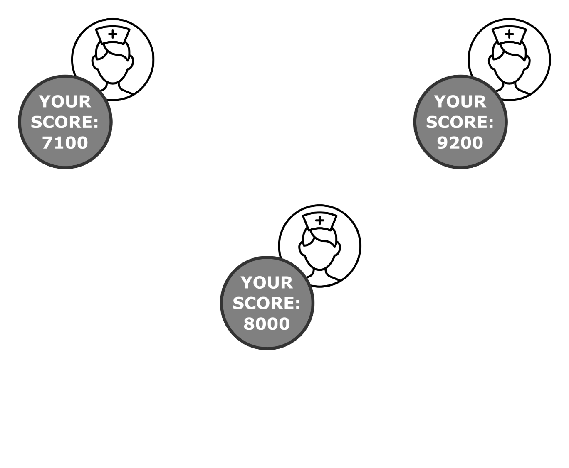
Privacy Protection
Personal data on own device
Modest value without comparison
Notes:
Gamification: key issue is comparison -> motivation

Slide 6
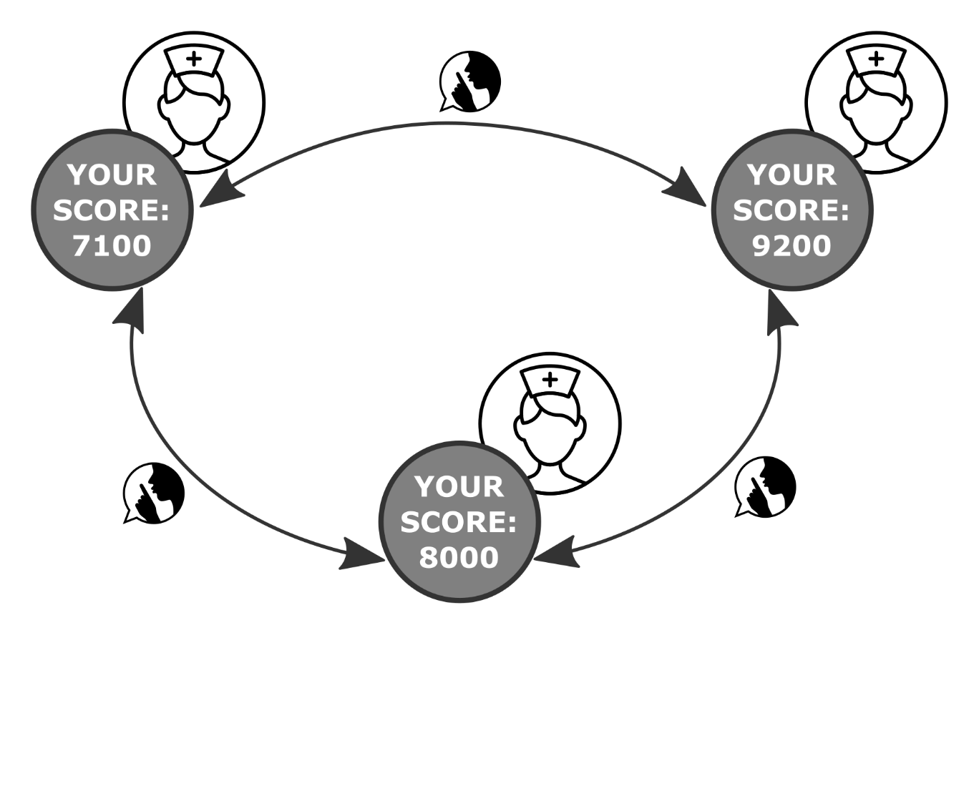
Privacy Protection
Exchange data for comparison
Notes:
Therefore privacy protecting exchange of data is needed so that …

Slide 7
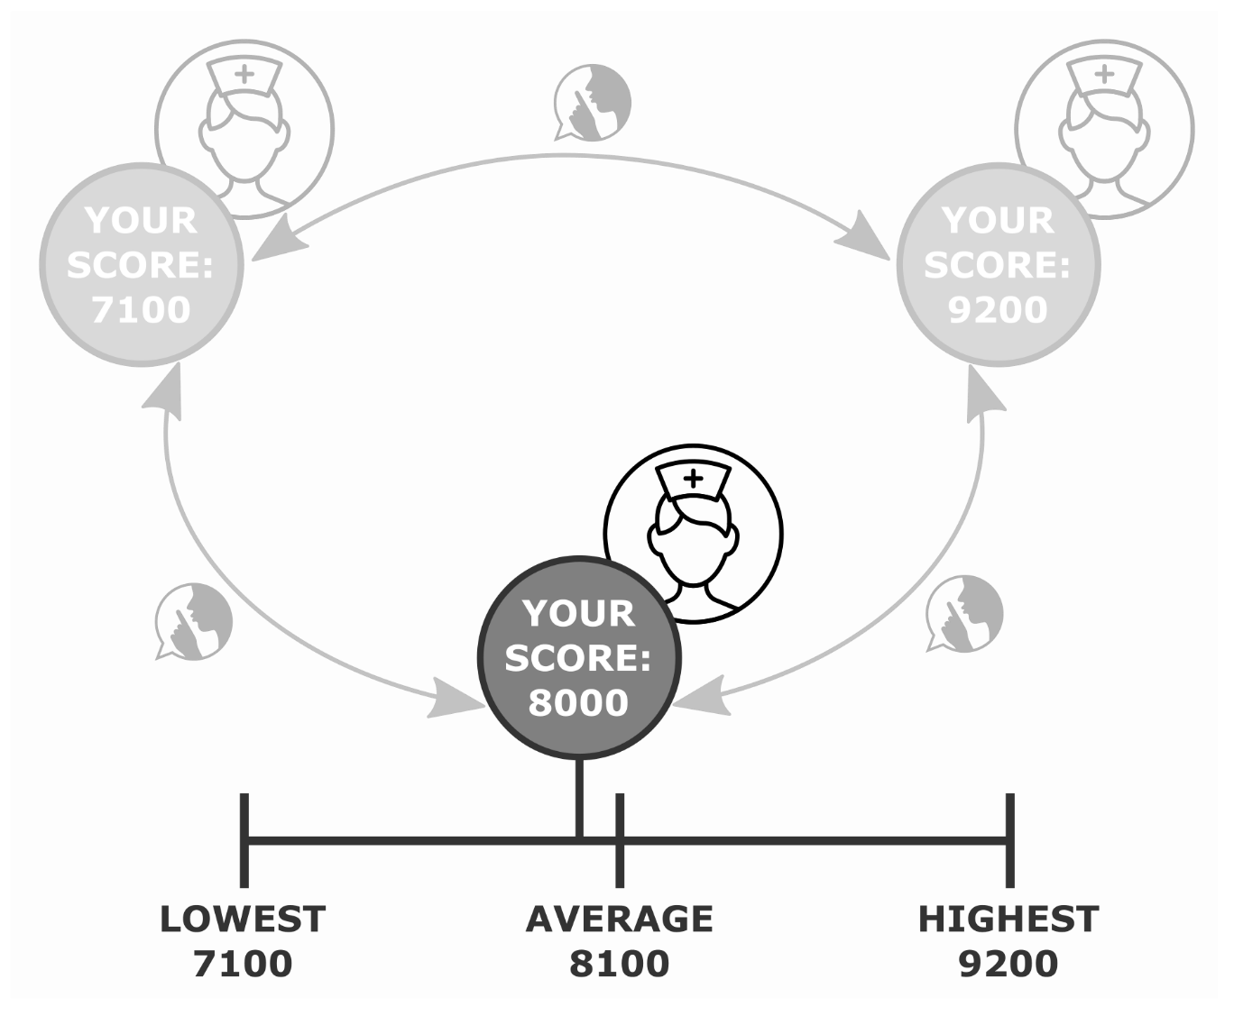
Privacy Protection
Notes:
Statistical data reflecting system wide performance for comparison
While data exchange and privacy seem to be contradictory,
Solution to maintain privacy while doing computation on data from multiple parties is SMPC

Slide 8
SMPC
Subfield of cryptography:
compute function over inputs of multiple parties
keep the inputs private

Slide 9
SMPC
Three parties
Score as input
Notes:
Returning to the initial example…

Slide 10
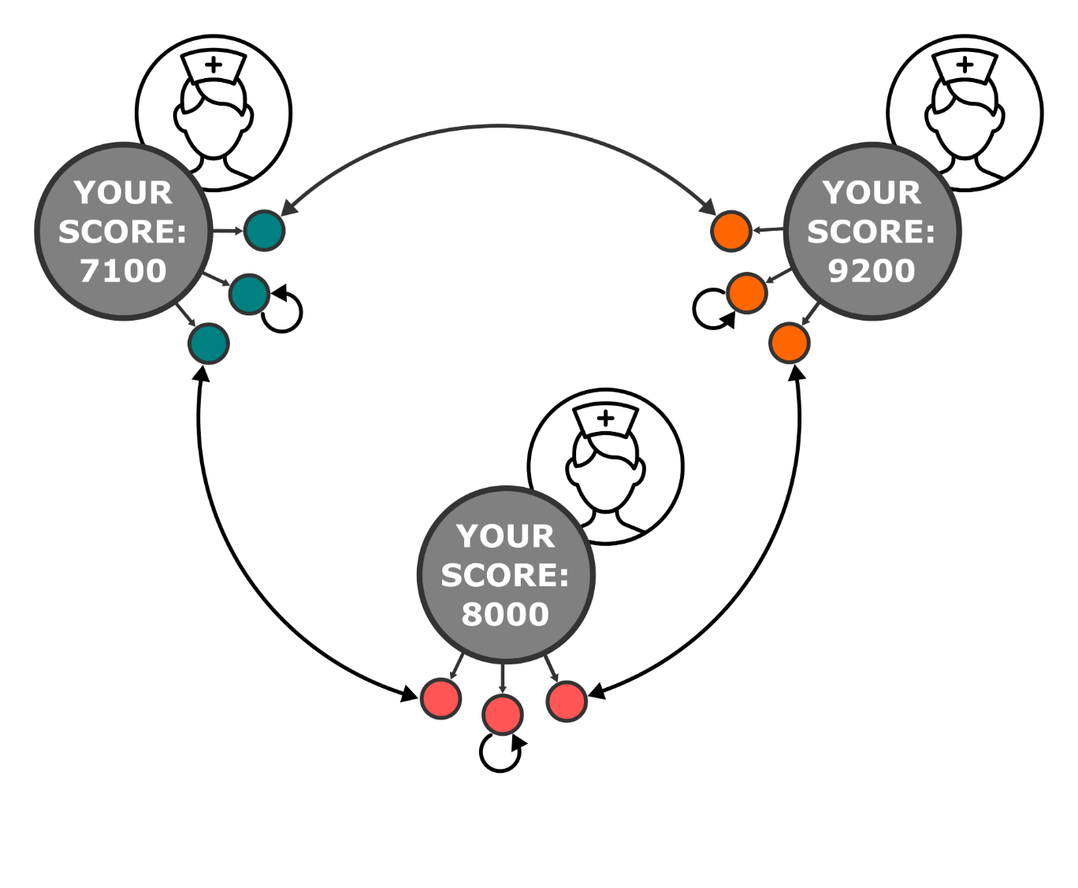
SMPC
Secret sharing: n shares for n parties
Notes:
Instead of sharing their score (also called secret)…
Standalone share is nearly irrelevant.

Slide 11
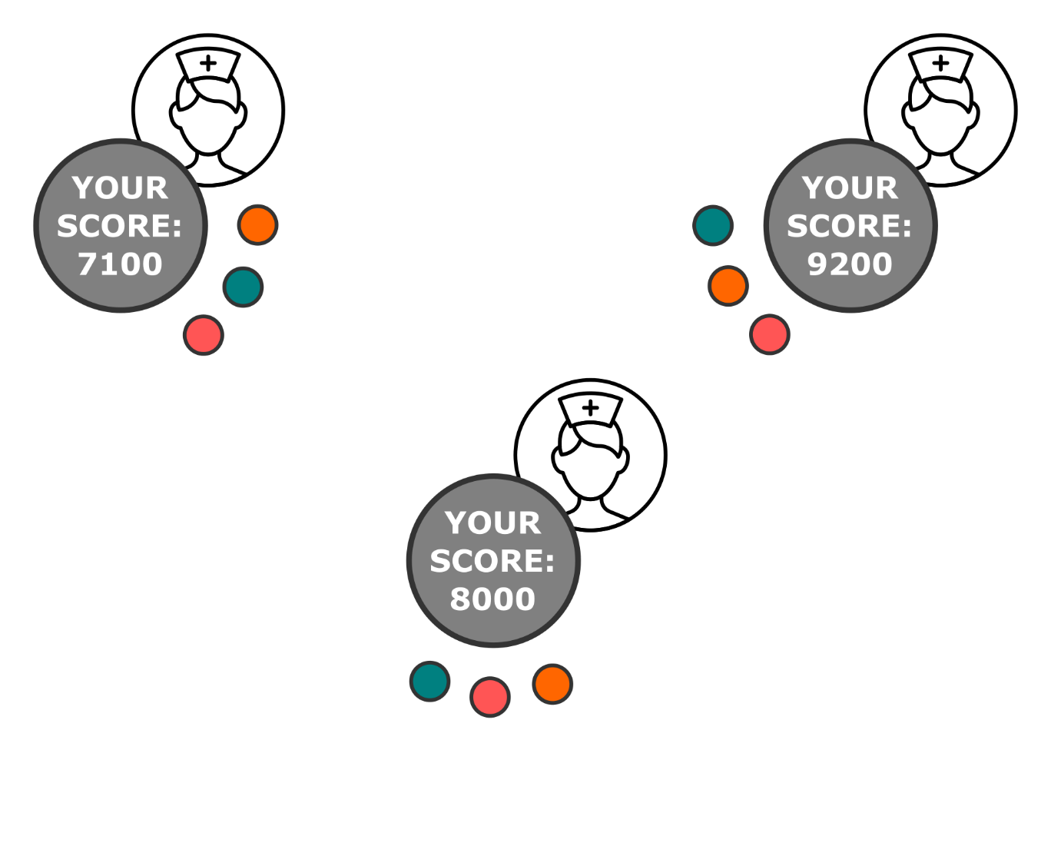
SMPC
Each player: set of n shares

Slide 12
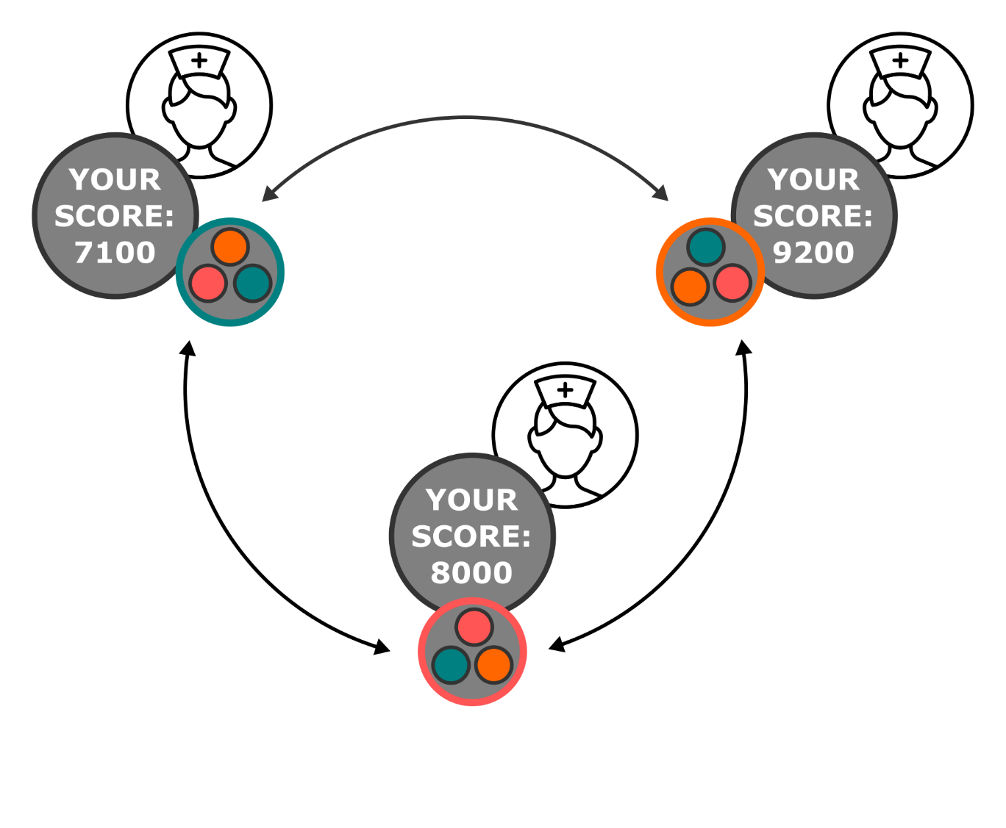
SMPC
Computation on shares
Broadcasting of result
Notes:
Computation on shares (for example sum them up)

Slide 13
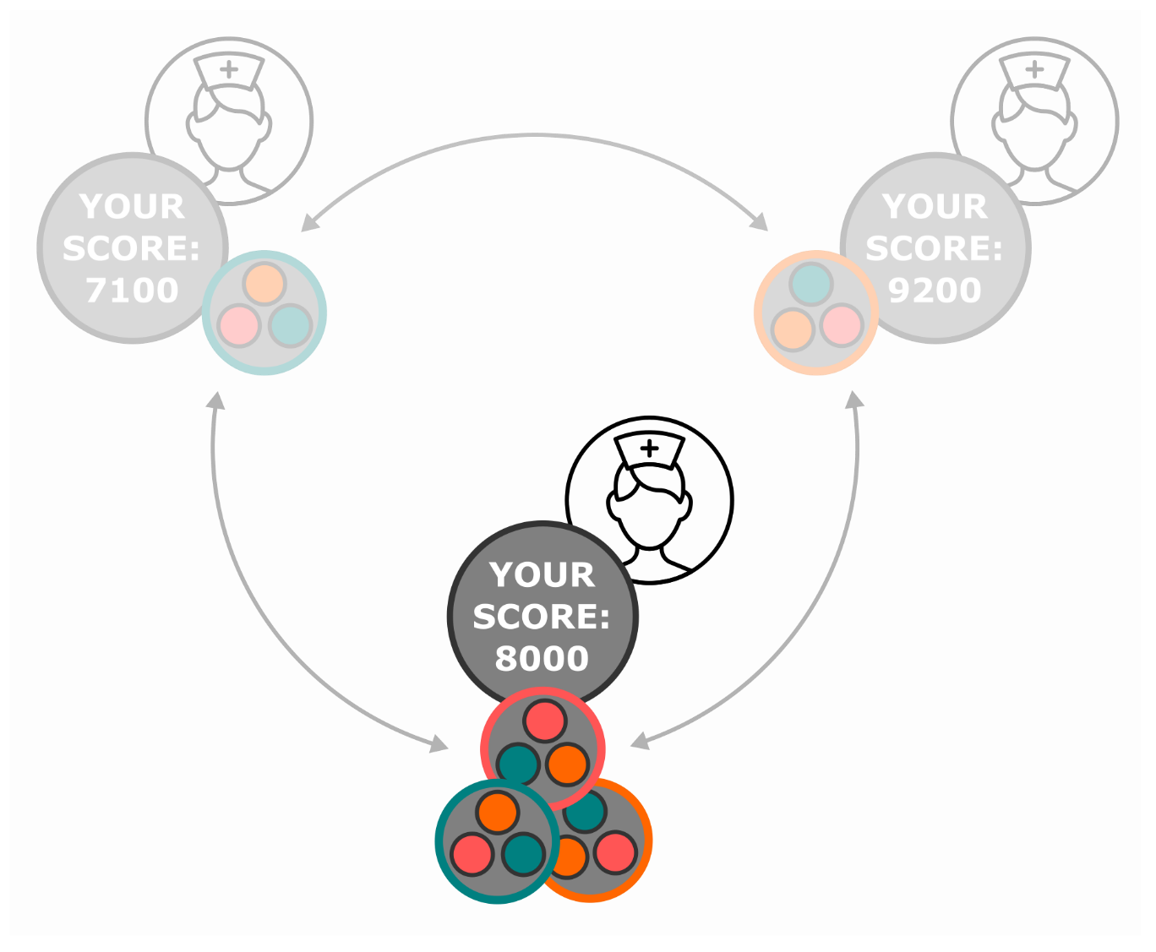
SMPC
Each party:
Complete information for computation
Other inputs remain secret

Slide 14
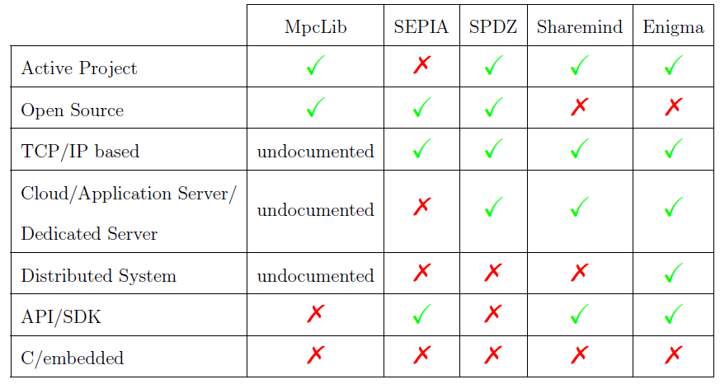
Existing Frameworks
Existing frameworks
Rely on the Internet
Clinical environment: EMI
Powerful but complex

Slide 15
Requirements
Framework
System-wide statistics using SMPC
Infrastructure-less, self-forming Mobile ad-hoc network
Feasible algorithms for acceptance
Notes:
For gamification and comparison …
For clinical setting …

Slide 16

Design: MANETs
MANET/SPAN
Mesh networks with moving nodes
Infrastructure-less, self-forming, self-healing
TODO: FIGURE

Slide 17
Design: MANETs
MANET/SPAN on Android
Not included in API
Abilities of Bluetooth modules vary
Sequential communication
Pairing-less connection
Insecure RFCOMM
Encryption layer

Slide 18
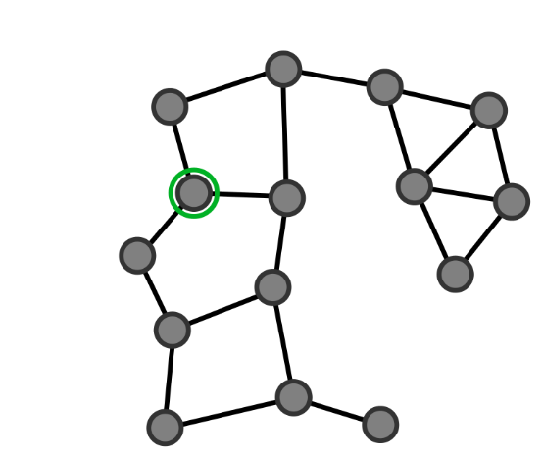
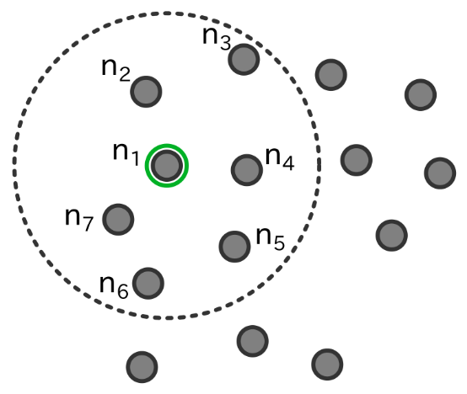
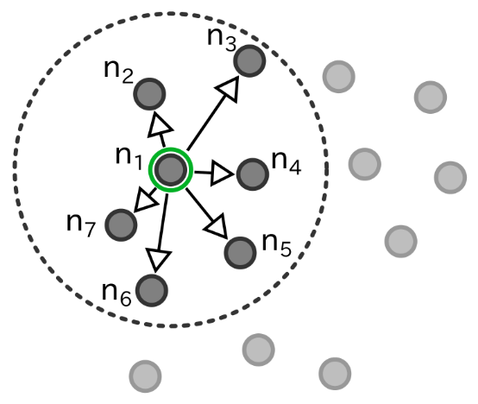
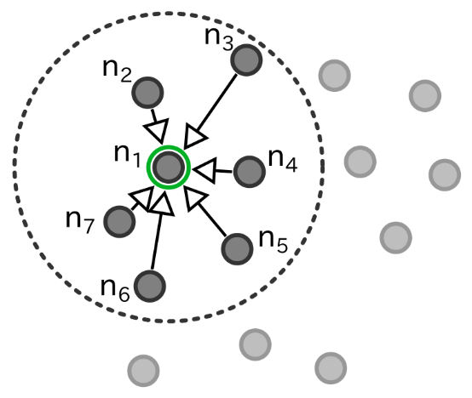
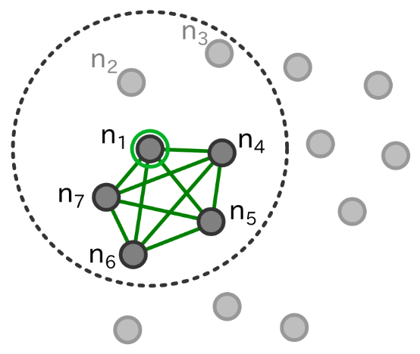
Design: Coordinator Election
Coordinator election
Event driven
Timer based
Notes:
Formation of fully meshed sub network only for SMPC

Slide 19

Design: Clock Synchronization
Internal synchronization of clocks
Berkeley Algorithm

Slide 20
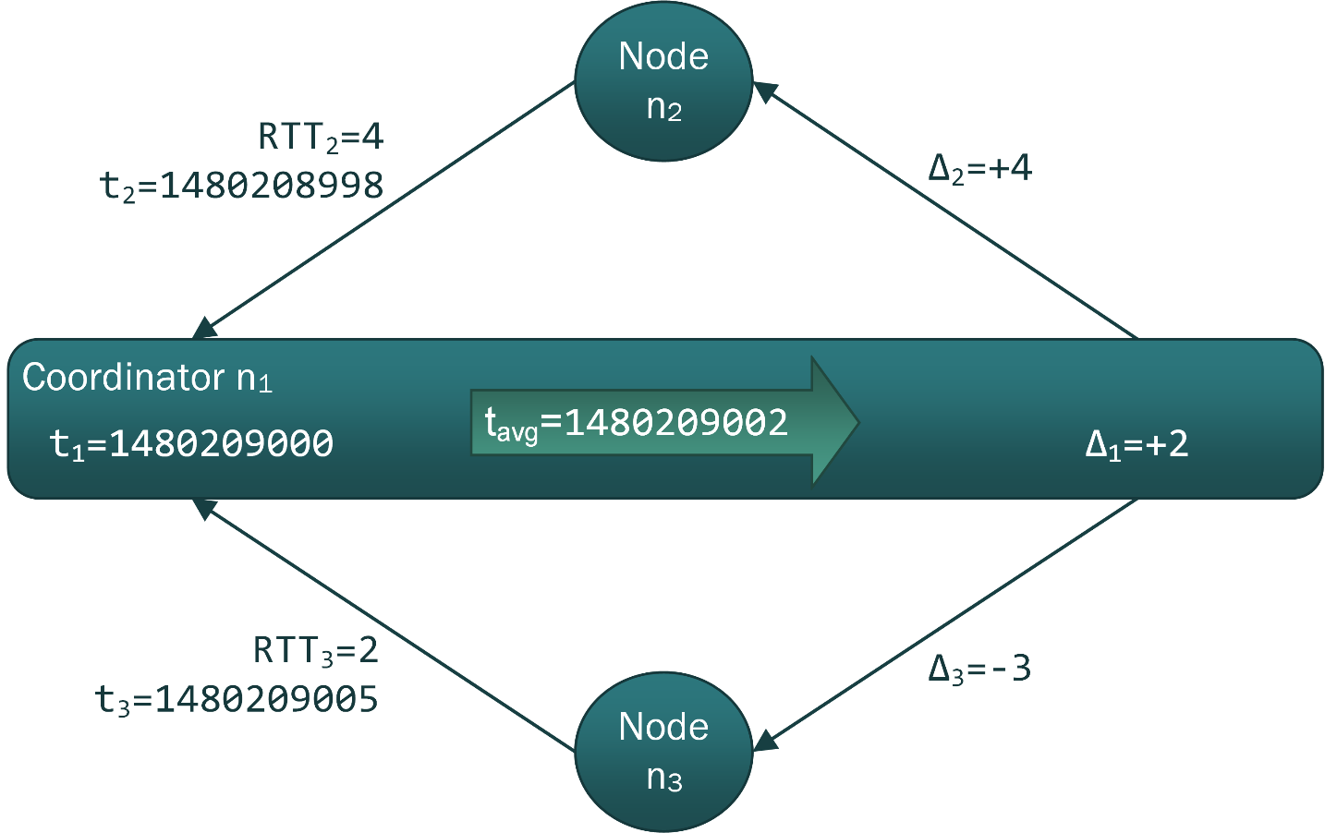
Design: Clock Synchronization
Internal synchronization of clocks
Berkeley Algorithm

Slide 21
Design: Distributed Database
Node maintains copy of database
Callback for framework to query database
Database comparison with neighboring nodes
Hash-tree for finding differences

Slide 22


Design: SMPC algorithms
Based on Shamir’s secret sharing
Defines function for shares
Lagrange interpolation for recombination

Slide 23
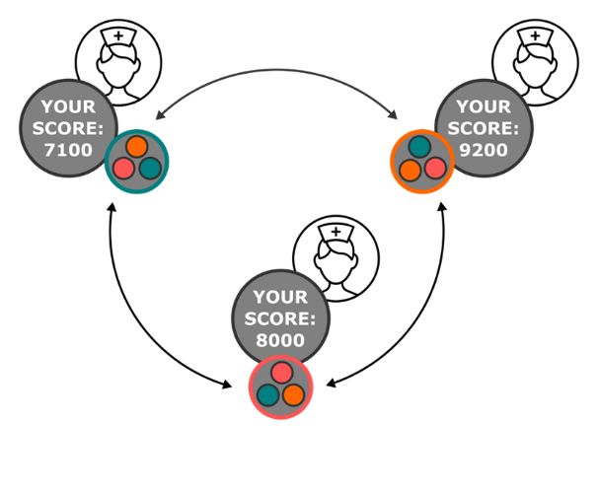
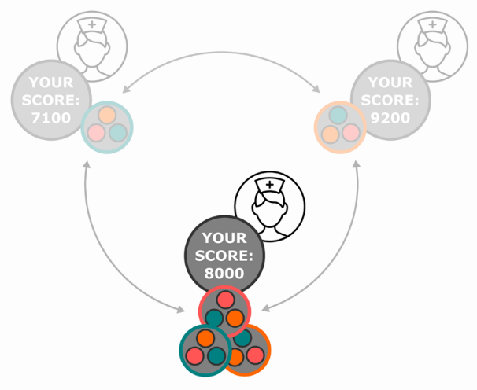
Design: SMPC algorithms
Secure Sum
Sum over secrets equals Lagrange interpolation over sum of shares

Slide 24
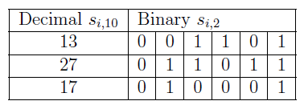
Design: SMPC algorithms
Secure Maximum
Bit decomposition
Secure sum for each bit position from MSB
Self disqualification

Slide 25
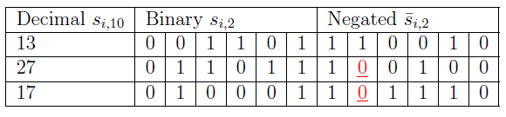
Design: SMPC algorithms
Secure Minimum
Bit decomposition
Inverting
Secure sum for each bit position from MSB
Self disqualification
Inverting result

Slide 26
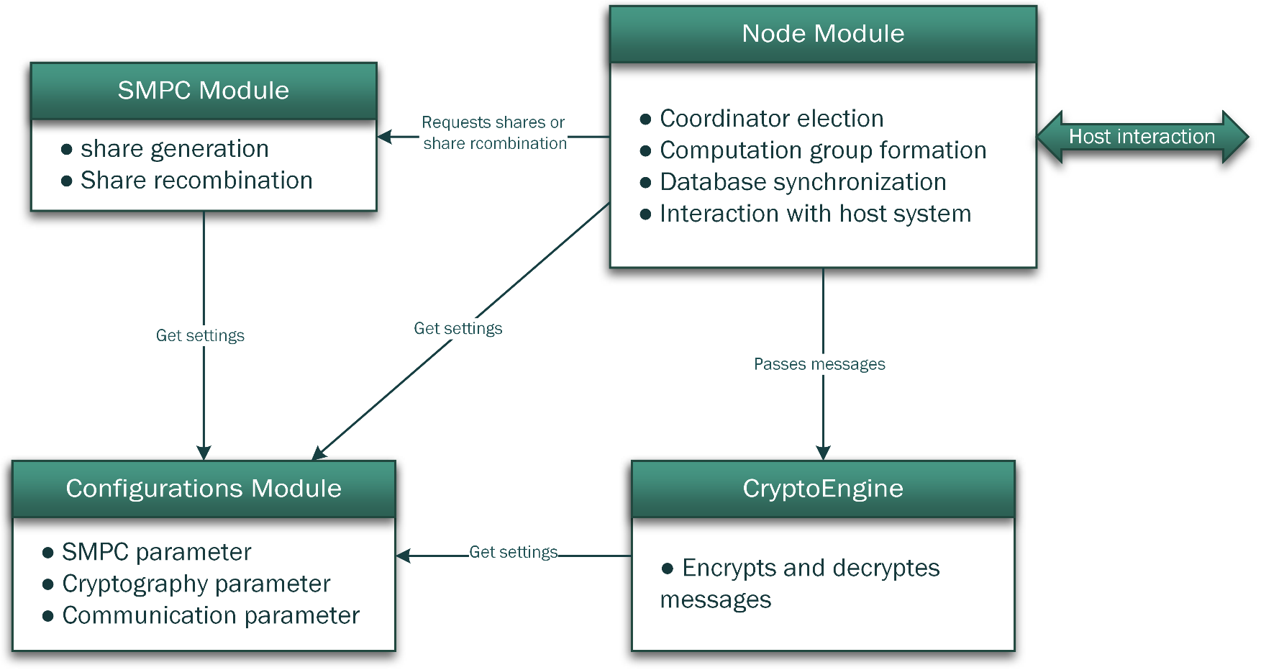
Design: framework
C library for compatibility
All parameters in Configuration
Interfacing through Node Module

Slide 27
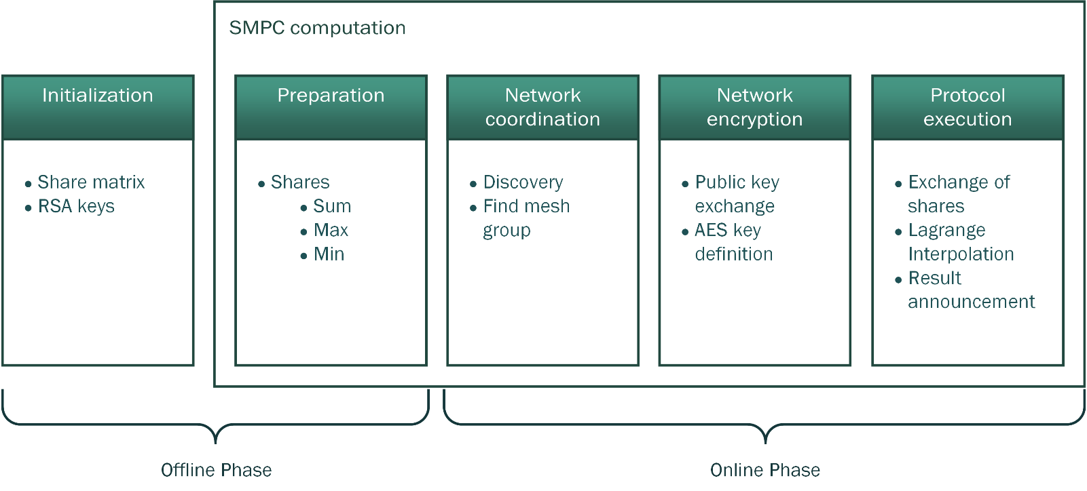
Evaluation
Performance of online phase
Android integration
Implementation of core system
Node module, SMPC module, integration of crypto library WolfCrypt
Notes:
Applicable for real life situations?
Acceptable for users: power consumption? Interaction needed?

Slide 28
Evaluation: Simulation
Linux script creating nodes
Adjustable number of nodes
Delayed named pipes to simulate wireless connection
Restriction of CPU through power management

Slide 29
Evaluation: Android Integration
NDK/JNI wrapper
Demonstration
TODO: Smartphone Demo

Slide 30
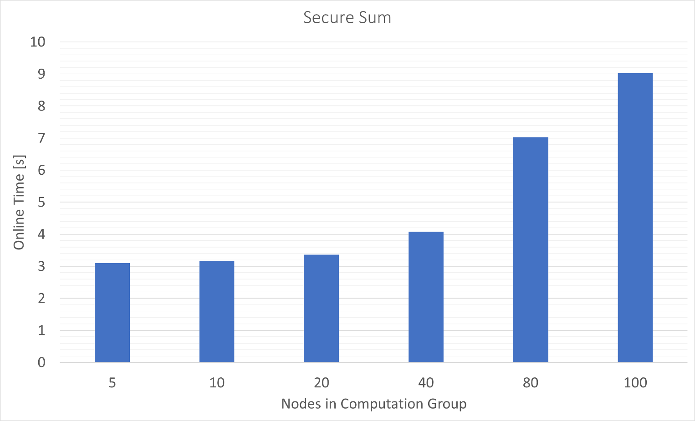
Discussion: Simulation Results
Discovery bottle neck
Computation fast

Slide 31
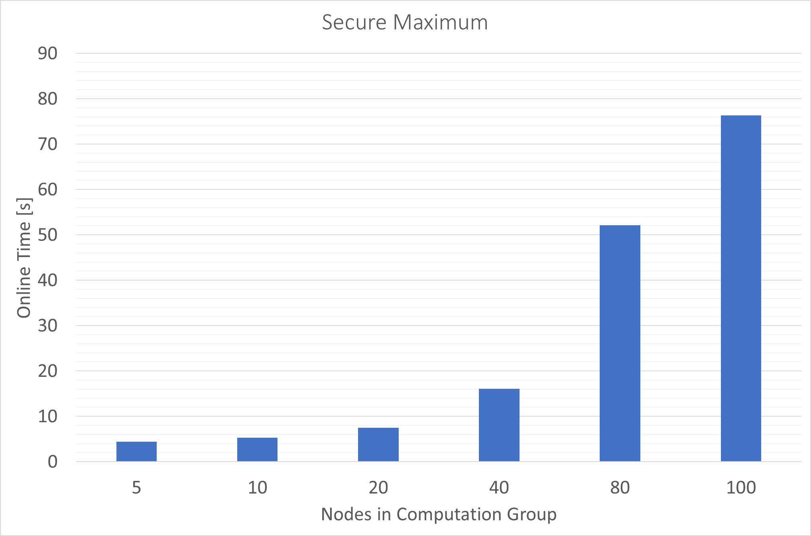
Discussion: Simulation Results
Number of messages squared
Larger computation groups: high risk of network partition

Slide 32
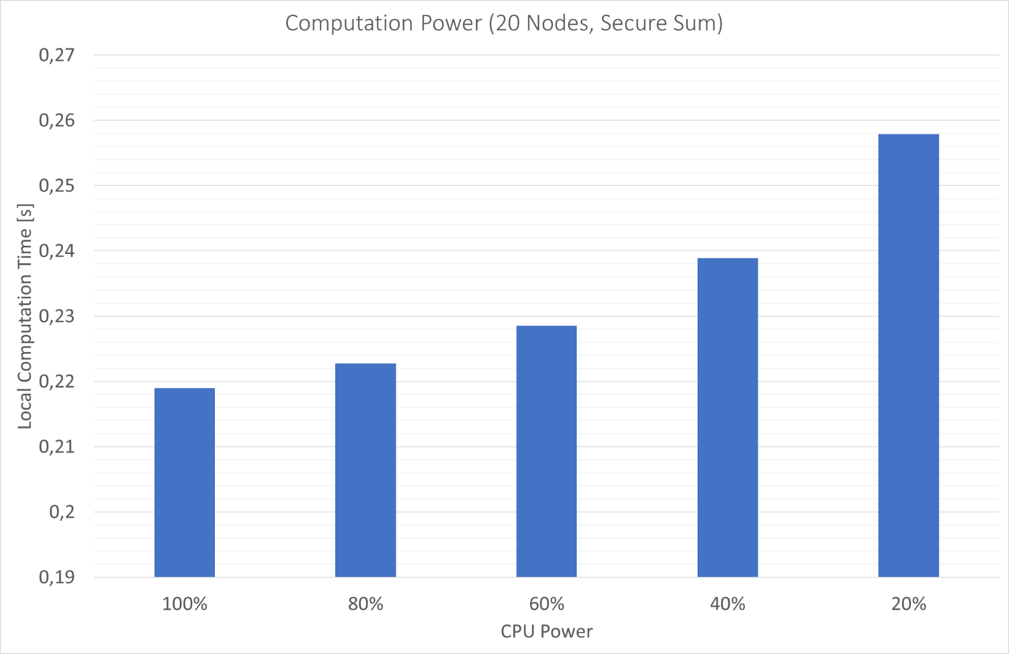
Discussion: Simulation Results
Influence of computation power low compared to message overhead

Slide 33
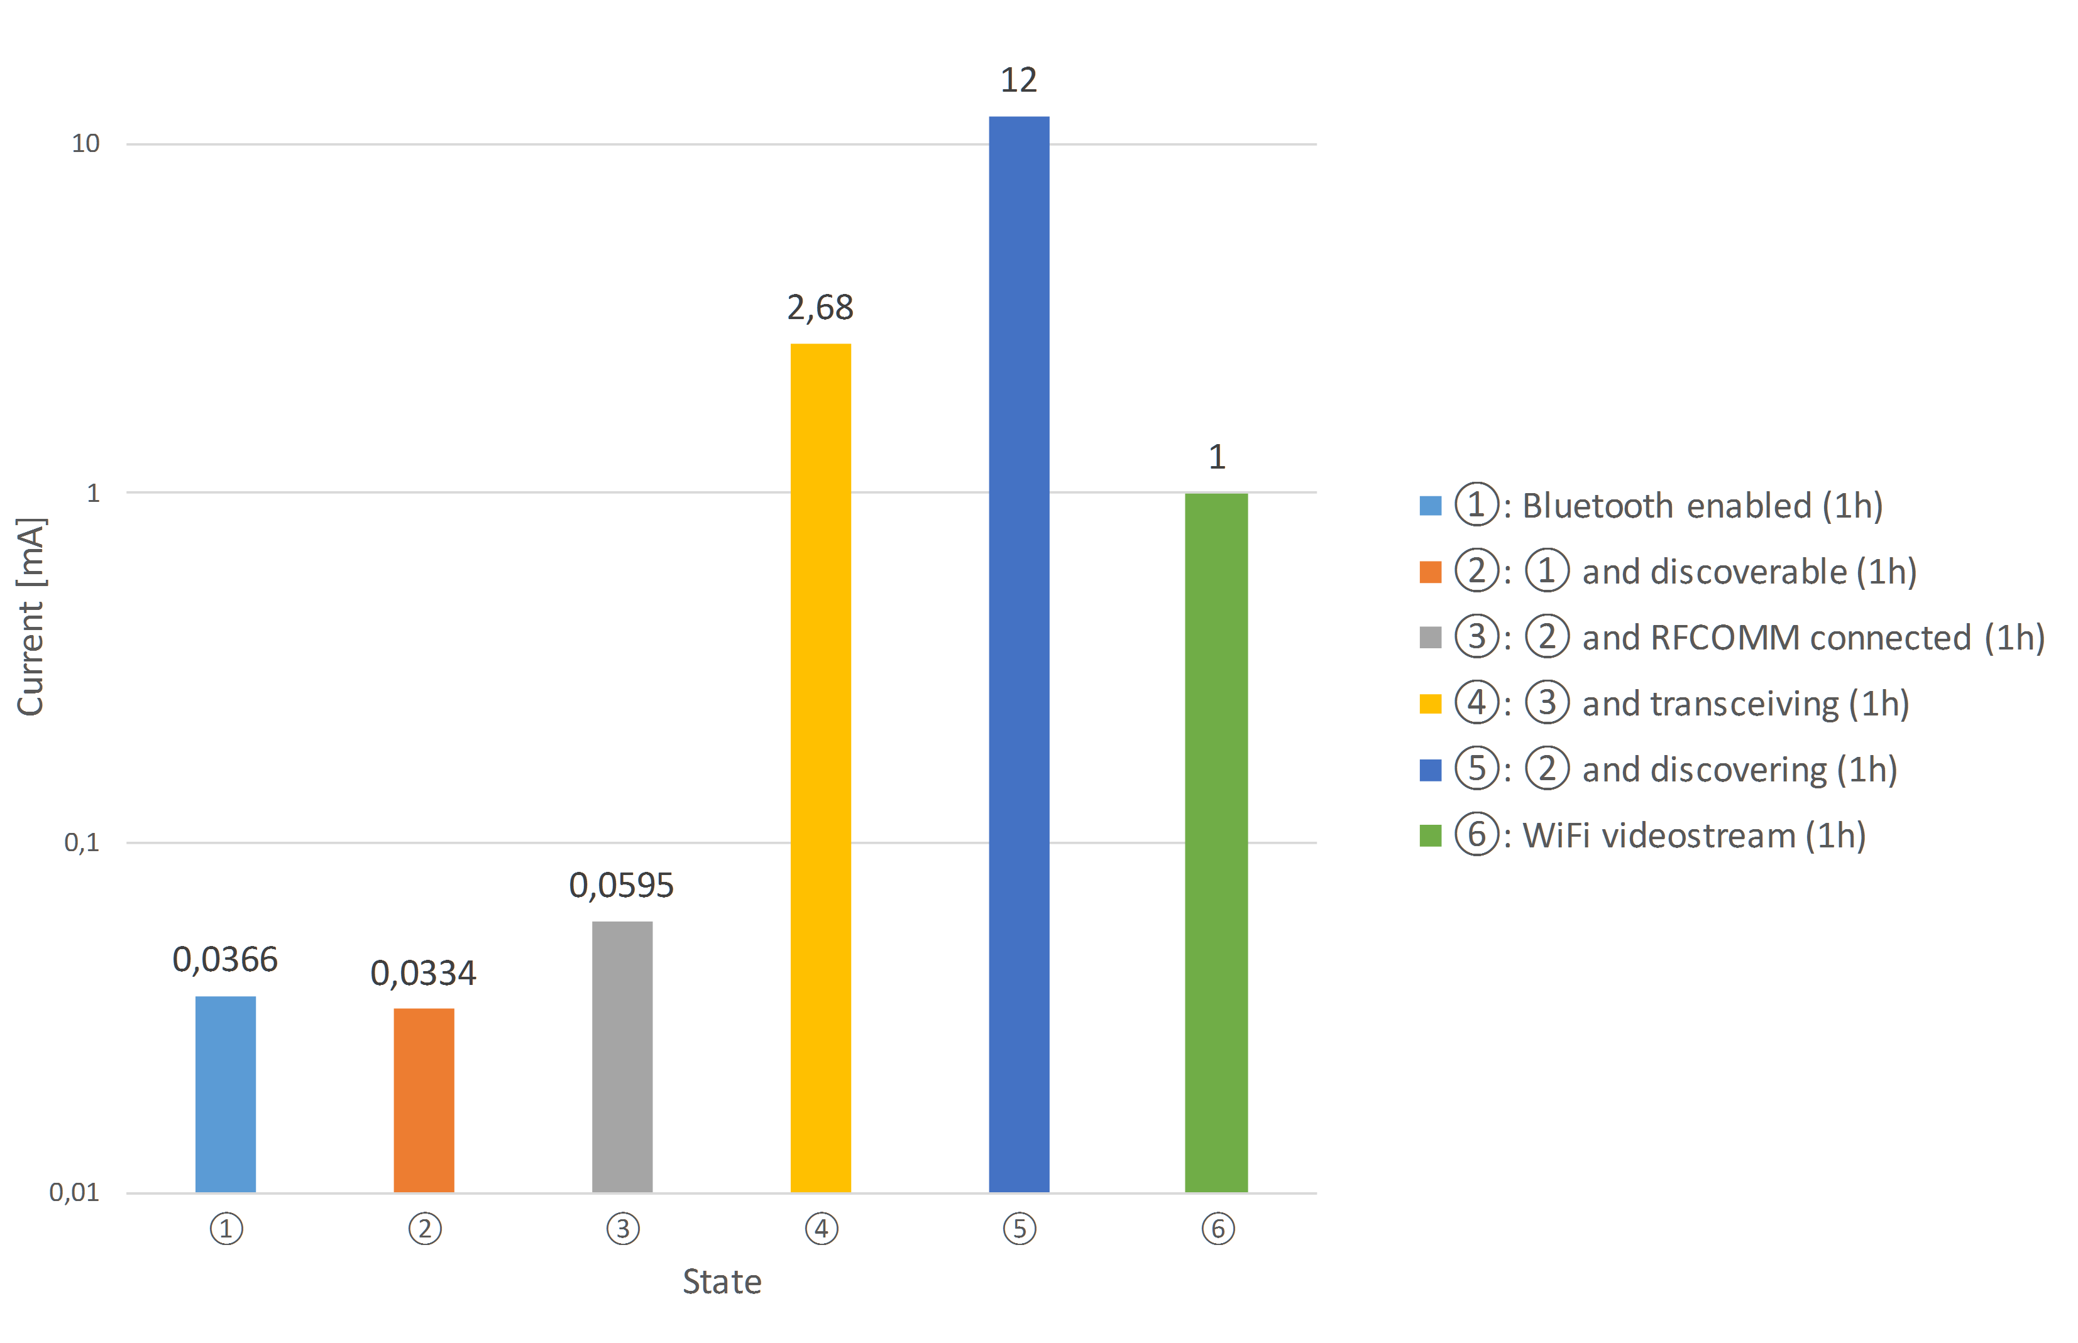
Discussion: Android Results
Discovery and transmission expensive
But:
discovery << display
Discovery << capacity

Slide 34
Discussion: Problems
Leftovers
Strong coupling with Bluetooth
Different behavior on different Android versions

Slide 35
Outlook
Implementation of missing features
Distributed Database
Timeout Callbacks

Slide 36
Outlook: Improvements
Separate MANET features into standalone library
Extend with other wireless technologies
Use BLE advertisement instead of Bluetooth Classic discovery
Leftovers:
Minimum/Maximum: compute with previous results
Sum: TODO

Slide 37
Outlook: Usage
Host as open source project
Write paper on combination on secure multi-party gamification to gain attention
Extend simulation script
Implement into Hygiene Games for a study

