Slide 1
SMPC for Decentralized Distributed Systems
Frederic Klein – Proposal Talk

Slide 2
The Hygiene Games
Gamification for hand hygiene
Requirements
Privacy protection
Computation of system statistics
Bluetooth mesh network
Notes:
Around a year and a half ago I joined a student team under the guidance of the mhealth department, that started to develop a system to tackle hospital acquired infections: the Hygiene Games.
HAIS: 4.1 million infections per year in the EU, a quarter preventable
Hygiene Games serves as a case study
Limited access to Wi-Fi/GSM in clinics (Electromagnetic Compability)
The development of a framework, that meets these requirements will be the topic of my thesis.

Slide 3
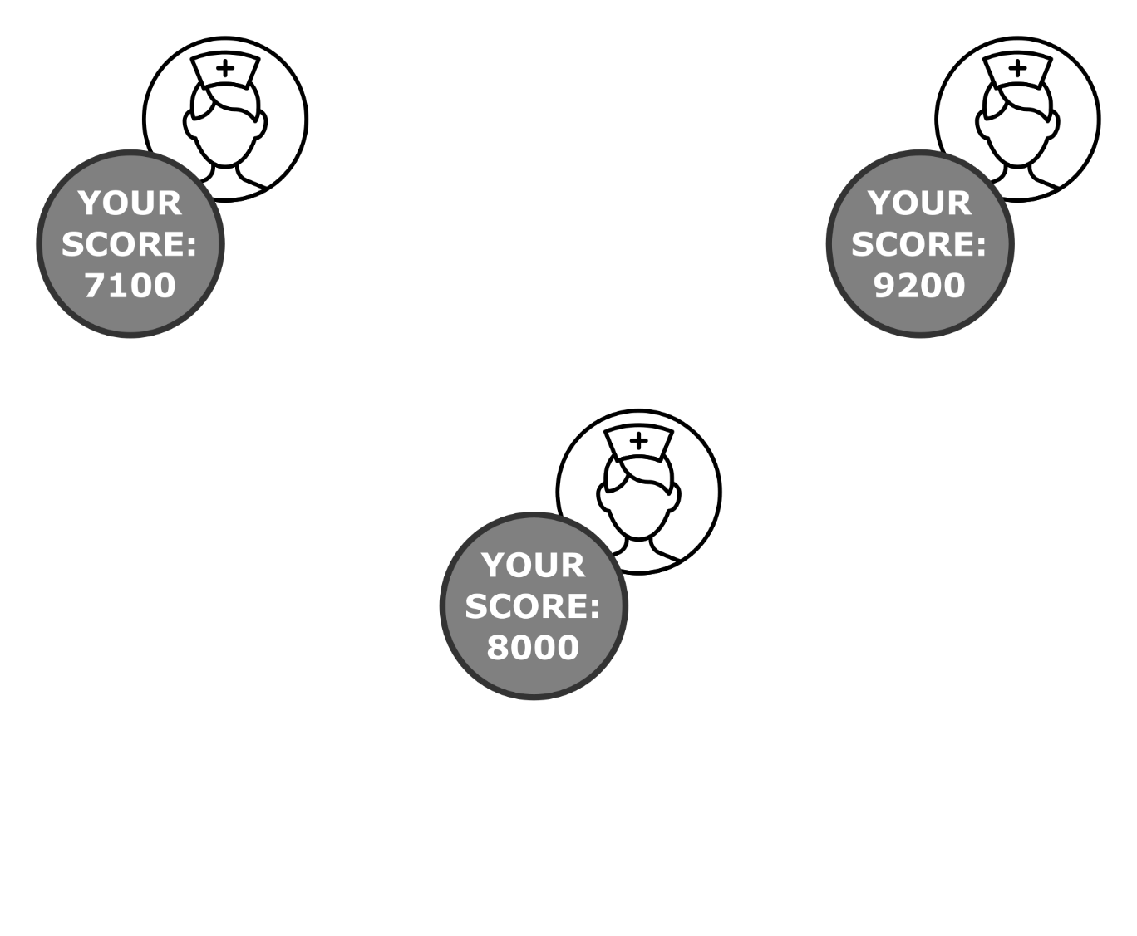
Privacy Protection
Personal data on own device
Modest value without comparison
Notes:
Gamification: key issue is comparison -> motivation

Slide 4
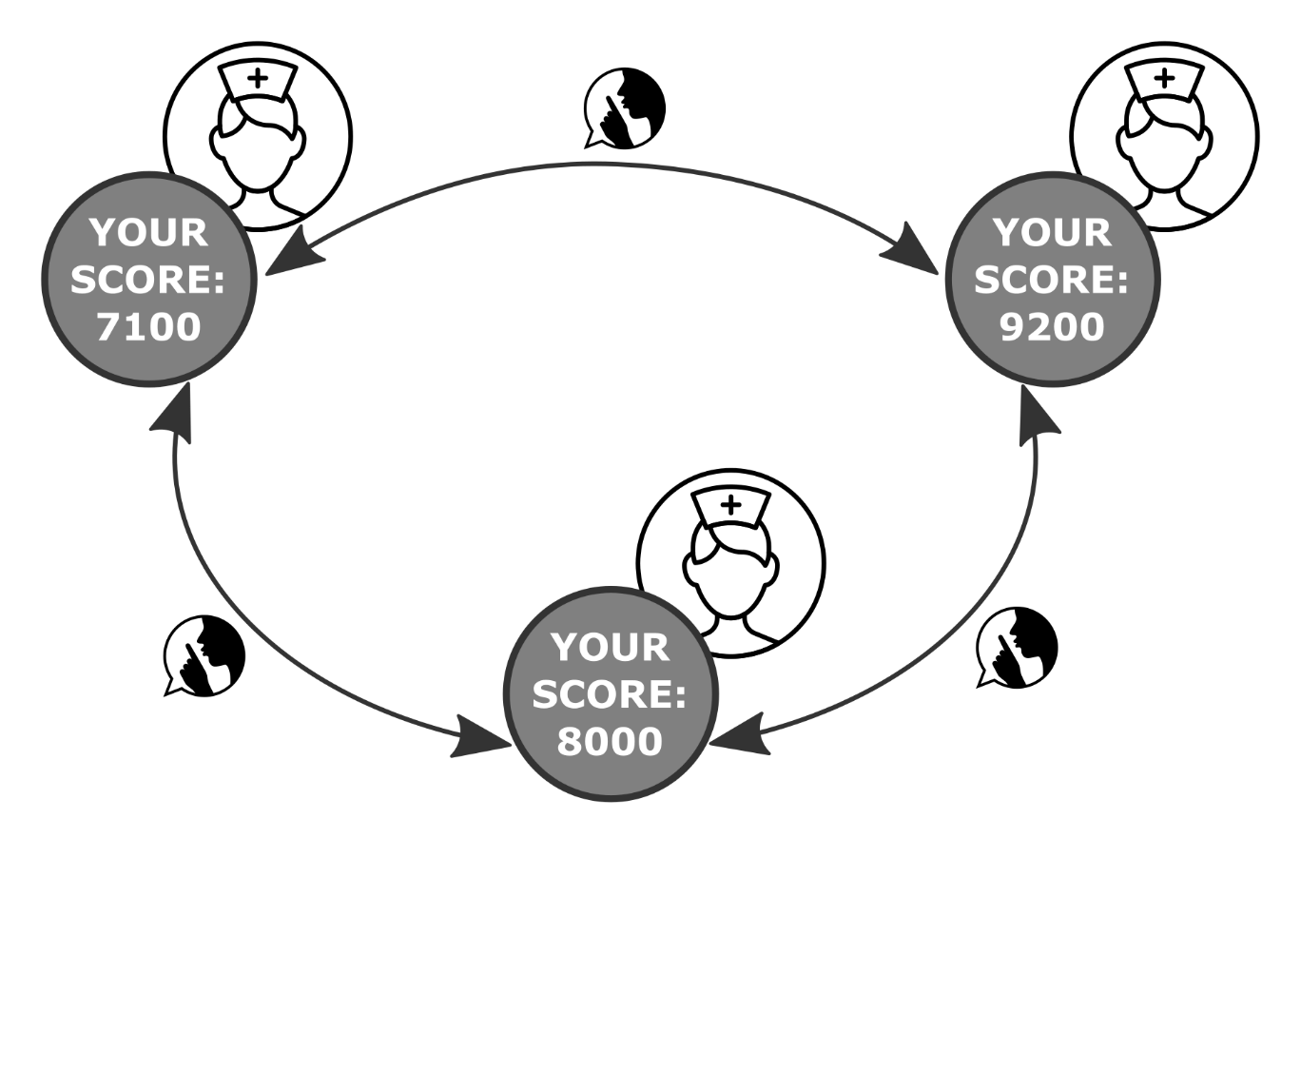
Privacy Protection
Exchange data for comparison
Notes:
Therefore privacy protecting exchange of data is needed so that …

Slide 5
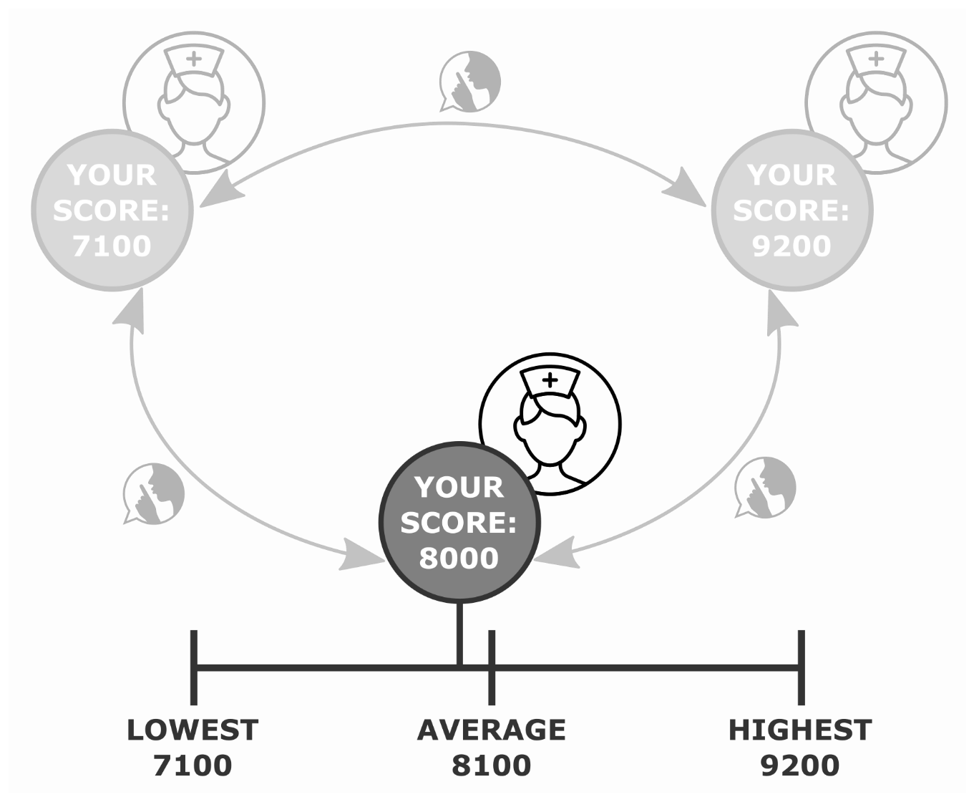
Privacy Protection
Notes:
Statistical data reflecting system wide performance for comparison
While data exchange and privacy seem to be contradictory,
Solution to maintain privacy while doing computation on data from multiple parties is SMPC

Slide 6
SMPC
Subfield of cryptography:
compute function over inputs of multiple parties
keep the inputs private

Slide 7
SMPC
Three parties
Score as input
Notes:
Returning to the initial example…

Slide 8
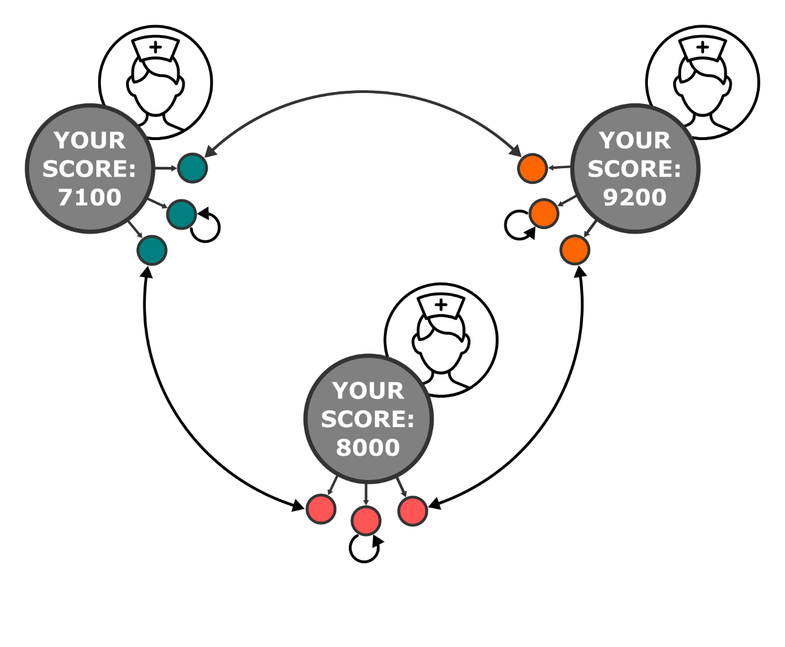
SMPC
Secret sharing: n shares for n parties
Notes:
Instead of sharing their score (also called secret)…
Standalone share is nearly irrelevant.

Slide 9
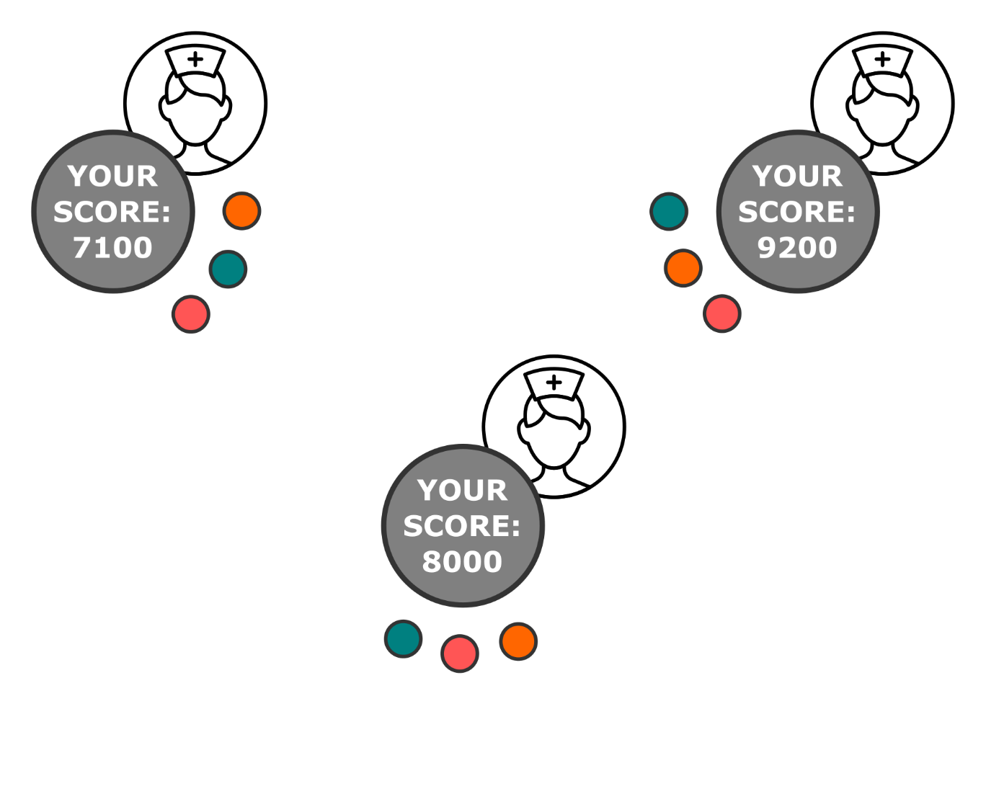
SMPC
Each player: set of n shares

Slide 10
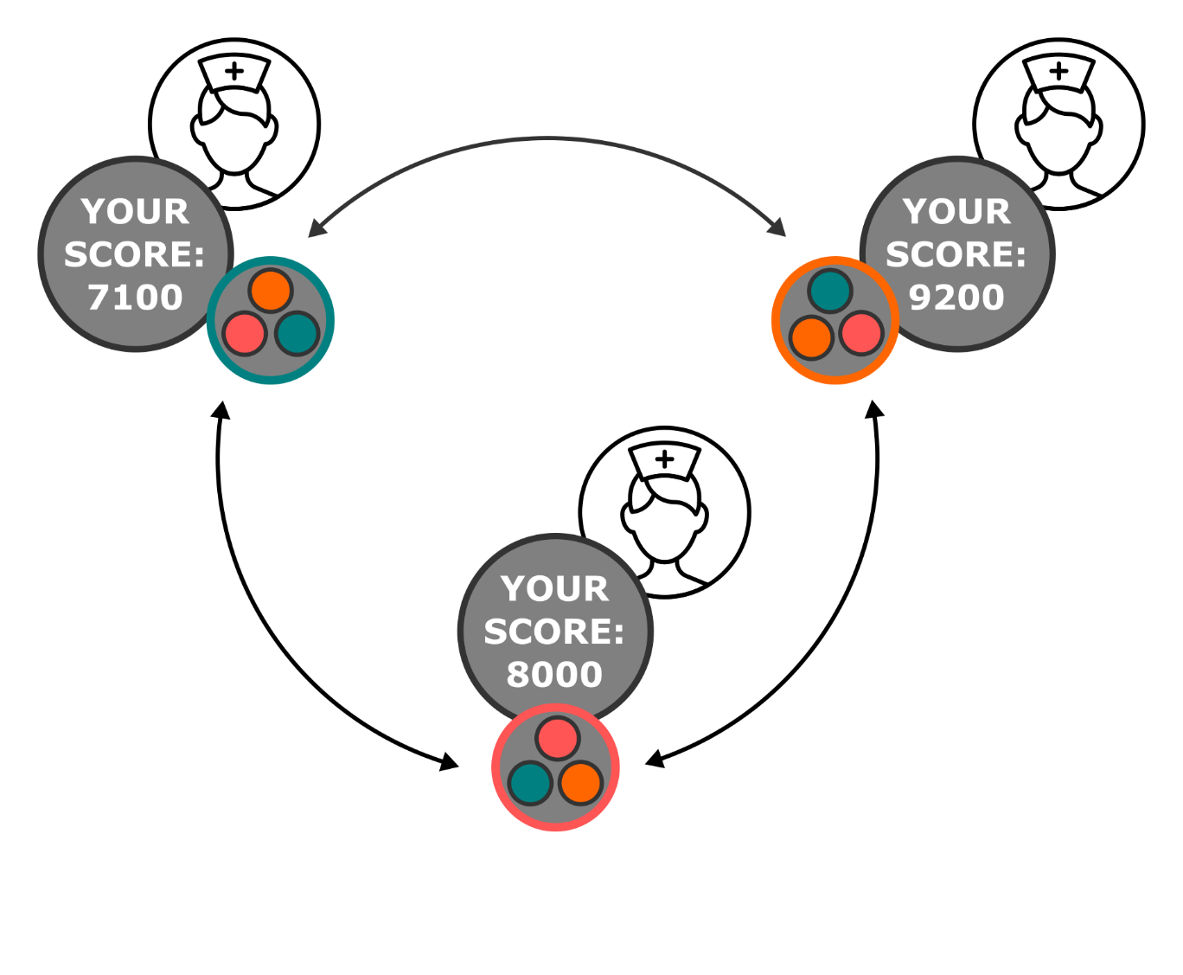
SMPC
Computation on shares
Broadcasting of result
Notes:
Computation on shares (for example sum them up)

Slide 11
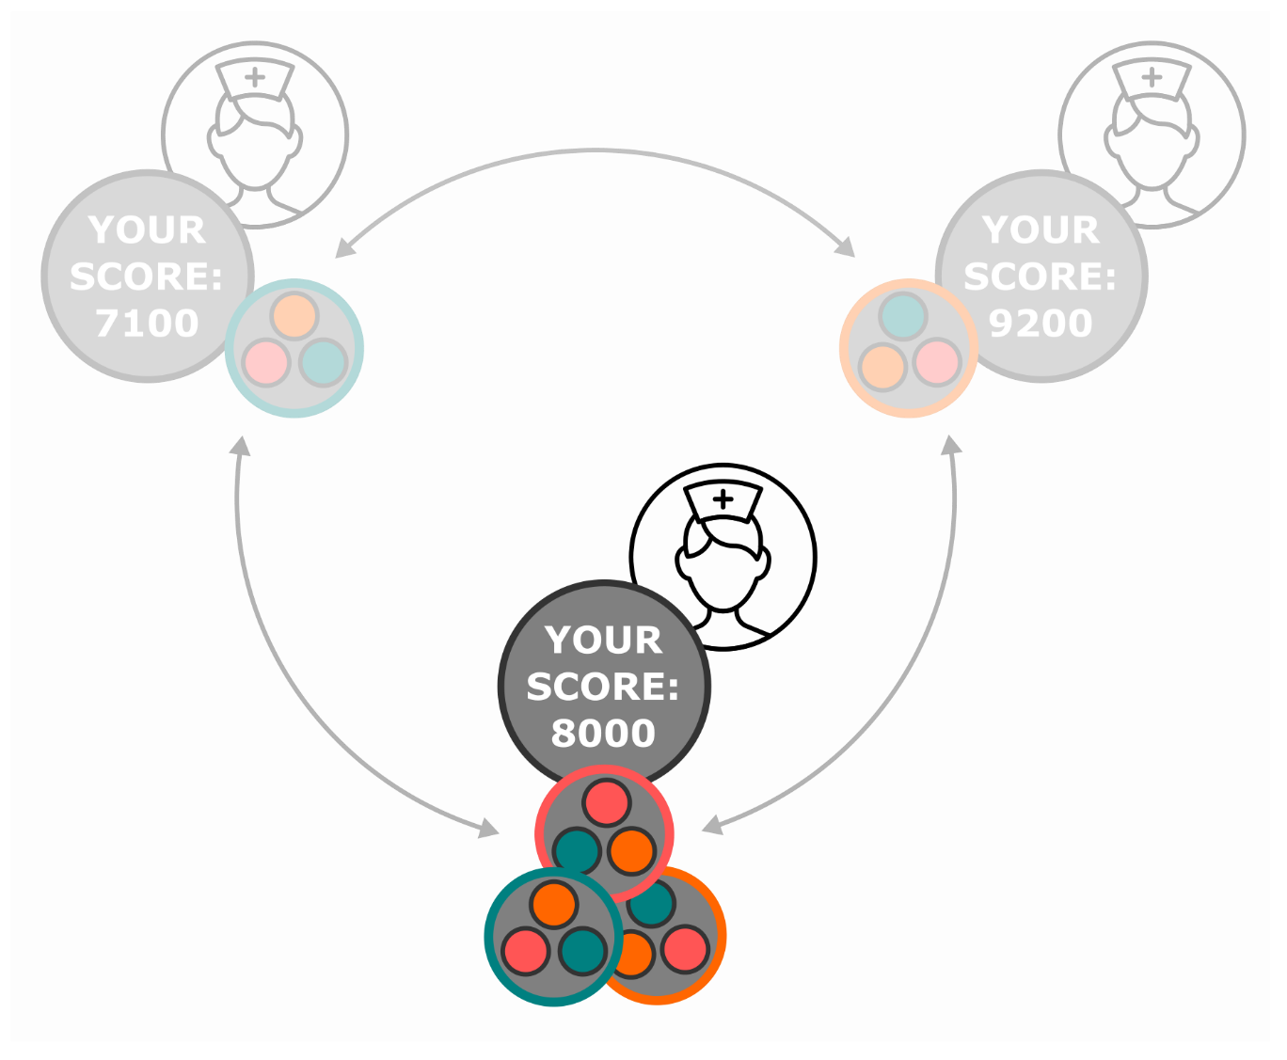
SMPC
Each party:
Complete information for computation
Other inputs remain secret

Slide 12
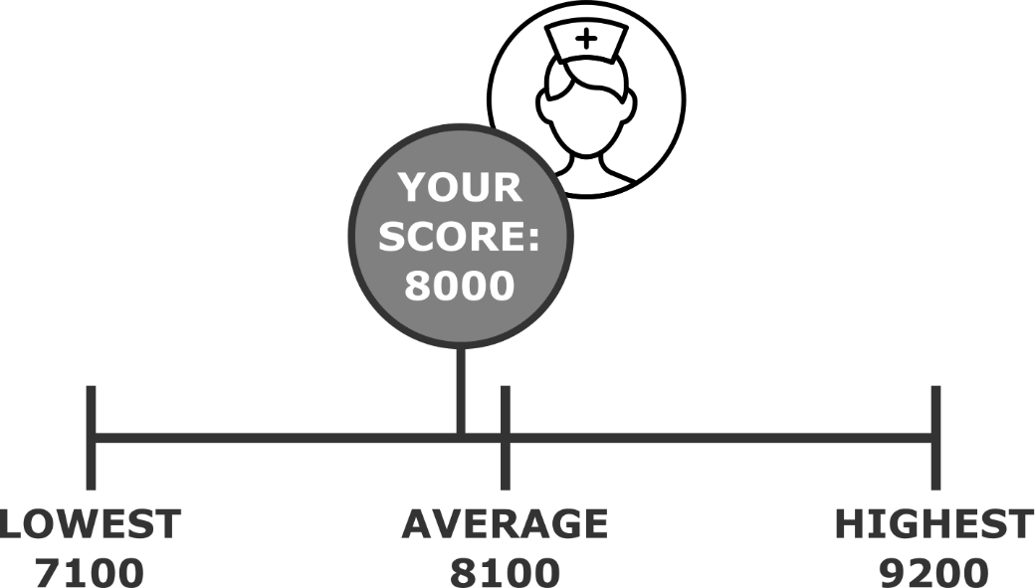
SMPC
Algorithms
Secure addition
Secure comparison
Notes:
For the case study two algorithms need to be implemented
The secure addition algorithm can also be used for referendums.

Slide 13
Decentralization
Mesh network
Computation partners not stationary
Partitioning possible
No central database server
Notes:
So far I left the underlying network aside, but taking the requirement for a mesh network into account

Slide 14
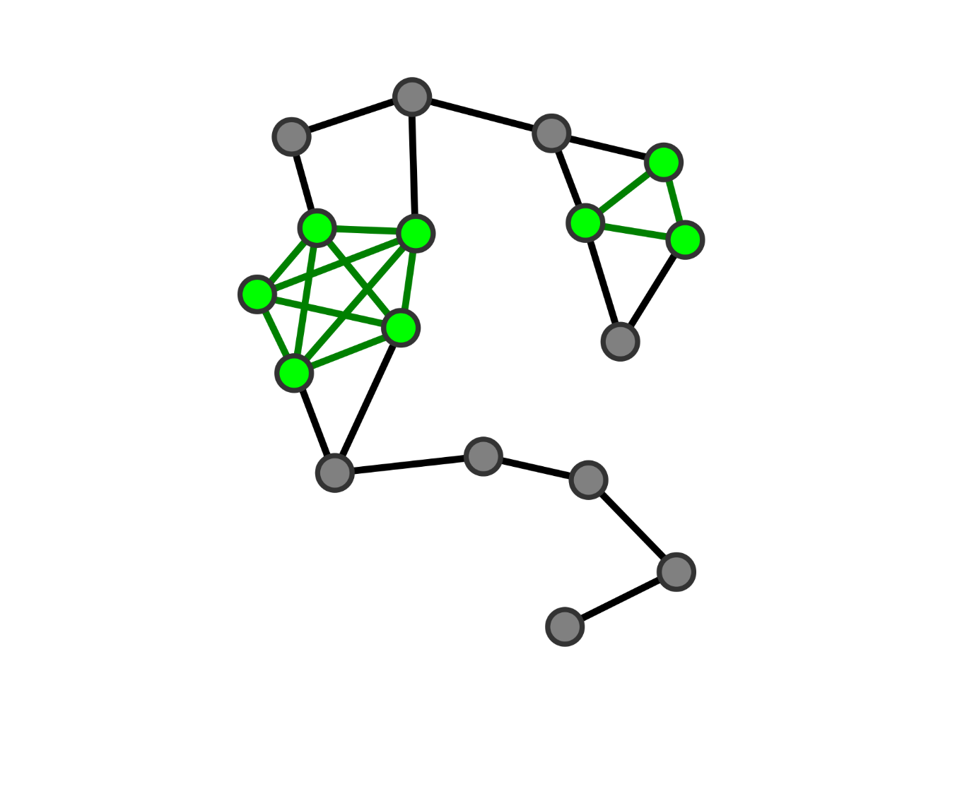

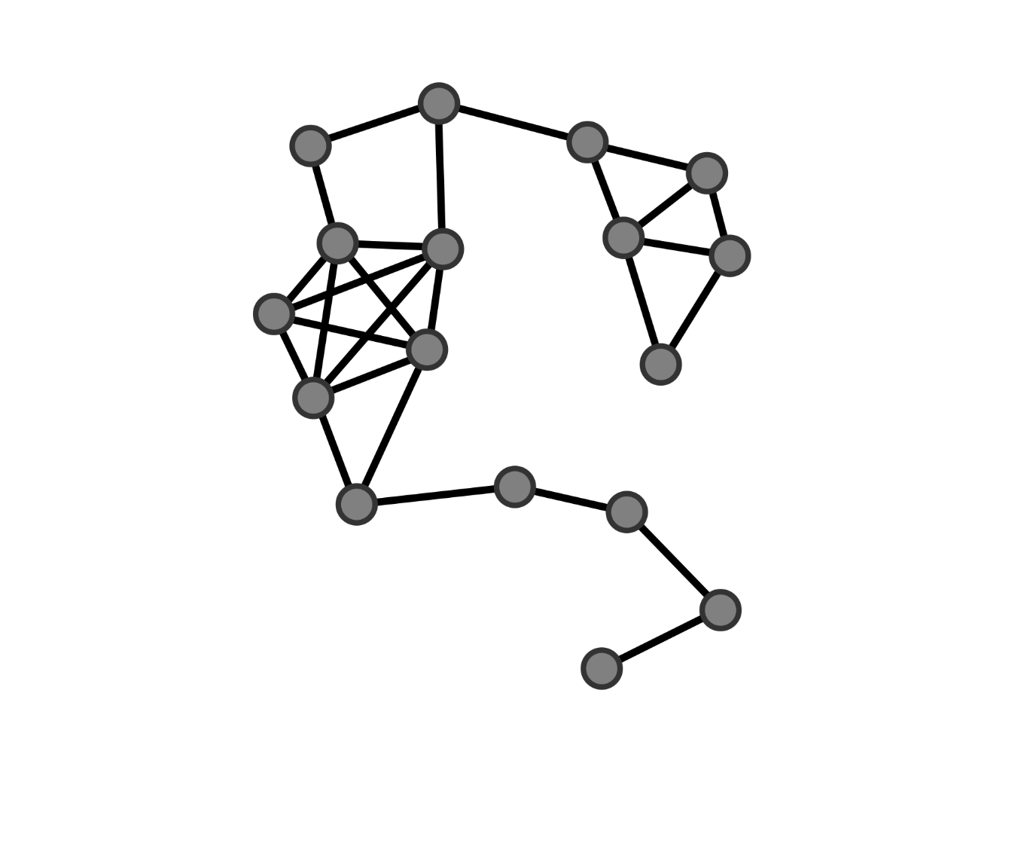
Decentralization
Broadcast protocols
Detection of nodes
Distribute data
Distributed Database
Blockchain
Notes:
Nomadic -> detection
Borrowing blockchain ideas

Slide 15

Distribution
Synchronization of clocks (Berkeley)
Coordinator election
Notes:
SMPC is a distributed computation

Slide 16
Requirements
C library; JNI for Java/Android usage
Node coordination and synchronization
SMPC
Data distribution and preservation
Notes:
C for low level devices

Slide 17
Tasks
Secure addition protocol
Secure comparison protocol
Secure communication layer
Detection/notification of participants
Coordinator election
Clock synchronization
Distributed Database/blockchain
Flooding
Notes:
C for embedded systems

Slide 18
Evaluation
Test framework with devices of diverse computation power
RasPi 3, various Android devices, Xadow GSM+BLE, TI CC2650STK
Field application tests
Attack scenarios
Security evaluation in different environments
Notes:
Security: honest majority, honest minority

Slide 19
Schedule
Research/Requirements
11/7/2016 - 7/10/2016
SMPC Helper Functions
10/8/2016 - 23/8/2016
SMPC Algorthms
26/9/2016 - 16/10/2016
Clock Synchronization
16/10/2016 - 23/10/2016
Security Layer
23/10/2016 - 30/10/2016
Blockchain
30/10/2016 - 13/11/2016
JNI Library
13/11/2016 - 20/11/2016
Cross-Platform Tests
20/11/2016 - 24/11/2016
Field Application Tests
24/11/2016 - 28/11/2016
Jul
Aug
Sep
Oct
Nov
Dec
11/7/2016
Now
20/11/2016
Registration
7/10/2016
Finalization of Implementation
Conclusion of Research Phase
28/11/2016
Evaluation
12/12/2016
Final Submission

Slide 20
Summary
SMPC for Decentralized Distributed Systems
privacy protecting computations
Mesh network
Notes:
So the topic … implies the development and discussion of a framework
Using selected SMPC algorithms for the intended area of application: serious games

Slide 21
The Hygiene Games – 2.0
this thesis proposes the development of a framework for SMPC, data distribution and data preservation for serious games in a Bluetooth mesh network
Limited access to Wi-Fi/GSM in clinics (EMC)
distributed system: avoids server administration, reduces system integration/installation costs
high-performance smartphones, low level wearables

