Slide 1
Modeling California Housing Prices by Combining Housing Indicator- and
Satellite Image-based Features
By Fred Pearce
9/30/17

Slide 2
Motivation
What drives Housing Prices?
Do “Natural”, as well as Human, factors impact housing price?
Let's try to get at this by combining traditional housing indicators with high-resolution satellite imagery of individual housing “clusters”.

Slide 3
Objective
Develop a machine learning model that can accurately predict housing prices using
Traditional Housing Indicators, e.g. average # of bedrooms or median household income, and
Satellite Imagery

Slide 4
Outline
Data: California Housing and Satellite Imagery
Method
  Data Preprocessing
  Regression Model for Predicting Housing Price

Slide 5
Data
California Housing Dataset (CHD) contains 20,640 observations of nine variables, as described in Pace et al. [1997]¹, with each variable representing a housing value aggregated across a roughly equal number of densely clustered houses (i.e. 1990 Census “blocksgroup”):
1) Median House Price in blockgroup,
2) Median Income in blockgroup,
3) Median Age of Housing in blockgroup,
4) Average Number of Rooms in blockgroup,
5) Average Number of Bedrooms in blockgroup,
6) Total Population in blockgroup,
7) Average Number of Occupants in blockgroup
8) Average Latitude of blockgroup in degrees
9) Average Longitude of blockgroup in degrees
1 Pace, R. Kelley and Ronald Barry, Sparse Spatial Autoregressions, Statistics and Probability Letters, 33 (1997) 291-297.

Slide 6
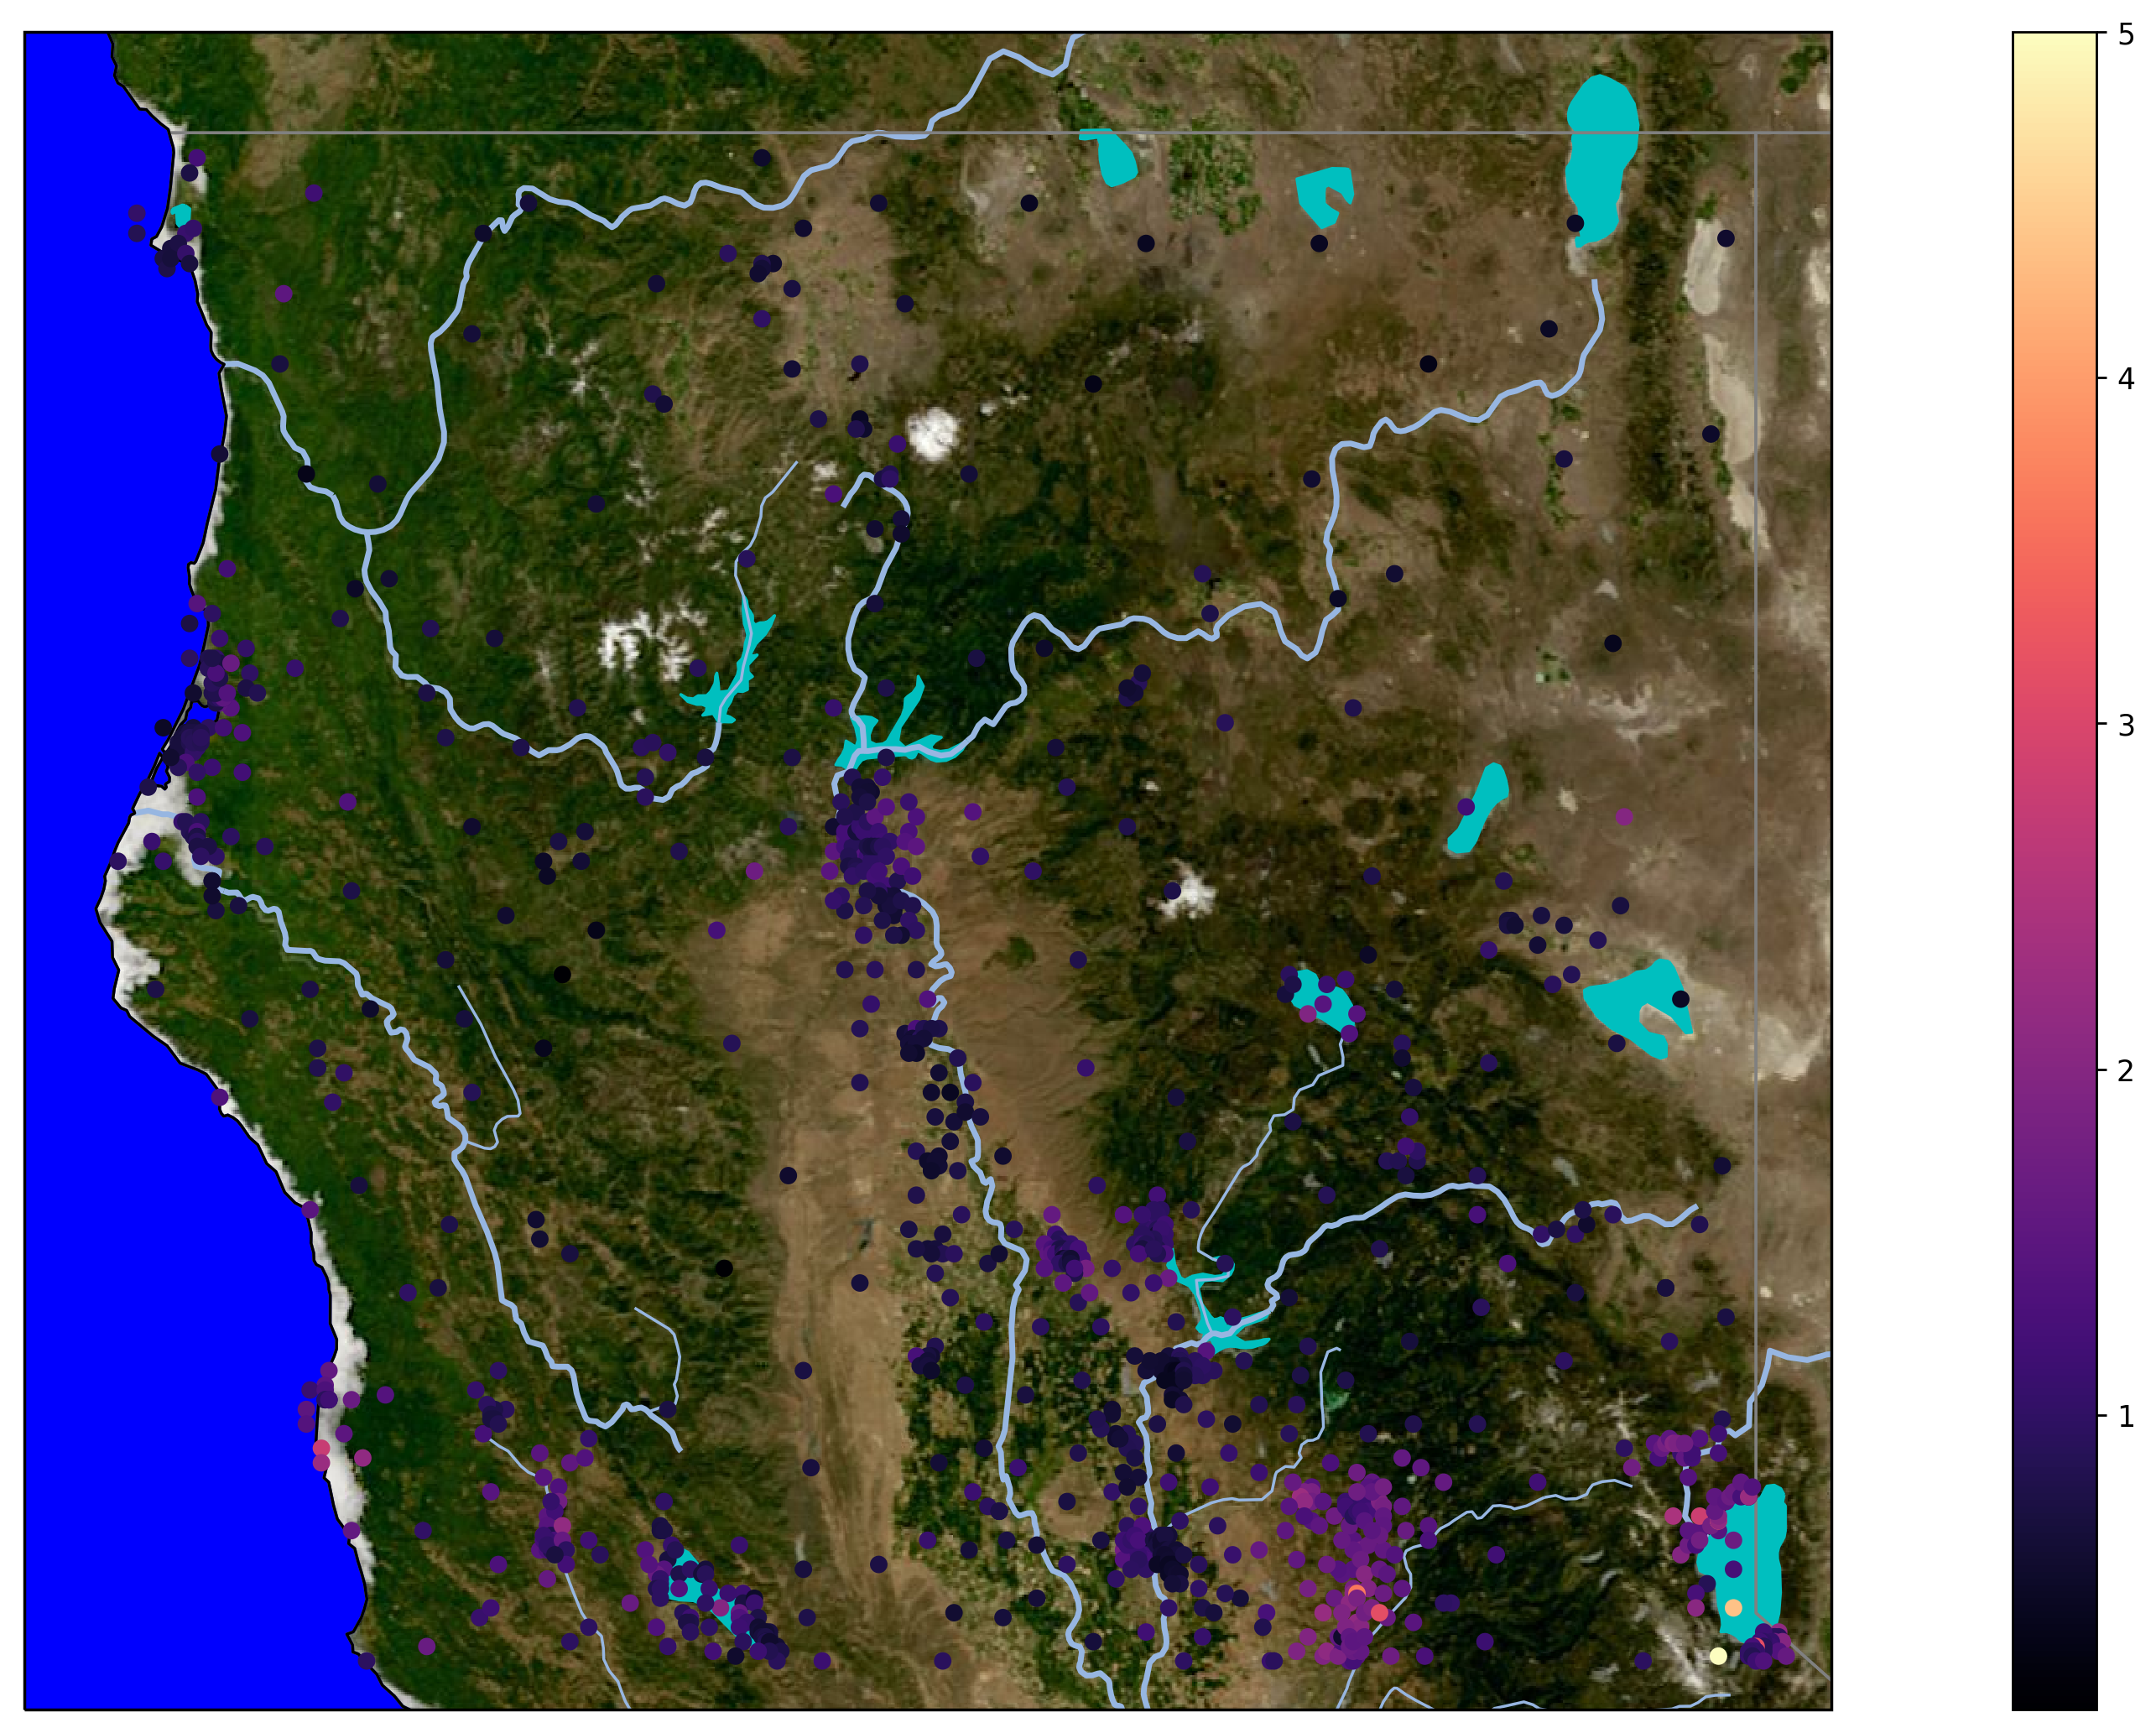
Data

Slide 7
Method

