Slide 1
How Can We Build an AI Agent for Facial Recognition?
Software Engineering Technology •
Group One Project
COURSE CODE: COMP.120
GROUP ONE
Focus
Stack
Outcome
• Frederick Kwame Attitsogbui
• Sahil Badery
AI agent + facial recognition pipeline
Python • HTML • CSS • APIs
A working recognition interface
• Prince madu
• Seeyar Kakar
• Oluwadamilola
COMP.120

Slide 2
FOUNDATION
2
What Is an AI Agent?
A program that perceives input, makes decisions, and performs actions.
Perceive
Decide
Act
Receives image or video input and detects relevant information.
Processes the input and determines what the system should do next.
Returns a result such as a recognition label, confidence score, or alert.
Software Engineering Technology • Group One
COMP.120

Slide 3
AI PIPELINE
3
Face Detection vs. Face Recognition
Two different stages of the same pipeline.
1 • Face Detection
2 • Face Recognition
Finds where a face appears in an image or video frame. Output: face location / bounding box. It does not identify the person.
Determines who the person is by comparing a face representation with known identities. Output: closest match and confidence.
Software Engineering Technology • Group One
COMP.120

Slide 4
AI PIPELINE
4
How Face Recognition Works
The system turns a detected face into a numerical representation.
Image
Camera frame
Detect
Find face
Embed
Create vector
Compare
Match vector
Result
Identity / no match
Embeddings are numerical representations that make comparison possible.
Software Engineering Technology • Group One
COMP.120

Slide 5
ARCHITECTURE
5
High-Level System Architecture
How the main project components fit together.
Camera / Image
Input
HTML + CSS
User interface
API Layer
Data exchange
Python AI
Recognition
Stored Embeddings
Known identities
• Frontend displays the live camera and results.
• Backend performs image processing and recognition.
• APIs connect the interface to backend services.
Software Engineering Technology • Group One
COMP.120

Slide 6
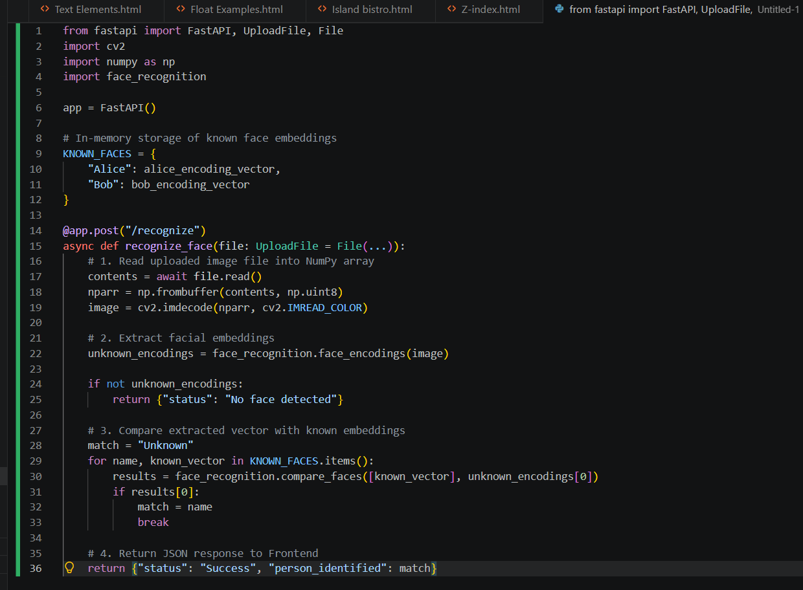
BACKEND
6
The Backend Engine: Python
Python handles image processing and the core AI logic.
Data Processing
Clean, resize and format raw image data before recognition.
Core Libraries
OpenCV • Pillow • NumPy
Software Engineering Technology • Group One
COMP.120

Slide 7
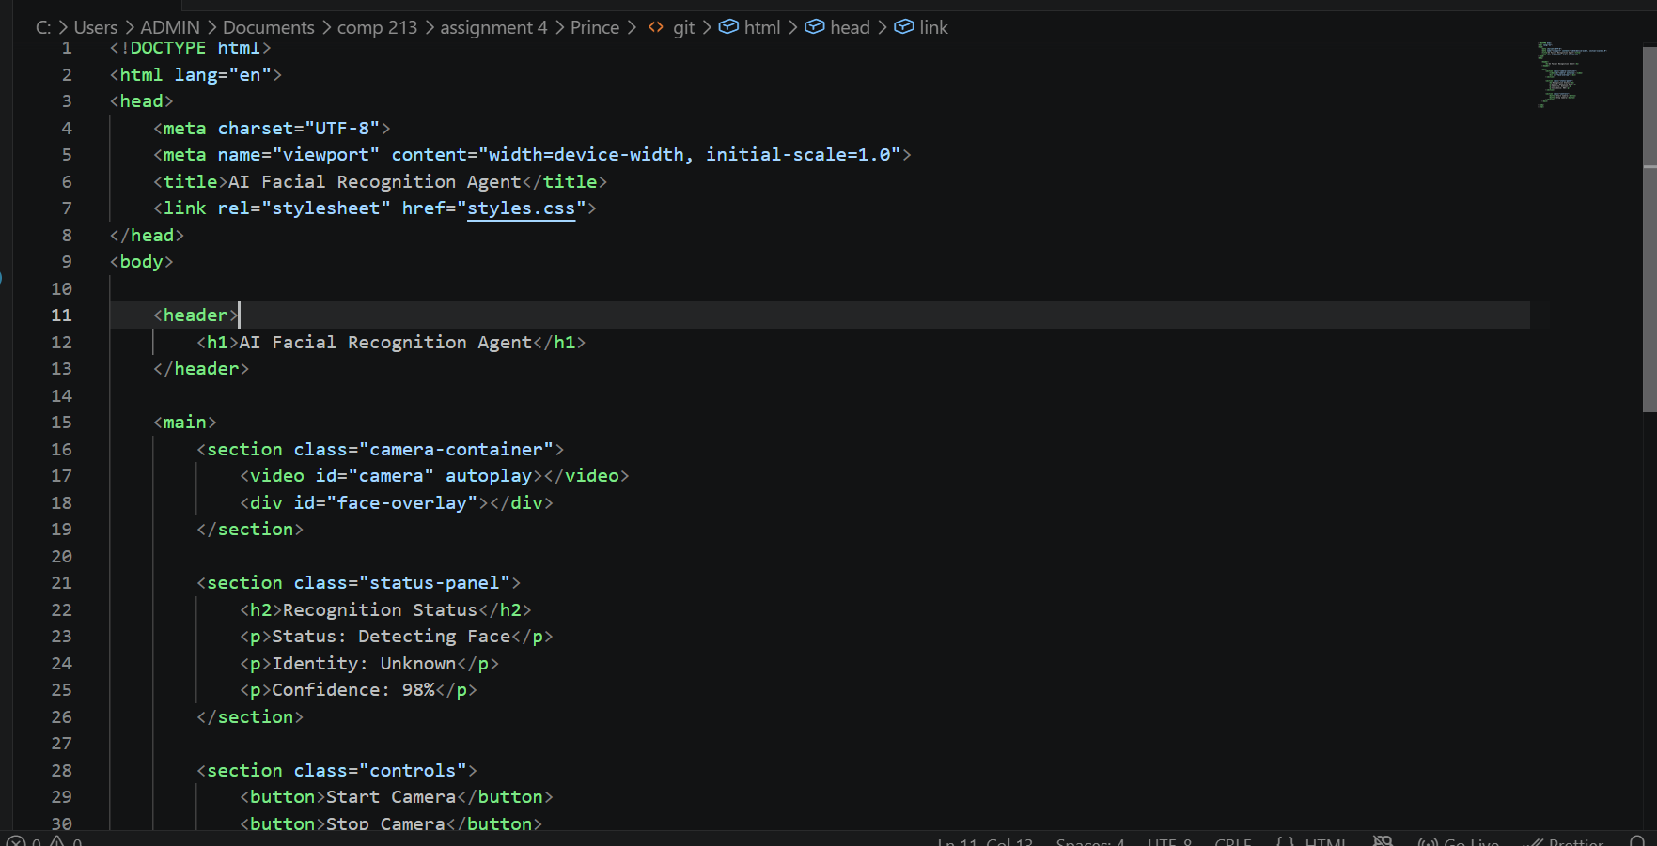
FRONTEND: HTML
7
Generating Face Embeddings
The AI converts a face into a numerical representation for comparison.
• Detect and crop the face.
• Pass the face through a recognition model.
• Generate an embedding vector.
• Compare the vector with stored embeddings.
Software Engineering Technology • Group One
COMP.120

Slide 8
AI MODEL
8
Recognition Decision
The closest stored embedding becomes the candidate match.
Compare
Threshold
Return Result
Measure similarity between the new face embedding and stored embeddings.
Accept the match only when similarity meets the system's threshold.
Display the identity, confidence score, or an unrecognized status.
Software Engineering Technology • Group One
COMP.120

Slide 9
FRONTEND
9
Frontend Development: HTML
HTML provides the structure of the facial recognition web application.
Camera Feed
Overlay
Status Area
The <video> element displays the live camera stream.
A positioned container allows face boxes and labels to appear over the video.
The interface can show recognition labels and confidence scores.
Software Engineering Technology • Group One
COMP.120

Slide 10
FRONTEND
10
Frontend Development: CSS
CSS controls layout, overlays and the visual state of the AI results.
Responsive Video
Bounding Boxes
AI States
16:9 aspect ratio keeps the live camera feed aligned across screen sizes.
Absolute positioning places detection boxes directly over faces.
Verified and unrecognized states can use distinct visual treatments.
Software Engineering Technology • Group One
COMP.120

Slide 11

INTEGRATION
11
Connecting the UI to the AI Backend
The interface receives recognition data and turns it into visible feedback.
Coordinate Mapping
Map AI coordinates to CSS top, left, width and height.
Data Stream
Use REST APIs or WebSockets to transfer results.
Frontend Stack
HTML5 + CSS3 + Flexbox/Grid + CSS variables.
Software Engineering Technology • Group One
COMP.120

Slide 12
INTEGRATION
12
API Integration
APIs provide the communication layer between the frontend and backend.
RESTful API
GraphQL / gRPC
Security
Standard HTTP-based communication using structured requests and responses.
Alternative interfaces for structured data access or service-to-service communication.
Authentication mechanisms such as API keys or OAuth 2.0 can protect services.
Software Engineering Technology • Group One
COMP.120

Slide 13
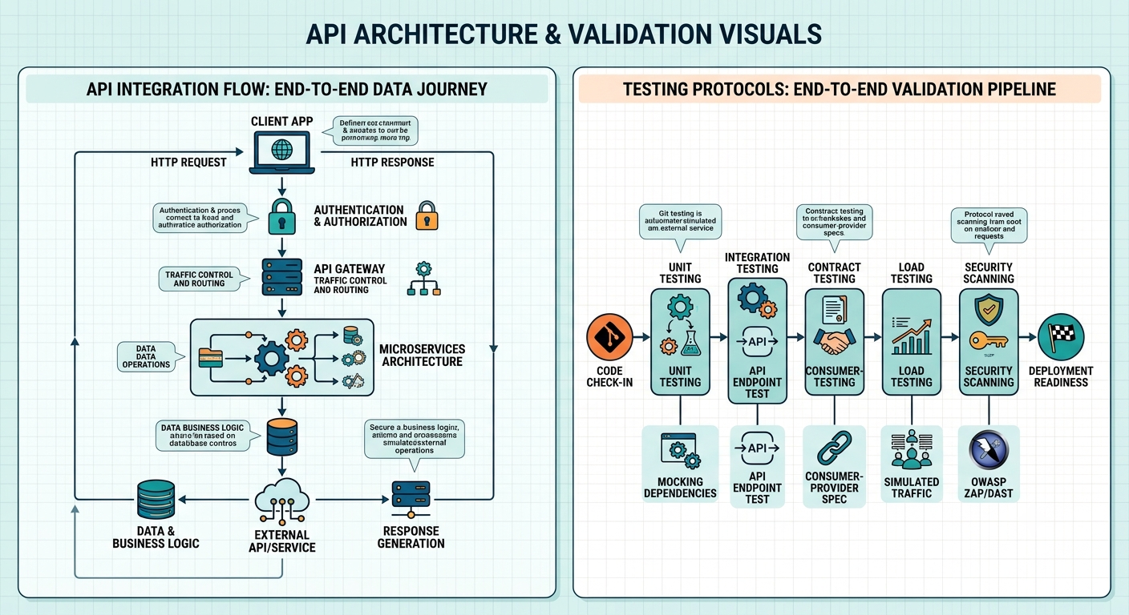
QUALITY ASSURANCE
13
Testing Protocols
Testing verifies that the AI service and APIs behave reliably before release.
• Contract testing checks API schema compatibility.
• Unit and functional tests validate expected behavior.
• CI/CD regression checks help catch breaking changes.
• Load testing evaluates performance under higher traffic.
• Validate status codes, payloads, authentication and latency.
Software Engineering Technology • Group One
COMP.120

Slide 14
ECOSYSTEM
14
Integrations & Ecosystem Standards
Tools that can support a production-oriented architecture.
REST + OpenAPI
Kong
Apache Kafka
Interface and documentation standard • HTTP verbs • JSON payloads • Machine-readable contracts • Interactive documentation
API gateway and traffic management • Authentication • Rate limiting • Key management • Security proxying
Event streaming and distributed messaging • Real-time pipelines • Asynchronous services • Fault tolerance • Event replay
Software Engineering Technology • Group One
COMP.120

Slide 15
SYSTEM FLOW
15
End-to-End Flow
Putting the frontend, API layer and AI model together.
Camera
Capture
HTML/CSS
Display
API
Send data
Python
Process
Embedding
Represent
Database
Compare
Result
Show match
• The key idea is separation of responsibilities: UI displays, APIs communicate, and Python performs recognition.
Software Engineering Technology • Group One
COMP.120

Slide 16
CONCLUSION
16
Key Takeaways
The project combines AI, software engineering and web technologies.
• Face detection locates faces; recognition identifies them.
• Embeddings provide a numerical representation for comparison.
• Python handles the core image and recognition processing.
• HTML and CSS provide the real-time user interface.
• APIs connect the frontend to backend services.
• Testing protects reliability, security and performance.
Software Engineering Technology • Group One
COMP.120

Slide 17
Thank You
Questions & Discussion
Software Engineering Technology • Group One
COMP.120

