Slide 1
Tamr Data Mastering
Bridging the Gap Between Data and Business Outcomes

Slide 2












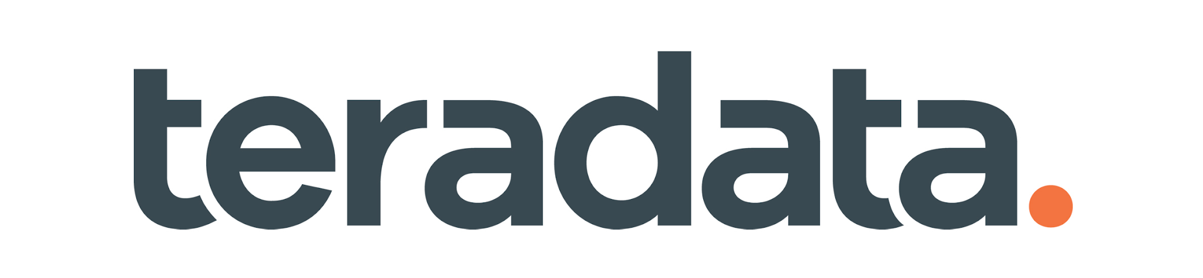


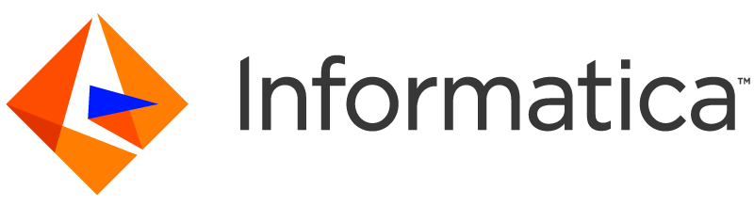

Big Data Isn’t a Problem. Bad Data Is.
Data Lakes
No single view of customers
Data Lakes
Cloud Data Platforms
Master Data Management
Analytics are incomplete or stale
Cloud Elastic
Compute
Data Warehouses
The data in operational systems “can’t be trusted”
Notes:
There has been a massive shift over the last decade in the progression of moving data to cloud data platforms. Along with data, compute is also moving to the cloud, ushering in a new opportunity to scale data management capabilities in unprecedented ways.
However, there’s still a massive gap between data and analytic outcomes. Traditional MDM solutions aimed to solve this problem but they have failed to deliver on the promise of cleansed, mastered data at scale.

Slide 3




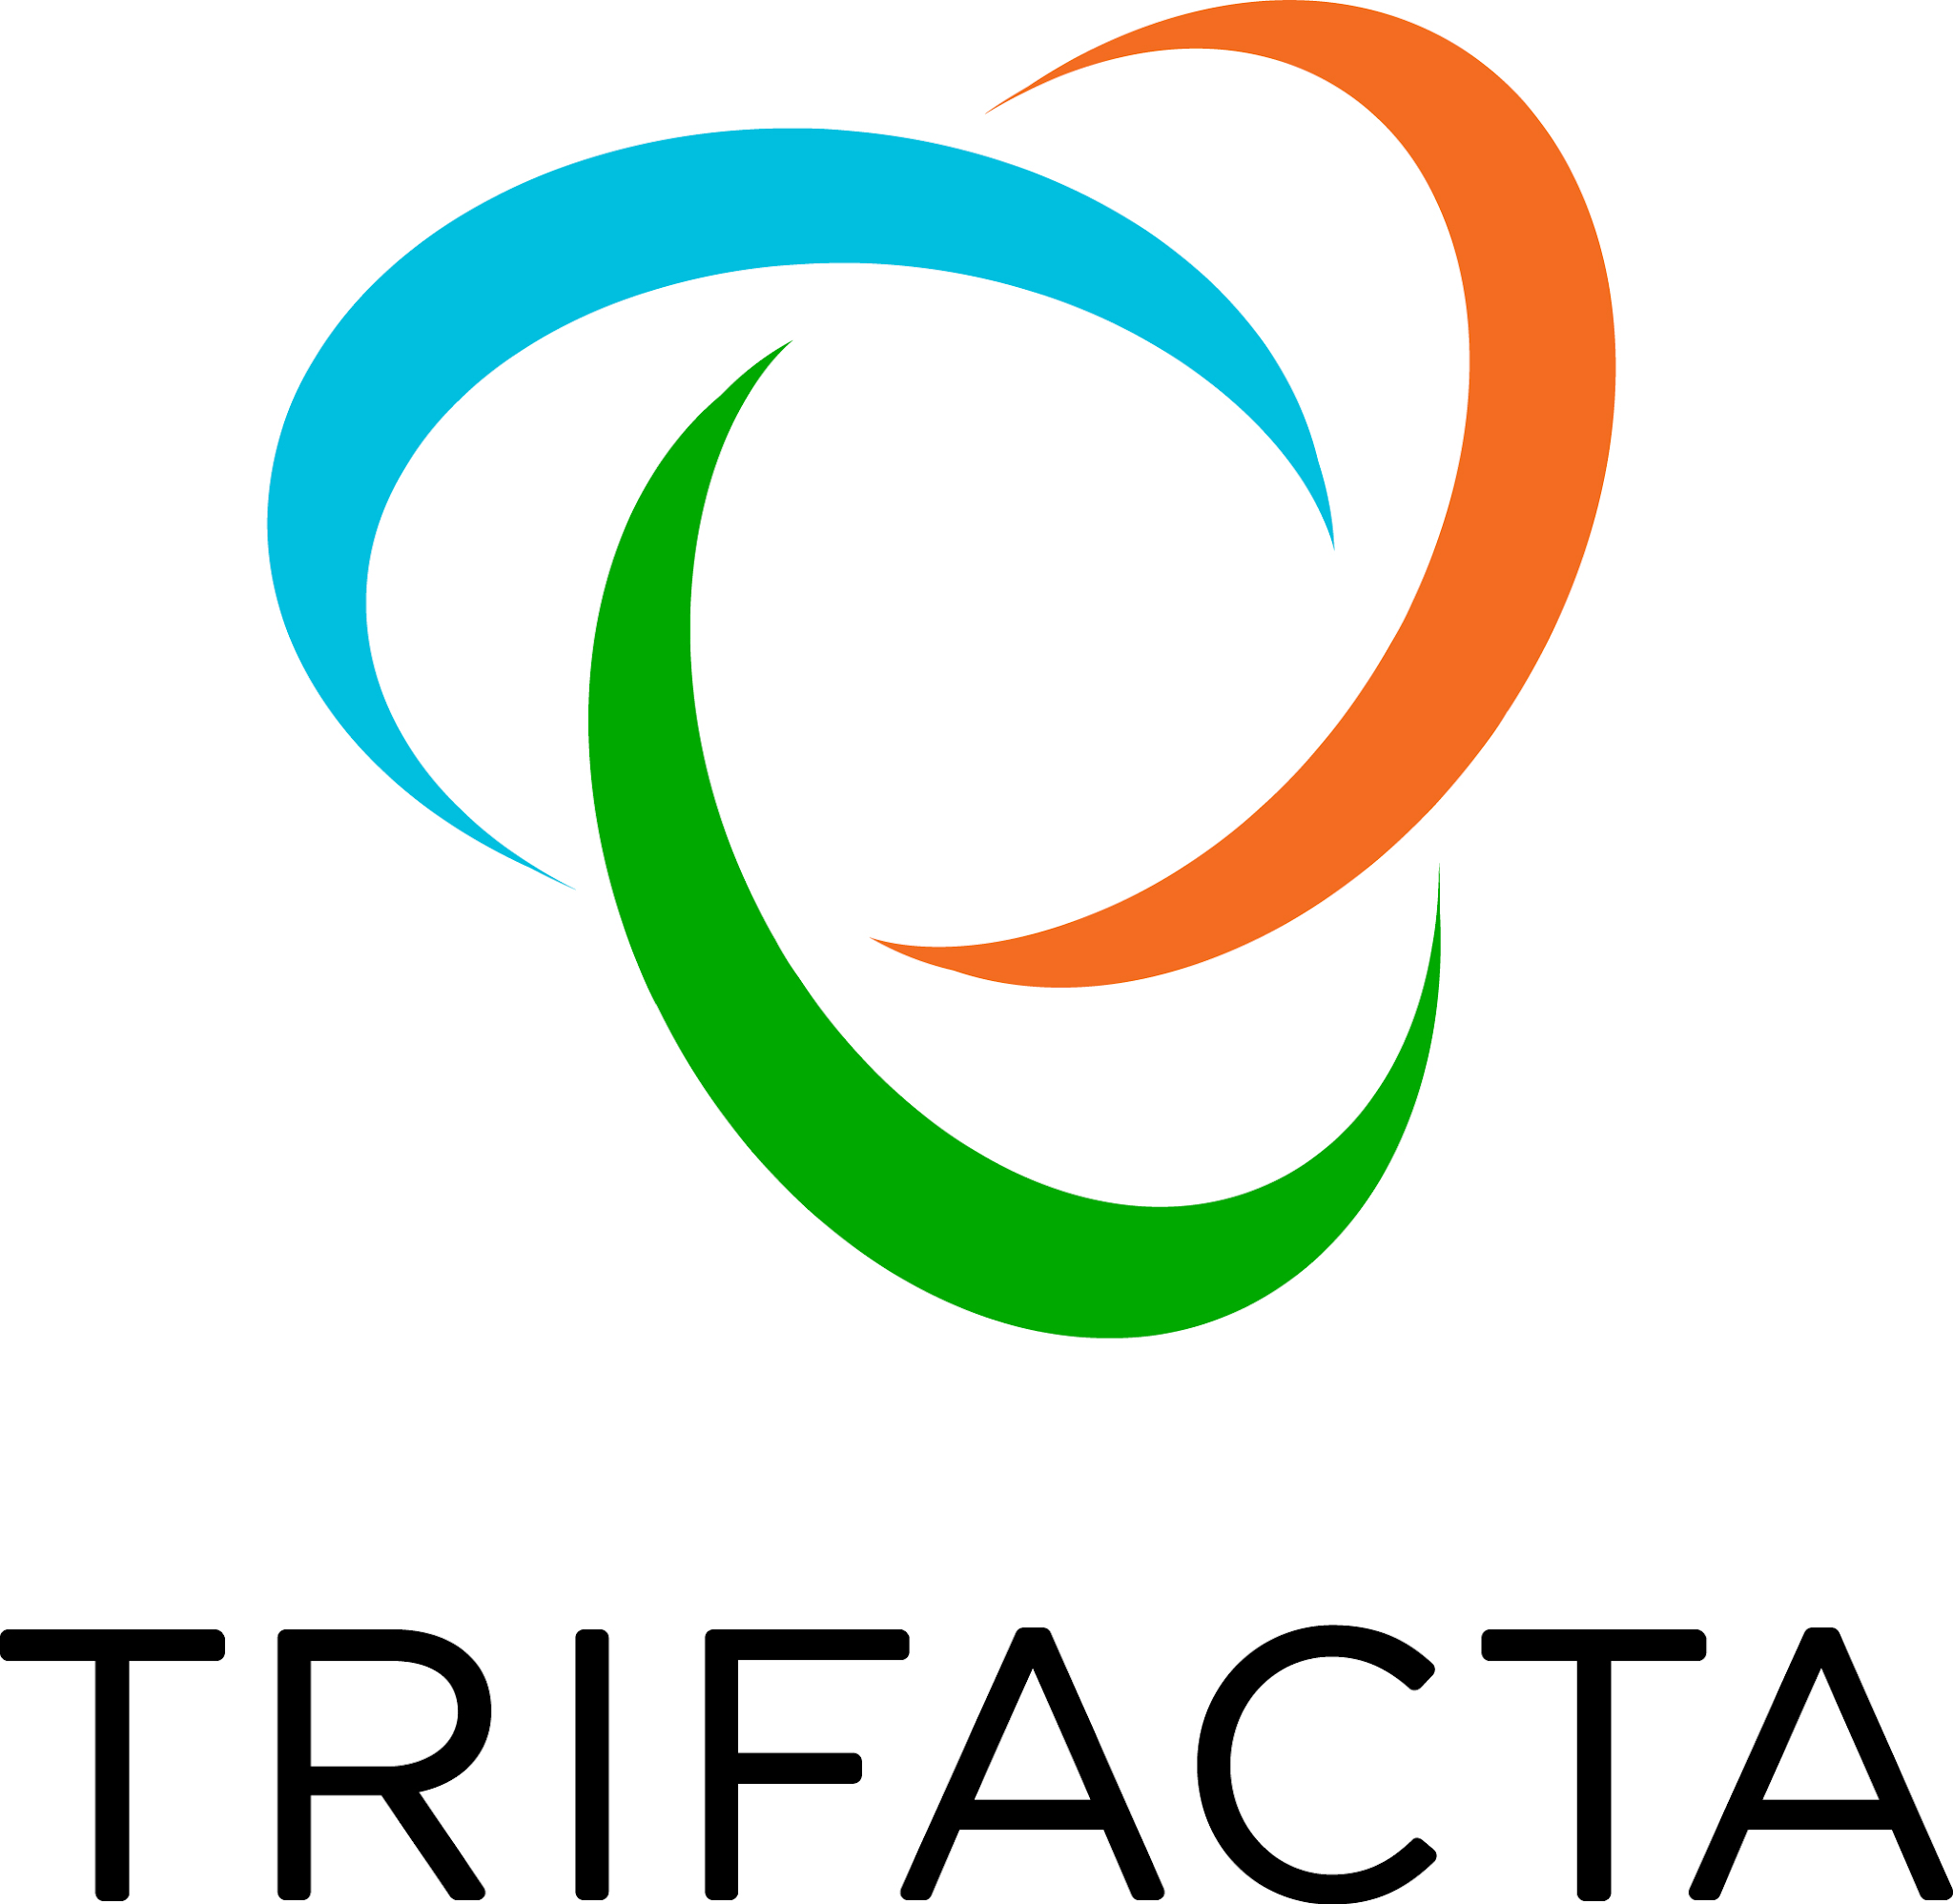






Big Data Isn’t a Problem. Bad Data Is.
Data Lakes
Data Lakes
DataOps
Cloud Data Platforms
Master Data Management
Cloud Elastic
Compute
Data Warehouses
Agile
Continuous
Collaborative
Interoperable / Best of Breed
Scale Out/Distributed
Notes:
Today, the opportunity lies in next-gen data mgmt. solutions to power DataOps strategies that address both speed and scale. Having worked with dozens of Global 2000 Customers on their data and analytics initiatives, Tamr sees consistent patterns of key principles that are in stark contrast to traditional “single vendor,” “single platform” data processing approaches that are advocated by vendors such as Palantir, Teradata, Informatica, Oracle and others. These principles describe how people, process and tools need to work together to deliver successful initiatives. DataOps and these next-gen solutions promote:
Agility
Continuous
Collaborative
Interoperability
Scale
This iterative, open, best-of-breed approach may require some uncomfortable changes to organizational thinking to get started, but is much more effective in the medium to long term: it represents a winning strategy for maximizing the generation and use of quality data in the enterprise that can stay agile to the business’s shifting needs.

Slide 4



















Data Mastering: Modern
Alternative to MDM
Tamr’s data mastering solutions are based on Turing award winner Mike Stonebraker’s research at MIT’s Computer Science and AI Lab
Tamr delivers on the unfulfilled promise of master data management with the only cloud-native data mastering solution built for enterprise scale.
Michael Stonebraker,
CTO & Co-Founder, Tamr
Andy Palmer,
CEO & Co-Founder, Tamr
Notes:
Tamr’s cloud-native data mastering solutions offer the next generation in master data management (or MDM) platforms, delivering on the unfilled promise of generating curated, mastered datasets that propel the business forward.
Initially formed out of research at MIT led by Turing award winner Michael Stonebraker, at the core of our solutions is machine learning with patented workflows that engage subject matter experts effectively to guide the ML models and accelerate analytic outcomes with curated, mastered data in weeks to months instead of years.
Since then, we have scaled to meet the world’s largest organizations mastering needs, with next-gen data mastering solutions are cloud-native, taking advantage of elastic and ephemeral cloud compute and storage for high volumes of data.

Slide 5
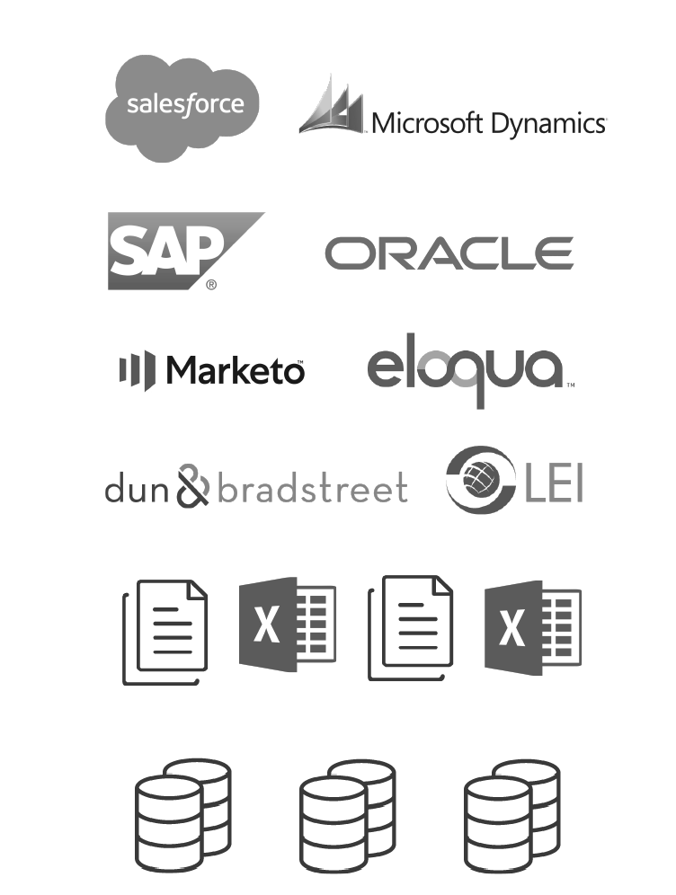
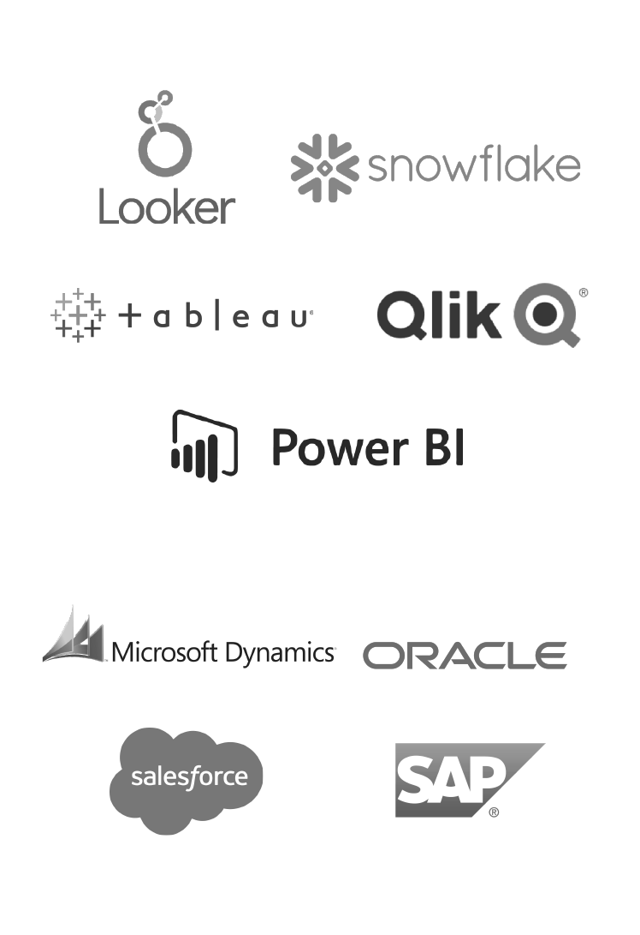

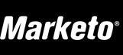



Data Mastering Drives Analytical and Operational Outcomes
Curation
Feedback
Enrichment
Publishing
Google
Mtn. View
CA, US
Google Inc.
1600 Amphitheatre Parkway
Mountain View
CA 94043
(650) 253-0000
www.about.google.com
Analytic Stores
Google Inc.
Palo Alto
CA
Alphabet
Operational Stores
Data Mastering: Human-guided machine learning
Notes:
Tamr’s cloud-native data mastering solutions offer a human-guided, ML approach to data curation, feedback, enrichment and publishing.
The output is high-quality, cleansed, mastered datasets that power analytical and operational use cases at scale.
Our philosophy is that machines do some things very well but that humans are irreplaceable. Tamr combines machine learning with subject matter expert input to train the model and rules (when it helps) to enable the machine to do the heavy lifting to generate curated mastered datasets at scale that align with the business needs.
Tamr ingests data from disparate data sources, and then leverages our human-guided machine learning approach to deliver analytics ready datasets:
Data Curation: Tamr combines disparate data sources by mapping differing data schemas (attributes and categories), such as in this example, where tables have different naming schemas like Name or Company, or CNA1. This process also includes matching and deduplicating records across thousands or millions of rows, generating a unique Tamr ID for golden records of customers or suppliers, and categorizing the data leveraging well-defined taxonomies to power analytical insights.
Data Feedback: Our data mastering workflow makes it easy to engage subject matter experts through simple yes or no questions to train the machine learning algorithms. The machine takes that human feedback as a signal for learning and applies it at scale so that all the delivered data meets their needs, not just what has been reviewed in detail.
Enrichment: With Tamr’s integrated data enrichment services, you can improve data accuracy about organizations (e.g., B2B customers, suppliers, and distributors) and people (e.g., B2C Customers). In this example, we have a unique record for Google Inc. comprised of the best sources across the organization, but sometimes the best data is in external sources -- and with Tamr you can leverage 1-click data enrichment for address, email and phone validation from external sources.
Publishing: Tamr offers an intuitive user interface that captures mastered data sets and key details about mastered records for core business entities (e.g., suppliers, parts, customers, etc…), and makes it easy to publish data to downstream cloud data stores for analytical use cases or operational needs.

Slide 6
Data Mastering Drives Analytical and Operational Outcomes
Curation
Feedback
Enrichment
Publishing
Google
Mtn. View
CA, US
Google Inc.
1600 Amphitheatre Parkway
Mountain View
CA 94043
(650) 253-0000
www.about.google.com
Analytic Stores
Google Inc.
Palo Alto
CA
Alphabet
Operational Stores
Tamr Core
Notes:
Tamr’s cloud-native data mastering solutions offer a human-guided, ML approach to data curation, feedback, enrichment and publishing.
The output is high-quality, cleansed, mastered datasets that power analytical and operational use cases at scale.
Our philosophy is that machines do some things very well but that humans are irreplaceable. Tamr combines machine learning with subject matter expert input to train the model and rules (when it helps) to enable the machine to do the heavy lifting to generate curated mastered datasets at scale that align with the business needs.
Tamr ingests data from disparate data sources, and then leverages our human-guided machine learning approach to deliver analytics ready datasets:
Data Curation: Tamr combines disparate data sources by mapping differing data schemas (attributes and categories), such as in this example, where tables have different naming schemas like Name or Company, or CNA1. This process also includes matching and deduplicating records across thousands or millions of rows, generating a unique Tamr ID for golden records of customers or suppliers, and categorizing the data leveraging well-defined taxonomies to power analytical insights.
Data Feedback: Our data mastering workflow makes it easy to engage subject matter experts through simple yes or no questions to train the machine learning algorithms. The machine takes that human feedback as a signal for learning and applies it at scale so that all the delivered data meets their needs, not just what has been reviewed in detail.
Enrichment: With Tamr’s integrated data enrichment services, you can improve data accuracy about organizations (e.g., B2B customers, suppliers, and distributors) and people (e.g., B2C Customers). In this example, we have a unique record for Google Inc. comprised of the best sources across the organization, but sometimes the best data is in external sources -- and with Tamr you can leverage 1-click data enrichment for address, email and phone validation from external sources.
Publishing: Tamr offers an intuitive user interface that captures mastered data sets and key details about mastered records for core business entities (e.g., suppliers, parts, customers, etc…), and makes it easy to publish data to downstream cloud data stores for analytical use cases or operational needs.

Slide 7
Data Mastering Drives Analytical and Operational Outcomes
Curation
Feedback
Enrichment
Publishing
Google
Mtn. View
CA, US
Google Inc.
1600 Amphitheatre Parkway
Mountain View
CA 94043
(650) 253-0000
www.about.google.com
Analytic Stores
Google Inc.
Palo Alto
CA
Alphabet
Operational Stores
Tamr
Notes:
Tamr’s cloud-native data mastering solutions offer a human-guided, ML approach to data curation, feedback, enrichment and publishing.
The output is high-quality, cleansed, mastered datasets that power analytical and operational use cases at scale.
Our philosophy is that machines do some things very well but that humans are irreplaceable. Tamr combines machine learning with subject matter expert input to train the model and rules (when it helps) to enable the machine to do the heavy lifting to generate curated mastered datasets at scale that align with the business needs.
Tamr ingests data from disparate data sources, and then leverages our human-guided machine learning approach to deliver analytics ready datasets:
Data Curation: Tamr combines disparate data sources by mapping differing data schemas (attributes and categories), such as in this example, where tables have different naming schemas like Name or Company, or CNA1. This process also includes matching and deduplicating records across thousands or millions of rows, generating a unique Tamr ID for golden records of customers or suppliers, and categorizing the data leveraging well-defined taxonomies to power analytical insights.
Data Feedback: Our data mastering workflow makes it easy to engage subject matter experts through simple yes or no questions to train the machine learning algorithms. The machine takes that human feedback as a signal for learning and applies it at scale so that all the delivered data meets their needs, not just what has been reviewed in detail.
Enrichment: With Tamr’s integrated data enrichment services, you can improve data accuracy about organizations (e.g., B2B customers, suppliers, and distributors) and people (e.g., B2C Customers). In this example, we have a unique record for Google Inc. comprised of the best sources across the organization, but sometimes the best data is in external sources -- and with Tamr you can leverage 1-click data enrichment for address, email and phone validation from external sources.
Publishing: Tamr offers an intuitive user interface that captures mastered data sets and key details about mastered records for core business entities (e.g., suppliers, parts, customers, etc…), and makes it easy to publish data to downstream cloud data stores for analytical use cases or operational needs.

Slide 8





Solutions to Accelerate Outcomes at Unprecedented Scale
Drive Growth, Reduce Risk, and Lower Costs
Dozens of data silos, hundreds of attributes, millions of records, changing business requirements, and manual reconciliation rules-based processes. Humans alone can’t keep up to provide a single customer view.
Tamr’s solutions offer a 90% reduction in manual development and curation processes.
Customer Data Mastering
Supplier Data Mastering
Products, Parts, Materials Mastering
Spend Analytics
Cloud Migration
Mergers & Acquisitions
Notes:
Built on top of our platform are data mastering solutions to solve the toughest data challenges, and are key to driving growth strategies and lowering costs. For B2B organizations, we always begin with customer data as it delivers extraordinary value quickly. With curated 360 views of customers, companies like Google and Santander are better positioned to power growth strategies, and it serves as the foundation for mastering additional business-critical data entities, such as suppliers, giving you a more complete picture of demand to align with supply. With product mastering, companies like Johnson and Johnson improve visibility into product assets and streamline go-to-market activities. And for Thermo Fisher and other Tamr customers, the ability to categorize spend data at an extremely granular level has resulted in unprecedented cost savings.
For customer data, with dozens of data silos and millions of records, along with constantly shifting business requirements, humans can’t keep up with providing a single customer view. Ultimately, Tamr’s data mastering solutions offer a 90% reduction in manual development and curation processes compared to traditional MDM systems, making the ability to connect all of this enterprise data a reality.

Slide 9






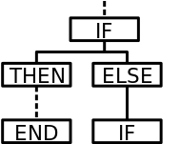





Customer Data: Choose Your Own Adventure
CORE DATA CHALLENGES
ATT
Dallas, Texas
Website: null
Unification
Quality
Relationship
Mapping
?
AT & T
208 Akard St, Dallas
Bellsouth.com
Enterprise Swampland
Departmental Wild Wild West
Data Lakes
Remained data swamps
Sales CRM plugins & one-off cleans
Governance nightmare
PATH
Failed to meet flexibility & accuracy needs
Marketing Customer Data Platforms
Duplicate, inaccurate records
Rules-based MDM
Finance & Risk ERP integrations & migrations
Restricted data structure
1 out of 3 isn’t terrible
Unified but couldn’t meet the quality and classification needs of the business
Unlimited Silos
Disjointed customer views, multiplied across analytics applications
RESULT

Slide 10
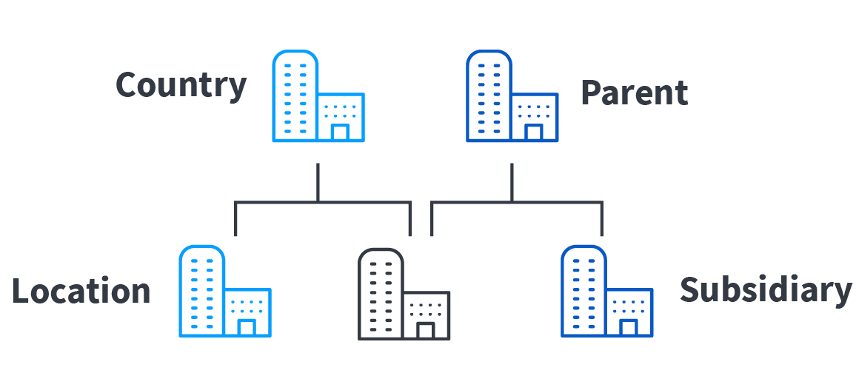


Tamr Masters Data for How You Manage Customers
Human-Guided Machine Learning
Human-Guided Machine Learning
360° View of Organizational Customers
Tamr ID
Persistent ID that gives a connected, golden record view of customers across systems
Hierarchy Mastering
Customer classification flexibility, from sites to regions to corporate structure
Enrichment
Built-in capability to enhance & verify key customer information through third party sources
Human-Guided Machine Learning
Improved Match Accuracy
Increased trust in the accuracy of customer data through human guided ML
Lower Total Cost of Ownership
90% reduction in manual effort vs. rules based approaches
Scale & Flexibility as Needs Change
Built to be Interoperable with a cloud-first, best of breed approach to architecture
Notes:
Marketing would focus on CDPs only
Sales focus on Salesforce

Slide 11


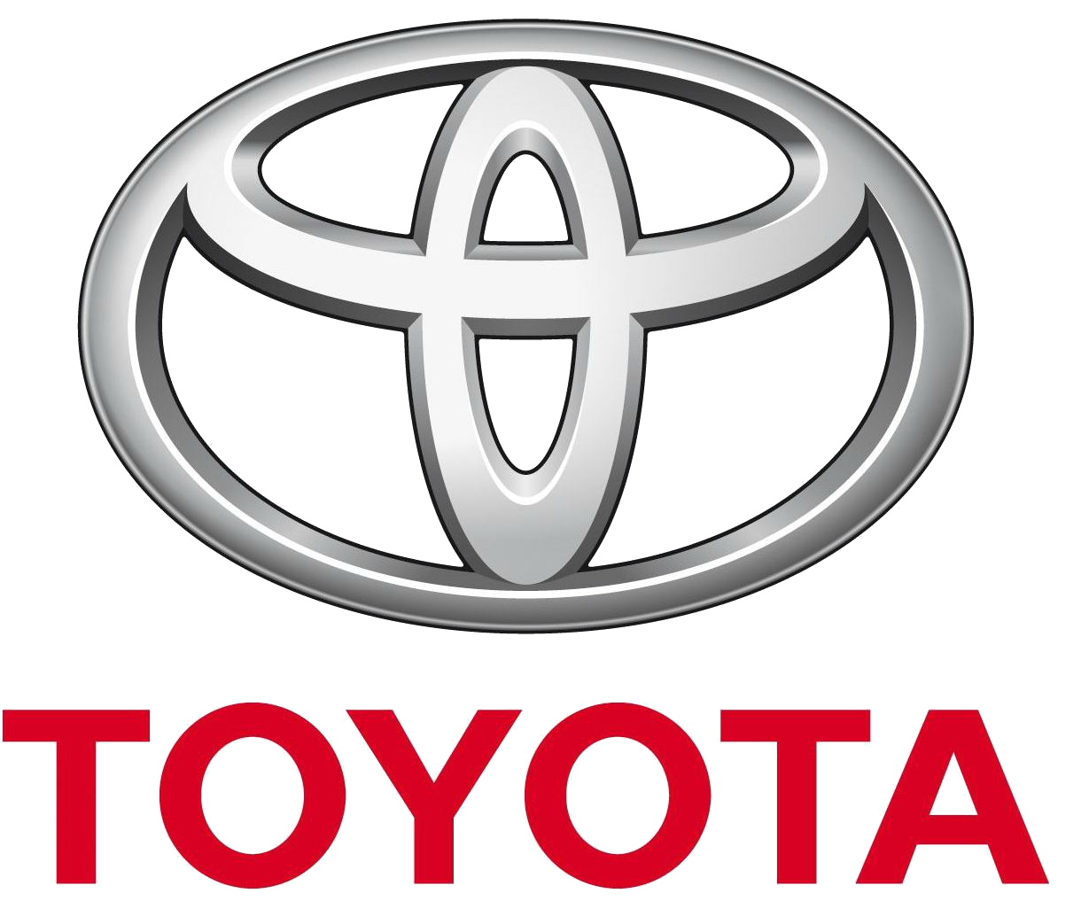

Delivering Business Outcomes
Leveraging mastered customer data to drive growth, reduce risk, and lower spend.
Financial Services
High Tech
Manufacturing
Entertainment
KYC / AML
Lowered risk and streamlined compliance reporting by matching millions of customer records across 30 data sources in under 6 mos.
Distributor Mastering
Improved sales pipeline velocity by generating unique, comprehensive records for global distributors.
Customer 360
Unified buyer profiles across dealership systems in 30+ geos to improve customer experience.
Client Experience
Connect internal client data with external datasets to uncover talent opportunities.
Tamr’s dedicated domain experts accelerate time-to-value and increase adoption across the enterprise.
Notes:
Tamr works with the largest organizations in the world to solve several business problems that tie to the need for timely, high quality customer data.
Our domain experts support several solutions for private and public sectors that improve customer experiences and boost marketing and sales performance.
One of our customers, Analog Devices, used Tamr to drive a 50% increase in the match rate of sales leads to existing accounts within 2 weeks, improving lead response time and accelerating sales pipeline.

Slide 12
Steps To Deliver Customer Success
Discovery
Understand the strategic priorities for the business for data mastering
and how Tamr aligns to those goals to deliver value
Solution Design
Align on how Tamr’s solutions – technology, architecture,
use cases and demo – can be applied to solve the core challenge
Preliminary Business Case
Outline of the quantified business impact of solving your challenges
Technical Scoping
Carry out a technical proof point to show Tamr’s impact on your data
Business Value & Technical Results Presentation
Business and technical results are presented
to the key decision makers
Finalize Proposal
Commercial terms are made, reviewed
and executed. Implementation begins
Notes:
This is an overview of our sales cycle that begins with a clear understanding of the top business priorities which we will align on throughout the process and ensure that all of our work, from demo to implementation, is focused on the key value drivers. As a next step, I recommend that we engage the appropriate technical and business stakeholders to determine the top business priority that requires high quality customer data, define the optimal data mastering solution to meet the business case, and then we will carry out a technical proof point -- such as a custom demo -- to see your data in action.

Slide 13
Appendix

Slide 14



“Accomplished what no
other tool could”
Customer reviews:
Excellent overall experience. Truly easy to integrate and expand. I really enjoyed the teamwork and collaboration. A+
4.9
Master Data Management Solutions
Excellent UI and workflow + human-in-the loop ML = Happy Customer
Very positive experience in data unification, data cleansing and golden records mastering at scale in short period of time
The product is best in class
A sophisticated AI platform that also leverages human smarts to tackle big data mastering
August 2021
very positive experience in data unification, data cleansing and golden records mastering at scale in short period of time.

Slide 15

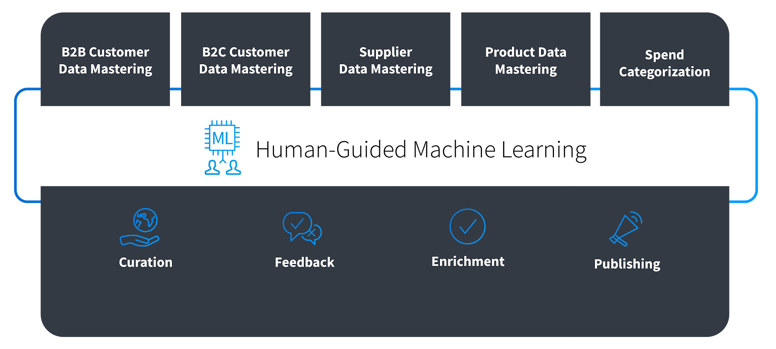
Next-Gen Cloud-Native Data Mastering
Data Mastering Solutions
✓ 90%+ accuracy for record matches
✓ Reduce manual workflows by
up to 90%
✓ Match millions of records in weeks
✓ Derive value from thousands of internal & external sources
Data Mastering Platform
Map schemas, generate golden records, categorize & transform data
Engage SMEs with intuitive feedback workflows for ML
Integrated data enrichment from third party sources
Map schemas, generate golden records, categorize & transform data
Engage SMEs with intuitive feedback workflows for ML
Integrated data enrichment from third party sources
Publish curated datasets to cloud data stores
Cloud-Native Capabilities
Notes:
Data Curation: Tamr combines disparate data sources by mapping differing data schemas (attributes and categories), matching and deduplicating records across thousands or millions of rows, generating a unique Tamr ID for golden records of customers or suppliers, and categorizing the data leveraging well-defined taxonomies to power analytical insights.
Data Feedback: Our data mastering workflow makes it easy to engage subject matter experts through simple yes or no questions to train the machine learning algorithms. The machine takes that human feedback as a signal for learning and applies it at scale so that all the delivered data meets their needs, not just what has been reviewed in detail.
Enrichment: With Tamr’s integrated data enrichment services, you can improve data accuracy about organizations (e.g., B2B customers, suppliers, and distributors) and people (e.g., B2C Customers) with 1-click address, email, and phone validation.
Publishing: Tamr offers an intuitive user interface that captures mastered data sets and key details about mastered records for core business entities (e.g., suppliers, parts, customers, etc…), and makes it easy to publish data to downstream cloud data stores.
Cloud-first, designed and architected to maximize leverage from cloud components for scalability.

Slide 16
Solutions to Accelerate Outcomes at Unprecedented Scale
Drive Growth, Reduce Risk, and Lower Costs
Customer Data Mastering
Golden record with unique Tamr ID for each customer, hierarchy management, integrated 3rd party data enrichment
Supplier Data Mastering
Mastered supplier data with unique Tamr ID, address and phone validation, and hierarchy management
Products, Parts, Materials Mastering
Consolidate product, parts, or materials data from ERP systems, and categorize them at an extremely granular level
Spend Analytics
Categorize global spend leveraging internal or external taxonomies for unprecedented views into spend
Cloud Migration
Mergers & Acquisitions
Notes:
Built on top of our platform are data mastering solutions to solve the toughest data challenges, and are key to driving growth strategies and lowering costs. For B2B organizations, we always begin with customer data as it delivers extraordinary value quickly. With curated 360 views of customers, companies like Google and Santander are better positioned to power growth strategies, and it serves as the foundation for mastering additional business-critical data entities, such as suppliers, giving you a more complete picture of demand to align with supply. With product mastering, companies like Johnson and Johnson improve visibility into product assets and streamline go-to-market activities. And for Thermo Fisher and other Tamr customers, the ability to categorize spend data at an extremely granular level has resulted in unprecedented cost savings.
For customer data, with dozens of data silos and millions of records, along with constantly shifting business requirements, humans can’t keep up with providing a single customer view. Ultimately, Tamr’s data mastering solutions offer a 90% reduction in manual development and curation processes compared to traditional MDM systems, making the ability to connect all of this enterprise data a reality.

Slide 17
Tamr’s Core Data Mastering Capabilities
Schema Mapping
Record Matching (Dedupe)
Record Mastering
Categorization
Source 1: Vendor_Name
Should “Husky #.25 J Blt”
in table “Invoices” be categorized as
“Hardware > Fasteners > Bolt”?
Unified Name
Husky Manufacturing
342 Suite 34
KY
Allied Husky Incorporated
342 Main St
KY, USA
IBM | Way | (+1) 1234
IBM Corp. | Way Str | 001 1234
I.B.M. | Way Str | 01234
Source 2: Supplier
=
Source 3: LFA1-MANDT
Supplier Name
or
Source 4: CompanyNm
Source n: Nom_de_Cie
IBM | Way Str | 01234
Extract signals from underlying data to drive mastering decisions
Increase levels of mastering automation as sources increase
Automatically group similar records using machine learning
Gather expert feedback easily and quickly for maximum accuracy
Consolidate clusters to be represented as a single entity
Specify golden rules for each attribute and create golden rules
Automatically map records into any taxonomy
Leverage standard or custom n-tier categorization scheme
Data Enrichment
X
✓
Enrich data with external sources directly from Tamr to boost signals to the ML algorithms
1-click address, email, and phone validation
ATT
Dallas, Texas
Website: Null
AT&T
208 S Akard St,
Dallas, Texas
75202-4206
www.att.com
Notes:
Here we briefly introduce a few of the core capabilities of the system, each of which relies on our approach of using machine learning and expert input to achieve the best possible outcome.
Schema mastering COMBINES disparate data sources through a process that leverages machine learning and expert input to efficiently align columns in data sources into a master schema. In the pharmaceutical sector, this capability has been pushed to extremes by customers like GSK and Amgen who are combining thousands of clinical studies with millions of columns into a single unified schema. Performing schema alignment at this scale is beyond the limits of what humans could do alone, and Tamr’s machine-learning powered approach has enabled the vast majority of this work to happen automatically.
Record matching, of large scale data from disparate sources uses active machine learning to quickly generate a single, trustworthy, unified view of a unique entity, such as a customer or a supplier. Tamr customers like Toyota, and Scotabiank, use Tamr to combine many data sets with extensive duplication and overlap resulting in 10s to 100s of millions of clean, clear, complete customer, supplier and part records. You can think of it as agile data mastering without all the heavy MDM overhead.
Record mastering consolidates the clusters into GOLDEN RECORDS, unifying each entity into a single representation for use in downstream systems. In combination with Tamr’s powerful record matching, Golden Records provides the complete, accurate data required to help your organization truly understand customers, suppliers or other entities.
CATEGORIZATION maps records to taxonomies to facilitate understanding and analysis. Tamr can utilize industry standard taxonomies, taxonomies generated by other systems, or can suggest a taxonomy based on a combination of machine learning and expert input. It’s here that our work in Procurement Analytics with customers like Societe Generale, J&J, and Carnival has really played a major role in powering analytics to tame spend.
DATA ENRICHMENT With Tamr’s integrated data enrichment services, you can improve data accuracy about organizations (e.g., B2B customers, suppliers, and distributors) and people (e.g., B2C Customers). Our first release includes 1-click address, email, and phone validation. These integrated enrichment capabilities not only reduce spend on third party APIs, but can also boost signals to the ML models, in some cases increasing ML efficacy by 50% immediately.
The output from Tamr is clean, curated, versioned data that powers a host of downstream uses such as data visualization tools like Sagemaker or QuickSight, or for data scientists or wranglers to use in analysis, or to power custom apps like customer 360 pages, and programmatic or operational integration using Tamr’s APIs.

Slide 18
Customer Case Studies

Slide 19


Use Case: Customer Mastering for B2B Sales
Mastered customer data from direct & indirect channels to enable on-demand analytics & insight into the corporate hierarchies of customers, creating opportunities for upsell and cross-sell across accounts
Challenge
Solution
Impact
Low quality and inconsistent data capture by distributors limited visibility into customer accounts
Limited visibility into the corporate relationship across accounts, preventing upsell
Unable to tie sparsely populated quote information to transactions to monitor fulfillment
Unified data from 1.4M customer accounts to reveal the underlying 0.5M unique customers through golden records
Generated persistent IDs as primary identifiers in SAP Business Warehouse & linked accounts to corporate parents
Created a repeatable pipeline to tie their approx. 0.8M quotes to ~5M transactions for fulfillment monitoring
Advanced from one-off reports to on-demand analytics to analyse sales pyramids and churn reports
Ability to prioritize top accounts & identify upsell opportunities by consistently tracking performance
Insight into channel performance to better inform distributor exclusivity rights
Multinational conglomerate
Financial data provider
Unified distributor data to customer accounts and quotes to orders to drive cross-channel upsell for key customer accounts

Slide 20


Use Case: Customer Mastering for B2B Sales
Accurately matched leads to existing accounts to drive cross-sell and upsell account strategy, while reducing reliance on costly, slow third party match services
Challenge
Solution
Impact
Struggled to match new leads to existing accounts with only 36% of leads matched to corporations
Slow & costly third-party vendors (D&B, Pitney Bowes Spectrum) reduced prospect response time
Difficulty handling mix of customer languages with a large proportion of data in Chinese and Japanese
Machine learning based approach drove a 50% sales lead match increase within the first 2 weeks
Removed or significantly reduced the reliance on third parties by improving in-house enrichment capabilities
Leveraged Google translate enrichment to tackle language challenges across locations
Drove cross-sell & upsell by leveraging existing relationship information to inform marketing strategy to leads
Improved lead response time from weeks to days and saved hundreds of thousands of dollars on third-parties
Achieved a global view of accounts to enable holistic contract management & inform negotiations with key accounts
Multinational conglomerate
Financial data provider
Drove a 50% increase in the match rate of sales leads to existing accounts within the first 2 weeks

Slide 21


Use Case: Data Mastering for Customer-360
Mastered customer data to enable faster loan approval and more informed credit decisions while addressing regulatory requirements
Challenge
Solution
Impact
Limited view of customers and exposure due to enterprise data silos
Slow lending decisions due to inability to reconcile disparate customer data silos
Multiple failed data remediation attempts with rules-based systems
Created complete, up-to-date customer views from 45 sources and 10s of millions of records in under 4 wks
Generated unique Tamr ID for each customer composed of corporate, retail, Salesforce, & global business data
Ability to cluster customer views into business-ready segments (e.g., by products, region)
Faster lending processes by cutting credit decision times in half with rollout of new lending system
Increased reliability of reporting data with unified data feeds for financial, credit risk & regulatory reporting
Empowered sales for cross-sell opportunities with holistic view of customers across divisions and products
Multinational conglomerate
Financial data provider
Cut lending processing time in half with new lending system powered by single, complete customer views from 45 data sources
Notes:
Before, Santander struggled with slow lending decisions due to a lack of unified views into their customers; both existing and new. Data was siloed across 45 different sources, and there were multiple failed attempts at reconciling these data silos with rules-based systems.
With Tamr, Santander was able to Created complete, up-to-date customer views from 45 sources and 10s of millions of records in under 4 wks. This enabled them to successfully roll out a new lending system, which cut credit decision times in half, and also empowered sales teams for cross-sell opportunities w/ a unified view of customers across divisions and products.

Slide 22
Use Case: Data Mastering for Customer-360
Mastered customer data to enable faster loan approval and more informed credit decisions while addressing regulatory requirements
Santander Customer Digital Architecture
Customer Digital Services
Onboarding, Servicing,
Products Portals
Customer Relationship Management (CRM)
Salesforce
Document Production & e-Signing
SpringCM + DocuSign
Decisions, Workflow & Operating System
nCino
Single customer view powered by Tamr data mastering
“Data mastered by Tamr underpins the entire digital journey - if we didn't have the single customer view, we wouldn't be able to feed information downstream into decision and risk engines”
Jonathan Holman
Head of Digital Transformation, Santander
Notes:
How Tamr helped
-- Santander UK is confident that when undertaking due diligence or credit risk or pricing activity that they understand the customer holistically and what services and products the customer buys from them, leading to upsell opportunities and lowers the risk of a customer defaulting on loan payments.
-- ML provides a scalable way to master data and lets the bank avoid the inefficiency associated with manual reconciliation. Before data mastering, data analysts had to manually approve tons of exception reports for duplicate customer records that Jonathan’s team wanted to condense into one record. With Tamr, ML handles most of the recording matching and greatly reduces the number of exception reports for duplicate records.

Slide 23
Top 10 Contract Research Organization (CRO)
Use Case: Data Mastering for Customer-360
Unified customer data across lines of businesses to better understand consumer behaviors and increase sales
Challenge
Solution
Impact
Lack of global view on business customers hindered sales and marketing opportunities
Breaking down data silos and unraveling hierarchical relationships to obtain 360 view of customers across the enterprise
Manual approach to data mastering proved time consuming
Use machine learning to master customer data at scale and reduce manual work
Use cloud-native technology to leverage flexibility, scalability of AWS and control data mastering costs
Avoid MDM solutions that require extensive rule writing
Increased customer data quality across multiple lines of business
Realized cost savings by replacing manual processes
Generated better visibility into customer behavior by leveraging mastered product data
Improved customer insights across lines of business with better visibilities of customer relationships across systems

Slide 24



Use Case: Clinical Trials Data Repository
Accelerating R&D Outcomes with Unified Historical Clinical Trials
Challenge
Solution
Impact
Breaking down data silos for clinical analysis to accelerate R&D outcomes
Lack of unified view of historical trials data to power new drug discovery
Minimal use of CDISC standards across historical data inhibited cross-trial analytics
Converted 1000+ legacy studies into SDTM data models in under a year with a pipeline that processes 10 billion records/day
Converted over 30 billion real world data records into OMOP standards to enrich clinical analytics
Reconciled over 1,000 historical trials into an analytics-ready data repository in under a year
Accelerated drug discovery processes with improved cross-study analytics
Created time-saving, repeatable pipeline for reconciling assay, clinical and genetics data with human-guided machine learning
Control data mastering costs by using cloud-native technology to leverage flexibility, scalability of Microsoft Azure
Converted 1000+ legacy studies into SDTM data models and over 30 billion real world data records into OMOP
Notes:
Use case: Clinical trial mastering
GSK challenges
-- R&D data was too siloed and fragmented to be used effectively for exploratory analysis around developing new drugs.
-- GSK had millions of data elements to master and manually mastering this data would take too much time and effort.
-- Here’s a Forbes article about GSK’s use if Tamr: https://www.forbes.com/sites/tomdavenport/2018/01/08/biting-the-data-management-bullet-at-glaxosmithkline/#778530055577
How Tamr helped
-- Allowed GSK to master millions of source attributes across more than 40,000 sources of clinical trial data.
-- Allowed GSK to expand use cases for its R&D data from 10 to 250.
-- Mastered clinical trial data is helping GSK accelerate the drug discovery process.

Slide 25


Use Cases: B2B Customer Mastering
Mitigating operational risk by creating a single source of client data
Challenge
Solution
Impact
No single, authoritative source of client data across Global Banking and Market
Rules-based solution unable to accommodate all customer data across disparate systems
Legacy system doesn’t scale with data volume and variety increases
Unified client data across multiple systems and optimized to scale
Replace rule-based solution with human-guided machine learning solution
Establish an automated, repeatable process for rapidly onboarding new data sources
Mitigate operational risks across business units in wholesale banking
Empower business users by supporting data consumption across multiple systems
Improve the quality, accuracy and speed of distribution of client reference data
Establish a single, authoritative client data source across GBAM to accurately identify legal entities and mitigate operational risks

Slide 26


Use Cases: Supplier Mastering, Spend Analytics
Achieved first-ever unified view of up-to-date global spending while reducing manual data preparation by 90%
Challenge
Solution
Impact
Legacy, rules-based solution unable to scale and accommodate all spend data
Existing ERP add-on system too expensive to maintain and support
High security and infrastructure requirements with tight implementation timeline
Master supplier data leveraging human-guided machine learning
90% reduction in manual data preparation
Significant increase in analytic adoption and trust with 80%+ accuracy of classification
Drove procurement savings by generating accurate views of the company’s spend for 300+ user groups in 3 months
Allowed IT staff to focus on higher value projects instead of data preparation
New data sources added in 5 days instead of 60 days for faster time to value
Achieved first-ever unified view of up-to-date global spending with 90% reduction in manual data preparation

Slide 27


Use Case: Know-your-customer (KYC)
Enabled the bank to create a single profile of every customer across dozens of jurisdictions, providing the foundation for regulatory compliance and reporting efficiency
Challenge
Solution
Impact
Separate data instances with high heterogeneity because of sovereignty requirements and inorganic growth inherits data across jurisdictions
Large volume of data measured in petabytes, with increases in columns and relationships
Unreliable data quality with wildly varying degrees of data formats and completeness across multiple systems
High-scale ML clustering of customer records taking input and curation by human SMEs to train the model
Multiple golden records created with Hive DB integration and ability to cluster and create unified IDs at multiple levels
Custom confidence level and manually adjustable output to account for complicated business scenario and inconsistency
Reduced risk of error, improved compliance by mastering across 35 systems with ~4M entities
Hierarchies for sales, risk and legal enabled customized views at different levels depending on business needs
Cutting time to required to onboard a new system from months to days with unified customer data kept up-to-date through daily remediation
Effectively cutting regulatory reporting cycle with improved risk management and customer experience
Notes:
Use case: KYC
Scotiabank’s challenges
-- Customer data at Scotiabank lived in hundreds of data silos.
-- This siloed data limited Scotiabank’s ability to comply with regulatory KYC requirements.
-- Scotiabank wanted customer golden records to more effectively meet regulatory requirements, improve risk management and the customer experience.
How Tamr helped
-- Tamr is helping Scotiabank master millions of U.S. and global customer records to create golden records.
-- Tamr potentially saved Scotiabank millions of dollars in fines by enabling compliance with regulatory requirements.
-- Tamr enabled cross-usage of data sources among different groups within the bank, helping Scotiabank better use this data.

Slide 28
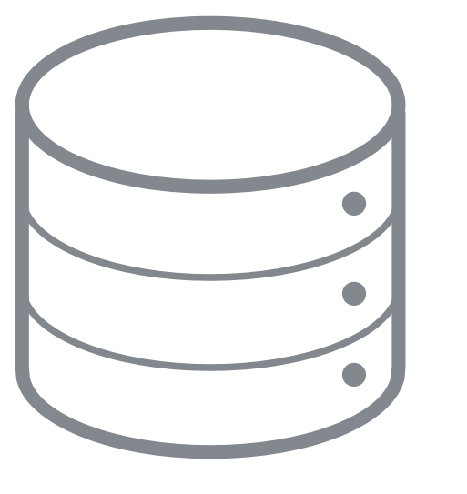



Use Case: Know-your-customer (KYC)
Enabled the bank to create a single profile of every customer across dozens of jurisdictions, providing the foundation for regulatory compliance and operational efficiency
Data Sources
Tamr Data Mastering
Distribution
Users
Onboarding
Compliance
Analytics
Schema Mapping
Consolidate & combine data sources
Data Mastering
Accurate, up-to-date golden records
Apache Hive DW
Onboarding
Transactions
Reference data
Funds, accounts
Human-guided
machine learning
6 months from project kick-off to downstream consumption of certified results
“We chose Tamr’s probabilistic machine learning model approach versus
traditional rules-based as a way to accelerate project implementation.”
Dan Waldner
Director of Customer Data,
Scotiabank

Slide 29



Use Case: Product Mastering
Unified consumer product sales data to better understand consumer preferences and increase sales
Challenge
Solution
Outcomes
Lack of global view on consumer products hindered sales and marketing opportunities
Breaking down data silos and combining hundreds of product data sources
Manual approach to data mastering proved time consuming
Use machine learning to master product data at scale and reduce manual work by thousands of hours
Create complete, or golden product records, for granular product sales views across countries
Improved consumer product sales strategies and marketing campaigns
Realized cost savings by replacing manual processes
Generated better visibility into global product base by leveraging mastered product data
Establish an automated, repeatable process for rapidly onboarding new data sources
Boosted sales and improved marketing opportunities with a global view of consumer product sales
Notes:
Use case: Product mastering
Johnson & Johnson challenges
-- Lacked a unified sales of view of consumer products.
-- Wanted to master external and internal sales data and distributor data to improve sales of consumer products.
-- The volume and variety of data made mastering challenging. There were internal data sources, thousands of global retail partners and third party enrichment sources.
-- Manually mastering this data was a time-consuming and slow process.
How Tamr helped
-- Johnson and Johnson considered an MDM but decided Tamr’s human guided machine learning offered advantages in time-to-value, scalability, & flexibility.
-- Mastered data allows Johnson and Johnson to better understand sales performance and customers’ preferences, generating increased sales.

Slide 30

Use Case: Spend Optimization
Better manage global spend by increasing the accuracy of
spend classification data
Challenge
Solution
Outcomes
Spend data came from 75 ERP systems and prevented classification at a granular level
Rules-based system required management and maintenance of 300,000 rules
Data quality issues made obtaining accurately classified spend data difficult
Machine learning enables continuous improvement of spend data with minimal overhead and manual effort
Provide trusted data to visualization tools to improve effectiveness of spend analytics
Better visibility into billions of dollars of annual spend across the organization
Delivered more granular and accurate spend data in 3.5 months
Drive common sourcing strategies across groups for better pricing
Delivered more granular and accurate spend data in 3.5 months
Notes:
Use case: Spend classification
ThermoFisher’s challenges
-- Disparate data sources with varying standards made it difficult to obtain accurately classified spend data.
-- ThermoFisher has almost 100 ERP systems producing millions of records annually.
-- Adding new data was an extremely manual & time consuming process.
-- Data volume was an issue. ThermoFisher added hundreds of thousands of new records each month.
-- Data quality was an issue. Some parts had ambiguous descriptions, there was duplicate data, some manufacturer part numbers weren’t in the ERPs and the same items were classified differently.
How Tamr helped
-- Allowed ThermoFisher to create a global, unified view of spend classification to better track, analyze and manage spend,
-- ThermoFisher can take advantage of strong supplier relationships to drive better pricing.
-- ThermoFisher can better enforce corporate level policies for spend compliance.
ncrease the accuracy and trustworthiness of its spend classification data, ensuring global spend across the enterprise can be better managed and analyzed.

Slide 31

Use Case: Customer Mastering
Improving post-sales outreach, increasing upsell
opportunities with complete customer records
Challenge
Solution
Outcomes
Incomplete, duplicate customer records complicated upsell opportunities and post-sales customer service
Legacy MDM tool failed to scale with data variety and generate useful, accurate records
Quickly generating accurate customer views to fuel a new ERP system
Created complete, up-to-date customer views from millions of records and multiple ERPs in weeks
Identified 2 times the number of duplicate customer records compared to the legacy MDM solution
Power digital transformation initiatives (e.g. ERP migration) with accurate customer views
Develop personalized marketing campaigns to increase revenue from existing customers
Improved customer service by offering relevant product training courses post-sales
Reduced product shipping errors to improve distribution
Expanding use of Tamr to include product mastering
“I'm amazed by the speed at which Tamr can dedupe customer data. The time to market was in weeks rather than months.” -- Dinny Mathew, Senior Director of Enterprise Architecture, Data and Analytics, Avid

Slide 32


Use Case: Parts Mastering
Drive cost savings through supply chain optimization
Challenge
Solution
Outcomes
Breaking down data silos to create a global view of part inventory
Negotiating better prices for parts with key suppliers
Reducing maintenance costs by improving visibility into part performance
Created a golden databases for each class of ships containing an inventory of all parts stored on those vessels
Created a golden database containing an inventory of all parts stored on a global fleet of more than 100 vessels
Mastered millions of parts records from more than 70 ERP systems in weeks using machine learning
Drove hundred of millions of dollars in cost savings by utilizing existing inventory, improving supplier negotiations, & purchasing parts that require fewer repairs
Resolve potential maintenance issues before parts failed
Justified spend on more expensive parts by showing they performed better
Drove hundreds of millions of dollars in cost savings with golden databases containing mastered parts data
Notes:
Use case: Parts mastering
Carnival challenges
-- Grew by acquiring multiple cruise lines.
-- Buying other companies meant data silos across Carnival Corp.
-- Here’s a sense of the data challenge: 1.4 million parts to track, across more than 100 ships sailing around the world, more than 50 different ship management systems storing data, data was in different formats, data quality varied.
-- Each ship carries hundred of millions of dollars of parts and across the entire fleet there are 1.5 million spare parts.
-- Carnival wanted to master parts and components data to save money by better negotiating with key suppliers, use parts that had fewer maintenance issues, and using parts it had instead of buying them.
How Tamr helped
-- Allowed Carnival to create a golden database for each ship by cleaning up data. These database will be added to another Carnival Corp.-wide database. This is an ongoing project.
-- Carnival has a better supply chain, allowing it to better use parts. Instead of spending millions on a new part, it can see if a ship in the fleet has the part and send it to the ship that needs it.
-- Carnival knows what parts perform better and breakdown less frequently, decreasing maintenance costs and the hassle of repairing and replacing broken parts. And Carnival can justify the cost if better performing parts cost more since they’ll have lower maintenance costs.
-- At scale, parts mastering will save Carnival millions. Carnival won’t allow us to say the actual number but the projects figure is several hundreds of millions of dollars.
-- This blog has more details and quotes: https://www.tamr.com/blog/how-carnival-sailed-toward-global-data-alignment/

Slide 33


Use Case: Customer 360
Modernized their master data management approach with Tamr’s cloud-native data mastering solutions to curate customer data from disparate data sources and boost B2B sales and marketing initiatives
Challenge
Solution
Impact
Outdated and incomplete customer data slowed marketing initiatives and disrupted sales operations
Correcting single customer data records took months due to manual coding required to adjust rules systems
High total cost of ownership due to dozens of highly-skilled resources required to maintain rules
Created complete, up-to-date customer views from millions of records across 11 Salesforce & operational data sources
Generated unique Tamr ID for each customer, removing the 40% duplication identified between Salesforce and systems
Ability to cluster customer views into business-ready segments (e.g., by territory, industry)
Improved marketing efficacy by powering campaign systems with accurate, up-to-date customer data
Improved sales operations with unified customer views from Tamr powering Salesforce for global market segments
Enhanced customer experience initiatives with comprehensive data on B2B customers
Multinational conglomerate
Financial data provider
Improved marketing and sales operations with unified customer views from millions of records across 11 sources powering Salesforce and campaign systems
Notes:
Staples leverages Tamr’s cloud-native data mastering solutions to curate customer data from disparate sources and boost B2B sales and marketing initiatives.
Before, they leveraged a rules-based master data management approach to gathering customer and prospect data. They had dozens of highly skilled engineers and a dozen more business users to maintain the dataset, which was more often than not outdated or inaccurate. When a business user noticed duplicate or incorrect records in Salesforce, it would take months to update the data due to the manual coding required to adjust the rules system and push changes to production.
Initially, with Tamr, we were able to identify nearly 40% duplicate records across operational systems and Salesforce instances. With Tamr, they were able to curate millions of unique customer records from 11 sources -- both from Salesforce and operational data sources, and enrich that data in such a way that they were able to cluster and segment customer views to support marketing and sales ops by territory or industry.
The impact to the business and streamlining marketing and sales campaigns has elevated Tamr to a business-critical partner, and as they expand the data they master with Tamr, they plan to expand the use cases to customer experience initiatives with more targeted campaigns and beyond.

Slide 34

Use Case: Passenger-360 for Security
Since 2017, Tamr has helped the DHS master passenger data to screen against risk criteria for threat prevention, public health dangers and a variety of other use cases
US Department of Homeland
Security (DHS)
Challenge
Solution
Impact
Difficulty distinguishing/discerning one specific traveler from all others on an incoming flight
Slow vetting of high risk travelers such as foreign terrorists due to inability to reconcile data silos (both commercial and government)
Past efforts were manual and did not build traveler profiles quickly or over time
Created complete, up-to-date traveler views from manifests, reservations systems and various other country implemented systems
Generated unique Tamr ID for each traveler showing traveler’s full history, origination, embark point and destination to border control officers
Tamr allowed subject matter expertise to make informed decisions based on machine learning probability of match
Faster vetting processes allowing users to go from screening flights - one at a time - to vetting passengers hundreds at a time
US DHS offers GTAS as a free software license with installation tailored to partner country, technical support and training which strengthens our partnership with these nations.
Increased targeting by all partner countries increases security for all - DHS concept
Multinational conglomerate
Financial data provider
Expedited process to identify persons of interest coming into the US and partner nation borders

Slide 35




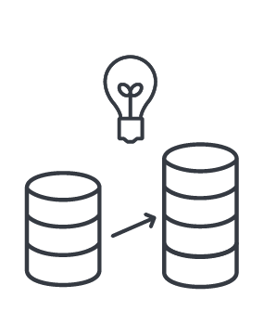



Use Case: Passenger-360 for Security
Since 2017, Tamr has helped the DHS master passenger data to screen against risk criteria for threat prevention, public health dangers and a variety of other use cases
US Department of Homeland
Security (DHS)
Global Travel Assessment System (GTAS): Passenger Data and Analytics
Tamr Recognition by DHS
Perform real time assessment
Receive and store air traveller reservations
Incorporate across multiple data sources
Query flight and travel history
Manage risk criteria and watch lists
Gain 360 visibility on high risk travellers for US and member countries
2019 Performer Award
Crossing the Valley of Death: technical transition success story
Inaugural Phase 5 Award for Government Solutions (June 2020)
“Successful development of a fast and accurate high-tech solution to screen international travellers will now be applied to other operational challenges”
Read more here
Risk criteria
Passenger Manifest
Travel Reservation
Intergovernmental
INTERPOL Exchanges
Phase 1 - Accuracy
Improve accuracy of entity resolution with biographical and reservation data
Phase 2 - Automation
Build data pipeline and automate data movement and system controls
Phase 3 - Performance
Optimize performance through a new low latency match service and reliable, robust communications
Phase 4-Interoperability
Ensure stability for deployment into variety of environments
“When we were looking for companies, Tamr fit our bill perfectly. They understood what we were trying to do, why it was important to international security, and they demonstrated the capacity to execute at a commercial level”
- Ari Schuler, Advisor, Office of the Commissioner
Notes:
Use case: Passenger 360
DHS challenges
-- Quickly and reliably Identifying passengers of suspect
-- Integrating information from multiple government (US and partner nations) and commercial systems
-- Manual effort to perform similar tasks often did not identify persons of interest until post entry
How Tamr helped
-- Using ML reduced manual integration efforts significantly
-- Speed up data integration efforts of reservation systems, manifests and other systems used by US and partner countries

Slide 36


Use Case: Supplier Data Mastering
Gained data insights into supplier relationships at site and intermediary level to better inform account management & significantly reduce external data enrichment costs
Challenge
Solution
Outcomes
Supplier data available at the global parent level only, restricting insights into brand, site & intermediary relationships
Expensive enrichment process with D&B with many suppliers left unmatched, resulting in high manual effort
Slow, end-of-quarter data clean up process that took 6 weeks and delayed access to actionable insights
Machine learning enables clustering of supplier records at multiple levels, beginning with site-level insights
Built-in enrichment capabilities to improve the quality of supplier records, reducing reliance on external providers
Integrated 25M transactional records into the mastering pipeline, taking, and feeding data to, Microsoft SQL
Insight into suppliers at more granular corporate levels to drive prioritization of supplier accounts
Achieved hundreds of thousands of pounds in enrichment cost savings by reducing D&B record requests by 75%
Significantly reduced manual effort of the analytics team on data clean-up by removing errors and edge cases
Reduced records sent to D&B from ~2.1M to ~500K, driving six-figure cost savings

Slide 37


Use Case: Customer 360
Generating millions of complete customer records in weeks for better upsell opportunities
Challenge
Solution
Impact
Legacy MDM solution slow to provide insight and value; after 5 years, a team of 60 mastered only 5 of 130 entities. Mastering accuracy was also questionable
Manual rules-based approach failed to scale with data volume and variety
Mastering additional entities with legacy MDM solution would have required substantial headcount increases and still taken years to deploy
Generated more than 3 million complete customer records in weeks using human-guided machine learning
Utilize cloud-native Azure deployment for fast and efficient processing of data at scale, generating results in weeks instead of months
Open API based platform and low latency matching capabilities allow seamless integration into customer’s data architecture
Drive customer upsell opportunities valued at several million dollars with complete customer records
Onboard new data sources in weeks compared to months with legacy rules-based MDM solution
Pursue supplier use case estimated to save millions of dollars by identifying key vendors and negotiating optimal pricing
Multinational conglomerate
Financial data provider
Generated more than 3 million complete customer records in weeks

Slide 38


Use Cases: Customer Mastering, Supplier Mastering
Adopted modern master data management solution to drive millions in supplier savings and customer upsell opportunities
Challenge
Solution
Impact
Integrating millions of customer and supplier records using manual, rules-based data mastering approaches
Improving marketing analytics to drive customer retention and identify upsell opportunities
Realizing cost savings by driving supply chain efficiencies
Adopt modern approach to MDM that uses human-guided machine learning
Create golden customer and supplier records by mastering millions of entities in weeks
Reduce manual data preparation by 80% with automation
Improve customer upsell opportunities by $10 million and increased operational efficiency by reducing manual workflows around consolidating marketing data
Drive $17 million in cost savings with improved contract negotiations, optimized repair maintenance plans, better inventory management
Drive millions in cost savings and upsell opportunities with integrated customer, supplier records
Notes:
Boeing, a Tamr customer since 2018, recently renewed its contract and will soon be deploying our solution in their Google Cloud environment.
Boeing’s use cases are mainly focused on mastering customer and supplier data. Clean, accurate data in golden customer records allows Boeing to improve marketing campaigns and boost upsell opportunities by an estimated $10 million. And golden supplier records will drive an estimated $17 million in cost savings by providing an accurate view of key suppliers for better contract negotiations and inventory management.
Given the millions of data entities involved, a manual, rules-based approach wouldn’t scale. Using the capabilities of Google Cloud along with machine learning powered by Tamr will provide faster time to value and help Boeing bridge the gap between data and analytic outcomes.

Slide 39


Massachusetts Executive Office of Education
Use Case: Customer Mastering
EOE uses Tamr to create golden records and obtain a 360-degree view of the people and organizations served across all agencies, allowing EOE to improve its services.
Challenge
Solution
Impact
Siloed, disparate data prevented EOE from obtaining a deep understanding of the people and organizations it works with
A bad experience using a legacy, rules-based data mastering product that had a steep learning curve
Different entities and lack of visibility of relationships across entities
System workflow limitations that drove users to create duplicate records to achieve short-term goals
Created golden records for people, organizations, and addresses by unifying hundreds of thousands of records
Used machine learning to improve data quality by identifying duplicate and incomplete records
Used Tamr’s persistent cluster IDs to create unique EOE IDs for people and organizations, replacing existing student and education professional identifiers
Demonstrated fast time to value by establishing a repeatable pipeline six months into the project
Established a data publishing service to supplement or augment Mass EOE application data based on the golden records
Enabled analysts and researchers to make evidence-based policy decisions
Micro-targeted populations to better allocate scarce resources
Leveraged 360-customer views to anticipate and recommend services
“Tamr has allowed us to better understand how our various data sources intersect with each other. It provides the means to creatively experiment and iterate, rapidly deepening our understanding and pinpointing the source system data inconsistencies.” - Ed Anderson, Business Analyst, EOE

Slide 40


Blackstone is one of the world’s leading investment firms, managing over $500bn in assets
“Ultimately how I was led to engage with Tamr was our MDM project and understanding how we can take four decades of data and produce a golden copy of a unified data set”
Tamr is Blackstone’s solution for mastering four decades of institutional data, along with a growing library of external data sources, and serves as a cornerstone for their data work across all key business entities
Thomas Pologruto
Managing Director, Chief Data Architect & CTO

Slide 41


Toyota is the second largest automobile manufacturer in the world.
“We want to deeply understand our customers and provide them with the best products and services we have to offer in a very innovative way. We saw a more integrated approach to unifying customer data as a core component of this.”
Tamr enables Toyota to deliver a consistent, high quality experience to its customers across Europe through up-to-date, mastered data across 50 countries and 250+ data sources
Matt Stevens
Director of Information Systems
Notes:
Use case: Customer 360
Toyota Motors Europe challenges
-- TME needed a unified customer view to provide better customer experience and improve the effectiveness of sales and marketing campaigns.
-- European customer data was silo and stored in different databases across 50 countries. Some databases were centralized, others were created by certain business functions.
-- TME tried to manually master this data but that worked for only small amounts of data and didn’t scale as data volume and complexity increased.
-- Wanted to a mastering solution that ran on AWS,used machine learning and required little manual input.
How Tamr helped
-- TME created golden customer records by mastering data from more than 250 data sources.
-- Having golden customer records improved TME’s ability to meet customer expectations for connected, seamless experiences and optimized upsell
opportunities.
-- TME saw a 40% reduction of duplicative customer records, allowing for an increase in marketing efficiency and business value by decreasing redundant outreach.

Slide 42


Novartis is one of the largest pharmaceutical companies in the world
Our purpose is to reimagine medicine to improve and extend people's lives.
“Tamr passed stringent vendor requirements and is now installed and configured in Novartis-managed environments serving several business use cases.”
Novartis is pursuing an enterprise-wide initiative to improve its data management practices. Tamr’s data mastering capability will be part of Novartis’ core data management infrastructure as part of a 3 year deal at or above $1m annually
In addition, Tamr Supplier Mastering project enables Novartis’ procurement team to pursue multi-million dollar cost-savings
Remy Evard
Former CIO, Novartis
Chief Information and Digital Officer at Flagship Pioneering
Notes:
Use case: Several, including supplier mastering, which we’re focusing on here.
Novartis’ challenges
-- The drug maker is undergoing an enterprise-wide initiative to build a next-generation data platform. This includes data mastering various project, which is why they’re our first adoption license customer.
-- Siloed and messy data prevents quick and accurate access to supplier information, constraining efficiency and incurring unnecessary costs.
-- Needed a solution that could scale to meet the volume of data. Novartis has millions of records in several SAP systems.
-- Data has different attribute names, comes in a variety of formats, quality is inconsistent.
How Tamr helped
-- Novartis estimates that mastering supplier data will lead to multi-million dollar cost savings.

Slide 43


Hess is a leading global independent energy company engaged in the exploration and production of crude oil and natural gas.
“A data source that would have taken us months, and $150k+ to connect, now can be connected in < 1 day with Tamr.”
Tamr enables Hess to master dozens of internal and external data sources about their wells to prioritize asset acquisition, divestiture, and improvement opportunities
Graeme Gordon
Exploration Senior Geological Advisor – Strategy, Planning & New Basins
Notes:
Use case: Wells mastering
Hess’ challenges
-- Adding new external and internal data sources to the MDM system Hess previously used was time-consuming and expensive.
-- Needed golden records of all Hess well drilling in North America, offshore well drilling and exploratory well drilling.
-- Data experts spend 90% of their time cleaning dirty data, a task Hess wanted to automate.
How Tamr helped
-- Creating golden records allows Hess to better determine which exploratory wells to invest in, leading to better use of capital.
-- ML handles data cleaning, letting data experts more time on analytics.
-- Adding new data sources faster saves Hess $150,000 and 6-8 months of time.

Slide 44


CAA creates limitless opportunities for the storytellers, trendsetters, icons, and thought leaders who shape popular culture.
“Time to insight has been significantly reduced. Imagine 1000 agents empowered by easy access to all this information to quickly identify opportunities and demonstrate our clients are the best.”
Tamr enables CAA to provide 1000+ agents with curated data about talent & content to match the best talent with the best opportunities
André Vargas
Executive - Data Innovation
Notes:
Use case: Talent mastering
CAA challenges
-- CAA needed a more efficient way to match its internal data on its more than 3,400 clients with the hundreds of TV series and thousands of commercial opportunities available while factoring in external data like audience sentiment analysis, viewer affinity and demographics.
-- Combining talent and opportunity data with external data required extensive manual work and was time consuming.
-- CAA needed to master this data faster and leverage it more efficiently if it wanted to better match its clients with opportunities.
-- Wanted to use human-guided machine learning.
How Tamr helped
-- Faster time to insights for agents, allowing them to quickly narrow and better match their clients with opportunities.
-- Tamr engineering team acted like an extension of CAA’s team, earning praise from CAA CDO André Vargas.
-- First Tamr use case in media and entertainment.
-- We have a video testimonial: https://www.tamr.com/video/data-insights-caa-and-tamr/

Slide 45

Societe Generale is a leading European financial services institution with assets exceeding $1 trillion.
“I’ve been impressed by not only the caliber of the human-guided machine learning that rapidly scaled our analytical operations but also by the professionalism and expertise of the field engineering teams of Tamr.”
Societe Generale used Tamr to obtain a global view of spend analytics by mastering data from more than 100 ERP systems. With Tamr, Societe Generale added data sets faster, allowing IT to focus on more valuable projects, and reduced procurement costs by obtaining a holistic view of supplier spend and engagement.
Jean-Baptiste Anne
Former Head of Sourcing Methods and Information Systems
Notes:
Use case: Spend analytics
Soc Gen challenges
-- More than 100 ERPs only 15 connected
-- This meant Soc Gen had only 40% visibility into global spend -- leaving a lot of money on the table
-- Connecting new data sources technically challenging and time consuming process
Tamr impact
-- Easily add new data sources, reducing manual efforts of adding data by 70%, freeing IT to work on more valuable projects.
-- Integrating data faster helped SocGen get a complete view of global spend faster.
-- Global view allowed SocGen to reduce risks of becoming too dependent on one supplier and better negotiate with vendors it does a lot of business with.

Slide 46


Thomson Reuters is the world's leading provider of news and information-based tools to professionals.
“Since we brought Tamr in four years ago, it has become an integral part of our big data platform which powers our products and services.”
TR’s Enterprise Customer Mastering (ECM) team maintains data spanning >20 different sources into a single view of ultimate company ownership and industry classification.
Tamr enabled Thomson Reuters to expedite entity integration efforts by several months while reducing the manual effort by over 40%.
Mona Vernon
Former CIO Thomson Reuters Labs
Notes:
Use case:
Thomson Reuters challenges
-- TR’s Enterprise Customer Mastering Team needed to combine data from more than 20 different sources.
-- This data needs to be integrated quickly since TR’s financial services customers use it to make business decisions.
-- TR wanted to use machine learning to minimize the amount of manual work required.
How Tamr helped
-- Using ML reduced manual integration efforts by over 40%.
-- Speed up data integration efforts by several months, providing TR’s customers with business-critical faster.
-- Providing customers with data faster allows them to grow faster and demonstrate the value of TR’s services.

