Slide 1


ThinLTO: Scalable and Incremental LTO (CGO’17)
reading event
Nov. 4, 2021. Bowen Zhang

Slide 2
Contents
Link Time Optimization(LTO)
What is LTO?
What benefits?
Why LTO couldn’t be enabled by default?
How ThinLTO overcomes this…
Discussion

Slide 3
Traditional Build
Source
Source
Source
1. compile
2. intra-module analysis
3. optimization
compiler
.o
.o
.o
1. link
linker
Binary

Slide 4
Build with LTO
Source
Source
Source
1. compile
2. Intra-module analysis
3. optimization
compiler
.o
.o
.o
At link stage we have knowledges of the whole program!
cross-module analysis
link time optimization
linker
3. link
Binary

Slide 5
Benefits
Smaller Binary Size
Main contribution
Dead Code Elimination
Constant Propagation
Better Performance
10% improvement is common.
Main contribution: Inline
Usually performed with PGO(profile-guided optimization)

Slide 6
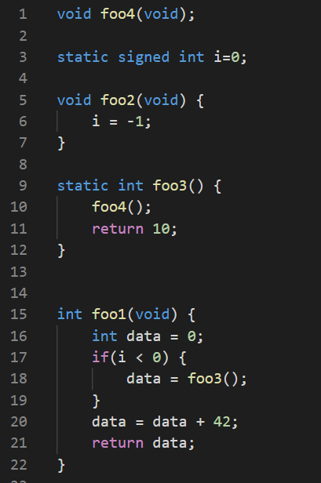
Binary Size
A.c
Can we reduce the code size?
-very hard
We don’t know whether foo2 is called at some other places, so we can’t eliminate this if-block.

Slide 7
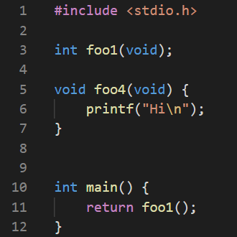
Binary Size
A.c
Can we reduce the code size now?
-yes
foo2 never used
main.c
foo3 never used
foo4 never used
(don’t need to link printf() into the binary too!)
i < 0 always false
data = 42

Slide 8
Performance
A.c
Do we reach the end?
-no
main.c
Inline
try compile this example with LTO yourself
clang –c main.c A.c -flto
clang –o main main.o A.o -flto

Slide 9





Can’t enable LTO by default
GCC’s LTO(–g0)
clang
55 s
2 GB
chromium
4 mins
8 GB
Ad Delivery
LLVM’s LTO can’t even finish this task.
3 hours
>25 GB
*Google's ad recommendation application
which has 2X call graph nodes, and 3X call graph edges, compared with Chromium

Slide 10
ThinLTO: scalable & low memory lean
Why?
GCC’s LTO(–g0)
ThinLTO
clang
55 s
2 GB
5 s
0.13 GB
chromium
4 mins
8 GB
30 s
1 GB
Ad Delivery
3 hours
>25 GB
*Google's ad recommendation application
which has 2X call graph nodes, and 3X call graph edges, compared with Chromium
102s
2.27 GB

Slide 11
Previous Design of LTO GCC, Clang(<3.9), and others
What’s the bottleneck?
Source
Source
Source
1. compile phase
paralleled
.o
.o
.o
serial
2.1 cross-module analysis
2. LTO phase
2.2 IR transformation
paralleled
.o
.o
.o
3. link phase
Binary

Slide 12
ThinLTO Design Summary-based LTO
Source
Source
Source
compile phase
Generate module summary on the fly
result
.o
result
.o
result
.o
Summary
Summary
Summary
2.1 cross-module analysis
very fast, low memory lean
2. LTO phase
2.2 IR transformation
.o
.o
.o
3. link phase
Binary

Slide 13
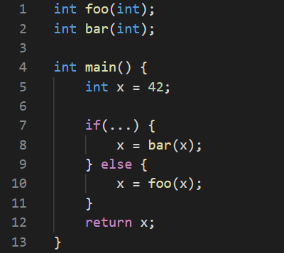
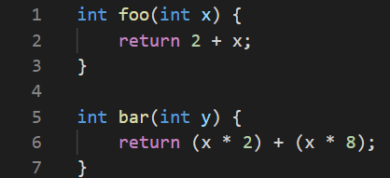
score
foo() at line 10 | 20
bar() at line 8 | 10
Represent Module Summary?
A naïve inline opt under ThinLTO
main.c
hotness
foo() at line 10 | 5
bar() at line 8 | 30
A.c
weigh
foo | 100
bar | 300
Our Inline heuristic:
A function call f at call site c has inline score:
score(f, c) = weigh(f) / hotness(c)
If score < 15 then we inline f at this call site.
*weigh(f) is the 100* (total operations in f).
*hotness(c) is the called frequency recorded by profiling

Slide 14
ThinLTO is a framework,
not specific optimization algorithms
Design our own optimizations in ThinLTO framework
Compile phase: collect and add information to module-summary.
/lib/Analysis/ModuleSummaryAnalysis.cpp
Cross-module analysis: gather module-summary and generate analysis result for each module.
lib/LTO/ThinLTOCodeGenerator.cpp::ProcessThinLTOModule()
IR Transformation: For each module, perform optimizations and transformations individually and parallelly.
/lib/LTO/LTOBackend.cpp

Slide 15
Distributed Build Supports contain “import info” in analysis result
Server is assigned to do phase2.2 for A.o
-need A.o + B.o
Server is assigned to do phase2.2 for B.o
-need B.o + C.o
Server is assigned to do phase2.2 for C.o
-need C.o
Source
Source
Source
Import bar
compile phase
Import foo
result
A.o
result
B.o
result
C.o
Summary
Summary
Summary
2.1 cross-module analysis
2. LTO phase
2.2 IR transformation
A.o
B.o
C.o
3. link phase
Binary

Slide 16
Incremental Build Support
Source
Source
Source
Source
compile phase
A.o
B.o
C.o
result
result
C.o
Natually incremental(make)
maintain a cache system:
Source → .o file & summary
result
result
result
result
Summary
Summary
Summary
Summary
2.1 cross-module analysis
2. LTO phase
2.2 IR transformation
A cache system
Analysis-result → .o file
A.o
A.o
B.o
B.o
C.o
C.o
3. link phase
Binary

Slide 17
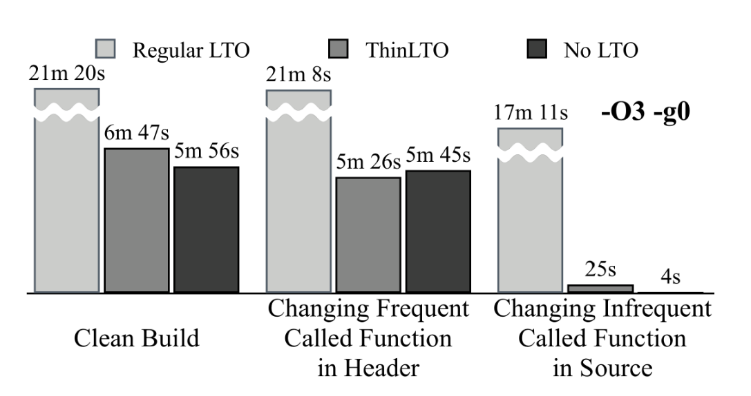
Incremental Build Support:
Not always so helpful?

Slide 18
Discussion
Incremental build
Can we reduce redundant computation even when frequent called function is modified?

Slide 19
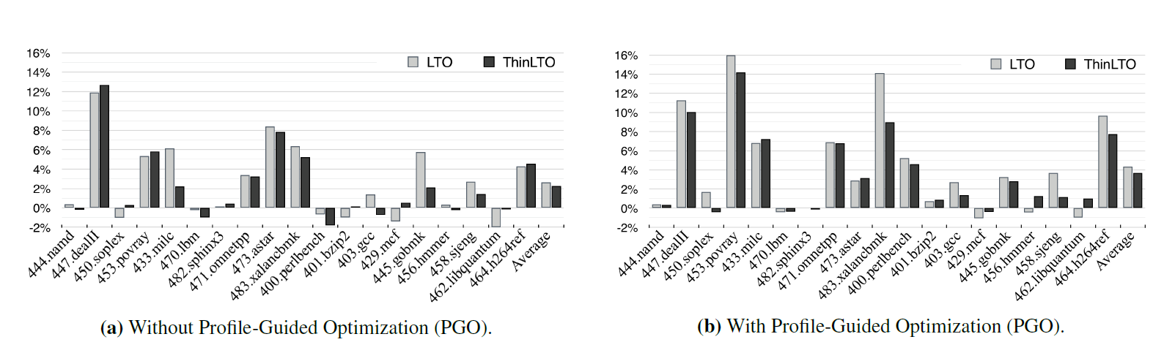
Discussion
Whole program analysis
Optimize and transform for each .o file
Summary based LTO is like one-step optimization
Limitation: Optimize result (make program run faster)
ThinLTO’s optimize result on SPEC is just “as good” as LTO.
ThinLTO doesn’t do aggressive whole program analysis.

Slide 20
Discussion
A.c
Optimization limitation: cont
Consider that i and foo3 are not static, and are located in other files.
Can ThinLTO handle this?
main.c

Slide 21
Discussion
Consider static analysis after LTO.
After LTO, code is smaller while semantic is the same
ThinLTO is fast and we can afford this cost.

Slide 22
Thank you!

Slide 23
Links
ThinLTO: https://dl.acm.org/doi/10.5555/3049832.3049845
LLVM doc: https://clang.llvm.org/docs/ThinLTO.html
Talk at cpp-conf: https://youtu.be/p9nH2vZ2mNo
GCC’s LTO: https://arxiv.org/abs/1010.2196

