Slide 1
Refinement of Macromolecular structures using REFMAC5
Garib N Murshudov
York Structural Laboratory
Chemistry Department
University of York

Slide 2
Contents
  Introduction
  Considerations for refinement
  Overall parameters
  TLS
  Dictionary and alternative conformations
  Twin
  Some new features in REFMAC
  Conclusions

Slide 3
Available refinement programs
SHELXL
CNS
REFMAC5
TNT
BUSTER/TNT
Phenix.refine
RESTRAINT
MOPRO

Slide 4
What can REFMAC do?
Simple maximum likelihood restrained refinement
Twin refinement
Phased refinement (with Hendrickson-Lattmann coefficients)
SAD/SIRAS refinement
Structure idealisation
Library for more than 8000 ligands (from the next version)
Covalent links between ligands and ligand-protein
Rigid body refinement
NCS local, restraints to external structures, jelly body
TLS refinement
Map sharpening
etc

Slide 5
Considerations in refinement
Function to optimise (link between data and model)
  Should use experimental data
  Should be able to handle chemical (e.g bonds) and other (e.g. NCS, structural) information
Parameters
  Depends on the stage of analysis
  Depends on amount and quality of the experimental data
Methods to optimise
  Depends on stage of analysis: simulated annealing, conjugate gradient, second order (normal matrix, information matrix, second derivatives)
  Some methods can give error estimate as a by-product. E.g second order.

Slide 6
Two components of target function
Crystallographic target functions have two components: one of them describes the fit of the model parameters into the experimental data and the second describes chemical integrity (restraints).
Currently used restraints are: bond lengths, angles, chirals, planes, ncs if available, some torsion angles, reference structures

Slide 7
Crystallographic refinement
The function in crystallographic refinement has a form:
L(p)=wL_{X}(p)+L_{G}(p)
Where L_{X}(p) is -loglikelihood and L_{G}(p) is -log of prior probability distribution - restraints.
It is one of many possible formulations. It uses Bayesian statistics. Other formulation is also possible. For example: stat physical energy, constrained optimisaton, inverse problem etc.
Notes:
IUCR Computing School, Kyoto 2008

Slide 8
Various forms of X-ray component
SAD functions uses observed F+ and F- directly without any preprocessing by a phasing program (It is not available in the current version but will be available soon)
SIRAS – uses native and derivative anomalous data directly
MLHL - explicit use of phases with Hendrickson Lattman coefficients
Rice - Maximum likelihood refinement without phase information

Slide 9
-loglikelihood
-loglikelihood depends on assumptions about the experimental data, crystal contents and parameters. For example with assumptions that all observations are independent (e.g. no twinning), there is no anomolous scatterers and no phase information available, for acentric reflections it becomes:
And for centric reflections:
All parameters (scale, other overall and atomic) are inside |F_{c}| and Σ
Note that these are loglikelihood of multiples of chi-squared distribution with degree of freedom 2 and 1
Notes:
IUCR Computing School, Kyoto 2008

Slide 10
Twin refinement in REFMAC
Twin refinement in refmac (5.5 or later) is automatic.
  Identify “twin” operators
  Calculate “Rmerge” (Σ|I_{h}-<I>_{twin}| /ΣΙ_{h}) for each operator. Ιf Rmerge>0.50 keep it: Twin plus crystal symmetry operators should form a group
  Refine twin fractions. Keep only “significant” domains (default threshold is 5%): Twin plus symmetry operators should form a group
Intensities can be used
If phases are available they can be used
Maximum likelihood refinement is used

Slide 11
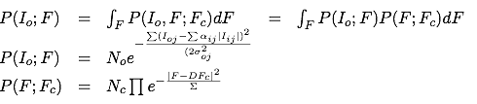
Likelihood
The dimension of integration is in general twice the number of twin related domains. Since the phases do not contribute to the first part of the integrant the second part becomes Rice distribution.
The integration is carried out using Laplace approximation.
These equations are general enough to account for: non-merohedral twinning (including allawtwin), unmerged data. A little bit modification should allow handling of simultaneous twin and SAD/MAD phasing, radiation damage

Slide 12
Twin: Few warnings about R factors
For acentric case only:
For random structure
Crystallographic R factors
No twinning 58%
For perfect twinning: twin modelled 40%
For perfect twinning without twin modelled 50%
R merges without experimental error
No twinning 50%
Along non twinned axes with another axis than twin 37.5%
Non twin
Twin

Slide 13
Map calculation
After refinement programs usually give coefficients for two type of maps: 1) 2Fo-Fc type maps. They try to represent the content of the crystal. 2) Fo-Fc type of maps. They try to represent difference between contents of the crystal and current atomic model. Both these maps should be inspected and model should be corrected if necessary.
Refmac gives coefficients:
2 m F_{o} - D F_{c} – to represent contents of the crystal
m F_{o} –D F_{c} - to represent differences
m is the figure of merit (reliability) of the phase of the current reflection and D is related tomodel error. m depends on each reflection and D depends on resolution
If phase information is available then map coefficients correspond to the combined phases.

Slide 14
Parameters
Usual parameters (if programs allow it)
Positions x,y,z
B values – isotropic or anisotropic
Occupancy
Derived parameters
Rigid body positional
  After molecular replacement
  Isomorphous crystal (liganded, unliganded, different data)
Rigid body of B values – TLS
  Useful at the medium and final stages
  At low resolution when full anisotropy is impossible
Torsion angles

Slide 15
Bulk solvent
Method 1: Babinet’s bulk solvent correction
At low resolution electron density is flat. Only difference between solvent and protein regions is that solvent has lower density than protein. If we would increase solvent just enough to make its density equal to that of protein then we would have flat density (constant). Fourier transformation of constant is zero (apart from F000). So contribution from solvent can be calculated using that of protein. And it means that total structure factor can calculated using contribution from protein only
S
P
ρs+ρp=ρT <==> Fs+Fp=FT
ρs+kρp=c <==> Fs+kFp=0
Fs=-kFp ==> FT=Fp-kFp=(1-k)Fp
k is usually taken as kb exp(-Bbs²). kb must be less than 1. kb and Bb are adjustable parameters

Slide 16
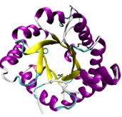
Bulk solvent
Method 2: Mask based bulk solvent correction
Total structure factor is the sum of protein contribution and solvent contribution. Solvent region is flat. Protein contribution is calculated as usual. The region occupied by protein atoms is masked out. The remaining part of the cell is filled with constant values and corresponding structure factors are calculated. Finally total structure factor is calculated using
S
FT=Fp+ksFs
ks is adjustable parameter.
Mask based bulk solvent is a standard in all refinement programs. In refmac it is default.

Slide 17
Overall parameters: Scaling
There are several options for scaling:
Babinet’s bulk solvent assumes that at low resolution solvent and protein contributors are very similar and only difference is overall density and B value. It has the form: k_{b}= 1-k_{b} e(-B_{b} s²/4)
Mask bulk solvent: Part of the asymmetric unit not occupied by atoms are asigned constant value and Fourier transformation from this part is calculated. Then this contribution is added with scale value to “protein” structure factors. Total structure factor has a form: F_{tot} = F_{p}+s_{s}exp(-B_{s} s²/4)Fs.
The final total structure factor that is scaled has a form:
s_{aniso}s_{protein} k_{b}F_{tot}

Slide 18
TLS

Slide 19
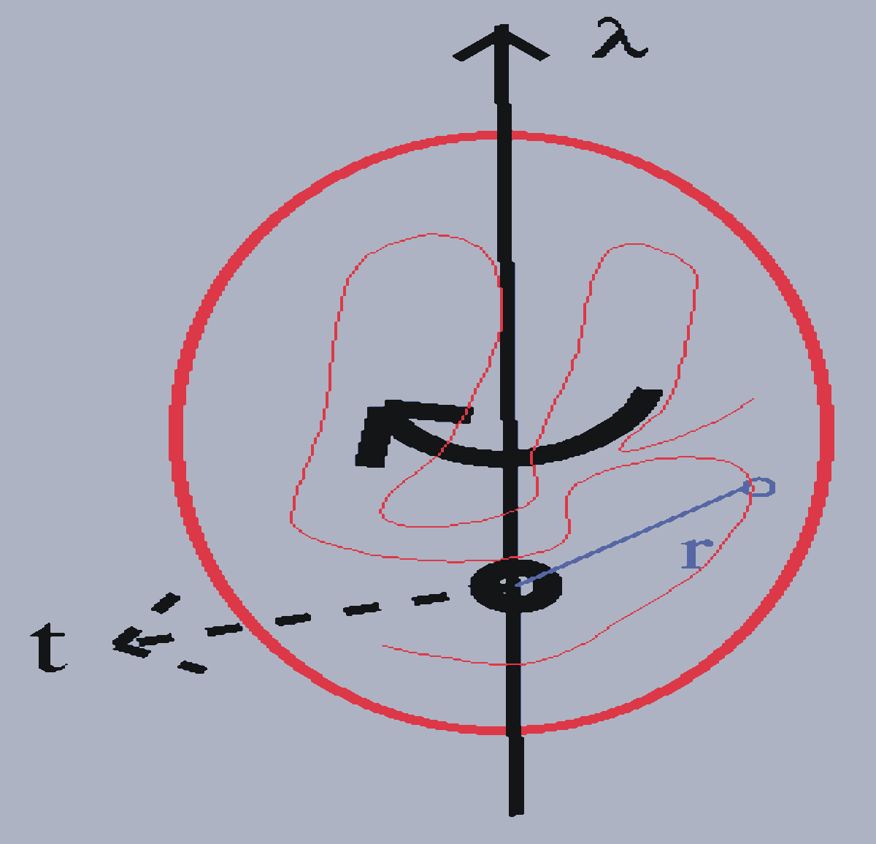
Rigid-body motion
General displacement of a rigid-body point can be described as a rotation along an axis passing through a fixed point together with a translation of that fixed point.
u = t + Dr
for small librations
u ≈ t + λ×r
D = rotation matrix
λ = vector along the rotation axis of magnitude equal to the angle of rotation

Slide 20
TLS parameters
Dyad product:
uu^{T} = tt^{T} + tλ^{T}×r^{T} -r×λt^{T} -r×λλ^{T}×r^{T}
ADPs are the time and space average
  U_{TLS} = ⟨uu^{T}⟩ = T + S^{T}×r^{T} -r×S -r×L×r^{T}
T = ⟨tt^{T}⟩ 6 parameters, TRANSLATION
L = ⟨λλ^{T}⟩ 6 parameters, LIBRATION
S = ⟨λt^{T}⟩8 parameters, SCREW-ROTATION

Slide 21
TLS groups
Rigid groups should be defined as TLS groups. As starting point they could be: subunits or domains.
If you use script then default rigid groups are subunits or segments if defined.
In ccp4i you should define rigid groups (in the next version default will be subunits).
Rigid group could be defined using TLSMD webserver:
http://skuld.bmsc.washington.edu/~tlsmd/

Slide 22
Use of available knowledge
1) NCS local
2) Restraints to known structure(s)
3) Restraints to current inter-atomic distances (implicit normal modes or “jelly” body)
4) Better restraints on B values
These are available from the version 5.6
Note
Buster/TNT has local NCS and restraints to known structures
CNS has restraints to known structures (they call it deformable elastic network)
Phenix has B-value restraints on non-bonded atom pairs and automatic global NCS
Local NCS (only for torsion angle related atom pairs) was available in SHELXL since the beginning of time
Notes:
Should be able to well-align similar proteins, but should also be able to align dissimilar proteins, so that a meaningful score can be given in all cases.

Slide 23
Auto NCS: local and global
Align all chains with all chains using Needleman-Wunsh method
If alignment score is higher than predefined (e.g.80%) value then consider them as similar
Find local RMS and if average local RMS is less than predefined value then consider them aligned
Find correspondence between atoms
If global restraints (i.e. restraints based on RMS between atoms of aligned chains) then identify domains
For local NCS make the list of corresponding interatomic distances (remove bond and angle related atom pairs)
Design weights
The list of interatomic distance pairs is calculated at every cycle
Notes:
Should be able to well-align similar proteins, but should also be able to align dissimilar proteins, so that a meaningful score can be given in all cases.

Slide 24

Auto NCS
Aligned regions
Chain A
Global RMS is calculated using all aligned atoms.
Local RMS is calculated using k (default is 5) residue sliding windows and then averaging of the results
Chain B
k(=5)
Notes:
Should be able to well-align similar proteins, but should also be able to align dissimilar proteins, so that a meaningful score can be given in all cases.

Slide 25
Auto NCS: Iterative alignment
Example of alignment: 2vtu.
There are two chains similar to each other. There appears to be gene duplication
RMS – all aligned atoms
Ave(RmsLoc) – local RMS
********* Alignment results *********
-------------------------------------------------------------------------------
: N: Chain 1 : Chain 2 : No of aligned :Score : RMS :Ave(RmsLoc):
-------------------------------------------------------------------------------
: 1 : J( 131 - 256 ) : J( 3 - 128 ) : 126 : 1.0000 : 5.2409 : 1.6608 :
: 2 : J( 1 - 257 ) : L( 1 - 257 ) : 257 : 1.0000 : 4.8200 : 1.6694 :
: 3 : J( 131 - 256 ) : L( 3 - 128 ) : 126 : 1.0000 : 5.2092 : 1.6820 :
: 4 : J( 3 - 128 ) : L( 131 - 256 ) : 126 : 1.0000 : 3.0316 : 1.5414 :
: 5 : L( 131 - 256 ) : L( 3 - 128 ) : 126 : 1.0000 : 0.4515 : 0.0464 :
----------------------------------------------------------------------------------------------------------------------------------------------
Notes:
Should be able to well-align similar proteins, but should also be able to align dissimilar proteins, so that a meaningful score can be given in all cases.

Slide 26
Auto NCS: Conformational changes
Domain 2
In many cases it could be expected that two or more copies of the same molecule will have (slightly) different conformation. For example if there is a domain movement then internal structures of domains will be same but between domains distances will be different in two copies of a molecule
Domain 1
Domain 2
Domain 1
Notes:
Should be able to well-align similar proteins, but should also be able to align dissimilar proteins, so that a meaningful score can be given in all cases.

Slide 27
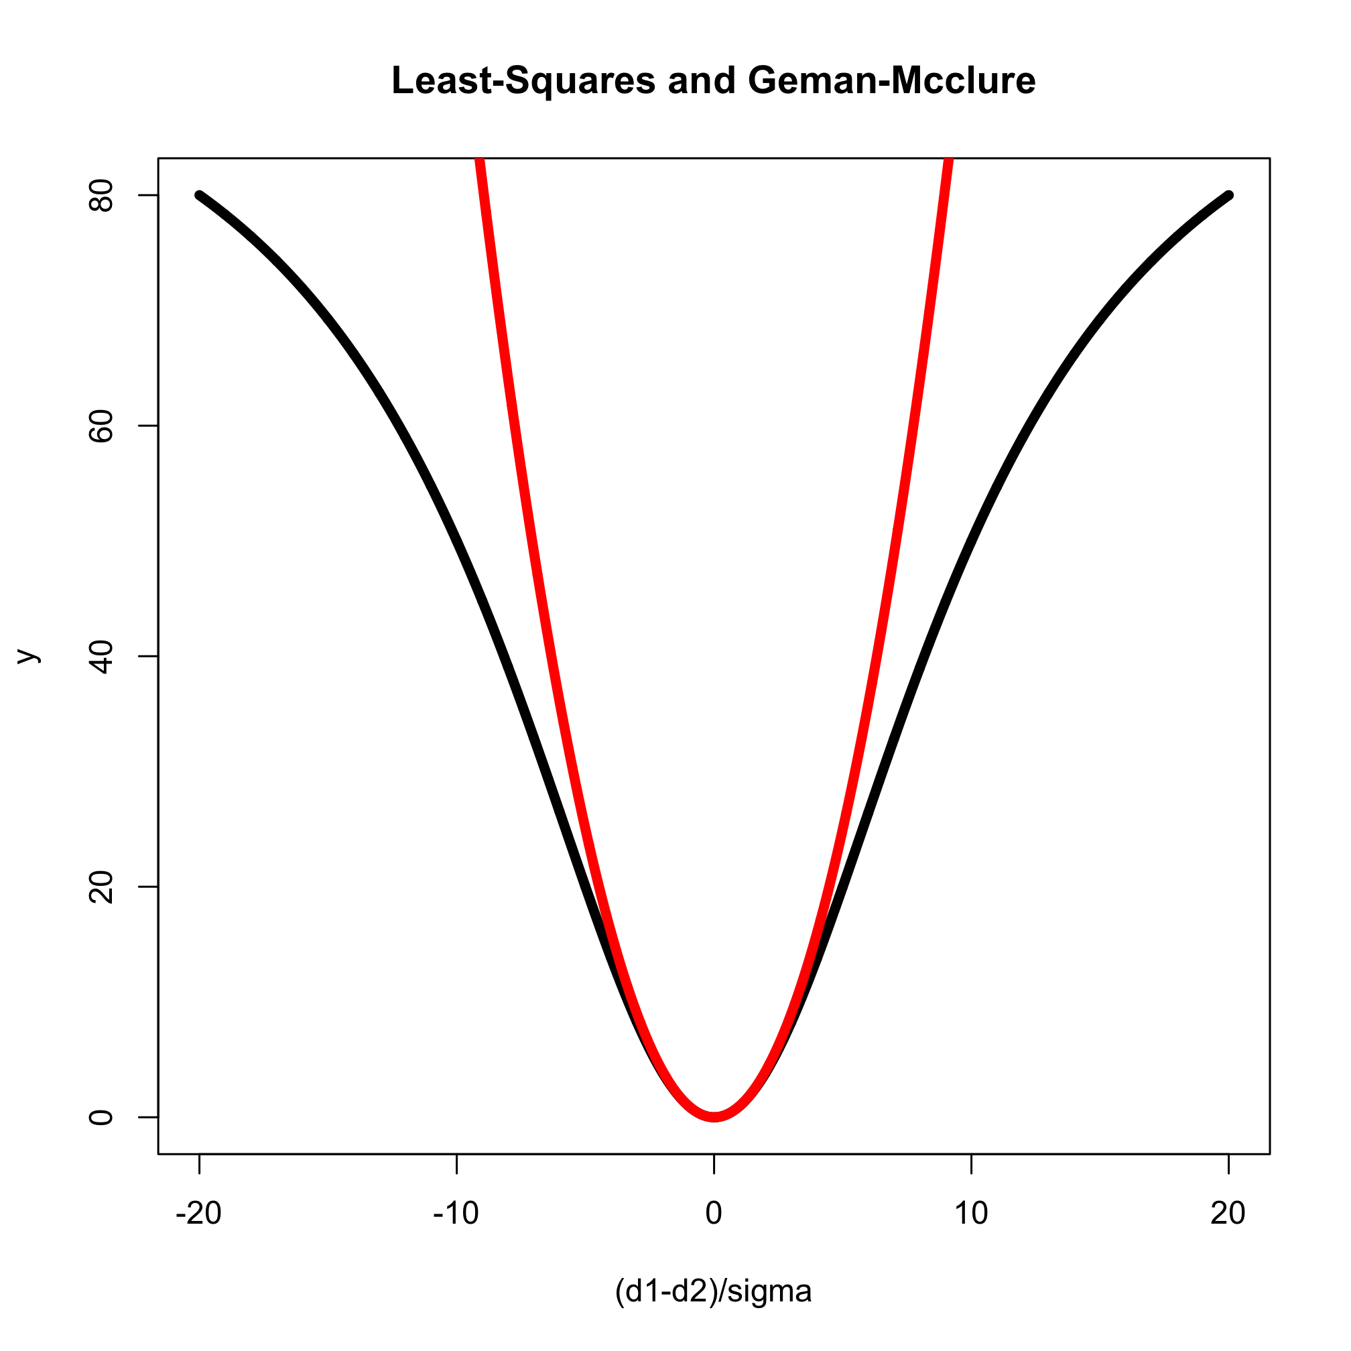
Robust estimators
One class of robust (to outliers) estimators are called M-estimators: maximum-likelihood like estimators. One of the popular functions is Geman-Mcclure.
Essentially when distances are similar then they should be kept similar and when they are too different they should be allowed to be different.
This function is used for NCS local restraints as well as for restraints to external structures
Red line: x²
Black line: x^2/(1+w x^2)
where x=(d1-d2)/σ, w=0.1
Notes:
Should be able to well-align similar proteins, but should also be able to align dissimilar proteins, so that a meaningful score can be given in all cases.

Slide 28
Restraints to external structures
It is done by Rob Nicholls
ProSmart
Compares Two Protein Chains
Conformation-invariant structural comparison
Residue-residue alignment
Superimposition
Residue-based and global similarity scores
Produces local atomic distance restraints
Based on one or more aligned chains
Possibility of multi-crystal refinement
Notes:
Should be able to well-align similar proteins, but should also be able to align dissimilar proteins, so that a meaningful score can be given in all cases.

Slide 29
ProSmart Restrain
structure to be refined known similar structure (prior)
Remove bond and angle related pairs

Slide 30
Restraints to current distances
The term is added to the target function:
Summation is over all pairs in the same chain and within given distance (default 4.2A). d_{current} is recalculated at every cycle. This function does not contribute to gradients. It only contributes to the second derivative matrix.
It is equivalent to adding springs between atom pairs. During refinement inter-atomic distances are not changed very much. If all pairs would be used and weights would be very large then it would be equivalent to rigid body refinement.
It could be called “implicit normal modes”, “soft” body or “jelly” body refinement.
Notes:
Should be able to well-align similar proteins, but should also be able to align dissimilar proteins, so that a meaningful score can be given in all cases.

Slide 31
B value restraints and TLS
Designing restraints on B values is much more difficult.
Current available options to deal with B values at low resolutions
Group B as implemented in CNS
TLS group refinement as implemented in refmac and phenix.refine
Both of them have some applications. TLS seems to work for wide range of cases but unfortunately it is very often misused. One of the problems is discontinuity of B values. Neighbouring atoms may end up having wildly different B values
In ideal world anisotropic U with good restraints should be used. But this world is far far away yet. Only in some cases full aniso refinement at 3Å gives better R/Rfree than TLS refinement. These cases are with extreme ansiotropic data.
TLS2
TLS1
loop
Notes:
Should be able to well-align similar proteins, but should also be able to align dissimilar proteins, so that a meaningful score can be given in all cases.

Slide 32
Kullback-Leibler divergence
If there are two densities of distributions – p(x) and q(x) then symmetrised Kullback-Leibler divergence between them is defined (it is distance between distributions)
If both distributions are Gaussian with the same mean values and U₁ and U₂ variances then this distance becomes:
And for isotropic case it becomes
Restraints for bonded pairs have more weights more than for non-bonded pairs. For nonbonded atoms weights depend on the distance between atoms.
This type of restraint is also applied for rigid bond restraints in anisotropic refinement

Slide 33
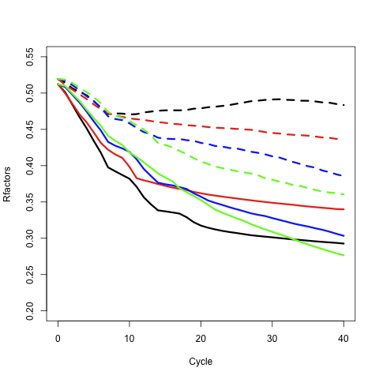
Example, after molecular replacement
3A resolution, data completeness 71%
Rfactors vs cycle
Black – simple refinement
Red – Global NCS
Blue – Local NCS
Green – “Jelly” body
Solid lines – Rfactor
Dashed lines - Rfree
Notes:
Should be able to well-align similar proteins, but should also be able to align dissimilar proteins, so that a meaningful score can be given in all cases.

Slide 34
Example: 4A resolution, data from pdb 2r6c
Starting R/Rfree = 36.0/35.6
R/Rfree after 40 cycles of refinement
 | None | Ncs local | Jelly body | External structure
R | 20.80 | 21.44 | 23.72 | 23.38
Rfree | 32.69 | 31.79 | 29.82 | 28.69

Slide 35
MAP SHARPENING: INVERSE PROBLEM
In general K is effect of such terms as TLS or smoothly varying blurring function.
Noises in electron density: series termination, errors in phases and noises in experimental data.
Very simple case: K is overall B value. Then the problem is solved using FFT: Fourier transform of Gaussian is Gaussian, Fourier transform of Laplace operator is square length of the reciprocal space vector.

Slide 36
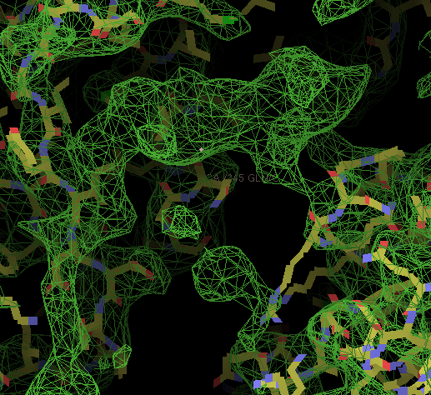
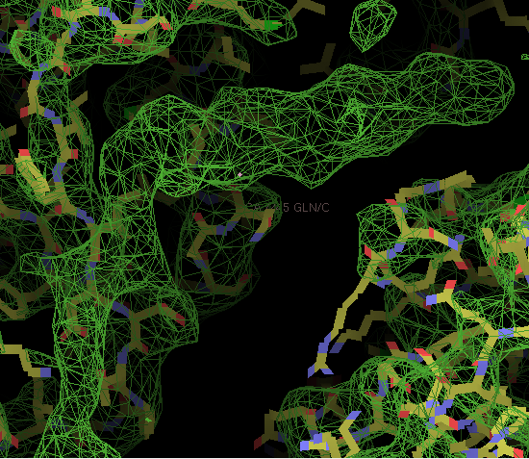
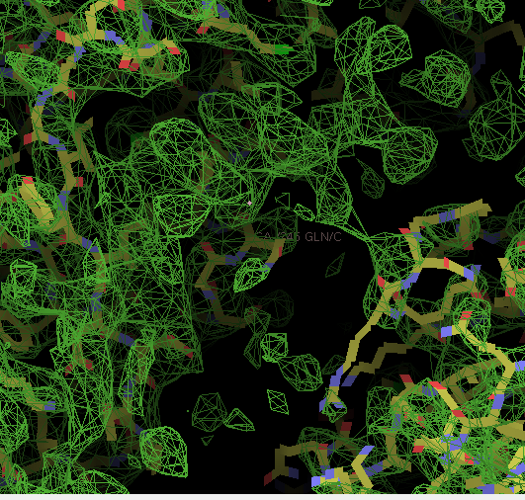
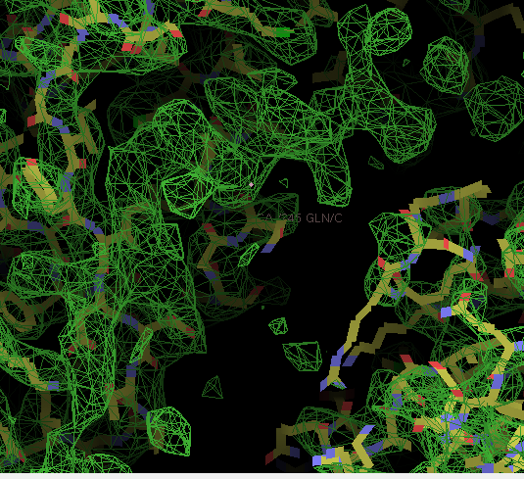
MAP SHARPENING: 2R6C, 4Å RESOLUTION
Original
No sharpening
Top left and bottom:
After local NCS refinement
Sharpening, median B
α 0
Sharpening, median B
α optimised

Slide 37
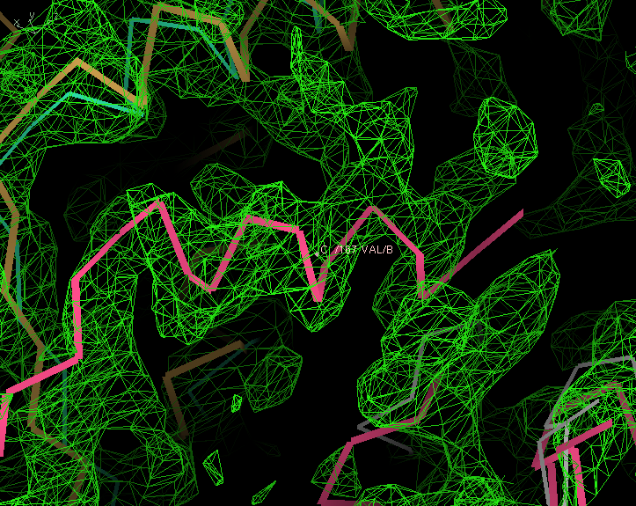
Example, 2r6c, Electron density
Known structure (2r6a) superimposed to 2r6c structure. There is a helix. Side chains are visible to some degree
Notes:
Should be able to well-align similar proteins, but should also be able to align dissimilar proteins, so that a meaningful score can be given in all cases.

Slide 38
Alternative conformation of links: how to handle
Description
Description of link(s) should be added to the library. When residues make link then each component is usually modified. Description of Link should contain it also
PDB
LINK C6 BBEN B 1 O1 BMAF S 2 BEN-MAF
LINK OE2 AGLU A 320 C1 AMAF S 2 GLU-MAF

Slide 39
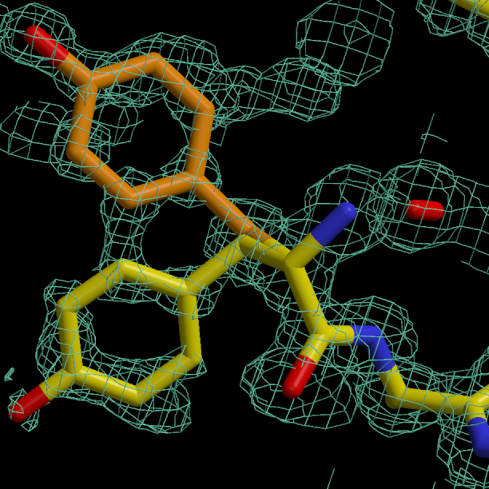
Alternative conformations
Example from 0.88Å catalase structure:Two conformations of Tyrosine. Ring is clearly in two conformation. To refine it properly CB also needs to be split. It helps adding hydrogen atom on CB and improves restraints in anisotropic U values

Slide 40
Alternative conformation: Example in pdb file
ATOM 977 N GLU A 67 -11.870 9.060 4.949 1.00 12.89 N
ATOM 978 CA GLU A 67 -12.166 10.353 4.354 1.00 14.00 C
ATOM 980 CB AGLU A 67 -13.562 10.341 3.738 0.50 14.81 C
ATOM 981 CB BGLU A 67 -13.526 10.285 3.654 0.50 14.35 C
ATOM 986 CG AGLU A 67 -13.701 9.400 2.573 0.50 16.32 C
ATOM 987 CG BGLU A 67 -13.876 11.476 2.777 0.50 14.00 C
ATOM 992 CD AGLU A 67 -15.128 9.179 2.134 0.50 17.17 C
ATOM 993 CD BGLU A 67 -15.237 11.332 2.110 0.50 15.68 C
ATOM 994 OE1AGLU A 67 -15.742 10.153 1.644 0.50 20.31 O
ATOM 995 OE1BGLU A 67 -15.598 12.213 1.307 0.50 16.68 O
ATOM 996 OE2BGLU A 67 -15.944 10.342 2.389 0.50 18.94 O
ATOM 997 OE2AGLU A 67 -15.610 8.027 2.235 0.50 21.30 O
ATOM 998 C GLU A 67 -12.110 11.473 5.386 1.00 13.40 C
ATOM 999 O GLU A 67 -11.543 12.528 5.110 1.00 12.98 O
Note that pdb is strictly formatted. Every element has its position

Slide 41
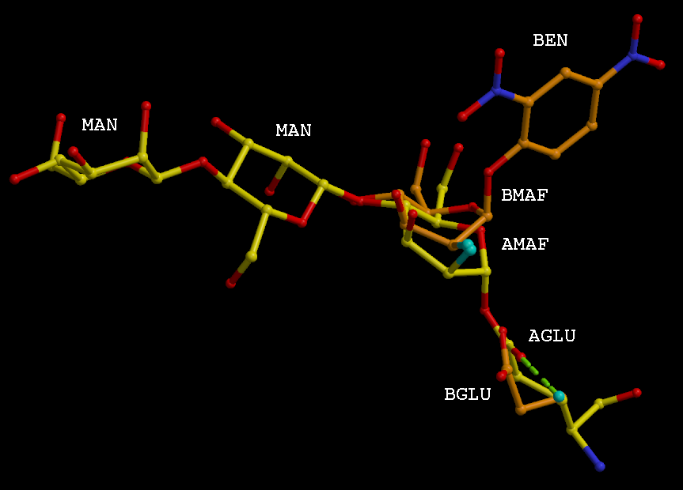
Link between residues in double conformation
Fluro-modified sugar MAF is in two conformation. One of them is bound to GLU and another one is bound to ligand BEN

Slide 42
Things to look at
R factor/Rfree: They should go down during refinement
Geometric parameters: rms bond and other. They should be reasonable. For example rms bond should be around 0.02
Map and coordinates using coot
Logggraph outputs. That is available on the cpp4i interface

Slide 43
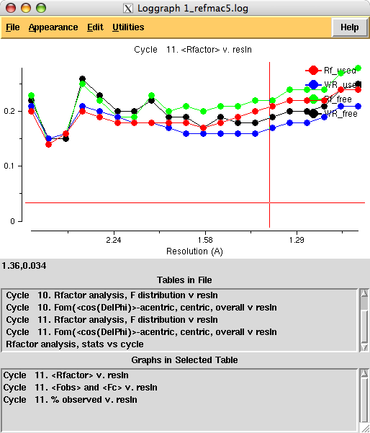
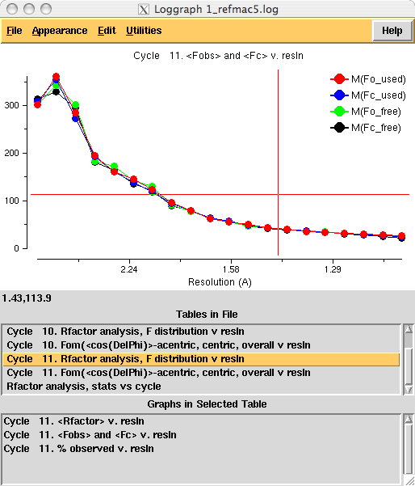
Behaviour of R/Rfree, average Fobs vs resolution should be reasonable. If there is a bump or it has an irregular behaviour then something is wrong with your data or refinement.

Slide 44
What and when
Rigid body: At early stages - after molecular replacement or when refining against data from isomorphous crystals
“Jelly” body – At early stages and may be at low resolution
TLS - at medium and end stages of refinement at resolutions up to 1.7-1.6A (roughly)
Anisotropic - At higher resolution towards the end of refinement
Adding hydrogens - Higher than 2A but they could be added always
Phased refinement - at early and medium stages of refinement
SAD – at the early srages
Twin - always (?). Be careful at early stages
NCS local – always?
Ligands - as soon as you see them
What else?

Slide 45
How to use new features
Download refmac from the website
www.ysbl.york.ac.uk/refmac/data/refmac_experimental/refmac5.6_linux.tar.gz
www.ysbl.york.ac.uk/refmac/data/refmac_experimental/refmac5.6_macintel.tar.gz
Download the dictionary:
www.ysbl.york.ac.uk/refmac/data/refmac_experimental/refmac5.6_dictionary_v5.18.gz
Change atom names using molprobity (optional: important if you have dna/rna)
http://molprobity.biochem.duke.edu/
Refmac refmac5 with the new one and you are ready for the new version.
Notes:
Should be able to well-align similar proteins, but should also be able to align dissimilar proteins, so that a meaningful score can be given in all cases.

Slide 46
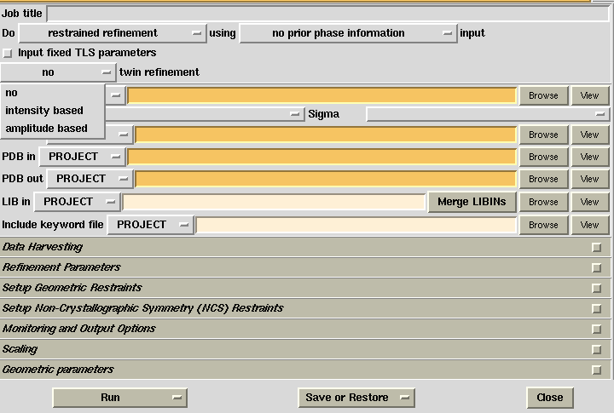
Twin refinement (it works with older version also

Slide 47
Adding external keywords
Add the following command to a file:
ncsr local # automatic and local ncs
ridg dist sigm 0.05 # jelly body restraints
mapcalculate shar # regularised map sharpening
Save in a file (say keyw.dat)

Slide 48
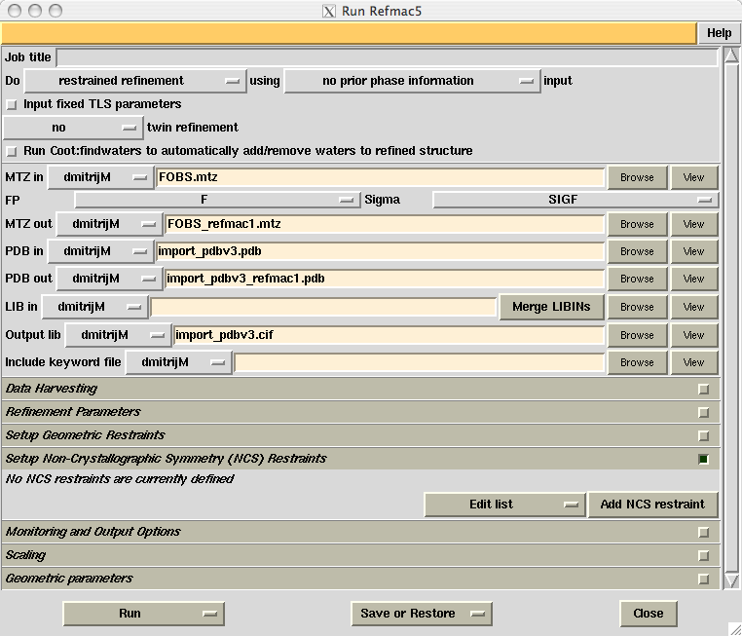
Add external keywords file in refmac interface
Browse files

Slide 49
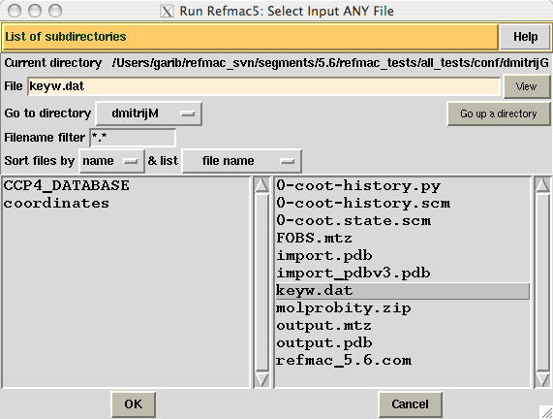
Add external keywords file in refmac interface
Select keywords file

Slide 50
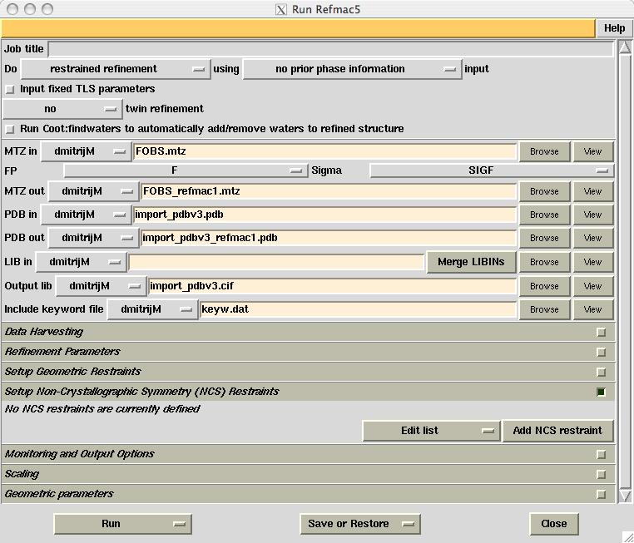
Add external keywords file in refmac interface
Keywords file

Slide 51
Conclusion
SAD/SIRAS can improve behaviour of model building
Twin refinement improves statistics and occasionally electron density
Use of similar structures should improve reliability of the derived model: Especially at low resolution
NCS restraints must be done automatically: but conformational flexibility must be accounted for
“Jelly” body works better than I thought it should
Regularised map sharpening looks promising. More work should be done on series termination and general sharpening operators

Slide 52



Acknowledgment
York Leiden
Alexei Vagin Pavol Skubak
Andrey Lebedev Raj Pannu
Rob Nocholls
Fei Long
CCP4, YSBL people
REFMAC is available from CCP4 or from York’s ftp site:
www.ysbl.york.ac.uk/refmac/latest_refmac.html
This and other presentations can be found on:
www.ysbl.york.ac.uk/refmac/Presentations/

