Slide 1




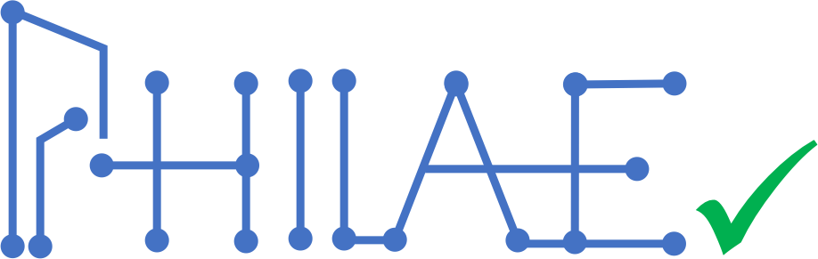
Identifying and Generating Missing Tests using Machine Learning on Execution Traces
Mark Utting – Bruno Legeard – Frédéric Dadeau – Frédéric Tamagnan Fabrice Bouquet
This work was supported in part by the French National
Research Agency: PHILAE project (N° ANR-18-CE25-0013)

Slide 2
Motivations
Efforts to automate tests are increasingly creating a project bottleneck (effort, time, ressources) and a strong reliance
The growing interest for AI in the testing field
The growing capacity of logs storage

Slide 3
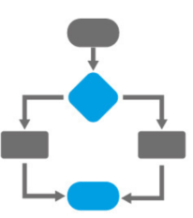




PHILAE project outline :
Traces d'exécution utilisateur
1 – Traces Clustering
Identifying regression
tests needs
2 – Training a ML model on the traces
Operationnal Traces
Test
Traces
3 – Test Scripts Generation
SYSTEM UNDER TEST
Web Service
Regression testing
Script

Slide 4
Main contributions of this paper :
Identifying regression test needs by comparing test execution traces and operational execution traces using clustering and visualisation techniques
Automating test generation using a predictive machine learning model of user traces to propose new test cases covering the identified regression test needs
An open-source toolbox supporting these services
Experimental evaluation on two industry web services

Slide 5
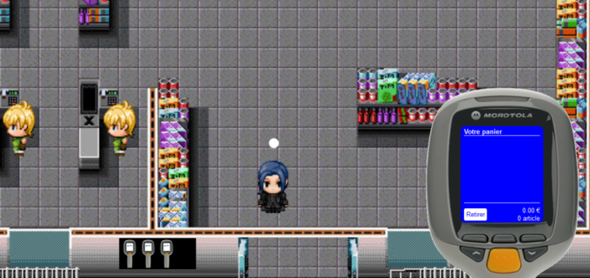
Running Example : Supermarket Scanner

Slide 6
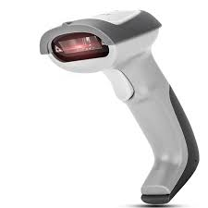
Running Example : Supermarket Scanner
Definition : device that is able to read products barcodes and store them into a shopping list

Slide 7
Running Example : Supermarket Scanner
Scanner Software
(to be tested)
Customer doing Shopping Simulator Software
Producting Logs (execution traces)

Slide 8
Running Example : Supermarket Scanner
List of possible actions for a customer doing shopping :
Unlock a scanner for shopping
Scan an article (as the customer put it into their physical basket)
Delete an article
Transmission to the checkout
Abandon the scanner

Slide 9
Running Example : Supermarket Scanner
Non-nomical cases :
The customer could scan an unknown bardcode. The article is added to the shopping list, but the cashier will have to add it manually later
The customer could be ask to a control check and have to re-scan the articles after the transmission

Slide 10
Running Example : Supermarket Scanner
List of possible actions for the cashier during the checkout:
Open a session
Add an article
Remove an article
Close the session
Make the customer pay

Slide 11
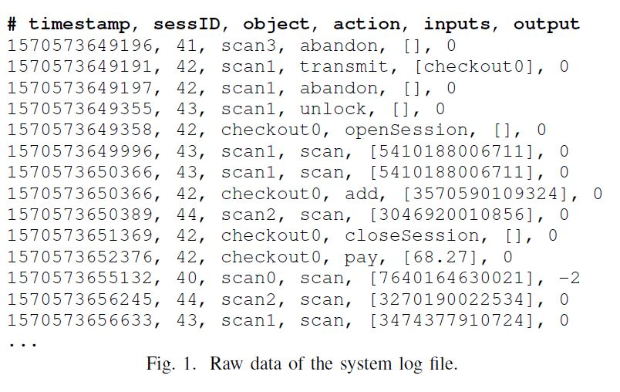
Running Example : Supermarket Scanner
Our logs are composed by 65000+ steps (actions) from 4518 traces.

Slide 12
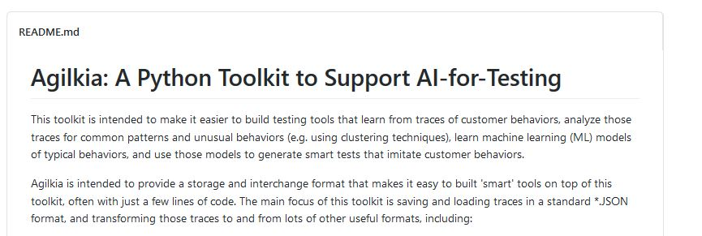
Trace preprocessing
https://github.com/utting/agilkia

Slide 13
Traces preprocessing
Loading csv into a Agilkia « Trace » object that contains a sequence of « Event » objects
Splitting and grouping the event by users session thanks to the user ID

Slide 14
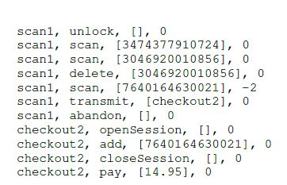
Traces preprocessing
Visualization of traces by mapping a letter to each method name (Unlock -> u, Scan -> . , delete -> d, etc)
u..d.tao+cp
(summarized view of each trace)

Slide 15
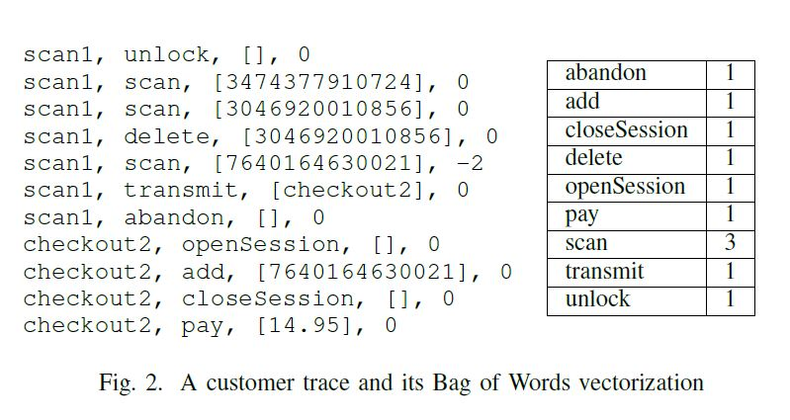
Traces preprocessing
Vectorization of the traces thanks to the bag-of-words representation

Slide 16
Trace clustering, visualization and test need identification

Slide 17
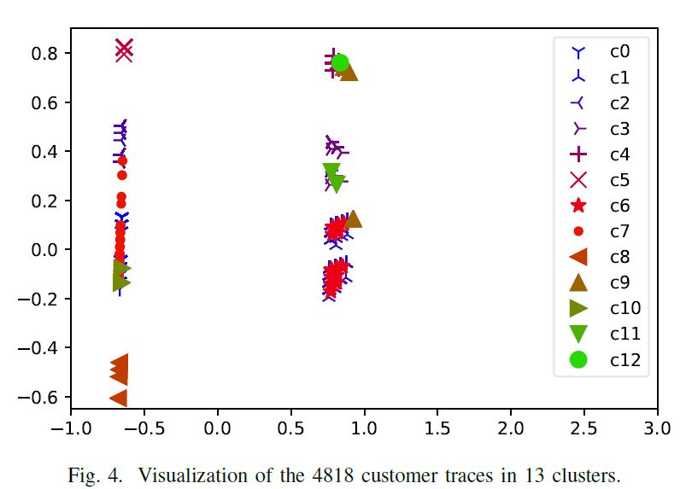
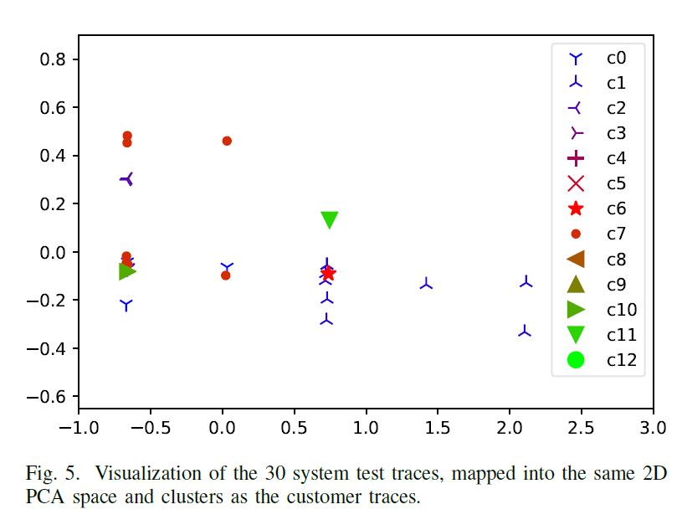

Traces clustering
Clustering of 4818 customer traces with MeanShift Algorithm with bag-of-words vectorization.
We compare the clustering of operational traces (4518) and test traces (30)

Slide 18
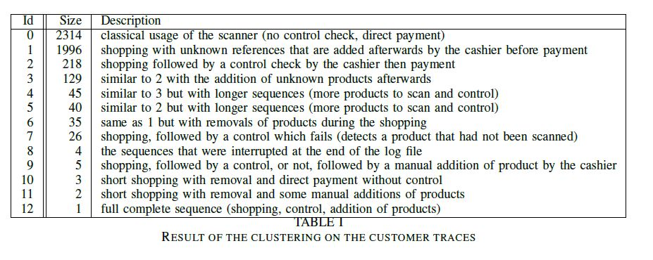
Traces clustering
The clusters represent the different behaviors that have been implemented in the scanner simulator

Slide 19
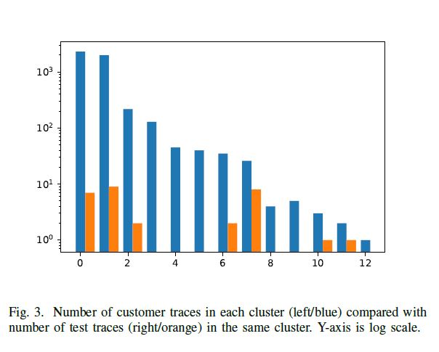
Traces clustering
That allows us to identify the testing needs

Slide 20
Test generation using a predictive ML model

Slide 21
Learning a model to predict the next action
Considering this trace : u.......t......tao+cp
It gives us 21 couples of (prefix, next action) to train a ML model :
(u,.)
(u.,.)
…
(u.......t......tao+c,p)
(u.......t......tao+cp,<END>)
We can take all the couples (prefix,next action) from a specific cluster which has no system test to train a model that generate sequences in this manner.

Slide 22
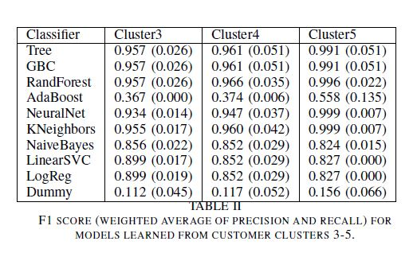
Learning a model to predict the next action
Classifier | Cluster3 | Cluster4 | Cluster5
Tree | 0.961(0.051) | 0.961(0.051) | 0.991(0.051)
GBC | 0.957(0.026) | 0.961(0.051) | 0.991(0.051)
RandForest | 0.957(0.026) | 0.966(0.035) | 0.996(0.022)
AdaBoost | 0.367(0.000) | 0.374(0.006) | 0.558(0.135)
NeuralNet | 0.934(0.014) | 0.947(0.037) | 0.999(0.007)
Kneighbors | 0.955(0.017) | 0.960(0.042) | 0.999(0.007)
NaiveBayes | 0.856(0.022) | 0.852(0.029) | 0.827(0.000)
LinearsSVC | 0.899(0.019) | 0.852(0.029) | 0.827(0.000)
LogReg | 0.899(0.019) | 0.852(0.029) | 0.827(0.000)
Dummy | 0.112(0.045) | 0.117(0.052) | 0.156(0.066)
We trained several classical ML model (Random Forests, Gradient Boosting, etc) over different clusters traces with 10-fold cross validation.

Slide 23
Generating Systematic Test suites
We can generate all the most common sequences by unrolling our models
The model has learned a function to map a trace prefix tr to probability distributions of the likely next events.
Unrolling the model gives us a tree of (tr,p) where tr is a trace prefix and p the probability of that prefix.

Slide 24
Generating Systematic Test suites
(Unlock,1)
Unlock
END
Scan
(Unlock Unlock,0.001)
(Unlock Scan,0.87)
…
(Unlock END,0.05)
LEAF

Slide 25
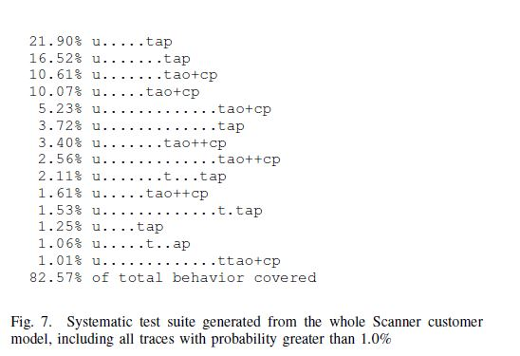
Generating Systematic Test suites
Given an maximum trace lenght L and a minimum probability P, we can explore the tree via a depth-first recursive algorithm and extract the most common/representative traces
Multiplying and summing the probabilities associated to our paths gives us the coverage of the traces generated regarding to our system

Slide 26
Application to two industry cases
Bus system and Supply chain

Slide 27
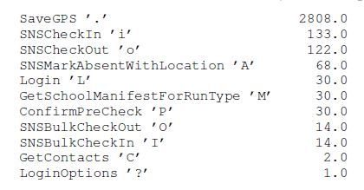
Bus system
Web service for tracking school buses and students
Events : GPS position of the bus, students swiping their ID cards upon entering or exiting the bus, drivers recordings absent students, etc :
3267 events from 15 buses and their frequencies :

Slide 28
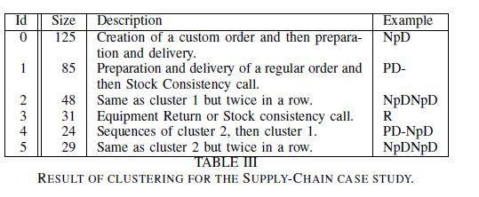
Bus system

Slide 29
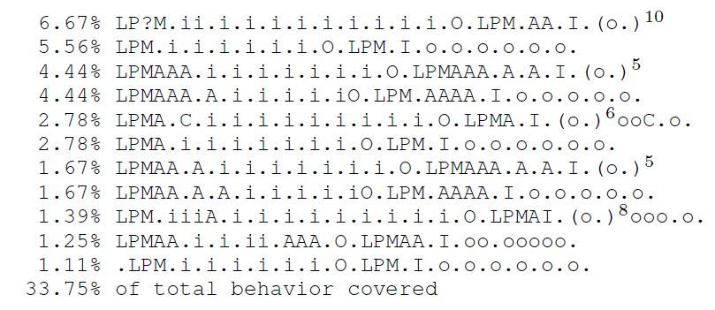
Bus system
Systematic test cases generated by unrolling the probabilities tree

Slide 30

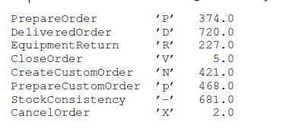
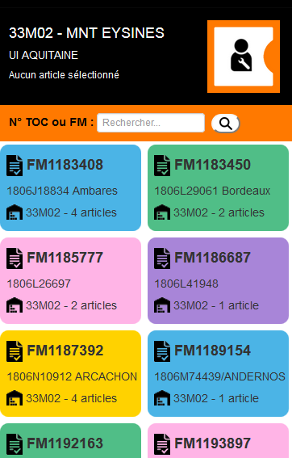
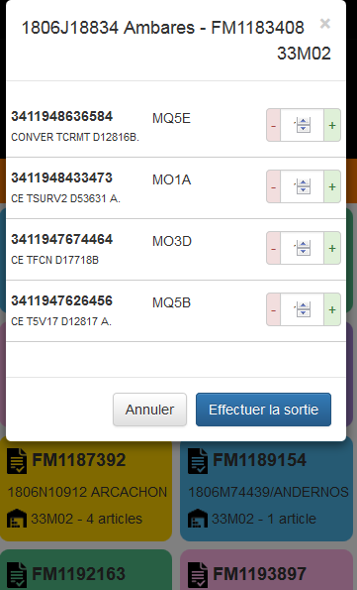
Supply chain
Set of web services for managing maintenance equipment
For each repair job, a list of required equipment is created by a remote operator
Technicians use a mobile app to record when tehy collect and return the required equiment
2898 events and their frequencies coming from 437 sessions

Slide 31
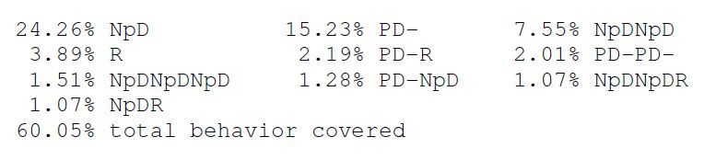
Supply chain
Systematic test cases generated by unrolling the probabilities tree

