Slide 1
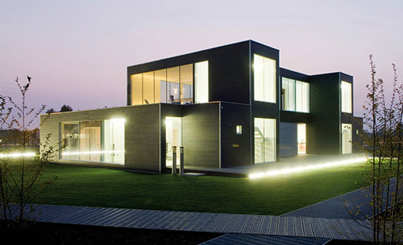
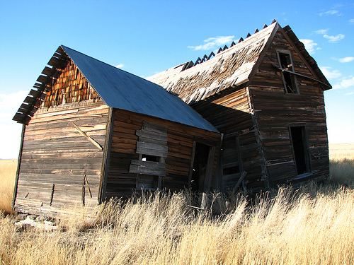
Re-engineering of software architectures
How to transform a ramshackle into a state-of-the-art “home”
Best practices
Quality indicators
Design pattern
AUT 3MT
Frederik Schmidt
Software Engineering Research Lab (SERL)
Notes:
In my PhD research I developed a novel approach to re-engineering software architectures of software systems. The developed approach offers automated support to turn a software ramshackle in a state-of-the-art software system.
I will motivate the significance of such an approach with the analogy of a home: You start out by building a small and neat house just for yourself; then you meet a girl or boy, she or he moves in and you extend the lounge and build a deck to enjoy the summer evenings. A few years on and you have kids, so you have to extend the house by a few rooms and a double garage.
When you set out with your small and neat home at the beginning, you have not thought that such extensions and changes to the initial design of your home would be required. Hence, you did not leave any options for extensions and your home does not follow a consistent design. An entire redesign would be required to re-establish a consistent design. This might even require a complete demolition and rebuild of the house.
A similar development is typical in software systems. A small and neat software system with a simple and functional design is build. But then new requirements arise and new functions and features are added to the software system. But through adding components without taking the whole system’s architecture under consideration the system’s quality is affected. This leads to low maintainability and instability. Everyone has experienced the effect of an eroded software system; it simply crashes or does not what it is supposed to do. Current research states that maintenance activities to deregulate the effects of software erosion constitute 70-80% of the total software development costs.
In my developed approach a software system is automatically transformed into an instance of the system which features improved software quality by keeping the original behaviour of the software system sound.
Design flaws within the software system are detected based on patterns of bad software design. These design flaws are eliminated by applying source code transformation techniques. The feasibility of this new version of the software system is evaluated based on quality indicators of good software design and best practices of software craftsmanship. Hence, the approach allows improving the quality and design of the software system and re-establishes a coherent architecture within the software system. As a result the approach helps software companies to build more flexible and robust software systems in a shorter period of time.

