Slide 1

90 days in the Android Market
Doug Johnstone
April 2012

Slide 2
Agenda
How large organisations take products to market
Key learning's from 90 days in Android Market
How you can help each other be successful launching your products to market

Slide 3
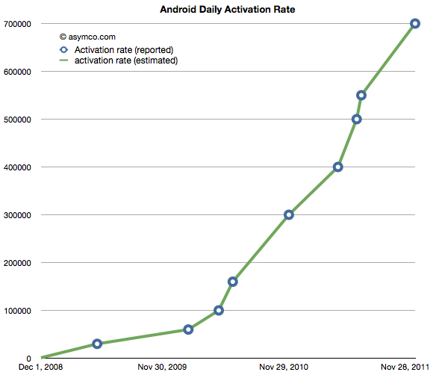
The size of the opportunity
Over 200 Million Android Devices active Dec 2011
Growth rate of over 850k devices per day!! (155%pa)

Slide 4
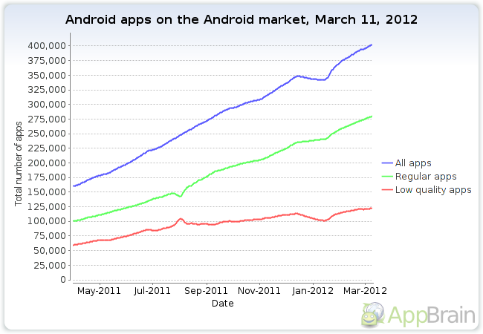
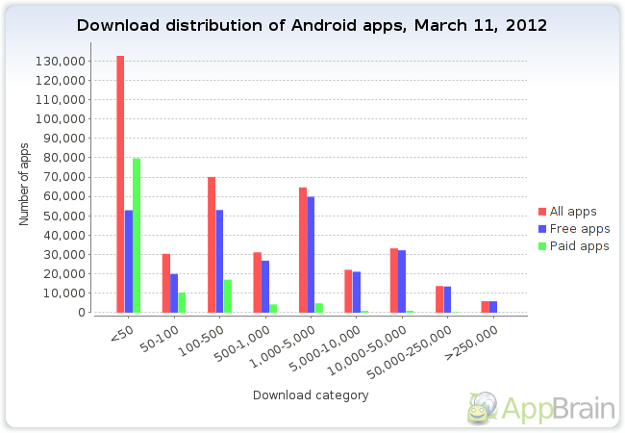
The competition
Currently 400k apps in market
Number of apps growing @15k per month (45%pa)
Download statistics are not pretty
40% (160k) <100 downloads
65% (260k) <1000 downloads
86% (345k) <10,000 downloads
1% (5K) > 250k downloads

Slide 5

Your No 1 challenge is being found!!

Slide 6
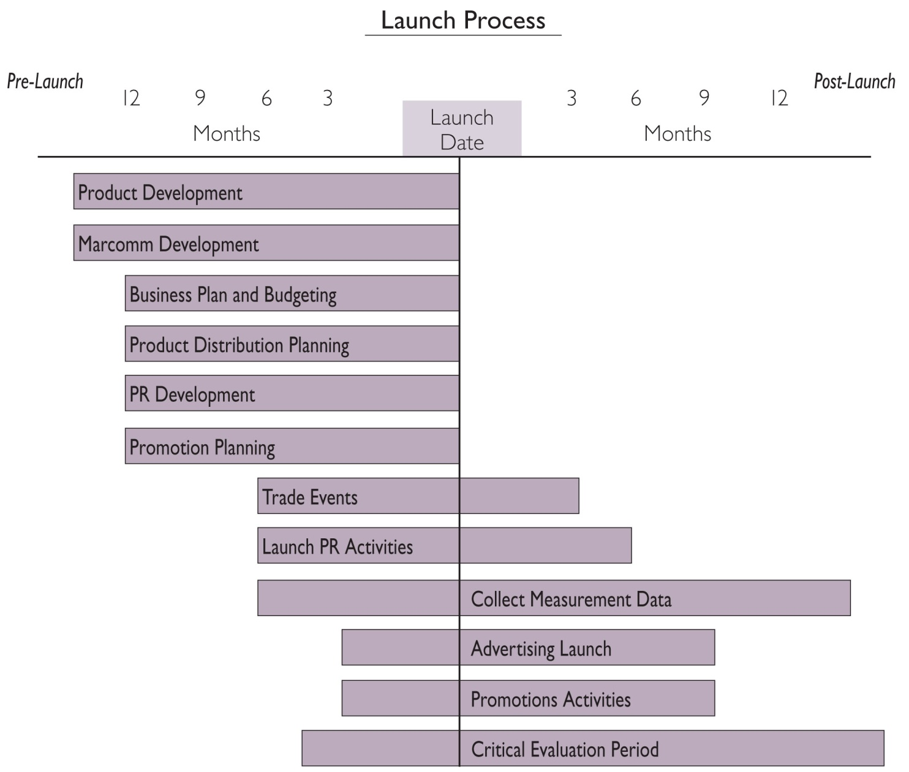
How Corporates take products to market
Source: Marketing Leadership Council, Developing a Marketing Checklist for New Product Launches, 2003, p. 5.
For more information on this topic, visit the link above.
© 2008 Corporate Executive Board. All Rights Reserved.

Slide 7
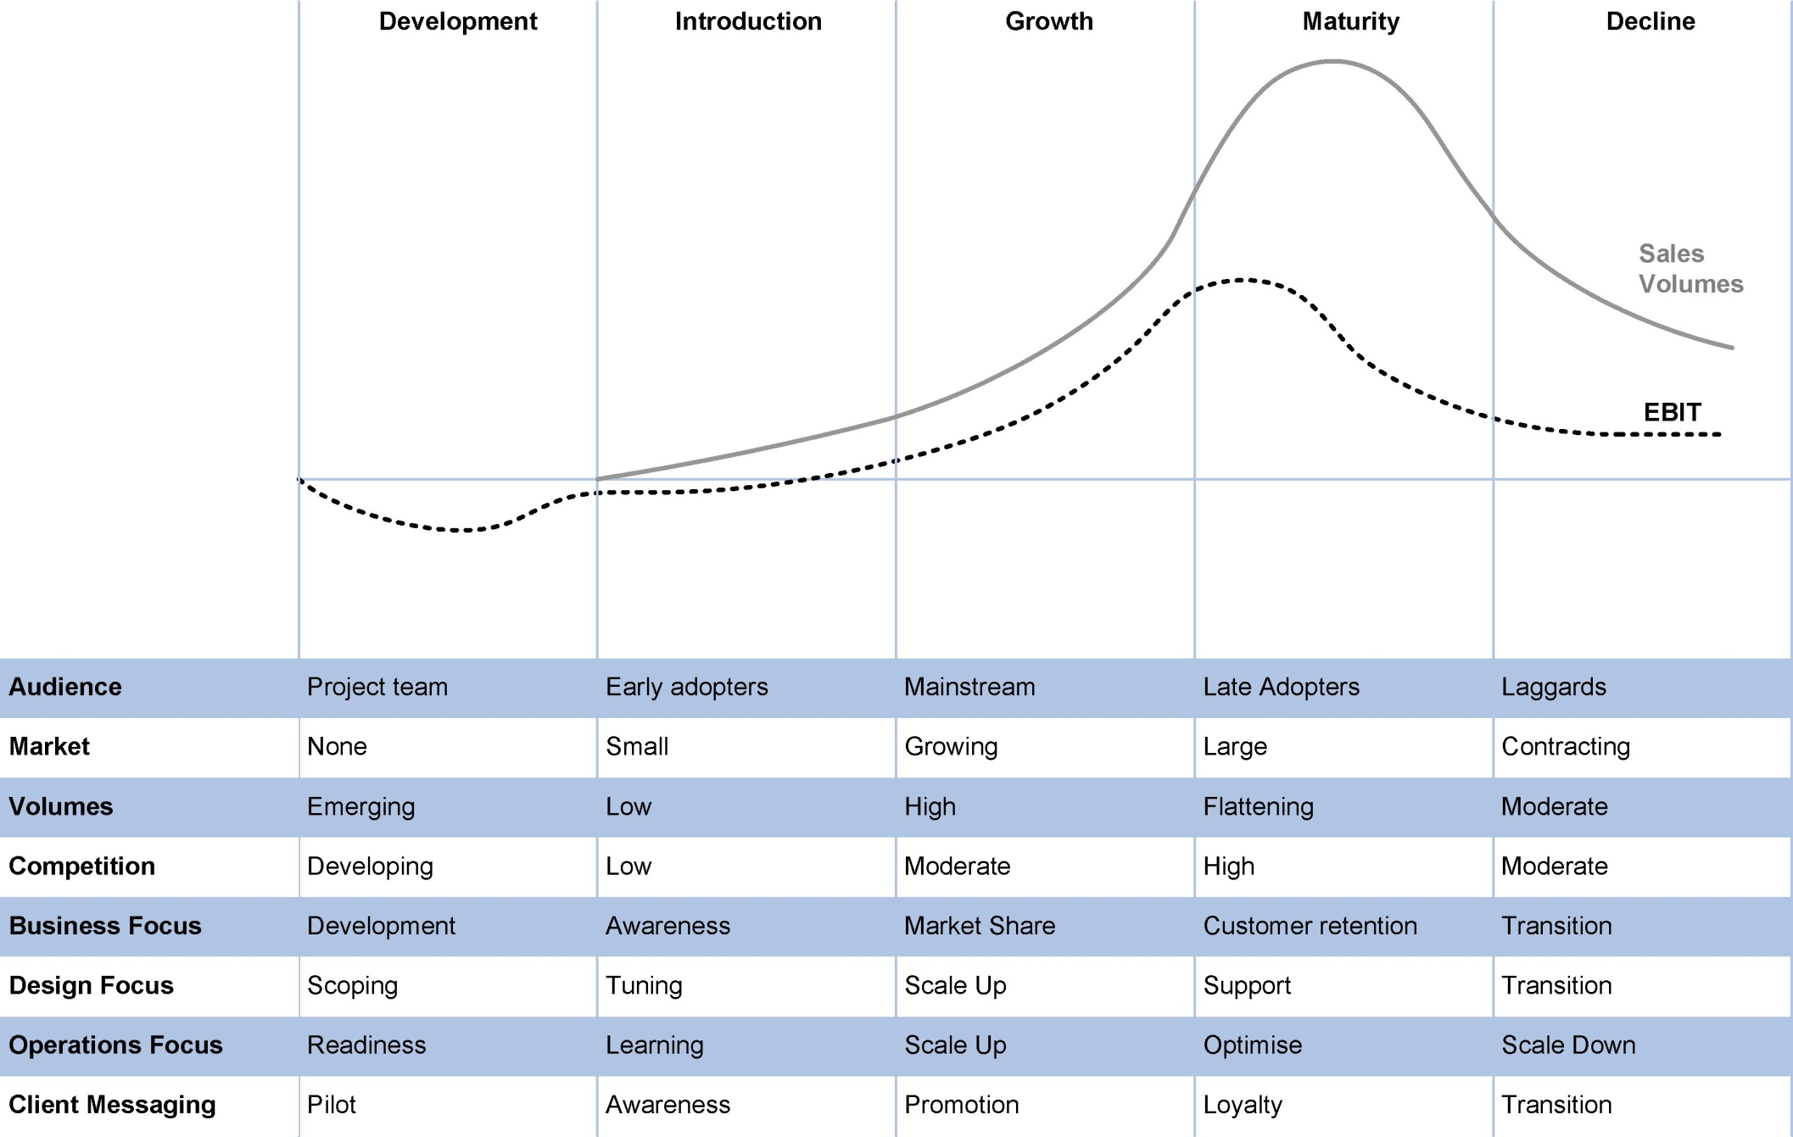
They focus on product lifecycle management
7

Slide 8
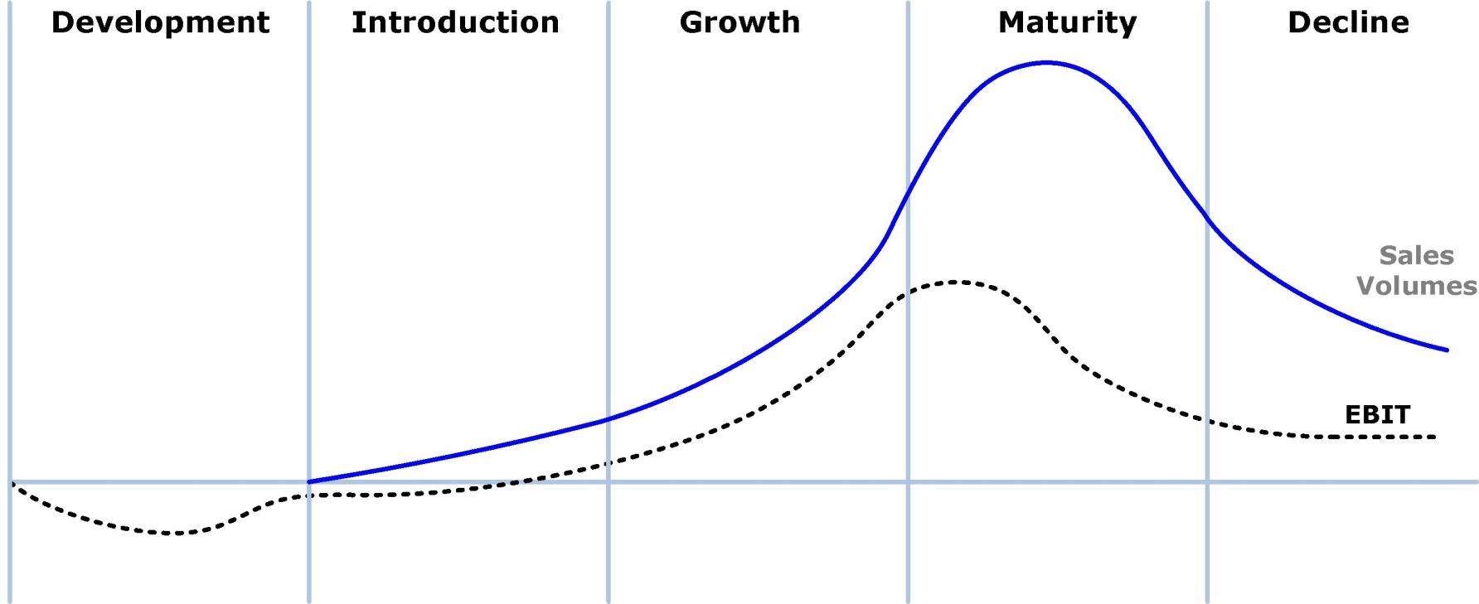
How Corporates take products to market
Key question: “Before I invest, where is my competition?”
8

Slide 9
How Corporates take products to market
Concept to Market Process
9

Slide 10
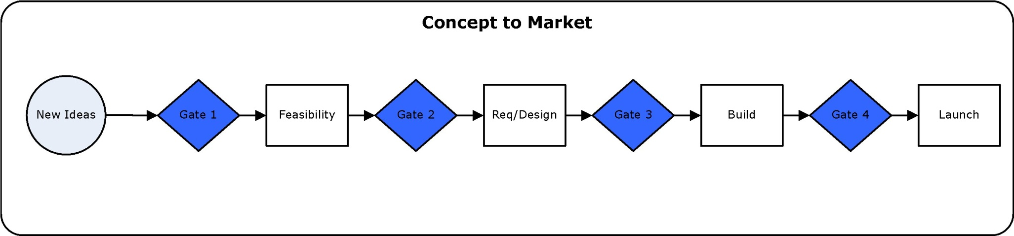
How Corporates take products to market
Balanced Score Card
Strategic fit
Market attractiveness
Client value proposition
Core competency leverage
Technical feasibility
Financial risk/reward
Next Phase readiness
2
3
Product Governance Forum
Forum provides coaching, checklists and feedback as move through process
A panel of SME’s assigned to each discipline in scorecard perform an assessment at each gate
1
10

Slide 11
Key Learnings over past 90 days

Slide 12
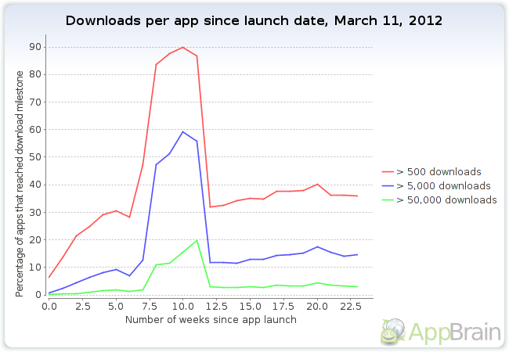
Android App Product Lifecycle is very short
Critical performance indicator
Start of growth 7-10 weeks
Not seeing this?
Proposition weak
Lack differentiation
Late entry to mature market
Lack of visibility
The process of proactively managing a products performance throughout its lifecycle in order to optimise return on investment (ROI) and market share of a product
As a product moves through each stage of its lifecycle there needs to be a different business focus
PLM involves the development of product strategies, plans and dashboards which provide context for investment in changes to products and services
Capital investment in the first three phases adding features and functionality is critical to maximise market share
7 -10 weeks
12

Slide 13
Key learnings
Visibility is your #1 problem
Your market is global not NZ
App consolidation is happening – look for opportunities!
First 30 days “New” status provides best opportunity for recognition – Use it!
Try before buy is almost mandatory for success (either freemium or free version)
Design for simplicity, ease of use. Personalisation is critical
Budget additional 25% dev costs for new release in first 3 months of launch
Build launch plan 2 months before launch
Build a brand through Social Media. It is your most powerful marketing tool (Twitter, Facebook, Youtube, Linkedin etc)
Get two reviews done within first 2 months of launch
The impact of reviews is immediate due to the number of people reading reviews and the social media following they have. They are essential in gaining app credibility & visibility.
If possible release a “network of apps” that cross promote each other (AppsGeyser)
Launch in Amazon (First!) then Google Play Market

Slide 14
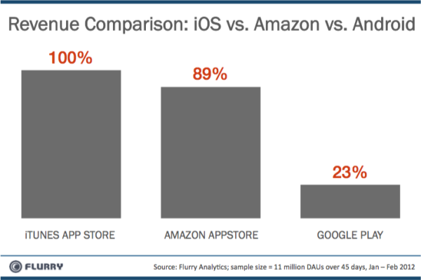

Slide 15


App reviews
Robert Nazarian, Editor in chief, Talk Android
The App has to be good!
We get hundreds of requests and only review apps that are either
high profile
interesting to the reviewer
Hit all blogs and review sites and hope someone is intrigued!
Offer an advance copy for them to review before it gets released (recommended 1 week before launch)
Offer free copies to the bloggers readers as an incentive for review as it drives more interest

Slide 16
How you guys could help each other succeed internationally
Build a shared library of collateral to help developers get product to market (Checklists, project plans, scorecards)
Assist with product launch by synchronising social media reach for the first 30 days of launch (200 advocates with 200 great reviews and a tweet a day would have an awesome effect!)
Form a product forum to run review and coaching sessions

Slide 17
Q&A
“Strive not to be a success, but rather to be of value” ~ Albert Einstein

Slide 18
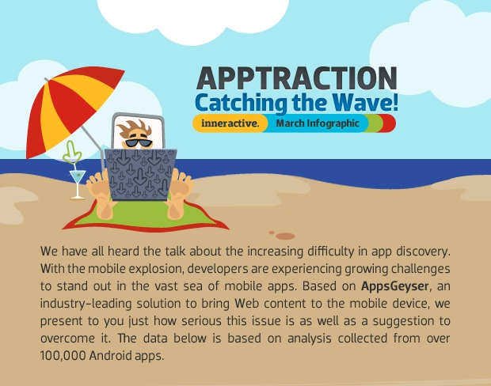

Slide 19
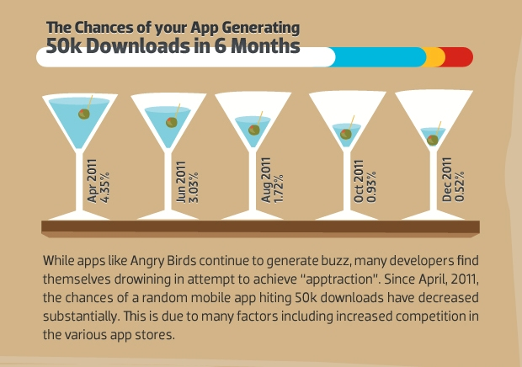

Slide 20
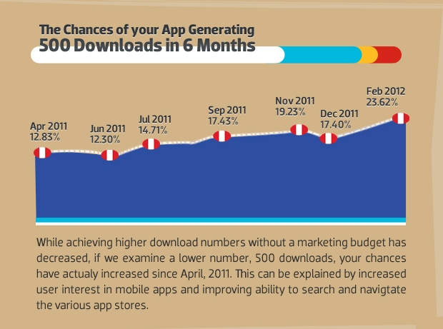

Slide 21
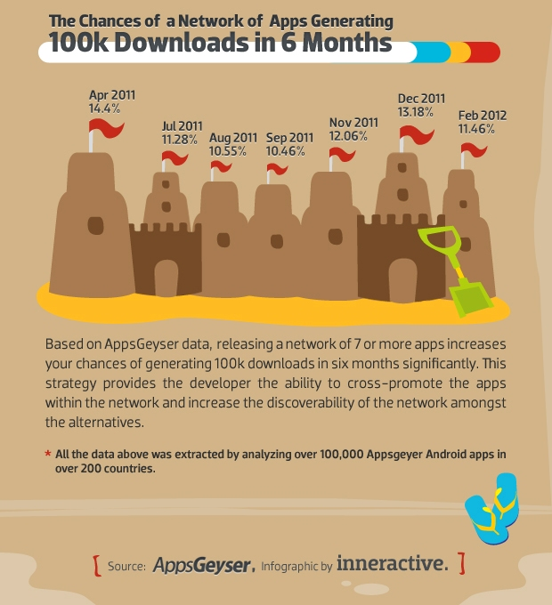

Slide 23
How Corporates take products to market
23

Slide 24

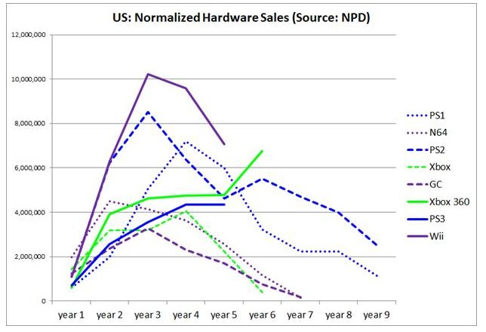
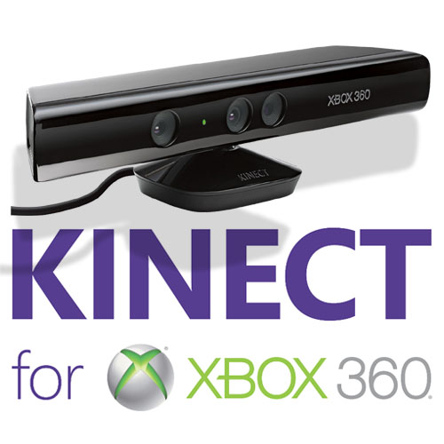
Why is PLM important?
Xbox 360 sales in the US are still accelerating six years into its life-cycle, thanks largely to enhancements like Kinect
Microsoft claim that "no other console in history can make that claim."
US Game Console Hardware Sales (Source: NPD)
Ensures we remain competitive in the market place
Enables us to make fact based decisions on what actions we should take to maximise product ROI and market share
React quickly to address issues with product performance issues
Strategic Programme 1 Training | June 2011
24

Slide 25
Why is PLM important?
Xbox 360 sales in the US are still accelerating six years into its life-cycle, thanks largely to enhancements like Kinect
Microsoft claim that "no other console in history can make that claim."
US Game Console Hardware Sales (Source: NPD)
Ensures we remain competitive in the market place
Enables us to make fact based decisions on what actions we should take to maximise product ROI and market share
React quickly to address product performance issues
25

Slide 26
Stage Gate Methodology

Slide 27
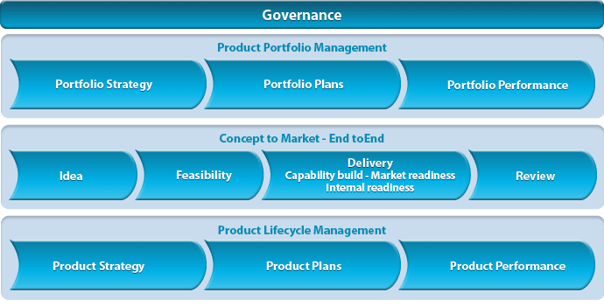
How a large organisations takes products to market
Proactively manage the lifecycle of all portfolios and products through a product governance framework
27
Notes:
This is our new Framework is under construction and an ongoing work in progress.

Slide 28
What is Product Lifecycle Management?
The process of proactively managing a products performance throughout its lifecycle in order to optimise return on investment (ROI) and market share of a product
As a product moves through each stage of its lifecycle there needs to be a different business focus
PLM involves the development of product strategies, plans and dashboards which provide context for investment in changes to products and services
Capital investment in the first three phases adding features and functionality is critical to maximise market share
28

Slide 29
What is Product Lifecycle Management?
The process of proactively managing a products performance throughout its lifecycle in order to optimise return on investment (ROI) and market share of a product
As a product moves through each stage of its lifecycle there needs to be a different business focus
PLM involves the development of product strategies, plans and dashboards which provide context for investment in changes to products and services
Capital investment in the first three phases adding features and functionality is critical to maximise market share
29

Slide 30
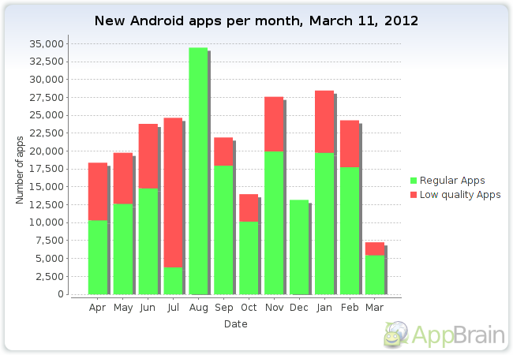

Slide 31
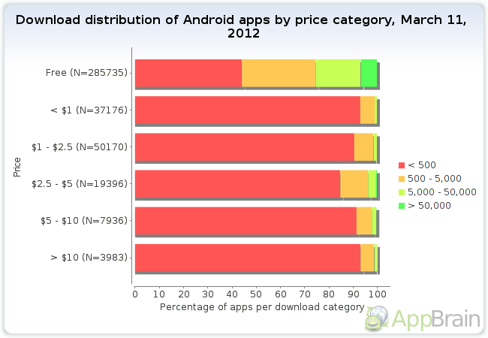

Slide 34
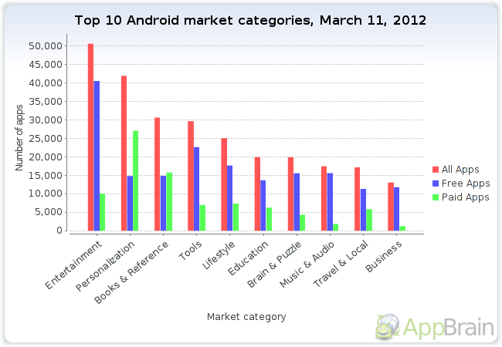

Slide 35
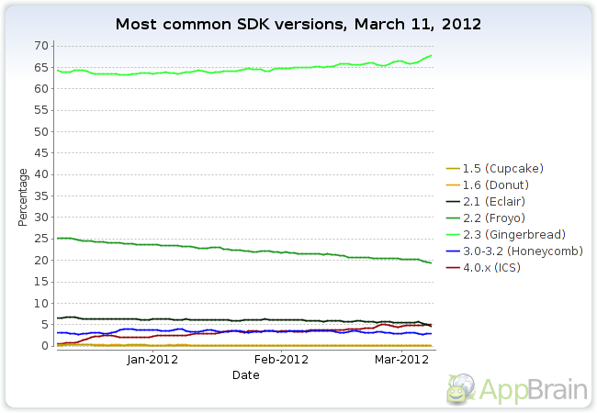

Slide 36
