Slide 1
dominoe
Notes:
Dominoe. I was in between. Fiercely independent, had money saved up, and some time before I went west.

Slide 2
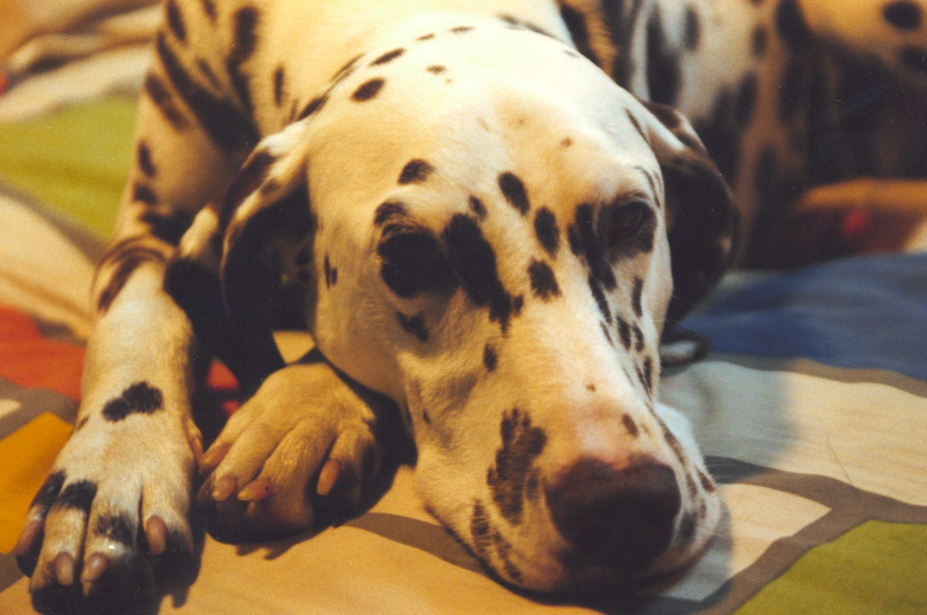
Notes:
My roommate called. Someone found a runaway dog. Dominoe.

Slide 3
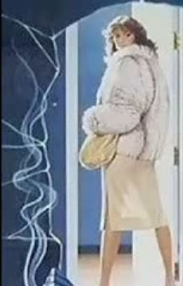
Notes:
Named her after the damsel in Sharky's Machine.

Slide 4
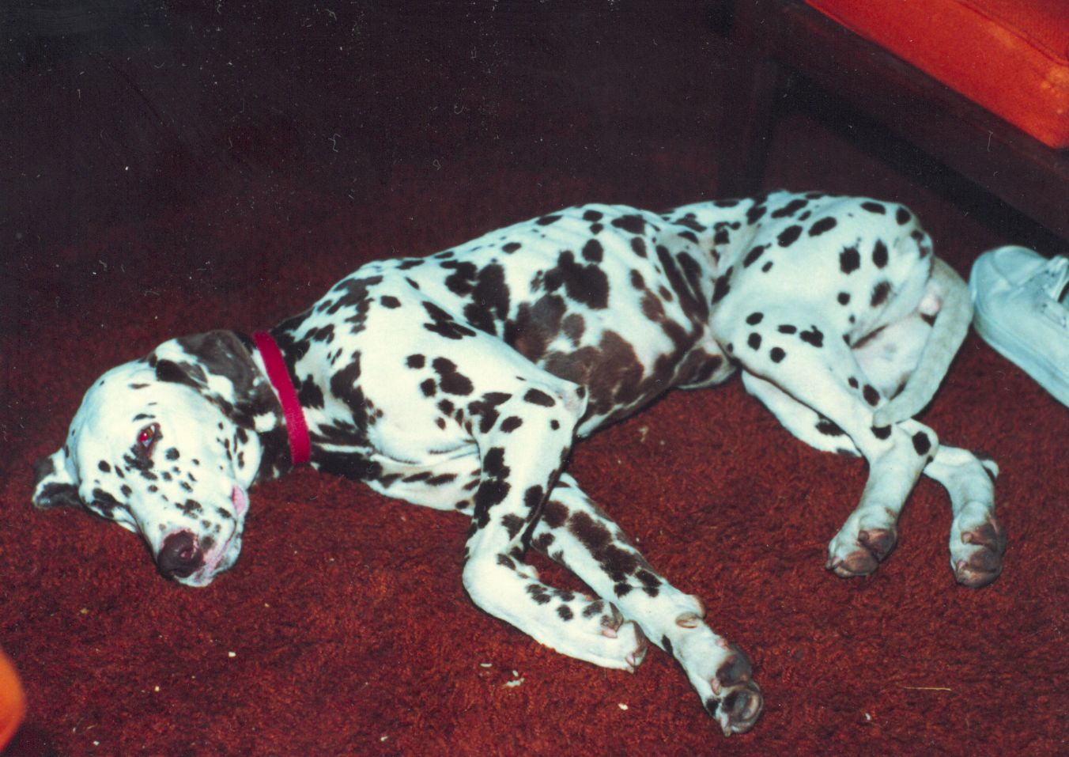
Notes:
Malnourished, skittish, afraid of a raised hand.

Slide 5
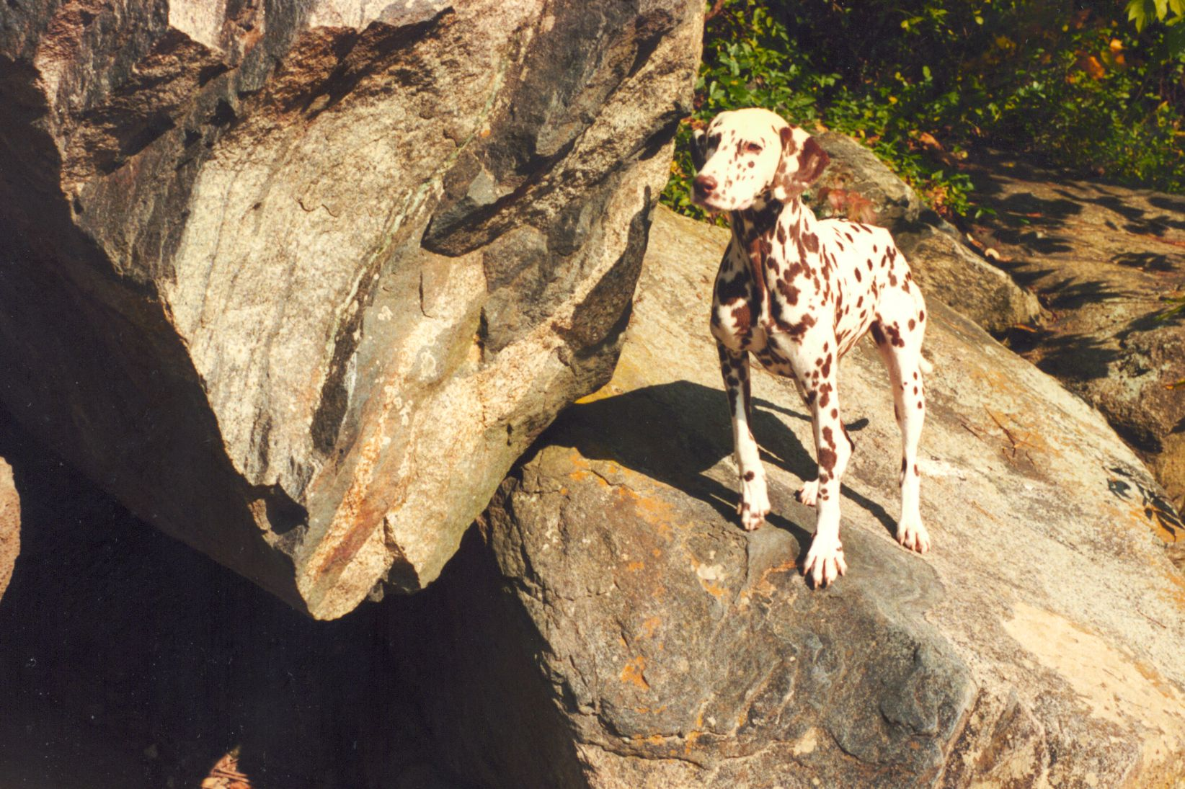
Notes:
We walked into the woods, she always following a few yards away, my buddy.

Slide 6
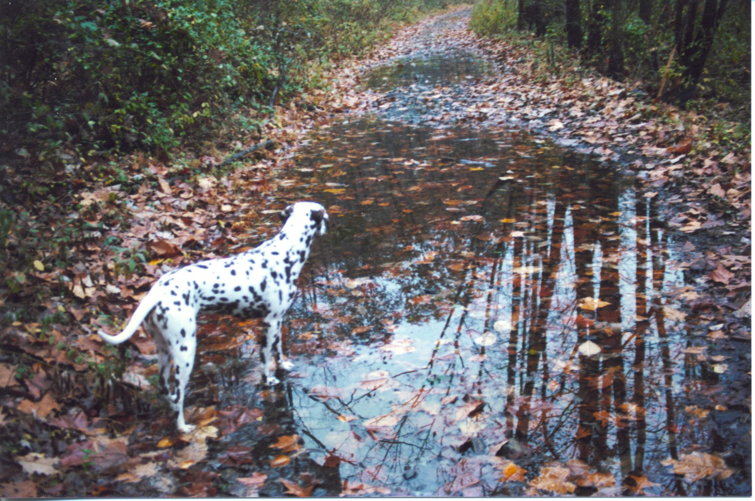
Notes:
One day we drove farther and walked in the autumn leaves.

Slide 7
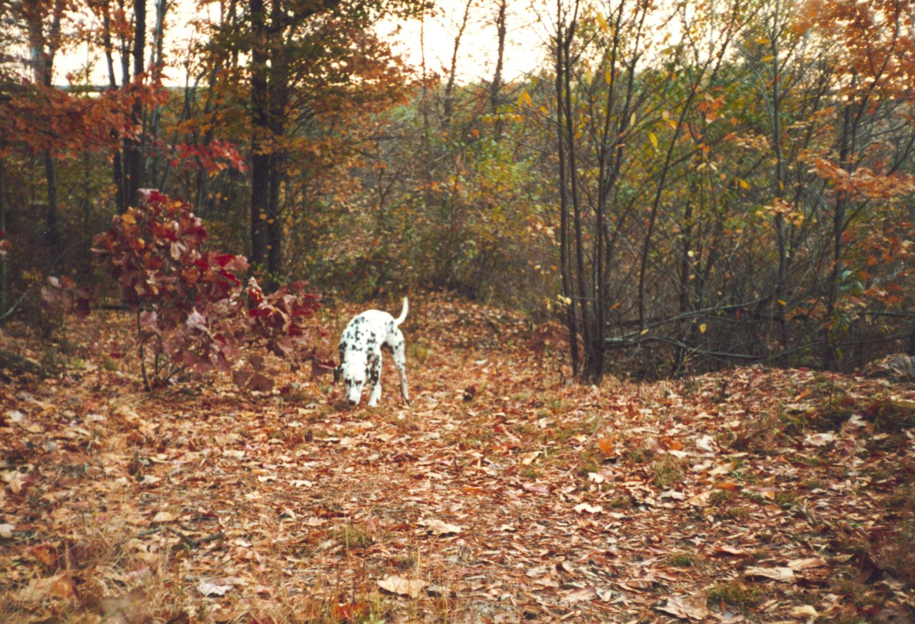
Notes:
Met an old friend. We chatted about 15 minutes, and I turned around.

Slide 8
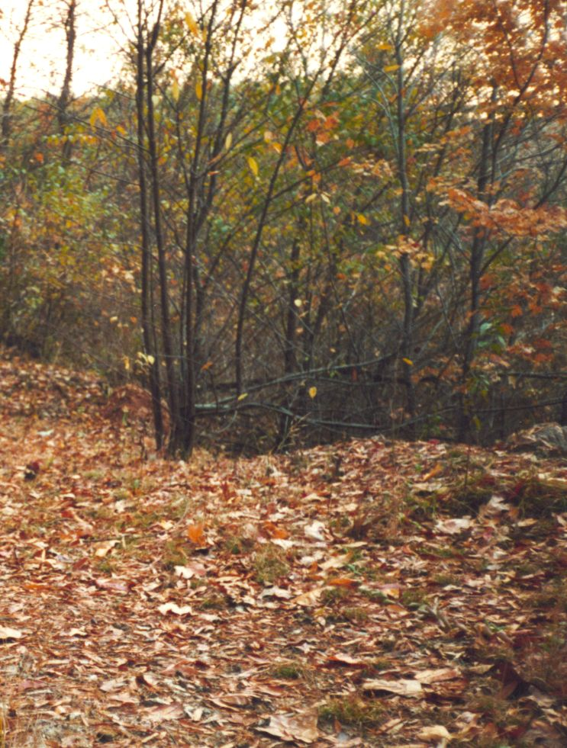
Notes:
She was gone.
I was hours running up and down the trail, crying out her name. I was worthless. I could take care of myself, but no one else, worthless.

Slide 9
darkness
Notes:
Darkness,

Slide 10
Notes:
I would camp out, return the next day. I would do that every day until I found her. Every day.

Slide 11
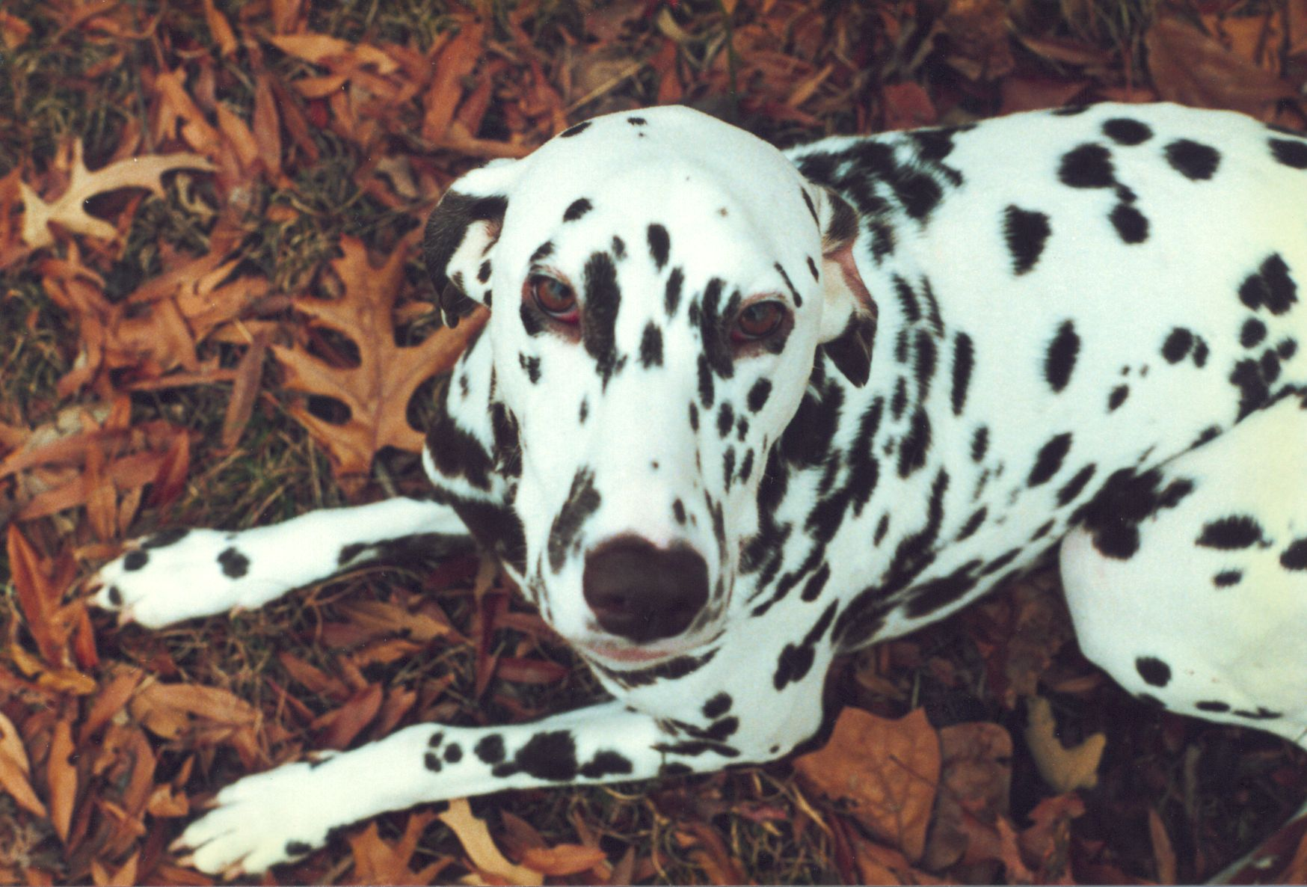
Notes:
I cried back to the car... and there she was, waiting for me.

Slide 12
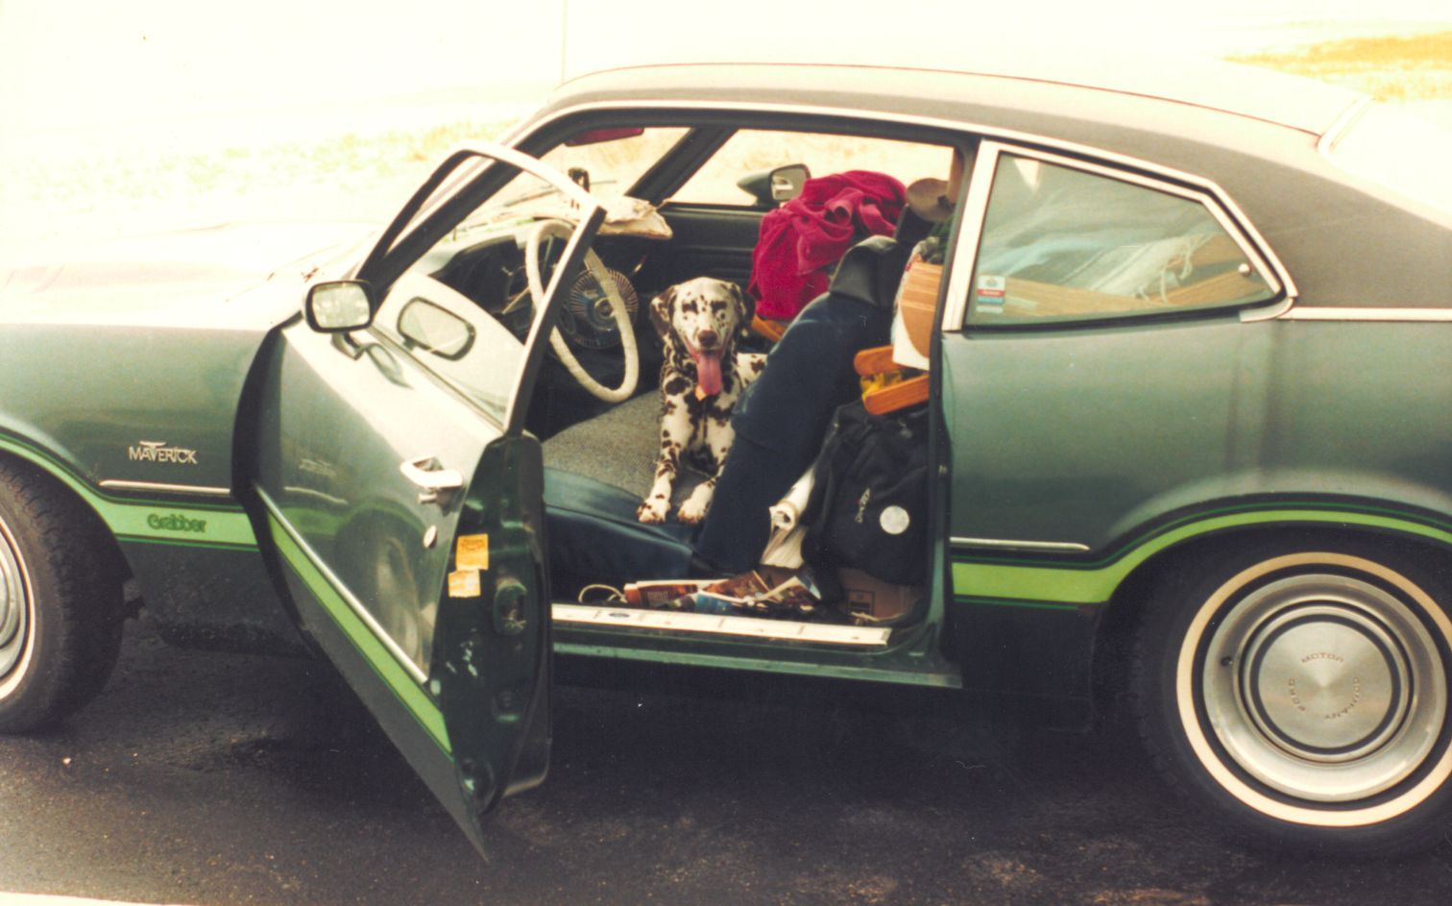
Notes:
My awareness became a circle of responsibility of more than just myself.

Slide 13
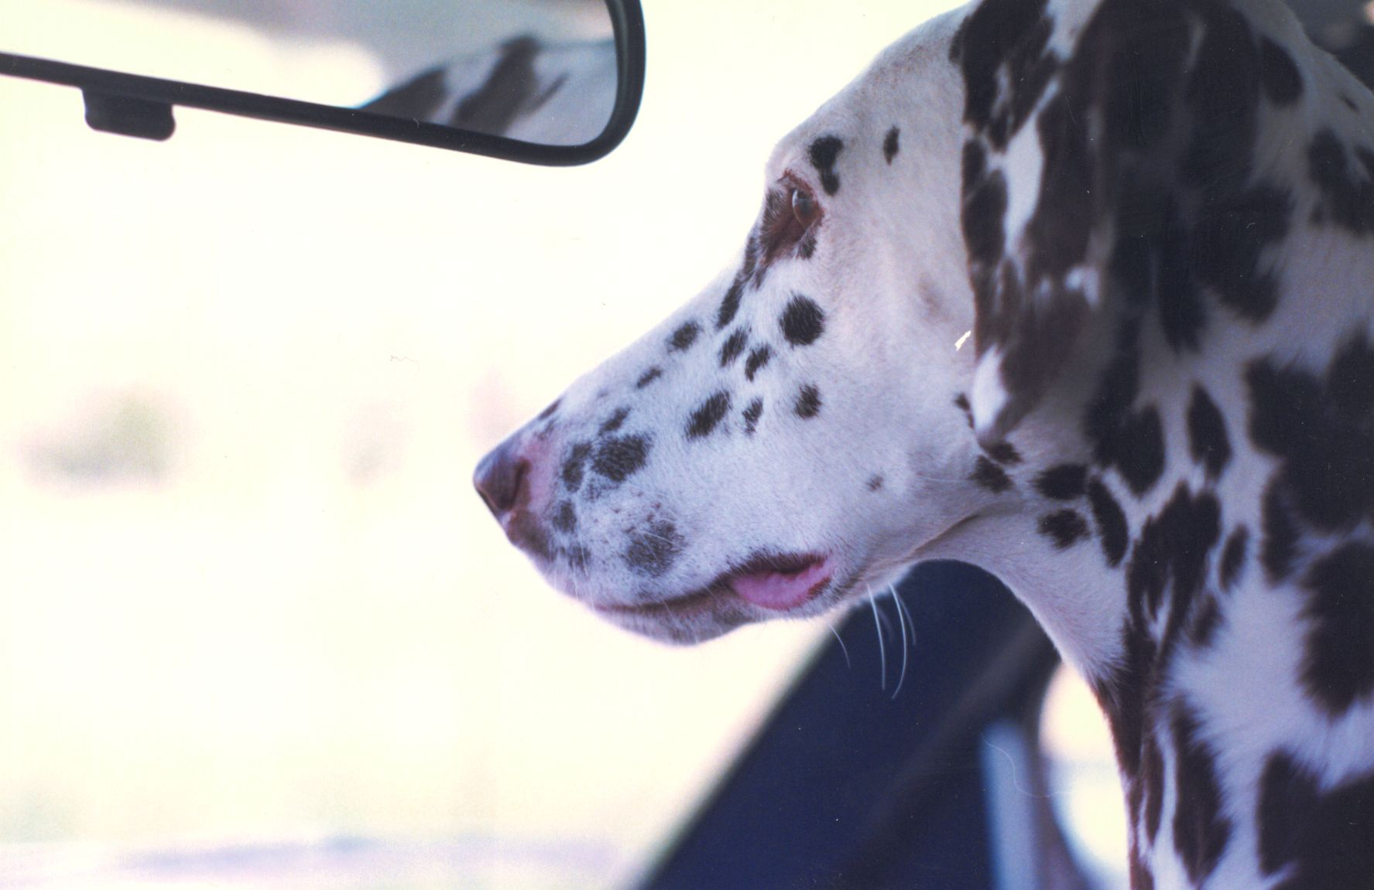
Notes:
We drove

Slide 14
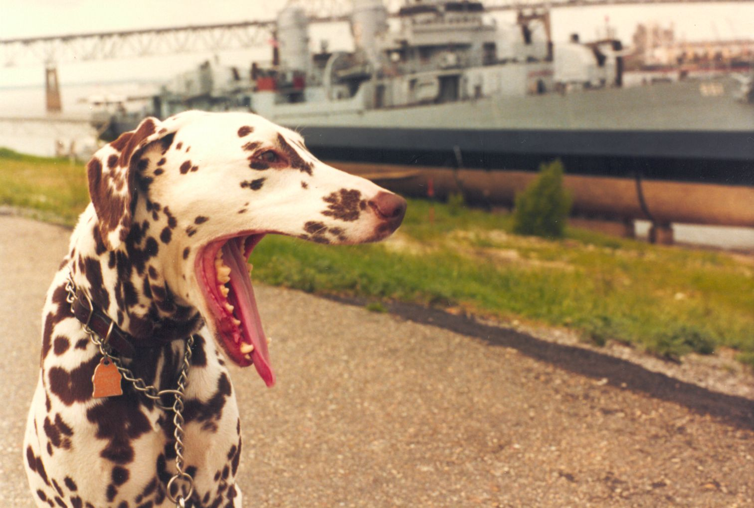
Notes:
across the country

Slide 15
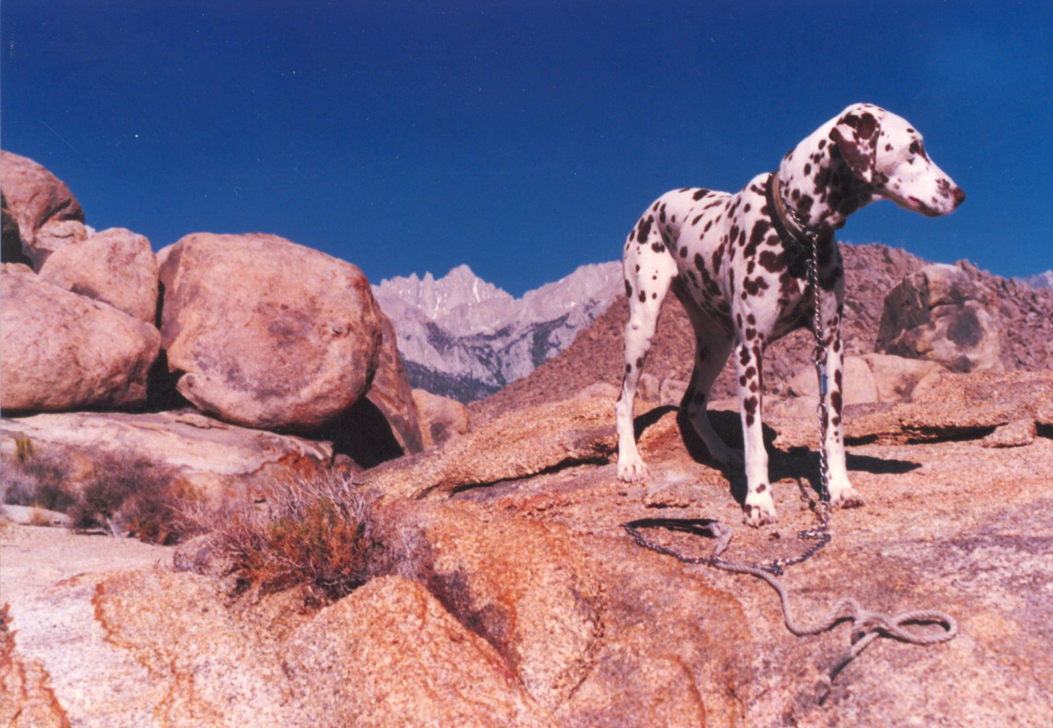
Notes:
we had adventures

Slide 16
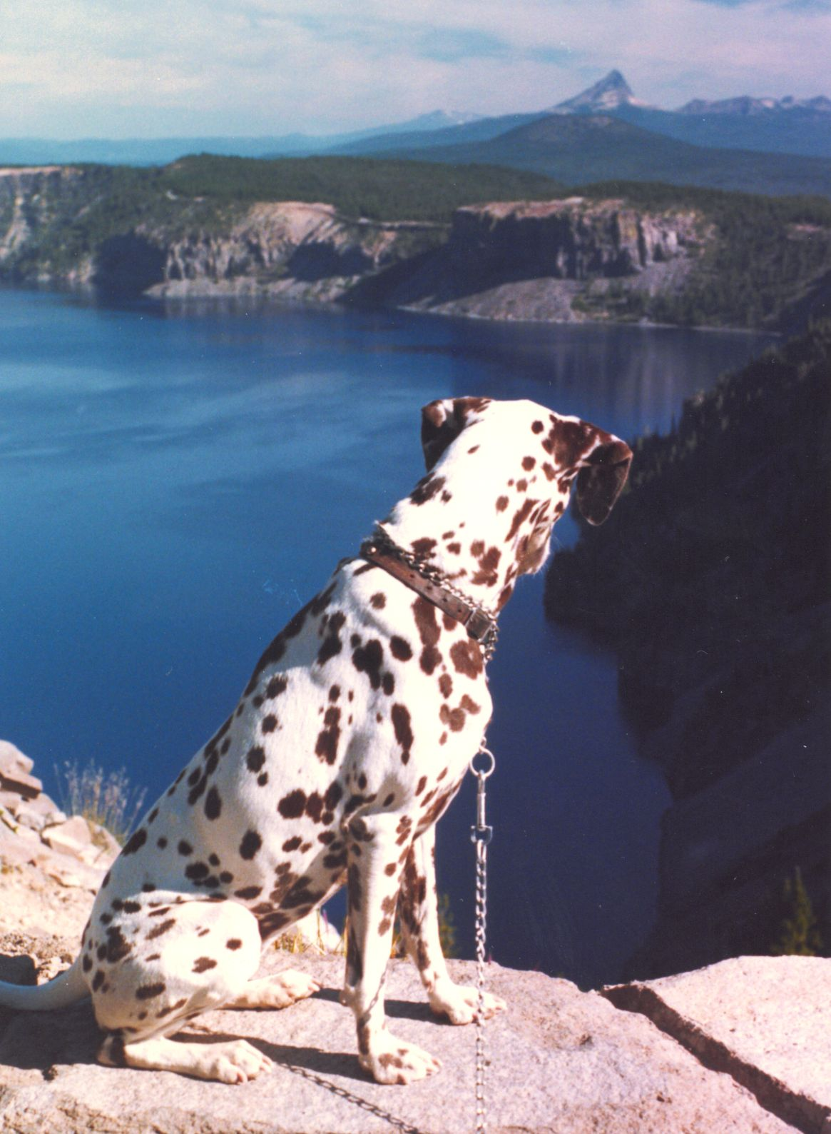
Notes:
to new exciting lands.

Slide 17
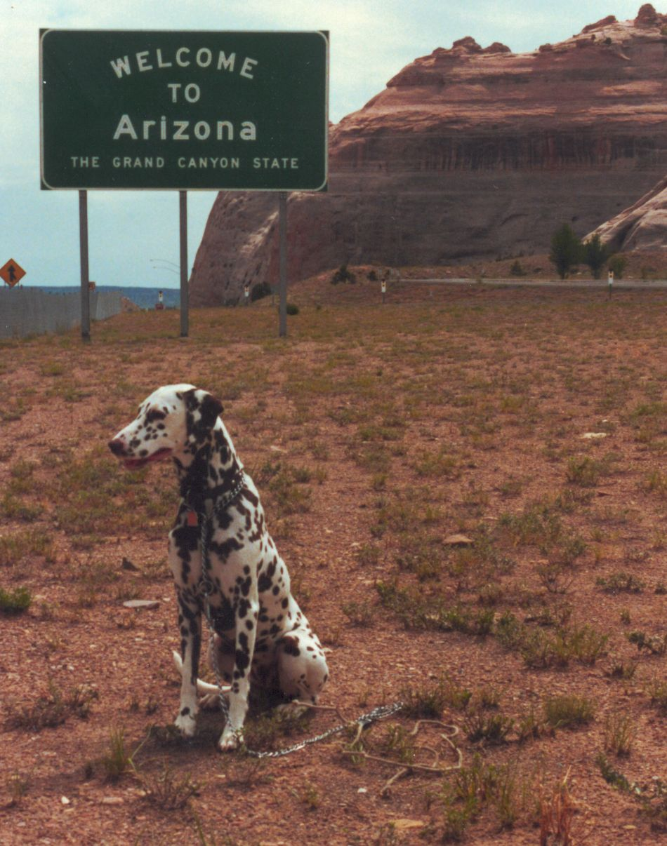
Notes:
Made a home in Arizona. We were companions.

Slide 18
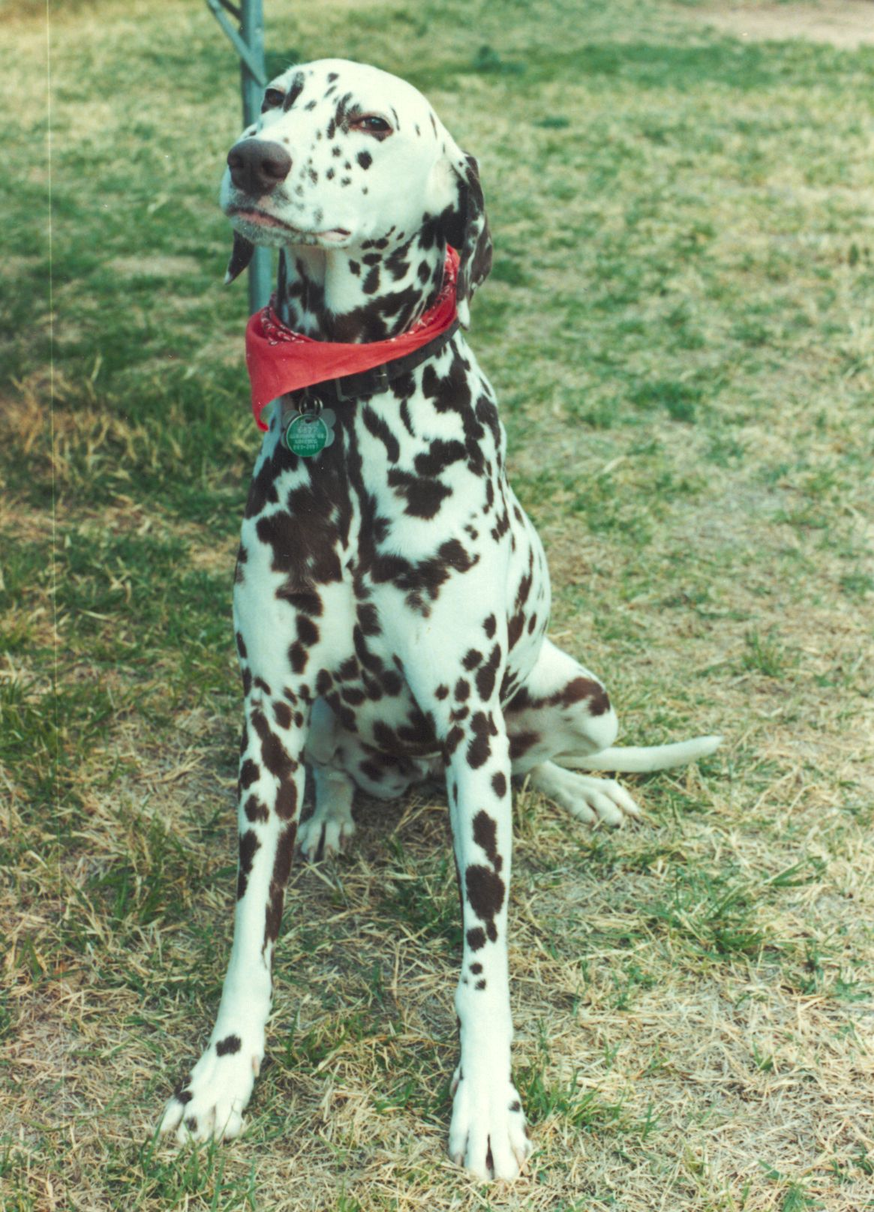
Notes:
We parted permanently, but I never forgot what I learned that day in the woods.

Slide 19
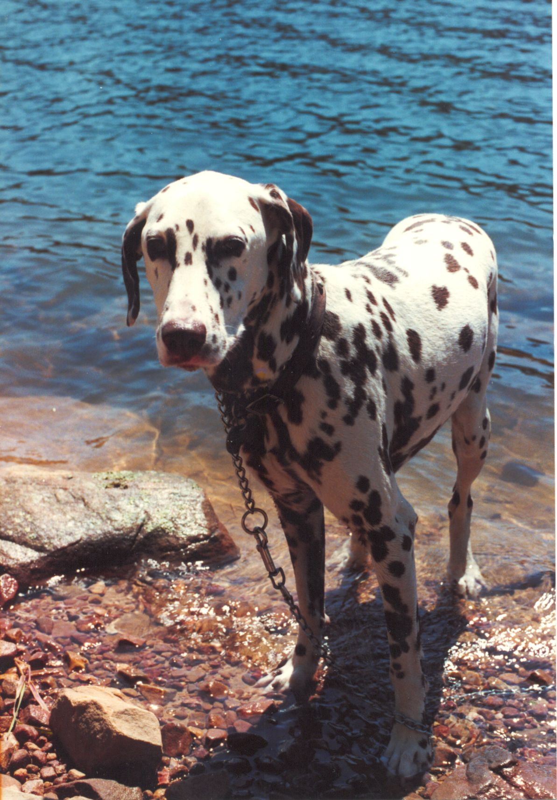
Notes:
Dominoe.

