Slide 1
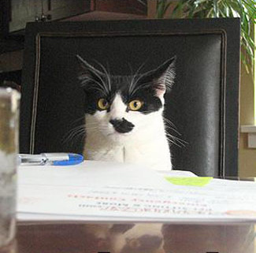

about me - Jasper
Software Engineer from Hamburg, Germany
Doing serious work in the financial sector
    (see Picture)
A bit of change: coming to New Zealand
Notes:
Hi team, this is Jasper with a little presentation about myself and what I'm working on right now.
I'm from the northern part of germany, close to the coast of the north sea. Technology has always been a fascinating thing for me, ever since I had my first computer in the eighties.
In the early nineties a got involved with computer networks like FIDONET and a bit later with the internet – GeoCities was the big thing at that point, if someone wants to recall this blinking beauty for the moment
So being on the boat right from the beginning, I started earning some money by doing static websites, progressing to database backed dynamic ones and decided that I should go to university to get a solid background in Software Engineering
After graduating I've been working for four years for a company which develops web applications for the financial sector.
The interesting part was certainly not the work on the backend where we had to implement complex but rather boring models about insurance payments, provision distrubution and similar oddities.
Since everything developed there was based on web technologies, I had the opportunity to learn a lot about all the neat things you can do to bring the user experience for a web application to a whole new level – using bleeding edge technologies has been a key factor for the success of company.
Working mostly on the frontend aspects of their inhouse web frameworks for the last two years, I had great freedom in further developing my skills on web applications but still -
I felt it was time for a change, and having been to New Zealand for eight month a couple of years ago my partner Marie and I deceided to come over, have a long holiday, travel around the country and see what might come along our path here

Slide 2
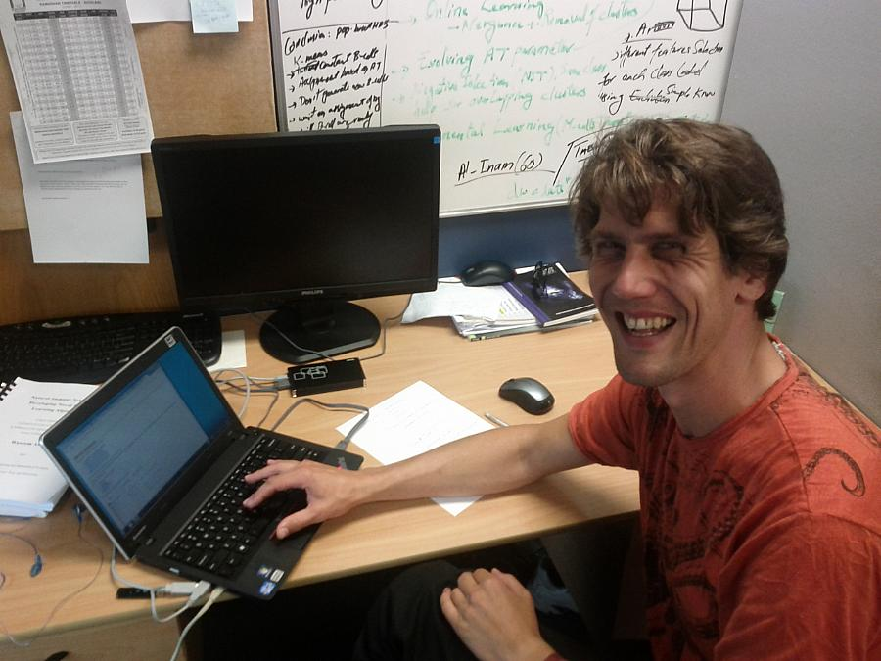
Working for SlideSpeech
Notes:
And then one morning John called and the next thing I know is me working on his project
Although I'm used to work in agile development environments, the work right now is quite a difference to everything I've experienced so far – you'll never know whats going to happen the next day!
Over the last three weeks we have added some new communication channels to coordinate the tasks inbetween the team members and I really like the idea that we'll be using our own product to help us in that respect as well
The question for me right now is the following: After I finished creating this presentation, what am I going to do to distribute it to all the team members?
Probably finding one of our currently running pagekite instances of SlideSpeech, getting a link by email and forward that to all the members of the team or posting it on yammer
Thats all easy, but what if I use a slidespeech instance that is used for development right now, and it won't work, or loose the content when somebody wants to have a look at it later?
I think if we're seroius about dogfooding, we have to address this issue, which will be the same for any organisation using slidespeech as a way of internal communication – providing a reliable and searchable storage and creating easy to use tools to establish a community of interacting users

Slide 3
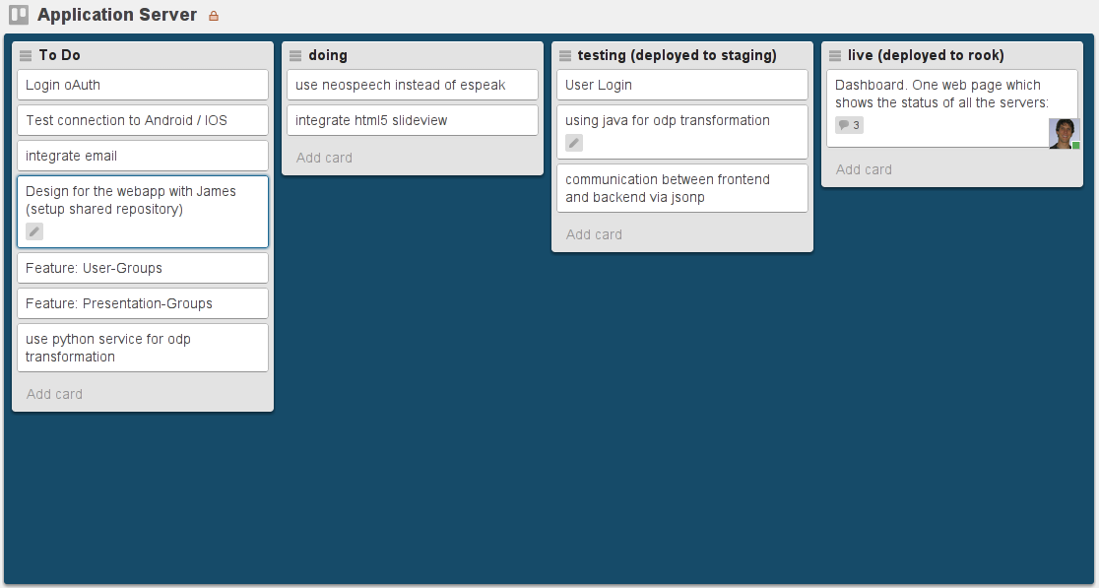
Architecture and development of the slidespeech application server
Notes:
My task is to develop a slidespeech application server which is used as a central hub for content and communication.
It serves as the first entry point for a new user to try out the possiblities slidespeech can offer, without the need to install anything or register yourself
It also collects and organises all the different kinds of content the users are creating and also gives them the ability to sell their content through our store
It can be used be a range of different devices and platforms to browse through the content and play slideshows from the server, just by downloading small packages of images and text
It also provides a set of tools to enable the users to collaborate on the creation and modification of content
Theres a lot to be done right now, so I'll better finish this presentation – any suggestions about features for the slidespeech application server you can think of are very much welcome, just mail to everyone on the list or do a post on yammer for the moment
And one last thing of course: I think virtual meetings are quite alright, but I really look forward to see you all again in the next real meeting!

