Slide 1
02445 - Statistical Evaluation of AI | midway check-in
Does Gemma do worse on graphs than on text?
The statistical tests we use - are they appropriate?
Gemma 4 answers 405 DTU ML exam multiple-choice questions (options A-D, plus E = don't know).
Outcome is binary: correct / wrong, scored against the official answer key.

Slide 2
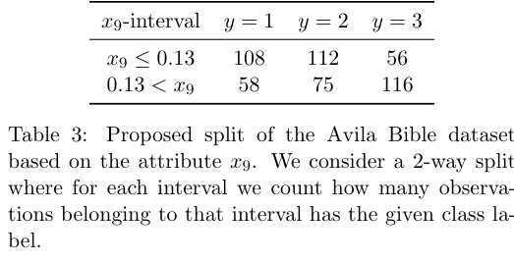
WHAT WE GIVE GEMMA
The same question, two formats
Consider the split in Table 3. We build a classification tree with only this split and evaluate it on the same data it was trained on. What is the accuracy?
A. 0.64 B. 0.29 C. 0.35 D. 0.43 E. Don't know
GIVEN AS TEXT
GIVEN AS IMAGE (cropped from the exam PDF)
x9-interval y=1 y=2 y=3
x9 <= 0.13 108 112 56
0.13 < x9 58 75 116
Only the format of the data changes - the stem and options are identical in both arms.
Gemma replies with one letter; we score correct / wrong (here the key is D).

Slide 3
THE DATA BEHIND THE TESTS
Accuracy numbers we feed into the tests
Accuracy by format
Paired set, image vs text (McNemar)
Format | Correct / n | Accuracy
pure text | 98 / 134 | 73.1%
figure/table as text | 80 / 127 | 63.0%
figure/table as image | 54 / 127 | 42.5%
geometric figure (image only) | 52 / 144 | 36.1%
 | text right | text wrong
image right | 45 | 9
image wrong | 35 | 38
127 paired questions; only the 44
disagreements (35 vs 9) drive the test.
Contamination check (exams Gemma may have seen vs. not): pre-cutoff 263 / 498 = 52.8% vs. post-cutoff 46 / 68 = 67.6%

Slide 4
THE TESTS WE USE
Each test and why it fits a binary outcome
Test | What it compares | Why it is appropriate
Binomial test (exact) | each format's accuracy vs. 25% chance | exact test for one proportion; no large-n assumption
McNemar, exact (paired) - PRIMARY | same question as image vs. as text | the paired binary test; pairing removes question difficulty
Two-proportion z (unpaired) | text questions vs. pure-graph questions | standard 2-proportion test; n > 130 per group
One-sided z | pre-cutoff vs. post-cutoff exams | 2-proportion test; one-sided (contamination has a direction)
95% confidence interval | every accuracy and difference | course-standard normal interval; paired diff uses paired formula
Binary outcome -> the proportion / McNemar family (not t-tests or ANOVA, which need a numeric outcome).

Slide 5
WHAT WE WOULD LIKE YOUR INPUT ON
Design choices to confirm
1. Binary outcome (correct/wrong) -> proportion / McNemar family rather than t-test / ANOVA. OK?
2. McNemar is our single confirmatory (primary) test -> we argue no multiple-testing correction is needed.
3. The unpaired text-vs-graph z has difficulty confounded with format -> we report it as secondary.
4. Contamination test is one-sided (pre-cutoff > post-cutoff). Is one-sided the right call?
5. Confidence intervals use the 02402 normal approximation (we dropped Wilson / bootstrap as off-syllabus).
Are these five choices appropriate, or would you change any before we scale up the analysis?

