Slide 1
MapReduce Large Scale Data Mining
Helge Holzmann, Avishek Anand
L3S Research Center, Hannover, Germany
14/04/2016
based on Mining Massive Datasets
by Jure Leskovec, Anand Rajaraman, Jeff Ullman (Stanford University)
http://www.mmds.org
Code examples on https://github.com/helgeho/MapReduceLecture

Slide 2
What are we going to talk about?
Programming from imperative, procedural; to functional; to parallel; to distributed; to MapReduce
Distributed computations and file systems
Problems and algorithms
Refinements, extensions, alternatives
… many buzzwords Hadoop, Pig, Hive, Spark, … is it Pokemon or BigData? https://pixelastic.github.io/pokemonorbigdata

Slide 3
MapReduce
Much of the course will be devoted to large scale computing for data mining
Challenges:
How to distribute computation?
Distributed/parallel programming is hard
Map-reduce addresses all of the above
Google’s computational/data manipulation model
Elegant way to work with big data

Slide 4
Single Node Architecture
CPU
Machine Learning, Statistics
Memory
“Classical” Data Mining
Disk

Slide 5
Motivation: Google Example
20+ billion web pages x 20KB = 400+ TB
1 computer reads 30-35 MB/sec from disk
~4 months to read the web
~1,000 hard drives to store the web
Takes even more to do something useful with the data!
Today, a standard architecture for such problems is emerging:
Cluster of commodity Linux nodes
Commodity network (ethernet) to connect them

Slide 6
Cluster Architecture
2-10 Gbps backbone between racks
1 Gbps between
any pair of nodes
in a rack
Switch
Switch
Switch
CPU
CPU
CPU
CPU
Mem
…
Mem
Mem
…
Mem
Disk
Disk
Disk
Disk
Each rack contains 16-64 nodes
In 2011 it was guestimated that Google had 1M machines, http://bit.ly/Shh0RO

Slide 7


Slide 8
Large-scale Computing
Large-scale computing for data mining problems on commodity hardware
Challenges:
How do you distribute computation?
How can we make it easy to write distributed programs?
Machines fail:
One server may stay up 3 years (1,000 days)
If you have 1,000 servers, expect to loose 1/day
People estimated Google had ~1M machines in 2011
1,000 machines fail every day!

Slide 9
Example: Sum of Number Strings
SUM("two", "seven", "one", "five") = 15
Map strings to numbers: two → 2, seven → 7, one → 1, five → 5
Sum (reduce): 2 + 7 + 1 + 5 = 15
Assumption: Mapping is expensive
Implementations (from imperative to functional):
Sequential: Sequential.java
Multi-threaded, concurrent: Threaded.java
Multi-threaded, synchronized: Synchronized.java
Multi-threaded, parallel: Parallel.java
Multi-threaded, parallel, refactored: ParallelRefactored.java
Functional, parallel (in Scala): NumberSum.scala

Slide 10
Implementations: Sum of Number Strings
Imperative / Sequential
Not easily parallelizable
Concurrent
Challenge: side effects
Synchronized
Losing parallelism
Functional / Parallel
No side effects
Easily parallizable
Think functional!

Slide 11
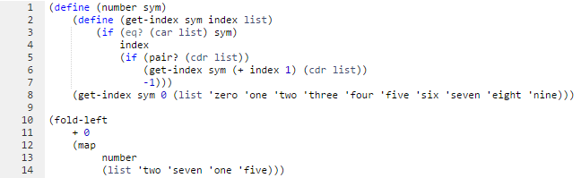
Functional Implementation in Scheme / Lisp
No side effects, less verbose
(reduce is performed by fold-left here)
Think functional!

Slide 12
From Parallel to Distributed
From one to multiple machines
Distribute the data
Distributed File System
Distribute the computation
Loosely coupled code, distributed computing, central coordination
Previous example: Sum of number strings
Hadoop Implementation: NumberSumHadoop.java

Slide 13
Distributed File System
Reliable distributed file system
Data kept in “chunks” spread across machines
Each chunk replicated on different machines
Seamless recovery from disk or machine failure
C₀
C₁
D₀
C₁
C₂
C₅
C₀
C₅
…
C₅
Chunk server 1
C₂
C₅
Chunk server 2
C₃
D₀
Chunk server 3
D₁
D₀
Chunk server N
C₂
Bring computation directly to the data!
Chunk servers also serve as compute servers
Notes:
13

Slide 14
Distributed File System
Chunk servers
File is split into contiguous chunks
Typically each chunk is 16-64MB
Each chunk replicated (usually 2x or 3x)
Try to keep replicas in different racks
Master node
a.k.a. Name Node in Hadoop’s HDFS
Stores metadata about where files are stored
Might be replicated
Client library for file access
Talks to master to find chunk servers
Connects directly to chunk servers to access data

Slide 15
MapReduce: Overview
Sequentially read a lot of data
Map:
Extract something you care about
Group by key: Sort and Shuffle
Reduce:
Aggregate, summarize, filter or transform
Write the result
Outline stays the same, Map and Reduce change to fit the problem

Slide 16
MapReduce: The Map Step
Input
key-value pairs
Intermediate
key-value pairs
k
v
map
k
v
k
v
map
k
v
k
v
…
…
k
v
k
v

Slide 17
MapReduce: The Reduce Step
Output
key-value pairs
Intermediate
key-value pairs
Key-value groups
reduce
k
v
k
v
v
v
k
v
Group
by key
reduce
k
v
k
v
v
k
v
k
v
…
…
…
k
v
k
v
k
v

Slide 18
More Specifically
Input: a set of key-value pairs
Programmer specifies two methods:
Map(k, v) → <k’, v’>*
Takes a key-value pair and outputs a set of key-value pairs
E.g., key is the filename, value is a single line in the file
There is one Map call for every (k,v) pair
Reduce(k’, <v’>*) → <k’, v’’>*
All values v’ with same key k’ are reduced together and processed in v’ order
There is one Reduce function call per unique key k’

Slide 19
Map-Reduce
Programmer specifies:
Map and Reduce and input files
Workflow:
Read inputs as a set of key-value-pairs
Map transforms input kv-pairs into a new set of k'v'-pairs
Sorts & Shuffles the k'v'-pairs to output nodes
All k’v’-pairs with a given k’ are sent to the same reduce
Reduce processes all k'v'-pairs grouped by key into new k''v''-pairs
Write the resulting pairs to files
All phases are distributed with many tasks doing the work
Input 0
Input 1
Input 2
Map 0
Map 1
Map 2
Shuffle
Reduce 0
Reduce 1
Out 0
Out 1

Slide 20
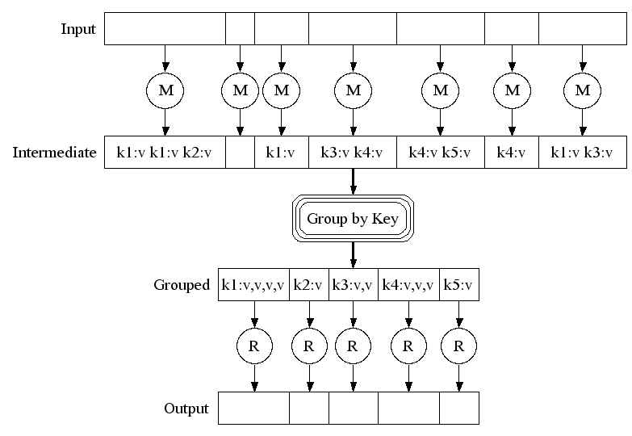
Map-Reduce: A diagram
Big document
MAP:
Read input and produces a set of key-value pairs
Group by key:
Collect all pairs with same key
(Hash merge, Shuffle, Sort, Partition)
Reduce:
Collect all values belonging to the key and output

Slide 21
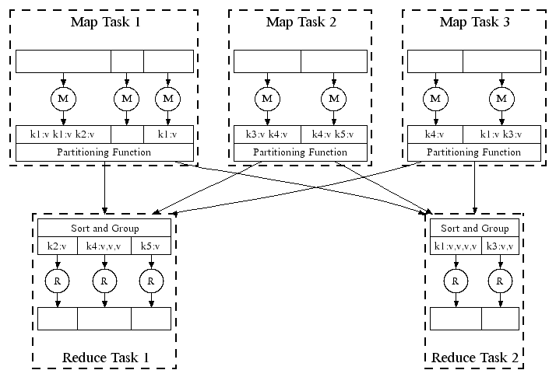
Map-Reduce: In Parallel
All phases are distributed with many tasks doing the work

Slide 22
Map-Reduce: Environment
Map-Reduce environment takes care of:
Partitioning the input data
Scheduling the program’s execution across a set of machines
Performing the group by key step
Handling machine failures
Managing required inter-machine communication

Slide 23
Data Flow
Input and final output are stored on a distributed file system (FS):
Scheduler tries to schedule map tasks “close” to physical storage location of input data
Intermediate results are stored on local FS of Map and Reduce workers
Output is often input to another MapReduce task

Slide 24
Implementations
Google
Not available outside Google
Hadoop
An open-source implementation in Java
Uses HDFS for stable storage
Download: http://lucene.apache.org/hadoop/
Aster Data
Cluster-optimized SQL Database that also implements MapReduce

Slide 25
Programming Model: MapReduce
Warm-up task:
We have a huge text document
Count the number of times each distinct word appears in the file
Sample application:
Analyze web server logs to find popular URLs

Slide 26
MapReduce: Word Counting
Provided by the programmer
Provided by the programmer
MAP:
Read input and produces a set of key-value pairs
Group by key:
Collect all pairs with same key
Reduce:
Collect all values belonging to the key and output
The crew of the space shuttle Endeavor recently returned to Earth as ambassadors, harbingers of a new era of space exploration. Scientists at NASA are saying that the recent assembly of the Dextre bot is the first step in a long-term space-based man/mache partnership. '"The work we're doing now -- the robotics we're doing -- is what we're going to need ……………………..
(The, 1)
(crew, 1)
(of, 1)
(the, 1)
(space, 1)
(shuttle, 1)
(Endeavor, 1)
(recently, 1)
….
(crew, 1)
(crew, 1)
(space, 1)
(the, 1)
(the, 1)
(the, 1)
(shuttle, 1)
(recently, 1)
…
(crew, 2)
(space, 1)
(the, 3)
(shuttle, 1)
(recently, 1)
…
Sequentially read the data
Only sequential reads
Big document
(key, value)
(key, value)
(key, value)

Slide 27
Word Count Using MapReduce
map(key, value):
// key: document name; value: text of the document
for each word w in value:
emit(w, 1)
reduce(key, values):
// key: a word; value: an iterator over counts
result = 0
for each count v in values:
result += v
emit(key, result)

Slide 28
Example: Word Count
Input: (big) text file(s), one sentence per line, split per line
Mapper input: one sentence
Mapper output: (word, 1) pairs
Reducer input: one word, corresponding pairs
Reducer output: (word, count) pairs
Implementations:
Functional: WordCount.scala
Hadoop: WordCountHadoop.java

Slide 29
Coordination: Master
Master node takes care of coordination:
Task status: (idle, in-progress, completed)
Idle tasks get scheduled as workers become available
When a map task completes, it sends the master the location and sizes of its R intermediate files, one for each reducer
Master pushes this info to reducers
Master pings workers periodically to detect failures

Slide 30
Dealing with Failures
Map worker failure
Map tasks completed or in-progress at worker are reset to idle
Reduce workers are notified when task is rescheduled on another worker
Reduce worker failure
Only in-progress tasks are reset to idle
Reduce task is restarted
Master failure
MapReduce task is aborted and client is notified

Slide 31
How many Map and Reduce jobs?
M map tasks, R reduce tasks
Rule of a thumb:
Make M much larger than the number of nodes in the cluster
One DFS chunk per map is common
Improves dynamic load balancing and speeds up recovery from worker failures
Usually R is smaller than M
Because output is spread across R files

Slide 32
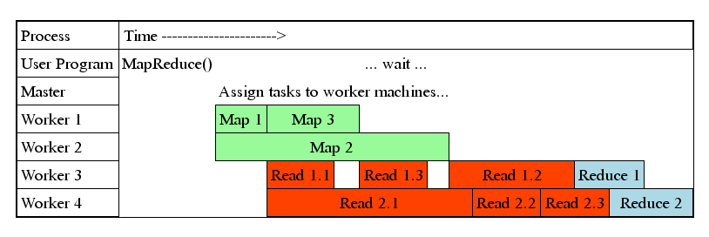
Task Granularity & Pipelining
Fine granularity tasks: map tasks >> machines
Minimizes time for fault recovery
Can do pipeline shuffling with map execution
Better dynamic load balancing

Slide 33
Refinements: Backup Tasks
Problem
Slow workers significantly lengthen the job completion time:
Other jobs on the machine
Bad disks
Weird things
Solution
Near end of phase, spawn backup copies of tasks
Whichever one finishes first “wins”
Effect
Dramatically shortens job completion time

Slide 34
Refinement: Combiners
Often a Map task will produce many pairs of the form (k,v₁), (k,v₂), … for the same key k
E.g., popular words in the word count example
Can save network time by pre-aggregating values in the mapper:
combine(k, list(v₁)) → v₂
Combiner is usually same as the reduce function
Works only if reduce function is commutative and associative

Slide 35
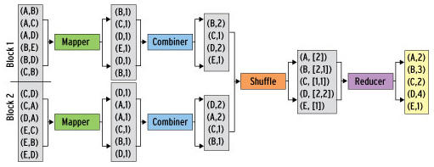
Refinement: Combiners
Back to our word counting example:
Combiner combines the values of all keys of a single mapper (single machine):
Much less data needs to be copied and shuffled!

Slide 36
Refinement: Partition Function
Want to control how keys get partitioned
Inputs to map tasks are created by contiguous splits of input file
Reduce needs to ensure that records with the same intermediate key end up at the same worker
System uses a default partition function:
hash(key) mod R
Sometimes useful to override the hash function:
E.g., hash(hostname(URL)) mod R ensures URLs from a host end up in the same output file

Slide 37
Example: Sorting with MapReduce
Sorting reduce values between Map and Reduce:
Mapper → Shuffle (Partition, Sort, Group) → Reducer
Map output: (key#secondary_key, value)
E.g., sort "col1 col2 col3 col4" on third column: ("key#c", "a b c d") "key#col3" is called a composite key, with 'key' called natural key
Partition: Ensure same natural key goes to same reducer
Sort: Sort records at the reducer by secondary key
Group: Group records by natural key
All steps can be customized to implement any sorting
Global sorting: one reducer or sorted partitioning
One reducer only for small data, sorting partitions not trivial

Slide 38
Example: Join By Map-Reduce
Compute the natural join R(A,B) ⋈ S(B,C)
R and S are each stored in files
Tuples are pairs (a,b) or (b,c)
A | B
a₁ | b₁
a₂ | b₁
a₃ | b₂
a₄ | b₃
B | C
b₂ | c₁
b₂ | c₂
b₃ | c₃
A | C
a₃ | c₁
a₃ | c₂
a₄ | c₃
⋈
=
S
R

Slide 39
Map-Reduce Join
Use a hash function h from B-values to 1...k
A Map process turns:
Each input tuple R(a,b) into key-value pair (b,(a,R))
Each input tuple S(b,c) into (b,(c,S))
Map processes send each key-value pair with key b to Reduce process h(b)
Hadoop does this automatically; just tell it what k is.
Each Reduce process matches all the pairs (b,(a,R)) with all (b,(c,S)) and outputs (a,b,c).

Slide 40
Chaining MapReduce Jobs
Required for chaining multiple operations: such as Join, Group, Aggregate, Sort, …
Simplified by tools, such as Hive, Pig, Spark, …
Hive allows SQL (HiveQL) queries
E.g., SELECT SUM(input1.field1) AS sum, COUNT(*) AS count FROM input1 JOIN input2 ON (input1.field2 = input2.field1) GROUP BY input2.field2 ORDER BY input2.field2 DESC;
Gets translated into multiple MapReduce jobs
Example: Inverted index creation
Implementation with Pig: IndexCreation.pig
Gets translated into multiple MapReduce jobs

Slide 41
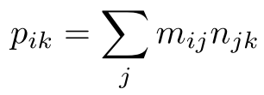

Example: Matrix Multiplication
m₁₁ | m₁₂ | m₁₃
m₂₁ | m₂₂ | m₂₃
m₃₁ | m₃₂ | m₃₃
n₁₁ | n₁₂ | n₁₃
n₂₁ | n₂₂ | n₂₃
n₃₁ | n₃₂ | n₃₃
p₁₁ | p₁₂ | p₁₃
p₂₁ | p₂₂ | P₂₃
p₃₁ | p₃₂ | p₃₃
x
=
p_{ik} = m_{i1}n_{1k} + m_{i2}n_{2k} + m_{i3}n_{3k}
Chain two MapReduce jobs:
1. Natural join, multiply values in reducer
Output values of reducer for key j: all pairs (i#k, m_{ij}n_{jk})
2. Group by key, sum values in reducer
Output value of reducer for key i#k: (i#k, )

Slide 42
Cost Measures for Algorithms
In MapReduce we quantify the cost of an algorithm using
Communication cost = total I/O of all processes
Elapsed communication cost = max of I/O along any path
(Elapsed) computation cost analogous, but count only running time of processes
Note that here the big-O notation is not the most useful (adding more machines is always an option)

Slide 43
Example: Cost Measures
For a map-reduce algorithm:
Communication cost = input file size + 2 × (sum of the sizes of all files passed from Map processes to Reduce processes) + the sum of the output sizes of the Reduce processes.
Elapsed communication cost is the sum of the largest input + output for any map process, plus the same for any reduce process

Slide 44
What Cost Measures Mean
Either the I/O (communication) or processing (computation) cost dominates
Ignore one or the other
Total cost tells what you pay in rent from your friendly neighborhood cloud
Elapsed cost is wall-clock time using parallelism

Slide 45
Cost of Map-Reduce Join
Total communication cost = O(|R|+|S|+|R ⋈ S|)
Elapsed communication cost = O(s)
We’re going to pick k and the number of Map processes so that the I/O limit s is respected
We put a limit s on the amount of input or output that any one process can have. s could be:
What fits in main memory
What fits on local disk
With proper indexes, computation cost is linear in the input + output size
So computation cost is like comm. cost

Slide 46
Spark vs. Hadoop/MapReduce
Spark has recently become a very popular alternative
Supports MapReduce computing model: map, reduce, …
Up to 100x faster than Hadoop (s. http://spark.apache.org)
Spark for Web archives @ L3S: ArchiveSpark https://github.com/helgeho/ArchiveSpark
Extensive use of main memory vs. disk
Lower communication costs
Fault tolerance by lineage / recovering vs. replication
Functional interface and lazy transformations
Transformations chained and defered until action (e.g., reduce, …)
Previous example: Inverted index creation (cp., Pig)
Spark implementation (in Scala): IndexCreation.scala

Slide 47
Summary
MapReduce: distributed computing model
Think functional!
Distributed file system replicates data
Provides fault tolerance
Computation exploits data locality
Computing where the data is stored
Refinements enable flexibility and optimizations
Combiners reduce at the mapper, shuffling allows for sorting
Chaining MapReduce tasks for larger algorithms
Tools can help, but it is crucial to understand the operations

Slide 48
Reading
Jeffrey Dean and Sanjay Ghemawat: MapReduce: Simplified Data Processing on Large Clusters
http://labs.google.com/papers/mapreduce.html
Sanjay Ghemawat, Howard Gobioff, and Shun-Tak Leung: The Google File System
http://labs.google.com/papers/gfs.html

Slide 49
Resources
Hadoop Wiki
Introduction
http://wiki.apache.org/lucene-hadoop/
Getting Started
http://wiki.apache.org/lucene-hadoop/GettingStartedWithHadoop
Map/Reduce Overview
http://wiki.apache.org/lucene-hadoop/HadoopMapReduce
http://wiki.apache.org/lucene-hadoop/HadoopMapRedClasses
Eclipse Environment
http://wiki.apache.org/lucene-hadoop/EclipseEnvironment
Javadoc
http://lucene.apache.org/hadoop/docs/api/

Slide 50
Resources
Releases from Apache download mirrors
http://www.apache.org/dyn/closer.cgi/lucene/hadoop/
Nightly builds of source
http://people.apache.org/dist/lucene/hadoop/nightly/
Source code from subversion
http://lucene.apache.org/hadoop/version_control.html

Slide 51
Further Reading
Programming model inspired by functional language primitives
Partitioning/shuffling similar to many large-scale sorting systems
NOW-Sort ['97]
Re-execution for fault tolerance
BAD-FS ['04] and TACC ['97]
Locality optimization has parallels with Active Disks/Diamond work
Active Disks ['01], Diamond ['04]
Backup tasks similar to Eager Scheduling in Charlotte system
Charlotte ['96]
Dynamic load balancing solves similar problem as River's distributed queues
River ['99]

