Slide 1


CODEHUNTER: CONTEXT-DRIVEN COMPONENT-BASED SYNTHESIS FROM BIG DATA
YU FENG, YUEPENG WANG, ARATI KAUSHIK, ISIL DILLIG

Slide 2
Objective and Goals
• CODEHUNTER is a system for component-based program synthesis in Java;
• Data-driven: Rather than using a fixed set of components, CODEHUNTER dynamically discovers relevant components in large code corpora;
• Context-driven: CODEHUNTER uses context of the program to be synthesized to identify pertinent code snippets. We interpret
program context in a broad way: it includes method signature, comments, test cases, program history . . .

Slide 3
Challenges
• Context abstraction: Identify a good abstraction
of program context to drive database queries for discovering relevant components;
• Interface alignment: Once we identify relevant component, figure out correspondence between this component’s interface and existing context elements;
• Adaptor code synthesis: We need to synthesize adaptor code to integrate component into program context.

Slide 4
Solutions
• Use Hidden Markov Models to learn a good abstraction of program context to drive database queries;
• Formulate interface assignment as a satisfiability modulo the theory of costs problem (i.e., find maximum cost matching that satisfies a set of integrity constraints);
• Use type-directed synthesis to generate adaptor code.

Slide 5
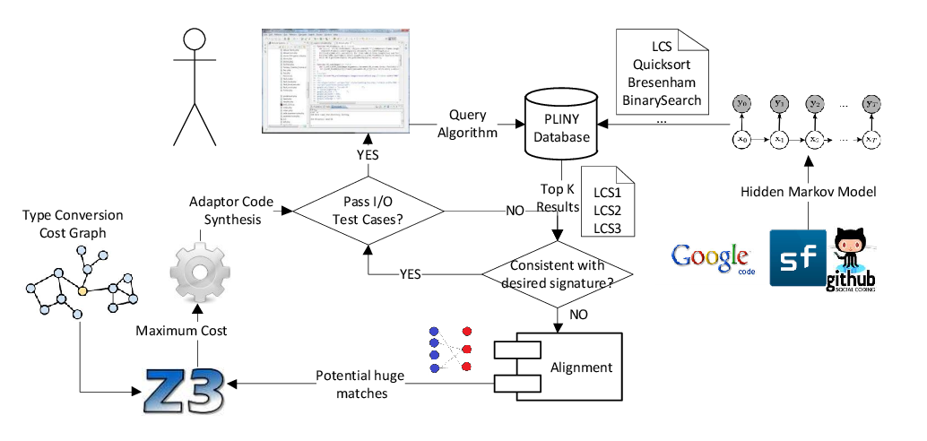
Overview

Slide 6
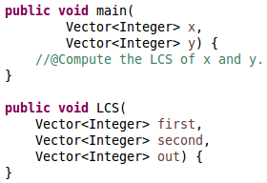




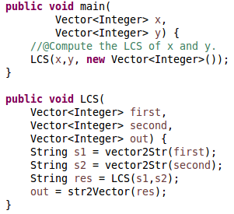
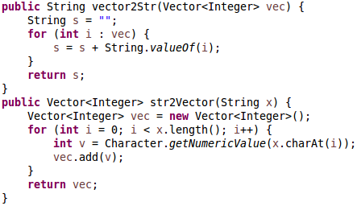
Our approach by example
int
int
int(0)
int(0)
int
String(1)
String
Array(2)
Array
Vector(2)
Type Conversion Cost
String
Vector(2)
Maximum Cost!
Adapter
Code
Synthesis

