Slide 1


CODEHUNTER: CONTEXT-DRIVEN COMPONENT-BASED SYNTHESIS FROM BIG DATA
YU FENG, YUEPENG WANG, ARATI KAUSHIK, ISIL DILLIG

Slide 2
OBJECTIVE AND GOALS
CODEHUNTER is a system for componentbased
program synthesis in Java. Unlike previous
component-based program synthesis approaches,
our approach is:
1. Data-driven: Rather than using a fixed
set of components, CODEHUNTER dynamically
discovers relevant components in large
code corpora.
2. Context-driven: CODEHUNTER uses context
of the program to be synthesized to
identify pertinent code snippets. We interpret
program context in a broad way: it
includes method signature, comments, test
cases, program history . . .

Slide 3
Challenges
Context abstraction: Identify a good abstraction
of program context to drive
database queries for discovering relevant
components
• Interface alignment: Once we identify relevant
component, figure out correspondence
between this component’s interface and existing
context elements
• Adaptor code synthesis: We need to synthesize
adaptor code to integrate component
into program context

Slide 4
Solution
We combine the advantages of statistical and
SMT-based techniques:
1. Use Hidden Markov Models to learn a good
abstraction of program context to drive
database queries
2. Formulate interface assignment as a satisfiability
modulo the theory of costs problem (i.e.,
find maximum cost matching that satisfies a
set of integrity constraints)
3. Use type-directed synthesis to generate
adaptor code

Slide 5
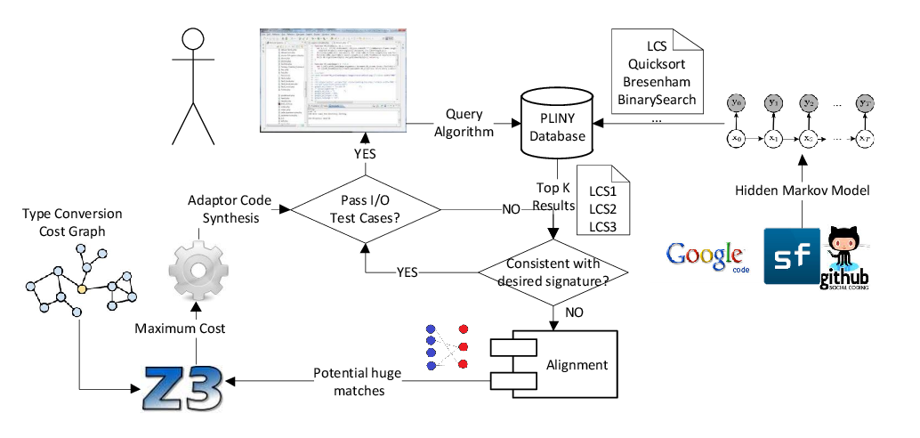
Overview

Slide 6
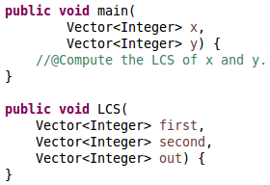




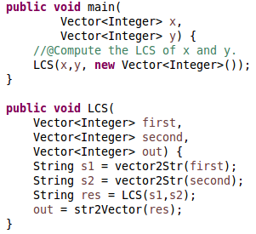
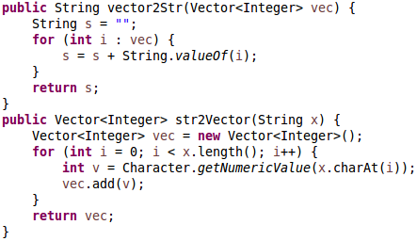
Our approach by example
int
int
int(0)
int(0)
int
String(1)
String
Array(2)
Array
Vector(2)
Type Conversion Cost
String
Vector(2)
Maximum Cost!
Adapter
Code
Synthesis

