Slide 1


Courant Institute of Mathematical Sciences
Department of Computer Science
CS102 Data Structures
Recitation Twelve

Slide 2
Objectives
Tree Traversals
Binary Search Trees(BSTs)

Slide 3
Get the height of a tree
Write a method to print out the height of a binary tree.
public static int height(TreeNode root)

Slide 4
Check if a tree is balanced
Given a binary tree, determine if it is height-balanced.
For this problem, a height-balanced binary tree is defined as a binary tree in which the height of the two subtrees of every node never differ by more than 1.
public static boolean isBalance(TreeNode root);

Slide 5
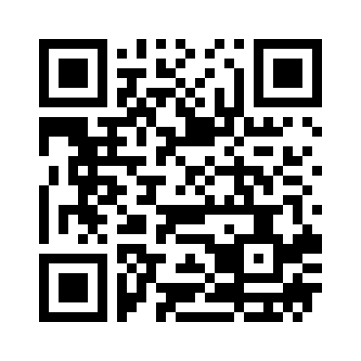
Signup Sheet

Slide 6
Minimum Absolute Difference in BST
Given a binary search tree with non-negative values, find the minimum absolute difference between values of any two nodes.
public int getMinimumDifference(TreeNode root)

