Slide 1


Courant Institute of Mathematical Sciences
Department of Computer Science
CS102 Data Structures
Recitation Eleven

Slide 2
Objectives
Trees
Binary Search Trees(BSTs)

Slide 3
Binary Search Tree
Binary search trees keep their keys in sorted order.
MAX(left subtree) is less than the parent.
MAX(right subtree is larger than the parent.

Slide 4
Operations on BST
Search
Insert
Delete

Slide 5
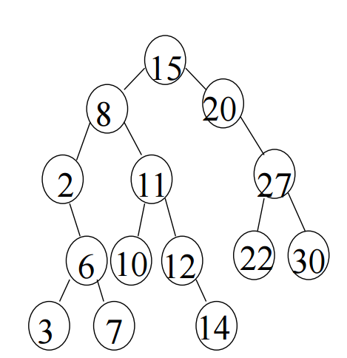
Searching in a BST
To search for a number b:
1. Compare b with the root; 
If b = root, return
If b < root, go left
If b > root, go right
2. Repeat step 1, comparing b with the new node we are at.
Repeat until either the node is found or we reach a non-existing node
Try it with b=12 and b=17.

Slide 6
Insertion into a BST
Insert(datatype b, Tree T)
Search for the position of b as if it were already in the tree. The position is the left or right child of some node u.
Create a new node, and assign its address to the appropriate pointer field in u.
Assign b to the data field of the new node

Slide 7
Deletion from a BST
Delete(datatype b, Tree T)
Search for b in tree T. If not found, return.
Call u the first node found to contain b.
If u is a leaf, remove u and set the appropriate pointer in the parent of u to NULL 4. If u has only one child v, remove u, and the parent of u becomes the direct parent of v

Slide 8
If u has two children, go to the left subtree, and find in there the largest node, and call it v. The node v can be found by tracing the rightmost path until the end. Note that v is either a leaf or has no right child. v is the predecessor of u
OR If u has two children, go to the right subtree, and find in there the smallest node, and call it v. The node v can be found by tracing the rightmost path until the end. Note that v is either a leaf or has no right child. Similarly, v is the successor of u.
Copy the data field of v onto the data field of u
Now delete node v in a manner similar to previous step.

Slide 9
Traverse a BST
Preorder traversal
Inorder traversal
Postorder traversal

