Slide 1
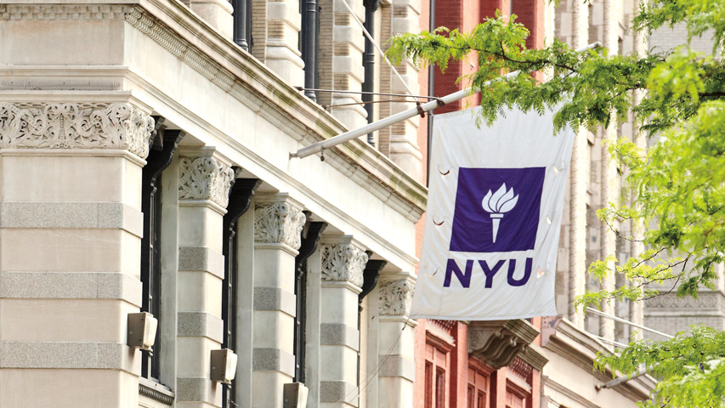

Courant Institute of Mathematical Sciences
Department of Computer Science
CS102 Data Structures
Recitation Four

Slide 2
Objectives
Recursion - revisited

Slide 3
Solution to Permutations
Given a number n, return all possible permutations of 1…n .
For example,
Input 3 have the following permutations:
[ [1,2,3], [1,3,2], [2,1,3], [2,3,1], [3,1,2], [3,2,1] ]
See codes for more example.

Slide 4
Answer this question on NYUClasses:
abstract classes vs interfaces - when to use which?
The choice of whether to design your functionality as an interface or an abstract class can sometimes be a difficult one. An abstract class is a class that cannot be instantiated, but must be inherited from. An abstract class may be fully implemented, but is more usually partially implemented or not implemented at all, thereby encapsulating common functionality for inherited classes.

Slide 5
Iterative Methods vs. Recursion
You can always make a recursive function an iterative one.
See Church Turing Thesis.
For example: Fibonacci Sequence
Demo

Slide 6
Greatest Common Divisor
Compute the GCD of two given number x and y using both iterative method and recursive method.
public static int gcdIterative(int x, int y)
public static int gcdRecursion(int x, int y)
Submit your codes to NYUClasses.

