Slide 1
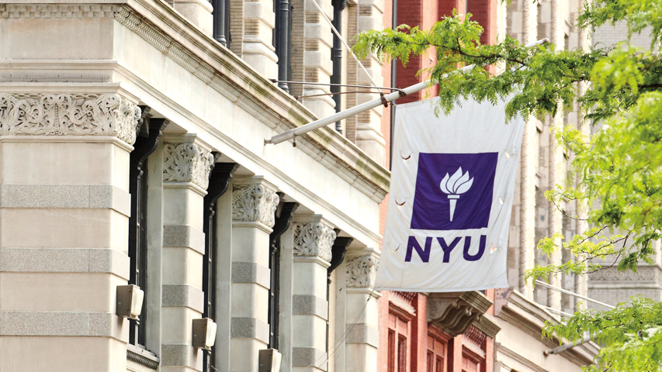

Courant Institute of Mathematical Sciences
Department of Computer Science
CS102 Data Structures
Recitation Seven

Slide 2
Objectives
Binary Search
Recursive Methods Revisit

Slide 3
Recursive Binary Search
In this exercise you will need to
implement a recursive binary search in Java
apply recursive calls to an array or numbers by hand
trace by hand the recursive calls. (No need to submit)

Slide 4
Recursive Binary Search
Input:
A sorted array X[ ] of size n
A value b to be searched for in X[ ]
Output:
If b is found, the index k where X[k]=b
If b is not found, return -1

Slide 5
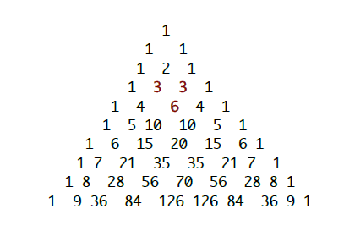
Pascal's Triangle
Implement a recursive program to determine and print the first n lines of Pascal's Triangle as shown below. Each interior value is the sum of the two values above it. For example, in line 5, 6 is the sum of 3+3 in line 4.

