Slide 1


Courant Institute of Mathematical Sciences
Department of Computer Science
CS102 Data Structures
Recitation Eight

Slide 2
Objectives
Solution for Lab 6 and 7
Linked List

Slide 3
Lab 6
Quick sort and merge sort
Need to make a copy of the original array
Create private methods to meet the interface
See codes for details

Slide 4
Lab 7
Recursive Binary Search
Use private methods to avoid redundant parameters for
Pascal Triangle
private static int pascal(int i, int j) { if (j == 0) { return 1; } else if (j == i) { return 1; } else { return pascal(i - 1, j - 1) + pascal(i - 1, j); } }

Slide 5
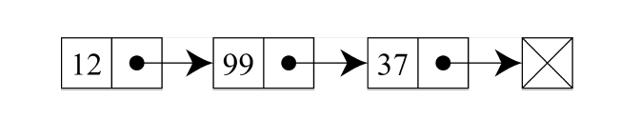
Linked List
In computer science, a linked list is a linear collection of data elements, called nodes, each pointing to the next node by means of a pointer. It is a data structure consisting of a group of nodes which together represent a sequence.

Slide 6
Java Linked List Implementation
public class LinkedList<E> extends AbstractSequentialList<E>
implements List<E>, Deque<E>, Cloneable, java.io.Serializable
See Demo.
Add elements to LinkedList.
Remove an element from a LinkedList.
Print a LinkedList.
Your own implementation.

Slide 7
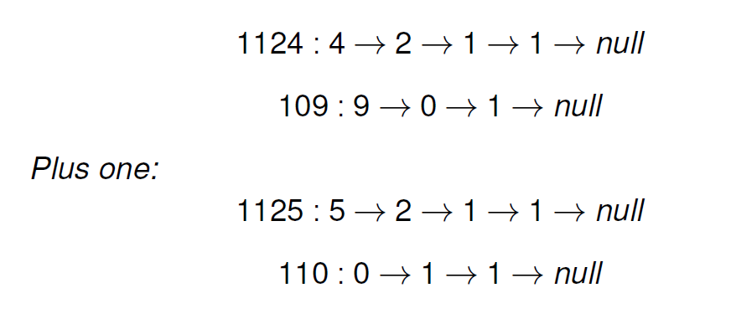
Plus One
Given a non-negative number represented as a singly linked list of digits, plus one to the number. The digits are stored such that the most significant digit is at the end of the list.

