Slide 1


Courant Institute of Mathematical Sciences
Department of Computer Science
CS102 Data Structures
Recitation Nine

Slide 2
Objectives
Linked List

Slide 3
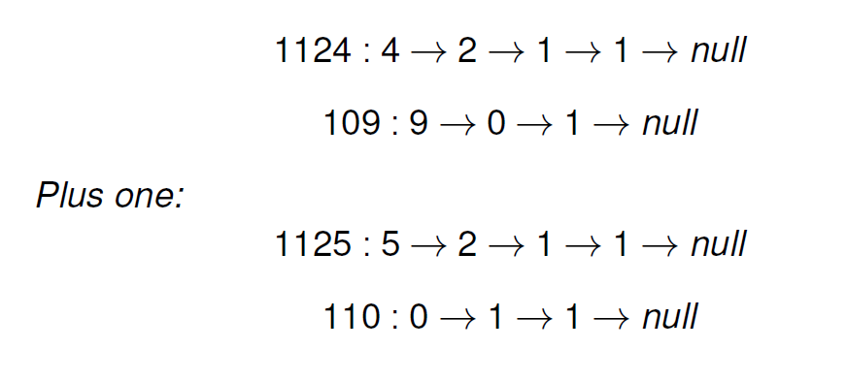
Plus One
Given a non-negative number represented as a singly linked list of digits, plus one to the number. The digits are stored such that the most significant digit is at the end of the list.

Slide 4
Reverse Linked List
Reverse a singly linked list.
A linked list can be reversed either iteratively or recursively. Could you implement both?(Optional)

Slide 5
Palindrome Linked List
Given a singly linked list, determine if it is a palindrome.
Could you do it in O(n) time and O(1) space? (Optional)

