Slide 1
FIAP_tech_challenge_v2
File created on: 10/30/2023 8:39:41 PM

Slide 2
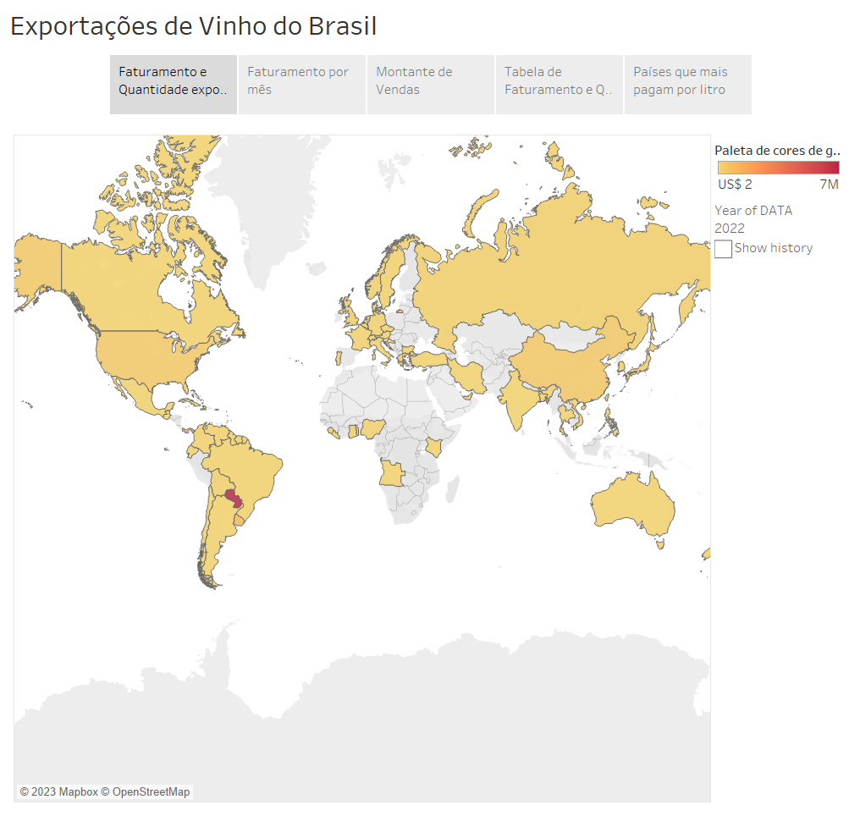

Slide 3
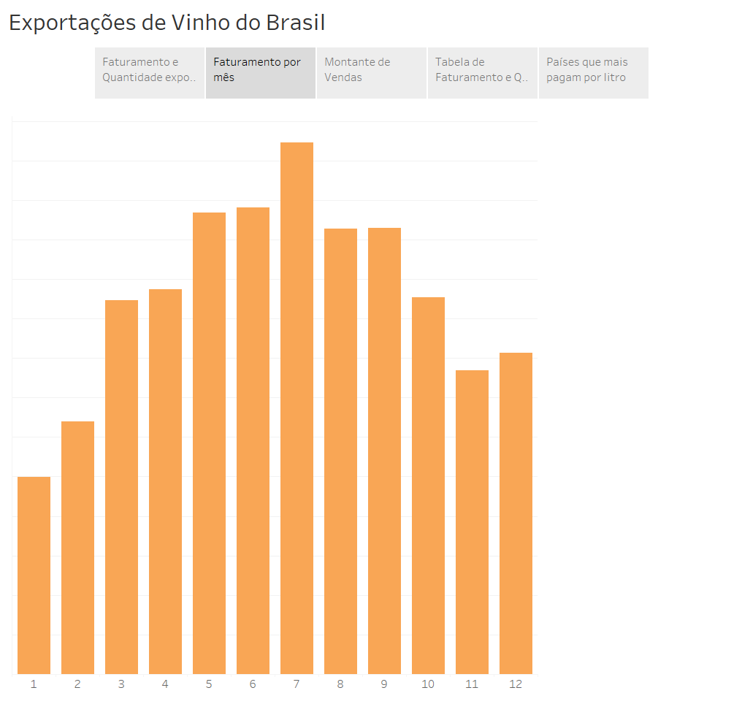

Slide 4
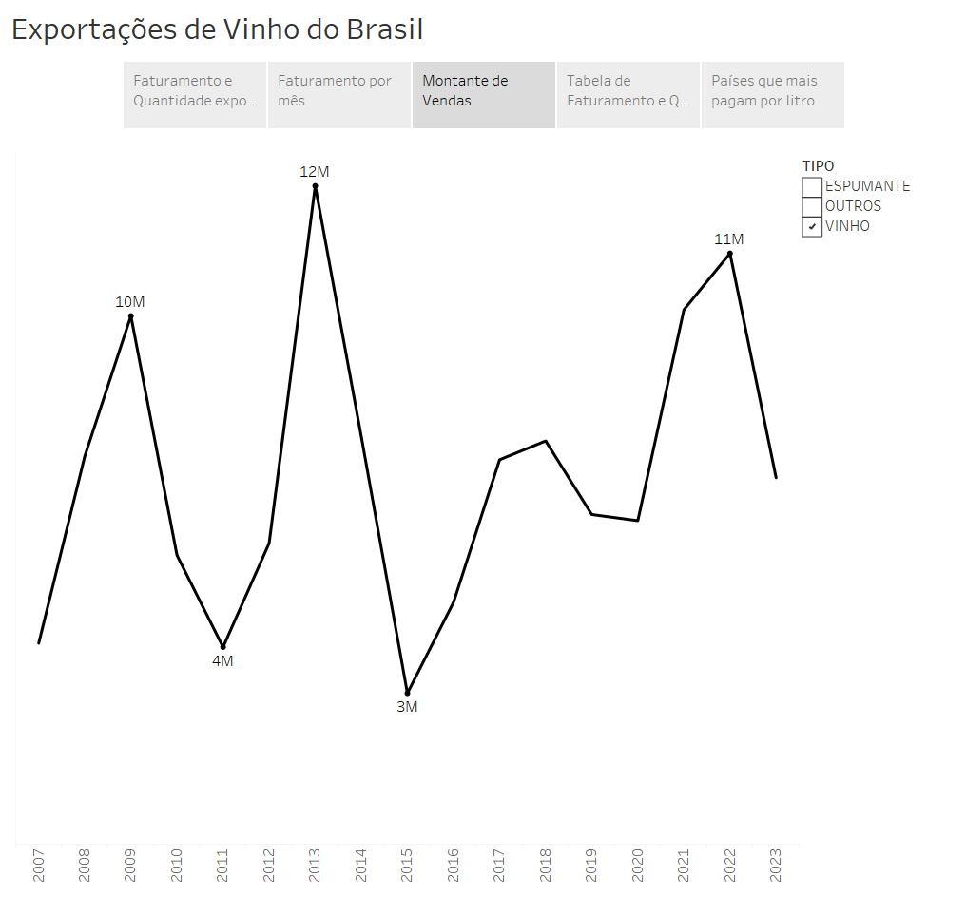

Slide 5
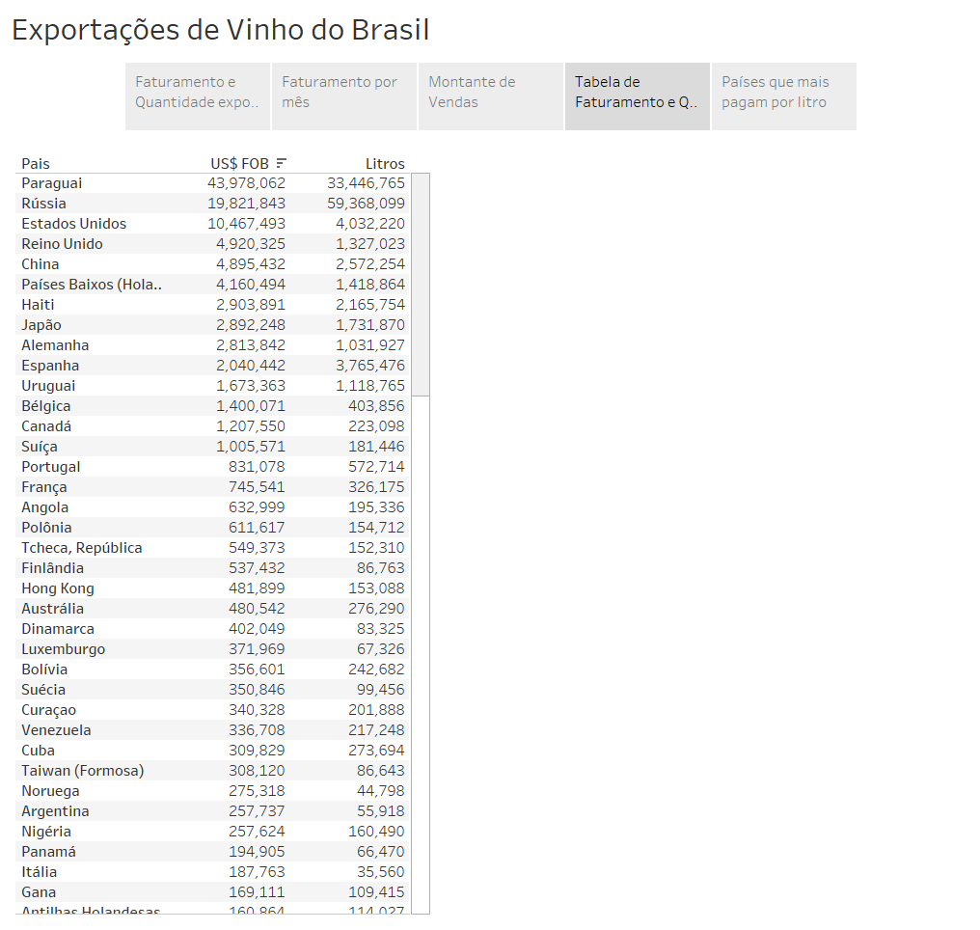

Slide 6
