Slide 1


FABRIC ATLAS
Fabric Atlas turns Fabric metadata
into a shared working catalog.
Development, architecture and implementation choices
React + Rayfin Functions · Fabric SQL · minimal Python compatibility
Connect → Discover → Collect → Validate → Publish
12 slides · October 2026 · Fabric Atlas 2.0.0

Slide 2
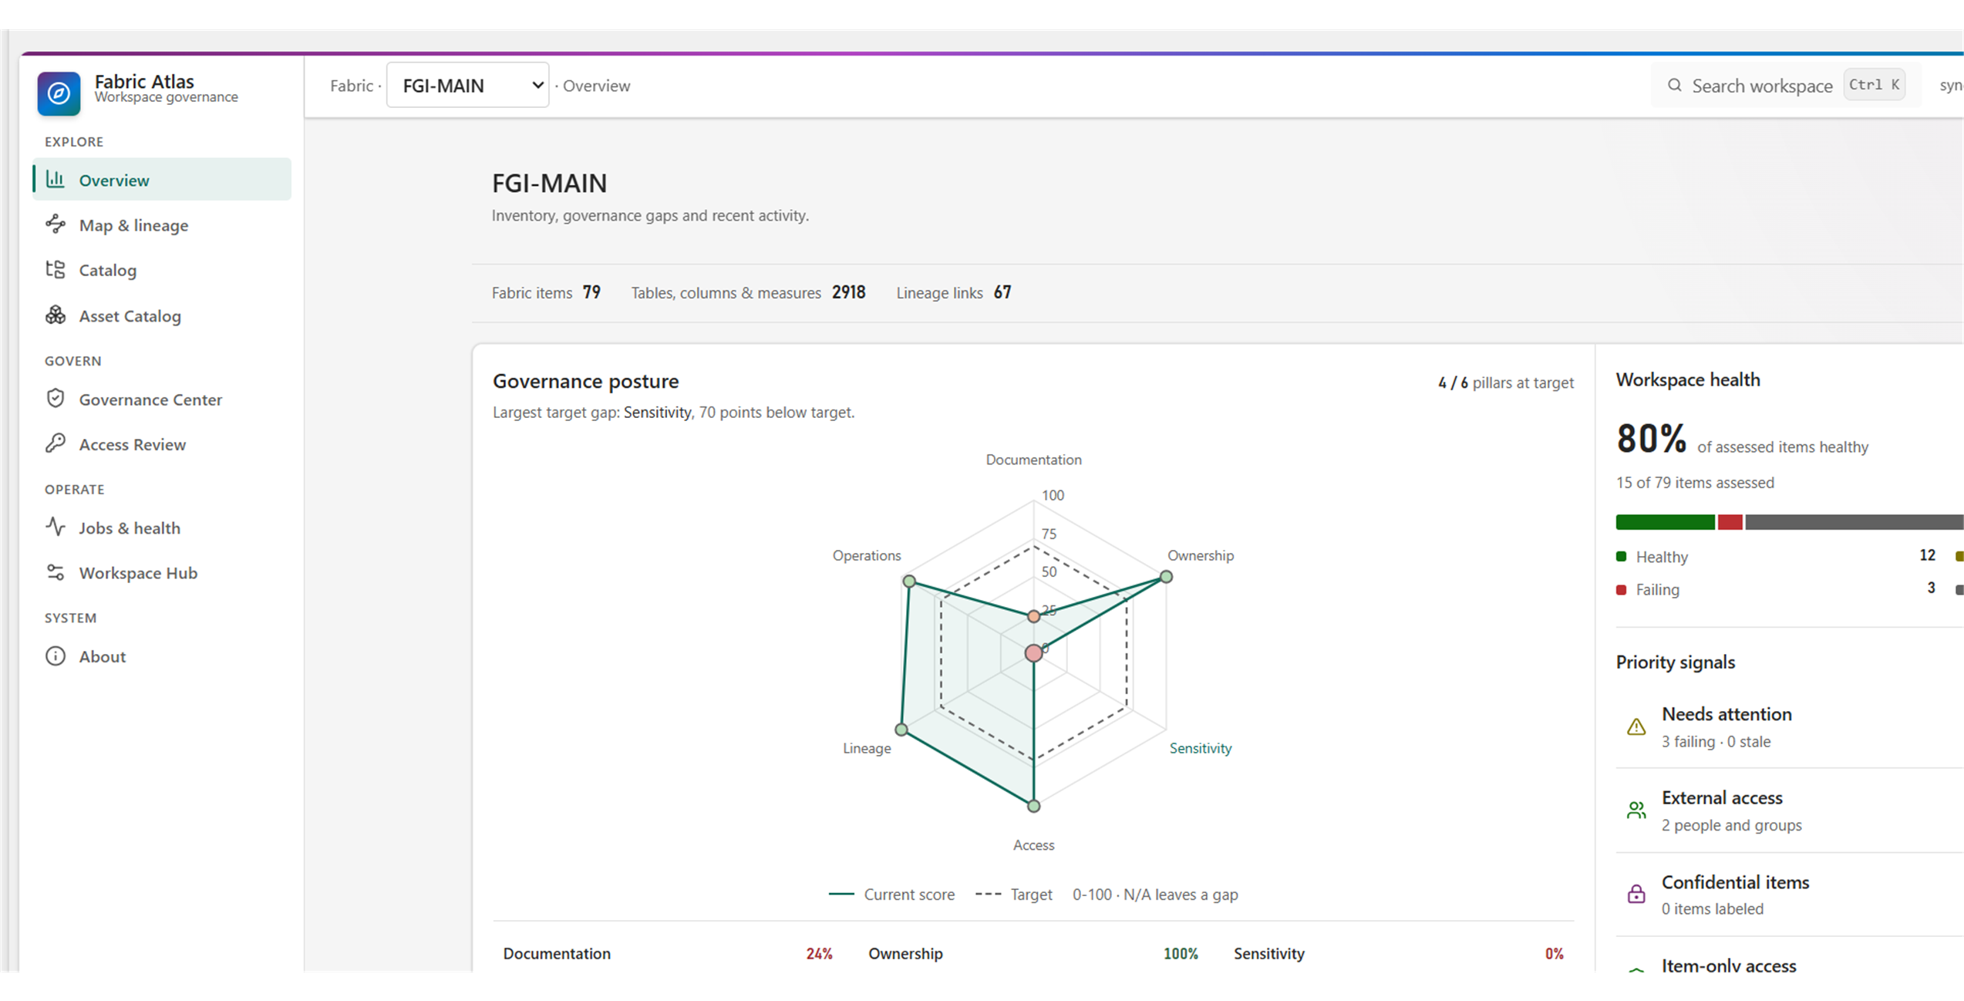
PRODUCT
One validated snapshot powers every selected workspace view.
Multi-workspace catalog and active-workspace switching.
Catalog, lineage, access, governance and recent jobs.
Semantic X-Ray, Item Relations Preview and change history.
Pages read the validated snapshot; they do not rescan Fabric.
Fabric Atlas 2.0 Overview; workspace figures are live evidence, not defaults.
Source: docs/screenshots/workspace-overview-v2.png
2

Slide 3
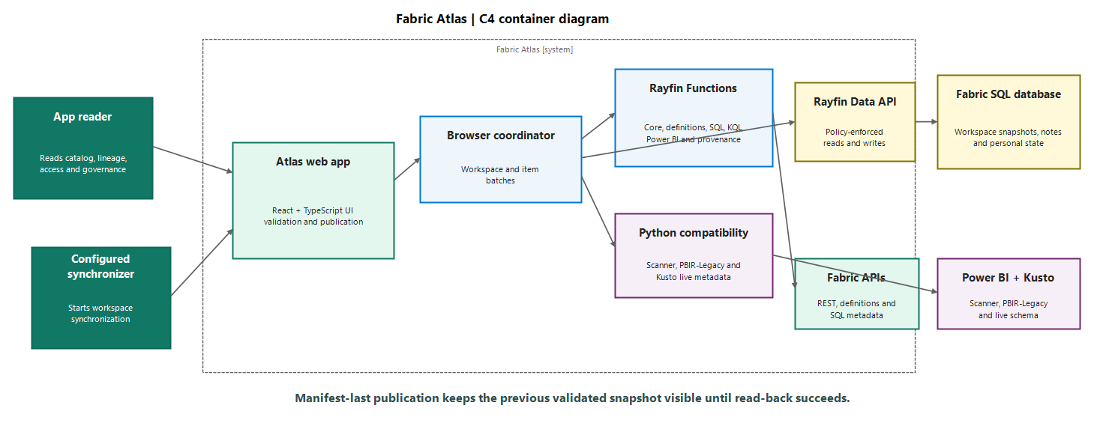
C4 ARCHITECTURE
Rayfin Functions collect. The browser validates and publishes.
Python remains only for the Power BI scanner, PBIR-Legacy and Kusto gaps.
Source: docs/architecture.md
3

Slide 4
SYNCHRONIZATION PROCESS
Synchronization follows five stages and publishes the manifest last.
1. Connect
2. Discover
3. Collect
4. Validate
5. Publish
Check the
identity
Resolve
scope
Run bounded
collectors
Check and
read back
Publish the
manifest
The previous snapshot stays visible until the Workspace manifest is created.
Source: src/atlas/browser-collector-sync.ts · src/atlas/backend.ts
4

Slide 5
BOUNDED COLLECTION
Rayfin Functions process large workspaces without restarting the run.
Core creates the workspace and item plan.
Rayfin collectors handle definitions, Item Relations, KQL, SQL and Power BI structure.
Python runs only the requested scanner, PBIR-Legacy and Kusto gaps.
Core
Batch 1
Complete
Workspace and items
Up to 8 IDs
Validate → Publish
T0
T1
T2
T3
T4
Plan
Python gaps
Collectors by item type
Exact remaining gaps
Every invocation has bounded time, attempts, pages and response size.
Completed evidence is retained while remaining work continues.
Source: src/atlas/browser-collector-sync.ts · rayfin/functions/
5

Slide 6
SNAPSHOTS AND DATA MODEL
The Workspace manifest publishes only a snapshot Atlas can read back.
Child rows use one new snapshotId.
Read-back uses the same path as application startup.
Workspace is written last and acts as the visibility switch.
1
Write candidate rows
2
Read back and validate
3
Create Workspace manifest
New snapshotId on all synchronized entities
Writer, counts, chunks and reconstructed catalog
The new snapshot becomes visible
Failure before the manifest → candidate rows stay invisible and readers keep the previous snapshot.
Source: docs/data-model.md · src/atlas/backend.ts
6

Slide 7
RAYFIN ENTITY MODEL
Rayfin receives twenty-six entity classes across four lifetimes.
Snapshot catalog
Shared control state
Workspace, FabricItem, LineageEdge, Principal,
AccessGrant, JobRun and ConfigEntry
Comment, policies, exceptions, WorkspaceScope and synchronizer authority
Sync and evidence state
Personal state
Sync runs, tasks, commands, payload records and evidence snapshots
SavedView, AccessReview, AccessReviewEvent and FindingAck
are filtered by user_id.
The entity classes define the database schema and the authorization boundary.
Source: rayfin/data/schema.ts
7

Slide 8
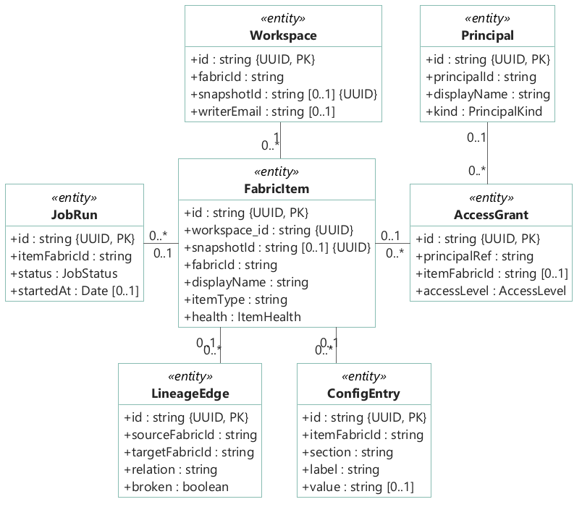
CORE LOGICAL MODEL
The core UML shows snapshot entities and logical associations.
Selected properties mirror the core TypeScript entities.
Workspace publishes a manifest; FabricItem anchors item evidence.
Additional v2 sync and evidence entities are grouped outside this core view.
Source: rayfin/data/*.ts (core entities)
8

Slide 9
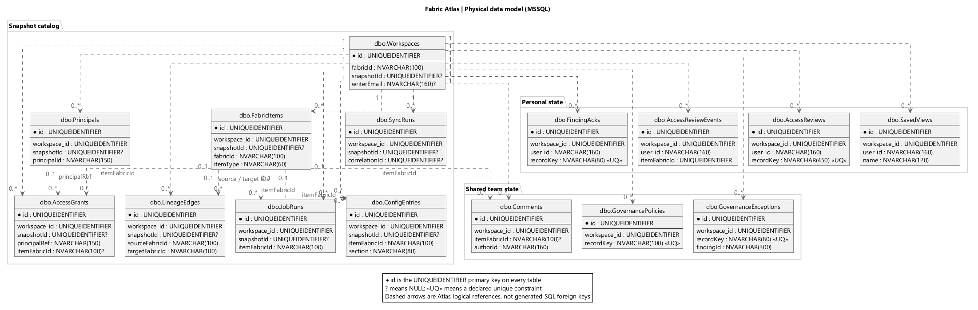
CORE PHYSICAL DATA MODEL
The MPD shows the fifteen core MSSQL tables and logical links.
Fabric Atlas 2.0 adds eleven sync, scope and evidence tables outside this core view.
Source: rayfin/data/schema.ts · @microsoft/rayfin-core 1.36.2
9

Slide 10
RAYFIN SCHEMA GENERATION
Rayfin turns decorated TypeScript classes into the Fabric SQL data model.
Data API
Builder
+
Fabric SQL
Field decorators define SQL types, limits and optional values.
Authorization decorators generate read and write policies.
schema.ts registers the 26 entities used by RayfinClient.
TypeScript
entities
schema.ts
rayfin up
@entity · fields · policies
RayfinClient
typed GraphQL proxies
Source: rayfin/data/schema.ts · rayfin/rayfin.yml
10

Slide 11
RAYFIN FUNCTION GAPS
Three platform gaps keep the Python compatibility UDF.
1. Power BI application audience or first-party scanner connector.
2. Kusto application audience for live schema metadata.
3. PBIR-Legacy report-page coverage.
4. Once all three pass parity, delete sync_compatibility and the Python UDF.
Scheduling is separate: it needs an unattended trigger plus durable claim and publication fencing.
Source: docs/rayfin-platform-gaps.md
11

Slide 12
FABRIC ATLAS
A trusted catalog stays available
while the next snapshot is built.
Collect with Rayfin Functions. Keep exact compatibility gaps. Publish after read-back.
Questions and feedback
github.com/fredgis/FabricAtlas
Rayfin Functions · Fabric SQL · Multi-workspace · Metadata only
Source: github.com/fredgis/FabricAtlas
12

