Slide 1


ASSEMBLY ENGINE.
AGENTS. FABRIC. PROOF.
A database engine in x86-64 assembly, the SaaS built around it, the Microsoft Fabric workload
that decodes it, the game that proves it works, and the eleven agents that built it all.
ASMDB ENGINE
WWW.ASMDB.CLOUD
ASMDB.ANALYTICS
WWW.PIXELSLIME.CLOUD
PIXELSLIME ANALYTICS
A 90-MINUTE DEEP DIVE
01

Slide 2

THE STORY
Five things, one thread
Each one only exists because the one before it did. Nothing here is a mock-up.
01
02
03
04
05
asmdb
asmdb.cloud
asmdb.analytics
pixelslime.cloud
PixelSlime Analytics
THE ENGINE
→
THE SERVICE
→
THE WORKLOAD
→
THE PROOF
→
THE PAYOFF
A transactional CRUD engine hand-written in x86-64 assembly. NASM -f bin, no linker, no libc. 43,741 bytes.
One database, one Container App, one writer. Entra ID at the front, private endpoints everywhere else.
A Microsoft Fabric workload that turns the engine's change log into Delta tables in a Lakehouse.
One AI-generated slime a day, stored in 175 bytes and fingerprinted on Polygon. A real product on the real service.
A Fabric app that decodes those bytes back into KPIs over Direct Lake.
The thread. An engine is only interesting if someone runs it. A service is only interesting if something depends on it. A pipeline is only interesting if it moves real bytes. So each layer exists to put the one below it under load — and the last one reads the first one's rows back out.
PIXELSLIME · ASMDB · MICROSOFT FABRIC
02

Slide 3
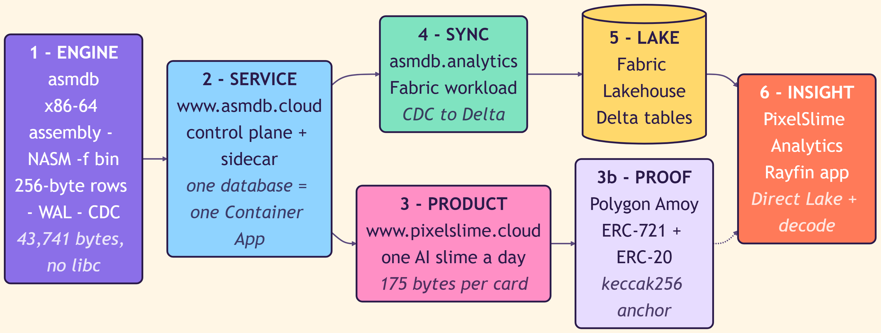
THE WHOLE SYSTEM
One byte's journey, end to end
A row written by 43 kilobytes of assembly ends up as a measure in a semantic model. This is the only slide you have to remember.
PIXELSLIME · ASMDB · MICROSOFT FABRIC
03

Slide 4
AGENDA
How the next ninety minutes go
01
The engine
Why 256 bytes, why no SQL, and why the store is the index
20 MIN
02
The service
Turning a 43 KB binary into a multi-tenant SaaS on Azure
15 MIN
03
The workload
Change data capture from an assembly engine into Fabric Delta tables
15 MIN
04
The product
PixelSlime: 175 bytes, one codec, four smart contracts
20 MIN
05
The payoff
Decoding the bytes back into KPIs with a Rayfin Fabric app
10 MIN
06
The method
How eleven agents built this without stepping on each other
10 MIN
PIXELSLIME · ASMDB · MICROSOFT FABRIC
04

Slide 5
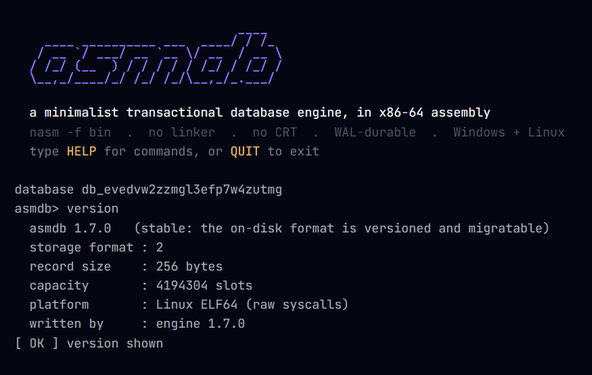
01
THE ENGINE
asmdb
A transactional database engine, hand-written in x86-64 assembly.
No linker. No C runtime. Nothing underneath it.
01 · THE ENGINE — asmdb
05

Slide 6
DEFINITION
Not a wrapper. Not a binding. The engine itself.
One source file assembles straight to an executable. There is no runtime between the SQL-less command parser and the syscall.
Written in assembly
Fixed-shape rows
x86-64, assembled with NASM in -f bin mode. The PE and ELF headers are emitted by hand, the import table is hand-built, and Linux talks in raw syscalls.
Every record is exactly 256 bytes. The row array is the index: open addressing with linear probing over a Fibonacci hash, 0x9E3779B97F4A7C15.
Durable by construction
One writer, many readers
A write-ahead log with a CRC-32 commit marker, a two-fsync commit point, and an append-only change log written before the data file is touched.
A byte-range lock on Windows, flock on Linux. Unlimited --reader sessions. No planner, no joins, no secondary indexes, and none of the code that would need them.
01 · THE ENGINE — asmdb
06

Slide 7
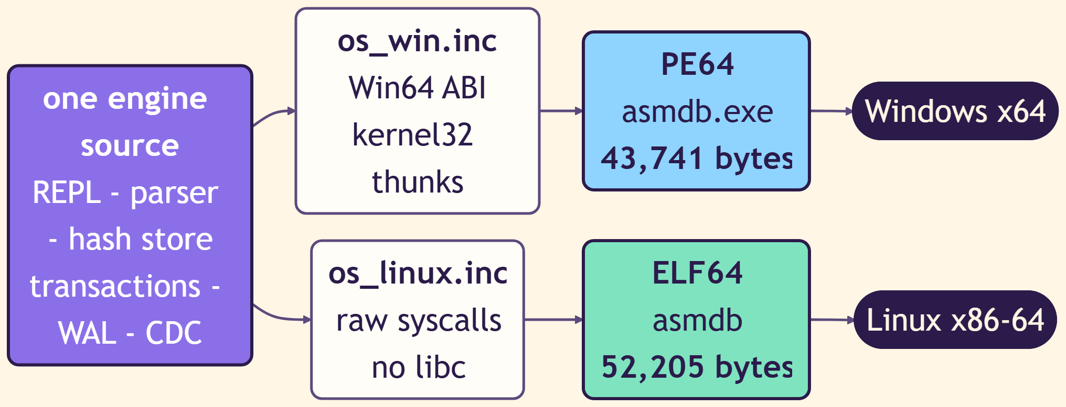
THE BUILD
One source, two operating systems, two binaries
The only thing that differs between Windows and Linux is how the engine asks the kernel for a file.
ASMDB.EXE · PE64
43,741 B
Windows x64. Smaller than most JPEGs on this slide.
ASMDB · ELF64
52,205 B
Linux x86-64, raw syscalls, no libc at all.
01 · THE ENGINE — asmdb
07

Slide 8
THE RECORD
256 bytes, and never one more
A power of two, so the address of slot N is a shift instead of a multiply. Every design decision downstream falls out of this one.
8 B
1 B
7 B
8 B
8 B
2 B
2 B
220 B
id
status
flags / version
created (µs)
modified (µs)
val len
tag len
value · tag · content (variable)
USABLE CONTENT
USABLE TAG
STATUS = 2
ADDRESSING
175 bytes
39 bytes
tombstone
shl rax, 8
Why it matters. Because 256 = 2⁸, finding a record is address = table_base + (slot × 256) — two instructions. No page table, no extent manager, no buffer pool, no catalog lookup. There is nothing to look up because there is nothing to look up in.
01 · THE ENGINE — asmdb
08

Slide 9
CAPACITY
The store is the index — so the size is decided up front
asmdb computes the slot from the id, then walks forward. That only works if it knows how many slots exist before the first insert.
CAPACITY
SLOTS
REGION
USABLE ROWS (75%)
Why not just grow it?
Small
524,288
128 MiB
393,216
The slot for an id depends on the total number of slots, so resizing rehashes every single record.
You cannot append empty slots to the file and call it a day.
A crash-safe resize needs migration state in the header, two regions, a write pause, reader coordination and CDC validation.
Dynamic resizing is an explicit, documented non-goal.
Medium
2,097,152
512 MiB
1,572,864
Large
4,194,304
1 GiB
3,145,728
4,194,304 slots × 256 bytes = 1,073,741,824 bytes = exactly 1 GiB
01 · THE ENGINE — asmdb
09

Slide 10
THE 75% RULE
Why a quarter of the table is deliberately left empty
Linear probing is fast until the table fills up. Then clusters form, and the cost of an unsuccessful search stops being a constant.
FILL RATE 50 %
FILL RATE 75 %
FILL RATE 90 %
FILL RATE 95 %
0.5 × (1 + 1 / (1 − load)²)
2.5
8.5
50.5
200.5
theoretical cost of an
unsuccessful search
slots examined
slots examined
slots examined
slots examined
4,194,304 slots × 0.75 = 3,145,728 usable records
The threshold is a trade between storage density, predictable performance, collision count, search time, and room for new inserts. At 95% a single insert can scan hundreds of slots; in the worst case store_locate walks the entire table. Leaving 25% empty is not waste — it is the performance guarantee.
01 · THE ENGINE — asmdb
10

Slide 11
PERFORMANCE
It is fast because of what is missing
Every one of these is a subsystem asmdb never had to write, debug, or pay for at runtime.
✕
B-tree
✕
Variable-size pages
✕
Extent manager
✕
Page allocation
✕
Catalog
✕
Index rebalancing
✕
Pointers between pages
✕
Buffer manager
store_locate
Memory-mapped, copy-on-write
; finding record N is two instructions
shl rax, 8 ; slot * 256
add rax, table_base ; done
; the slot itself is a multiply-shift
imul rax, GOLDEN ; 0x9E3779B97F4A7C15
mov cl, [g_cap_shift]
shr rax, cl ; keep the top bits
OPEN + COUNT
684 ms → 104 ms
PEAK WORKING SET
1,029 MB → 5 MB
ON A SPARSE FILESYSTEM
a 1 GiB region costs a few MiB until it is touched
01 · THE ENGINE — asmdb
11

Slide 12
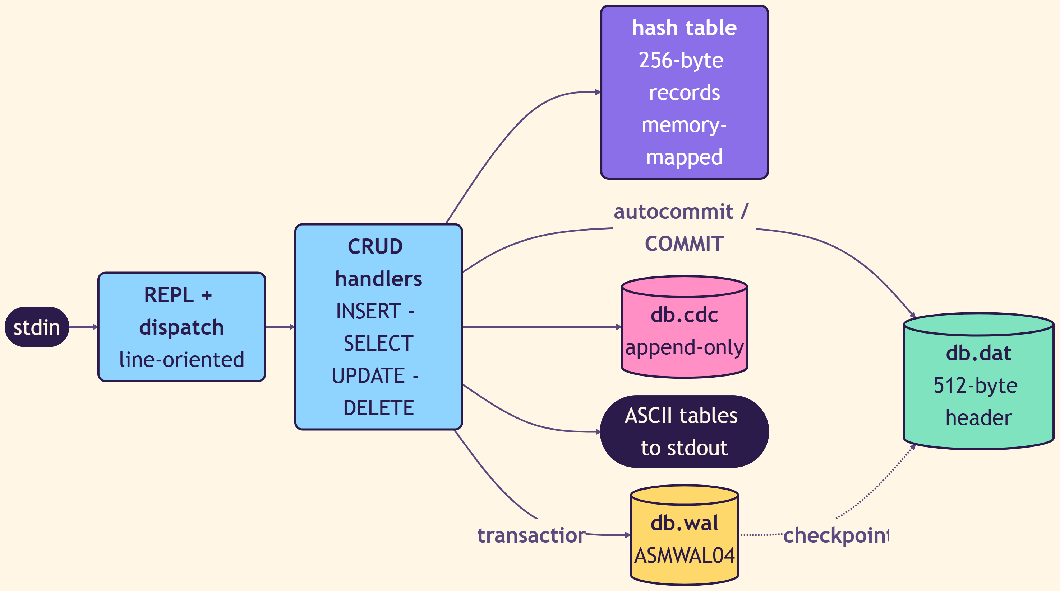
INSIDE A SESSION
One process, one table, one writer
stdin goes in, ASCII tables come out. The same code path serves the CLI, the sidecar, the REST API and the MCP server.
Three files, one database
<db>.dat
512-byte header, magic ASMDB, format version 2, capacity, live count, engine version, last_commit_seq
<db>.wal
ASMWAL04 staged frames, COMMIT01 marker, CRC-32, idempotent recovery
<db>.cdc
append-only, one frame per committed transaction, RESET for whole-table operations
01 · THE ENGINE — asmdb
12

Slide 13
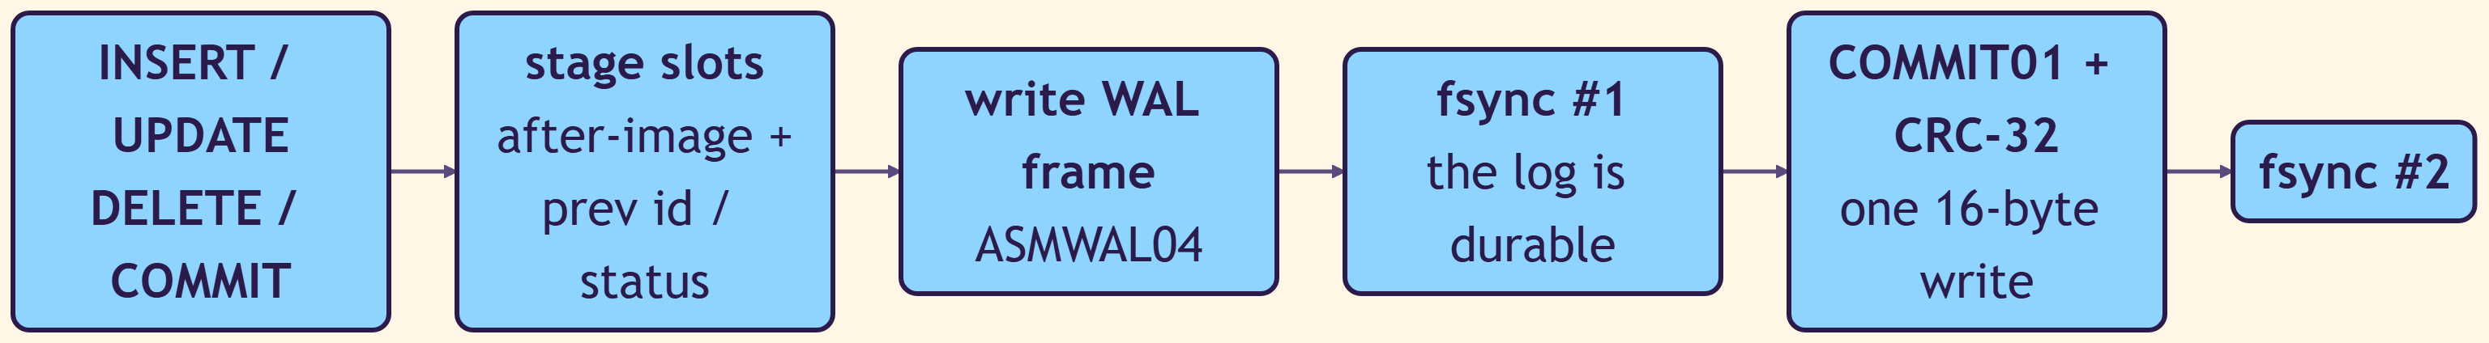
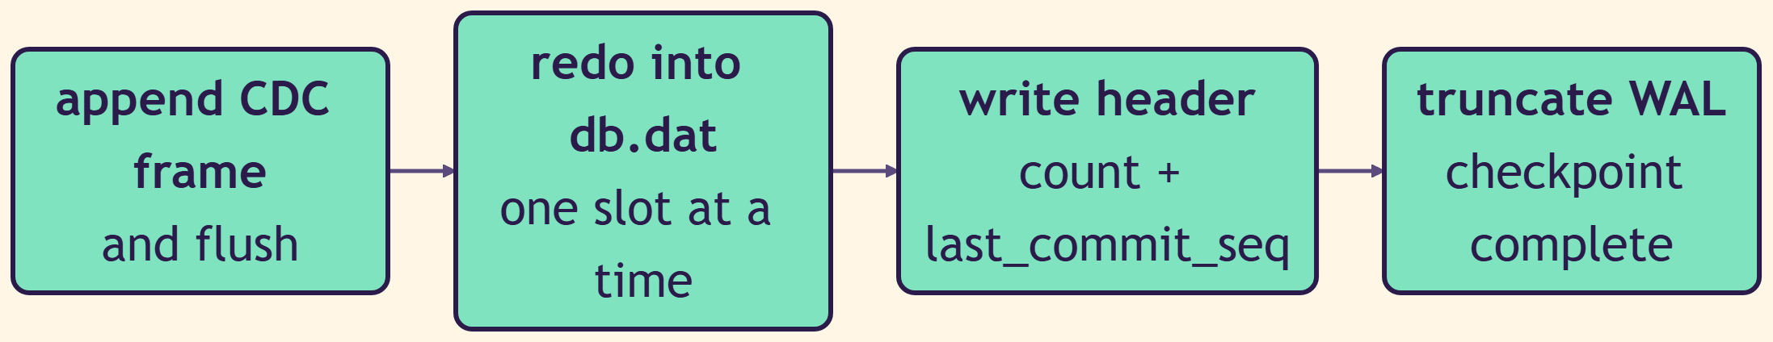
DURABILITY
The commit point is a place, not a feeling
Two fsyncs and a 16-byte marker. Everything before it can be thrown away; everything after it is pure, replayable redo.
BEFORE — nothing is visible yet
COMMIT POINT · atomicity and durability are established here
AFTER — pure redo, safe to replay
01 · THE ENGINE — asmdb
13

Slide 14
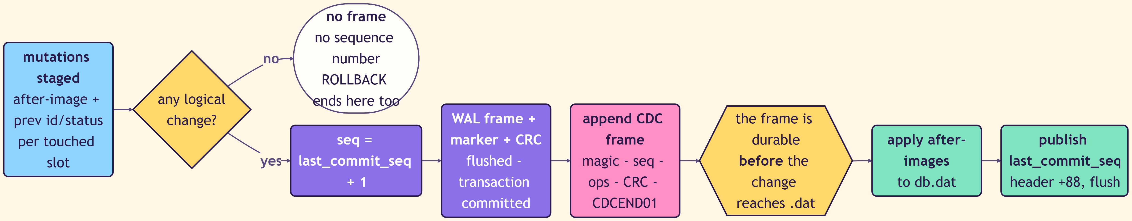
CHANGE DATA CAPTURE
CDC is not a feature bolted on afterwards
The change frame is flushed before the change reaches the data file. If the log says it happened, it happened.
Ordered
Honest
Auditable
One frame per committed transaction, numbered by a monotonic last_commit_seq published at header offset +88.
A rolled-back or no-op transaction produces no frame and consumes no sequence number. Nothing is invented.
Gaps and truncation are detectable states, not surprises. TRUNCATE emits RESET so a consumer knows to rebuild.
01 · THE ENGINE — asmdb
14

Slide 15
THE SURFACE
No SQL. Twenty-six commands.
There is no parser to exploit, no planner to mispredict, and no query that can accidentally cost a million rows.
CRUD
READ
TRANSACTIONS
INSERT
SELECT
UPDATE
DELETE
FIND
RANGE
COUNT
BEGIN
COMMIT
ROLLBACK
TRUNCATE
CATALOG
OPERATIONS
DIAGNOSTICS
TABLES
DATABASES
SCHEMA
TYPES
BACKUP
RESTORE
VERIFY
CDCTRIM
FORMAT
PAGE
HELP
EXIT
VERSION
BENCH
Also: --reader for unlimited read-only sessions, and --upgrade for a versioned, migratable on-disk format.
01 · THE ENGINE — asmdb
15

Slide 16
BENCHMARKS
What 43 kilobytes buys you
Measured on the same machine, same workload, against SQLite in its comparable mode.
IN-RAM INSERT
DURABLE BULK LOAD
DURABLE, ROW BY ROW
STDIO TRANSACTIONS
12.38 M
1.17 M
932
5,932
rows per second
12.3× SQLite
rows per second
1.4× SQLite
rows per second
two fsyncs each
rows per second
9.2× SQLite
The honest asterisk
asmdb is faster because it does less. There is no query planner to warm up, no page cache to manage, no B-tree to descend and no schema to consult. The numbers above are real, and they are also the entire argument for the design: if you accept a fixed-size row and a single table, you can delete most of a database engine and keep the part that matters — a durable, ordered, crash-safe write path.
01 · THE ENGINE — asmdb
16

Slide 17
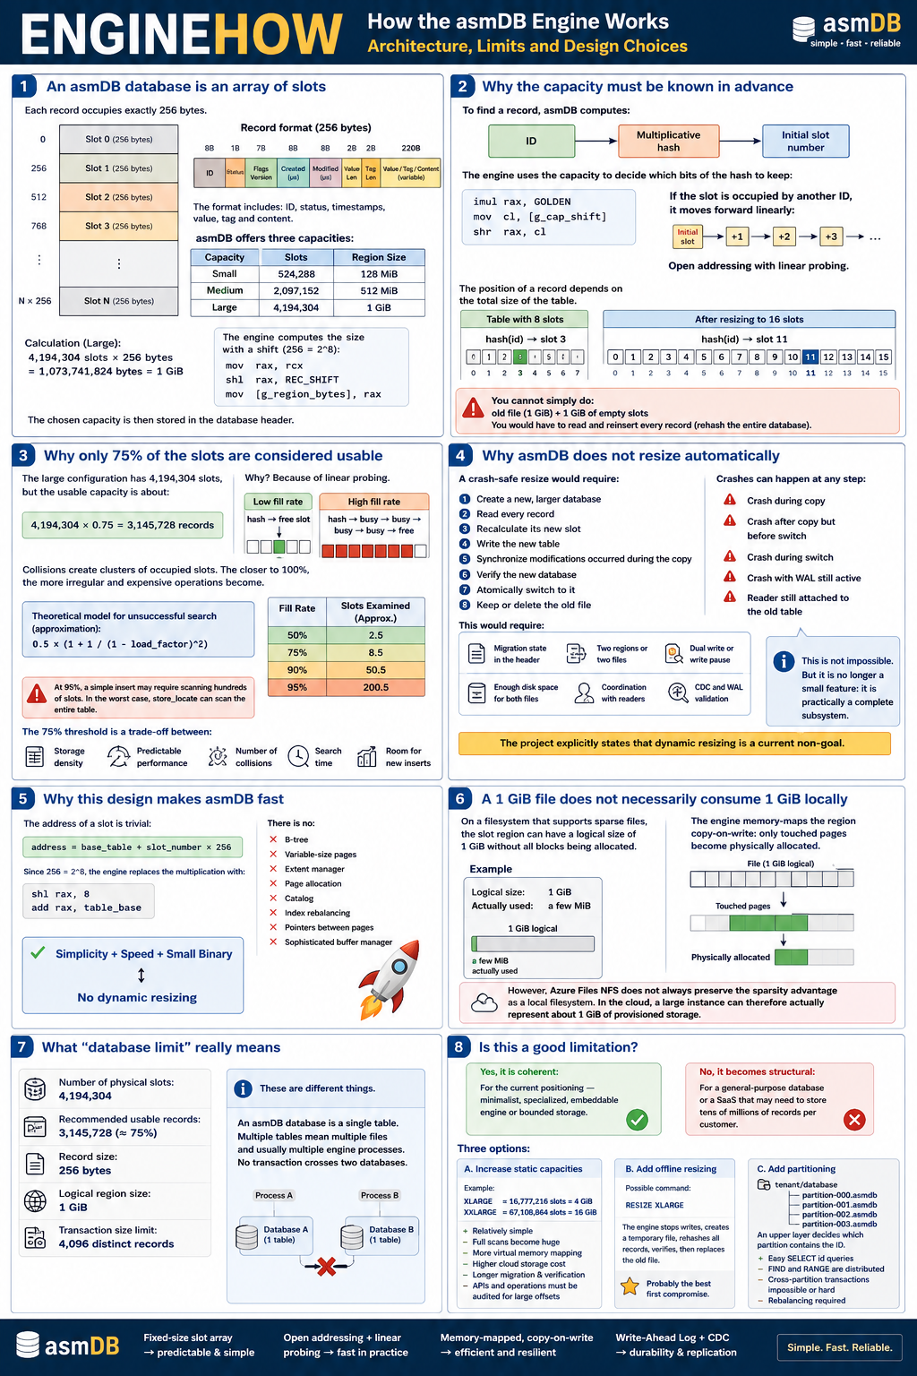
REFERENCE
The engine on one page
Slot array, open addressing, the 75% rule, why there is no automatic resize, and what “database limit” actually means.
1
An asmdb database is an array of slots
Each record occupies exactly 256 bytes, and the slot number is derived from the id.
2
The capacity must be known in advance
The engine uses the capacity to decide how many bits of the hash to keep.
3
Only 75% of the slots are usable
Because clusters form under linear probing, and cost explodes past that point.
4
It does not resize automatically
A crash-safe resize is a complete subsystem, not a small feature. It is a non-goal.
5
A 1 GiB file need not cost 1 GiB
Sparse files and copy-on-write mapping mean only touched pages are allocated.
6
Transaction limit: 4,096 records
REFERENCE SHEET · shared as a full-size handout
One database is one table. No transaction crosses two databases.
01 · THE ENGINE — asmdb
17

Slide 18
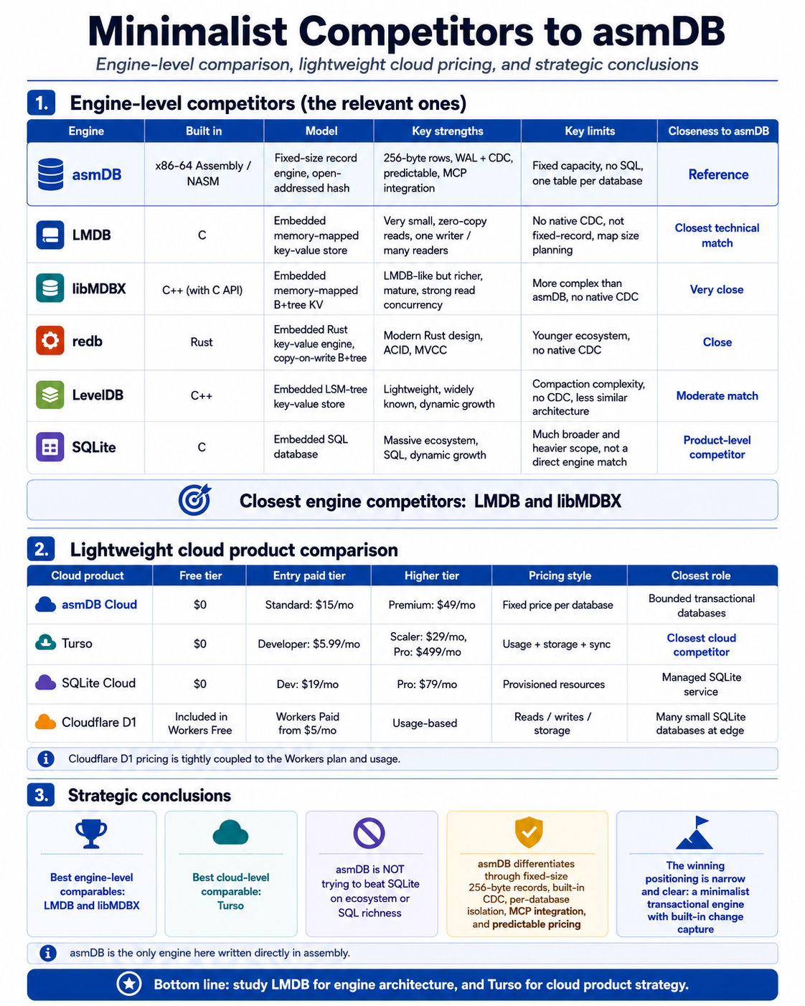
POSITIONING
Who asmdb is actually competing with
Not SQLite. The honest comparables are embedded, memory-mapped key-value engines.
LMDB
C
Closest technical match
libMDBX
C++
Very close, richer, more complex
redb
Rust
Close: ACID, MVCC, no native CDC
LevelDB
C++
Moderate: LSM-tree, no CDC
SQLite
C
A product-level competitor, not an engine match
asmdb differentiates on fixed-size 256-byte records, built-in change capture, per-database isolation, MCP integration and predictable pricing. It is the only engine in this table written directly in assembly.
REFERENCE SHEET · full comparison in the handout
01 · THE ENGINE — asmdb
18

Slide 19
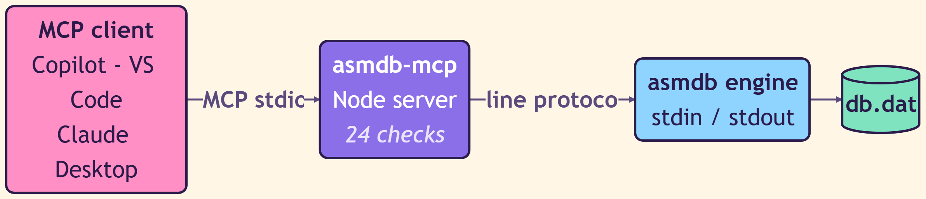
AGENTS
The engine is also a tool an agent can hold
An MCP server wraps the same stdio protocol, so a coding agent can create, query and verify a real database without a driver.
Same protocol
24 checks
Real state
The MCP server speaks the engine's line protocol over stdin and stdout. There is no second implementation to keep in sync.
The server ships with its own test suite covering every tool it exposes, run on both Windows and Linux.
The agent operates on a real .dat file with a real WAL. Nothing is simulated, so nothing lies about durability.
01 · THE ENGINE — asmdb
19

Slide 20

HONESTY
What asmdb is not
A design is only credible if it can name the things it refuses to do.
No SQL
One table per database
No joins, no planner, no secondary indexes, no CREATE TABLE.
Multiple tables means multiple files and usually multiple processes.
No transaction spans two databases
Fixed capacity
Cross-database atomicity does not exist and is not simulated.
Chosen at creation. Growing means creating a new database and migrating.
4,096 records per transaction
No read replicas or failover
A hard limit, enforced, not a guideline.
Not built. The change log is the replication primitive, not the replication system.
01 · THE ENGINE — asmdb
20

Slide 21
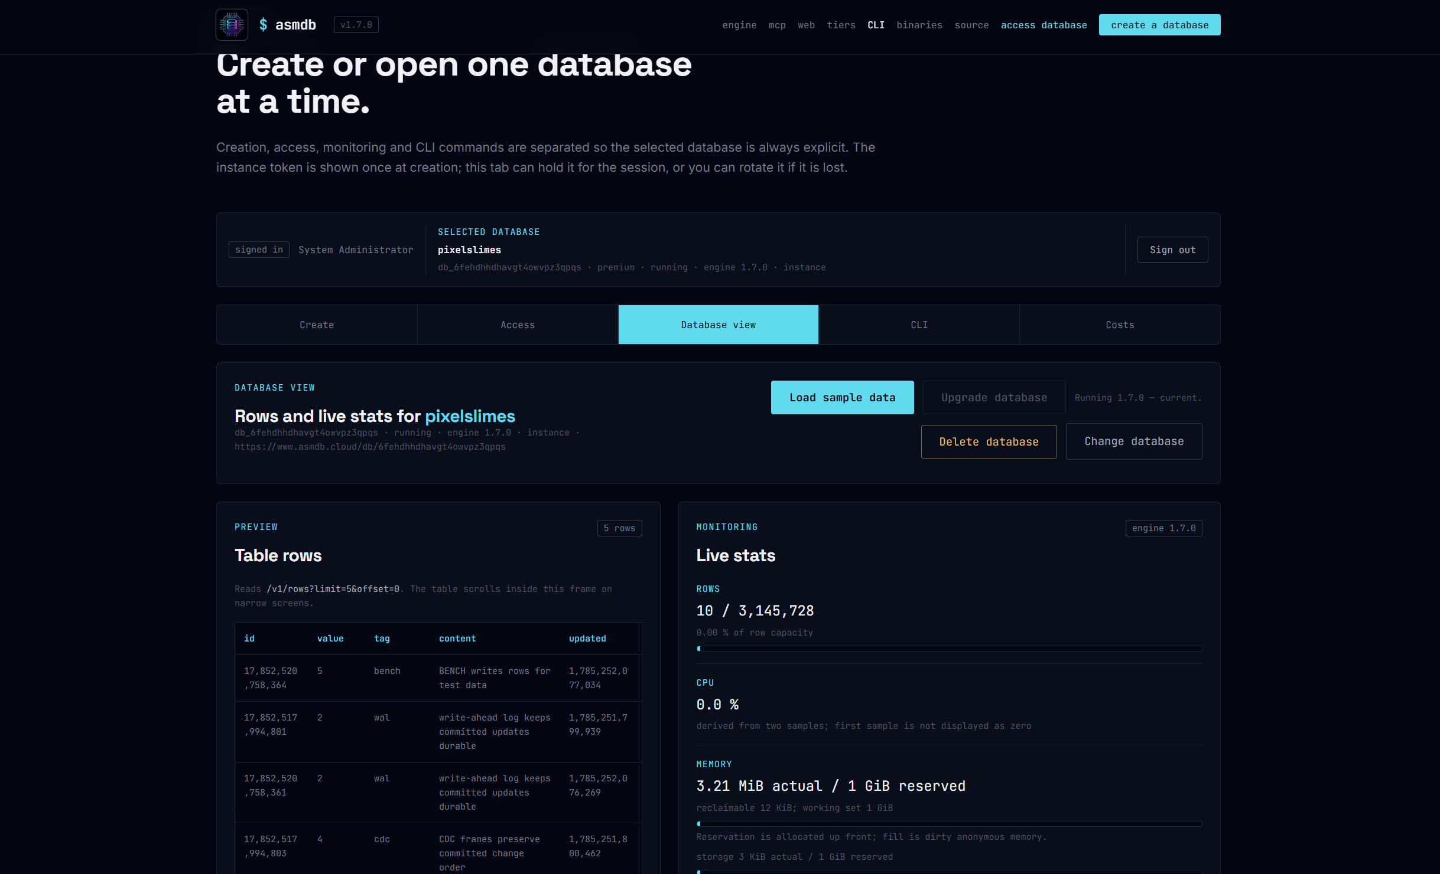
02
THE SERVICE
www.asmdb.cloud
A 43-kilobyte binary is not a product. This is what it took to make
one: a control plane, a sidecar, and one Container App per database.
02 · THE SERVICE — www.asmdb.cloud
21

Slide 22
THE GAP
Everything the engine deliberately does not do
The engine is single-writer, single-table and file-based. A service has to add the rest without changing any of that.
The engine gives you
The service must add
A process that owns one file
A line protocol on stdin and stdout
A byte-range lock for the single writer
An append-only change log on disk
A CRC-checked, crash-safe commit
Identity, tenancy and a token you can rotate
An HTTP surface with a stable contract
Isolation — one noisy tenant must not touch another
A private, read-only way to publish that log
Provisioning, monitoring, upgrade and a price
The rule that shaped every decision: the browser must never hold the instance token.
02 · THE SERVICE — www.asmdb.cloud
22

Slide 23
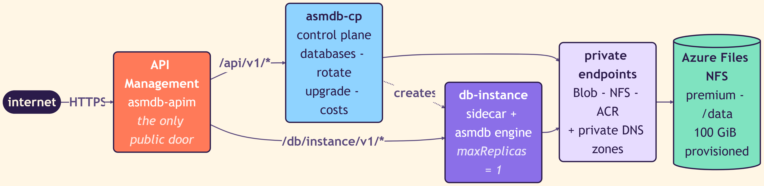
TOPOLOGY
One public door, and nothing else
API Management is the only thing on the internet. The control plane, the instances and the storage all live inside the VNet.
APIM
Control plane
Instance
Storage
Developer tier. Routes /api/v1/* to the control plane and /db/<instance>/v1/* to the instance. A 60-second forward timeout, so a cold start can finish.
Creates databases, rotates tokens, runs upgrades, reports costs. Internal Container Apps environment — not reachable from the internet.
The sidecar plus the engine, with maxReplicas pinned to 1 forever, because the engine allows exactly one writer.
Premium Azure Files NFS over a private endpoint, 100 GiB provisioned. Blob and ACR are private too, with their own DNS zones.
02 · THE SERVICE — www.asmdb.cloud
23

Slide 24
TENANCY
One database is one Container App
Not a schema. Not a row-level filter. A separate compute unit with its own mount subpath and its own token.
REPLICAS PER INSTANCE
TABLES PER DATABASE
SHARED STATE
TOKENS STORED
1
1
0
0
A hard ceiling. Two replicas would mean two writers, and the engine's lock would simply reject the second.
One file, one table. Multi-table means multiple databases and therefore multiple instances.
No shared buffer pool, no shared catalog, no shared process. A tenant cannot see or slow another.
Only the SHA-256 hash is persisted. The token itself is displayed exactly once, at creation.
The cost of that choice
Per-tenant containers are more expensive than a shared cluster, and they are slower to start. In exchange you get an isolation story you can explain in one sentence, a blast radius of exactly one customer, and an upgrade path that is a container image tag. For a bounded, embeddable engine that trade is the right way round — for a database that must hold tens of millions of rows per customer, it would not be.
02 · THE SERVICE — www.asmdb.cloud
24

Slide 25
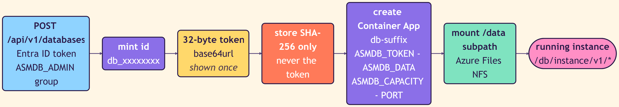
PROVISIONING
From POST to running instance
The token is generated, hashed, and forgotten. If the customer loses it, it is rotated — never recovered.
control plane
ADMIN AUTH
Entra ID v2 access token, membership of the ASMDB_ADMIN group checked on every management call.
BROWSER AUTH
PKCE. There is no client secret in the console, because there is nowhere safe to put one.
ROTATION
Two-phase. The pending token is sealed with AES-GCM until the client commits it, so a rotation cannot lock anyone out.
POST /api/v1/databases
Authorization: Bearer <Entra ID v2 access token>
201 Created
{ "id": "db_6fehdhhdhavgt4owvpz3qpqs",
"token": "…shown exactly once…",
"tier": "premium", "engine": "1.7.0" }
02 · THE SERVICE — www.asmdb.cloud
25

Slide 26
THE CONTRACT
Two planes, one gateway
Management calls are authenticated with a human or an app identity. Data calls are authenticated with the instance token, and never leave the browser.
MANAGEMENT PLANE · Entra ID
DATA PLANE · instance token
GET
/api/v1/version
GET
/db/{inst}/v1/rows
engine and platform versions
paged rows, limit and offset
GET
/api/v1/databases
GET
/db/{inst}/v1/count
list the databases you own
live row count
POST
/api/v1/databases
GET
/db/{inst}/v1/find
provision a new instance
point lookup by id
POST
/api/v1/databases/{id}/wake
GET
/db/{inst}/v1/range
explicit cold start
ordered scan between two ids
POST
/api/v1/databases/{id}/rotate-token
POST
/db/{inst}/v1/exec
phase one of rotation
raw engine command
POST
/api/v1/databases/{id}/upgrade
GET
/db/{inst}/v1/stats
move to a new engine build
rows, CPU, memory, storage
GET
/api/v1/costs
ANY
/db/{inst}/v1/mcp
what this account is actually costing
the engine as an agent tool
02 · THE SERVICE — www.asmdb.cloud
26

Slide 27
ECONOMICS OF IDLE
Scale to zero, and be honest about waking up
Free and standard instances stop costing money when nobody is using them. Premium stays warm because analytics cannot wait.
FREE
STANDARD
PREMIUM
Cold start
$0 / mo
$15 / mo
$49 / mo
A scaled-to-zero instance has to be woken. Rather than hide that behind a silent retry, there is an explicit wake endpoint and a 60-second gateway timeout — so the first call after an idle period is slow and honest, rather than fast and wrong.
vCPU / memory
0.25 vCPU · 0.5 GiB
Idle behaviour
scales to zero
CDC to Fabric
not available
vCPU / memory
0.5 vCPU · 1 GiB
Idle behaviour
scales to zero
CDC to Fabric
not available
vCPU / memory
1 vCPU · 2 GiB
Idle behaviour
stays warm
CDC to Fabric
included
The unit economics nobody puts on a pricing page
The platform costs roughly $141.76 per month before a single customer exists — API Management, the Container Apps environment, a premium registry, the NFS share and Log Analytics. A free instance then adds about $1.03 per month. That fixed floor, not the per-instance cost, is what a fixed price per database has to amortise.
02 · THE SERVICE — www.asmdb.cloud
27

Slide 28
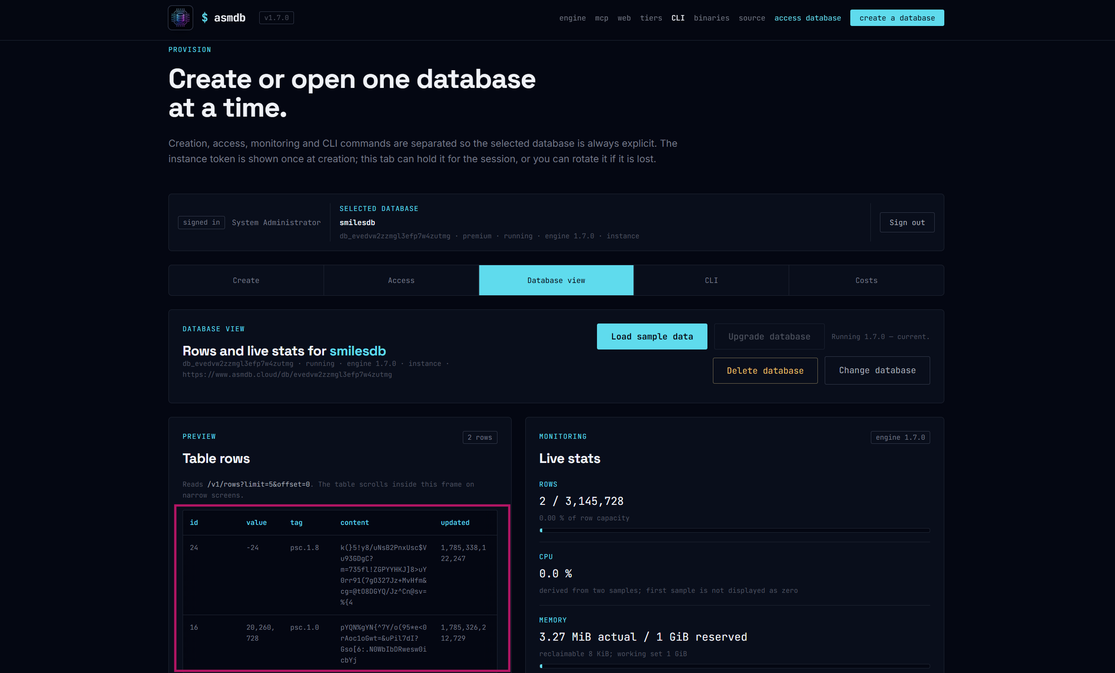
THE CONSOLE
Create, access, monitor and pay — kept separate
www.asmdb.cloud · the selected database is always explicit, so no command can run against the wrong instance.
CREATE
Choose a capacity and a tier. The token appears once.
ACCESS
Hold the instance token for the session, or rotate it.
DATABASE VIEW
Live rows straight from /v1/rows?limit=5&offset=0.
CLI
A browser terminal that speaks the engine's own protocol.
COSTS
What this database has actually consumed.
02 · THE SERVICE — www.asmdb.cloud
28

Slide 29
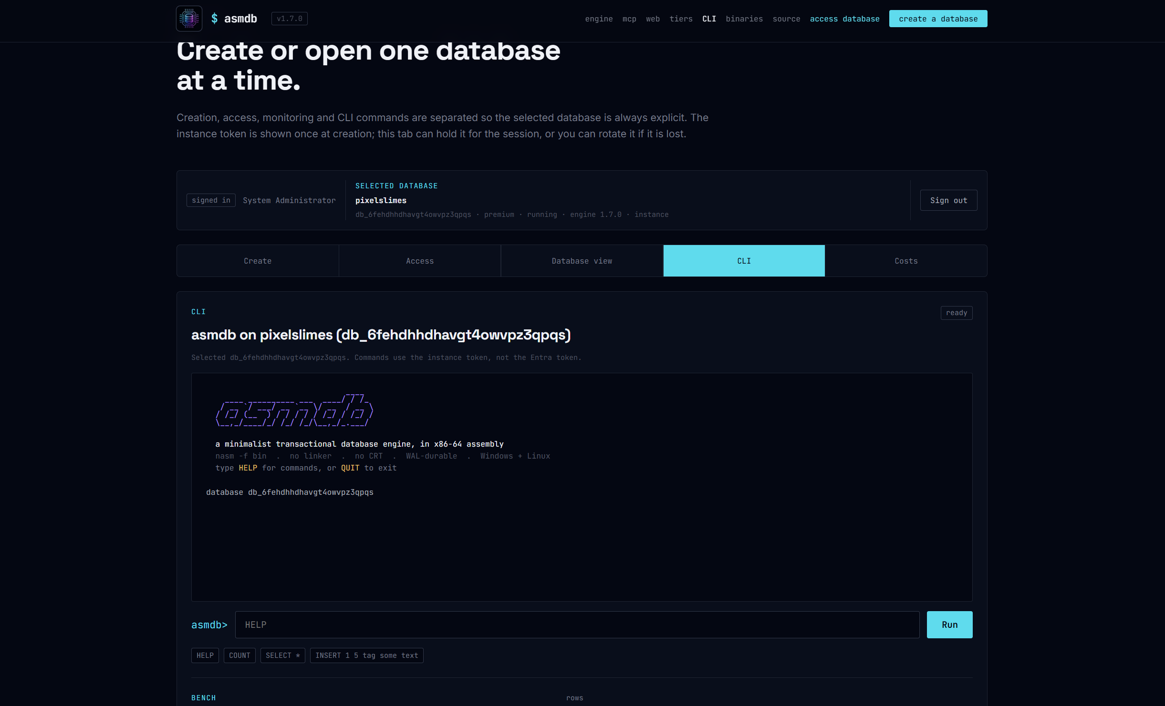
OBSERVABILITY
Live stats, straight from the engine
Not a metrics pipeline. The sidecar asks the running engine and reports what it says.
ROWS
10 / 3,145,728
0.00 % of row capacity used
MEMORY
3.21 MiB
actual, against 1 GiB reserved — the reservation is dirty anonymous memory, allocated up front
STORAGE
3 KiB
actual, against 1 GiB reserved. Sparse files mean logical size is not physical cost
02 · THE SERVICE — www.asmdb.cloud
29

Slide 30
STATUS
What landed, and what did not
A roadmap that only lists wins is a brochure.
LANDED
NOT LANDED
Contracts and the OpenAPI surface
Sidecar: REST, MCP, exec, stats
Control plane: databases, rotate, upgrade, costs
Infrastructure: Container Apps, APIM, VNet
Private endpoints for Blob, NFS and ACR pulls
Entra ID management auth and the PKCE browser flow
The browser terminal
Invoice-grade metering
Backup and point-in-time restore beyond the NFS snapshot and the pre-upgrade BACKUP
A build agent inside the VNet
Read replicas and failover
Automated share growth
Preallocation economics
02 · THE SERVICE — www.asmdb.cloud
30

Slide 31
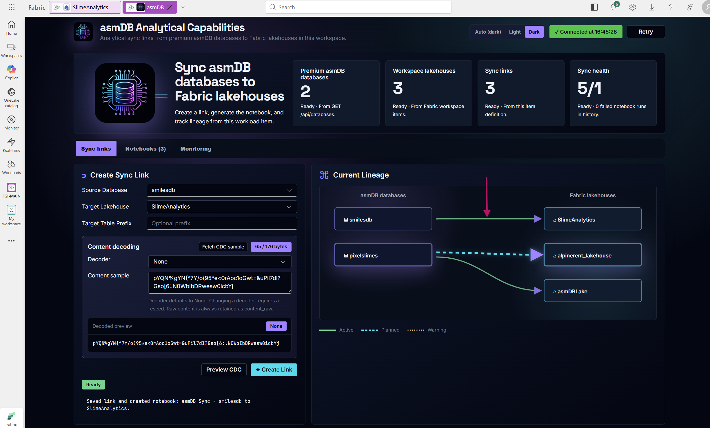
03
THE WORKLOAD
asmdb.analytics
A Microsoft Fabric workload that turns an assembly engine's change log
into Delta tables in a customer's Lakehouse — without ever writing them itself.
03 · THE WORKLOAD — asmdb.analytics
31

Slide 32
THE PROBLEM
A bounded OLTP engine is the wrong place to ask questions
3,145,728 rows of 256 bytes is a fine operational store. It is a terrible analytical one — and making it a good one would ruin it.
WHY NOT IN THE ENGINE
WHY IN THE LAKEHOUSE
No SQL
You cannot GROUP BY over a line protocol that only knows FIND and RANGE.
No columns
The payload is an opaque blob. There is nothing for a query engine to prune or push down.
One writer
An analytical scan competing with the write path is a scan that hurts production.
Fixed capacity
History has to leave the database eventually, or the database stops accepting writes.
Delta on OneLake
Columnar, statistics, file skipping, time travel — all the things the engine refuses to implement.
Fabric Spark
Compute that scales independently of the instance, and stops costing money when idle.
Direct Lake
A semantic model reading Parquet without a copy and without an import refresh.
Unlimited readers
Analysts, notebooks and reports never touch the single writer.
03 · THE WORKLOAD — asmdb.analytics
32

Slide 33
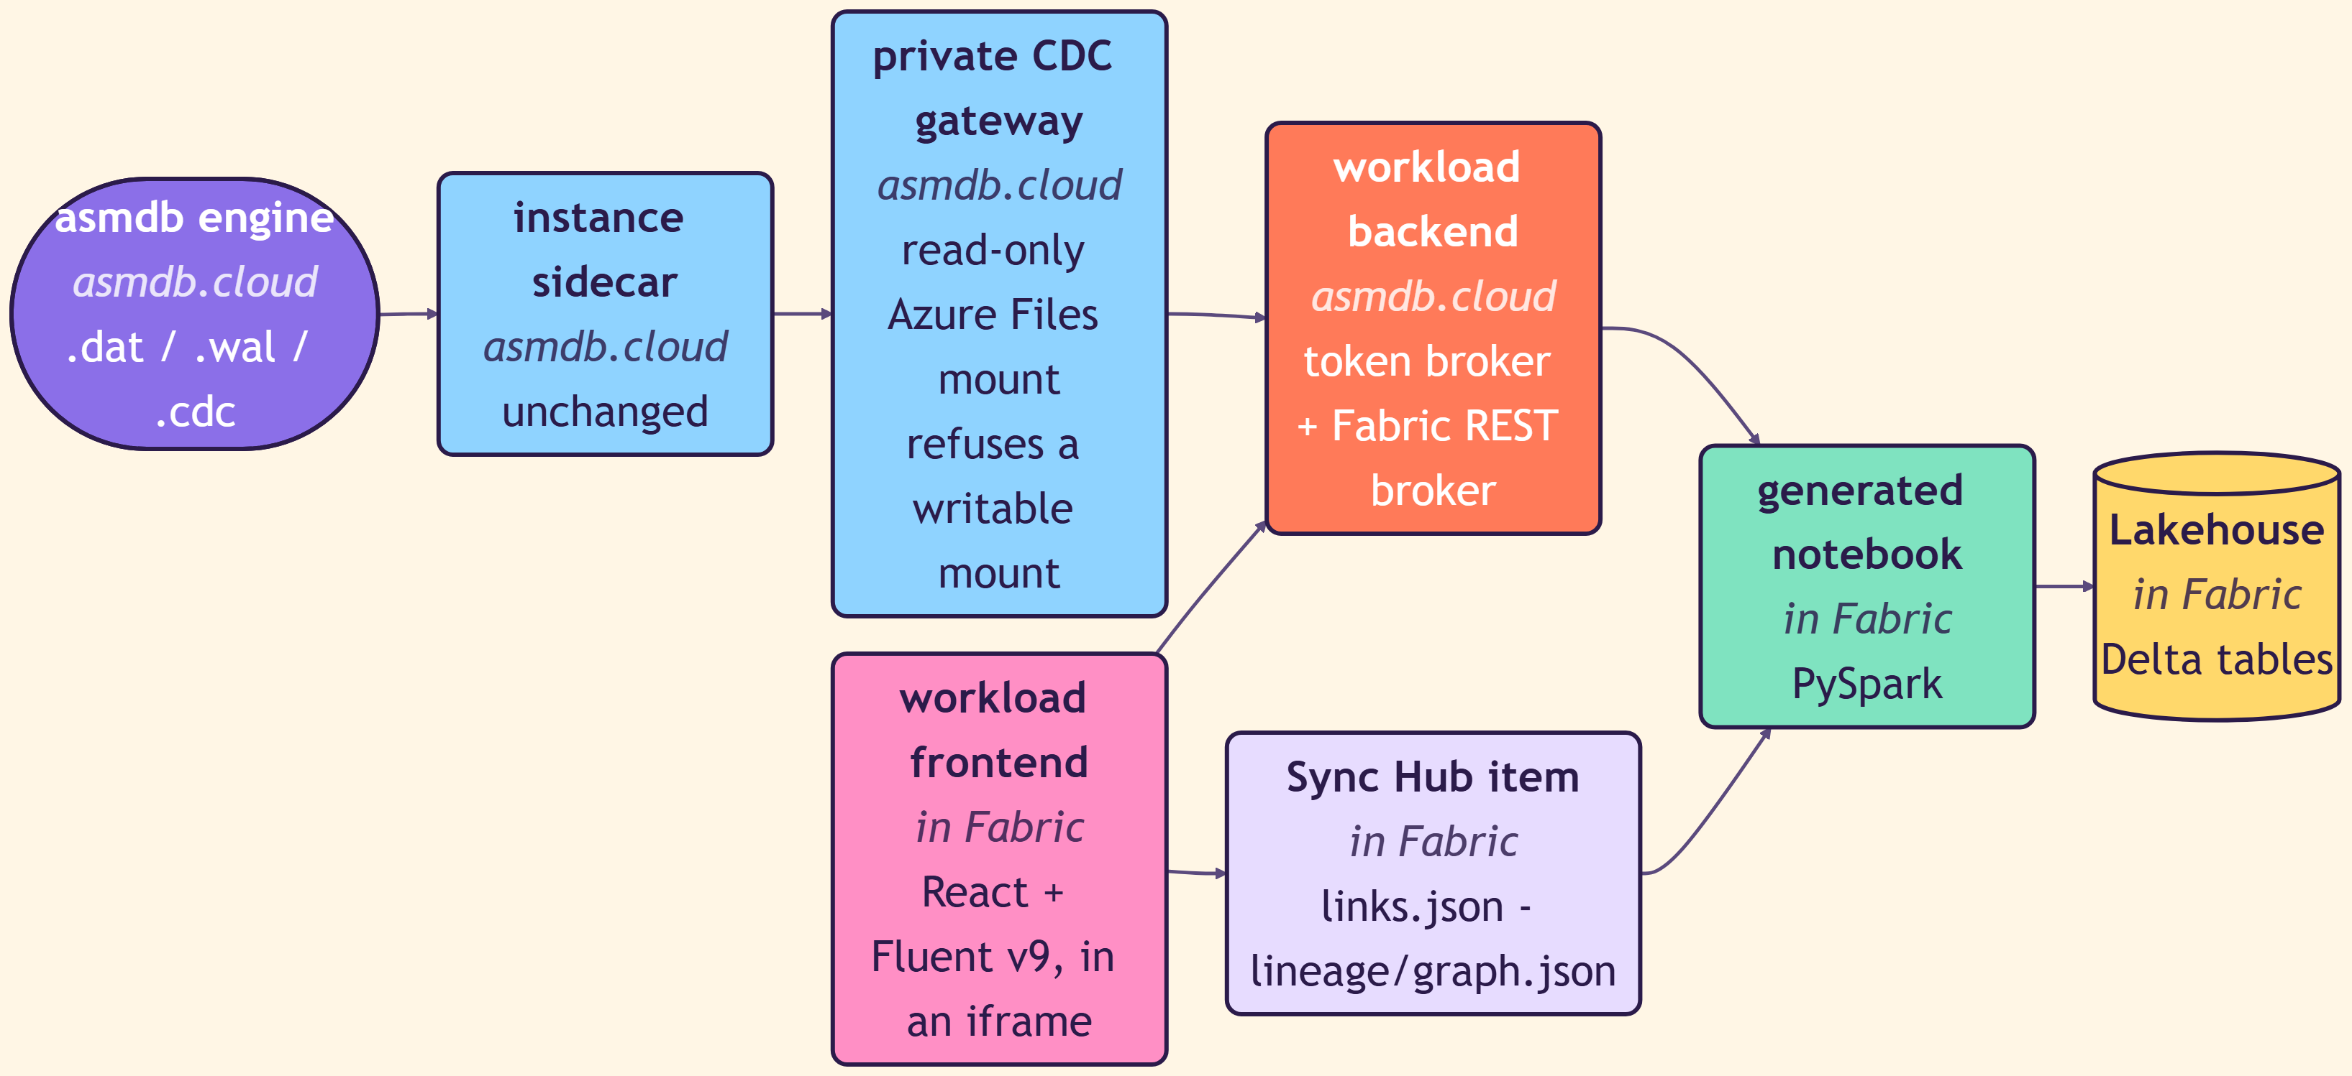
ANATOMY
What a Fabric workload actually is
A frontend that runs in an iframe inside Fabric, a backend that brokers tokens, an item definition that stores your links, and a notebook that does the work.
Five moving parts
FRONTEND
React and Fluent UI v9, hosted by us, rendered inside Fabric.
BACKEND
Exchanges a Fabric JWT for scoped asmdb Cloud credentials. No service identity fallback.
SYNC HUB ITEM
A first-class Fabric item. links.json and lineage/graph.json are its definition.
CDC GATEWAY
A small Go service on a read-only mount, inside our VNet only.
NOTEBOOK
Generated PySpark, owned by the customer's workspace.
03 · THE WORKLOAD — asmdb.analytics
33

Slide 34
THE GATEWAY
Read-only by construction, not by policy
The most dangerous component in this design is the one that reads another tenant's data files. So it was built so that it cannot do anything else.
It refuses a writable mount
It stores nothing
It is not on the internet
On startup the gateway checks that its Azure Files mount is read-only. If it is writable, it does not start. A misconfiguration becomes a failed deployment, not a silent risk.
No cache, no spool, no temp file. Frames are streamed from the change log to the caller. There is no copy of customer data to leak, and nothing to purge.
The gateway is reachable only from inside the service VNet. Fabric never talks to it directly — the notebook goes through the brokered backend.
The one sentence that settles every design argument
Fabric Spark writes the Delta tables. asmdb.cloud does not. We publish a change log and generate a notebook; the customer's own capacity, in the customer's own workspace, does the writing. That keeps the data in their tenant, the cost on their capacity, and the blame in the right place.
03 · THE WORKLOAD — asmdb.analytics
34

Slide 35
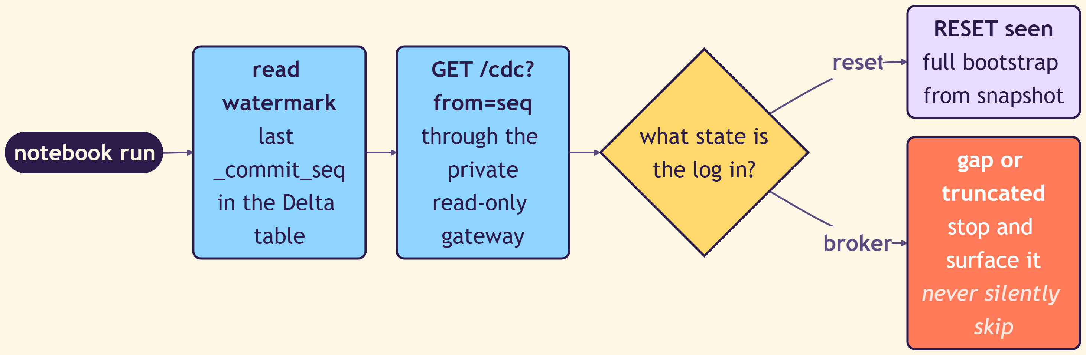
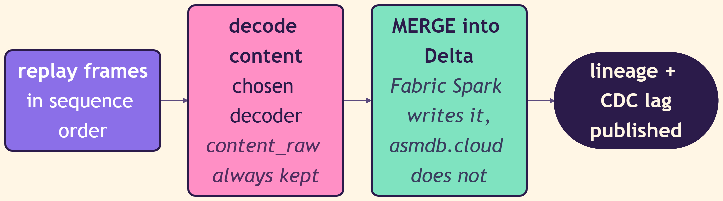
ONE SYNC RUN
Read the watermark, replay the frames, merge
The interesting part is not the happy path. It is what happens when the log is not what the notebook expected.
READ — never trust, always verify
WRITE — Fabric Spark owns the Delta table
Never silently skip
A gap in the sequence stops the run and shows up as a failed sync, not as a table that is quietly missing yesterday.
03 · THE WORKLOAD — asmdb.analytics
35

Slide 36
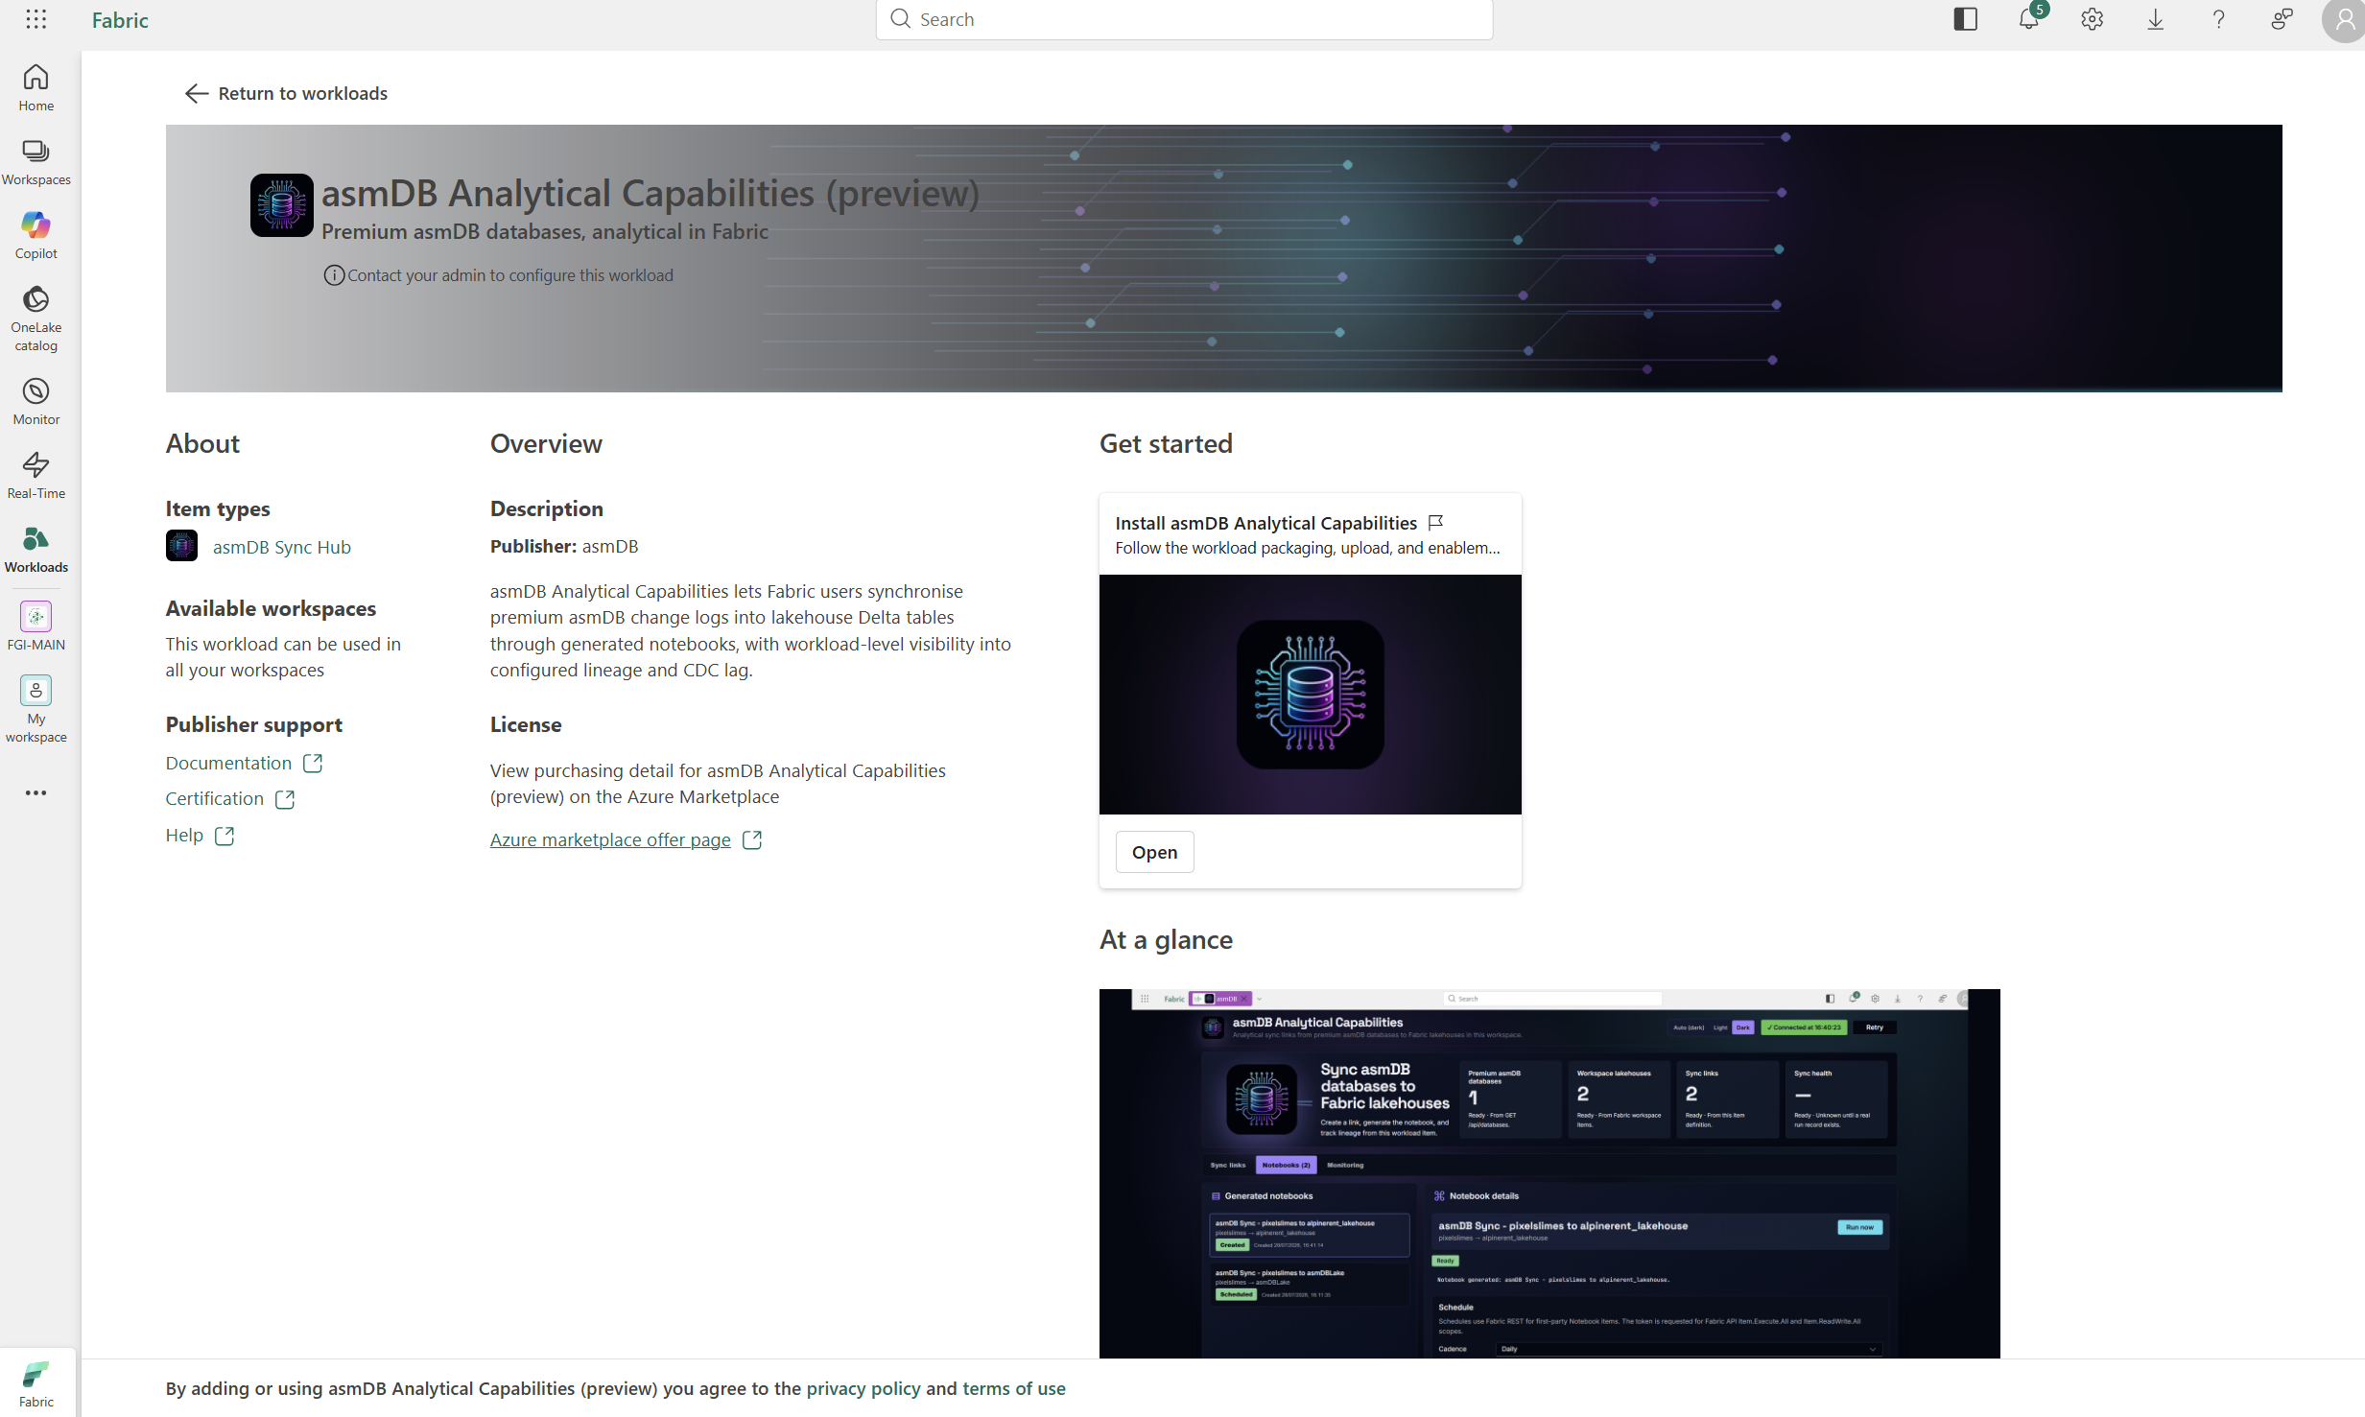
IN THE TENANT
It looks like any other Fabric workload, because it is one
Published through the Workload Development Kit: an item type, a publisher, a marketplace offer, and an admin who has to enable it.
ITEM TYPE
asmDB Sync Hub
PUBLISHER
asmDB
AVAILABILITY
All workspaces in the tenant, once an admin enables it
LICENSING
Through the Azure Marketplace offer page
DESCRIPTION
Synchronise premium asmDB change logs into Lakehouse Delta tables through generated notebooks, with workload-level visibility into lineage and CDC lag
03 · THE WORKLOAD — asmdb.analytics
36

Slide 37
CREATING A LINK
Source database, target Lakehouse, and a decoder
The decoder is the interesting field. content_raw is always kept, so choosing a decoder is never destructive — but changing one forces a reseed.
PREMIUM DATABASES
2
from GET /api/databases
WORKSPACE LAKEHOUSES
3
from Fabric workspace items
SYNC LINKS
3
from this item definition
SYNC HEALTH
5 / 1
0 failed notebook runs in history
03 · THE WORKLOAD — asmdb.analytics
37

Slide 38
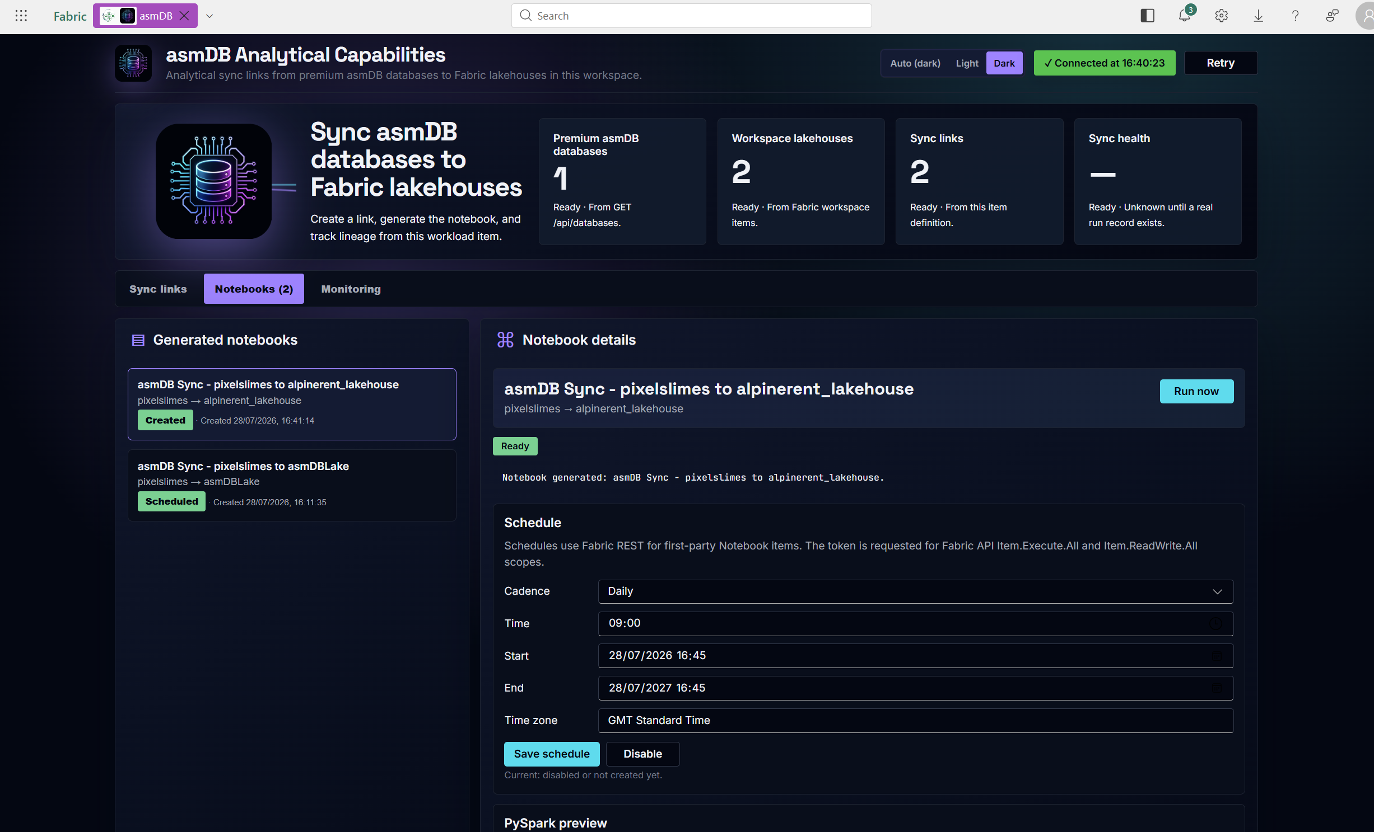
GENERATED CODE
The workload writes the notebook, the workspace owns it
Schedules use the Fabric REST API for first-party Notebook items, with the token requested for Item.Execute.All and Item.ReadWrite.All.
Why generate, not run
The customer can read every line before it touches their data.
It runs on their capacity, under their governance, with their identity.
They can edit it, fork it, or schedule it from a Data Factory pipeline instead.
If we disappear tomorrow, the notebook still works.
Convenience: native schedule, human identity.
Production: Data Factory pipeline, Workspace Identity.
03 · THE WORKLOAD — asmdb.analytics
38

Slide 39
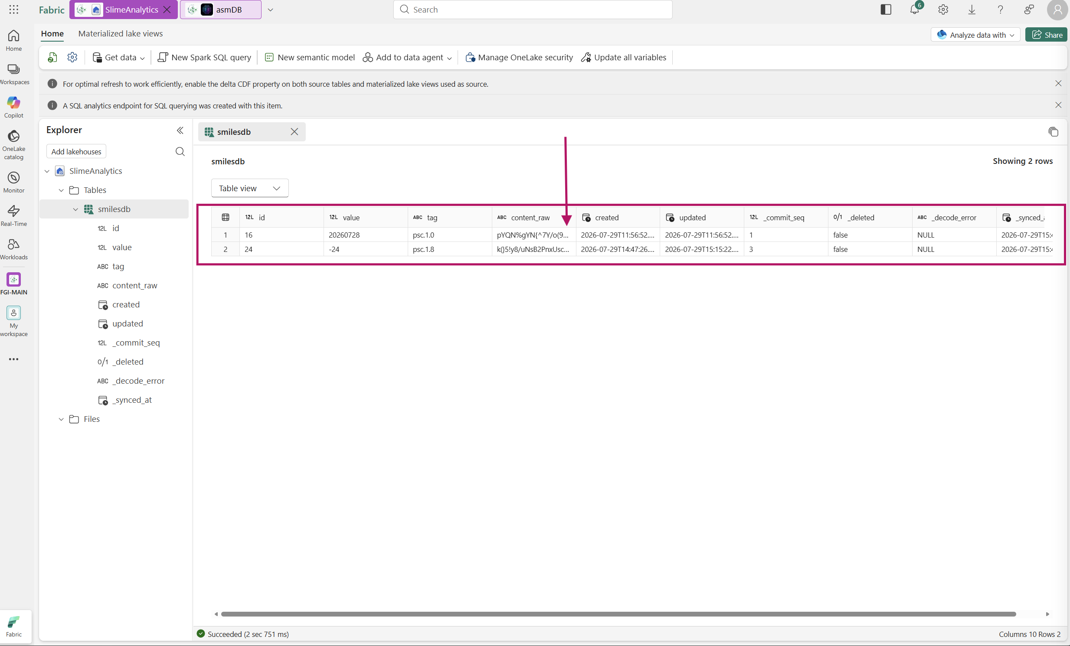
THE LANDING TABLE
What an assembly row looks like as Delta
Four columns from the engine, five added by the sync. The raw payload is never thrown away.
Columns
id
engine
value
engine
tag
engine
content_raw
engine
created
engine
updated
engine
_commit_seq
sync
_deleted
sync
_decode_error
sync
_synced_at
sync
03 · THE WORKLOAD — asmdb.analytics
39

Slide 40
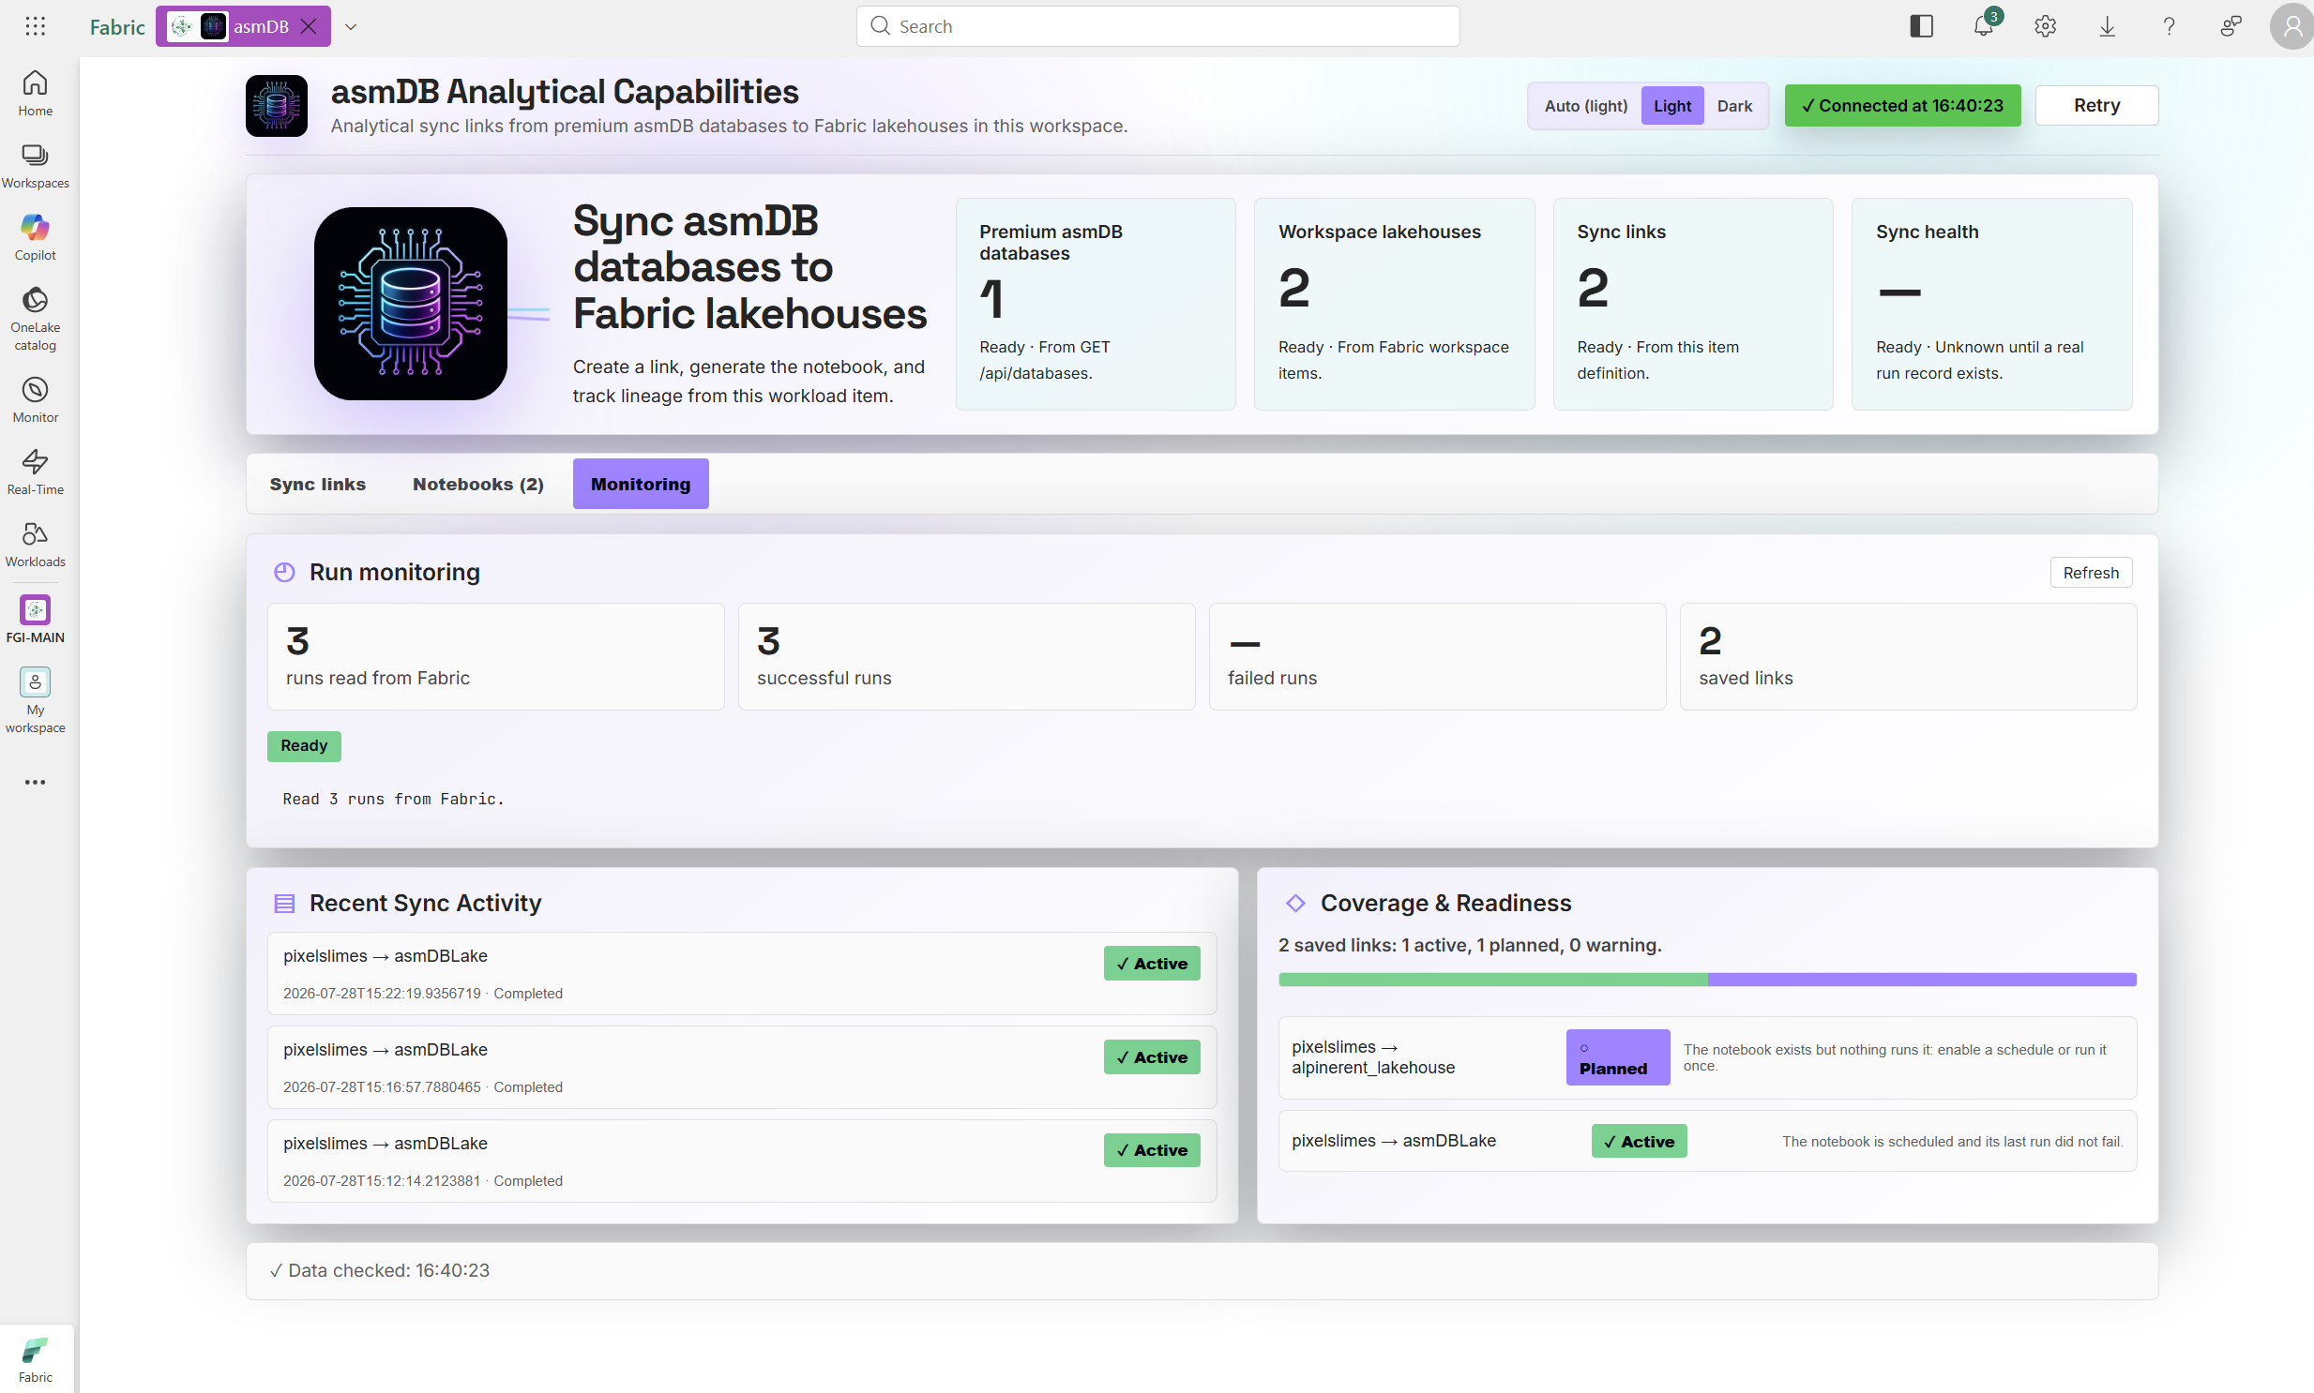
OPERATIONS
Lineage and lag, derived from what actually ran
Link state is not a status field somebody sets. It is computed from Fabric job history.
ACTIVE
PLANNED
WARNING
A notebook run has succeeded, and the watermark is moving.
The link and the notebook exist, but nothing has run yet. Shown as a dashed edge, never as a success.
Runs are failing, or the CDC lag has grown past what the schedule should allow.
Sync health, honestly
When there is no run history at all, the tile says “Unknown until a real run record exists” rather than showing a green tick. A dashboard that reports success before anything has happened is worse than no dashboard.
03 · THE WORKLOAD — asmdb.analytics
40

Slide 41
DECODING
Where opaque bytes become meaning
The engine stores 175 bytes of text and has no opinion about them. The workload gives you a place to say what they are — without ever losing the original.
content decoding
content_raw pYQN%gYN{^7Y/o(95*e<0rAoc1oGwt=&uPil7dI?Gso[6:.N0WbIbDRwesw0icbYj
decoder None → Z85 → PSC-1
sample size 65 / 176 bytes
; content_raw is ALWAYS retained.
; changing a decoder requires a reseed, because the
; decoded columns are derived, not authoritative.
The default is None
The decoder is the tenant's
Failure is a column
Doing nothing is the safe default. A sync that lands unreadable bytes is recoverable; a sync that lands wrongly-parsed bytes is not.
asmdb has no idea what PSC-1 is. PixelSlime does. The workload just carries the bytes and lets the owner name them.
_decode_error survives into the Lakehouse, so “how many rows did we fail to understand” is a query, not an incident.
03 · THE WORKLOAD — asmdb.analytics
41

Slide 42

04
THE PRODUCT
www.pixelslime.cloud
One AI-generated slime a day, forever. A whole trading card packed into
175 bytes of asmdb, and fingerprinted on Polygon so it cannot be quietly rewritten.
04 · THE PRODUCT — www.pixelslime.cloud
42

Slide 43
WHY
Proof by product, not proof by benchmark
A benchmark tells you an engine is fast. A product tells you it is correct, durable, operable, and worth paying for.
It writes every day
It cannot lose data
Not a load test that runs for an hour. A scheduled job that has to succeed at 10:00 Europe/Paris, unattended, or the site is visibly wrong.
Each card is unique and unrepeatable. There is no “regenerate it”. If asmdb loses a row, the loss is public and permanent.
It is externally verifiable
It produces analytics demand
The bytes in the database are hashed on a public chain. If storage silently corrupted anything, the hash would stop matching and anyone could check.
A daily stream of encoded rows is exactly the workload the Fabric workload was built to move — so the last two layers get tested too.
04 · THE PRODUCT — www.pixelslime.cloud
43

Slide 44
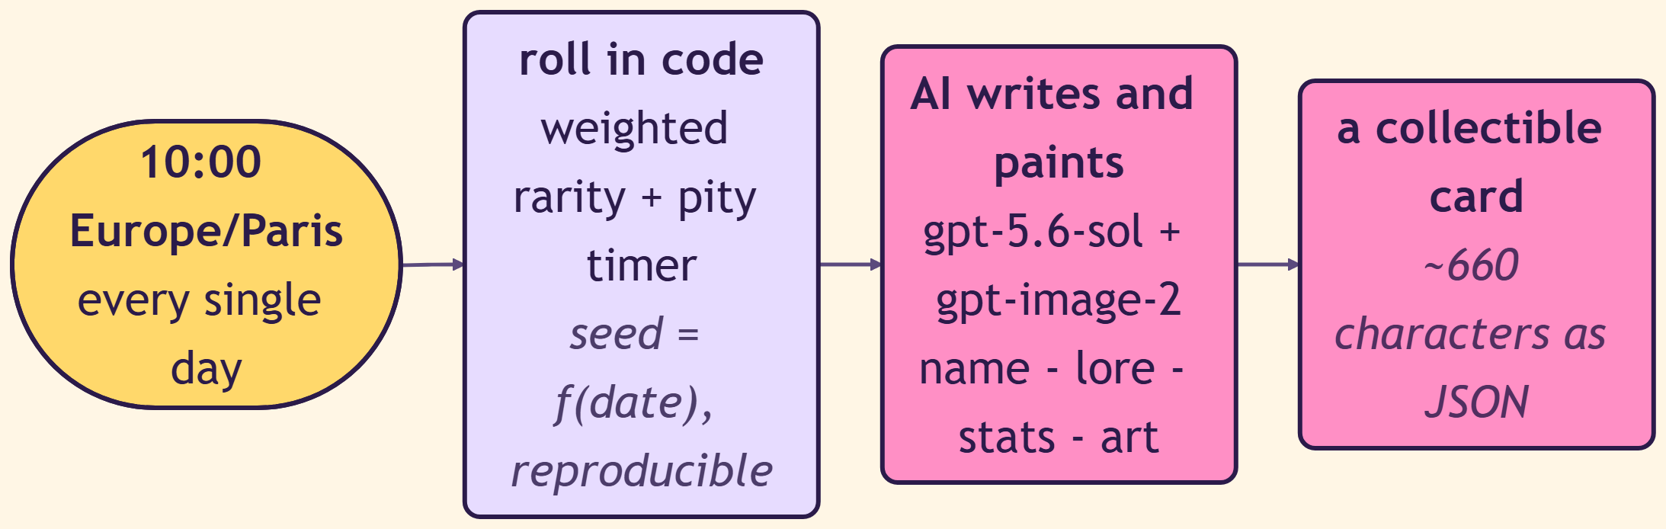
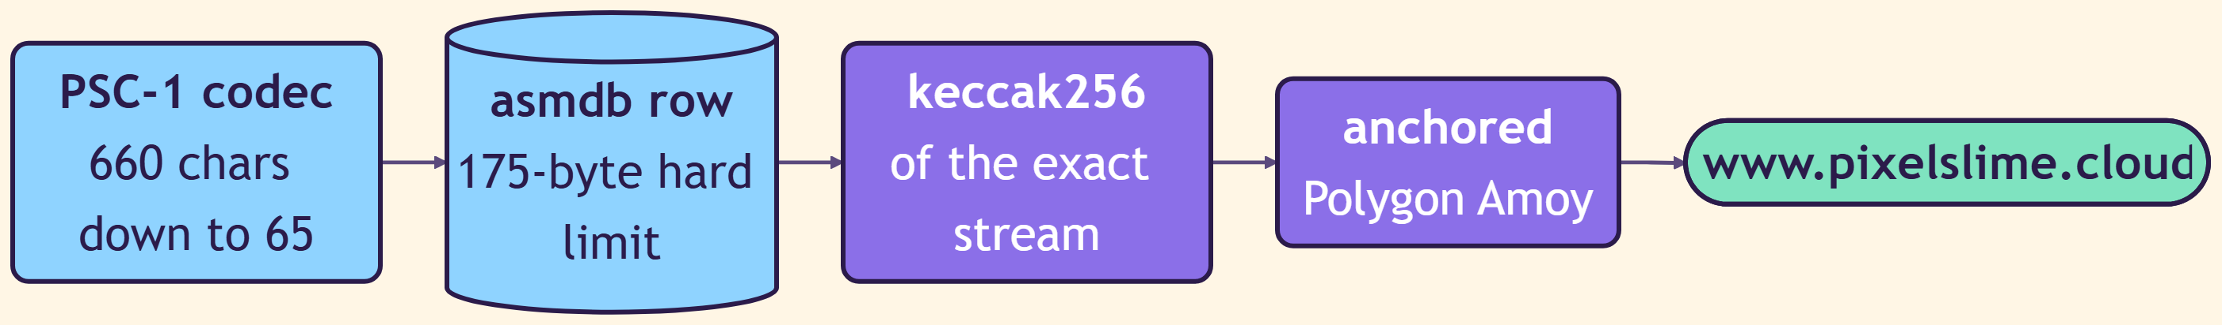
THE DAILY BLOOM
Make it, keep it, prove it
The rarity roll happens in code with a seed derived from the date, so the outcome is reproducible and the model cannot cheat.
MAKE — one card, invented from nothing
KEEP IT — and prove it
04 · THE PRODUCT — www.pixelslime.cloud
44

Slide 45
GENERATION · STEP ONE
The rarity is rolled in code, never by the model
An LLM asked to “pick a rarity” produces a distribution nobody can audit and nobody can reproduce. So it never gets asked.
COMMON
Puddle
45 %
plain wooden frame, soft palette
Reproducible
UNCOMMON
Dewdrop
27 %
silver frame, a light halo
The seed is a function of the date, so the same day always rolls the same card. The whole collection can be replayed from scratch and audited against the published weights.
RARE
Prism
17 %
blue frame, prismatic highlights
EPIC
Aurora
8 %
gold and violet frame, a crown gem
The pity timer
LEGENDARY
Starlight
2.5 %
celestial frame, constellation backdrop
Fourteen days without a card of RARE or better, and the next roll is forced to be at least RARE. At one card a day, pure randomness would eventually produce a stretch nobody would stay for.
MYTHIC
Dreamdrop
0.5 %
rainbow foil, a frame that overflows itself
04 · THE PRODUCT — www.pixelslime.cloud
45

Slide 46
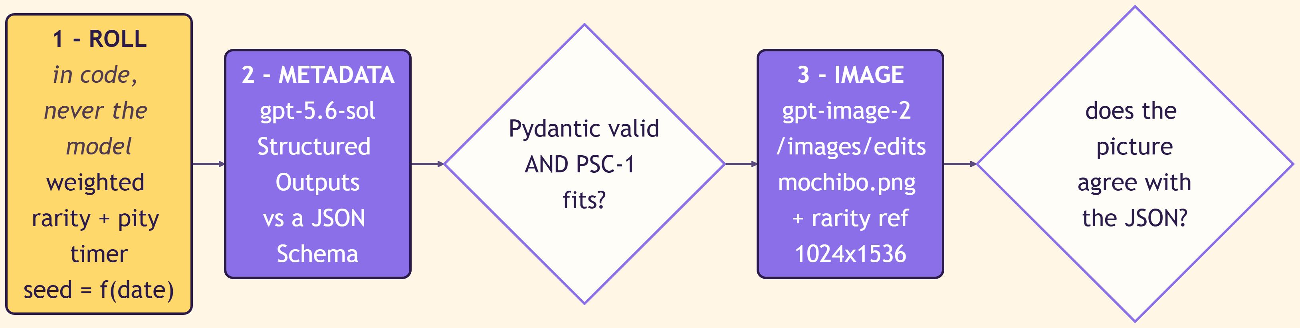
GENERATION · THE PRINCIPLE
Data first, image second
The obvious approach is to generate a beautiful card and then read the stats back off it. That approach is fragile, and it puts the model in charge of the database.
What we did not do
What we did instead
Paint a card, then OCR the name, level, rarity and four stat bars out of the pixels. Every card becomes a parsing problem, every font quirk becomes a data bug, and the database ends up believing whatever the renderer happened to draw.
Generate a structured JSON first, ask gpt-image-2 to paint exactly that JSON, then verify the image agrees with it. The data is authoritative and the artwork is a rendering of it — never the other way round.
Gate one retries the metadata up to twice · gate two repaints once · after that the day fails loudly rather than quietly
04 · THE PRODUCT — www.pixelslime.cloud
46

Slide 47
GENERATION · TWO MODELS
One model writes the facts, the other paints them
Neither is trusted with the other's job, and neither is trusted with a number the database will have to live with.
gpt-5.6-sol — the metadata
gpt-image-2 — the artwork
STRUCTURED OUTPUTS
Constrained to a JSON Schema, so the response cannot be prose, cannot miss a field and cannot invent one.
THE PROMPT
A versioned master prompt, plus the values already rolled in code, plus every name used so far.
LENGTH-CAPPED
Every field has a maximum, because the whole card has to fit in 175 bytes.
/images/edits, NOT /generations
Multipart, because only the edits endpoint accepts reference images at all.
image[] = mochibo.png
The anatomy canon, sent on every single generation, so 3,650 cards share one layout.
image[] = ref-<rarity>.png
An approved exemplar of the tier that was rolled, so rarity stays visible.
The wrinkle that made this interesting
Mochibo is an EPIC card — ornate gold and violet, gem at the crown. Use it as the only reference and a COMMON slime inherits an EPIC-looking frame, so rarity quietly stops being visible, which is the one thing a collectible cannot afford. The fix was not to stop sending Mochibo, but to split what the reference carries: the anatomy is pinned by the image, the finish is pinned by words and by a per-tier exemplar. Both are versioned.
04 · THE PRODUCT — www.pixelslime.cloud
47

Slide 48
GENERATION · THE ALPHA PROBLEM
The API said no, so Pillow said yes
A cute engineering detour that turned out to be the most reusable code in the pipeline.
the blocker
The fix
POST /openai/v1/images/edits model=gpt-image-2 background=transparent
400 {"message":"Transparent background is not supported
for this model.",
"param":"background","code":"invalid_value"}
# accepted on /generations, rejected on /edits — and /edits is the
# only endpoint that takes the reference card at all.
Ask the model for a flat solid white exterior, then recover real alpha with Pillow by flood-filling inward from the four corners.
That is the exact technique already written to strip the checkerboard off the reference card — the tool built to clean the input turned out to be the tool that produces the output.
Seeded per corner
A leak guard
Pillow decides, not the model
The fill starts from each corner's own colour and follows only connected pixels, so whites inside the card — clouds, text, highlights — are protected by the darker frame between them and the edge.
Any fill that consumes more than 75 % of the canvas is rejected outright. A flood fill on artwork is not risk-free, and a runaway fill would silently eat the slime.
The authoritative transparency check is the corner test in code. The vision model disagreed with itself across two test cards, because its answer depends on how its viewer composites alpha.
04 · THE PRODUCT — www.pixelslime.cloud
48

Slide 49
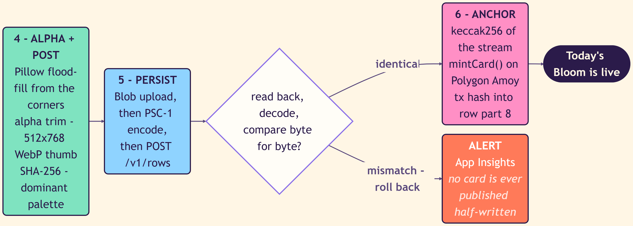
GENERATION · THE GATES
No card is ever published half-written
Four checks, each of which can stop the day's card. A missing bloom is embarrassing; a wrong one is permanent.
GATE 1 · SCHEMA
Pydantic validates the JSON and a trial PSC-1 encode has to fit. Up to two retries, then the day fails loudly.
GATE 2 · VISION
A model looks at the painted card and answers: do the name, level, rarity and stats match the JSON? Is there alpha? Is this a Mochibo clone?
GATE 3 · READ BACK
The rows are read out of asmdb, decoded, and compared byte for byte with what was sent. A mismatch rolls the whole thing back.
IDEMPOTENCY
The business key is the date. The job opens with GET /v1/range?lo=today&hi=today and stops if a card exists, so a retry or a redeploy cannot mint twice.
Why the vision gate is not the last word
A model checking another model's work is useful, but it is not evidence. So the only gate that can actually publish a card is the deterministic one: decode the bytes that landed in the database and compare them with the bytes that were sent.
04 · THE PRODUCT — www.pixelslime.cloud
49

Slide 50

THE SPECIMEN
Meet Mochibo — PS-0001
Everything on this slide lives inside 65 characters of a 175-character column.
EPIC · AURORA
FAIRY
LV 12
+760 $SMILE
ON-CHAIN #1
STRENGTH
28
ENDURANCE
55
AGILITY
65
HAPPINESS
95
THIS SLIME GENERATES +760 $SMILE happiness 95 × epic ×8 = 760
Minted fresh into the Claim Pool when this slime bloomed — while 100 $SMILE were burned from the Genesis Rain. Two different purses, on purpose.
id 16 tag psc.1.0
value 20260728 (positive = a header row)
content pYQN%gYN{^7Y/o(95*e<0rAoc1oGwt=&uPil7dI?Gso[6:.N0WbIbDRwesw0icbYj
04 · THE PRODUCT — www.pixelslime.cloud
50

Slide 51
THE CONSTRAINT
The 175-character wall
asmdb's content column is UTF-8 text, at most 175 bytes, with no NUL, CR or LF. That is not a suggestion. Everything else in PixelSlime is a consequence.
A CARD AS JSON
AFTER PSC-1
THE COLUMN
PER ROW, BINARY
~660
65
175
140
characters, formatted the obvious way
characters for Mochibo — a 10× reduction
characters, hard limit, enforced by the engine
bytes, because Z85 turns 4 bytes into 5 characters
Why not just widen the column?
Because the column cannot be widened. The record is 256 bytes, and after the id, the status byte, the flags, two microsecond timestamps and two length fields, 175 bytes are what remain for content. Widening it would mean changing the record size, which would change the address arithmetic, which would change the on-disk format. The constraint is not a product decision that can be revisited — it is the engine's geometry. So PixelSlime was designed to fit it, and the codec is the interesting part of the product precisely because of that.
04 · THE PRODUCT — www.pixelslime.cloud
51

Slide 52
PSC-1 · PART ONE
A 32-byte header, little-endian, fixed layout
Nothing here is self-describing. Every field is at a known offset, because a length prefix would cost bytes that do not exist.
0
1
2–3
4–5
6
7
8–9
10–11
magic 0x50
version
serial
total_len
level
rarity+type+shiny
height_mm
weight_g
12–15
16–19
20
21
22–23
24–25
26–29
30–31
strength · endurance · agility · happiness
art · style · frame · background id
biome
mood
flags
mint_day
art_sha (first 4)
CRC-16/CCITT
One byte holds three things
Four bytes of the art hash
The CRC is inside the budget
Rarity, elemental type and the shiny flag are packed into byte 7 as a bitfield. Six rarities and sixteen types fit comfortably; spending three bytes on them would not.
art_sha stores only the first four bytes of the artwork's SHA-256. Enough to detect that the image and the row have drifted apart; not enough to waste 28 bytes proving it.
A CRC-16/CCITT-FALSE over the header catches corruption before decoding starts. Two bytes to avoid ever rendering a card built from garbage.
04 · THE PRODUCT — www.pixelslime.cloud
52

Slide 53
PSC-1 · PART TWO
Compress against a dictionary you already agreed on
General-purpose compression is bad at short strings, because there is no room to build a table. So the table is shipped in advance.
encode
THE PINNED DICTIONARY
3,215 B
# five fields, joined by a unit separator
payload = "Mochibo\x1FSweet and cuddly\x1FSugar Squish\x1F..."
# raw DEFLATE, no zlib wrapper, preset dictionary
body = zlib.compress(payload, wbits=-15, zdict=DICT)
# 4 binary bytes become 5 printable characters
content = z85_encode(header + body)
shipped with the decoder, SHA-256 checked on every decode
PRIMING SAVES
35–50 %
on short strings, versus DEFLATE with a cold table
The catch, and why it is worth it
A preset dictionary is a shared secret between the encoder and every decoder that will ever exist. Change one byte of it and every card written before the change becomes unreadable. That is why the dictionary is version-pinned, distributed with the decoder, and verified by hash on every single decode — a silent dictionary mismatch would corrupt the entire collection at once, and it would look like a rendering bug.
04 · THE PRODUCT — www.pixelslime.cloud
53

Slide 54
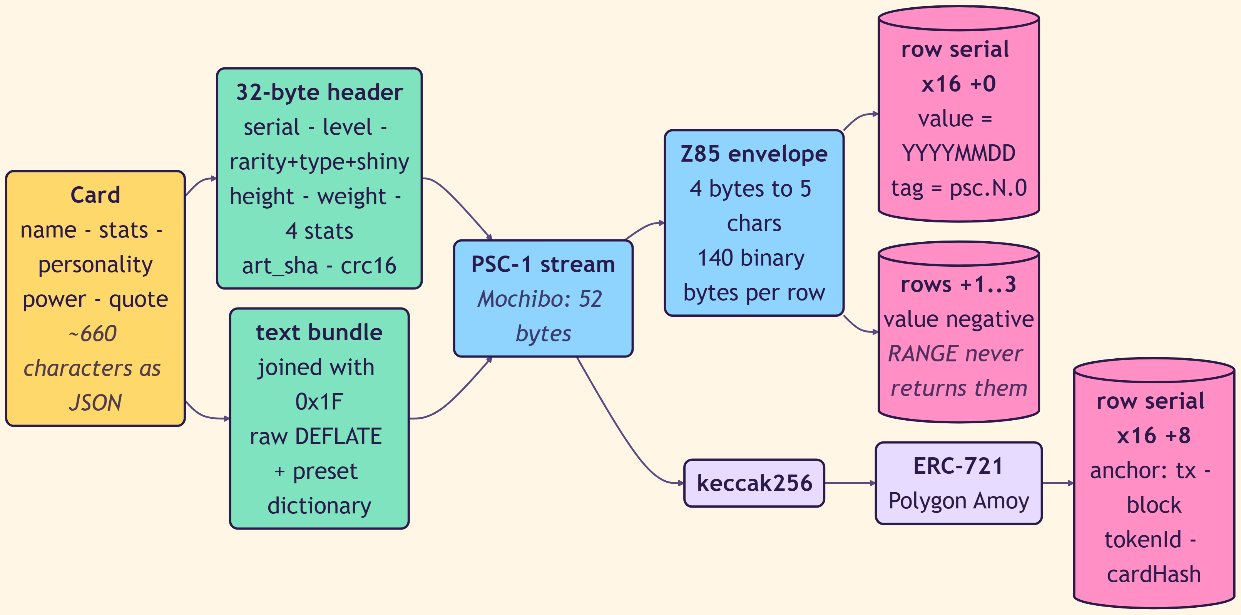
PSC-1 · END TO END
From a card to rows, and to a hash
The same stream is written to the database and hashed for the chain. There is exactly one source of truth for both.
Row addressing
row_id
serial × 16 + part
PART 0
the header row. value is the positive date, YYYYMMDD
PARTS 1–3
continuation. value is negative, so a RANGE scan over dates never returns them
PART 8
the anchor row: tx hash, block, tokenId and the full cardHash
MAX STREAM
560 bytes, four rows
04 · THE PRODUCT — www.pixelslime.cloud
54

Slide 55
THE CHAIN
Four contracts on Polygon Amoy
Chain id 80002. A testnet, deliberately — the point is verifiability, not speculation.
SmileToken
ERC-20 · $SMILE
0x0BBaC39Bf418ab63BF71802808A4C63D4B39b798
PixelSlimeCard
ERC-721 · SLIME
0xD88928B55CefcAe756e55824a48342cA432Baf7f
ClaimPool
the only minter
0xbce1362c1155777df19F9cea6c8ECa68B155160d
SlimeAdoption
ownership transfer
0x20d6A4F365d00b4d27726f13093Dc2C497473CcA
Guard rails that are in the contracts, not in a runbook: the treasury address and the admin address must differ; ClaimPool alone holds the minter role; and the signer is guarded so it can only ever act on a testnet.
04 · THE PRODUCT — www.pixelslime.cloud
55

Slide 56
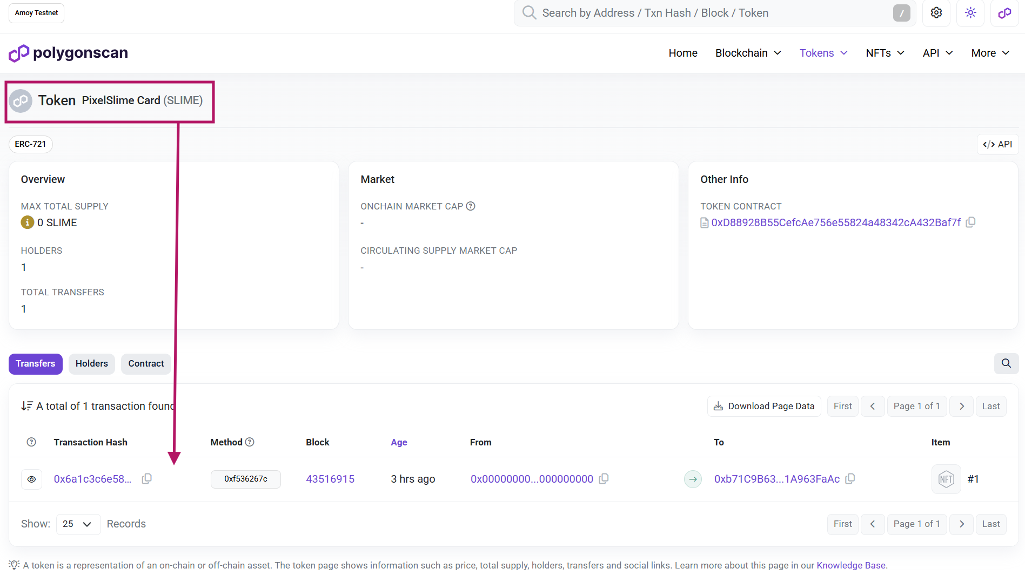
THE ANCHOR
Same bytes, same hash — or someone is lying
The keccak256 is taken over the PSC-1 stream itself, not over a JSON rendering of it. That is the whole trick.
1 · WRITE
The daily job writes the PSC-1 rows to asmdb.cloud and reads them straight back.
2 · COMPARE
It decodes what it read and compares byte for byte. A mismatch aborts before anything is published.
3 · HASH
keccak256 over the exact stream that is now in the database.
4 · MINT
mintCard(serial, cardHash, uri) on Polygon Amoy.
5 · ANCHOR
The transaction hash, block, tokenId and full cardHash are written back as row part 8.
04 · THE PRODUCT — www.pixelslime.cloud
56

Slide 57
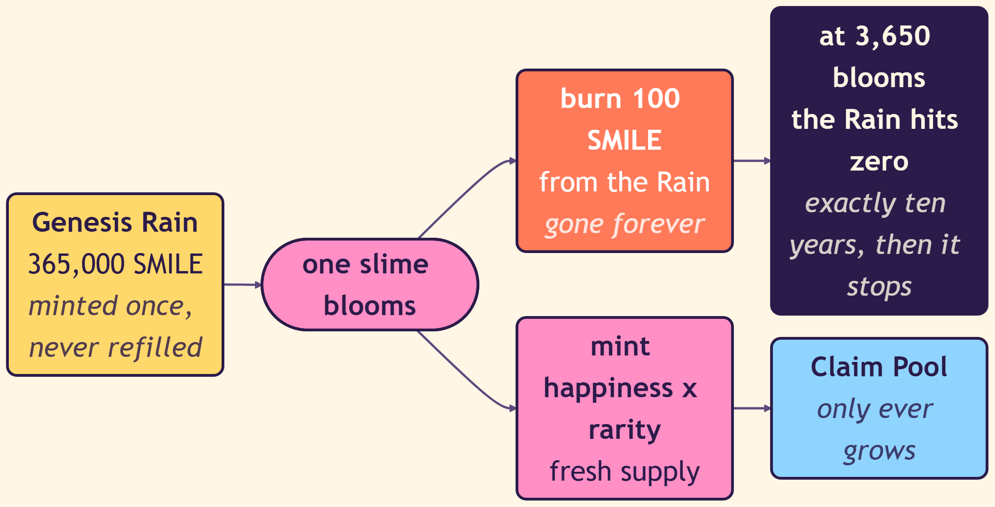
THE ECONOMY
Two tokens, one letter apart
SLIME is the card. SMILE is the currency. Conflating them is the single easiest way to misread everything that follows.
SLIME
ERC-721 · the card itself
WHAT IT IS
One non-fungible token per slime, holding the card's cardHash
HOW MANY
One per bloom. 3,650 will ever exist
WHAT IT PROVES
That this exact card existed on this exact day
SMILE
ERC-20 · the currency
WHAT IT IS
A fungible token minted into the Claim Pool by each bloom
HOW MANY
365,000 minted once as the Genesis Rain, never refilled
WHAT IT DOES
It is the thing that decrements — 100 burned per bloom
A ten-year clock made of arithmetic
365,000 ÷ 100 = 3,650 blooms. One a day. The end date is not a policy anyone can change — it is a division that was fixed the moment the Genesis Rain was minted.
04 · THE PRODUCT — www.pixelslime.cloud
57

Slide 58
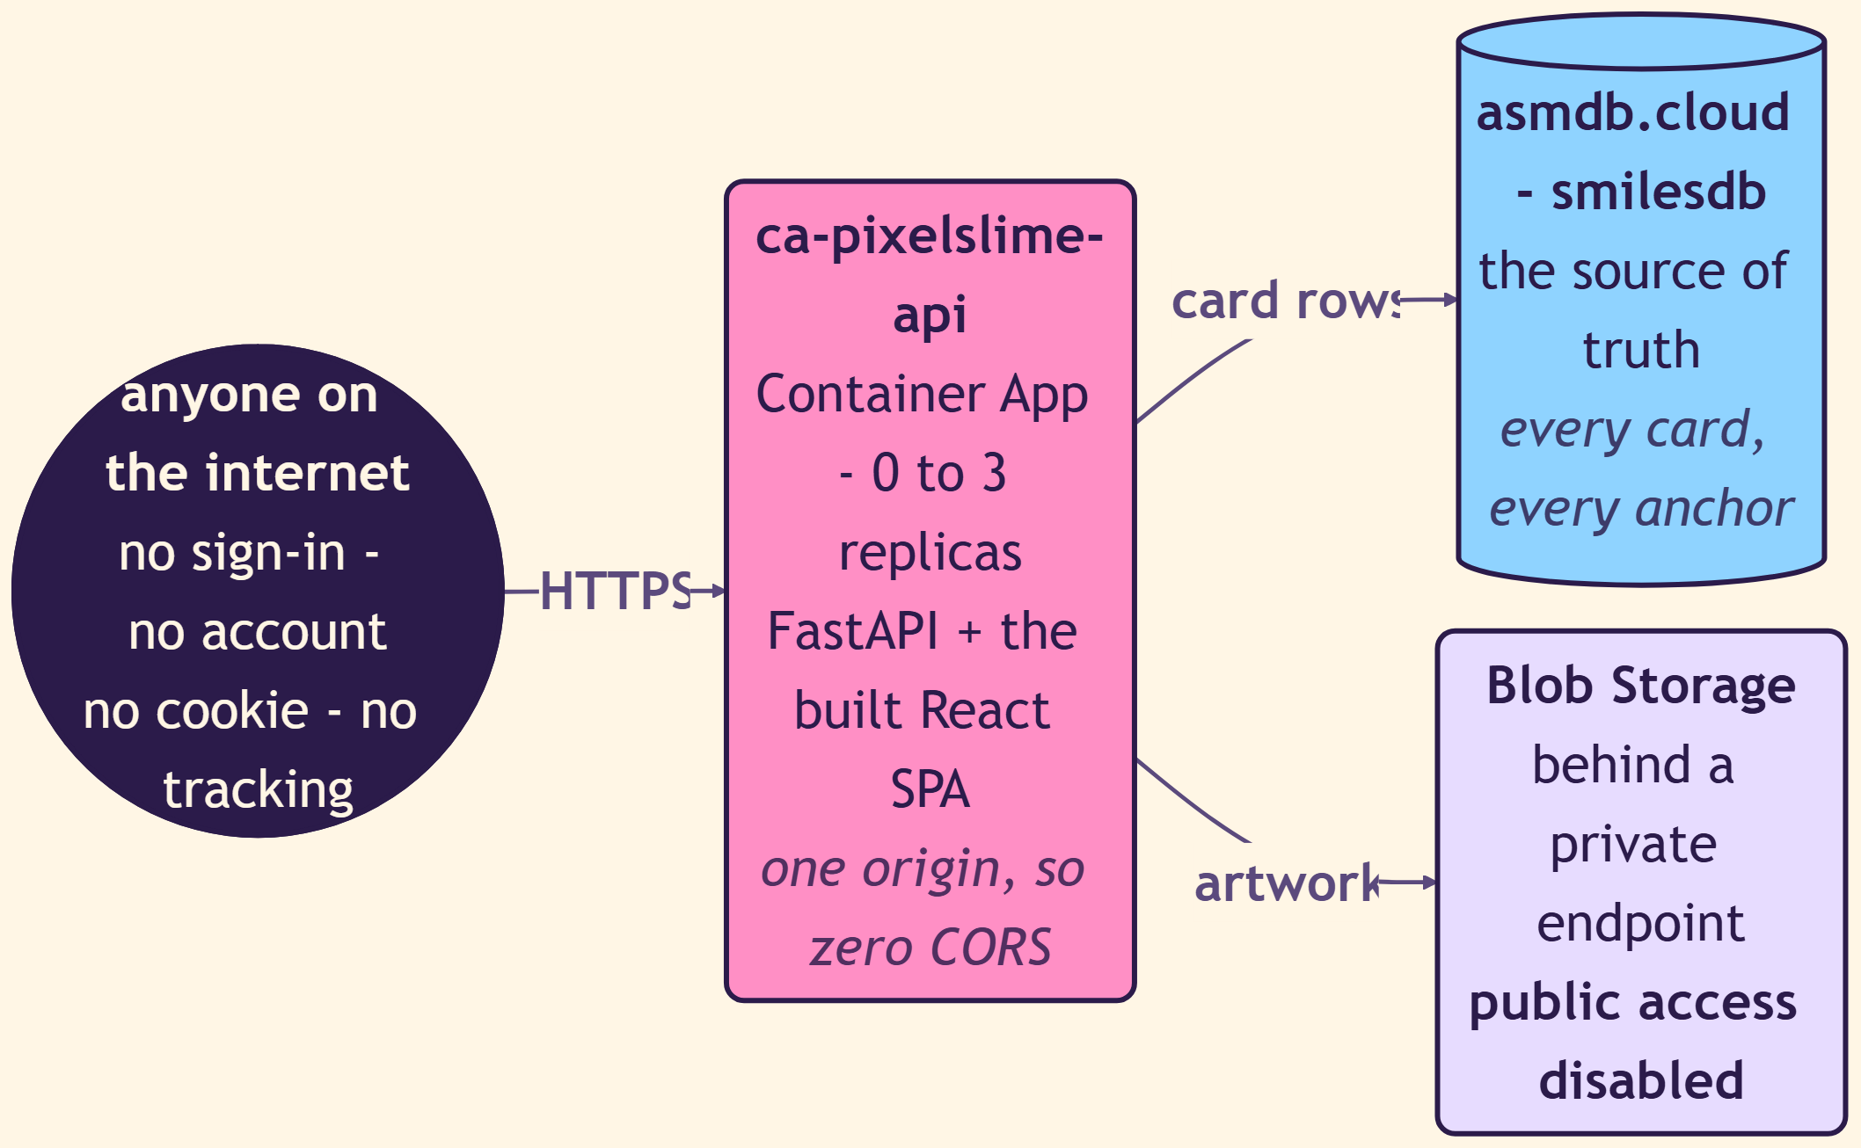
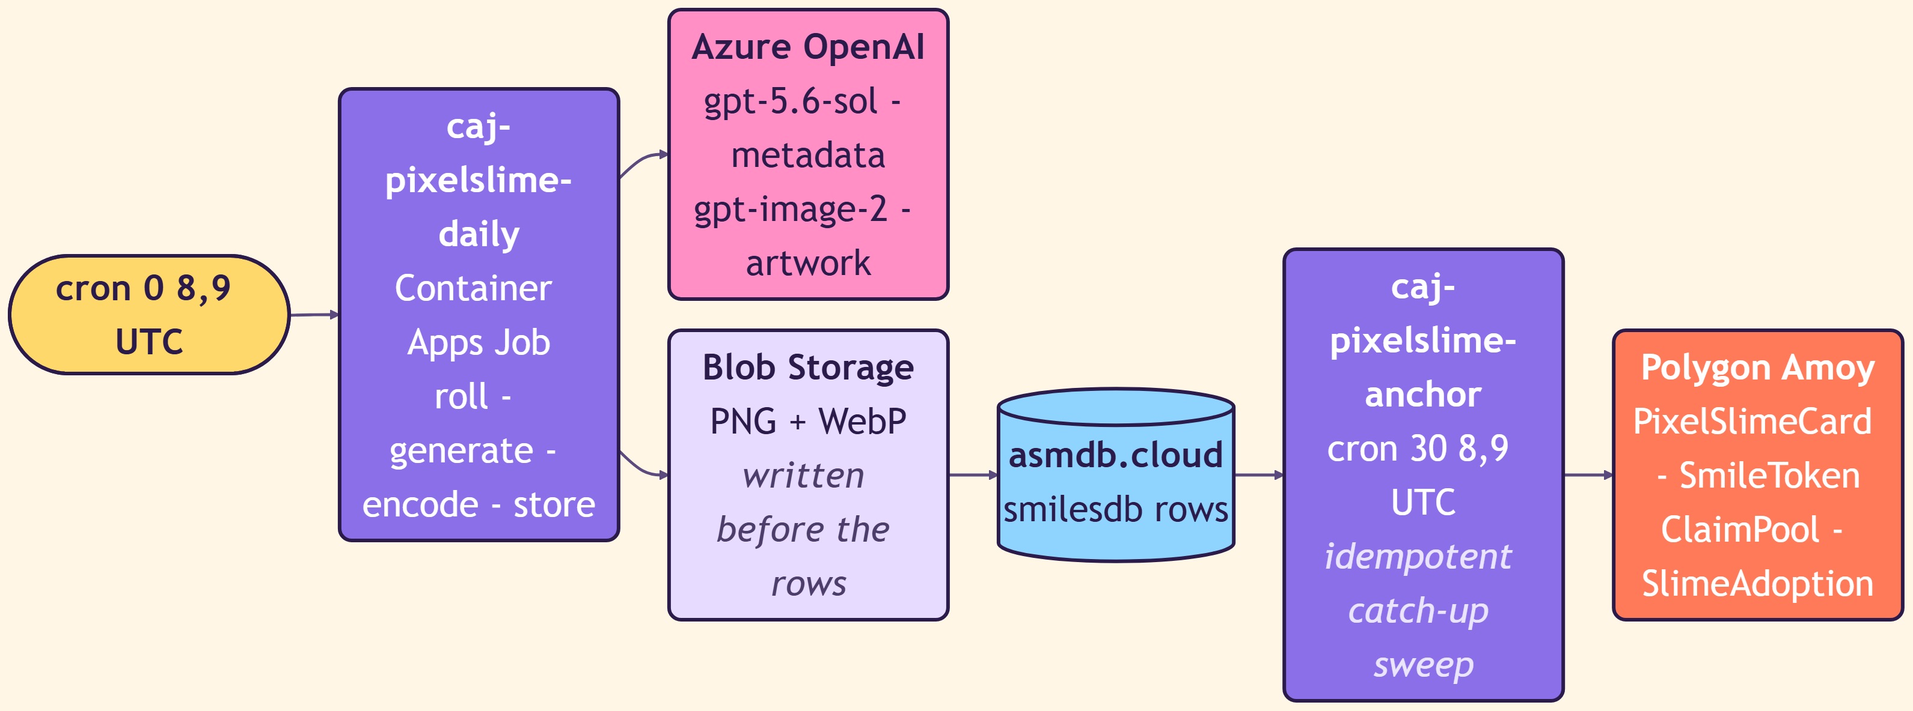
HOSTING
One Container App, two jobs, no account to create
The public site is anonymous by design: no sign-in, no cookie, no tracking. There is nothing to log into, so there is nothing to breach.
SERVING PATH
JOB PATH
One origin, zero CORS
Idempotent by default
A VNet forced by policy
Nothing published half-written
FastAPI serves the built React bundle from the same Container App, so there is no cross-origin configuration to get wrong.
The anchor job is a catch-up sweep, not a one-shot. Running it twice is safe; missing a run is survivable.
Storage and Key Vault had public access disabled by tenant policy, so private endpoints were not an aesthetic choice.
Blob artwork is uploaded before the rows exist, and the rows are read back and compared before the card goes live.
04 · THE PRODUCT — www.pixelslime.cloud
58

Slide 59
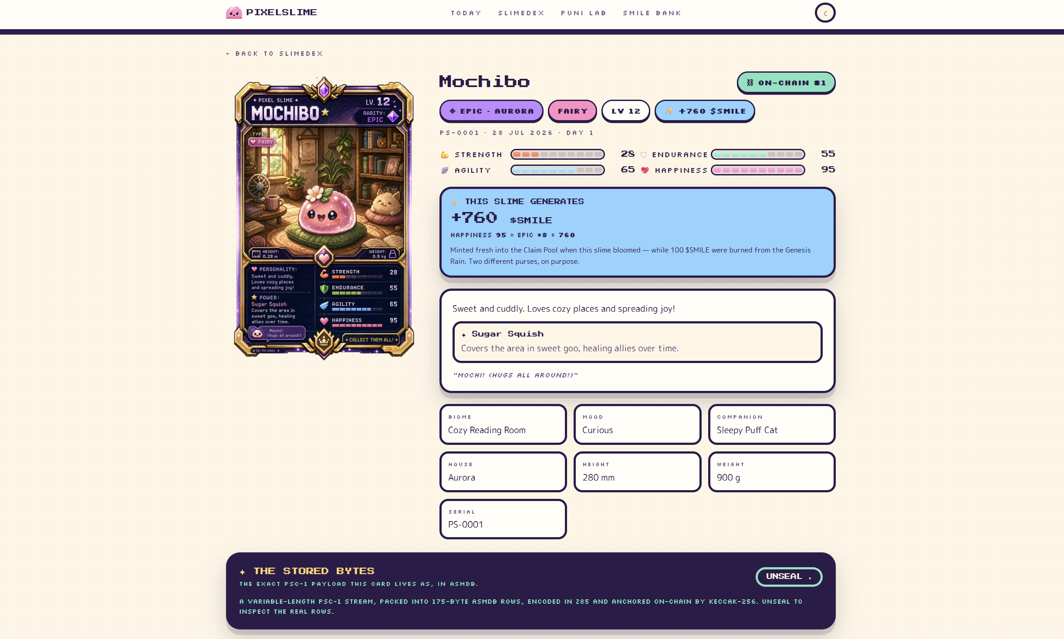
THE SITE
www.pixelslime.cloud
Every number on this page was decoded, in the browser, from the row you saw two slides ago.
The Stored Bytes
Every card page has an “UNSEAL” panel that shows the exact PSC-1 payload the card lives as, in asmdb. Not a pretty summary — the real rows.
It is the most important feature on the site and the least commercial. If a product claims its data is verifiable, it has to let you look.
SLIMEDEX the gallery
PUNI LAB how it works
SMILE BANK the economy
04 · THE PRODUCT — www.pixelslime.cloud
59

Slide 60
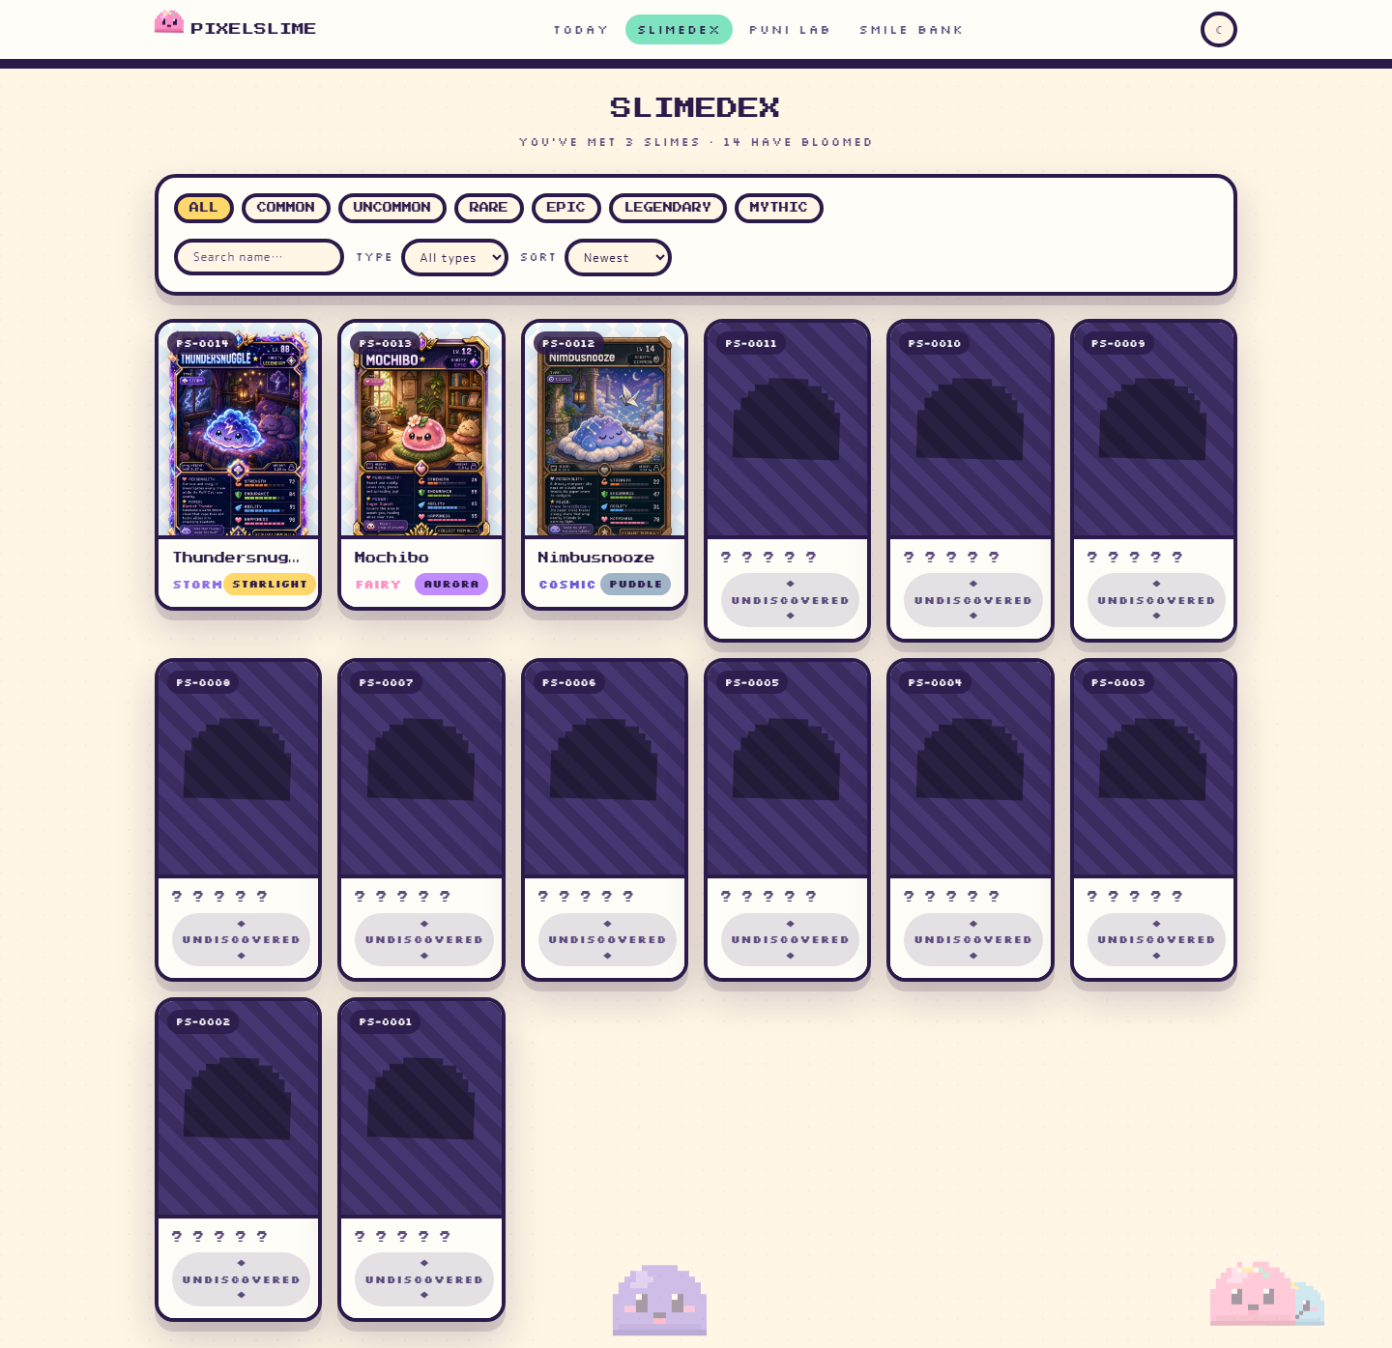
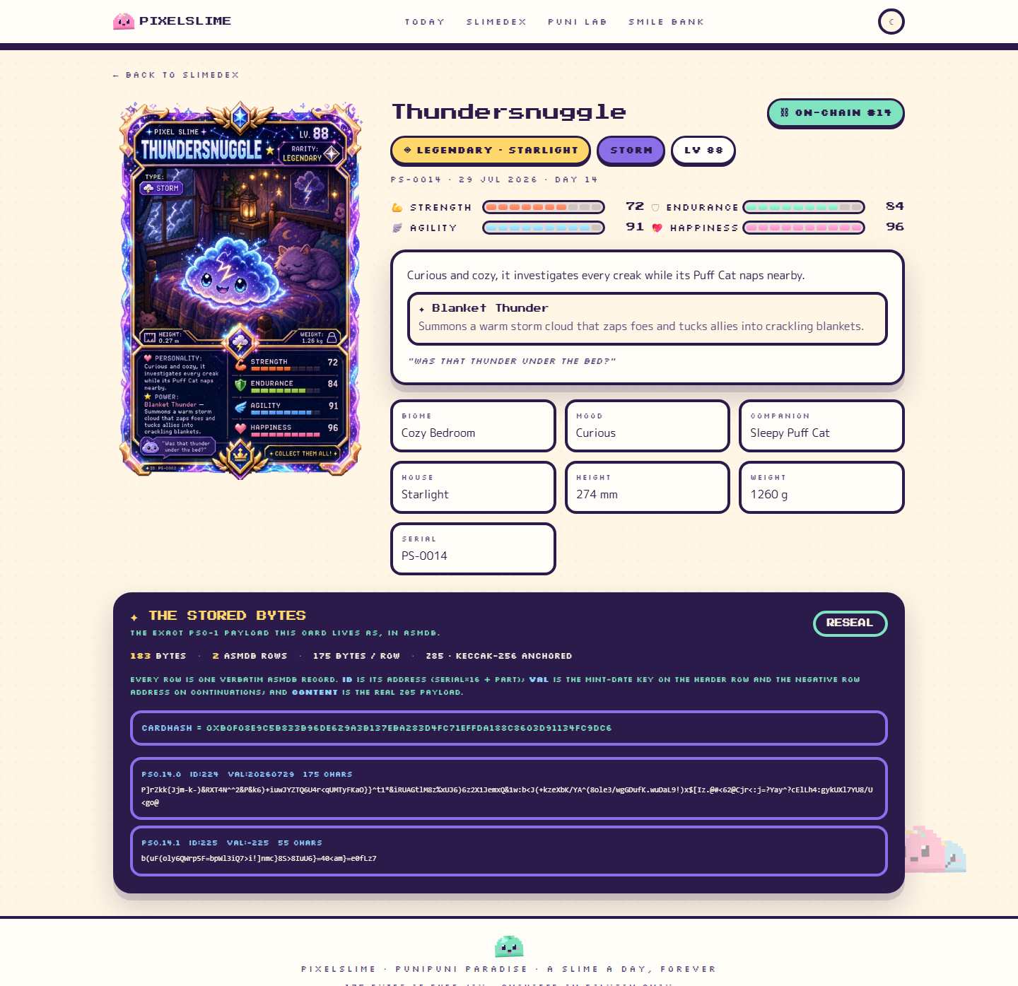
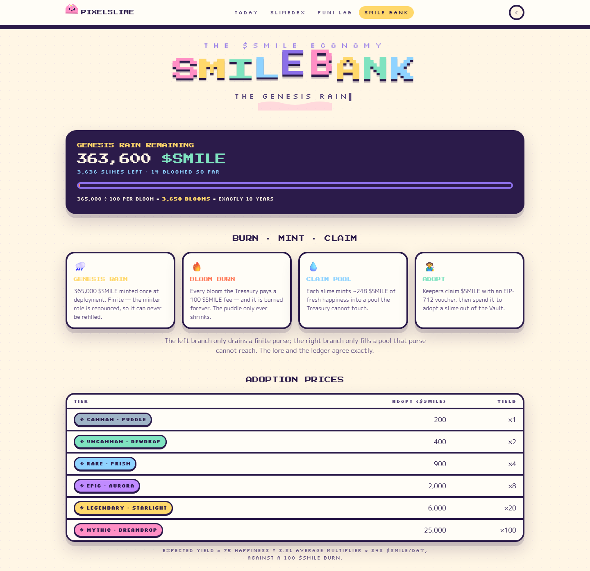
THE COLLECTION
One a day, forever — and a page for every one of them
The SLIMEDEX, a card profile with its provenance, and the SMILE BANK. All three read from the same 175-byte rows.
SLIMEDEX · the gallery
PROFILE · provenance and raw bytes
SMILE BANK · the ten-year clock
Anonymous, accessible and reduced-motion aware. There is a full Playwright screenshot suite for the reduced-motion variants, because “it works with animations off” is a claim that has to be tested, not asserted.
04 · THE PRODUCT — www.pixelslime.cloud
60

Slide 61
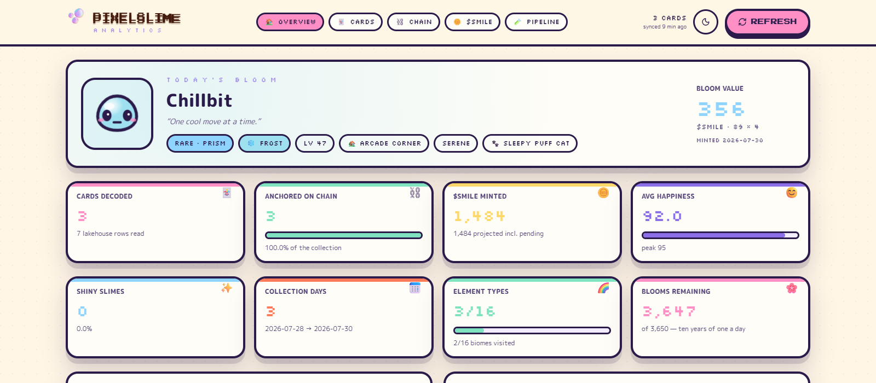
05
THE PAYOFF
PixelSlime Analytics
A Fabric app that reads the Lakehouse, decodes PSC-1 back into cards,
and answers the questions the engine was never designed to answer.
05 · THE PAYOFF — PixelSlime Analytics
61

Slide 62
RAYFIN
A Fabric app in three commands
Rayfin generates the app backend and its SQL database from entity classes, deploys the static bundle, and wires up Fabric authentication.
rayfin
What it hands you
npx rayfin login
npx rayfin up # deploy + apply schema changes
npx rayfin up status
npx fabric-app-data add semanticModel slimeRaw ...
npx fabric-app-data generate -o src/fabric.generated.ts
npm run dev # Vite on :5173
npm run build:fabric # the bundle Rayfin hosts
npm run test:fabric # validated inside the portal
AUTH
Fabric authentication and embed auth, so the app single-signs-on inside the portal
DATA
A managed SQL database generated from the TypeScript entity classes in rayfin/data/
HOSTING
Static hosting of the built bundle, declared in rayfin.yml
BINDING
fabric.yaml registers the semantic model; fabric.generated.ts is derived from it
The app can only be validated inside the Fabric portal embed flow — so every UI change is checked with a real browser session against the real tenant, never against a local mock.
05 · THE PAYOFF — PixelSlime Analytics
62

Slide 63
THE APP
Five pages, one question each
Every page reads precomputed rows from the Rayfin database. None of them queries the Lakehouse directly.
OVERVIEW
CARDS
CHAIN
$SMILE
PIPELINE
What is in the collection right now?
What does each individual card contain?
Is what we claim actually on chain?
Where is the money going?
How well is the encoding holding up?
Fourteen KPIs, rarity mix against the seeded roll table, element spread, blooms per day, biomes and moods.
Search, filter, sort and a detail modal with stats, stream size, capacity used, art fingerprint and sync state.
Anchored cards, awaiting anchor, average anchor lag, chain drift, and a ledger that links out to Polygonscan.
Minted, pending credit, burned, net supply change, Claim Pool, average yield per card and the burn runway.
Lakehouse rows read, total stream bytes, average capacity used, multi-row cards and storage pressure.
05 · THE PAYOFF — PixelSlime Analytics
63

Slide 64
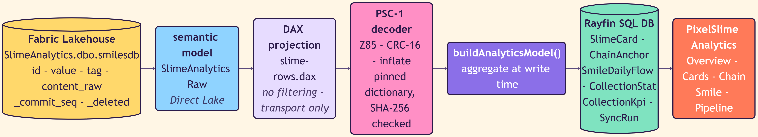
THE DATA PATH
Direct Lake in, aggregated rows out
The semantic model is a transport, not the analytics layer. The DAX query does no filtering at all — the decoder needs every version of every row.
The lakehouse is the only source
Aggregate at write time
Never trust flagOnChain
Decode errors stay visible
There is no second write path, no admin override and no seeded fixture. If it is not in the Lakehouse, the app does not show it.
The sync decodes, flattens and rolls up once, then persists. Pages read finished rows, so a page load never costs a decode.
A card's own bytes can claim it is anchored. Only an anchor row proves it. Every chain number is derived from on-chain evidence.
A card that fails to decode is displayed as a card that failed to decode. It is never dropped from a count to make a chart look tidy.
05 · THE PAYOFF — PixelSlime Analytics
64

Slide 65
THE MODEL
Six entities, declared in TypeScript
rayfin up reads these classes and produces the SQL schema. The star schema is a side effect of the domain, not a modelling exercise.
SlimeCard
ChainAnchor
SmileDailyFlow
FACT
FACT
FACT
One row per decoded card: stats, rarity, type, stream size, capacity used, art fingerprint.
One row per anchor found on chain. Belongs to at most one SlimeCard.
Minted, burned and net change per day — the supply curve.
CollectionStat
CollectionKpi
SyncRun
AGGREGATE
AGGREGATE
AUDIT
Distribution rows: rarity mix, element spread, biomes, moods.
The scalar tiles on the Overview page, computed once at sync time.
One row per pipeline run, so “when was this last true” is always answerable.
SlimeCard has many ChainAnchor. ChainAnchor has an optional SlimeCard — because an anchor can exist for a card the decoder has not yet understood, and that asymmetry is the bug the Chain page exists to find.
05 · THE PAYOFF — PixelSlime Analytics
65

Slide 66
THE NUMBERS
Fourteen KPIs, and none of them are decorative
Every tile is derived from decoded bytes or on-chain evidence. Nothing is a placeholder and nothing is rounded up.
CARDS DECODED
ANCHORED ON CHAIN
$SMILE MINTED
AVG HAPPINESS
SHINY SLIMES
COLLECTION DAYS
ELEMENT TYPES
BLOOMS REMAINING
VERIFIED
SEED CARDS
WITH COMPANION
WITH ACCESSORY
DECODE ERRORS
CHAIN DRIFT
Chain drift — the metric that admits failure
Chain drift counts cards whose own bytes claim they are anchored while no anchor row exists. It is the crash window between minting a token and writing the anchor back — and the bit inside the card cannot be corrected without invalidating its fingerprint. So the number can never be quietly fixed. It is displayed, permanently, derived from on-chain evidence rather than from what the card asserts about itself. Most dashboards would have deleted this tile. It is the most useful one on the page.
05 · THE PAYOFF — PixelSlime Analytics
66

Slide 67
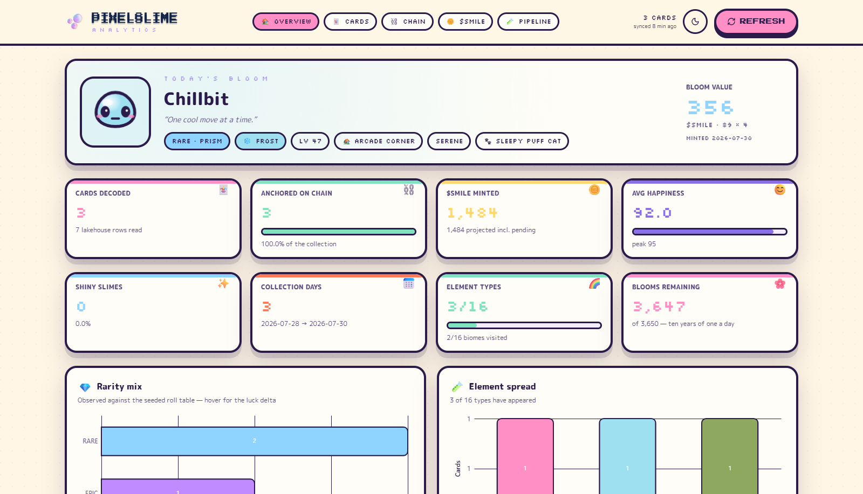
THE DASHBOARD
Everything, decoded, in one place
Today's bloom, the KPI grid, rarity against the seeded roll weights, and the luck report.
CARDS DECODED
3
from 7 lakehouse rows read
ANCHORED ON CHAIN
100 %
of the collection, verified against Polygon
$SMILE MINTED
1,484
projected, including pending credit
DECODE ERRORS
0
and chain drift is 0 as well
05 · THE PAYOFF — PixelSlime Analytics
67

Slide 68
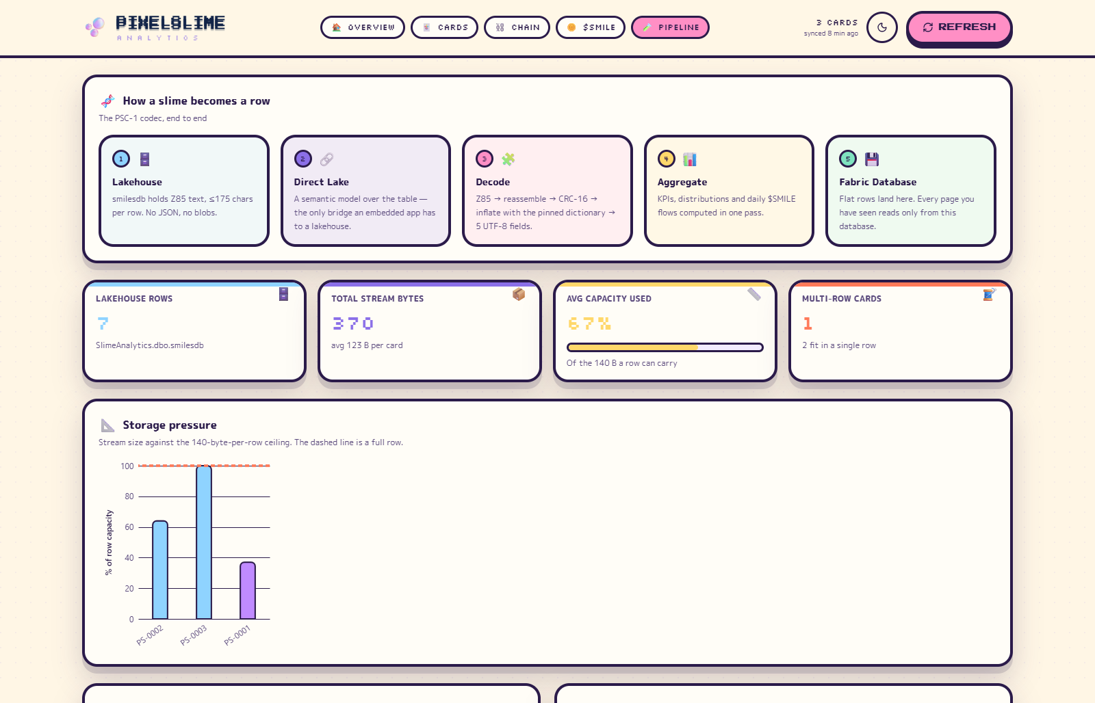
THE PIPELINE PAGE
How a slime becomes a row
The one page in the app whose entire job is to explain the constraint that shaped the product.
LAKEHOUSE ROWS
PIECE SIZE
7
140 B
raw rows read for 3 decoded cards
binary payload per lakehouse row
THE WALL
DICTIONARY
175
3,215 B
characters, per row, non-negotiable
pinned, hash-checked on every decode
Storage pressure, as a first-class view
The page shows the largest card in the collection against the 175-character ceiling. When a future slime has a longer name and a wordier power, the chart is where that shows up first — before an insert fails in production at ten in the morning.
05 · THE PAYOFF — PixelSlime Analytics
68

Slide 69
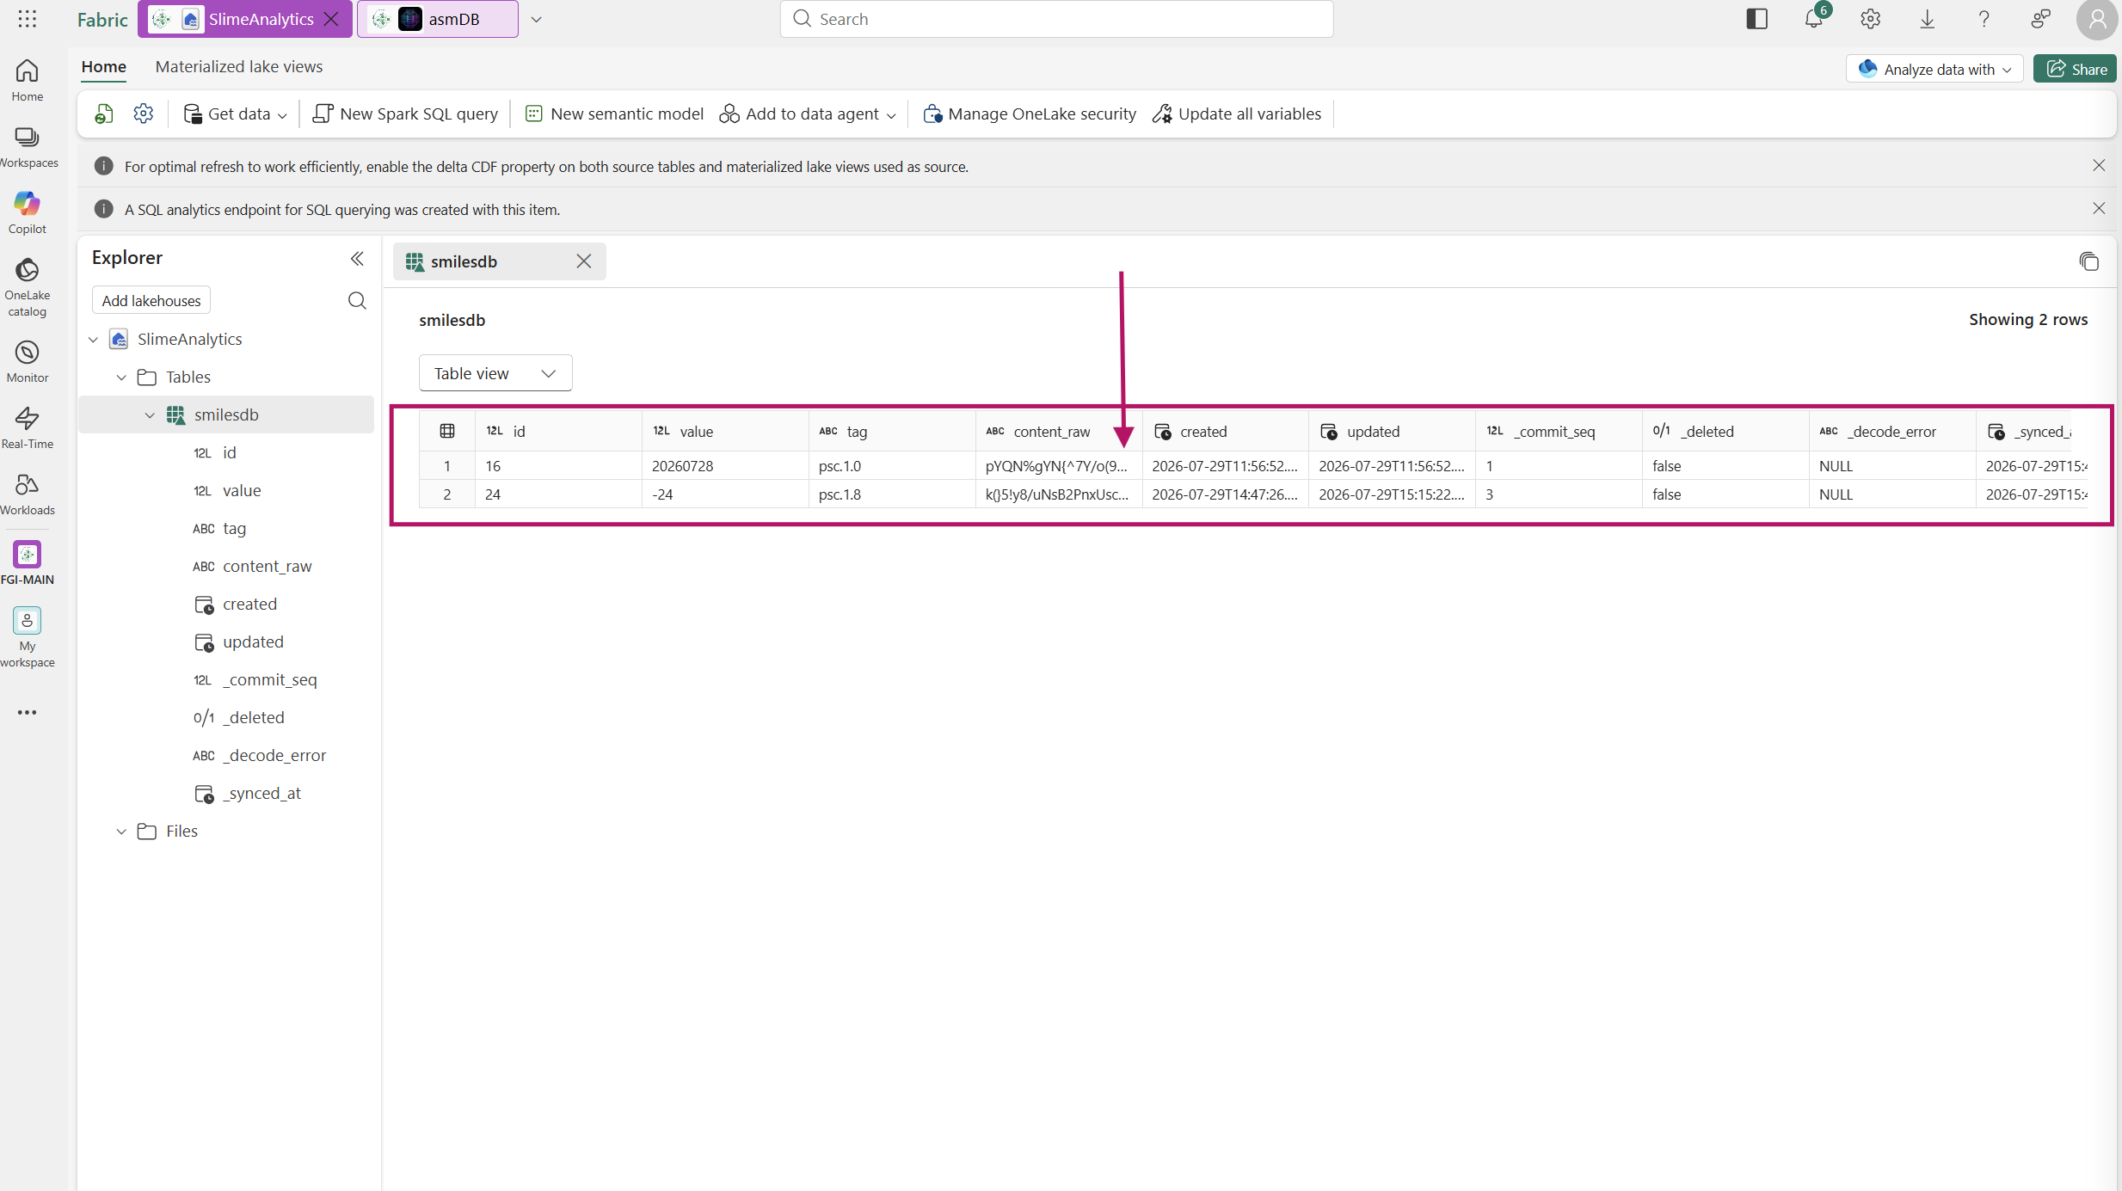
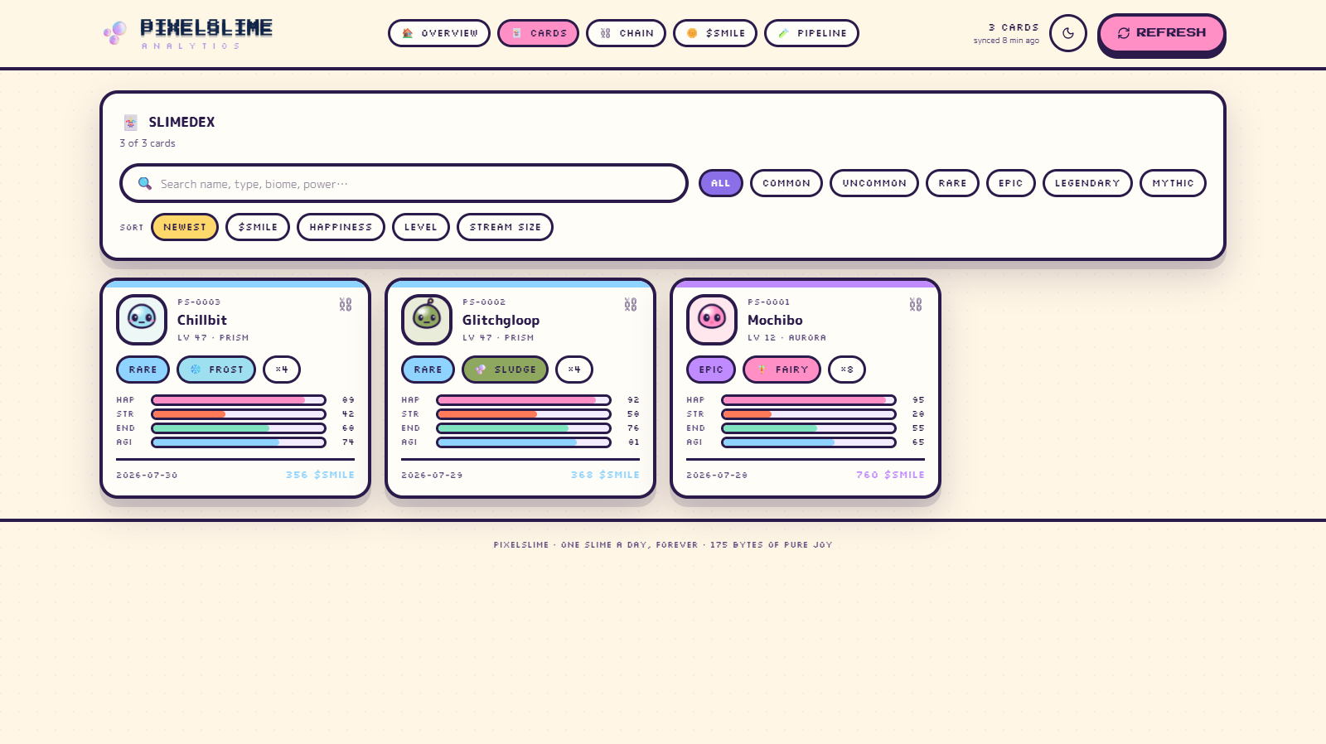
CLOSING THE LOOP
The row, and the row's reflection
Left: the bytes as asmdb stores them. Right: the same bytes, decoded by a Fabric app, four systems later.
THE LAKEHOUSE TABLE · content_raw, verbatim
PIXELSLIME ANALYTICS · the same card, decoded
Nothing between those two pictures was hand-carried. An assembly engine wrote the row, a Go gateway published the change frame, a generated PySpark notebook merged it into Delta, a Direct Lake semantic model transported it, and a TypeScript decoder in a browser turned it back into a slime.
05 · THE PAYOFF — PixelSlime Analytics
69

Slide 70
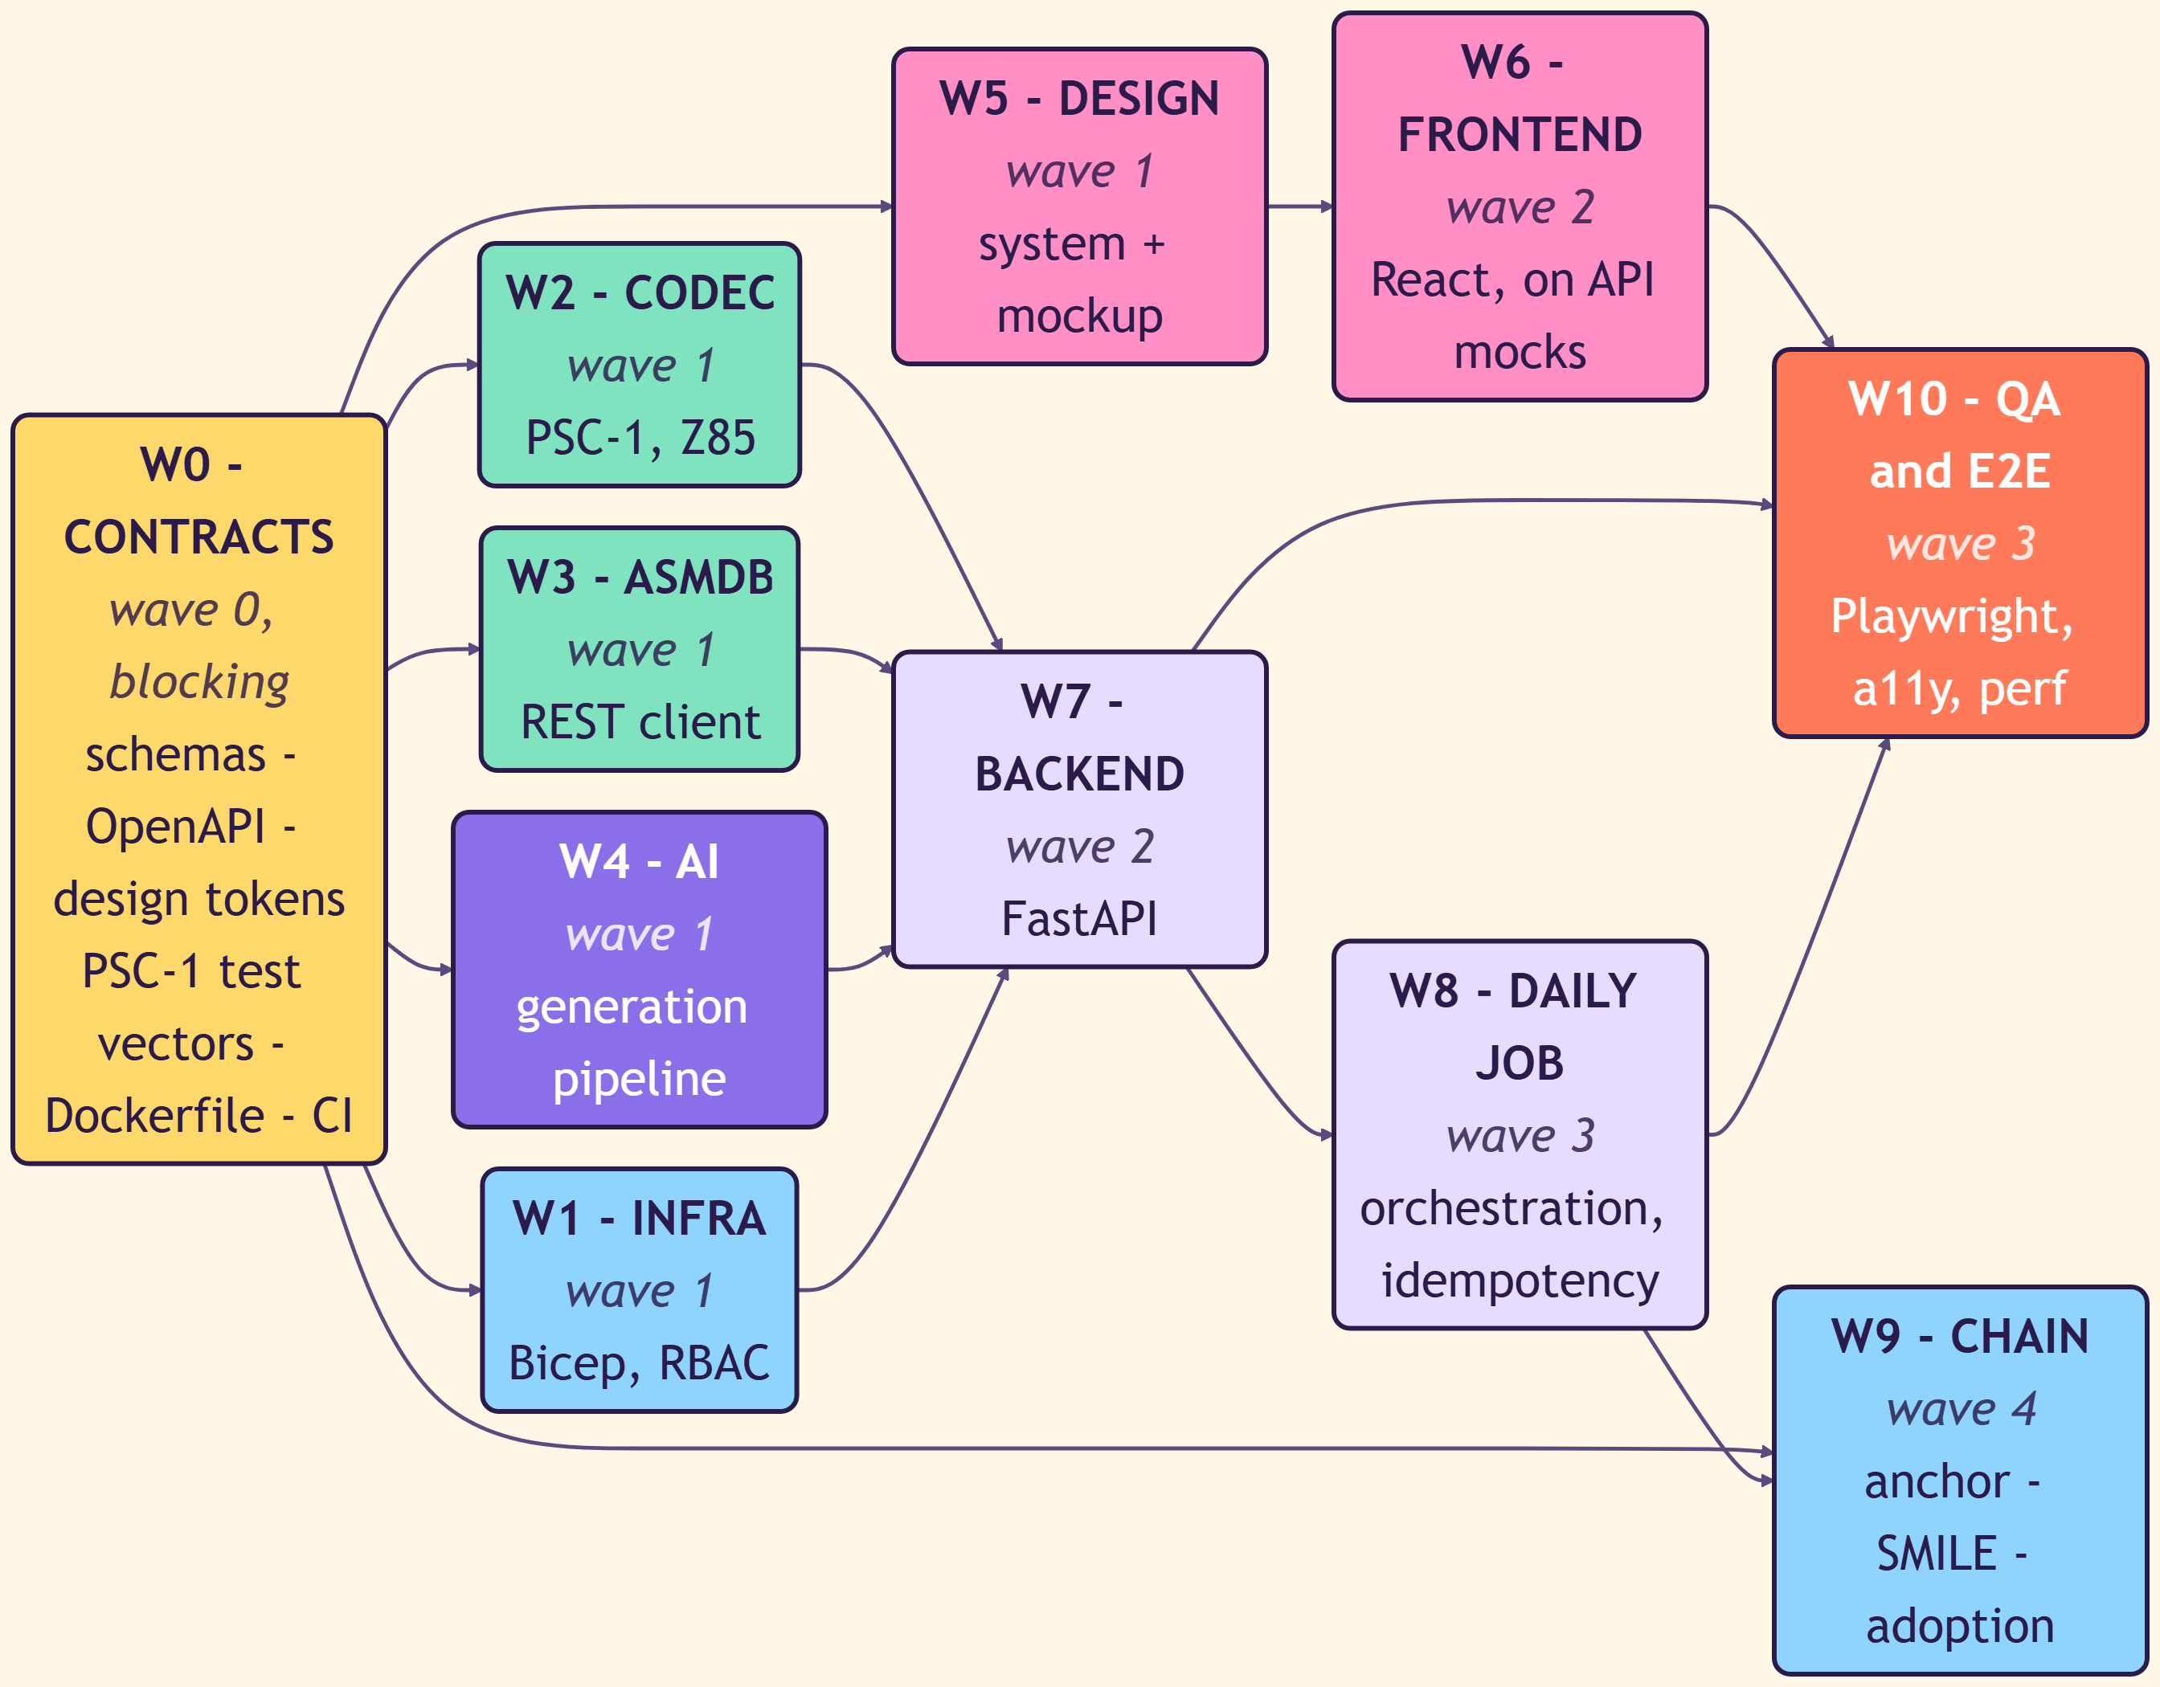
06
THE METHOD
How this was actually built
Five systems, one person, and a lot of agents. The interesting part is not
that AI wrote code — it is what had to be true before letting it.
06 · THE METHOD — how this was built
70

Slide 71
THE THESIS
Agents do not need supervision. They need boundaries.
Parallel agents fail for exactly the same reasons parallel teams fail: unclear ownership, unstable interfaces and a definition of done that lives in someone's head.
WHAT GOES WRONG
WHAT FIXES IT
Two agents, one file
They will both be right, and the second one will silently undo the first.
“Just make it work”
Produces code that passes no test, because no test was named.
An interface invented mid-task
Every other agent is now building against a contract that no longer exists.
A mock that was convenient
Ships. Nobody notices until the demo.
One directory, one owner
Ownership is a path, not a conversation. Conflicts become impossible rather than rare.
A written definition of done
ruff, mypy --strict, pytest, tsc, lint. Not opinions — exit codes.
Contracts frozen before code
Schemas, OpenAPI, design tokens and test vectors land first, and then stop moving.
Fake neighbours, never fake data
You may stub the agent next door. You may not stub the thing you are being judged on.
06 · THE METHOD — how this was built
71

Slide 72
THE ROSTER
Eleven workstreams, each owning exactly one directory
This is the entire coordination mechanism for PixelSlime. There is no standup, because there is nothing to coordinate.
W0
CONTRACTS
W1
INFRA
W2
CODEC
contracts/ · docs/ · .github/
infra/
backend/app/codec/
W3
ASMDB
W4
AI
W5
DESIGN
backend/app/asmdb/
backend/app/ai/
frontend/src/design/
W6
FRONTEND
W7
BACKEND
W8
DAILY JOB
frontend/src/ (except design/)
backend/app/api/ · core/ · storage/
backend/app/jobs/
W9
CHAIN
W10
QA & E2E
chain/ · backend/app/chain/
tests/e2e/
“One workstream owns one directory. Nobody writes outside their own.”
Eleven words. They removed the need for every merge-conflict conversation on the project, and they are enforceable by looking at a diff — which means an agent can check whether it is about to break the rule before it does.
06 · THE METHOD — how this was built
72

Slide 73
THE WAVES
The dependency graph is the schedule
Merge order is not negotiated. It is read off the graph: W0 → W1/W2/W3/W4/W5 → W6/W7 → W8 → W10 → W9.
WAVE 0
W0 alone
Contracts and skeleton. Blocking, and deliberately short.
WAVE 1
W1 · W2 · W3 · W4 · W5
Five agents in parallel. None of them can see each other's code, and none of them need to.
WAVE 2
W6 · W7
The frontend builds against API mocks generated from the frozen OpenAPI; the backend builds against the real codec.
WAVE 3
W8 · W10
Orchestration and end-to-end. The first point where anything is judged as a whole.
WAVE 4
W9
The chain last, because it is the only irreversible thing on the list.
06 · THE METHOD — how this was built
73

Slide 74
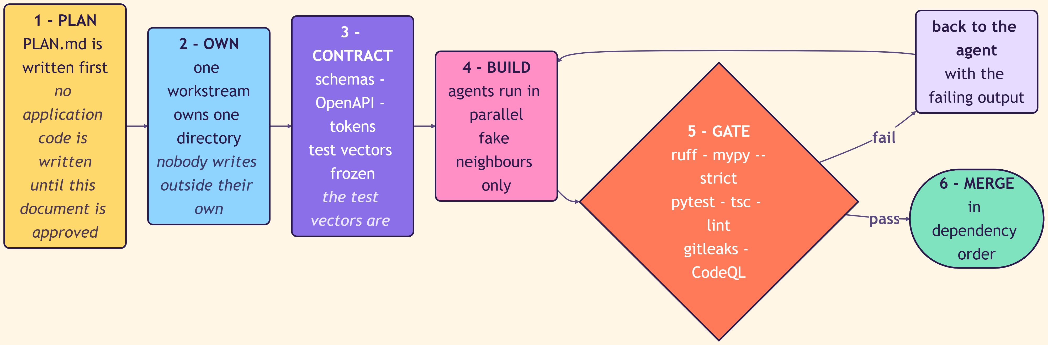
THE OPERATING LOOP
Plan, own, contract, build, gate, merge
The loop only has one interesting edge: what happens when the gate says no.
The plan is a document, not a ticket
A failing gate goes back with its output
Merging is mechanical
“No application code is written until this document is approved.” The plan file is long, argumentative, and reviewed by a human before a single agent starts.
Not “it does not work”. The exact ruff error, the exact mypy line, the exact failing test name. An agent given a stack trace fixes things; an agent given a complaint negotiates.
Because ownership was exclusive and contracts were frozen, integration is a sequence, not an event. Nothing has to be reconciled, because nothing overlapped.
06 · THE METHOD — how this was built
74

Slide 75
WAVE ZERO
The test vectors are the law
W0 produces nothing that runs. It produces the things everyone else will be measured against — and then it gets out of the way.
JSON schemas
The shape of every object that crosses a boundary.
“The test vectors are the law.”
OpenAPI
Four words that make a codec agent unarguable with. It is not asked to write a good encoder — it is asked to reproduce these bytes.
The public API, complete, before any endpoint exists. The frontend mocks are generated from it.
Design tokens
Colours, spacing and type as data, shared by the mockup, the app and the poster.
Deliberately short
PSC-1 test vectors
W0 blocks all ten other workstreams, so every extra day in wave zero costs ten agent-days. The plan says so out loud, which is why the contracts are minimal rather than complete.
Known cards with their known byte streams. The codec is not correct when it looks correct — it is correct when it reproduces these.
Dockerfile and CI
The gates exist before the code they will judge.
06 · THE METHOD — how this was built
75

Slide 76
THE GATES
Definition of done, as exit codes
An agent cannot argue with a non-zero exit status, and neither can I.
CONTRACTS
BACKEND
FRONTEND
schema validation
ruff check .
npx tsc --noEmit
requirements.txt sync
ruff format --check .
npm run lint
mypy app
npm run build
pytest --cov=app
IMAGE
SECRETS
SECURITY
docker build
gitleaks scan
CodeQL, weekly, JS/TS
Plus the rules that no linter can check: docstrings on every public function · no secrets in code or logs · no silent truncation or defaulting · docs updated in the same change · and, for the analytics app, never mock, fake or hardcode data and never guess a schema — query it.
06 · THE METHOD — how this was built
76

Slide 77
A DIFFERENT SHAPE
PixelSlime Analytics had no roster — it had phases
A five-page app does not need eleven owners. It needs to stop guessing.
1
AUTHORING
2
DESIGN
3
APP CODE
Discover the real data and validate the queries first. Query exploration is delegated to sub-agents running in parallel, one per question.
Settle the UX before any runtime code exists, against real values pulled from the semantic model — never against invented sample rows.
Only now. And every UI change is followed by browser validation inside the Fabric portal, because that is the only place the app truly runs.
“Break tasks into independent pieces and delegate them to sub-agents running in parallel.”
The instruction is in the repository, not in a prompt I retype. Alongside it live custom skills for app validation, DAX authoring and query design — so “how we do this here” is version-controlled, reviewed, and applies to every agent that touches the project, including the one writing this deck.
06 · THE METHOD — how this was built
77

Slide 78
TOOLING
What was actually wired in
None of this is exotic. All of it is checked into the repository, which is the entire point.
AGENTS & PROMPTS
QUALITY
PLATFORM
MODEL SURFACE
AGENTS.md per repository
.github/copilot-instructions.md
.agents/skills/ — app-validation, dax-authoring, query-design
Sub-agent delegation, in parallel
ruff · mypy --strict · pytest
TypeScript tsc --noEmit · ESLint
Playwright, including reduced-motion runs
gitleaks · CodeQL
Bicep for every Azure resource
Container Apps and Container Apps Jobs
Fabric Workload Development Kit
Rayfin CLI · fabric-app-data
MCP — asmdb exposed as an agent tool
gpt-5.6-sol for structured metadata
gpt-image-2 for artwork
Foundry and web3.py for the chain
MCP matters more than it looks: because asmdb speaks it, an agent can create a database, insert rows and verify durability against the real engine — not against a description of it.
06 · THE METHOD — how this was built
78

Slide 79
RETROSPECTIVE
What worked, and what I would do differently
The failures are more informative than the wins.
WHAT WORKED
WHAT I WOULD CHANGE
Exclusive directory ownership. Zero merge conflicts across eleven workstreams.
Freezing the codec test vectors first. The encoder and the decoder were written by different agents and matched on the first integration.
Generating frontend mocks from the OpenAPI file, so the UI was built before the API existed and still fitted it.
Making CI the definition of done. “Is it finished?” became a question with an exit code.
Wave 0 was still too long. Every day in contracts costs ten agent-days downstream, and I under-priced that.
“Never mock data” had to be written down twice, in capitals, before it stuck. Convenience mocks are the single most common failure mode.
Browser validation should have been a gate from day one, not a rule. Rules get skipped; gates do not.
The chain went last, which was right — but it meant the anchor crash window was discovered late, and it is now a permanent metric rather than a fixed bug.
06 · THE METHOD — how this was built
79

Slide 80
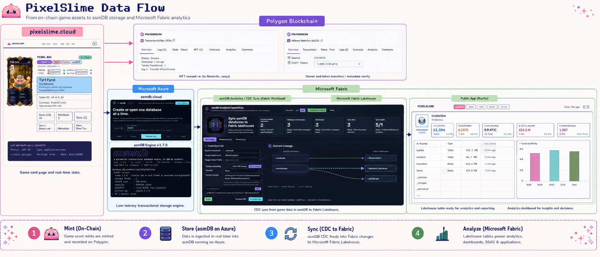
ONE MORE TIME
The whole thing, on one page
From an on-chain game asset to asmdb storage to Microsoft Fabric analytics — mint, store, sync, analyze.
PIXELSLIME · ASMDB · MICROSOFT FABRIC
80

Slide 81
THE NUMBERS
Everything that matters, in one place
ENGINE
SERVICE
PRODUCT
PROOF
Binary, Windows
Tiers
Bytes per card
Backend tests
43,741 B
$0 / $15 / $49
175
726
Binary, Linux
Platform floor
PSC-1 header
Chain tests
52,205 B
$141.76 / mo
32 B
49
Record size
Replicas per instance
Mochibo stream
MCP checks
256 B
1
52 B / 65 chars
24
Usable rows
Public endpoints
Genesis Rain
Contracts on chain
3,145,728
1
365,000 $SMILE
4
In-RAM insert
NFS share
Burn per bloom
Decode errors
12.38 M rows/s
100 GiB
100 $SMILE
0
Rows per transaction
Gateway timeout
Total blooms
Chain drift
4,096
60 s
3,650 = 10 years
0
PIXELSLIME · ASMDB · MICROSOFT FABRIC
81

Slide 82
THE ARGUMENT
Constraints are not obstacles you route around
Every layer in this stack got better when it was told what it was not allowed to do.
256-byte records
→
made the address arithmetic two instructions and deleted the entire storage manager
No SQL
→
removed the parser, the planner and every class of injection that comes with them
One writer
→
made durability provable instead of probabilistic, and made isolation a container boundary
175 bytes of content
→
forced PSC-1, which is the most interesting engineering in the product
One database per Container App
→
made the blast radius exactly one customer, and made upgrade an image tag
One directory per workstream
→
made eleven parallel agents cost nothing to coordinate
PIXELSLIME · ASMDB · MICROSOFT FABRIC
82

Slide 83
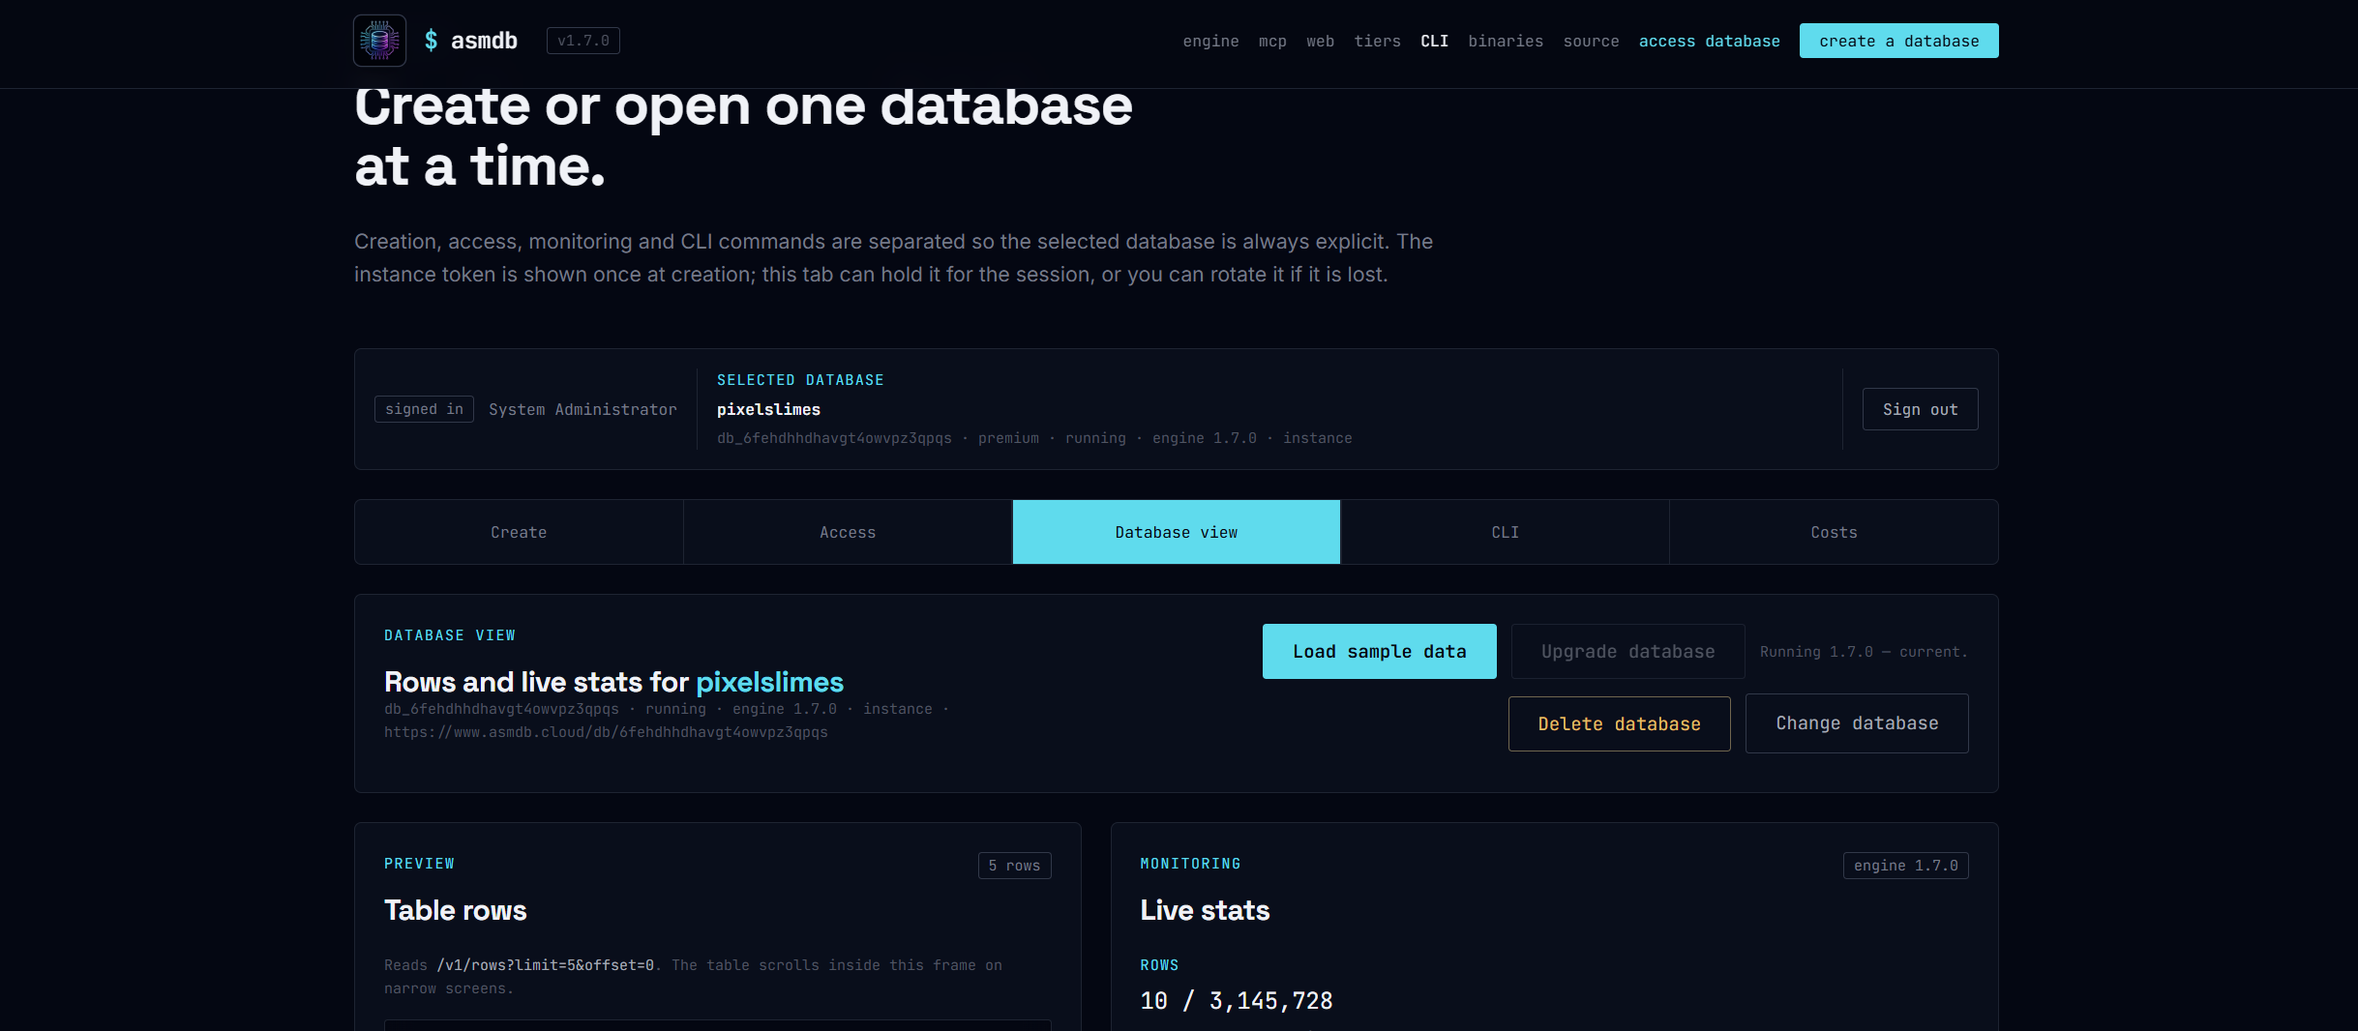
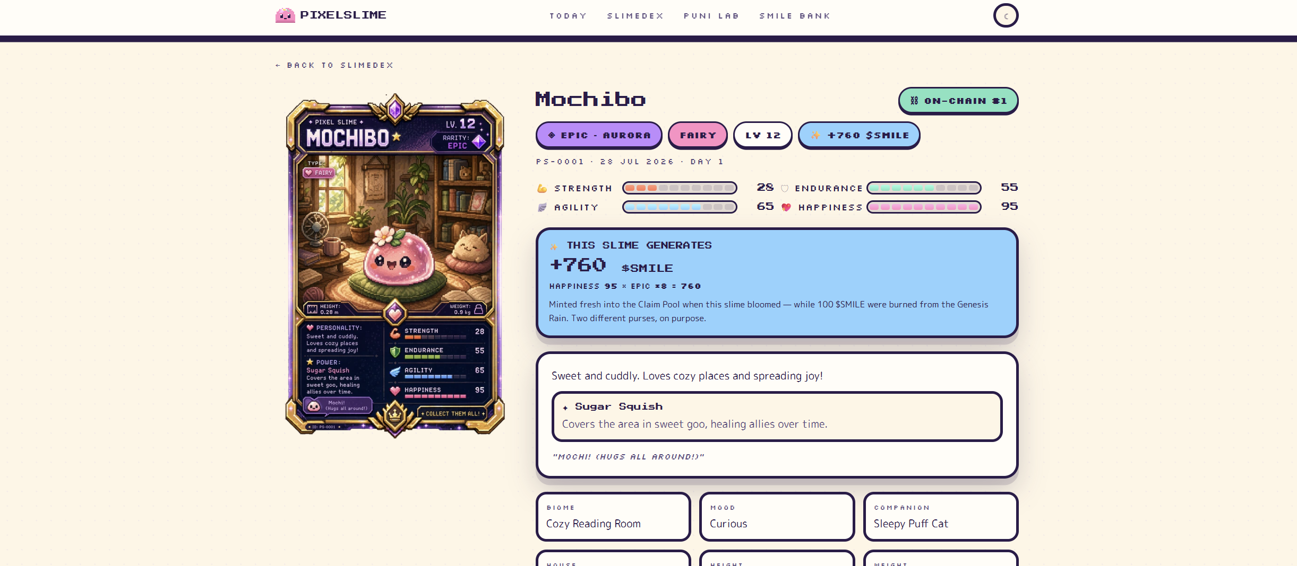
GO AND LOOK
It is all live, and it is all checkable
None of this needs an account, an NDA or a demo environment.
www.asmdb.cloud
www.pixelslime.cloud
The engine, the console, the CLI, the tiers and the costs page. Create a free database and run VERSION.
Today's bloom, the SLIMEDEX, and the UNSEAL panel that shows you the exact bytes behind every card.
PIXELSLIME · ASMDB · MICROSOFT FABRIC
83

Slide 84
One slime a day, forever.
175 bytes of pure joy.
Thank you. Questions, arguments and “why didn't you just use SQLite” all welcome.
WWW.ASMDB.CLOUD
WWW.PIXELSLIME.CLOUD
ASMDB.ANALYTICS
PIXELSLIME ANALYTICS
PIXELSLIME · ASMDB · MICROSOFT FABRIC
84

