Slide 1
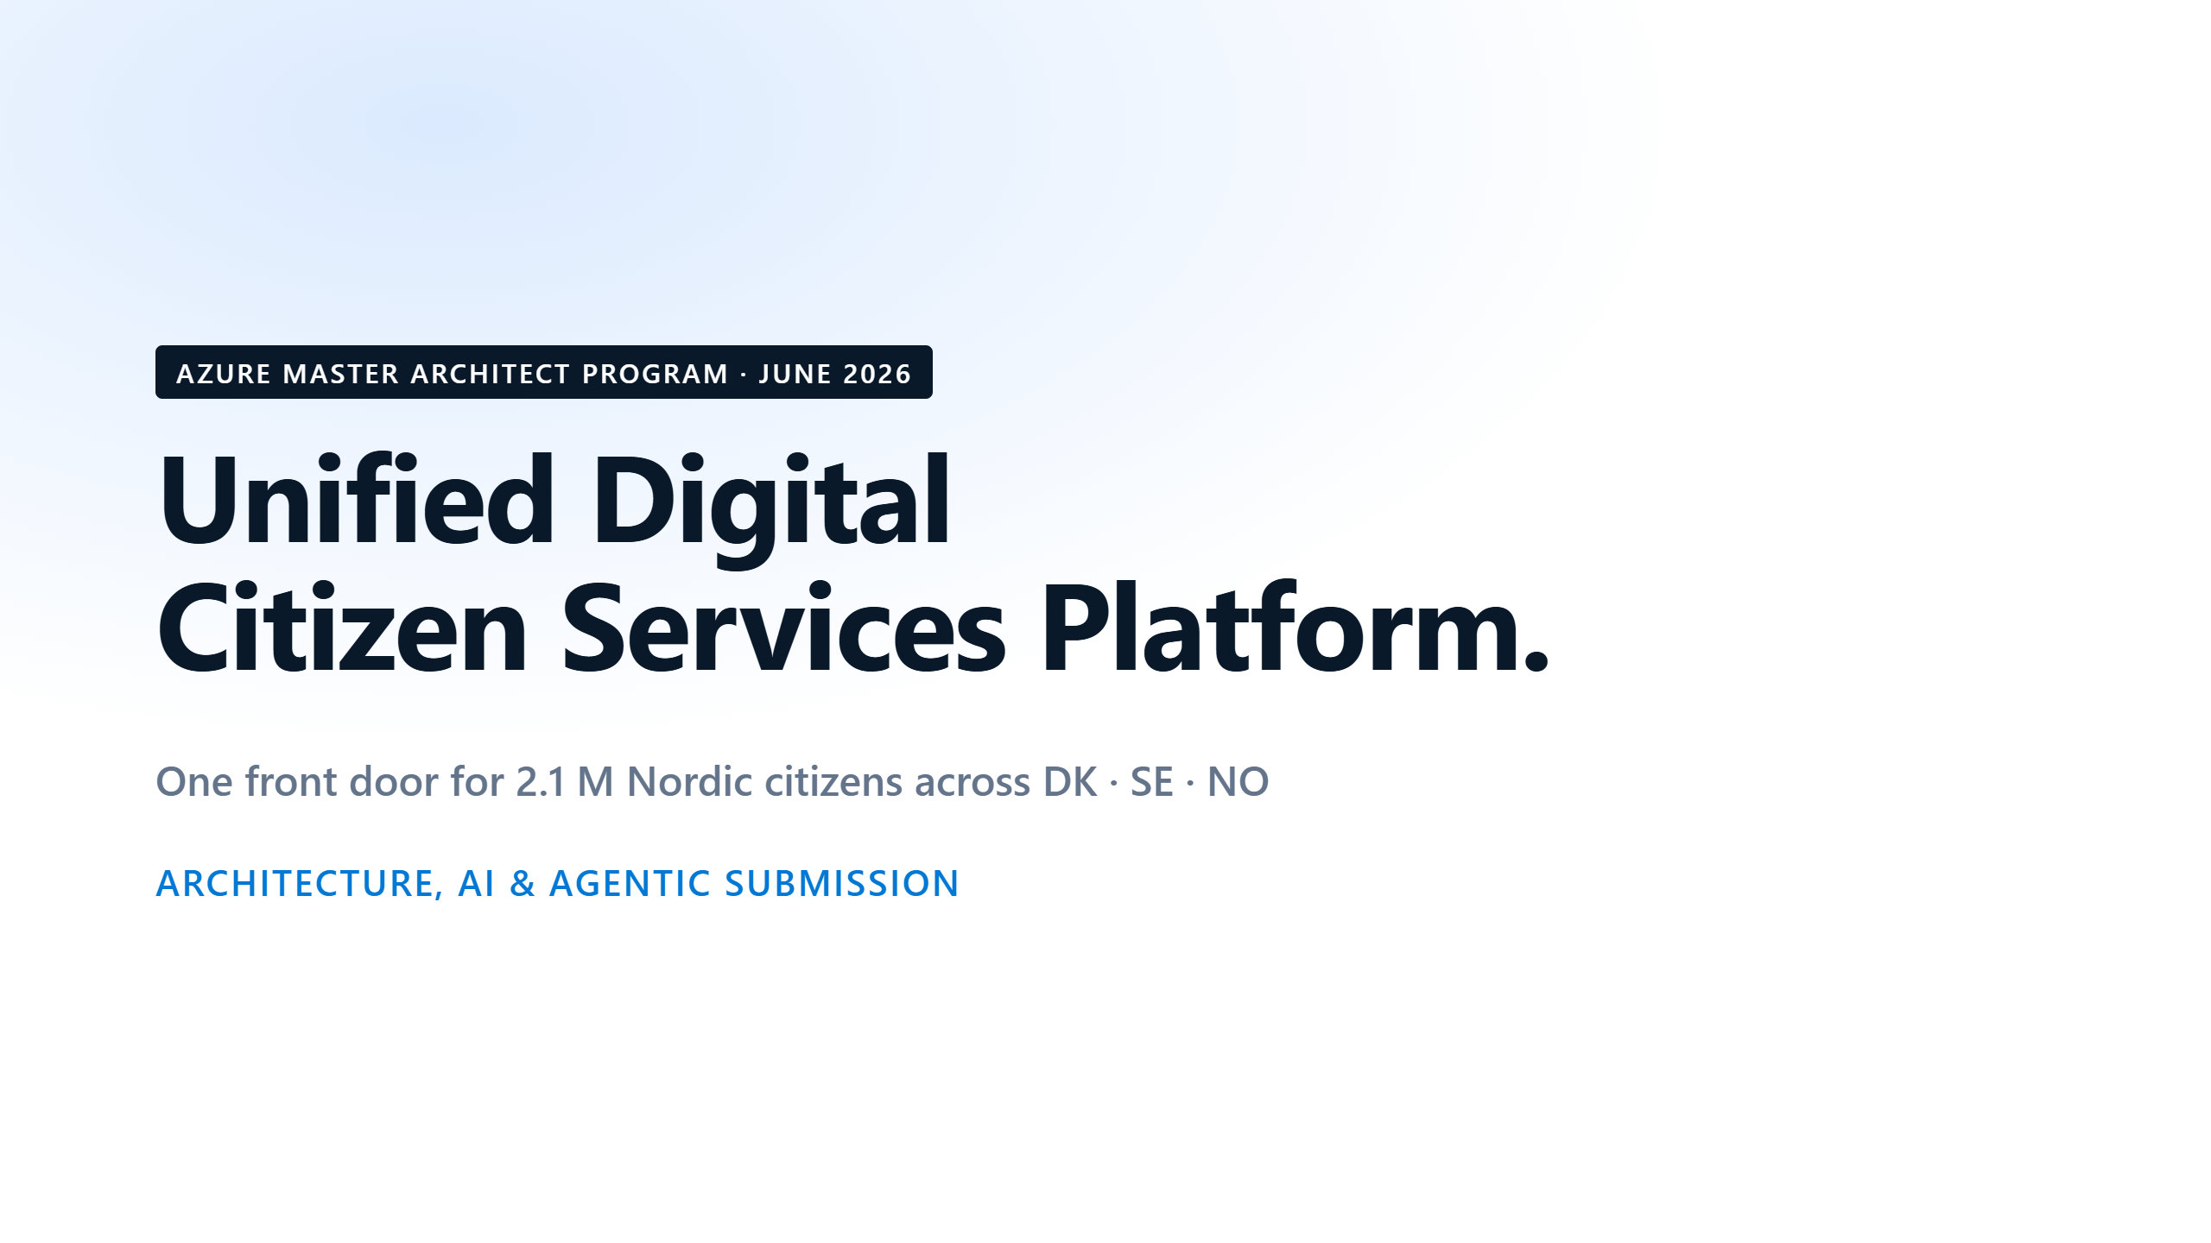
Notes:
⏱ 0:40 · Good morning. I'm Frederic.
Today, citizens prove who they are again and again. They retype the same papers in many systems.
UDCSP gives them one identity and one experience. The platform connects to the national systems behind the scenes.
It serves 2.1 million citizens in Denmark, Sweden and Norway.
In the next 35 minutes I show the problem, the architecture, the AI and the security. Then I run a live demo.

Slide 2
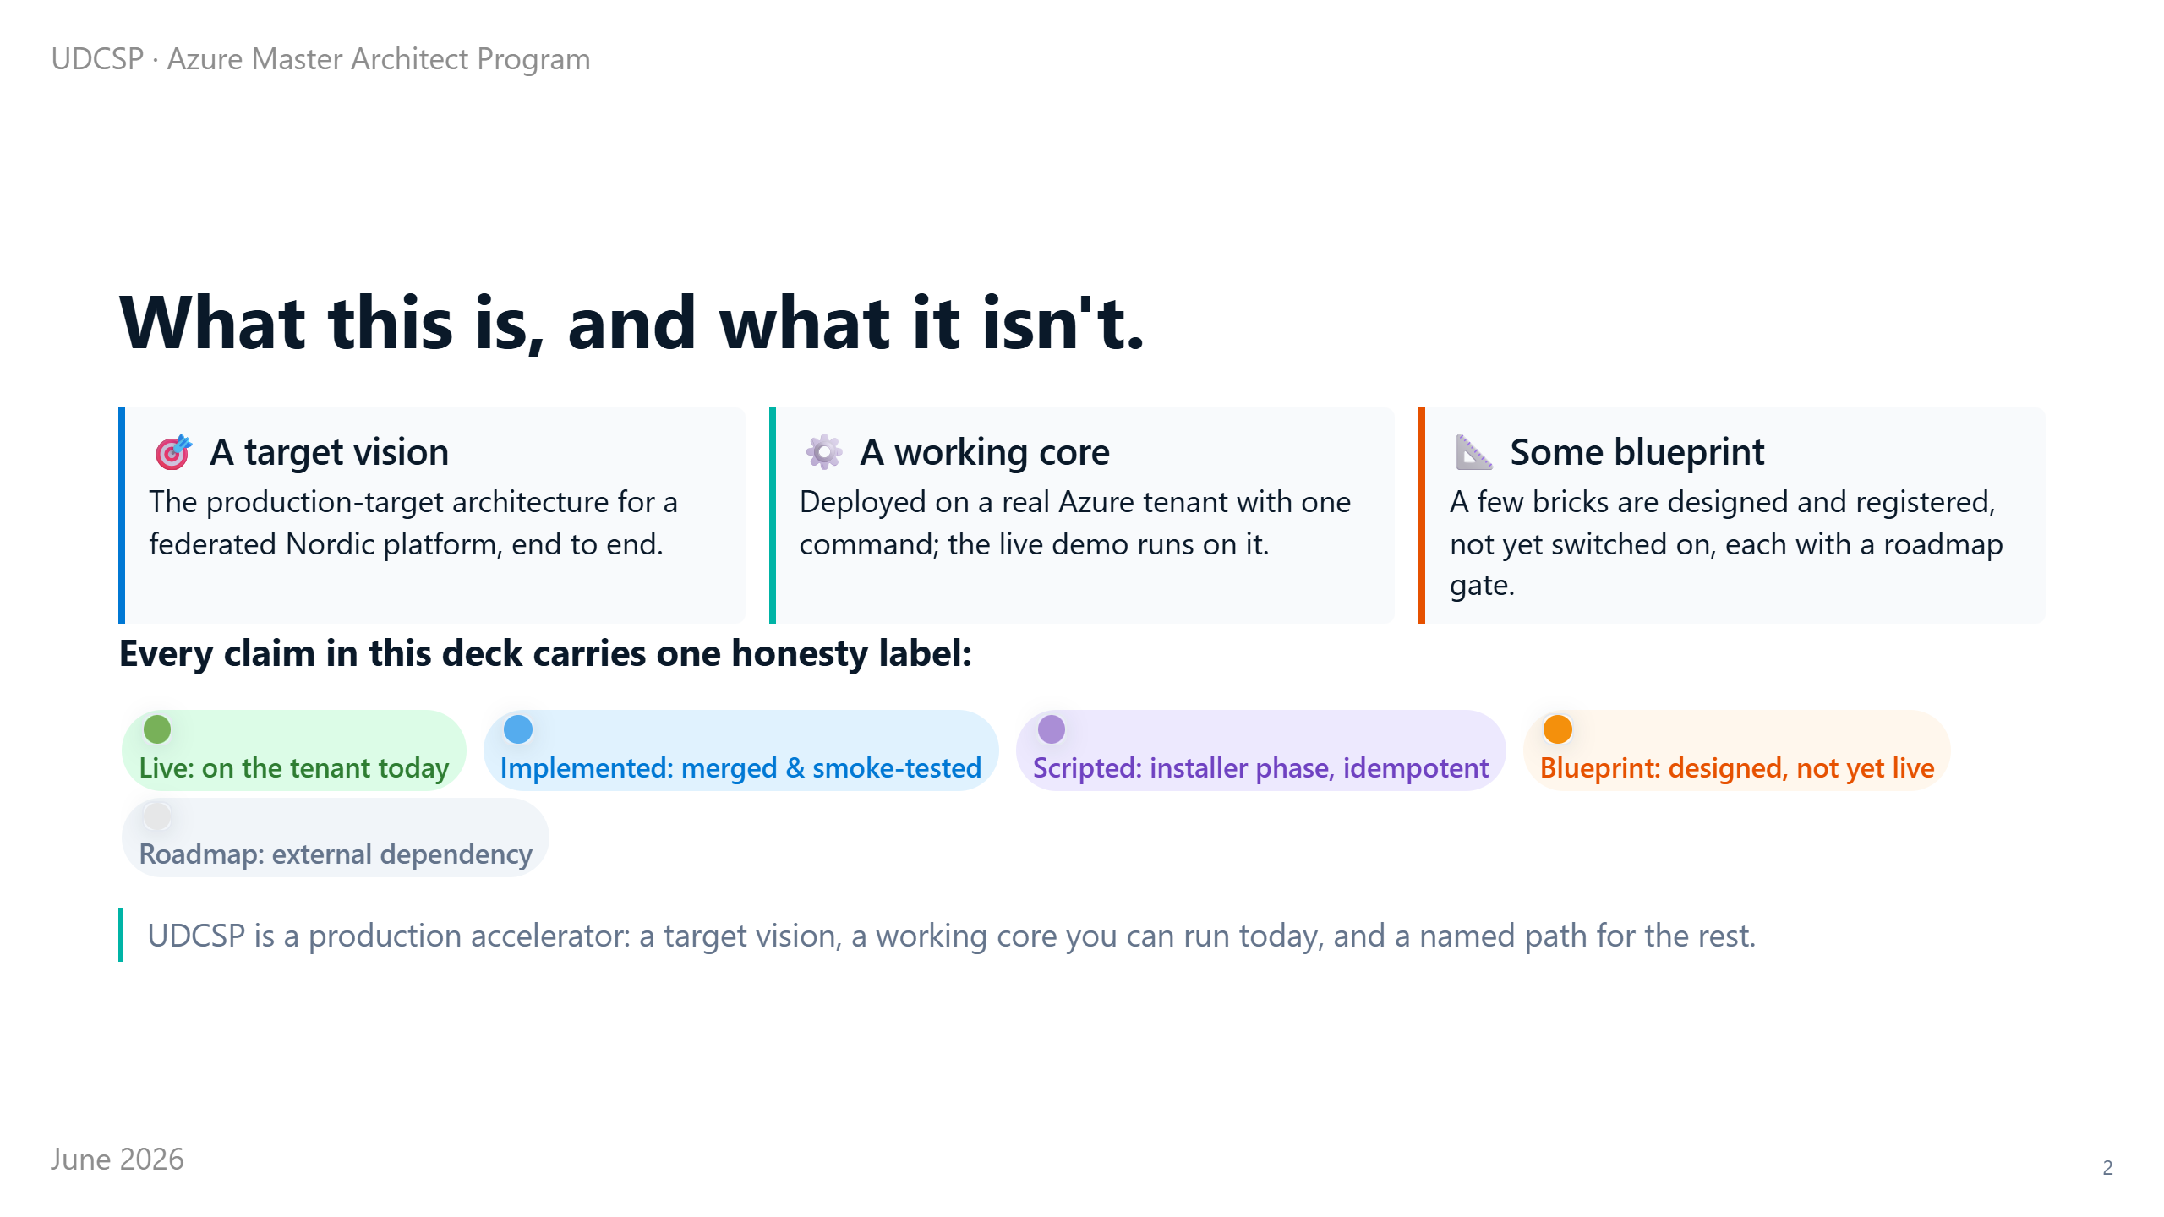
Notes:
⏱ 0:35 · First, an honest framing.
UDCSP is a production accelerator, not a finished product. You see a target vision, a working core you can run today, and a partial live demo.
A few parts are still blueprint: designed and registered, but not switched on yet. Each one has a gate on the roadmap.
Every claim carries one of five honesty labels. I show the full scorecard near the end.

Slide 3
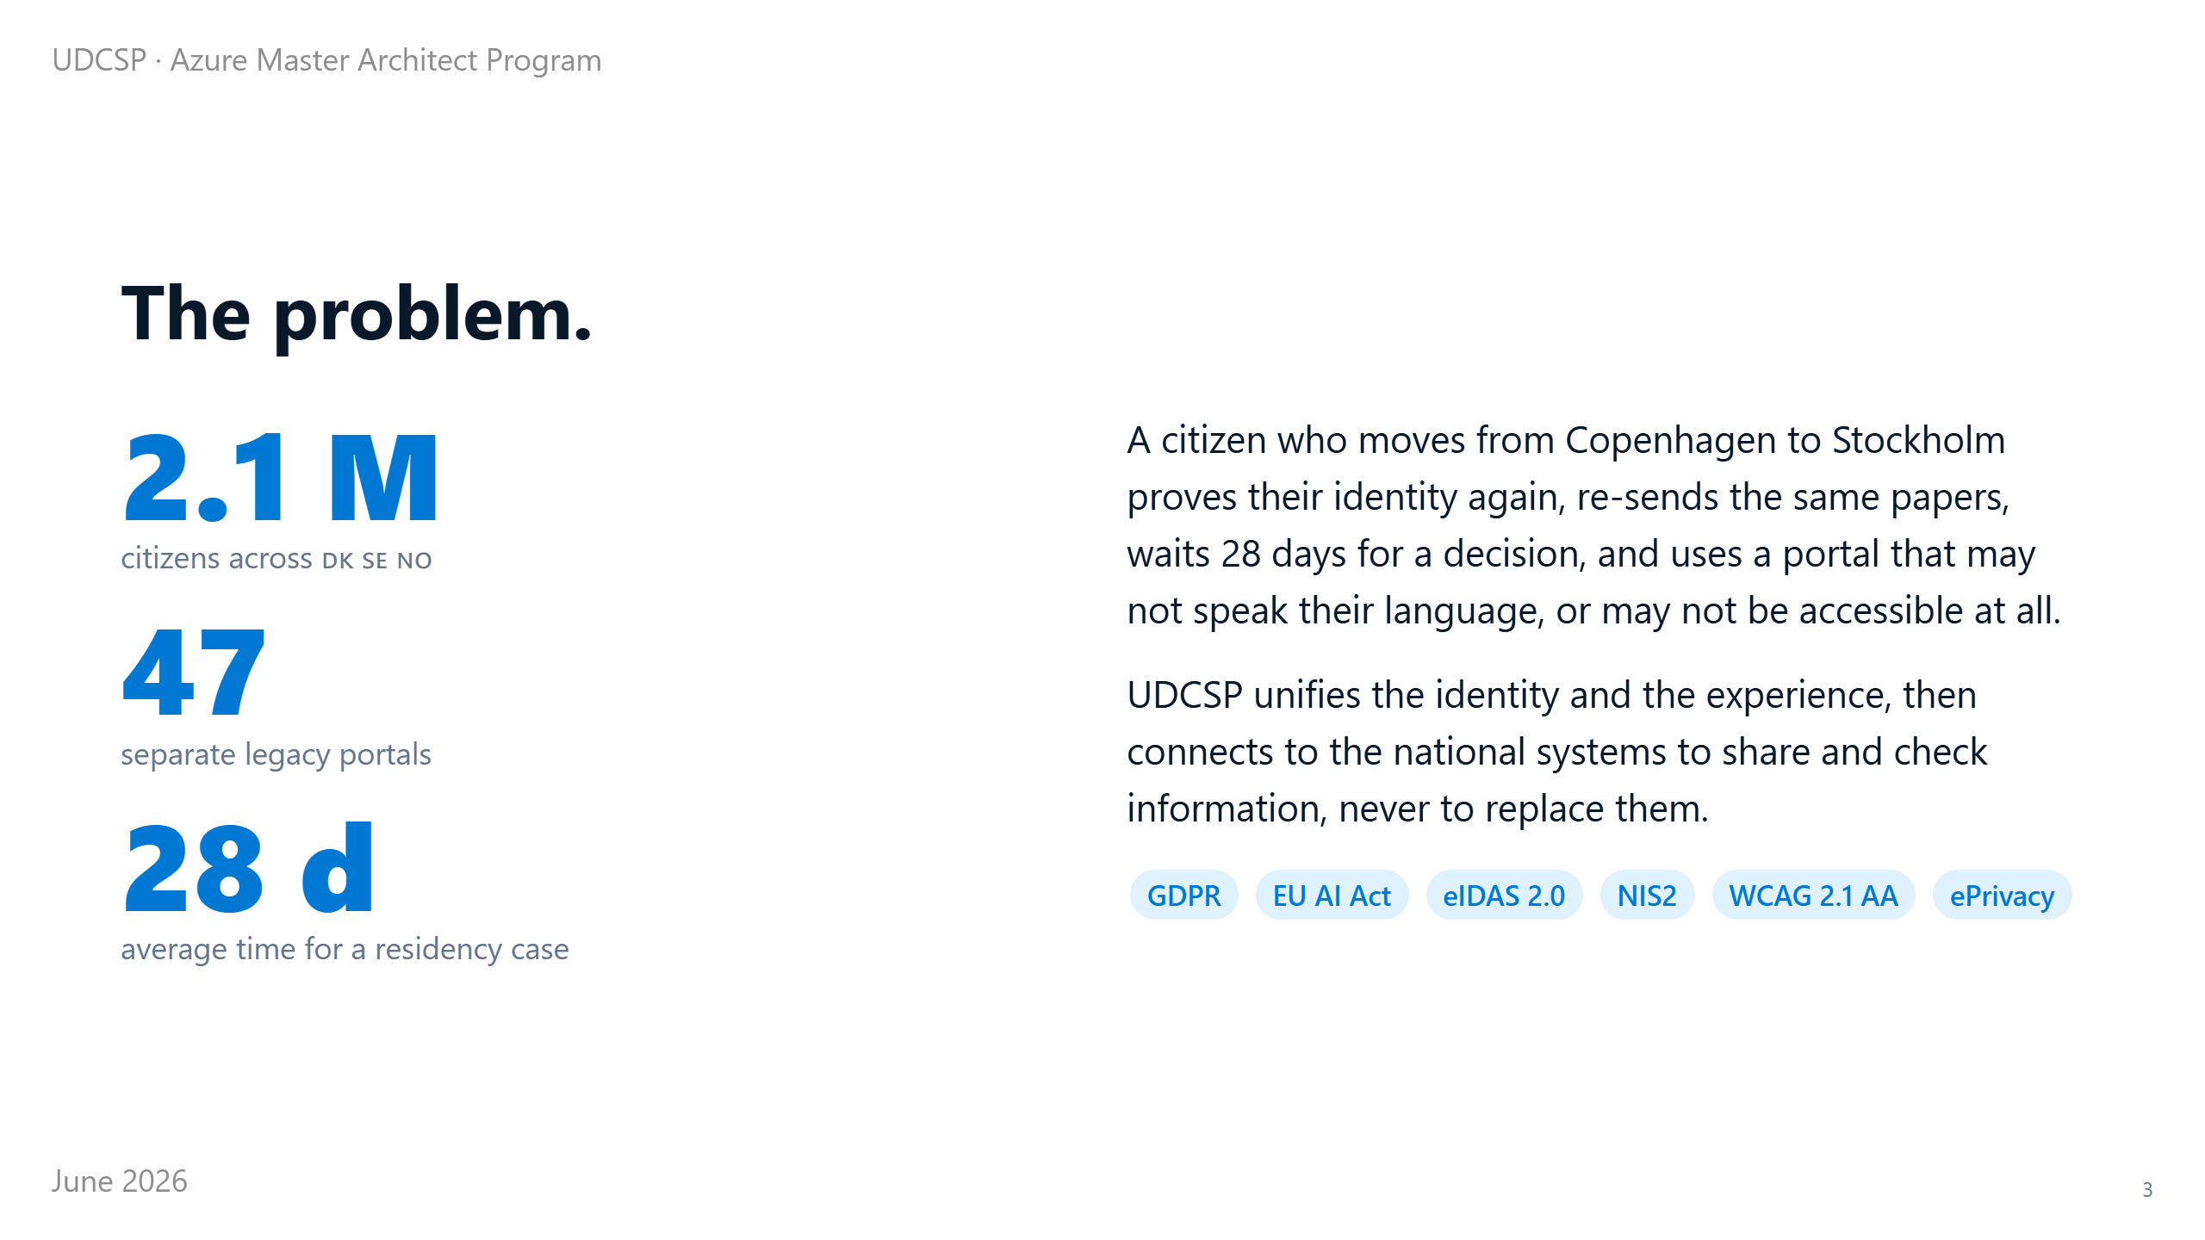
Notes:
⏱ 1:00 · Nordic public services are good. But they live in 47 separate portals that do not talk to each other.
The real problem: your identity and your data do not travel with you. Every system asks again who you are, and makes you re-enter the same papers.
So when someone moves country, they wait about 28 days for a residency decision. Often on a portal in the wrong language.
Our answer is one identity and one experience, connected to the systems that already hold the records.
Our rule: we do not replace the national authorities. We connect to them. That means private networks, every personal data tracked in Microsoft Purview, and eight European laws like GDPR and the EU AI Act mapped to real controls.

Slide 4
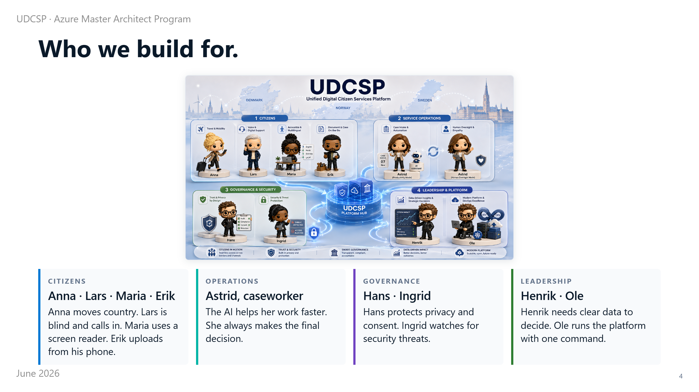
Notes:
⏱ 1:00 · Before writing code, we chose who we build for. Not a generic user: nine real roles.
Four are citizens. Anna moves between countries. Lars is blind and calls by phone. Maria uses a screen reader in her own language. Erik does everything on his phone.
Then Astrid, the caseworker, who keeps the final human decision.
Hans protects privacy, so we track every personal data in Purview. Ingrid watches security, so the whole platform runs on private networks.
And two leaders: Henrik needs clear data, Ole runs it with one command. Each role drove a real design choice.

Slide 5
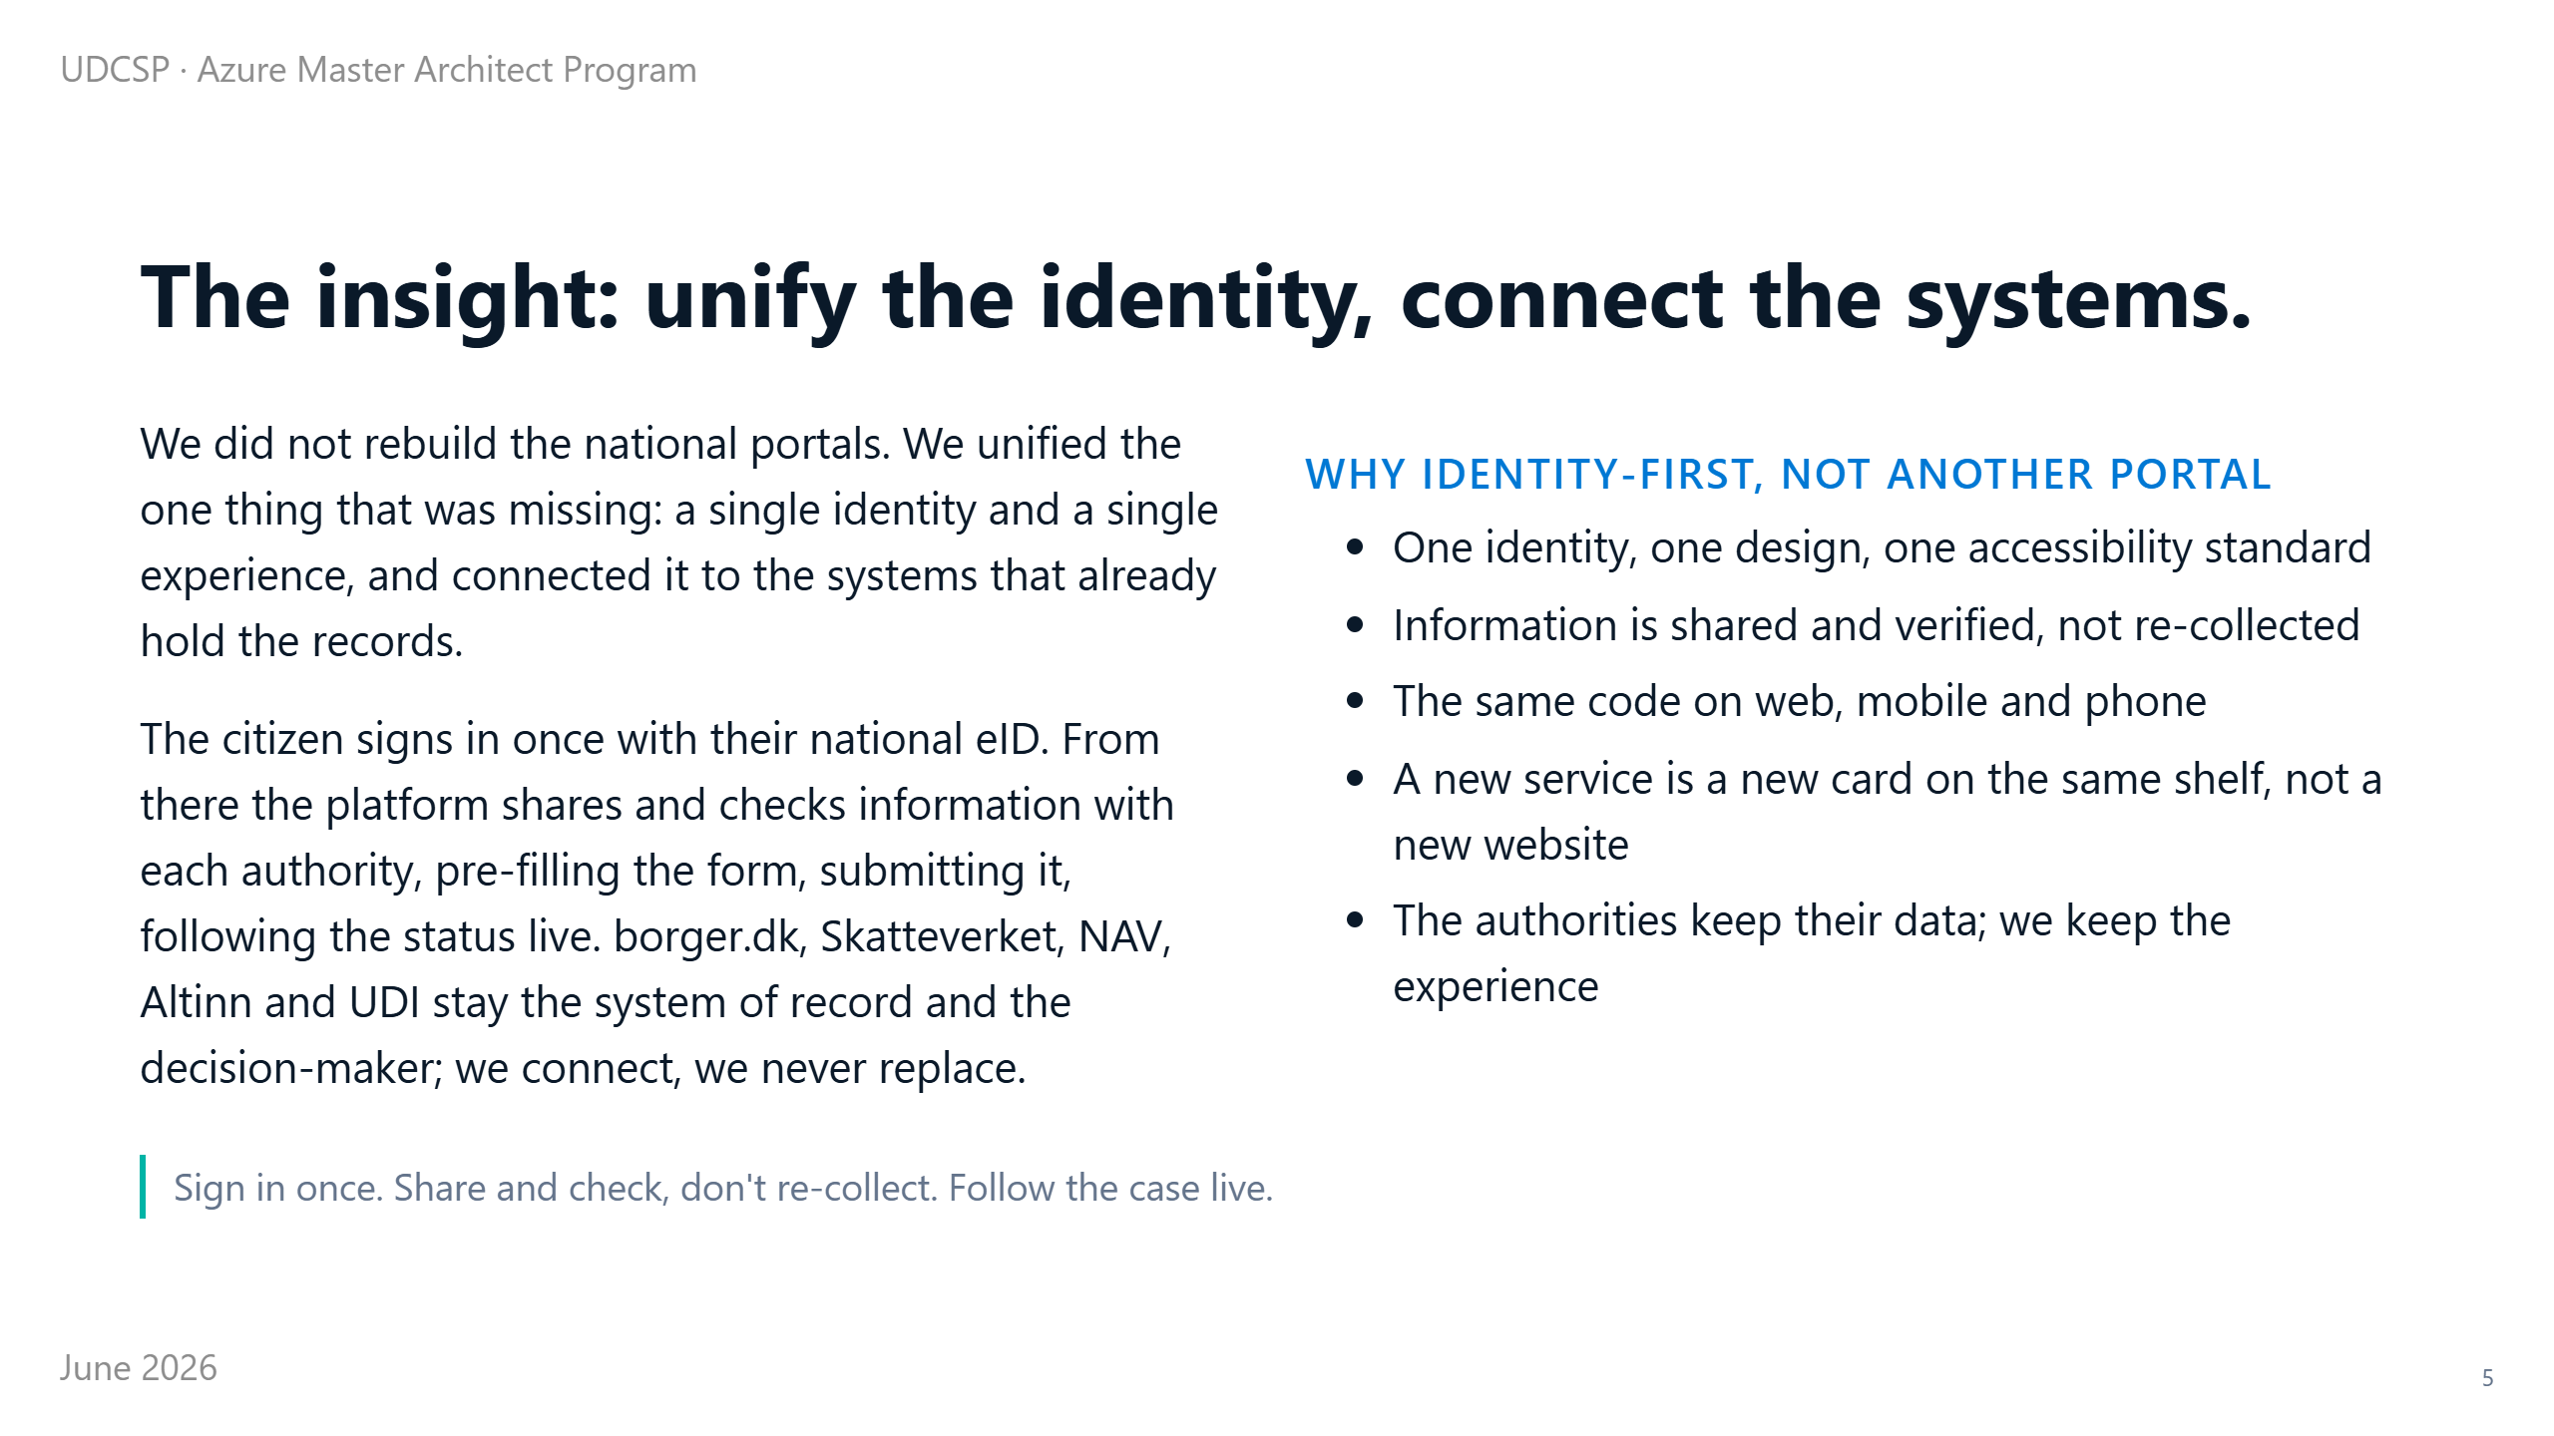
Notes:
⏱ 1:00 · This was the first and biggest choice.
We did not build another portal on the pile. We unified the one missing thing: a single identity and a single experience, connected to the systems that already hold the records.
The citizen signs in once. Microsoft Entra External ID is joined to the national electronic IDs through the European eIDAS standard. So we never store a password; we trust each country's own login.
From there, Azure Logic Apps talk to each authority. They pre-fill the right national form, submit it, and read the status back.
borger.dk, Skatteverket and NAV still hold the records and still decide. We own the experience, they own the case. Everything else in this talk follows from that one decision.

Slide 6
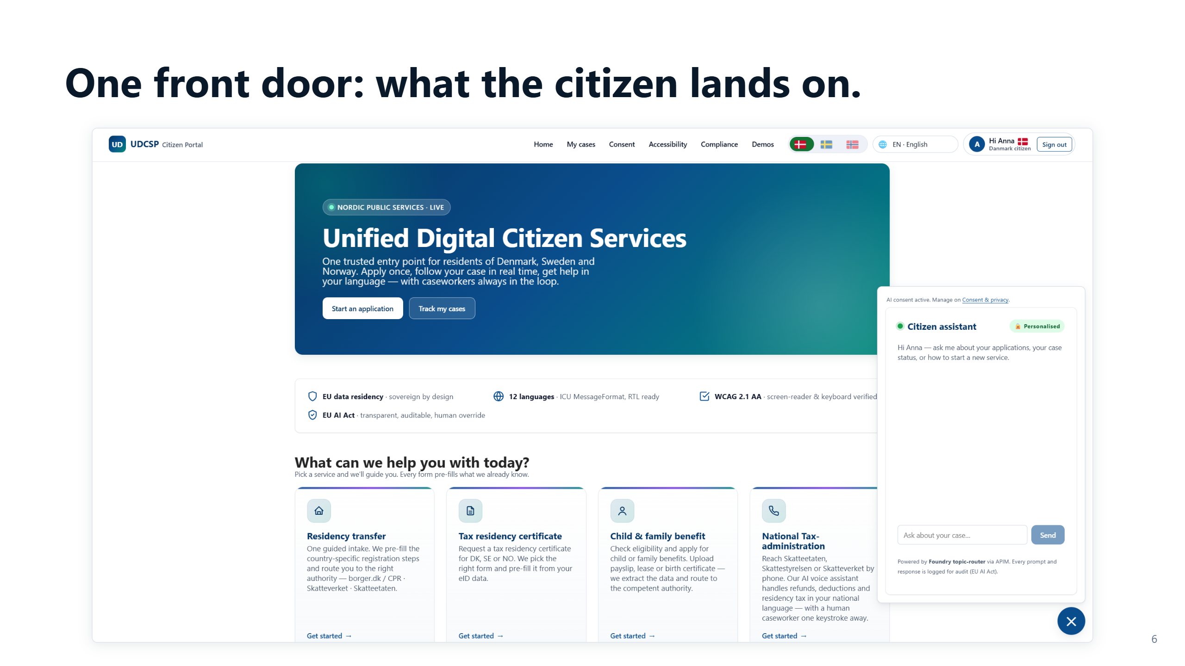
Notes:
⏱ 0:24 · This is what the citizen sees.
One home, in their own language. Every service is a simple card, and a help assistant is one click away.
They sign in once with their national eID, and the page greets them by name. No re-typing, and no choosing between 47 sites.

Slide 7
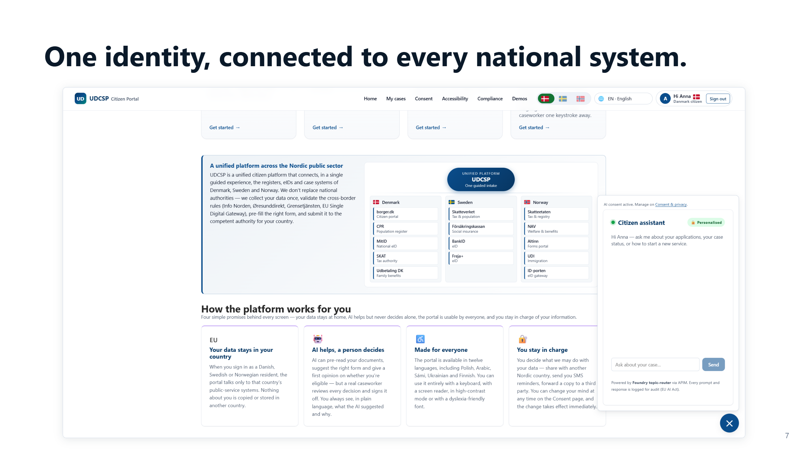
Notes:
⏱ 0:30 · Behind that calm home page, this is what happens.
The platform sits in the middle. It connects to the registers, the electronic IDs and the case systems of all three countries: borger.dk, Skatteverket, NAV, and the rest.
We collect the citizen's data once, check the cross-border rules, pre-fill the right national form, and submit it to the right authority.
They keep their data, we keep the experience. But first it has to find which country each request belongs to.

Slide 8
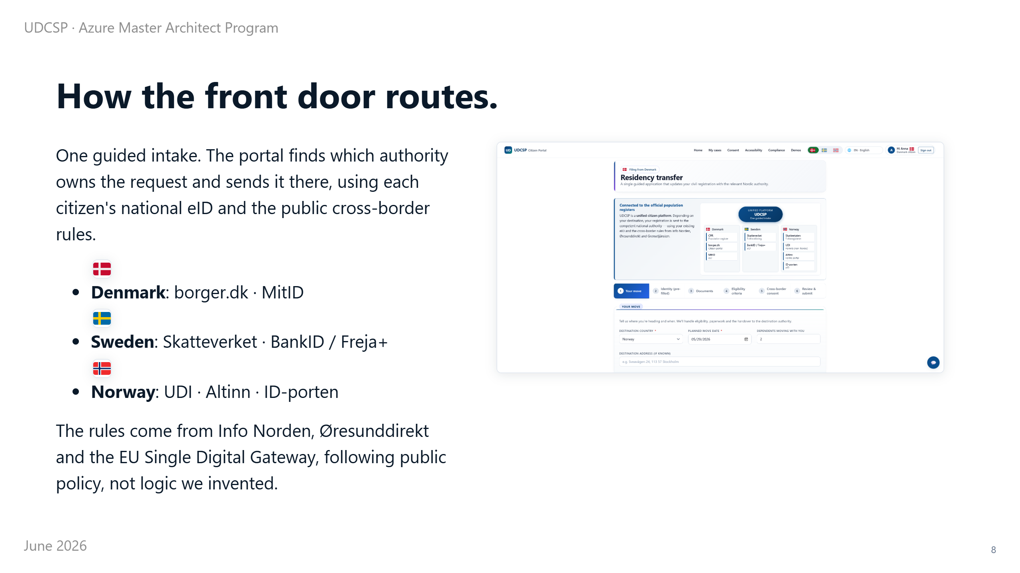
Notes:
⏱ 0:45 · So how does it know which country and which authority a request belongs to?
It uses the citizen's national electronic identity, their eID: MitID in Denmark, BankID in Sweden, ID-porten in Norway.
From that identity and the public cross-border rules, it finds who owns the request and routes it there over a private connection. Never the open internet.
The rules come from official sources, like Info Norden and the European Single Digital Gateway. So routing follows public policy, not logic we made up.

Slide 9
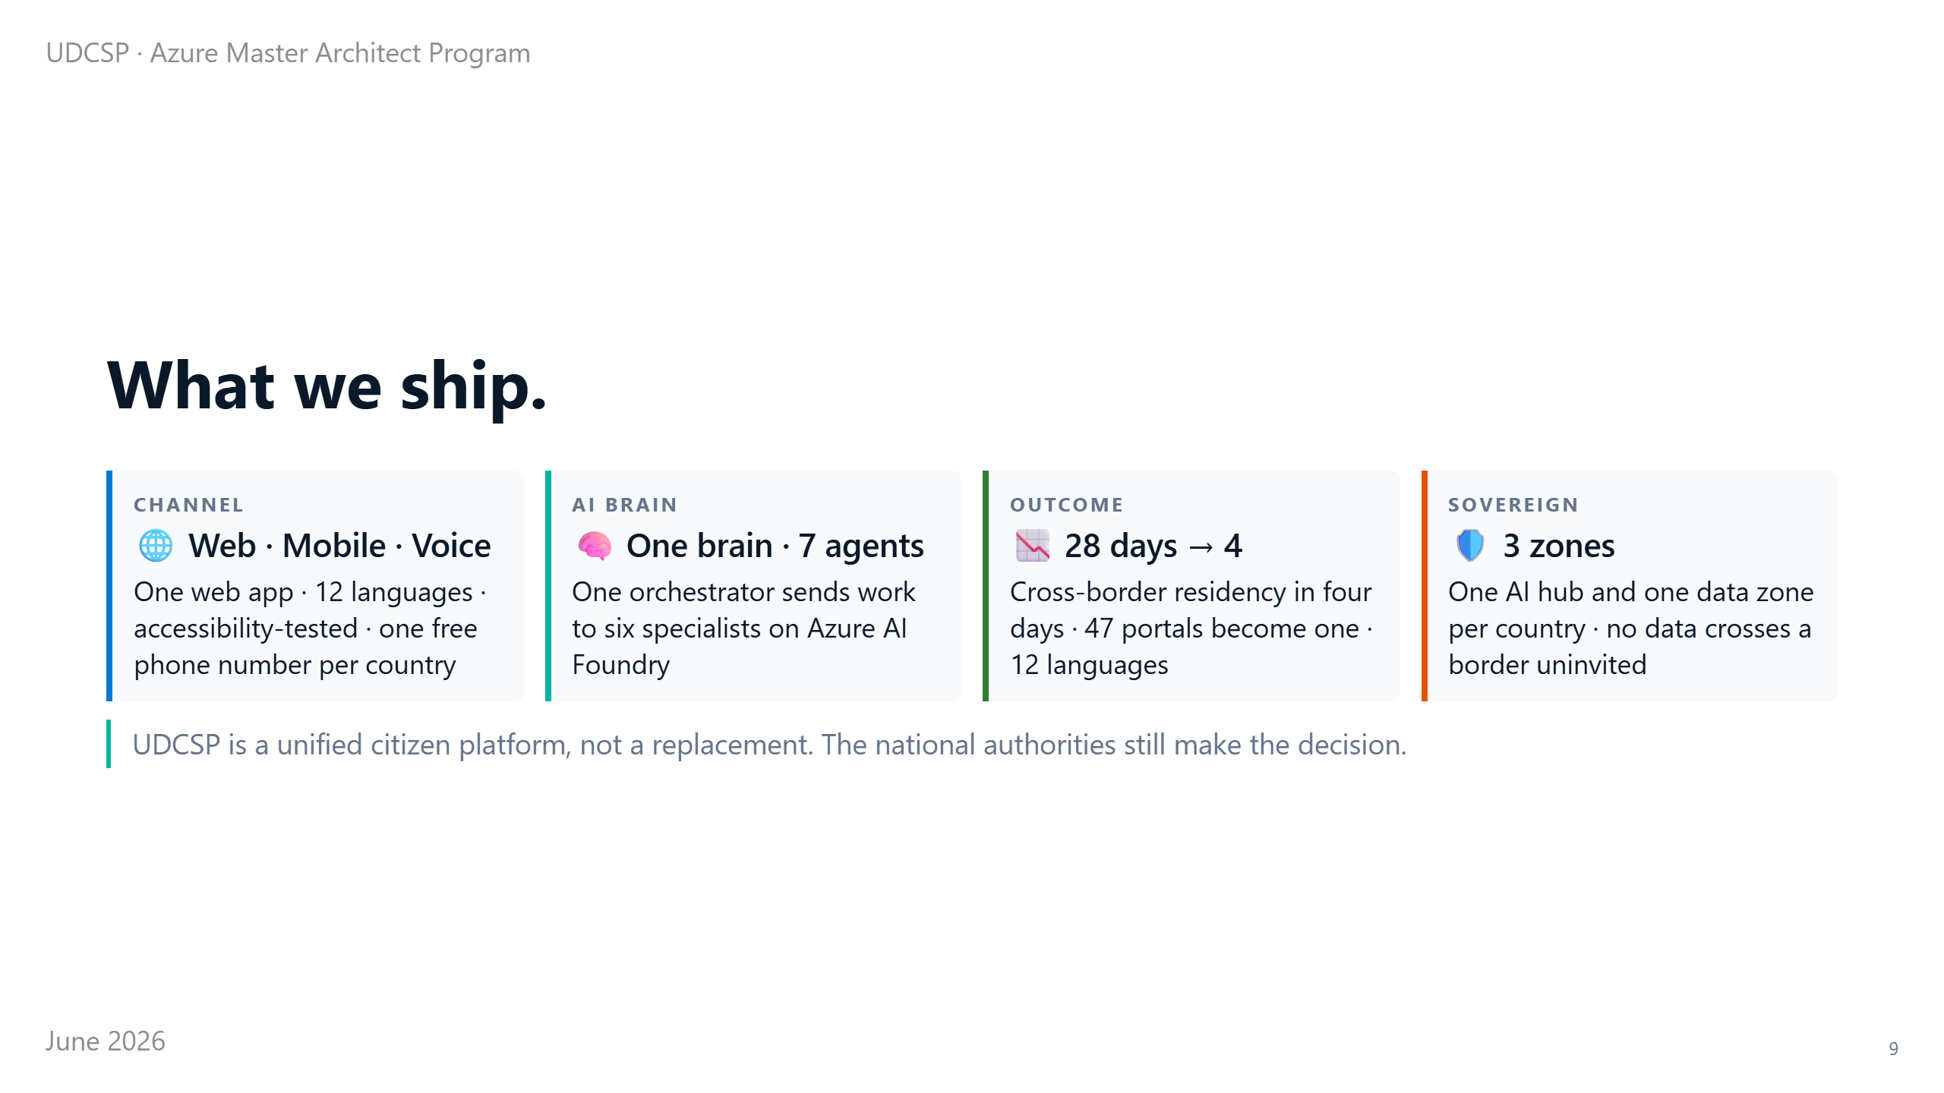
Notes:
⏱ 0:40 · It became three things.
First, one app reached three ways: web, phone, and a free phone number, in 12 languages.
Second, the brain: one coordinator and six specialist agents, seven in all, on Azure AI Foundry. That is Microsoft's platform to build and govern AI.
Third, a real change in outcome: a cross-border residency case now takes about four days instead of 28. And each country's AI and data stay inside its borders.

Slide 10
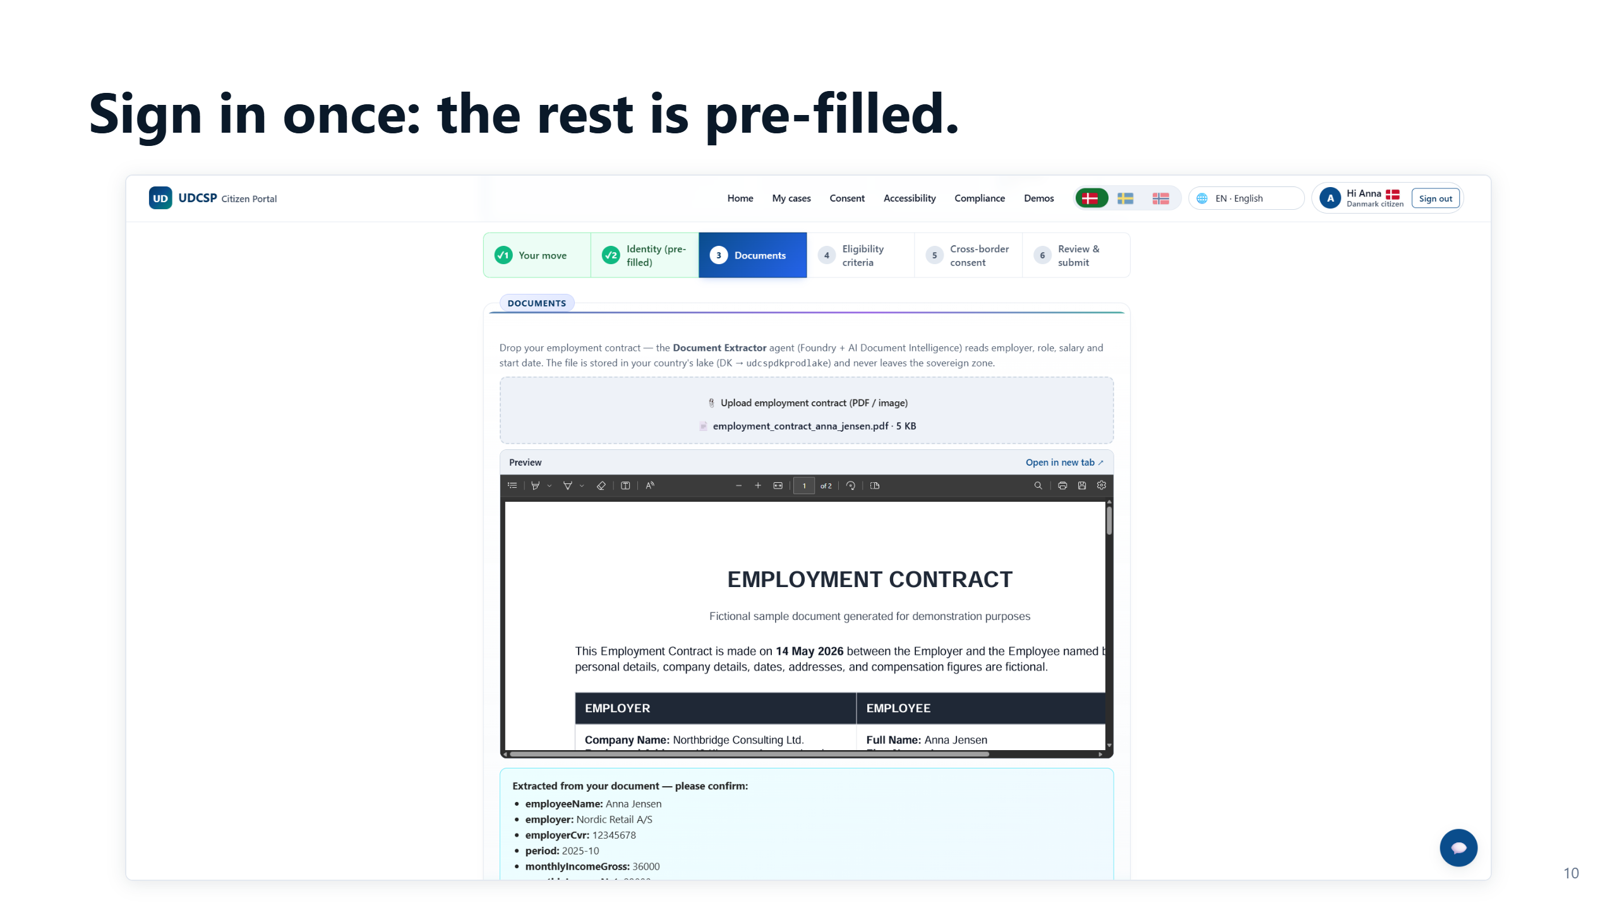
Notes:
⏱ 0:28 · Let's touch it. This is the guided application.
Look at the steps on top: your move, identity already pre-filled, documents, eligibility, cross-border consent, and submit.
The citizen signed in with their eID, so the identity step is already done. They never retype what the country knows.
They just add what is new, like an employment contract, and the platform reads it for them.

Slide 11
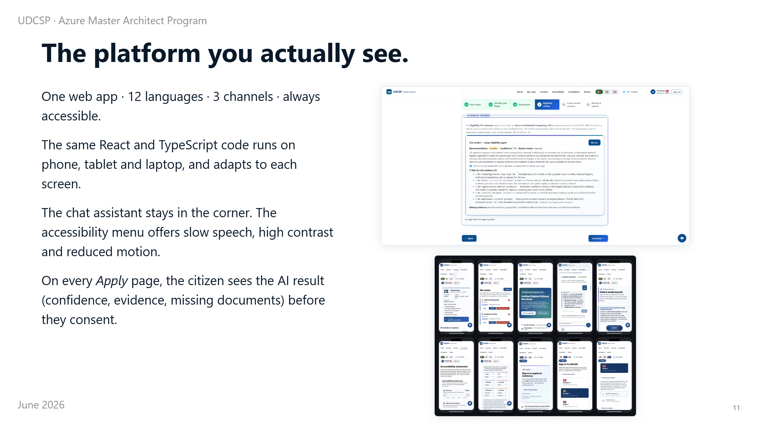
Notes:
⏱ 0:40 · What the citizen sees is one web app. The same code on a laptop and a phone. A help assistant in the corner, and accessibility built in for screen-reader users.
But one detail matters more than the rest.
On every application page, the citizen sees the AI's assessment before they consent: its confidence, the evidence for each rule, and anything still missing.
Nothing is hidden. That is the surface. Now let me take you behind it.

Slide 12
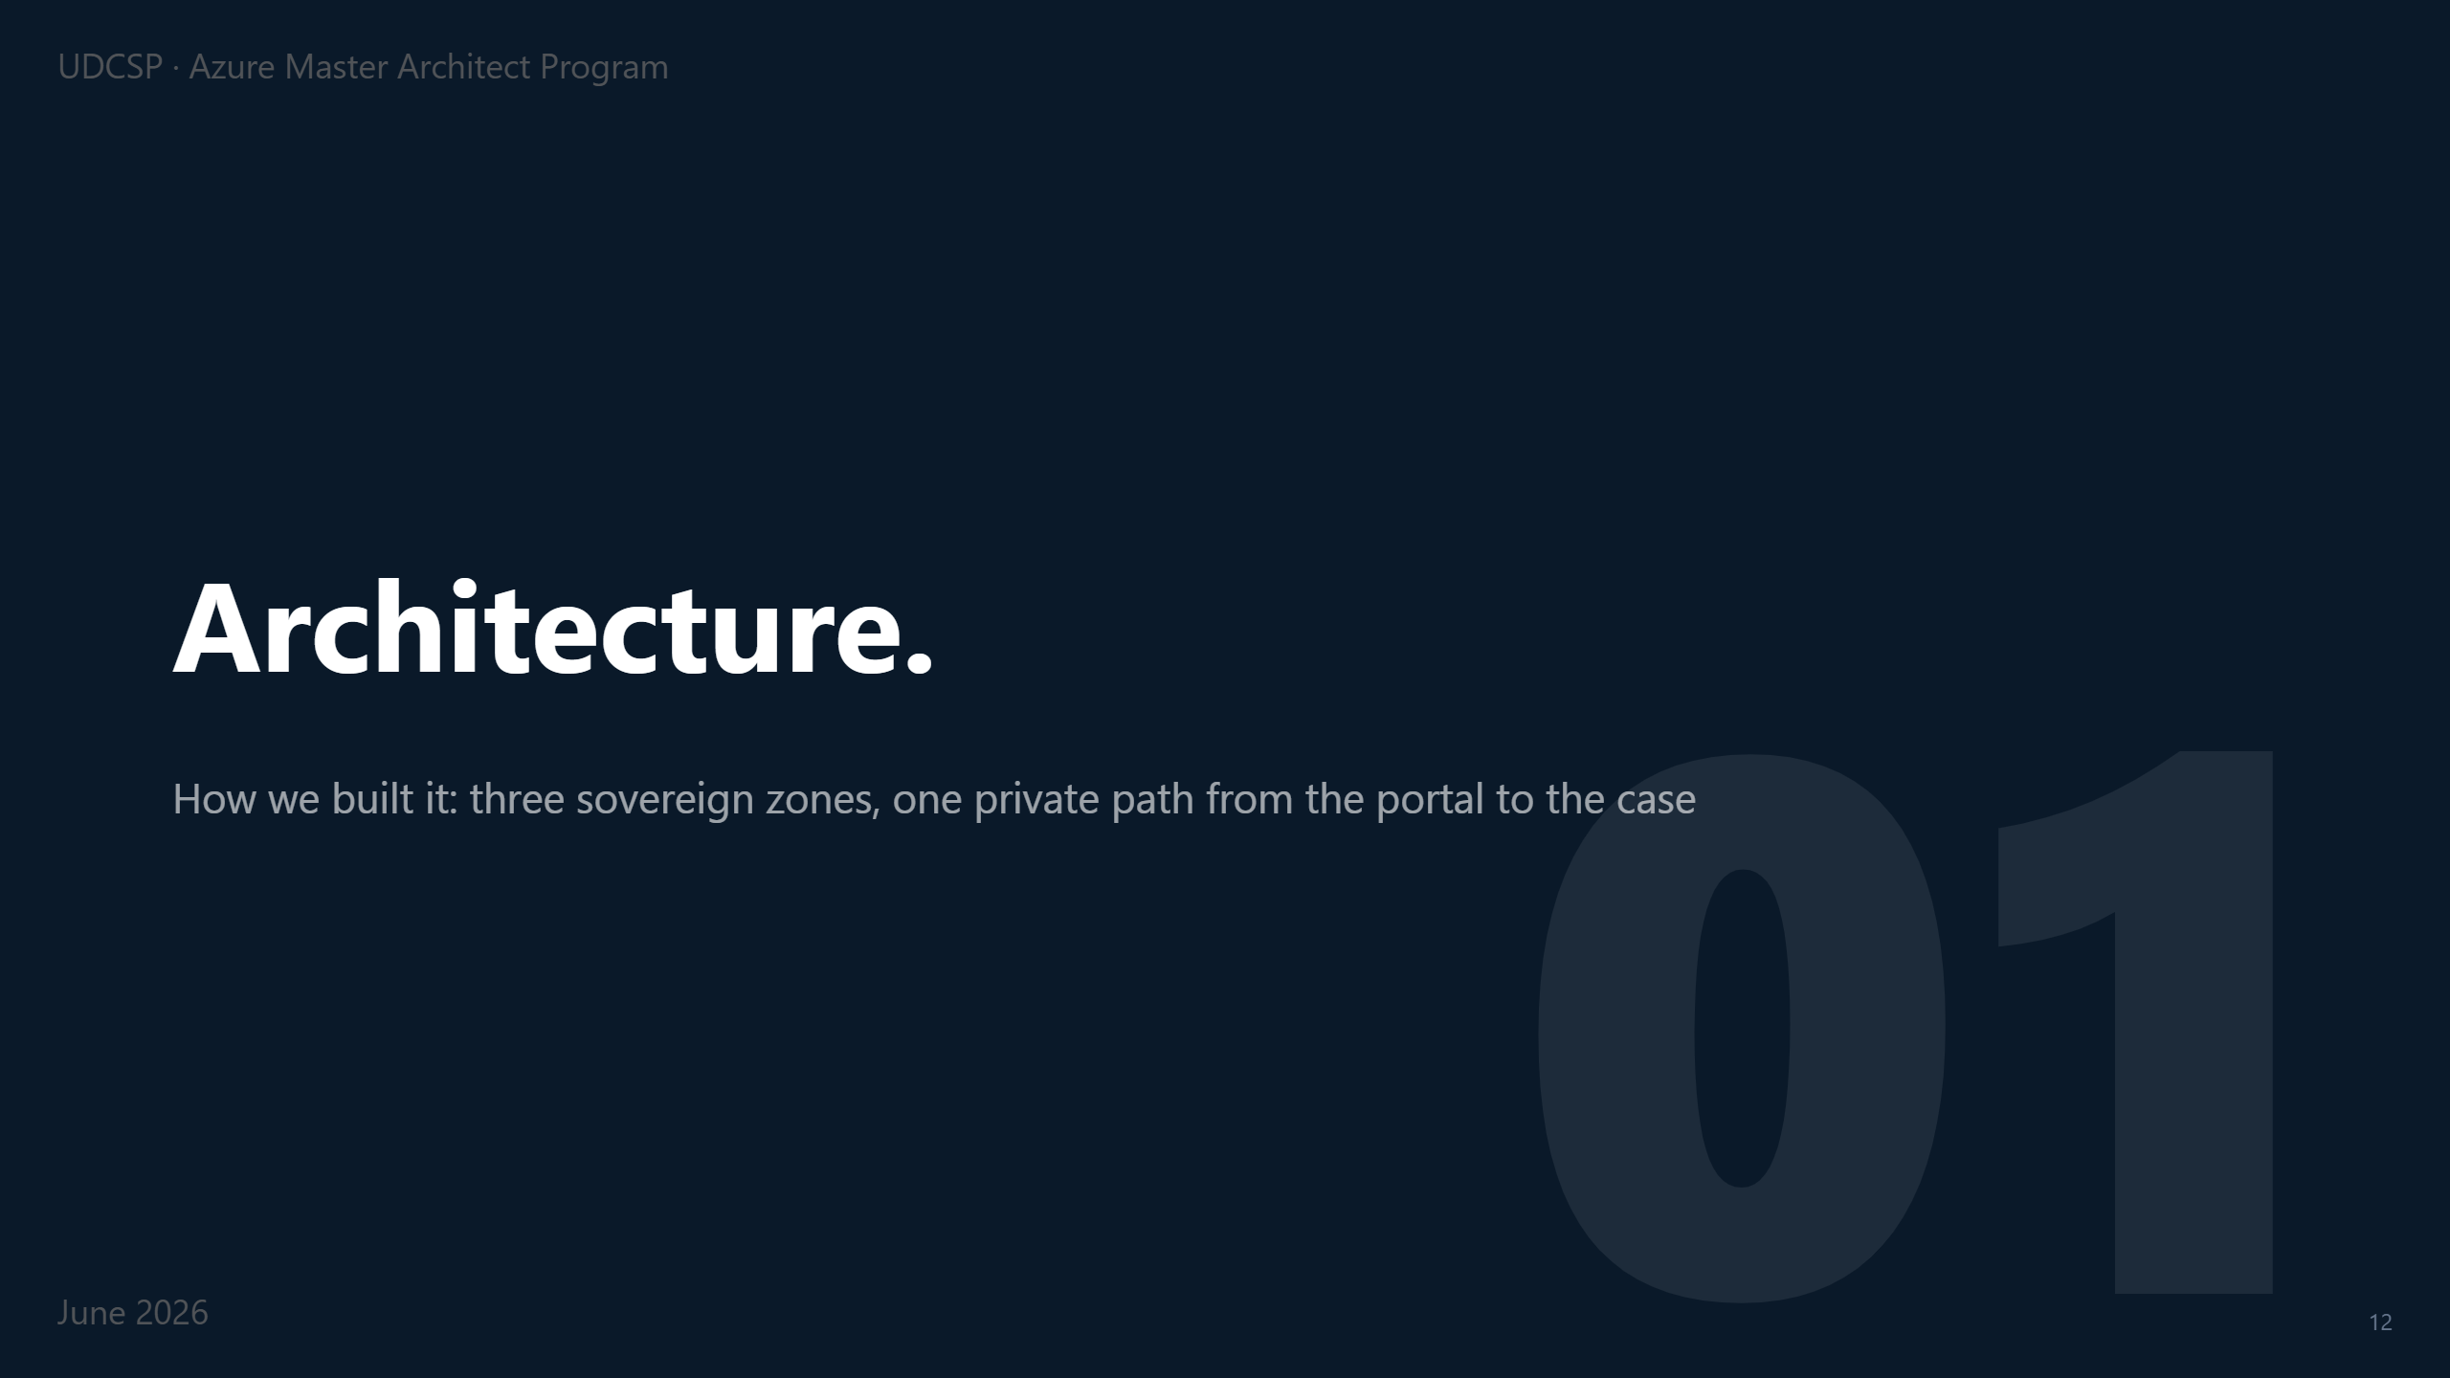
Notes:
⏱ 0:12 · Behind that simple door is where most of the engineering sits.
Two ideas hold the architecture together: keep every country sovereign, and keep the whole path private, from the first click to the caseworker.

Slide 13
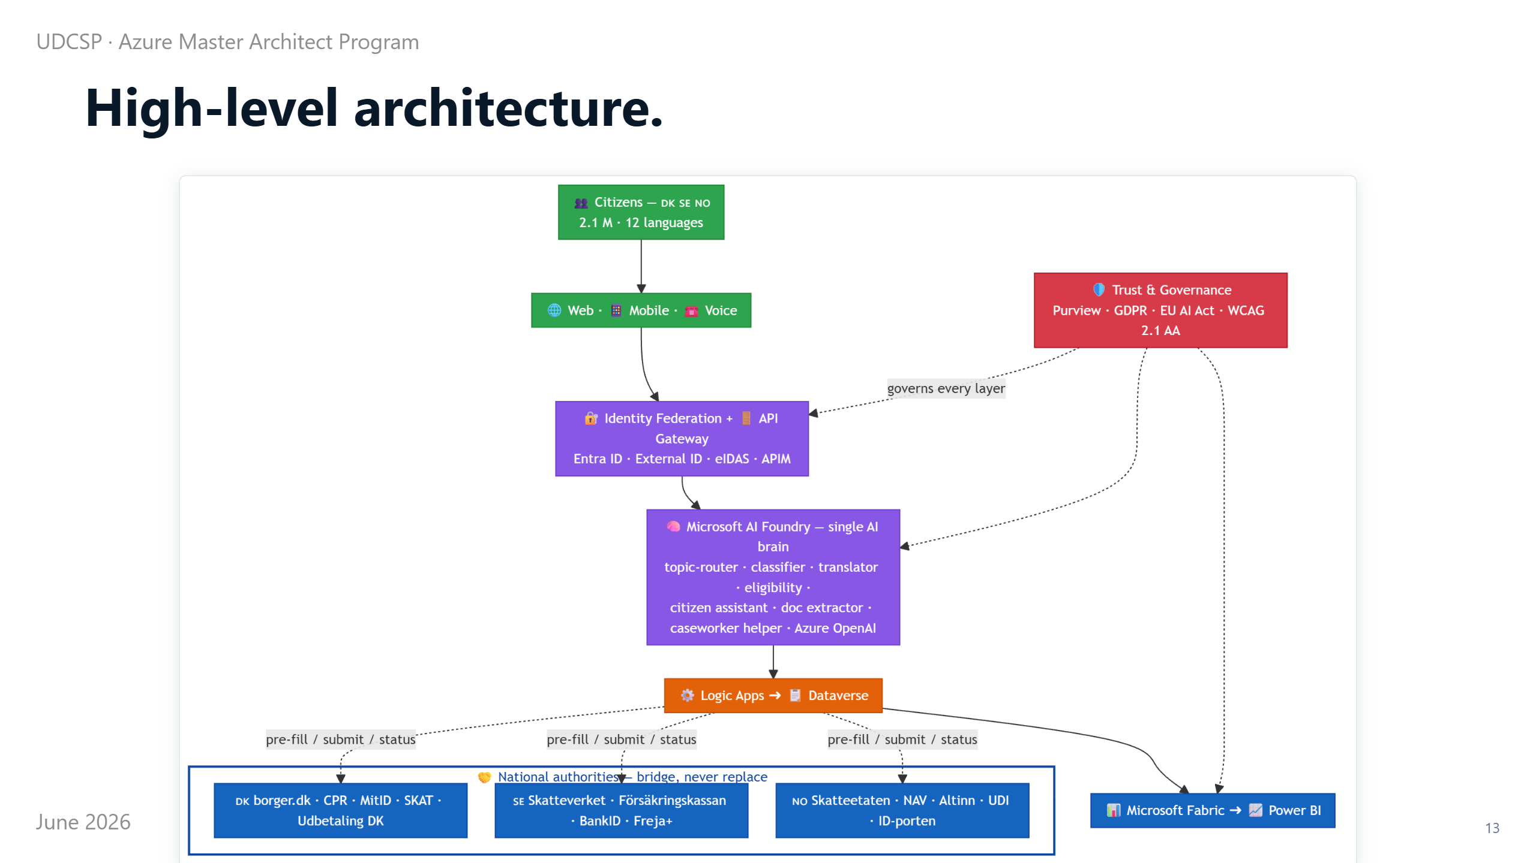
Notes:
⏱ 0:50 · At the highest level, the shape is simple: one experience on top for the citizen, and three separate back-offices underneath, one per country, that never mix.
The brain is copied into all three. So an AI call in Denmark stays in Denmark.
The only bridge to the national authorities runs through a single guarded gateway. We will come back to exactly how that bridge works.
So from outside it looks like one website. Inside, each country is a sealed world. Let me zoom into one of them.

Slide 14
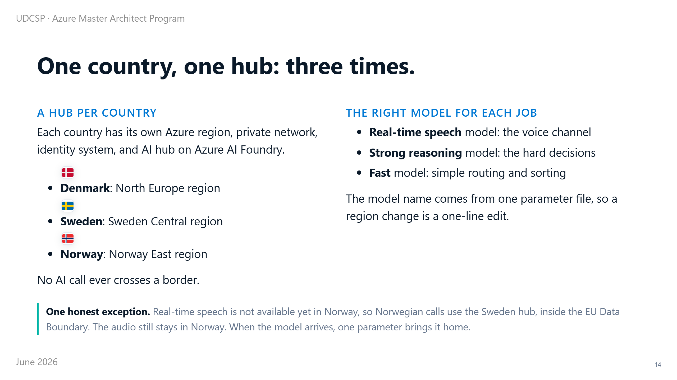
Notes:
⏱ 0:55 · Each country gets its own Azure region, its own private network, its own identity system, and its own AI hub.
Denmark runs in North Europe, Sweden in Sweden Central, Norway in Norway East. No AI call crosses a border.
Inside each hub we do not use one model for everything. We match the model to the job: a fast one sorts, a stronger one decides, a real-time one handles live speech on the phone.
The model names sit in one settings file, so changing region is a one-line edit.
One honest exception: real-time speech is not in Norway yet. Norwegian calls use the Swedish hub for now (still inside Europe), and one setting will bring it home.

Slide 15
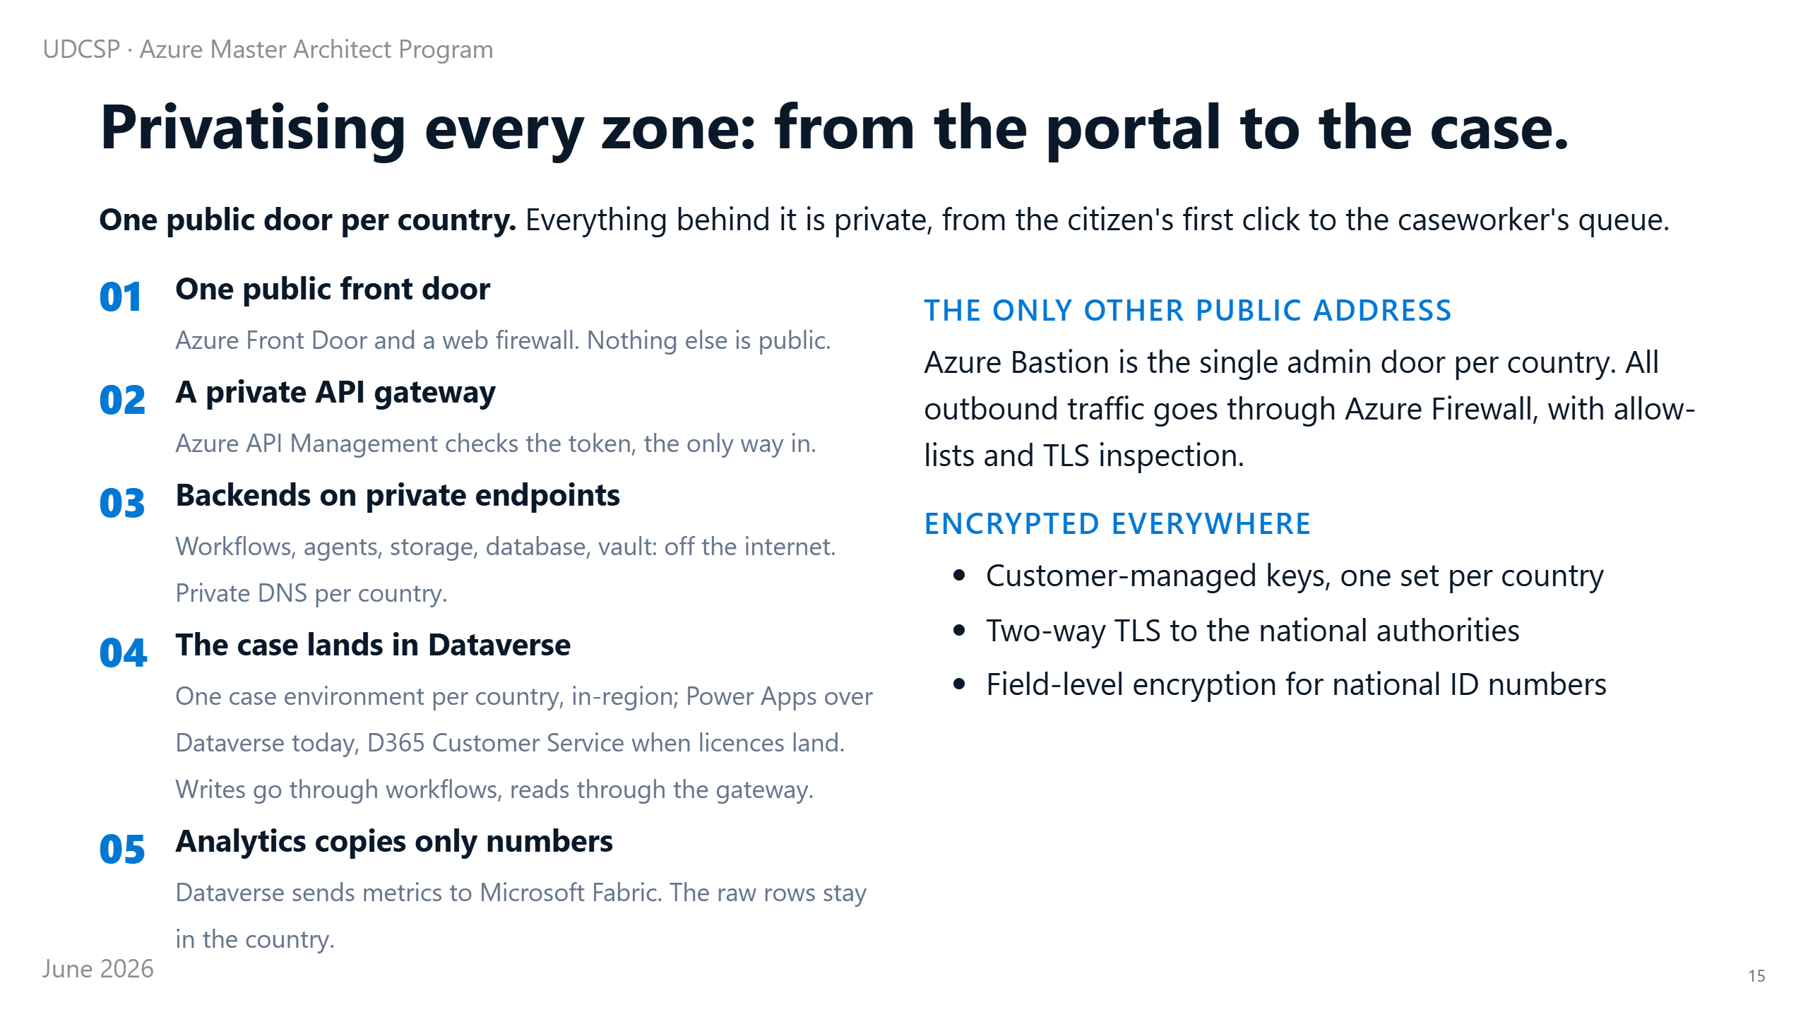
Notes:
⏱ 0:55 · Now to that promise: the whole path is private. It works as a chain.
The only public entry is Azure Front Door, with a web firewall in front. Nothing else has a public address.
Behind it a private gateway checks the token. The workflows, the agents, the storage, the database, and the secret vault all sit off the internet on private connections.
For analytics we never copy the real records out. We send only numbers, so the raw data stays home.
So from the first click to the caseworker's queue, nothing travels in the open, and it is encrypted the whole way. The one piece that does reach the outside world deserves its own slide.

Slide 16
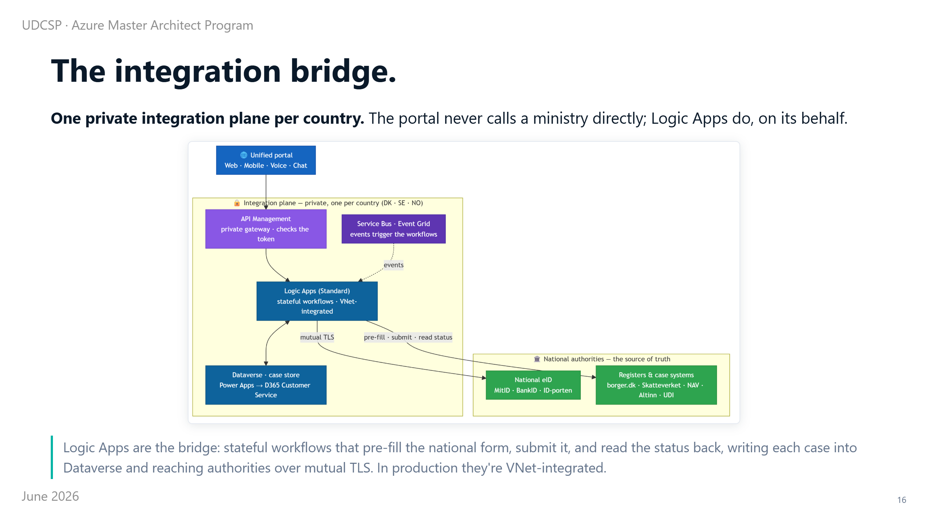
Notes:
⏱ 0:50 · That piece is the integration plane, and it runs on Azure Logic Apps.
A Logic App is just a workflow, a sequence of steps the platform runs for the citizen. Here each one pre-fills the right national form, submits it to the authority, and reads the decision back.
The portal never calls a ministry directly. The Logic App does, and it writes every case into Dataverse, our case data platform.
In the live demo that case store runs in degraded mode: Dataverse surfaced through a Power App. It becomes full D365 Customer Service when the licences land.
It is private by design: in production the workflows run on the country's own private network, and reach each authority over mutual TLS, where both sides show a certificate before any data moves.
It is event-driven too: a message on the event bus triggers the right workflow, while the private gateway stays the only checked way in. One plane like this per country; that whole private network looks like this.

Slide 17
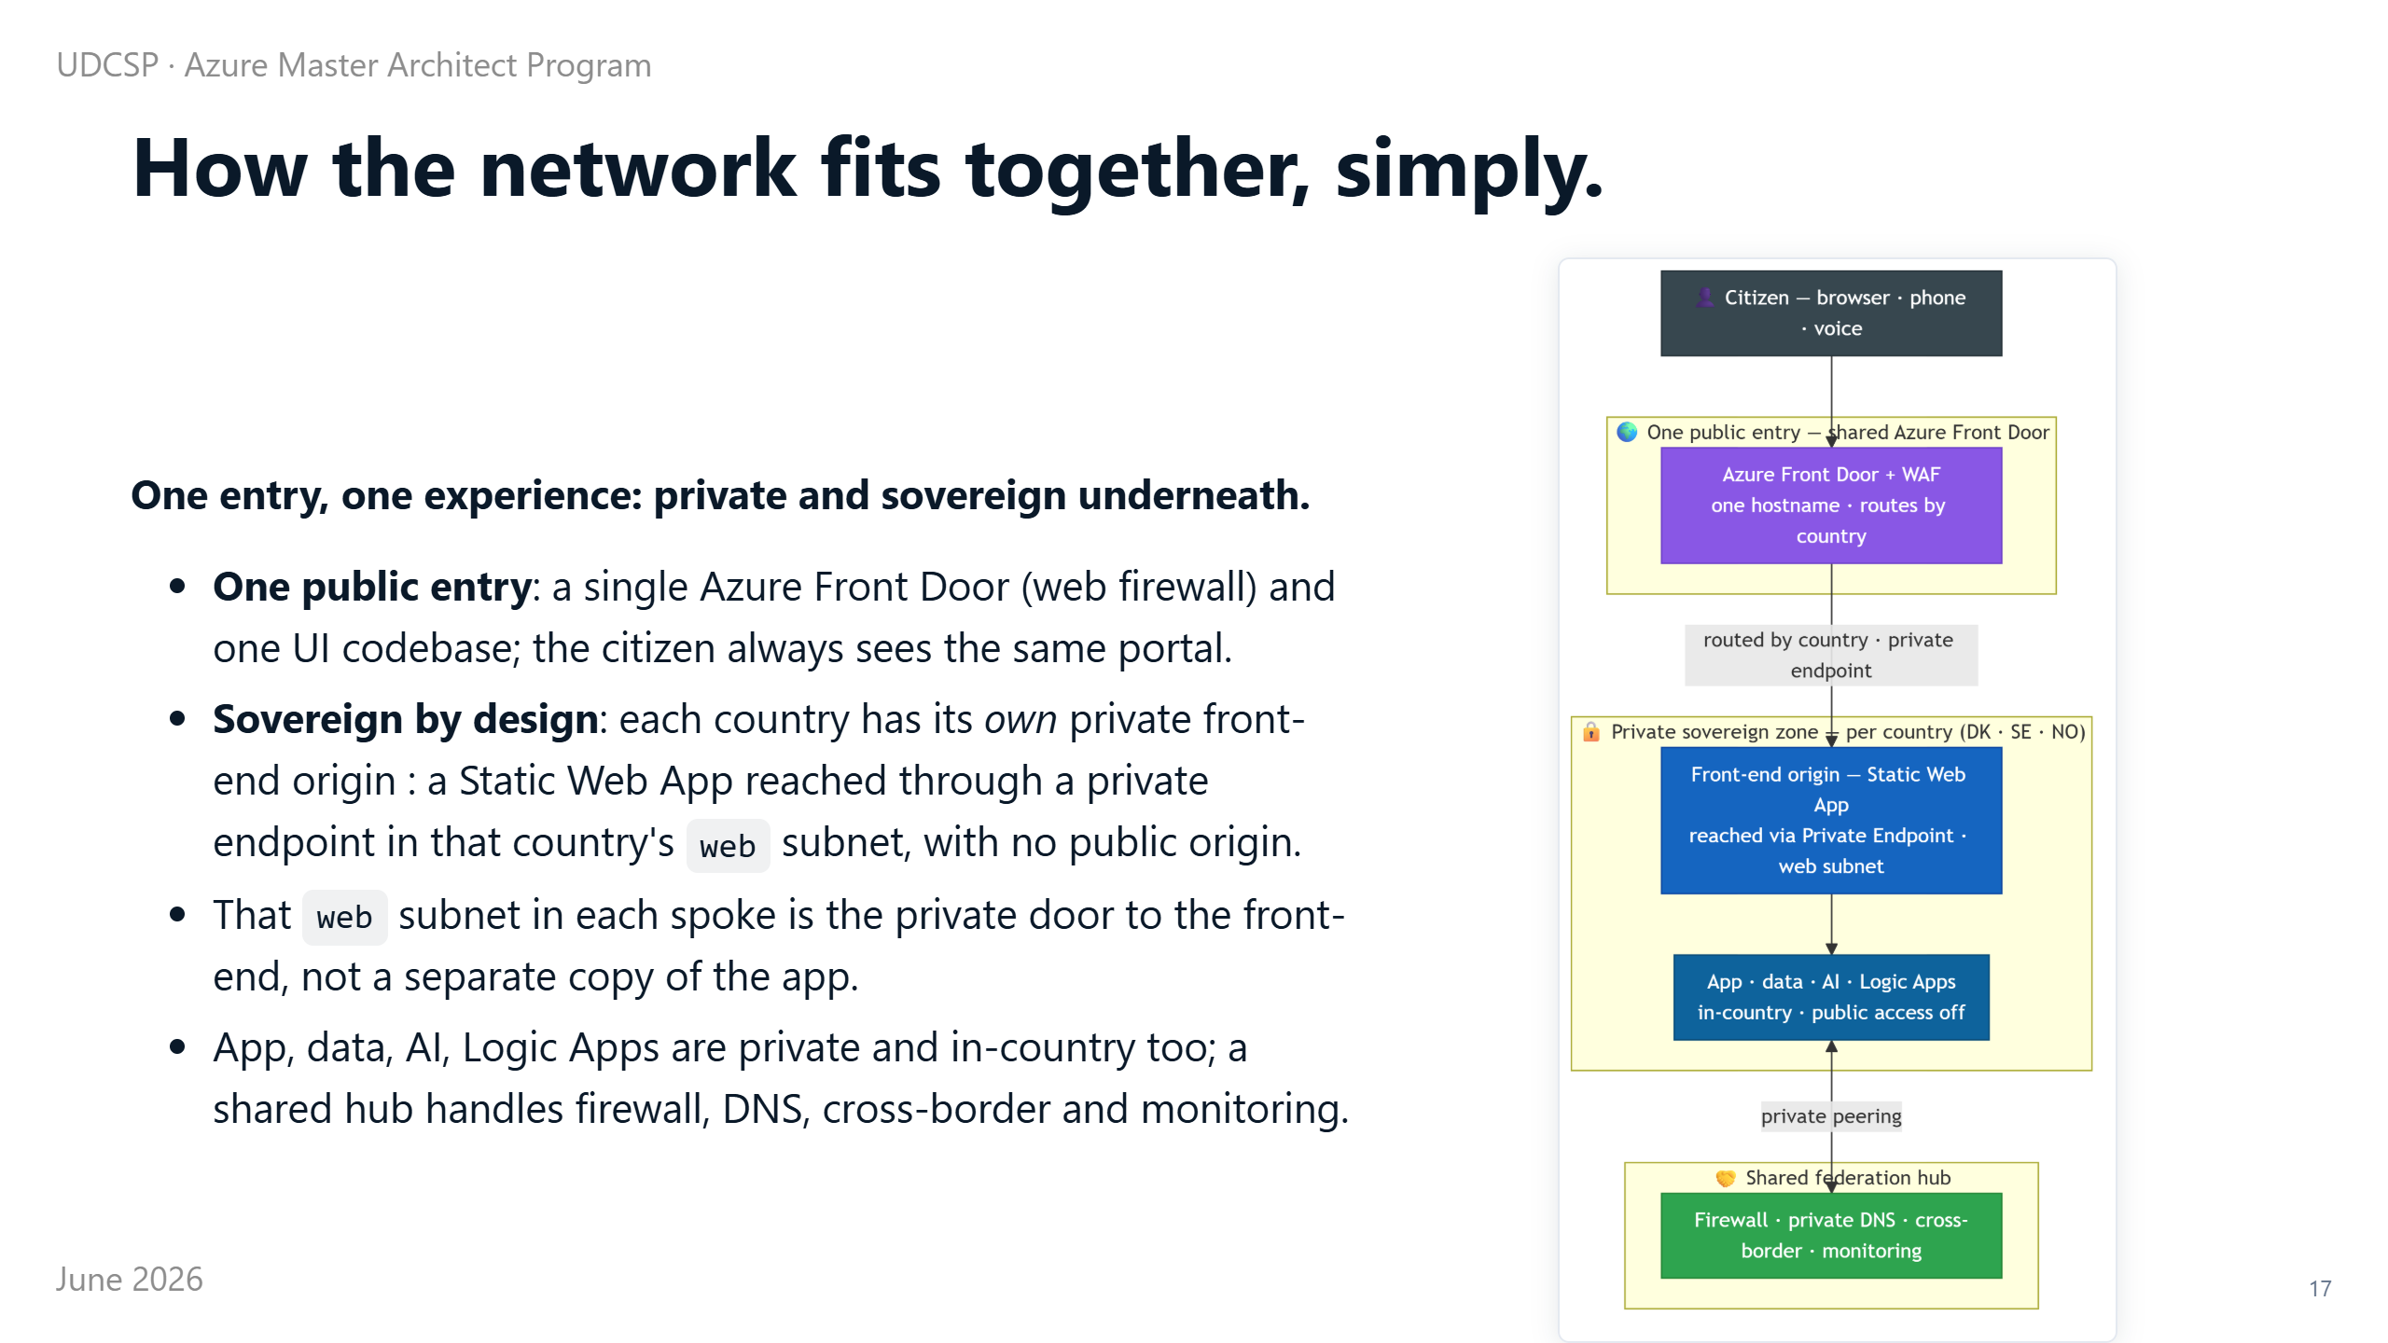
Notes:
⏱ 0:45 · Before the detailed map, here is the simple idea.
There is one shared front door and one user interface, so the citizen always sees the same portal.
But for sovereignty, each country has its own private front-end: a Static Web App with public access off, reached only through a private door in the country's web subnet.
So that web subnet is just the private door to the front-end, not a second copy of the whole application.
App, data, AI and the Logic Apps are also private and in-country. A shared hub handles the firewall, the private DNS, cross-border routing and monitoring.
To get this right we leaned on patterns the industry already trusts. The full network map is in the annex.

Slide 18
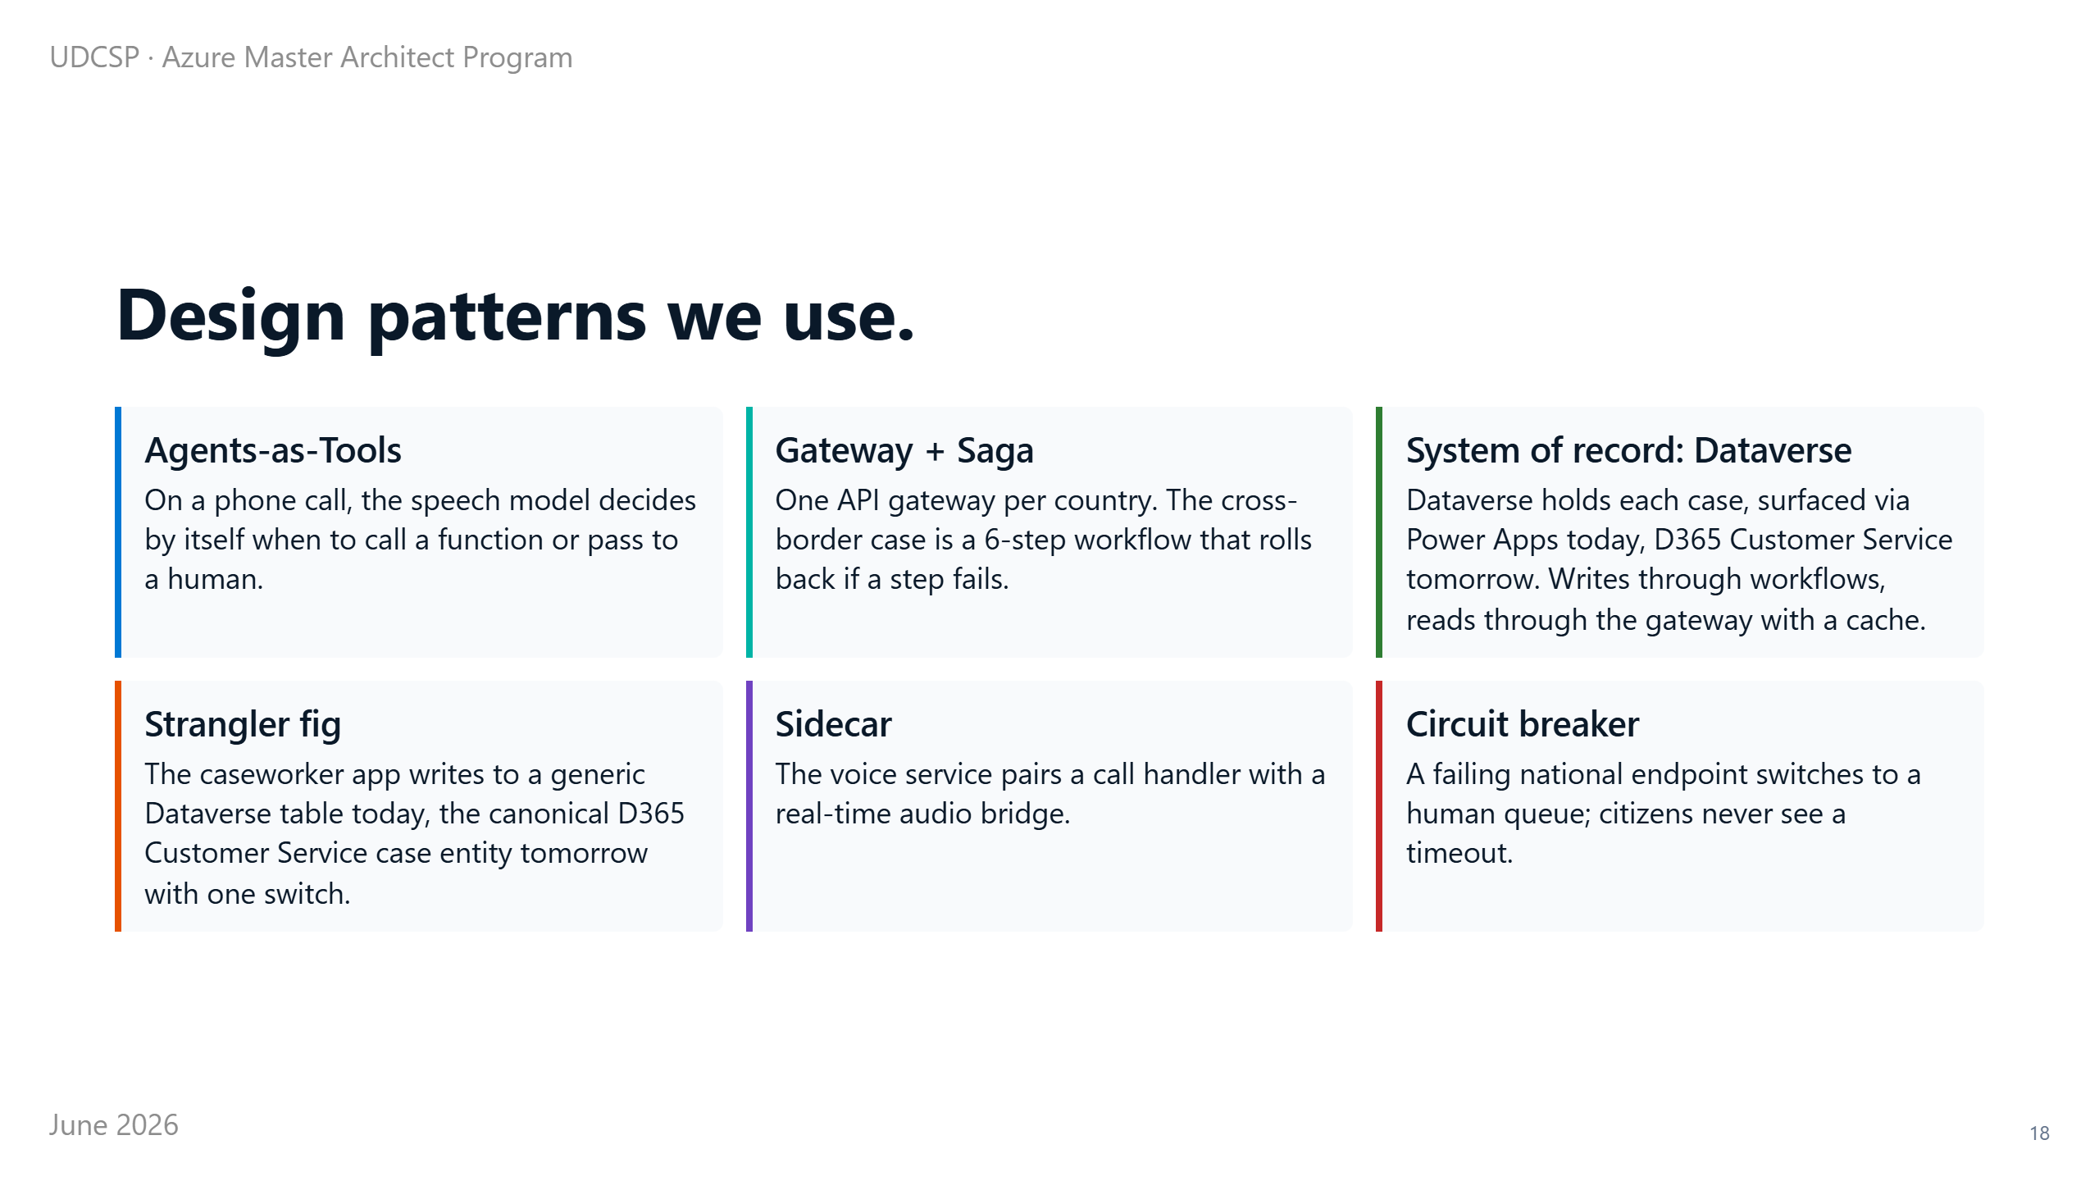
Notes:
⏱ 1:00 · Six patterns shaped the platform.
On the phone, the AI decides for itself when to look something up or hand the call to a human.
A cross-border case runs as a series of steps that can undo themselves if one fails, so a request never gets stuck half-done.
Dataverse stays the single source of truth for every case: a Power App today, D365 Customer Service when the licences land. We can swap pieces later without breaking anything.
And if a national service goes down, a safety switch sends the citizen to a human queue instead of an error.
None of this is exotic. Proven patterns, applied with care. With the body of the platform covered, let's look at its mind.

Slide 19
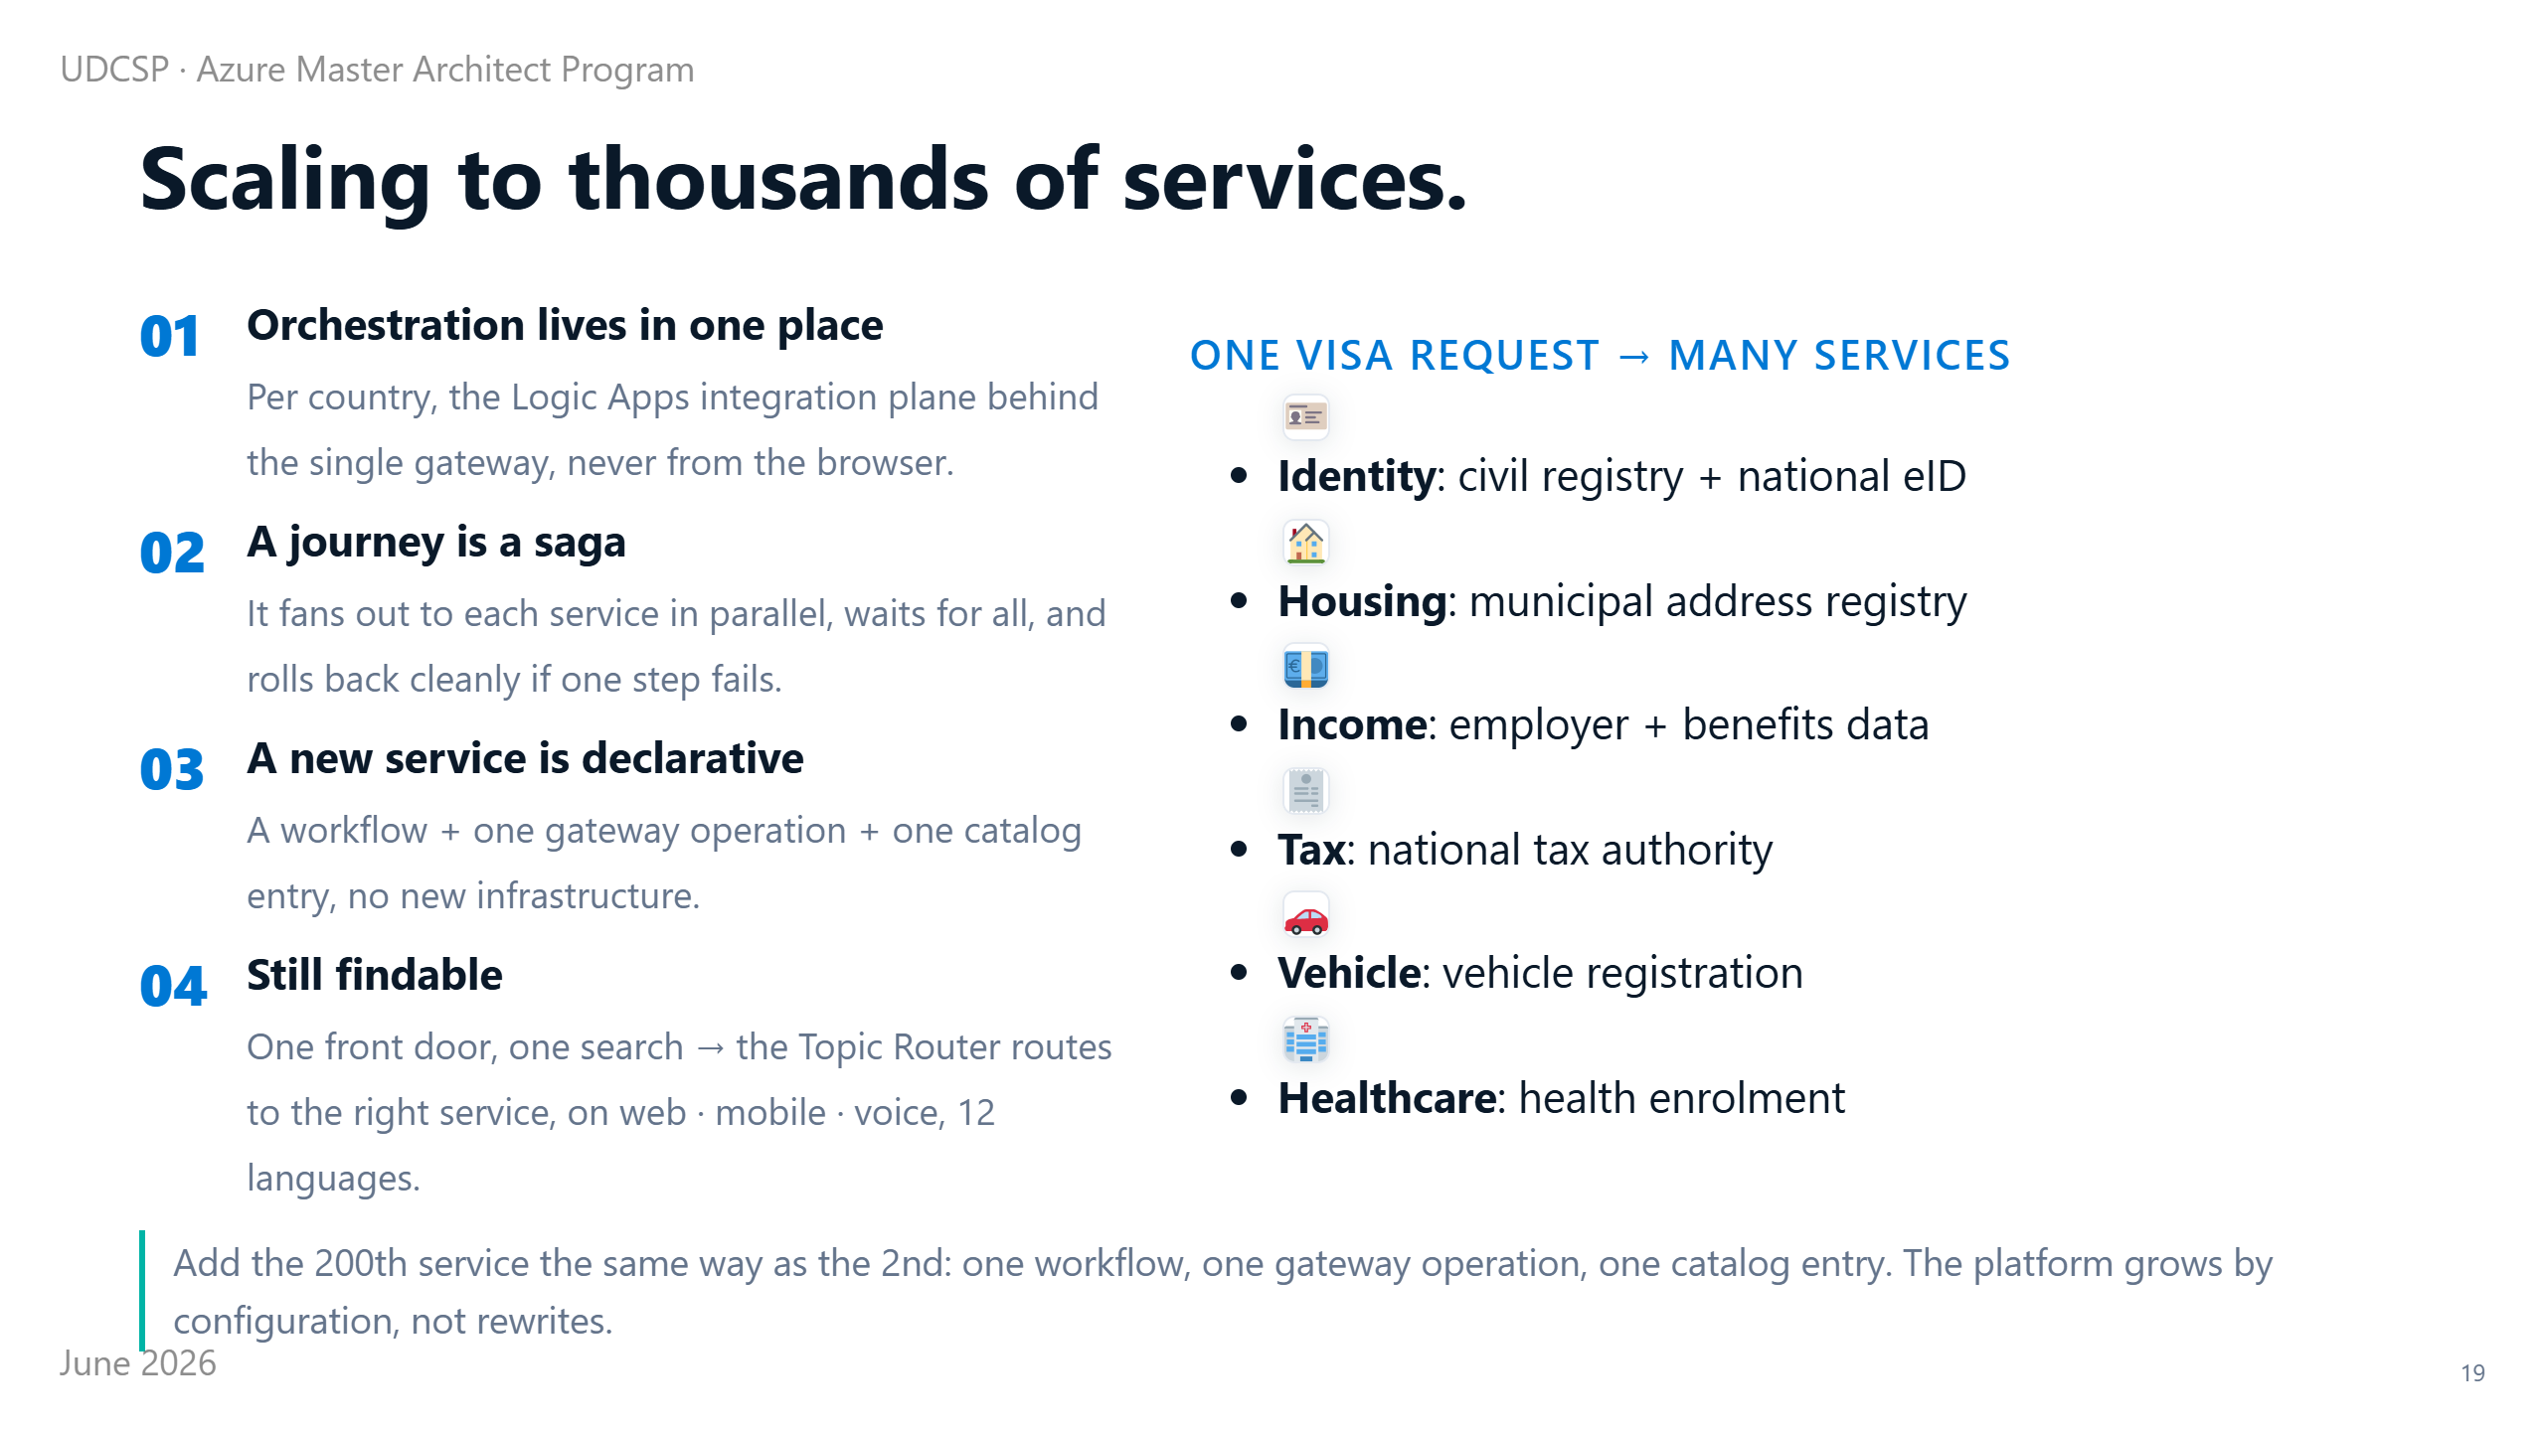
Notes:
⏱ 0:55 · A fair question: real government has thousands of services, not five. And one request can start many at once. A visa case needs identity, housing, income, tax, health and vehicle records, from six agencies.
So where does the orchestration happen? In one place per country: the integration plane, behind the single gateway. Nothing orchestrates from the browser.
A journey runs as a saga. It fans out to each service in parallel, waits for all, and rolls back cleanly if one step fails.
Adding the next service is small. A new declarative workflow, one gateway operation, one catalog entry, no new servers. The event bus wires it in.
And the citizen still finds it. One front door, one search: they type what they need, and the router sends them to the right service, on web, phone or voice, in 12 languages.

Slide 20
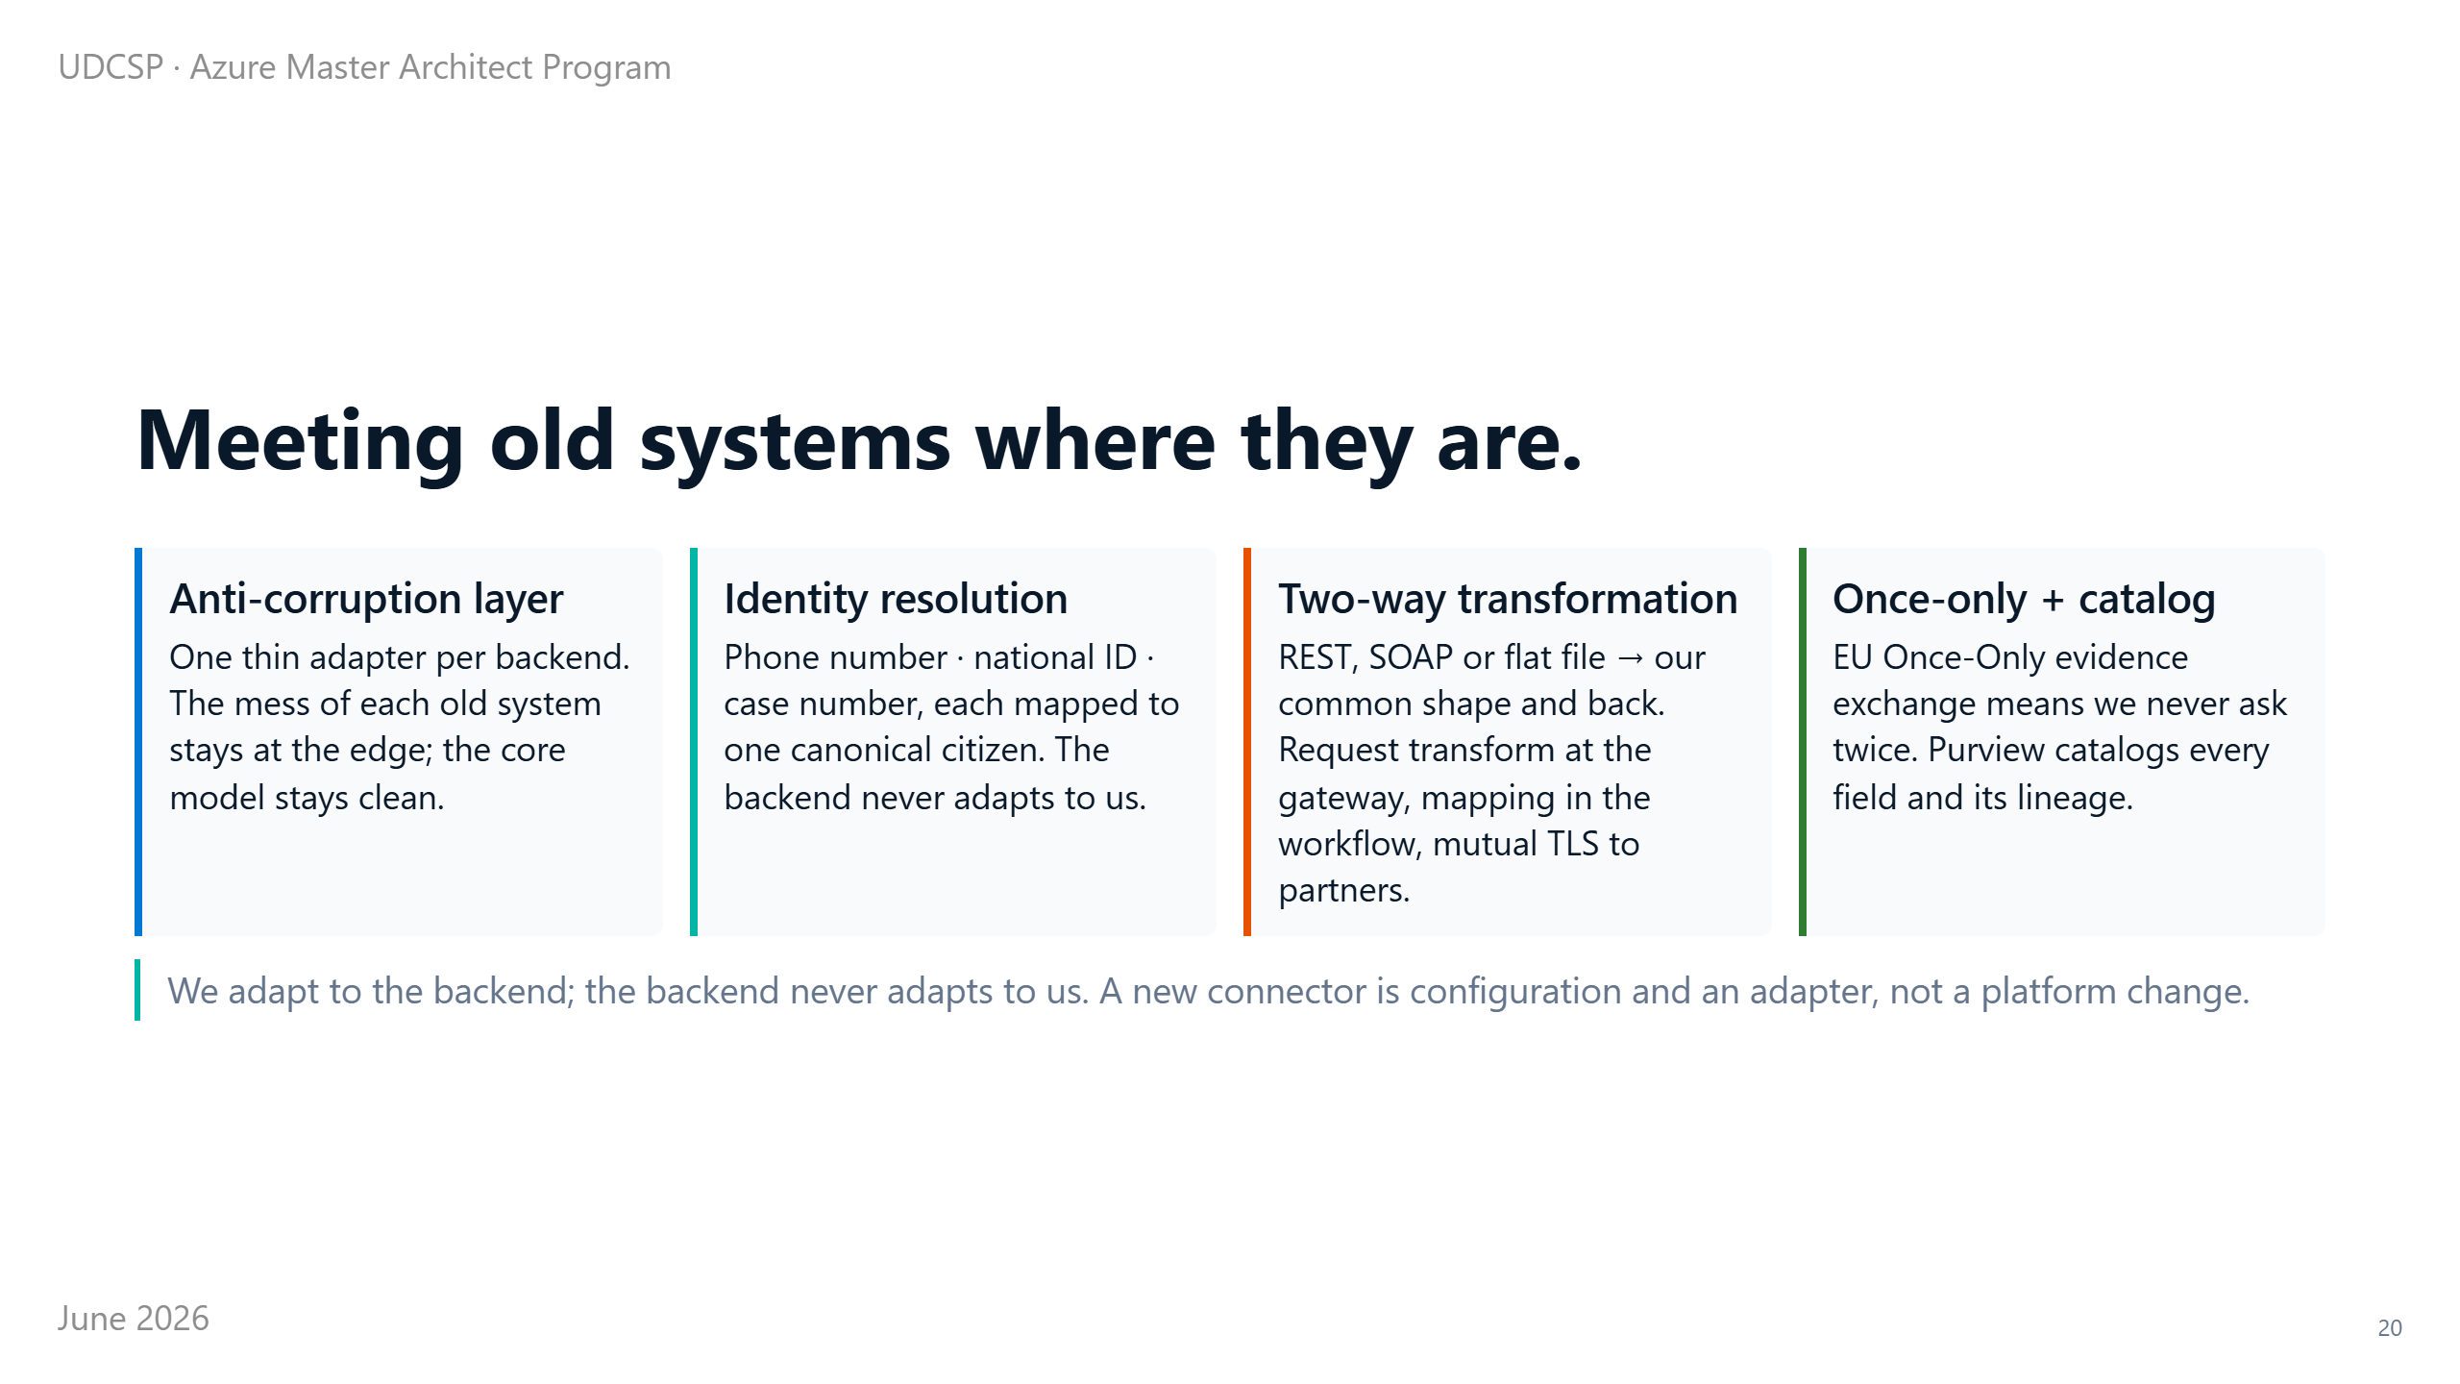
Notes:
⏱ 0:55 · Now the harder half. These backends are old, and they do not match each other. One system knows you by your phone number, another by your national ID, a third by a case number.
We do not ask them to change; we adapt to them. Each backend gets its own adapter: a thin layer that speaks its language, REST, SOAP or a flat file, over its own secure link.
The adapter does two jobs. It maps each system's identifier to one shared citizen profile. And it transforms their format into our common shape, both ways.
So the platform stays clean inside, while the mess stays at the edge. And by the once-only rule, data we already hold is never asked for twice. Purview catalogs every field and where it came from.

Slide 21

Notes:
⏱ 0:12 · At the centre of everything is the part we call the brain.
This is where the AI lives. It is built as one governed system, not a pile of separate chatbots.

Slide 22
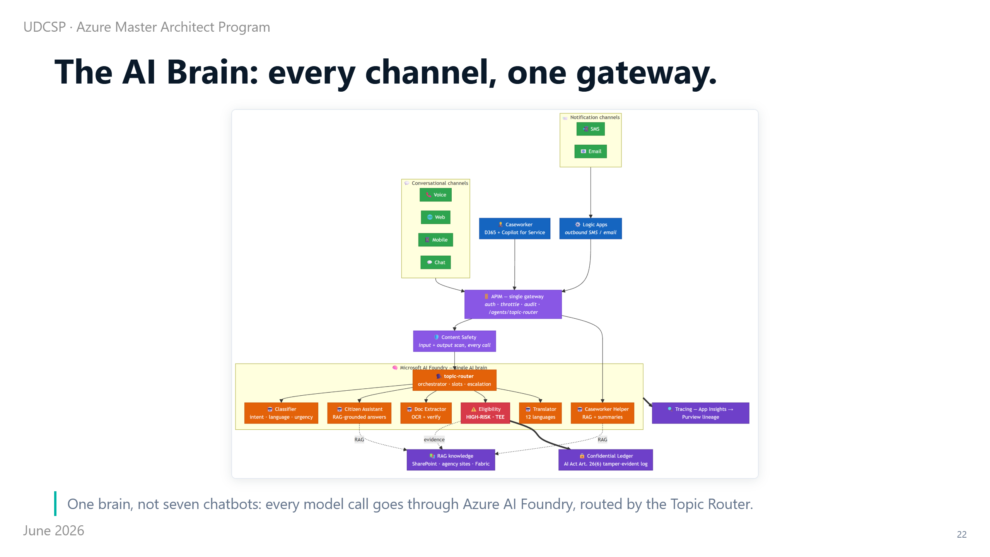
Notes:
⏱ 1:05 · At the centre of everything is one governed brain, shown here end to end.
Every AI request passes through a single place: Azure AI Foundry, Microsoft's platform for building and running AI agents. So safety, quality, tracing and the AI Act records all live in one spot.
Every channel comes in on the left: the website, the phone, the mobile app, the chat, even the caseworker's screen. They all enter through one door, the API Management gateway, which handles sign-in, rate limits and the audit log. No channel ever calls a model on its own.
From there, every message is scanned by Content Safety, on the way in and on the way out. Then the Topic Router picks the right specialist.
One of them, the eligibility agent, is the only high-risk part under the EU AI Act. It runs in a sealed enclave with a tamper-proof record. I'll come back to why.
The whole brain is copied into each country, so the conversation stays home, just like the data. Now let me trace one real request through it.

Slide 23
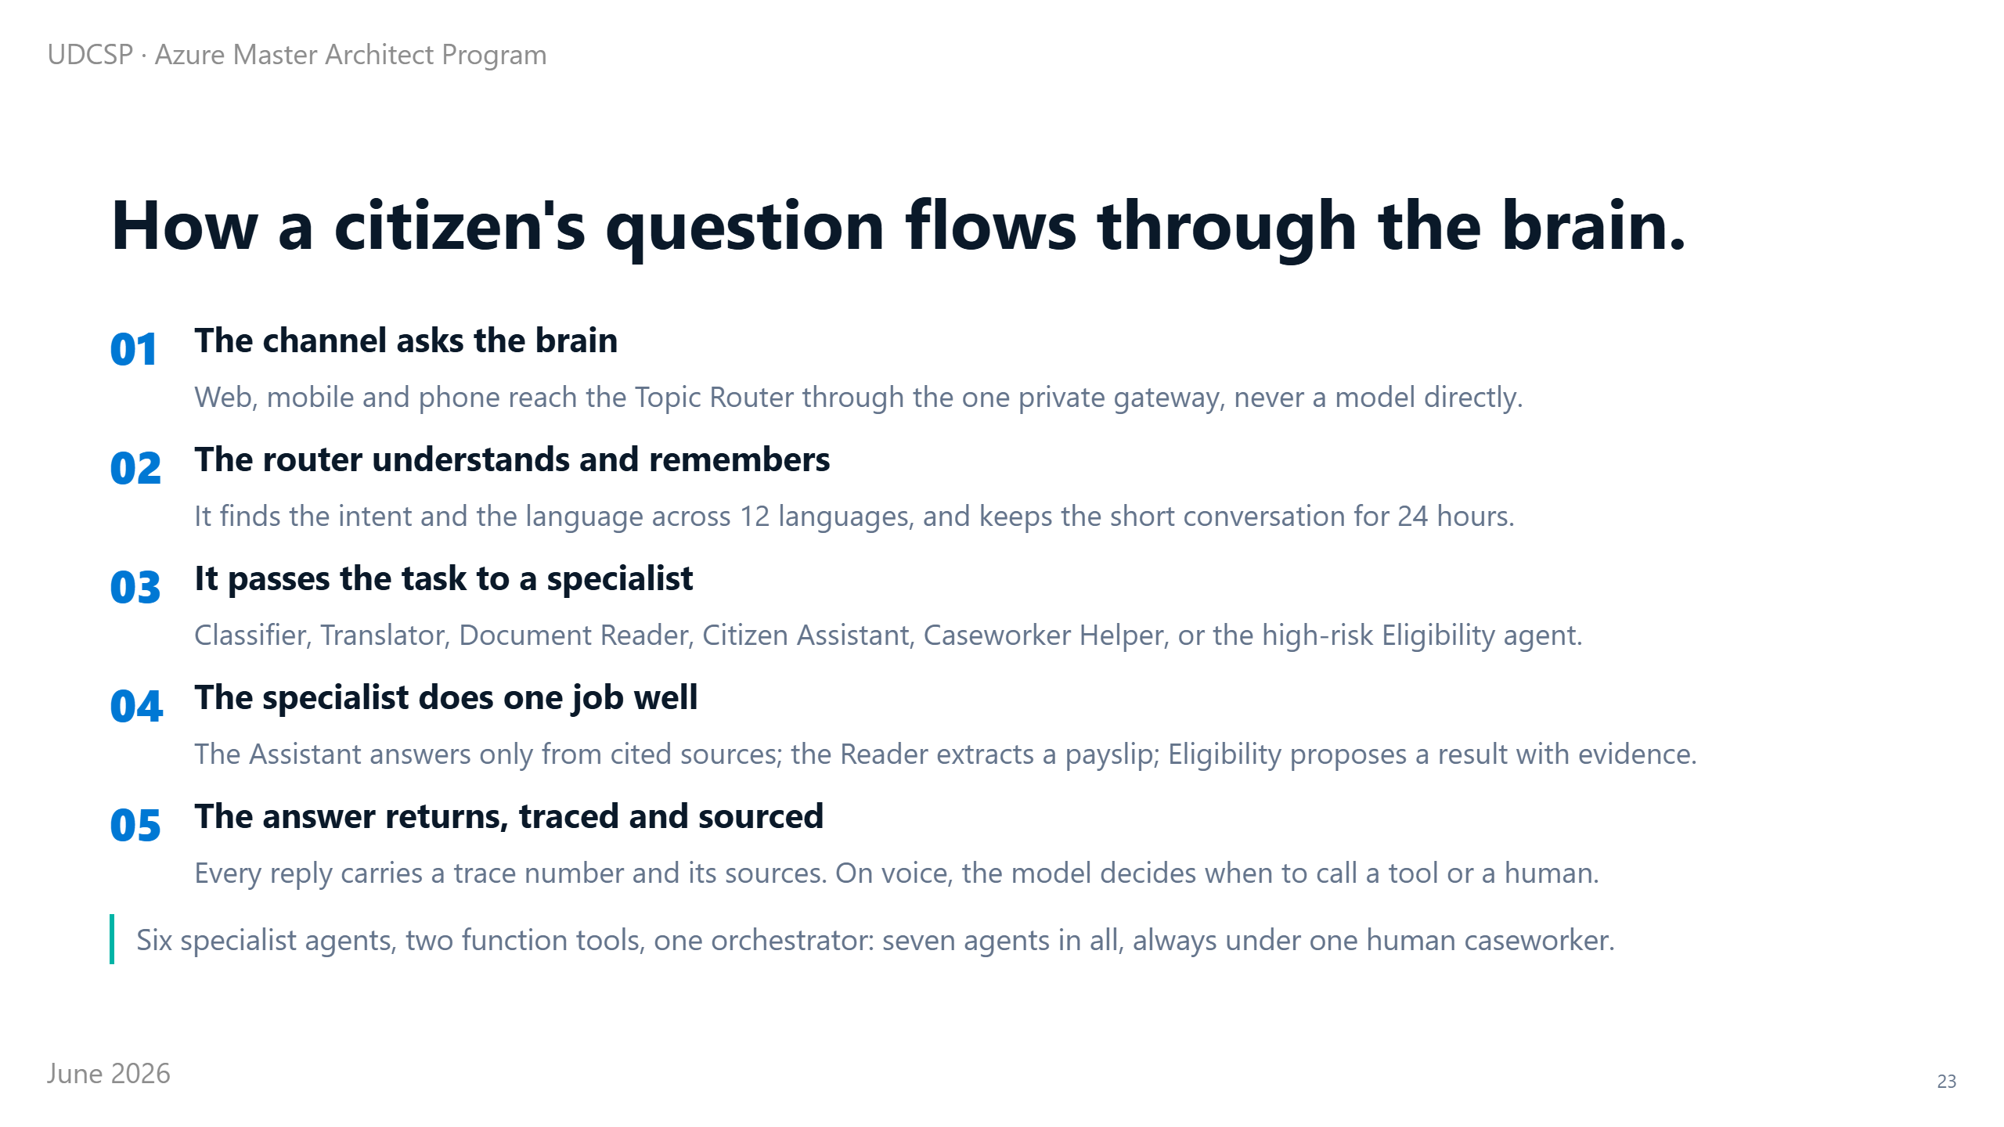
Notes:
⏱ 0:55 · Now that one request, step by step.
The router has already read the intent and the language, so here it just chooses who does the work.
A payslip goes to the document reader, which pulls out the numbers. A general question goes to the assistant, which answers only from official, cited sources, never from imagination. A residency case goes to the eligibility agent, which proposes an answer with the reason for every rule it applied.
Whatever comes back carries a trace number and its sources, so it can always be explained later. That trace number will come up again in the compliance section.
First, let me show you the agents themselves.

Slide 24
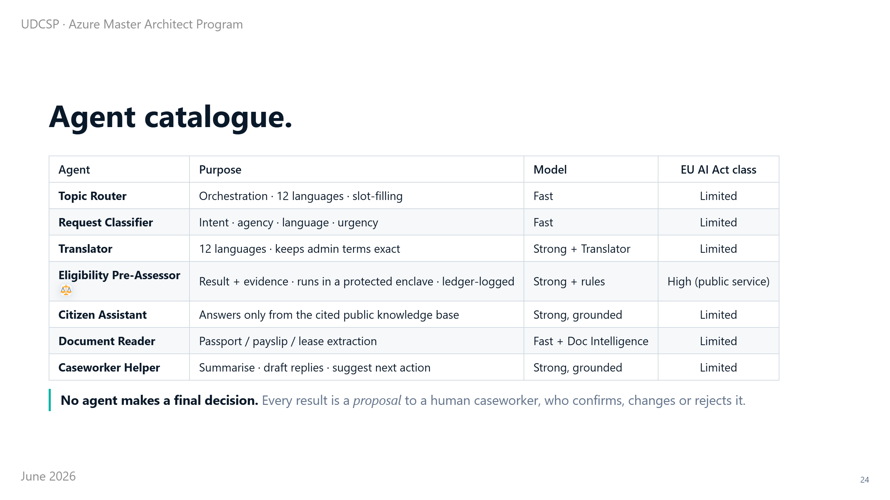
Notes:
⏱ 0:55 · There are seven agents in all, and the law treats them differently.
Most only sort, translate, or answer from public information. Under the European AI Act they count as limited risk.
One does not: the agent that pre-assesses eligibility. Because it affects access to an essential public service, the AI Act classes it as high risk.
So we handle it differently. It runs in a sealed, protected enclave, and every answer it gives is written to a record that cannot be altered.
And it never has the final word. Whatever it proposes is only a suggestion to the caseworker, who confirms it, changes it, or rejects it.
One agent deserves a closer look, because it shows the AI acting on its own.

Slide 25
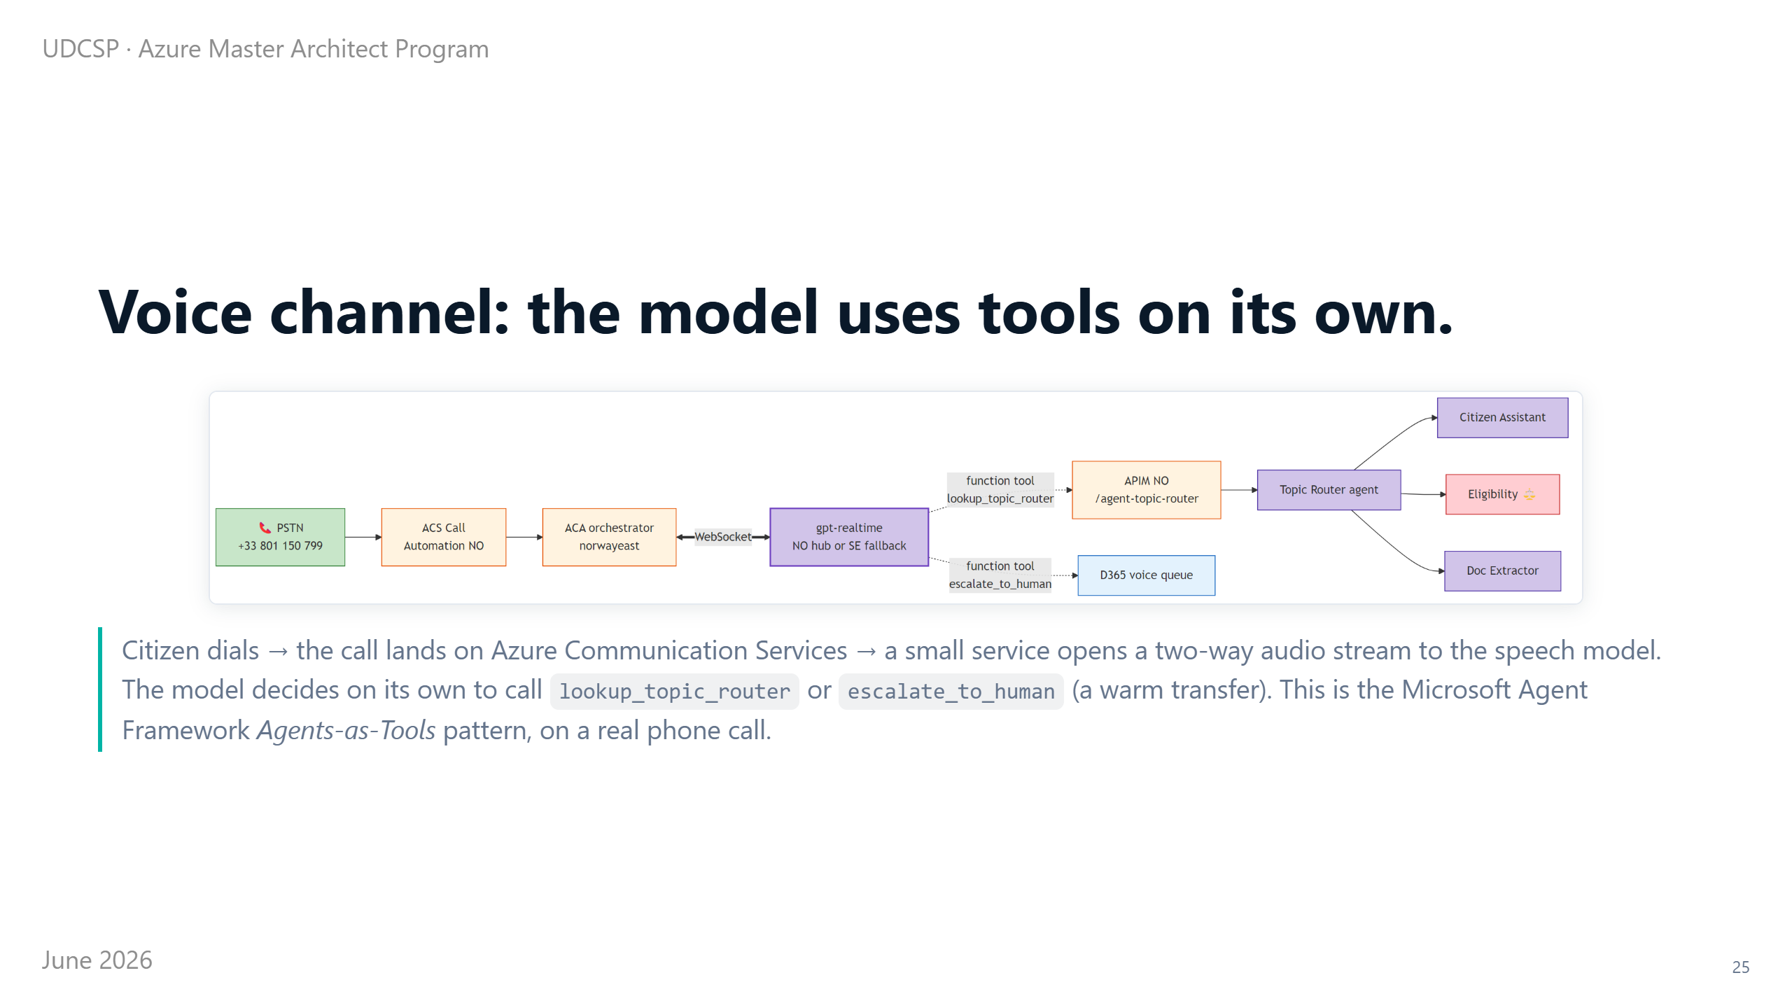
Notes:
⏱ 0:55 · That's the voice channel, the one a blind citizen uses by phone.
The call lands on Azure Communication Services, and we open a live, two-way audio link to a speech model. From there, the model runs the conversation itself.
When it needs information, it decides, on its own, to call into the brain. And when the caller needs a person, it decides, on its own, to transfer them warmly to a human.
We did not script that with rigid rules. The model chooses turn by turn.
It is the direction the whole industry is moving, and here it already works on a real phone line you could call today. Because that eligibility agent carries real weight, its model needs special care.

Slide 26
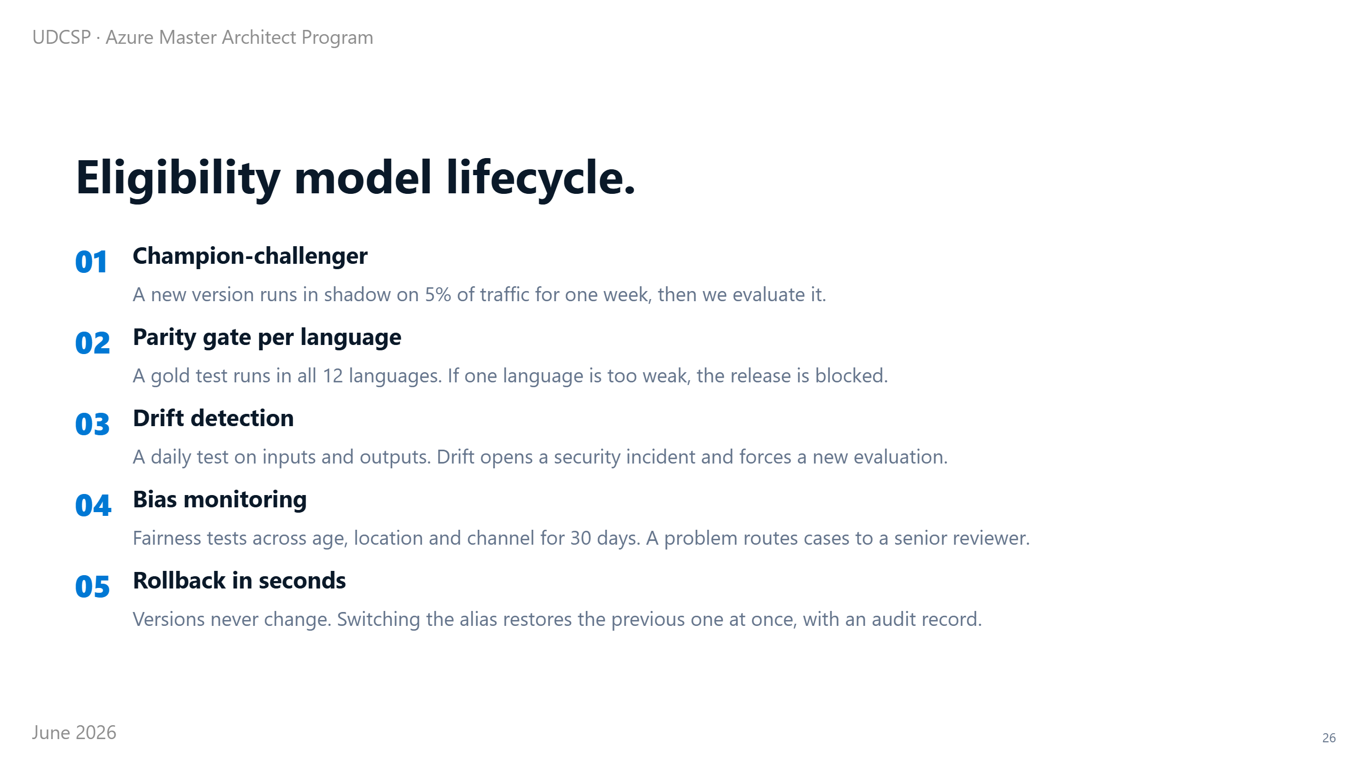
Notes:
⏱ 0:55 · We don't just deploy a new version of it and hope.
A new version first runs silently beside the old one, on a small slice of traffic, with no effect on real citizens, until we are sure it is better.
We test it in all 12 languages. If even one is weaker, it does not ship.
Every day we check whether the data has shifted under it, and any shift raises an alarm. Over a month, we check it treats people fairly across age, place, and channel.
And if anything ever goes wrong, we roll back to the previous version in seconds, with a full record. Beyond any single agent, these agents also work together as a team.

Slide 27
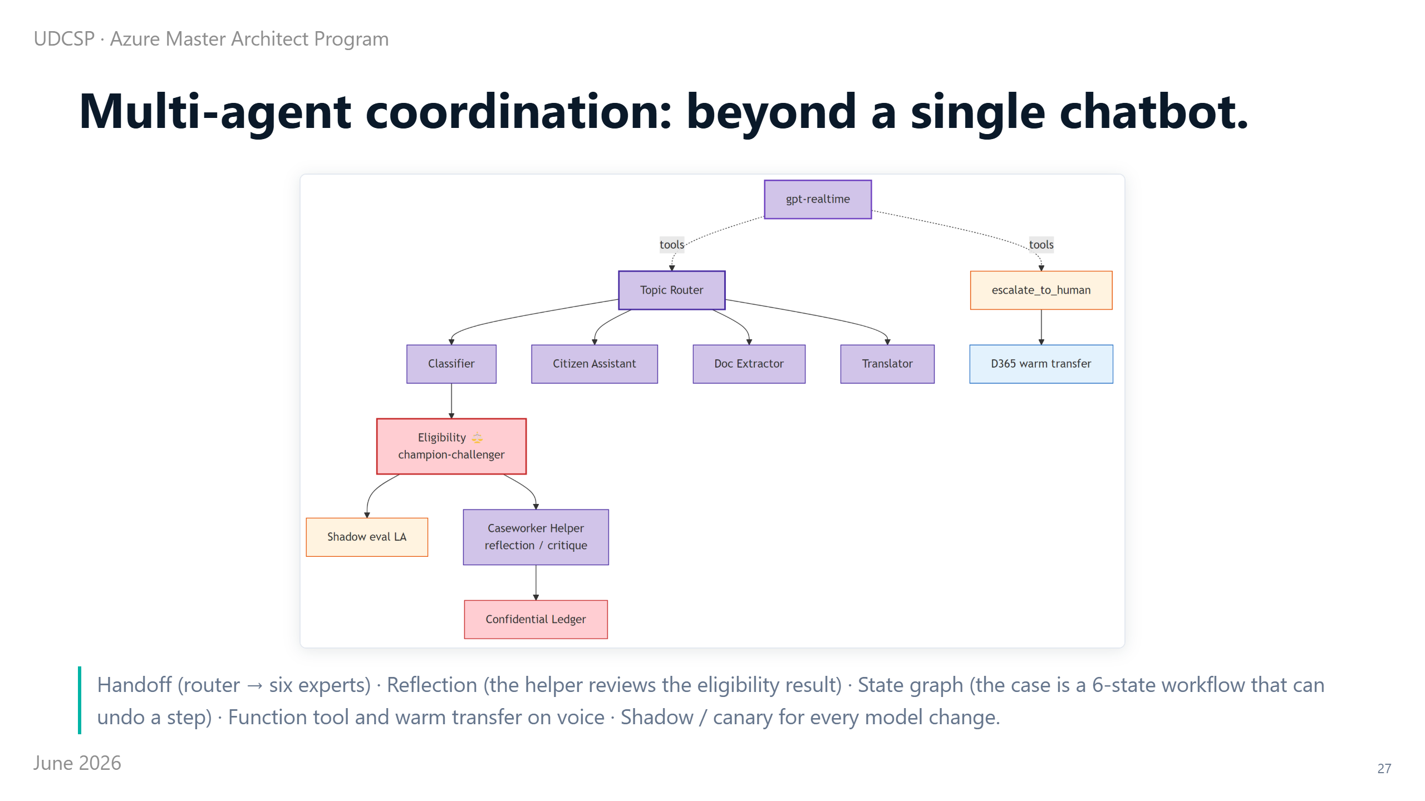
Notes:
⏱ 0:50 · This is what makes it more than one chatbot.
The router hands work off to the specialists. A helper reviews the eligibility answer, like a second pair of eyes on the first.
A cross-border case moves through clear stages and can step backwards when needed. On the phone, the model reaches for tools and for humans.
And every model change is tested in the shadows before it goes live.
Hand-off, review, stages and tools are the building blocks of real agent teamwork, and they are all here. With the AI explained, the next question is whether you can trust it.

Slide 28
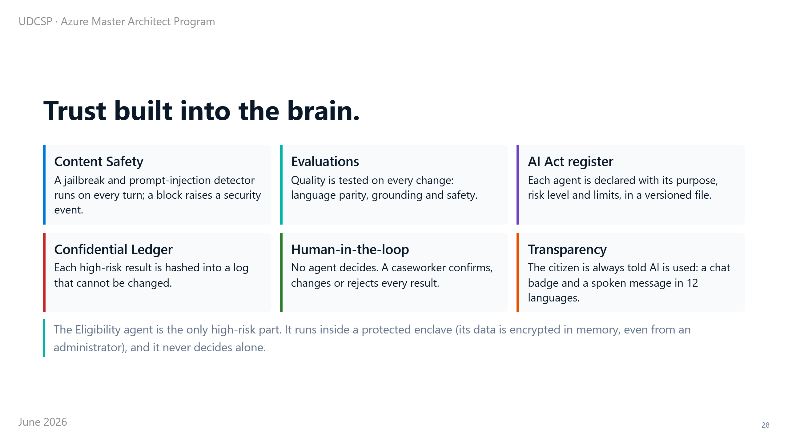
Notes:
⏱ 1:00 · Because this is AI making suggestions about people's lives, trust is built into the brain, with six guardrails.
Every message is screened for attempts to trick or jailbreak the model. Quality is tested on every change, in every language.
Each agent is officially declared in a register (its purpose, risk and limits), exactly as the AI Act requires. Every high-risk answer is sealed in a record that cannot be altered.
No agent decides alone. A human caseworker always has the final say.
And we never hide the AI. People are told, on screen and on the phone, in their language, that they are dealing with a machine. The high-risk agent even runs in a sealed enclave, where the data is protected from us, the operators, as well.
That leads straight into security and compliance.

Slide 29
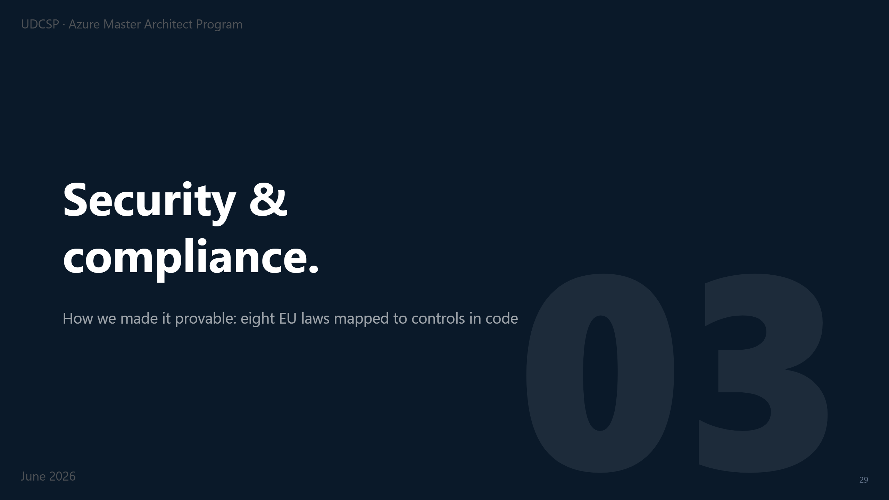
Notes:
⏱ 0:12 · For a government system, this is the part I care about most.
The goal was simple to say and hard to do: make every promise provable.

Slide 30
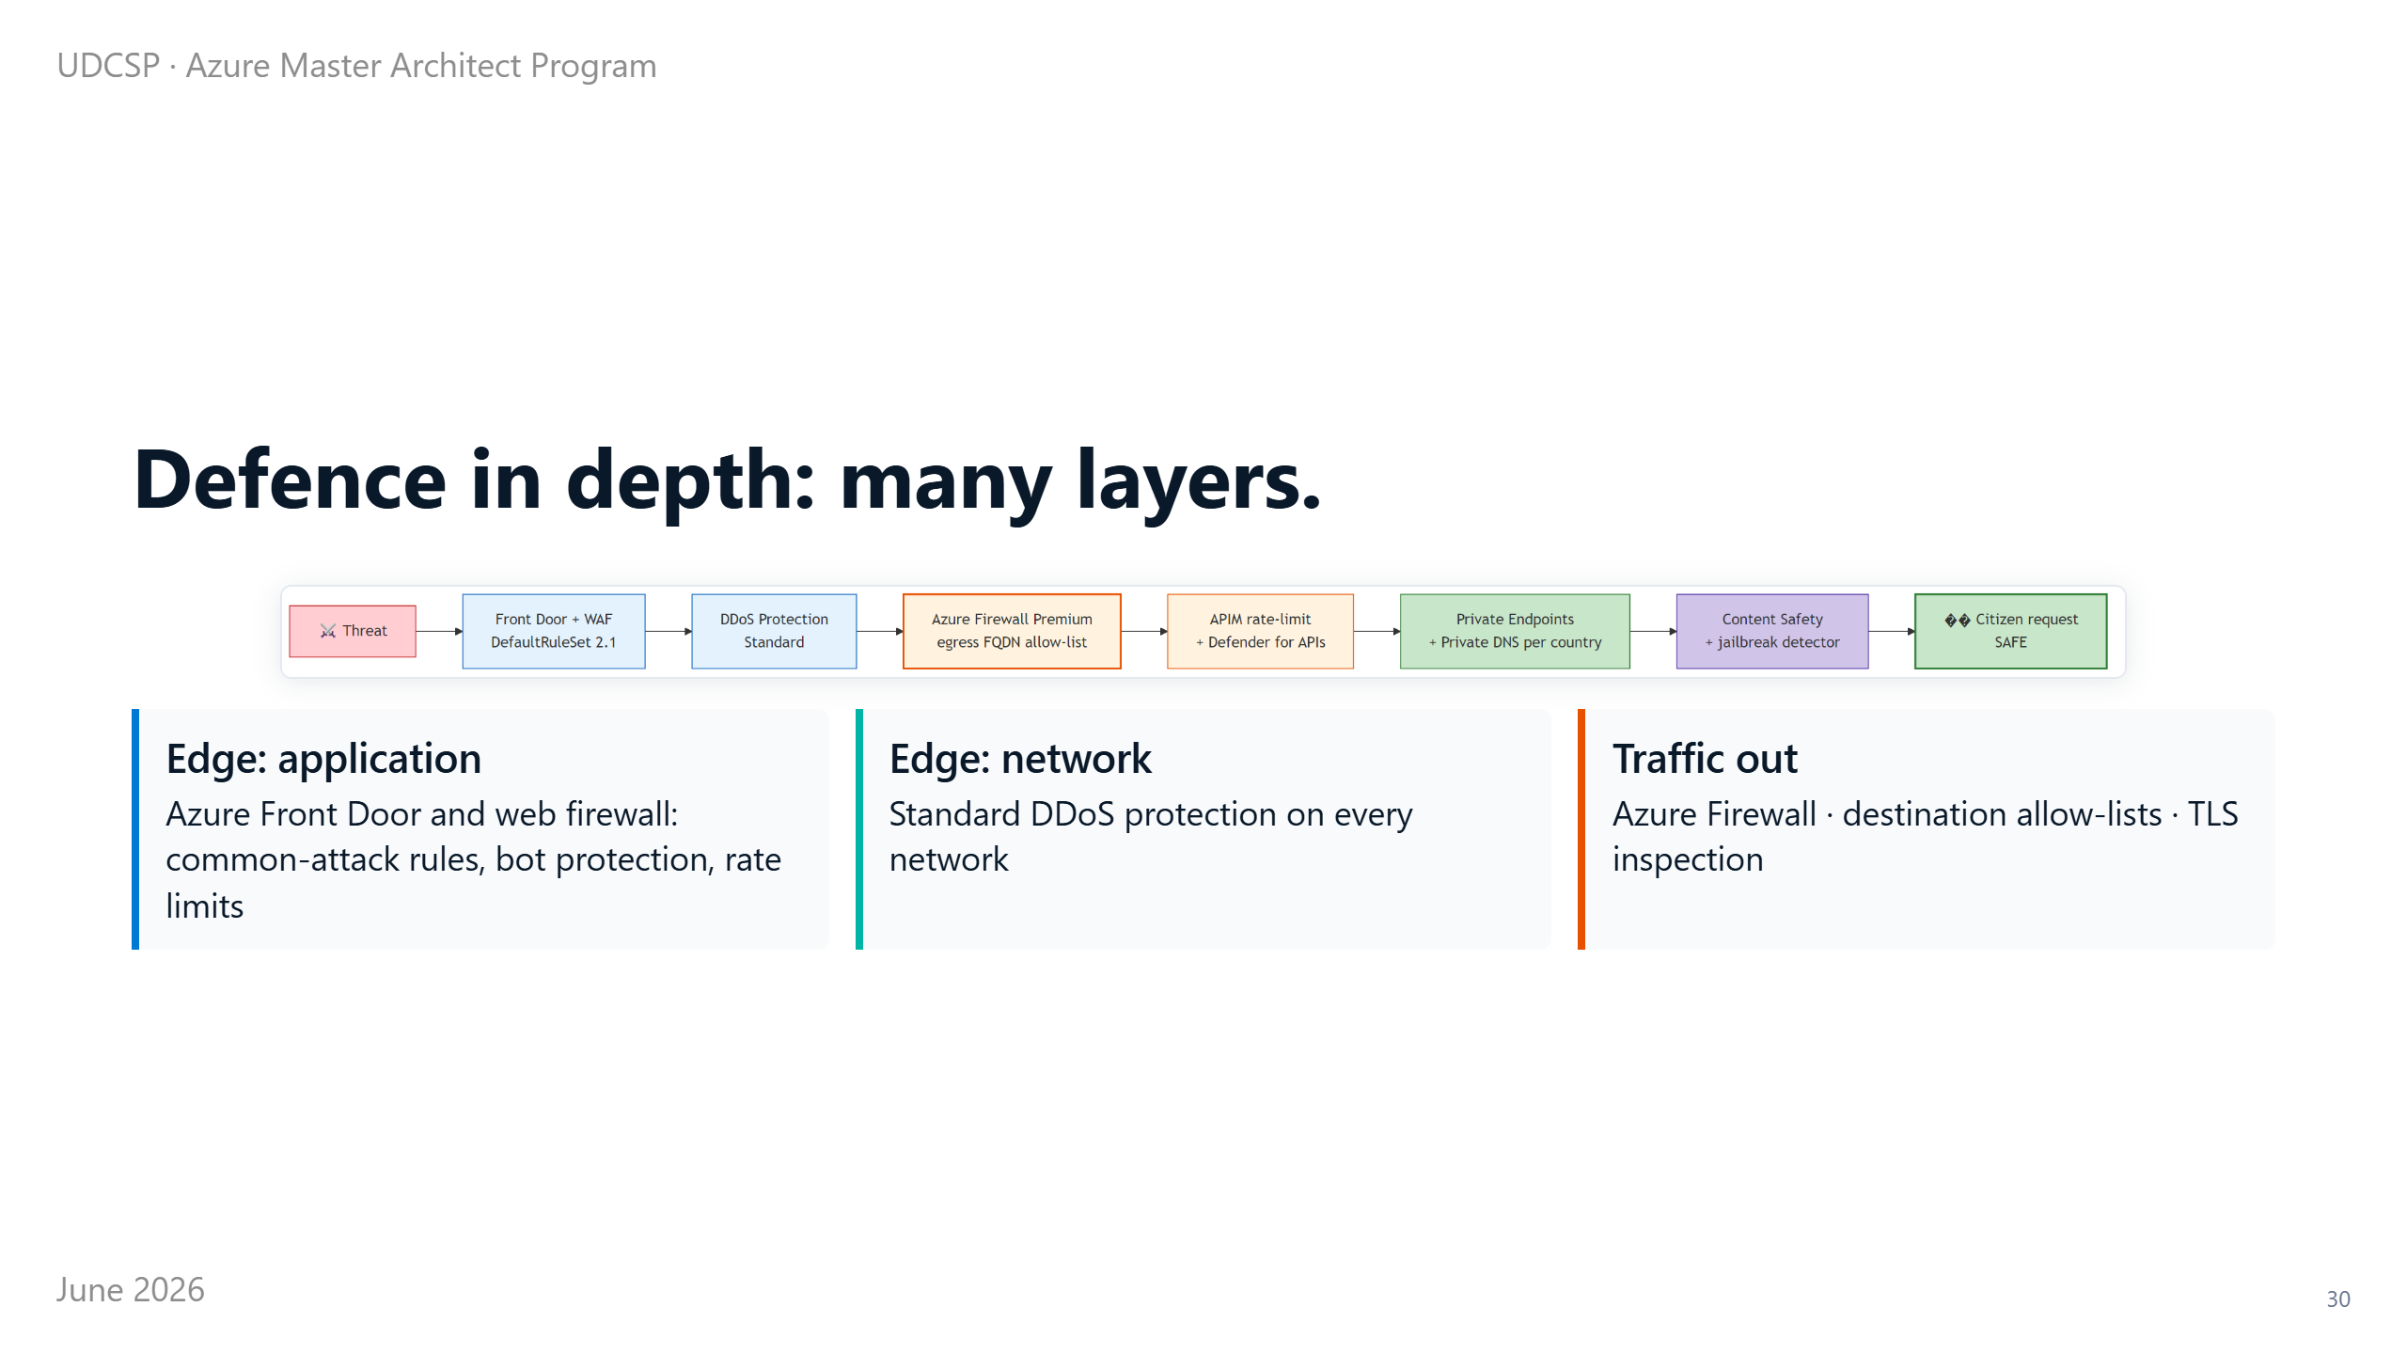
Notes:
⏱ 0:50 · On security, the rule was that no single wall should carry all the weight. So we built layers.
At the edge, a web firewall blocks the common attacks and the bots. Underneath it, there is protection against attacks that try to flood the network.
Anything leaving the platform is checked against a list of allowed destinations, so it cannot quietly phone home to a stranger.
And deep inside are the private connections, the identity checks, and the encryption already described.
If one layer ever fails, the next one still stands. Two of these layers deserve a closer look: identity, and where the data lives.

Slide 31
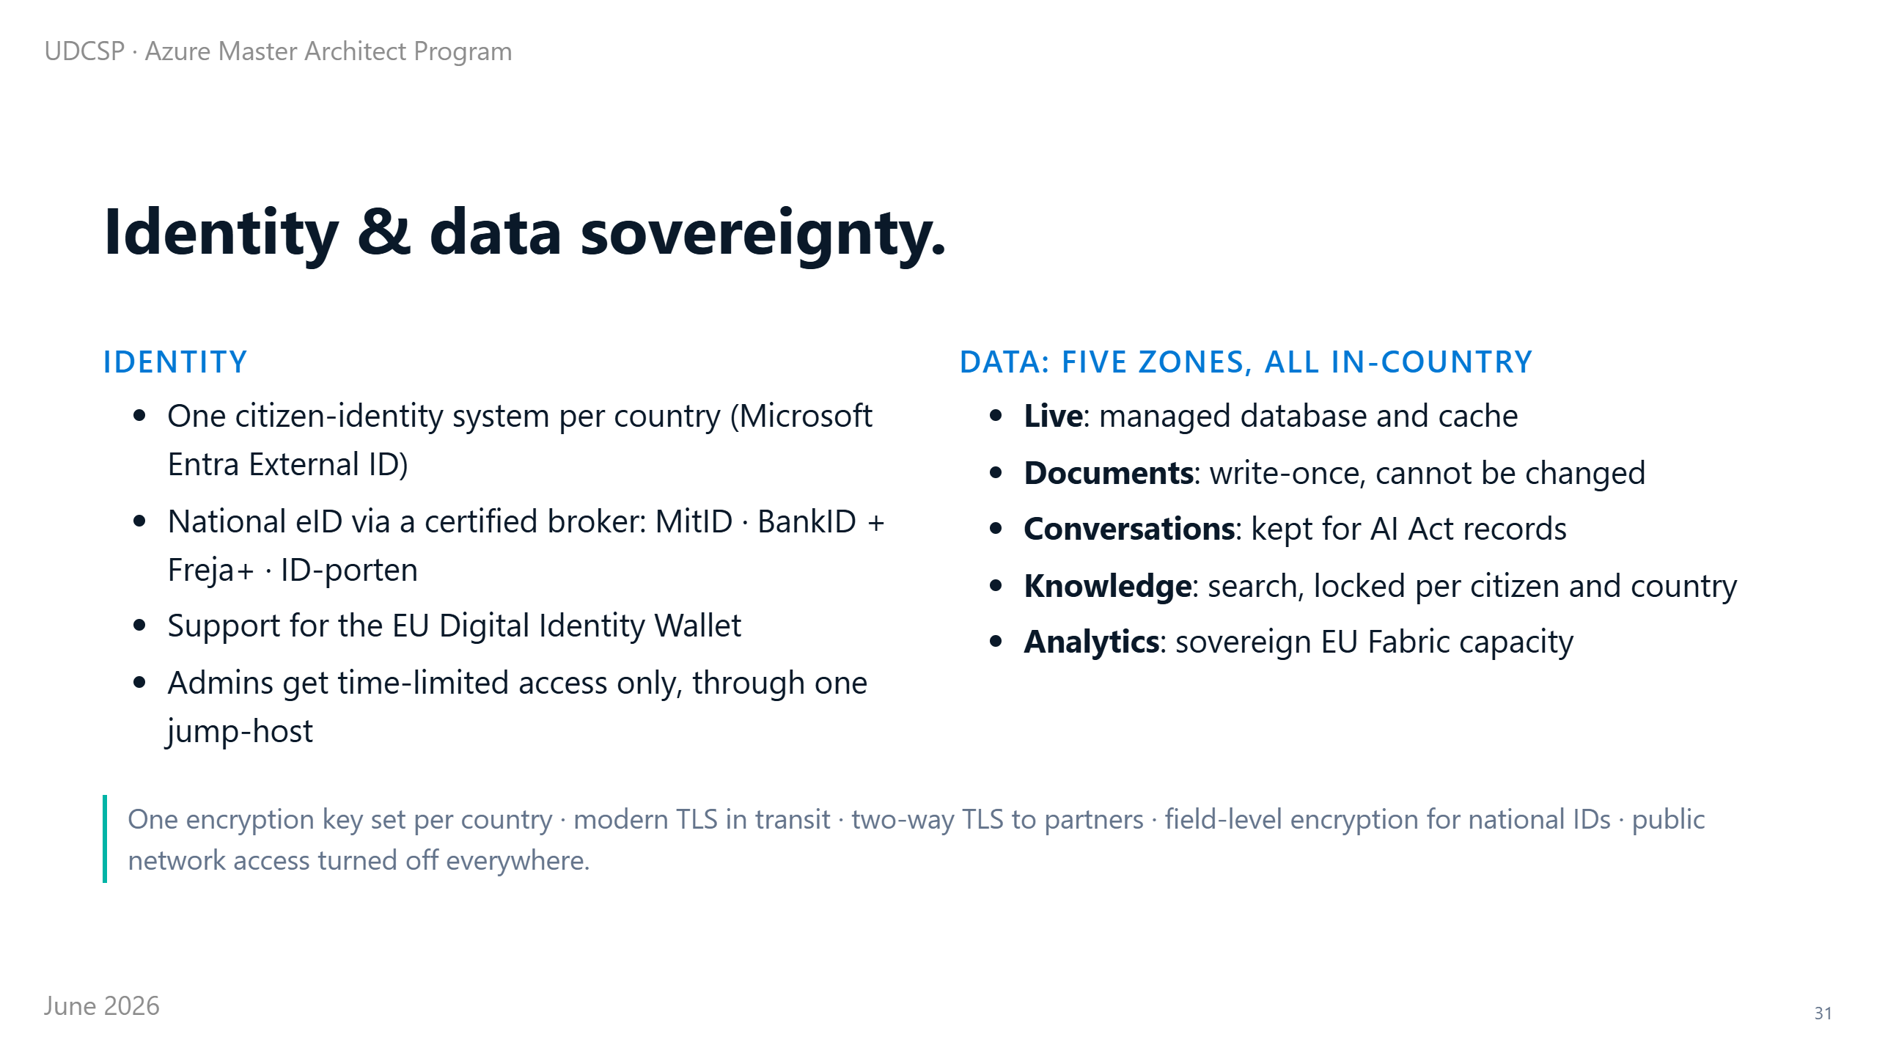
Notes:
⏱ 1:00 · Two things decide whether a system like this is trustworthy: who gets in, and where the data sits.
For who gets in, each country has its own identity system. People sign in with their national eID through a certified broker, so we never see a password. We also support the new European Digital Identity Wallet, for carrying identity across borders.
For where the data sits, everything stays in-country. The live record, the write-once documents, the conversations, the knowledge base and the analytics never leave.
Each country holds its own encryption keys, everything is encrypted in transit, and there is no public way into the data at all.
That is deliberate, not lucky. And it is only half the story; the other half is the law.

Slide 32
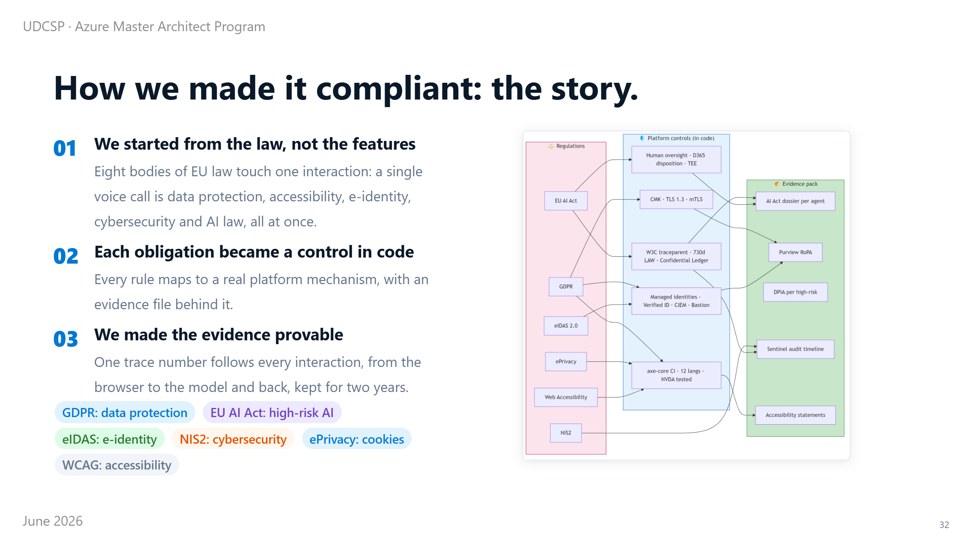
Notes:
⏱ 1:05 · People ask how we made this compliant. The honest answer: we worked backwards. We started from the law, not from the features.
When you look closely, eight European laws touch a single voice call at the same time. There is data protection, under GDPR (the General Data Protection Regulation). There is electronic identity, under a rule called eIDAS. There is cybersecurity, under a directive called NIS2. There is accessibility law. And there is the AI Act.
So we took each obligation, from each of those laws, and turned it into a concrete control in the code, with evidence behind it.
And one trace number ties it all together, following an interaction from the browser to the model and back, kept for two years.
So compliance here is not a binder on a shelf. It is wired into the system. Let me make the AI Act part concrete.

Slide 33
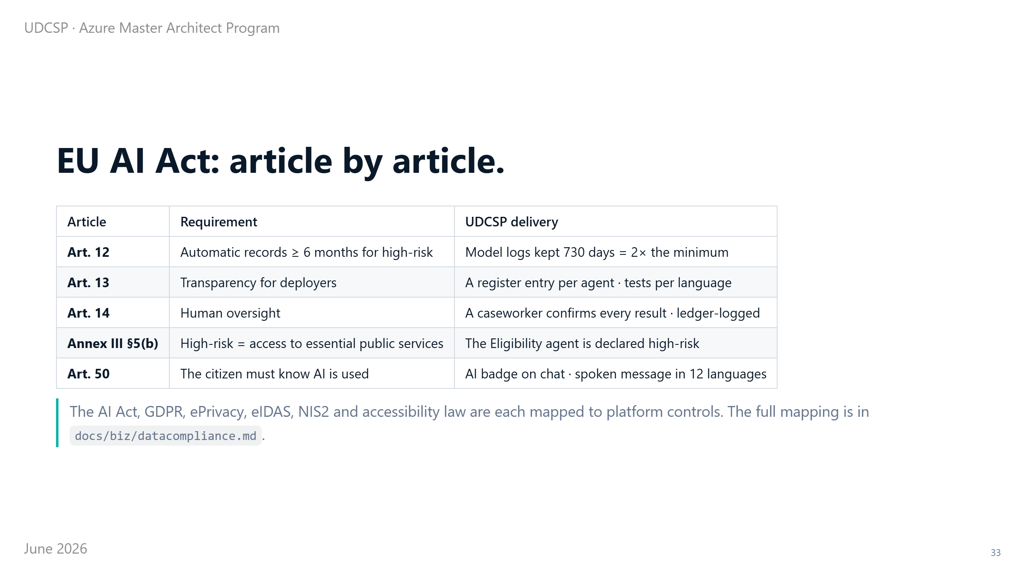
Notes:
⏱ 0:55 · The AI Act is easy to mention and hard to show. So here is exactly how we meet it.
It requires automatic records for at least six months for a high-risk system. We keep two full years, more than double.
It requires transparency about each AI part, so every agent has a written entry. It requires a human in control, so the caseworker confirms every decision.
It names access to essential public services as high risk, which is why we flagged the eligibility agent. And it requires telling people when AI is used, so we do, in writing and out loud, in their language.
Every line of the law has a matching line in the system. Theory is one thing, so let me show you two real moments.

Slide 34
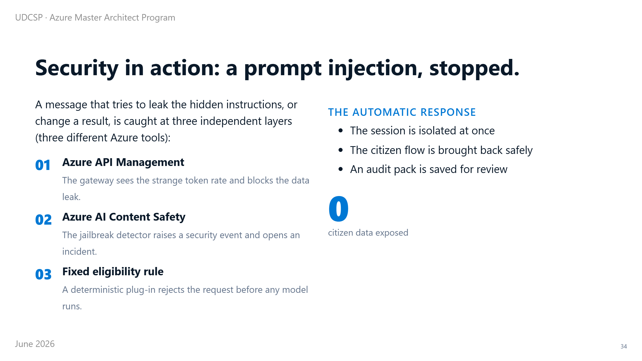
Notes:
⏱ 0:45 · The first is an attack.
Imagine a message crafted to trick the AI into revealing its hidden instructions, or quietly changing an eligibility result. That is called a prompt injection.
Three independent tools stop it. Azure API Management, the gateway, spots the strange token rate and blocks the data leak. Azure AI Content Safety, with its jailbreak detector, recognises the trick and opens a security incident. And our own fixed eligibility rule simply refuses the request before any model runs.
Then the platform isolates the session, brings the real citizen back, and saves the evidence. No citizen data is ever exposed.
The second moment is the opposite: not an attack, but an audit.

Slide 35
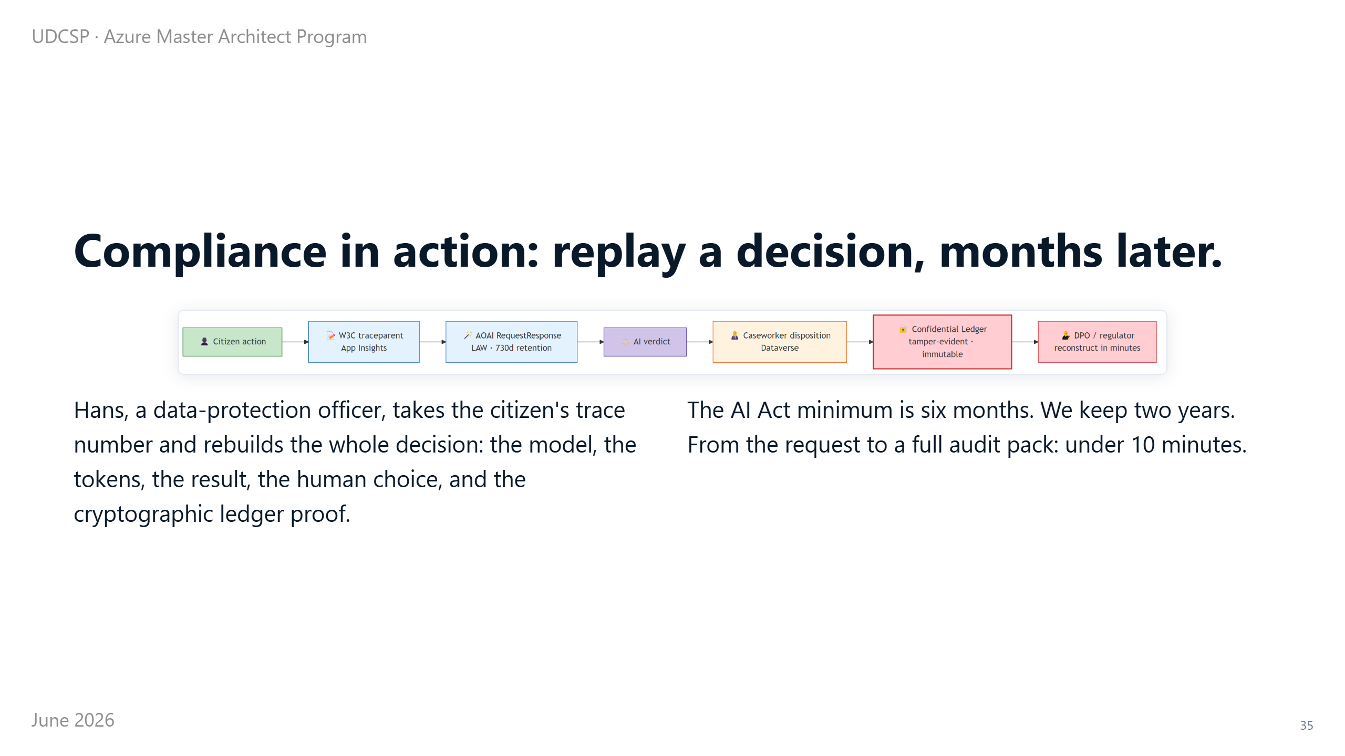
Notes:
⏱ 1:00 · Six months after a decision, a regulator asks the hardest question there is: why did the system propose this, back then?
In most places, that is a moment of panic. Here, it is a lookup.
The privacy officer takes the single trace number for that case and rebuilds the whole decision: which model ran, what it answered, what the caseworker did with it, and a sealed proof that nothing has changed since.
And from the question to a complete, signed audit file takes under ten minutes. That is what provable compliance actually means.
Once it is all running, of course, we still have to watch it and pay for it.

Slide 36
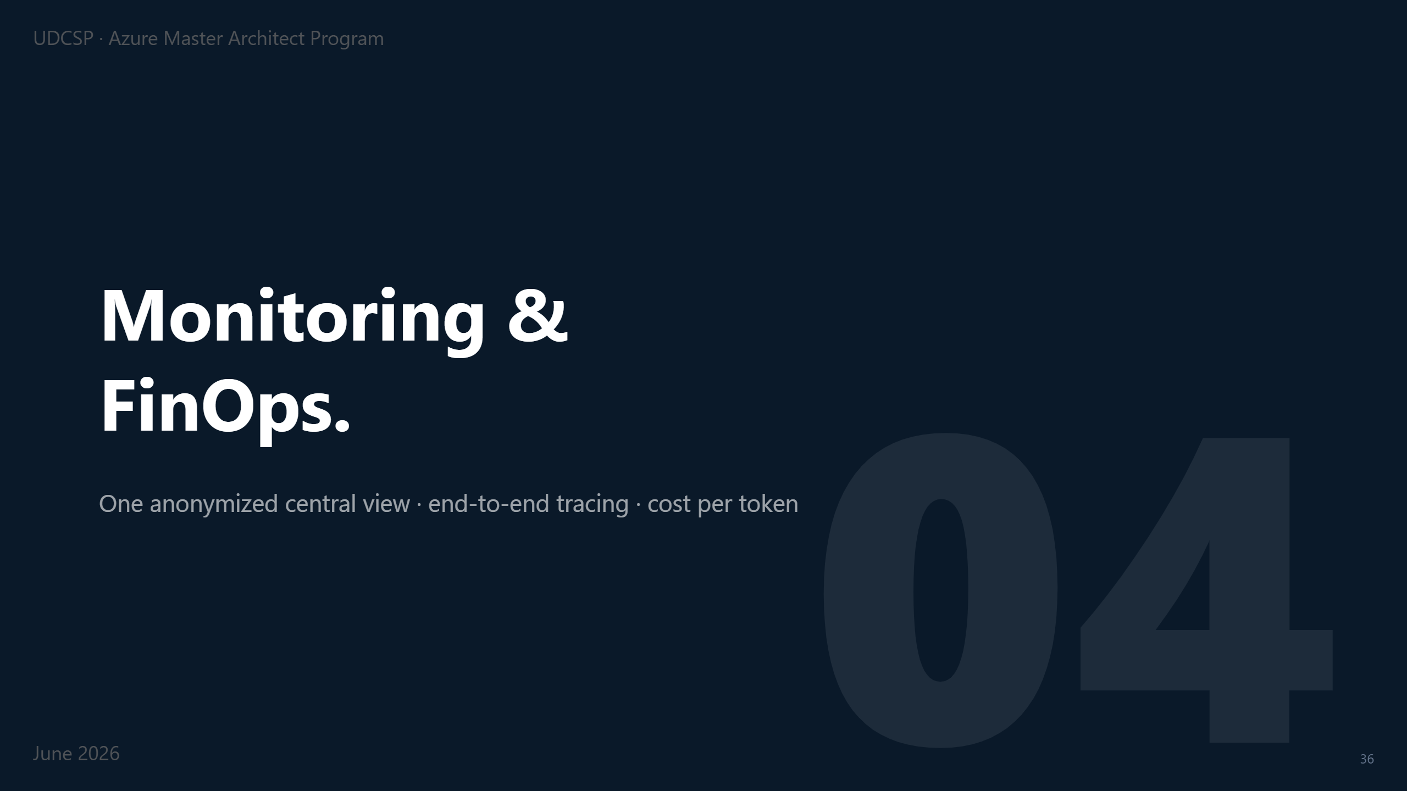
Notes:
⏱ 0:18 · A quick word on operations: how we watch the platform and its cost without breaking the walls between countries.
Monitoring rests on per-country pillars: separate logs that are never merged, one trace number that follows a request end-to-end, continuous AI-quality checks and sealed AI Act evidence. The full pillar map is in the annex.
The one view that needs real care is the cross-country picture, because it has to span all three countries at once.

Slide 37
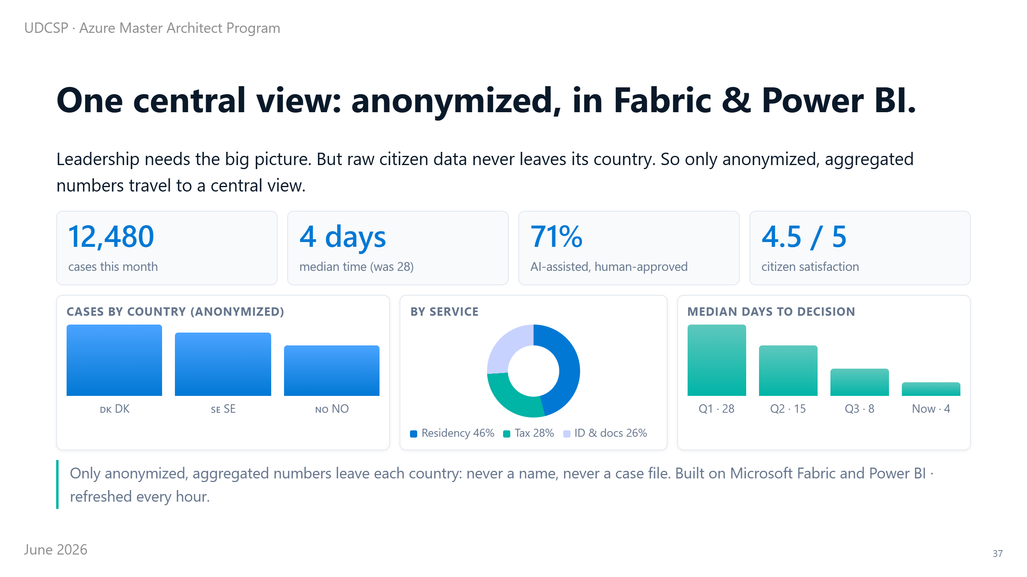
Notes:
⏱ 1:00 · A leader has to answer for results across the whole programme. But they cannot be allowed to see individual citizens; that would break everything we just built.
So the answer is a single shared view where the names and the case files have already been stripped away. Only anonymous, combined numbers ever leave each country, gathered into Microsoft Fabric and shown in Power BI, refreshed every hour.
The view shows roughly 12,000 cases this month, and the median time down to four days from 28. Satisfaction sits at four and a half out of five, and the processing time keeps falling quarter after quarter.
So leadership gets the full picture, and privacy stays completely intact. The other operational concern is cost.

Slide 38
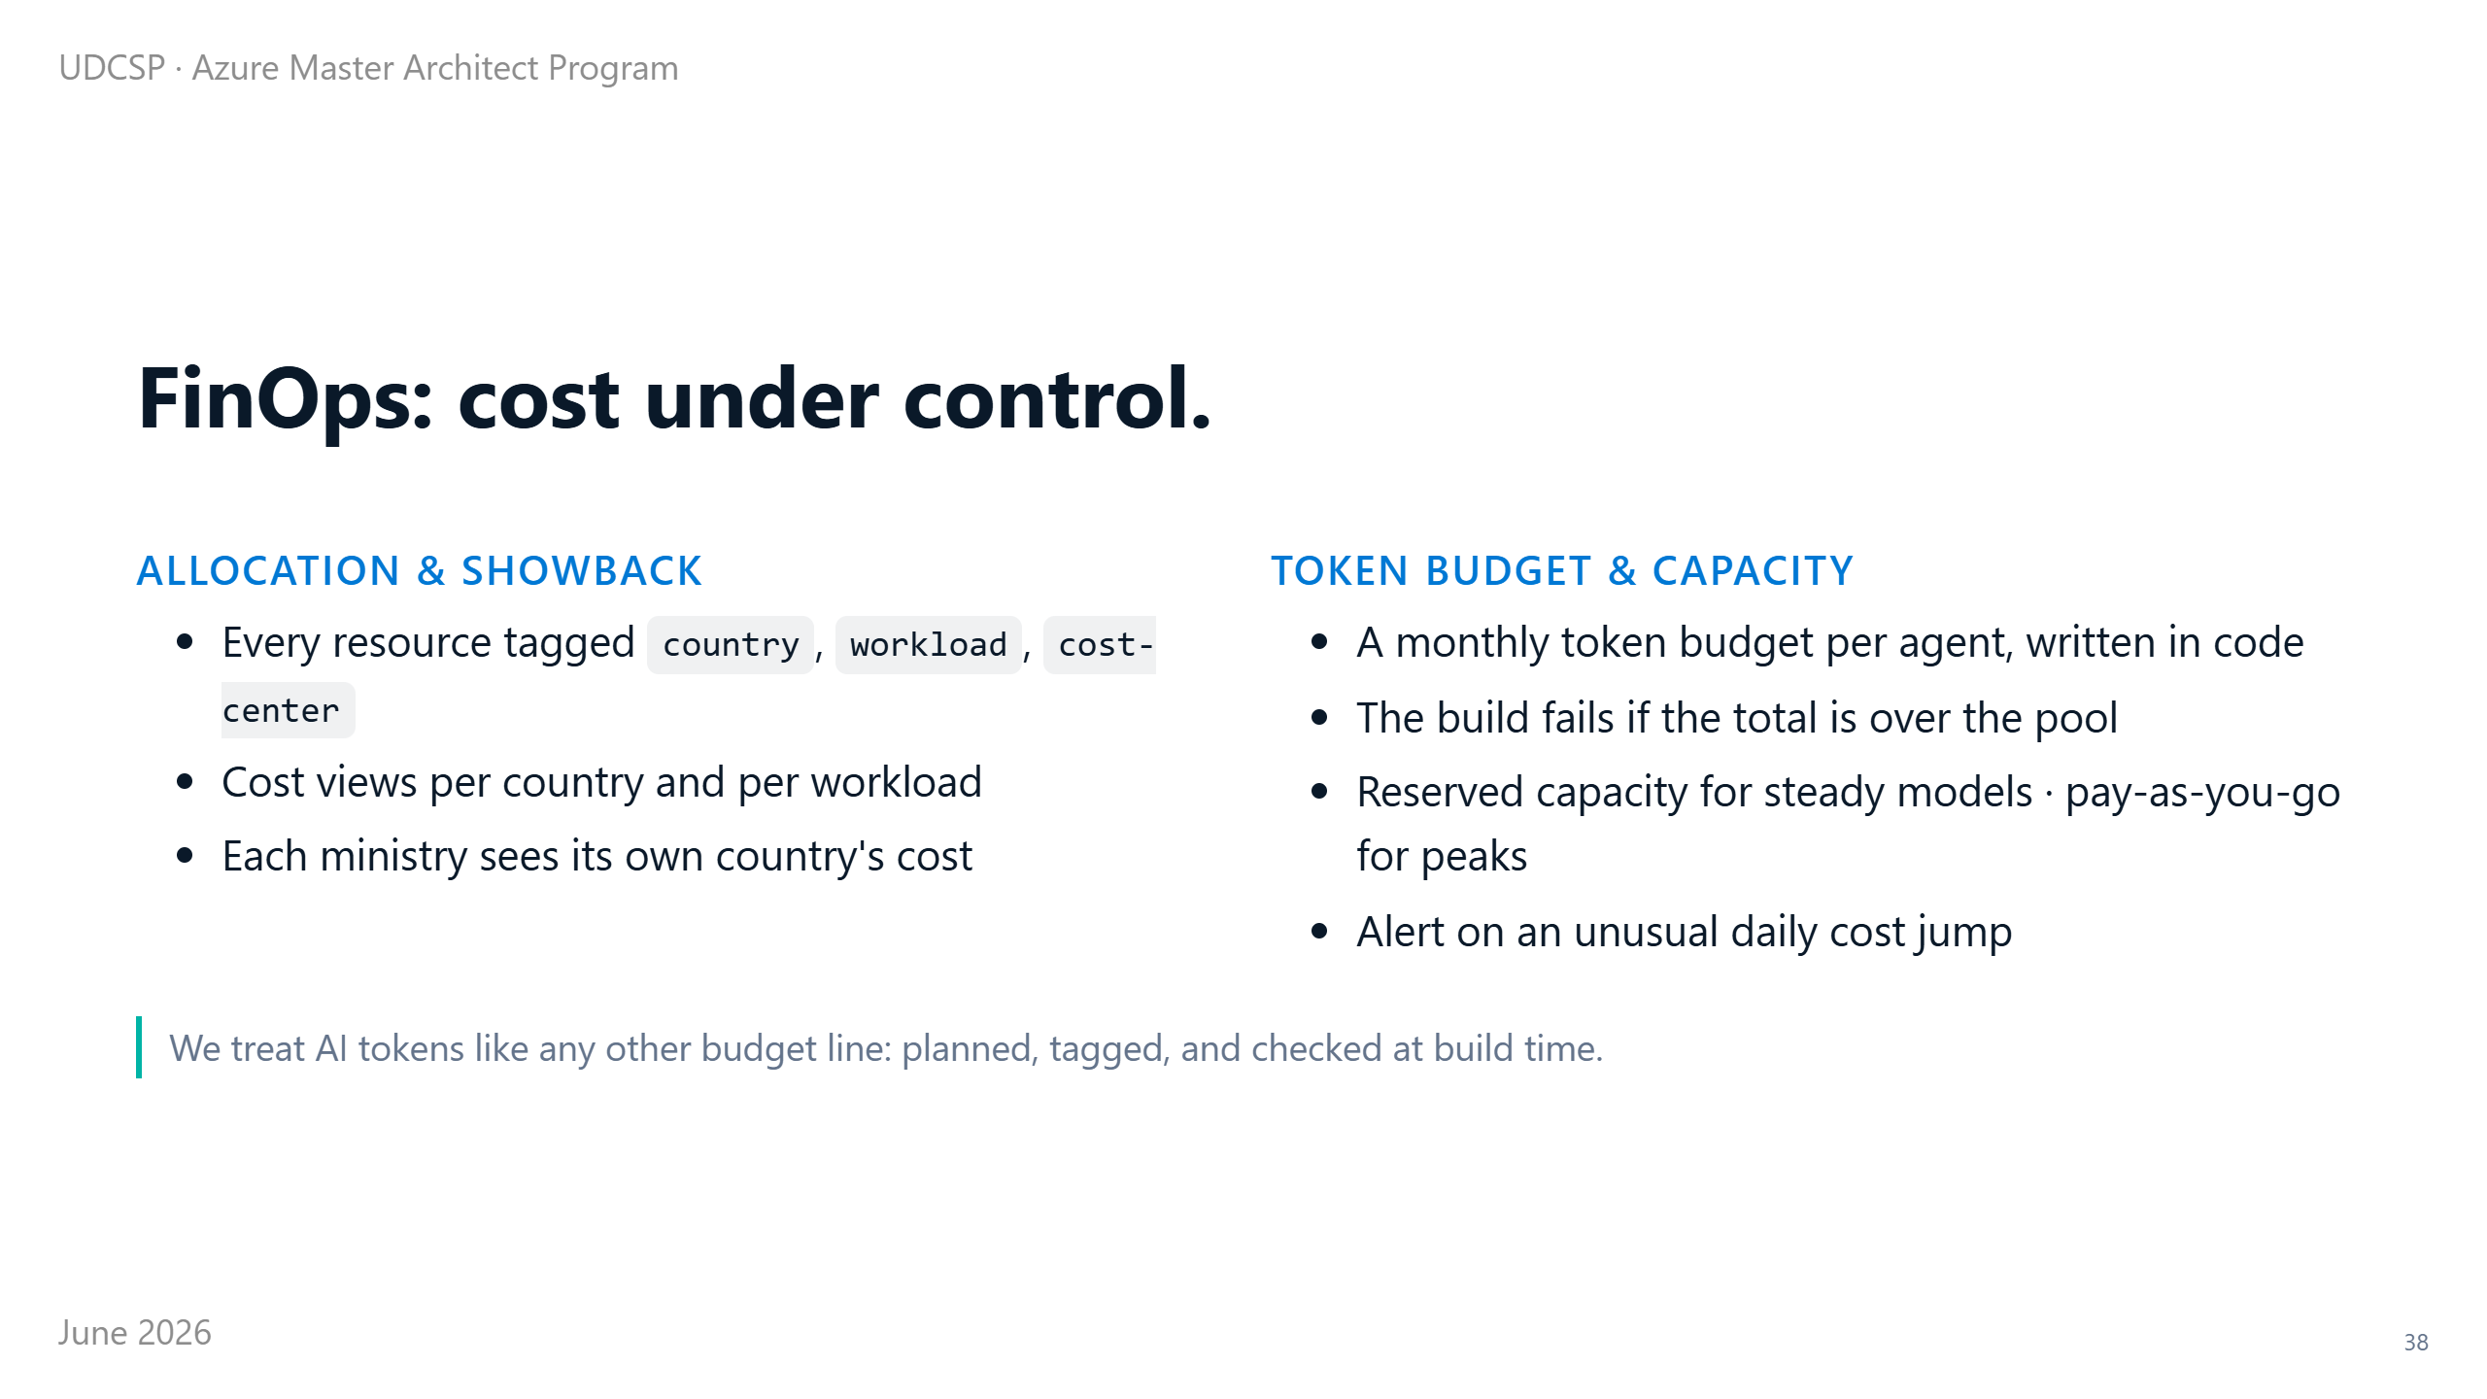
Notes:
⏱ 0:50 · AI can get expensive fast, so we treat it like any other budget.
Every resource is labelled by country, by workload, and by cost centre, so each ministry sees exactly what it spends.
Every agent gets a monthly budget of tokens (the unit you pay for with AI), written into the code. If a change would blow that budget, the build fails before it ships.
We reserve capacity for the steady work, pay only for the spikes, and get a warning the moment cost jumps. So there is no surprise invoice at the end of the month.
That keeps cost under control day to day. Now let me show you the bigger picture: what the whole platform actually costs.

Slide 39

Notes:
⏱ 0:12 · Now the question every government asks: what does this cost?
Let me show you the numbers, the cost per citizen, and the levers we use to keep it low.

Slide 40
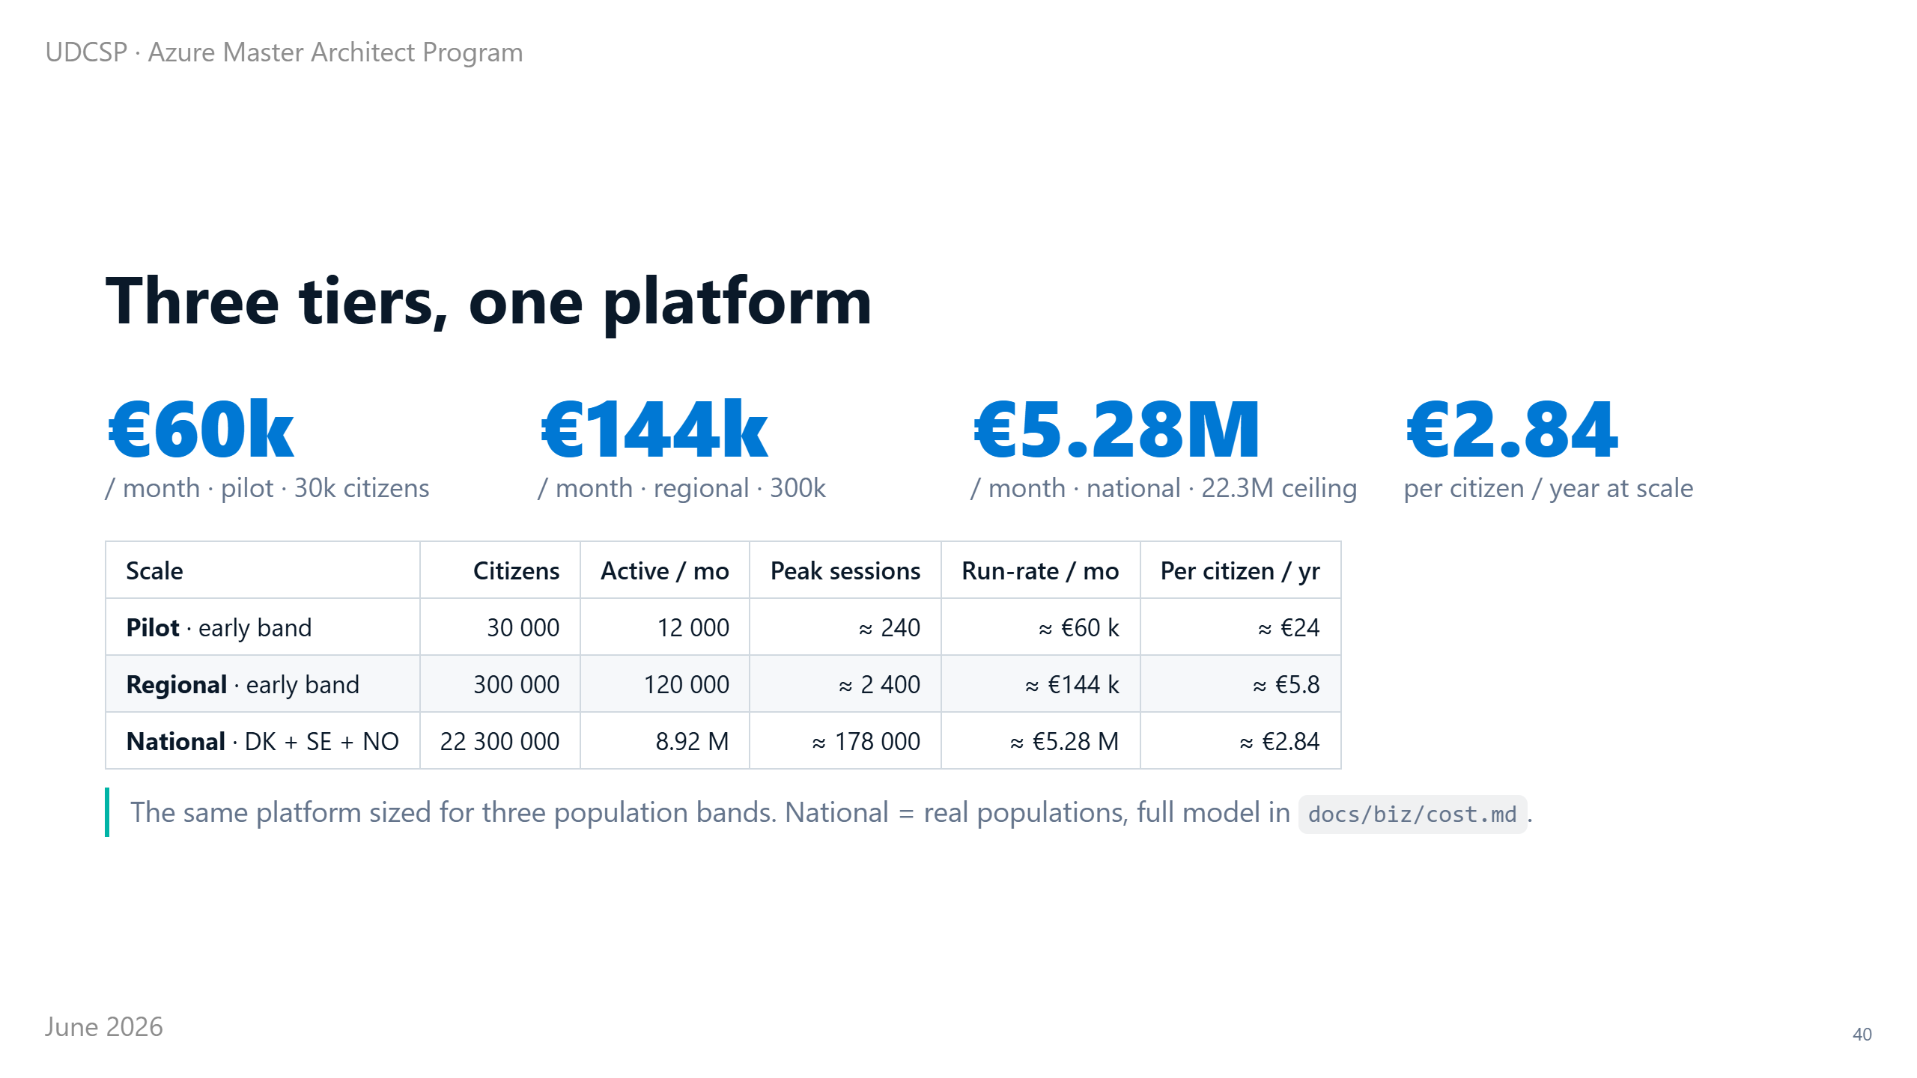
Notes:
⏱ 0:40 · Every government asks the same question: what does this cost?
We sized one platform for three steps.
A small pilot: thirty thousand people. A regional roll-out: three hundred thousand. And full national scale: the real Nordic populations, twenty-two million people across the three countries.
But not everyone uses a government portal. We size for the whole population, and we pay for the active citizens. Same code, same zones, same AI brain; only the capacity changes.

Slide 41
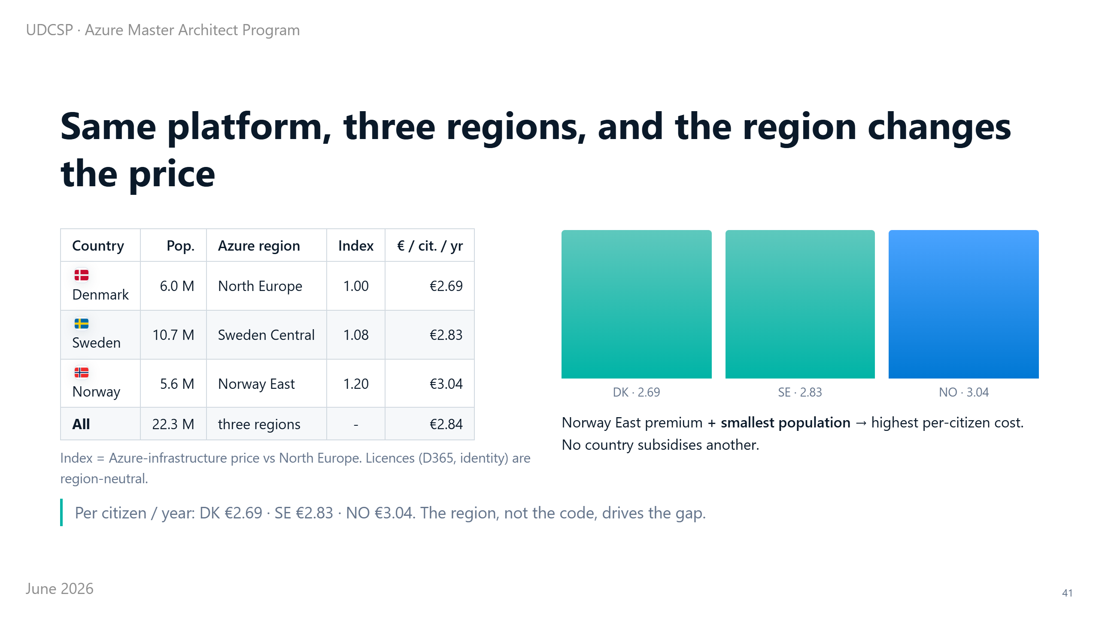
Notes:
⏱ 0:45 · Here is a subtle but important point. This is not one platform; it is three, one per country, each in its own Azure region.
And Azure prices are not the same in every region. Denmark runs in North Europe (one of the cheapest regions in the EU), our baseline. Sweden runs in Sweden Central, a few percent more. Norway runs in Norway East, a premium region, about twenty percent more expensive on infrastructure.
So look at the cost per citizen. Norway is the most expensive (three euros and four cents) for two reasons stacked together: the premium region, and the smallest population, so the fixed floor is shared by the fewest people. Denmark is the cheapest. You do not engineer this away; you plan for it.

Slide 42
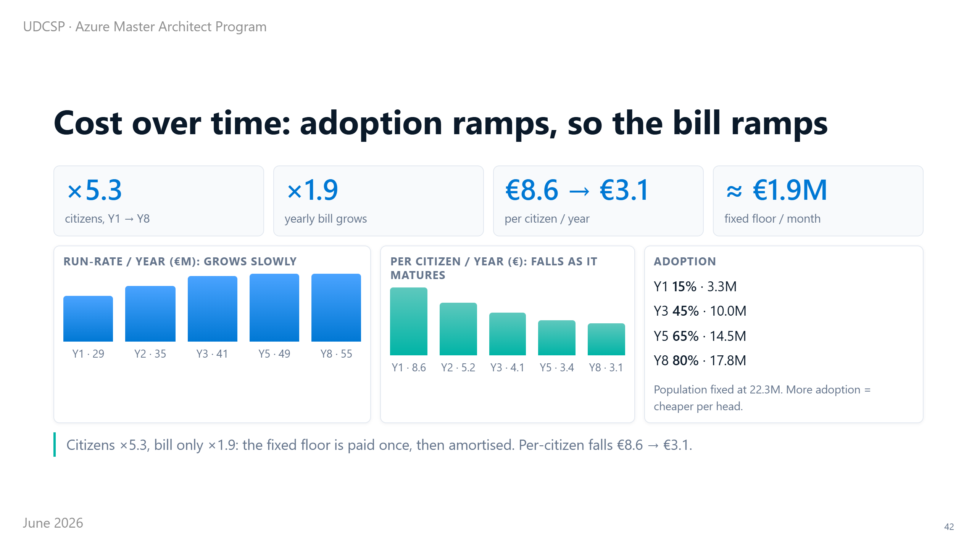
Notes:
⏱ 0:45 · And one more honest point. Not every inhabitant signs up on day one. Adoption ramps over years.
We model it growing from fifteen percent in year one to eighty percent by year eight, which is realistic for the Nordics, high-trust and high-adoption.
Watch the shape. Citizens grow five times (from three million to nearly eighteen), but the bill grows less than twice (from twenty-nine million to fifty-five). Because the fixed floor is built once, for national grade, then shared by an ever-larger crowd.
So the cost per citizen falls all the way down, from over eight euros to about three. The more people adopt it, the cheaper it gets for everyone.

Slide 43
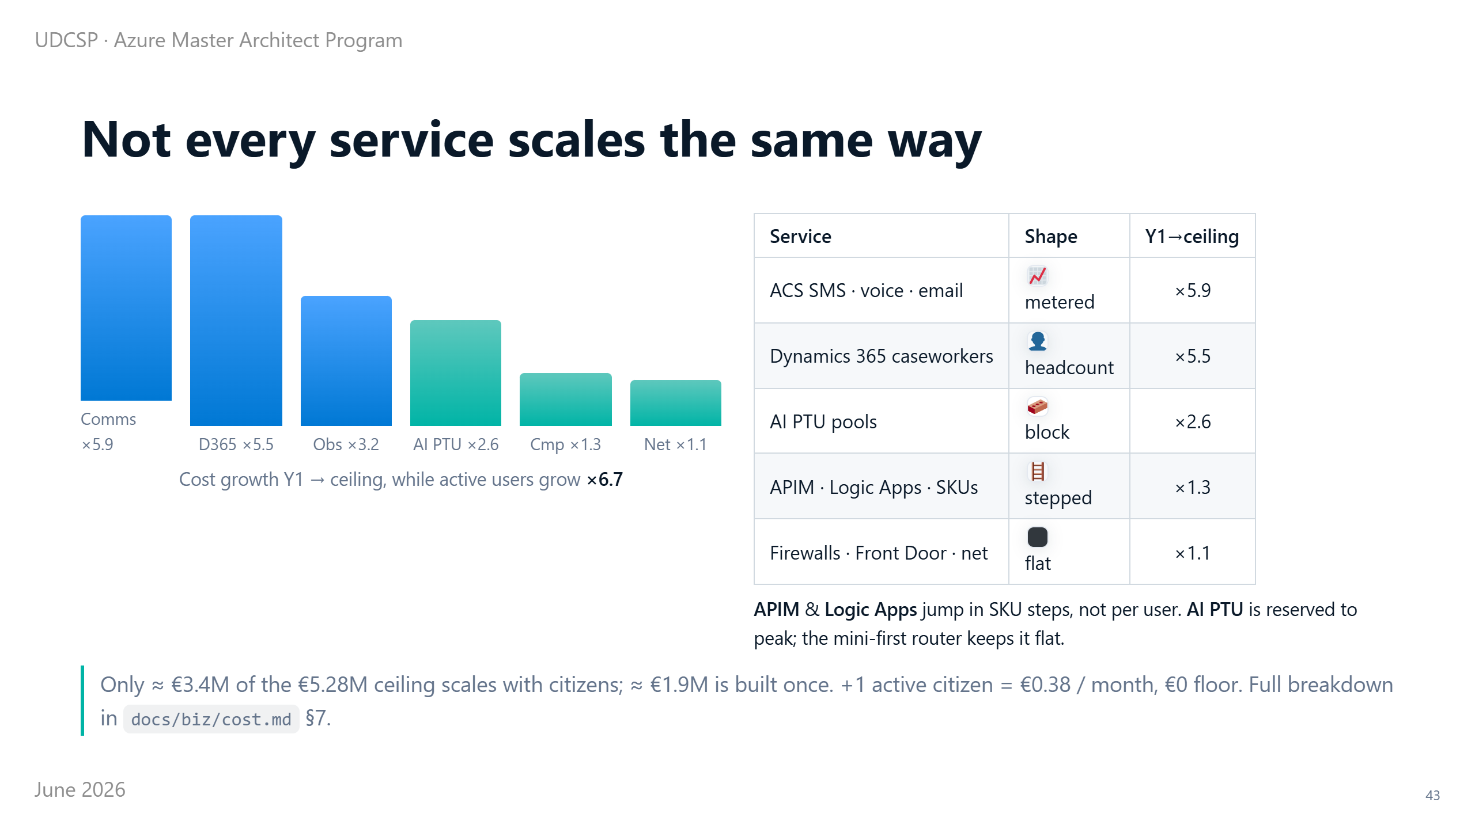
Notes:
⏱ 0:45 · One more thing about scale.
People ask: if you get almost seven times more users, does the bill grow seven times too?
No; the reason is that the services do not all grow the same way.
Some are metered, like every SMS and every email, so they follow the users almost one to one.
Some are reserved in blocks, like the AI capacity; we size it to the peak, and the small model handles most of the traffic, so it grows much slower.
And some are just a fixed floor: the firewalls, the gateway, the API gateway, the network, built once for the whole country.
So when the active users grow almost seven times, the total bill grows only about two times. That is the shape that makes this affordable.

Slide 44
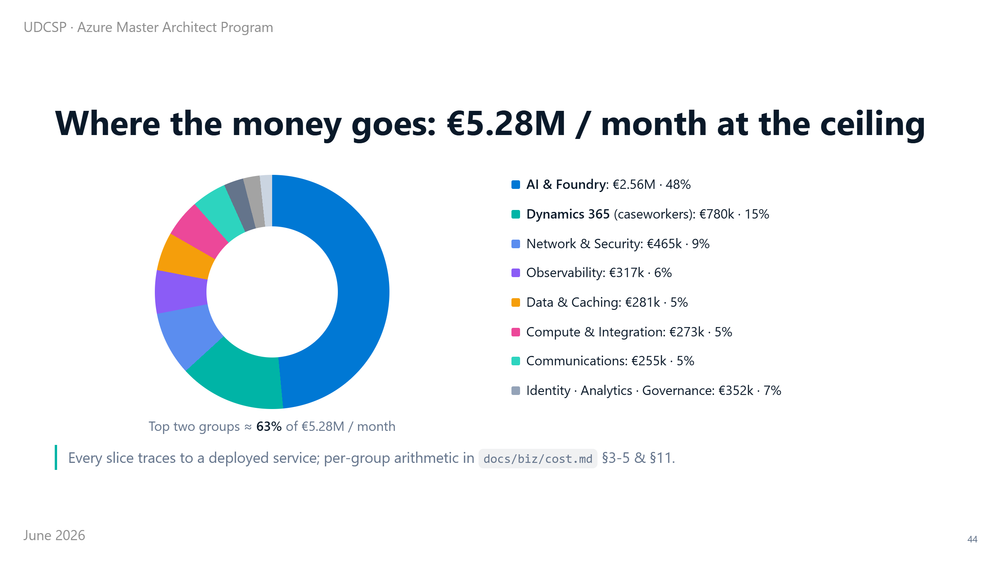
Notes:
⏱ 0:50 · So where does the money actually go at full scale?
This is the whole national bill in one picture.
One slice is large: the reserved AI capacity. The citizen assistant and the eligibility brain. Almost half the bill.
The next slice is the caseworker licences: the humans who stay accountable for every AI decision.
Together those two are about two thirds. Both are value, not waste.
Network, monitoring, data and communications make up a thin, well-controlled tail.

Slide 45
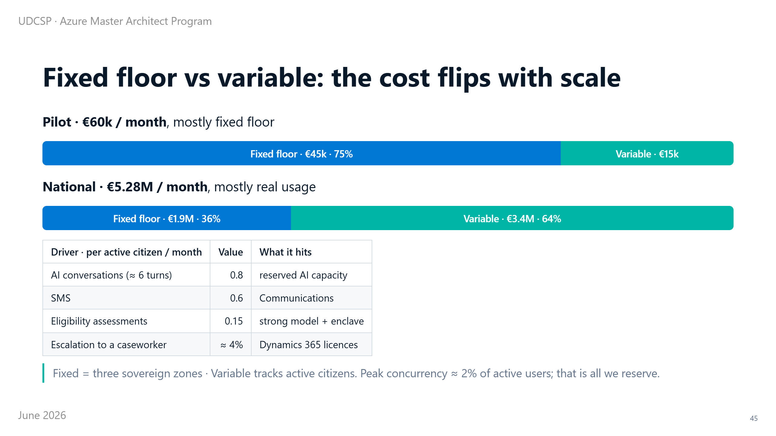
Notes:
⏱ 0:50 · It helps to see what kind of cost we pay.
Some cost is fixed. We pay it whether one citizen logs in or a million; it is the price of three private, sovereign zones. Gateways, firewalls, the base AI reservation.
The rest is variable. It follows the active citizens.
Now watch it flip. At pilot scale, most of the bill is the fixed floor: the platform is bigger than the crowd. At national scale, it is the opposite: most cost is now real usage.
That is exactly what you want: you pay for citizens, not for empty capacity.

Slide 46
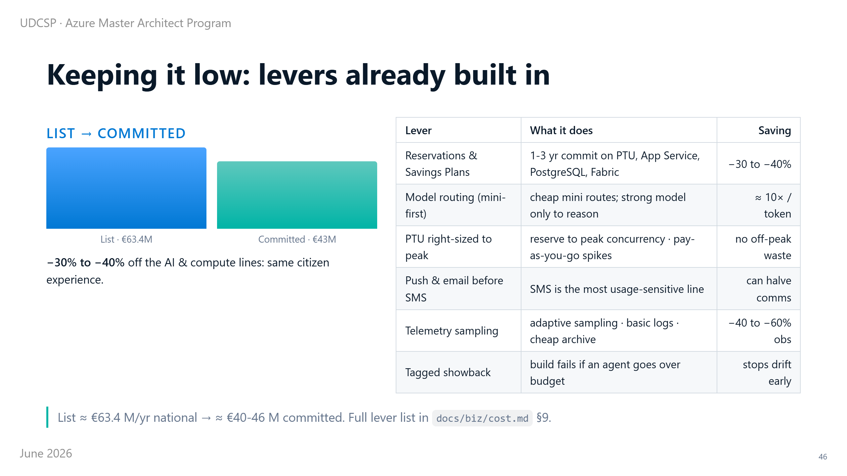
Notes:
⏱ 0:50 · And we are not paying list price. We have levers, already built into the platform.
We reserve capacity ahead of time, which alone removes thirty to forty percent. We send the cheap work to a small model. We prefer push and email over SMS, the most expensive channel. And every resource is tagged, so the build fails if an agent goes over its budget.
Put together, the national bill drops from about sixty-three million a year to about forty-three, with the exact same experience for the citizen.

Slide 47
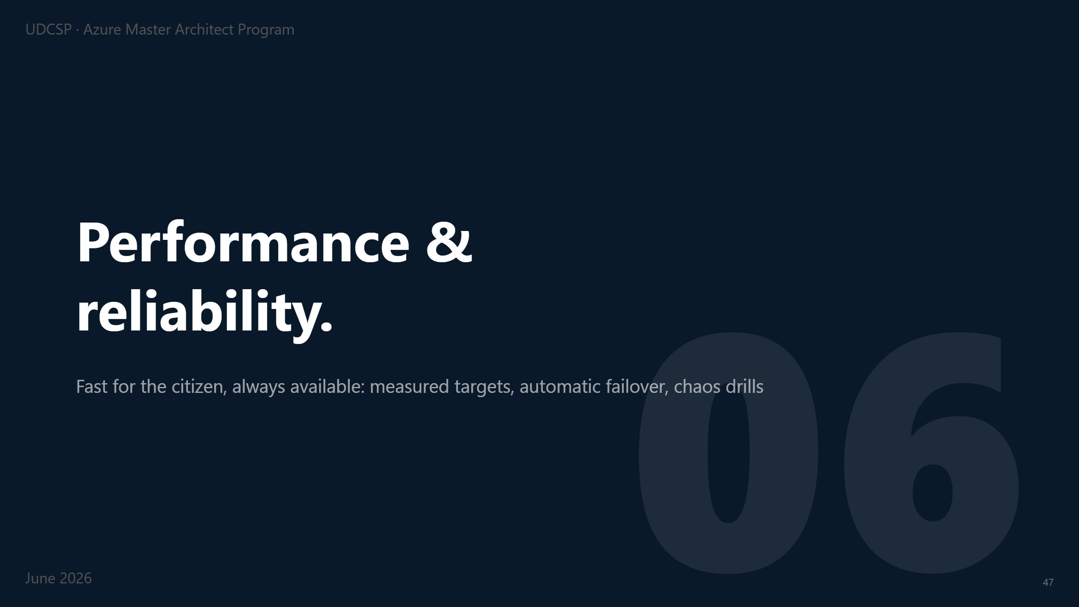
Notes:
⏱ 0:12 · Underneath everything is a quieter promise: the platform stays fast, and stays up, even when something breaks.
Here is how we keep it.

Slide 48
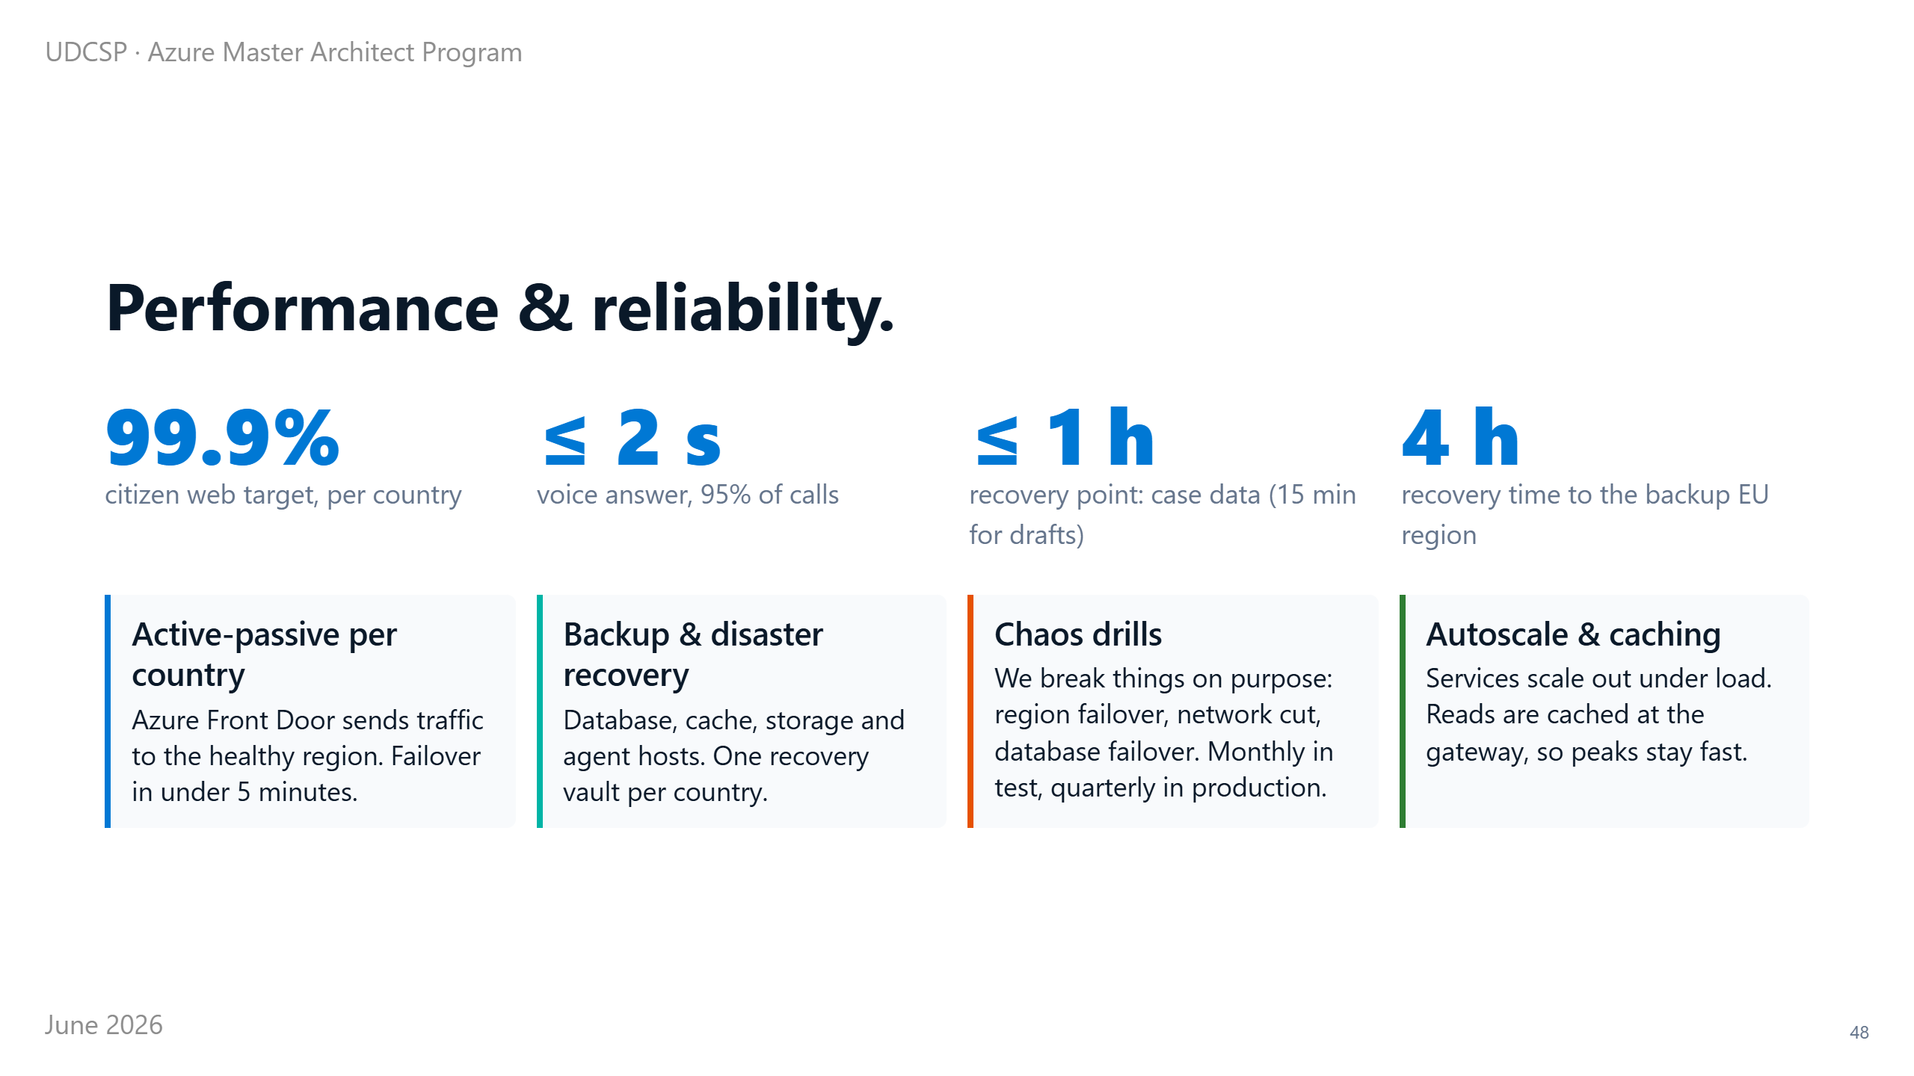
Notes:
⏱ 1:00 · We set the targets out loud, and then we test them.
The website should be available almost all the time, and we aim for 99.9 percent in every country. A phone call should be answered within two seconds, and it is, for almost every call.
If something serious ever fails, we should lose at most one hour of case data (only minutes for live form drafts) and be back within four hours, in a backup European region.
And we don't just hope those numbers hold. Each country runs a hot standby that takes over in minutes. We back everything up, in every country.
And we break things on purpose: knocking out a region, cutting a network, failing a database. We do it every month in test and every quarter in production, so the real failure, when it comes, is one we have already rehearsed.
There is one more thing worth showing, about how the platform was built.

Slide 49
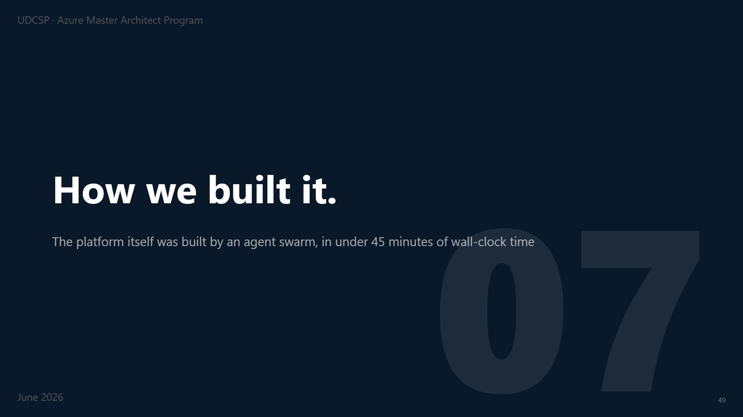
Notes:
⏱ 0:12 · This part surprised even us.
We didn't build the platform the way you might expect.

Slide 50
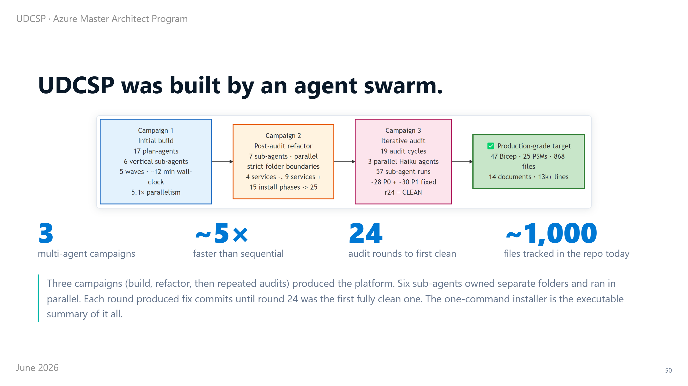
Notes:
⏱ 0:45 · We didn't write this by hand, file by file, over months. We built it with a swarm of AI agents working together.
There were three campaigns: a build, a clean-up after review, then round after round of audits.
Six specialist agents each took a separate part of the code, with no overlap, and worked at the same time, about five times faster than one could alone.
After each audit they fixed what they found. It took 24 rounds before one came back completely clean. Today the repository holds around a thousand files.
And the proof it holds together is simple: the whole platform installs with one command.

Slide 51
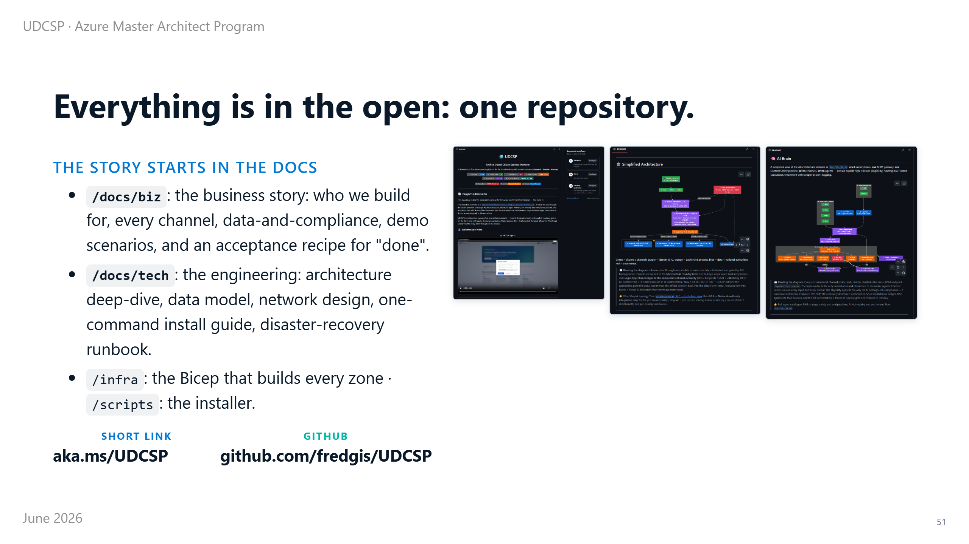
Notes:
⏱ 0:40 · And all of it lives in one place: a single public repository you can open right now.
The story starts in the documents, not the code.
Under docs-slash-biz is the business side: who we build for, every channel, the data and compliance rules, and an acceptance recipe for what "done" means.
Under docs-slash-tech is the engineering: the architecture, the data model, the network design, the install guide and a disaster-recovery runbook.
The infra folder holds the Bicep, and the scripts folder holds the installer. It is at a short address, aka.ms-slash-UDCSP. Everything I am claiming today, you can check there.

Slide 52
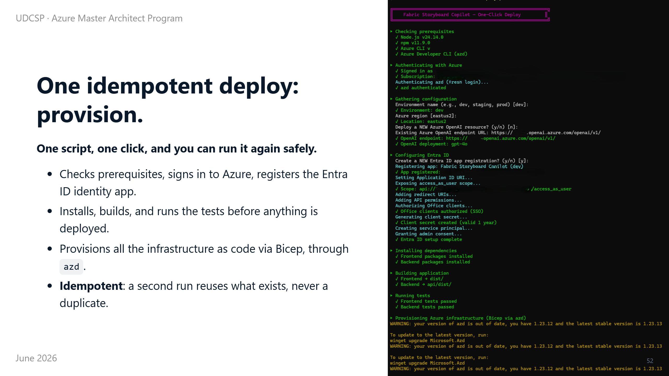
Notes:
⏱ 0:35 · So how do we actually ship all of this? With one idempotent command.
The same script checks the prerequisites, signs in to Azure, registers the identity app, builds the code and runs the tests. Then it provisions every Azure resource as code, with Bicep.
Idempotent means you can run it again safely: it reuses what already exists, and never creates a duplicate.

Slide 53

Notes:
⏱ 0:35 · The same run then deploys the application, generates the production manifest, and wires the redirect addresses and the access roles: RBAC (role-based access control).
It ends with a clear Deployment Complete and a full summary of every resource and URL.
And the very same script runs in our pipeline on every change, so a deploy is always repeatable, never done by hand.

Slide 54

Notes:
⏱ 0:12 · This one we genuinely did not plan.
It happened a few weeks ago, and it turned into a useful reality check on the whole design.

Slide 55

Notes:
⏱ 0:30 · Quick fun story to finish.
A few weeks ago I re-registered a car, and had to log in to France Titres, the official French government portal. I had never opened it while we were building UDCSP.
And there it was: the same single front door, the same service cards, even the same little assistant in the corner.

Slide 56

Notes:
⏱ 0:35 · The sign-in matched too.
France Titres uses FranceConnect and the France Identité app, with an EU cross-border identity marked "coming soon": pick your country, then your national eID.
That is our exact model: a national eID, plus the EU wallet for crossing borders.
We designed it months before I ever saw the French version. And that is genuinely the fun part.

Slide 57

Notes:
⏱ 0:15 · Before the demo, the honest scorecard.
Here is every headline capability with its label, and then the four gates that take the blueprint bricks to production.

Slide 58

Notes:
⏱ 0:55 · This is the whole submission on one slide.
The green and blue rows run today, or are merged and tested: unified identity, 12-language accessibility, the assistant across web, mobile and voice, the cross-border pre-fill, the eligibility decision with a human in the loop, and the one-command deploy.
The orange parts are blueprint: the full cross-border saga, live confidential compute, the immutable ledger and the Fabric capacity: designed and registered, waiting on a tenant capacity or a licence.
Nothing here is hand-waved. Every label is backed by code or a script in the repository.

Slide 59

Notes:
⏱ 0:50 · Here is how the blueprint becomes live, in four gates over about 20 weeks.
Gate one, weeks one to two: validate the tenant: the model deployments, the Fabric capacity and the DDoS plan.
Gate two, weeks three to six: switch eligibility onto live confidential compute, which flips demo six to live.
Gate three, weeks six to fourteen: sign the partner-agency agreements and stand up the production hub, so demo one talks to a real authority.
Gate four, weeks fourteen to twenty: bring in D365 Customer Service with Copilot for Service and repoint the writes off Power Apps, flipping demo five.
Each gate ships on its own. The platform is useful after every one.

Slide 60

Notes:
⏱ 0:18 · One last idea, and it is the one I am most excited about.
Everything so far makes the platform faster when a citizen asks.
Guardian is about the citizens who never ask.

Slide 61

Notes:
⏱ 1:05 · Here is the uncomfortable truth behind every benefits system.
Studies across the OECD show that between twenty and sixty percent of eligible people never claim what they are entitled to. It is not fraud, and it is not choice. They simply do not know they qualify, or the process is too hard.
Today our platform, like every portal, waits for the citizen to know, to find us, and to apply.
Guardian flips that. It is the step after the European once-only principle, the one people call no-stop-shop: the citizen should not even have to apply. The state notices, and reaches out first.
Same data, same agents, same rules. The only thing that changes is who starts the conversation.

Slide 62

Notes:
⏱ 0:55 · It runs as a loop, on a schedule and on events, and it walks one citizen through seven stages.
It scans the in-country data for a life event, a birth, a move, a job loss, someone turning sixty-seven.
It runs the eligibility agent we already have, but in shadow, with no application attached.
The caseworker helper drafts a short message in the citizen's language. A new critic agent checks the legal basis and the tone, and can send it back.
Then the hard gate: a human caseworker approves, adjusts, or rejects. Nothing is autonomous past that point.
Only then does the message go out, on the channels we already have, and every step is written to the ledger.

Slide 63

Notes:
⏱ 0:50 · Here is the whole thing on one picture, and the point is how little is new.
In teal are the only two new pieces: the event scanner that starts the work on its own, and the critic that reviews the draft.
Everything else is what you have already seen. The high-risk eligibility agent in its sealed enclave, the caseworker helper, the translator. The human gate in Dynamics. The outreach channels we already built for SMS, email, push and voice. And the same governance: consent, the tamper-proof ledger, the AI Act registry.
Two new agents, one new workflow, one dashboard tile. Everything else is a re-wire. That is why this is credible, not science fiction.

Slide 64

Notes:
⏱ 0:50 · I want to be clear on the risk, because reaching out to citizens is exactly what regulators watch.
Guardian never decides. It proposes, a human approves, and the citizen action stays voluntary, so the automated-decision rules are respected. There is a lawful basis, a one-click opt-out, and a full record in the ledger. The critic exists partly to protect citizens from a wrong or distressing message.
Done this way, proactive government is not a risk to hide. It is a demonstration of responsible autonomy.
And it changes the headline. We already went from twenty-eight days to four. Guardian adds a second number a minister cares about: the euros of entitlement we deliver to people who would have been missed. That is the new tile on the executive dashboard.

Slide 65

Notes:
⏱ 0:12 · So let's move to the demo, about ten minutes, live, on a real Azure tenant.
First the plan, then the live system.

Slide 66

Notes:
⏱ 0:50 · The demo runs five short scenes.
First, a cross-border move from Denmark to Sweden: sign in, upload a passport and a lease, watch the AI read and translate them and propose a result, consent, and the case crosses the border.
Then the one I most want you to see: a blind citizen calls a real phone number, and the AI answers in Norwegian and runs the call itself.
After that, the whole portal in Polish, with a screen reader. Then a payslip photographed on an iPhone. And finally, the entire platform stood up from nothing with a single command.
Let me switch to the live system.

Slide 67

Notes:
⏱ 0:45 · That single command isn't a demo trick. It is how we really ship.
You clone the repository, run one script, and it builds 25 stages in order: from network, identity, security, and data, through the gateway, the AI, the case system, the front end, and the voice line, all the way to governance.
At the end it runs its own health checks, and the same script runs automatically on every code change.
So this isn't a fragile demo machine. It is a platform we can rebuild from scratch, on demand. Let me bring it together.

Slide 68

Notes:
⏱ 0:45 · That's UDCSP: a production accelerator, a working core you can run today, with a named path to production.
Three sovereign countries, seven AI agents, and one private path from the first click to the caseworker. Every decision tied to a law, and every claim labelled and provable on a real Azure tenant.
It was built by a swarm of AI agents in under an hour, and quietly confirmed by a real government portal we stumbled into by accident.
And the headline is the number that matters most: a cross-border case went from 28 days to four.
Thank you. I'm happy to take your questions, and then run the demo.

Slide 69

Notes:
⏱ 0:20 · I'll leave these screens up for reference, and for your questions.
They cover the whole journey: the home page and the assistant, the residency form, the cross-border result, the compliance view, and the sign-in.
One app, 12 languages, three ways in. I'm happy to open any of them while we talk.

Slide 70

Notes:
⏱ 0:10 · Reference: the full private network behind the simplified slide.

Slide 71

Notes:
⏱ 0:10 · Reference: the full Foundry brain behind the gateway slide: every agent, slot and governance hook, copied per country.

Slide 72

Notes:
⏱ 0:10 · Reference: the six monitoring pillars behind the central view.

