Slide 1
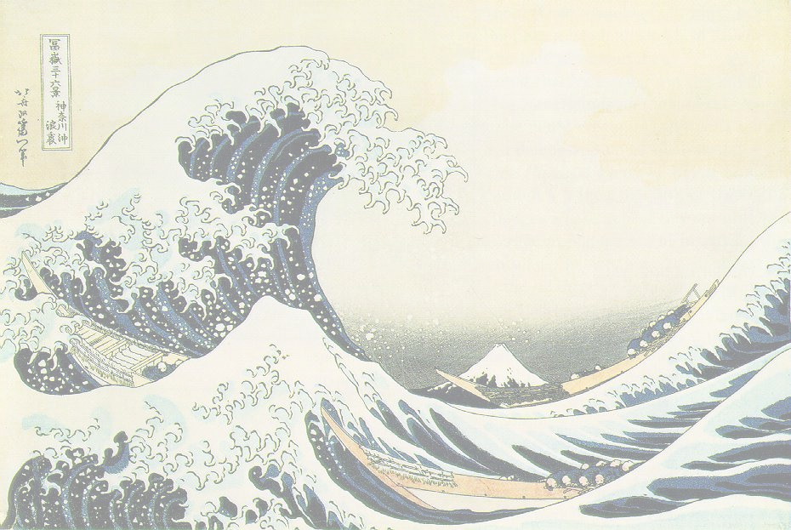
RECYCLING ONLY
This box is only for:
+newspaper +metal cans +cardboard
+plastic (with ♻) +glass bottles
+clean paper (junk mail, food boxes)
Keep these types of trash out:
-paper napkins –paper towels
-dirty items (e.g. food) –plastic film
-plastic bags -styrofoam

