Slide 1
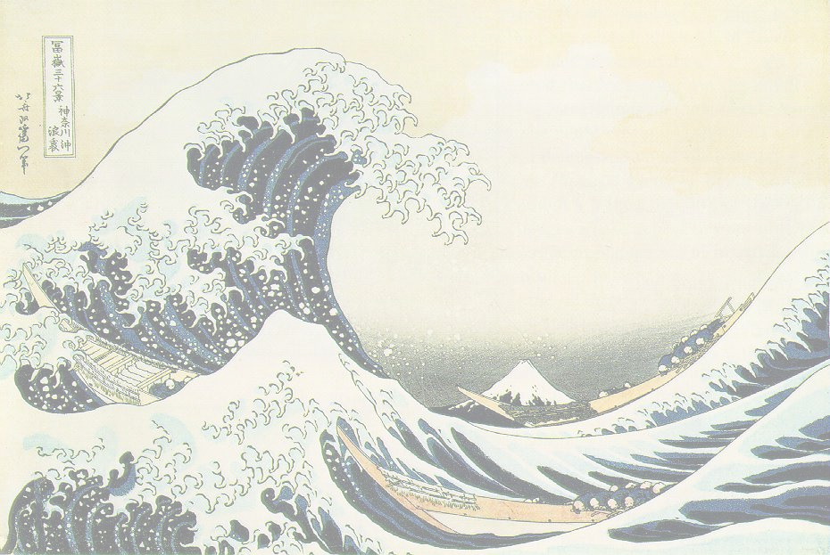
♻ RECYCLING ONLY ♻
This box is only for:
+newspaper +metal cans +cardboard
+plastic (with ♻) +glass bottles
+clean paper (letters or junk mail,
magazines, clean food boxes)
Keep these types of trash out:
-no paper napkins –no paper towels
-no dirty items (e.g. food) –no plastic film
-no plastic bags -no styrofoam
DO NOT put Recycling in a Trash Bag!!!

