Slide 1
Hourly Power Data
European wholesale power — prices, generation & capacity
Data as of 6 September 2026
ENTSO-E hourly data · self-contained snapshot (no live links)

Slide 2
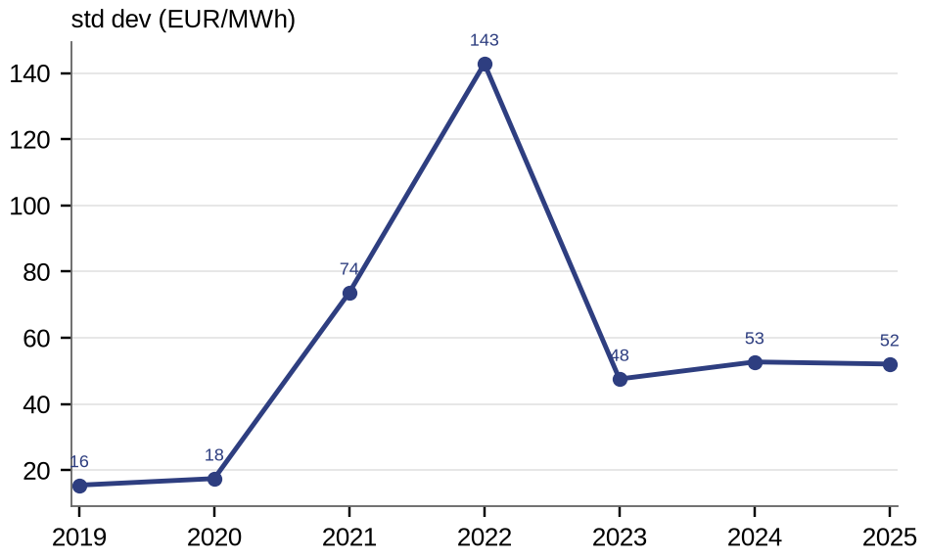
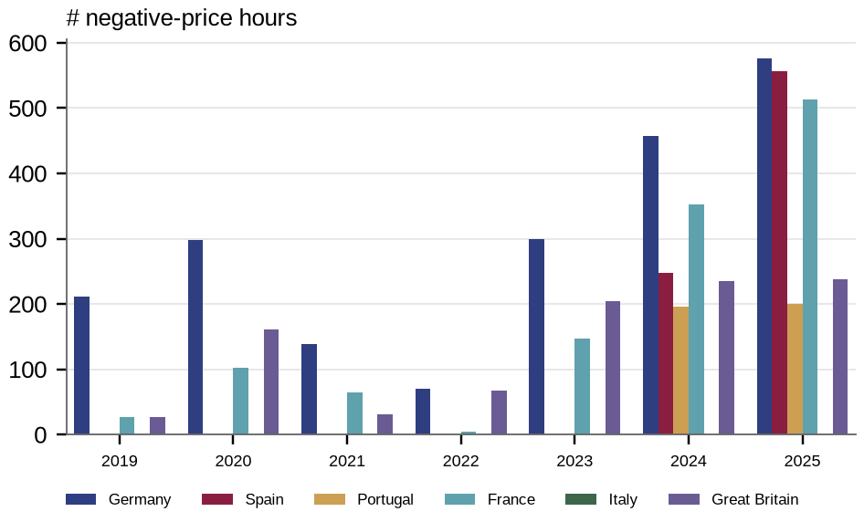
Price volatility & negative-price hours
Annual volatility and the incidence of negative prices across the five markets
Price volatility: annual SD of hourly day-ahead price (€/MWh)
Negative-price hours per year, by country
Source: ENTSO-E Transparency Platform (hourly prices, generation, flows & capacity).

Slide 3
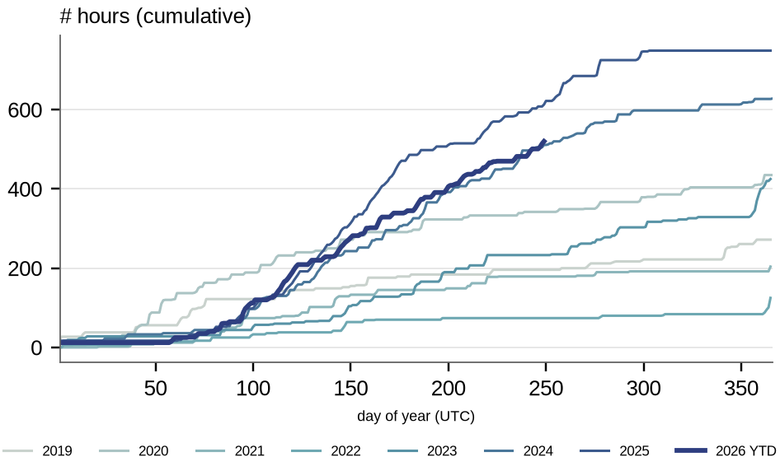
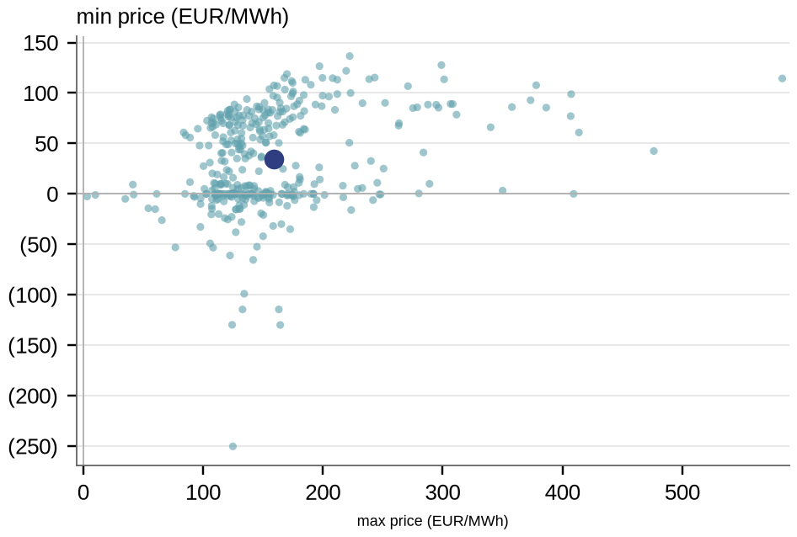
Negative & extreme prices in detail (Germany)
How negative-hour incidence builds through the year, and the daily price range
Cumulative near-negative-price hours through the year (Germany)
Daily minimum vs maximum price (Germany, 2025)
Source: ENTSO-E Transparency Platform (hourly prices, generation, flows & capacity).

Slide 4
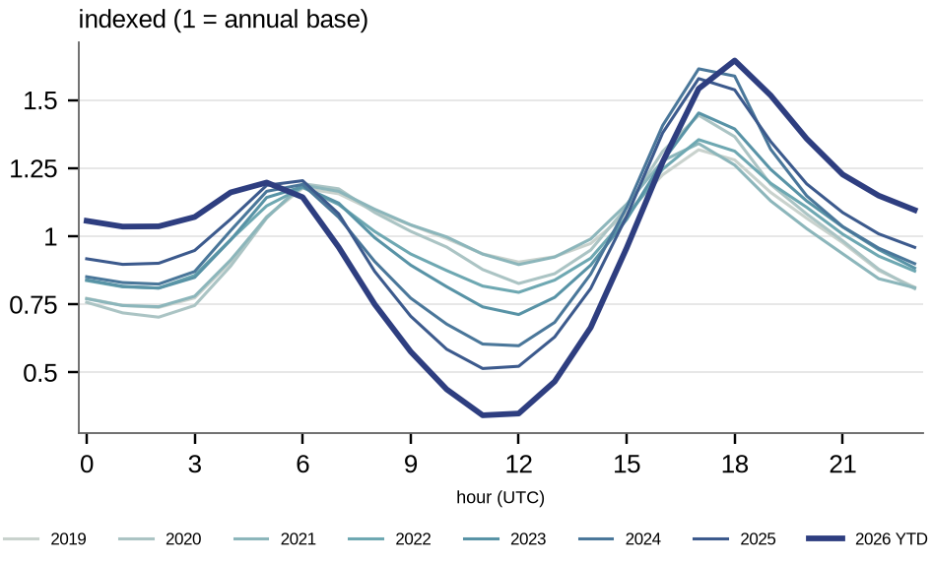
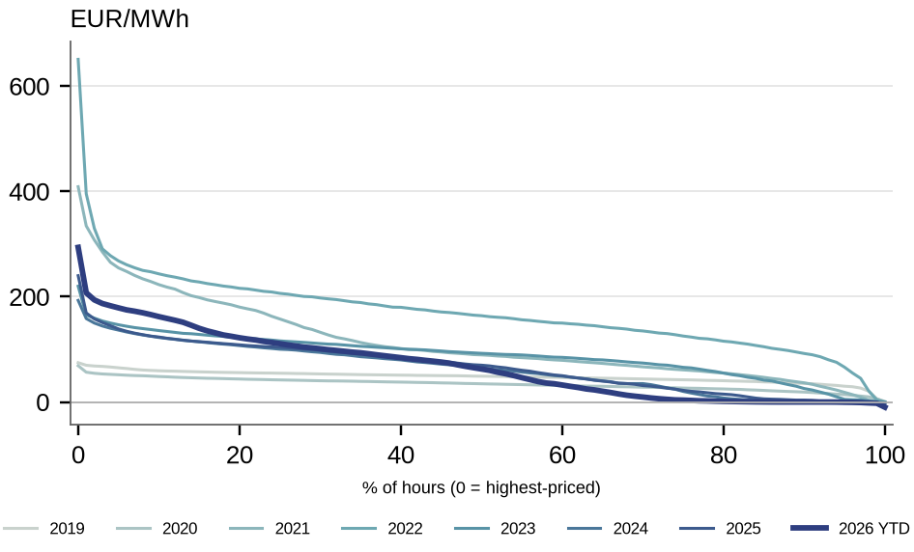
Intraday price shape & price duration
Average intraday price profile by year, and the full price distribution
Intraday price shape by year, indexed to daily mean (Germany)
Price duration curves by year (Portugal)
Source: ENTSO-E Transparency Platform (hourly prices, generation, flows & capacity).

Slide 5
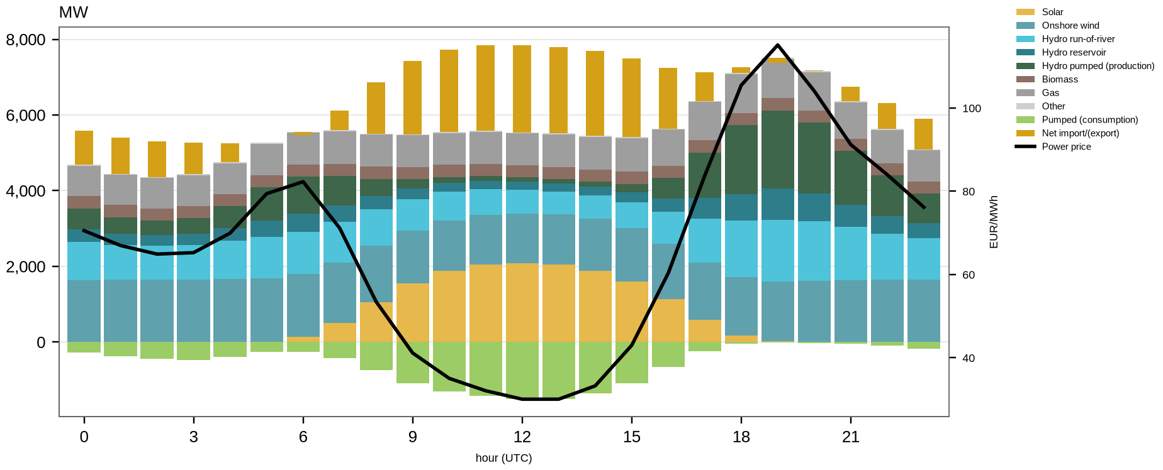
Intraday generation mix & price (Portugal, 2025)
Hourly generation by technology, with the wholesale price overlaid
Intraday generation mix and price (Portugal, 2025)
Source: ENTSO-E Transparency Platform (hourly prices, generation, flows & capacity).

Slide 6
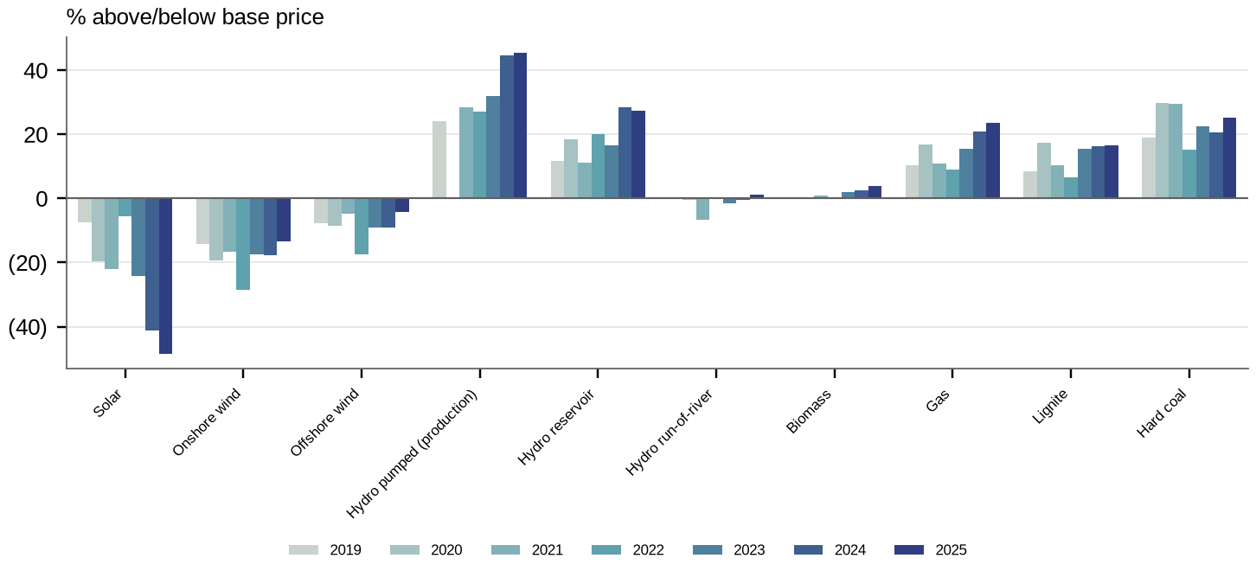
Capture price vs baseload by technology (Germany)
How each technology's realised (capture) price compares with time-weighted baseload
Capture price vs baseload by technology (Germany)
Source: ENTSO-E Transparency Platform (hourly prices, generation, flows & capacity).

Slide 7
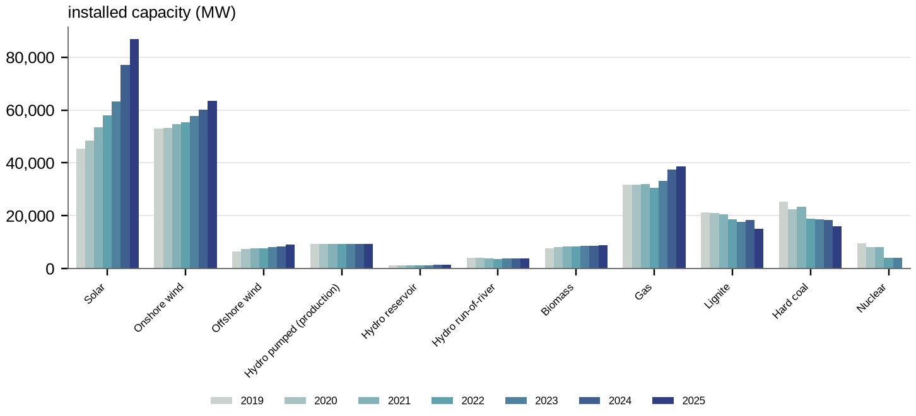
Installed generation capacity by technology (Germany)
Installed capacity by technology
Installed generation capacity by technology (Germany)
Source: ENTSO-E Transparency Platform (hourly prices, generation, flows & capacity).

Slide 8
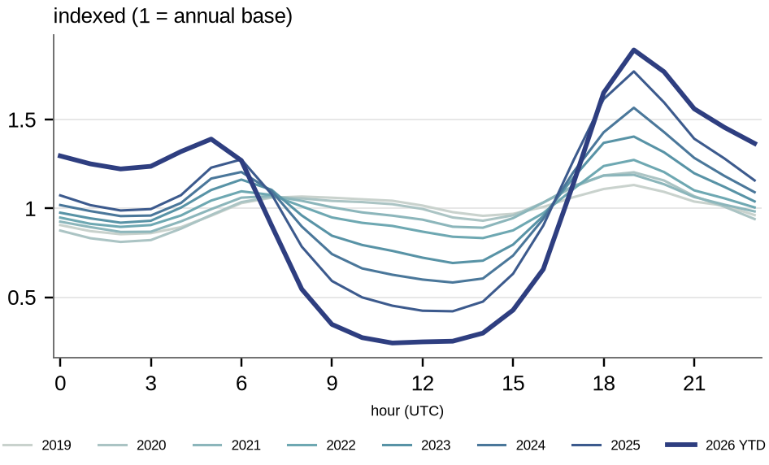
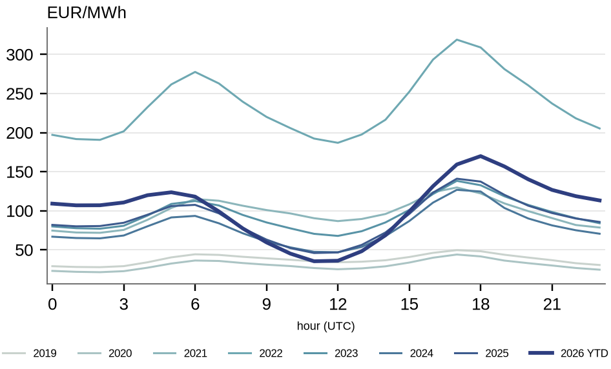
Intraday price shape — country variants
Spain's solar 'duck' in the indexed profile, and Germany's absolute price belly
Spain — intraday price shape, indexed to daily mean
Germany — intraday price shape (€/MWh)
Source: ENTSO-E Transparency Platform (hourly prices, generation, flows & capacity).

Slide 9
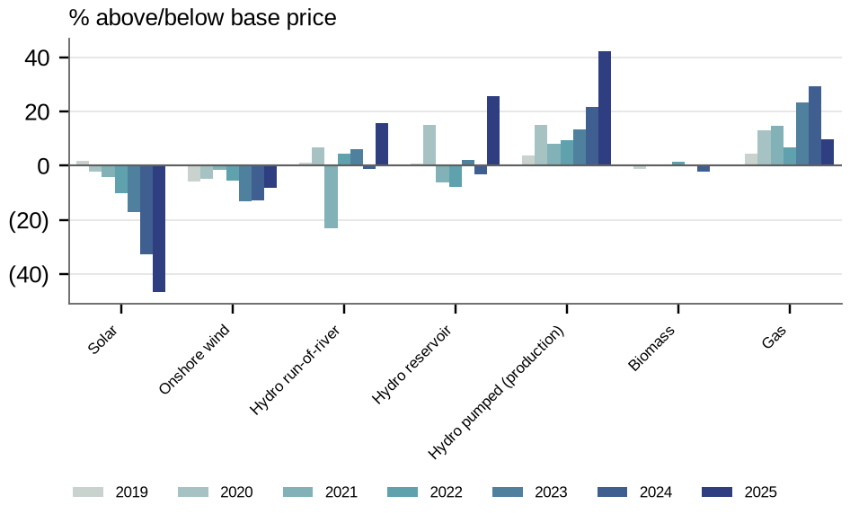
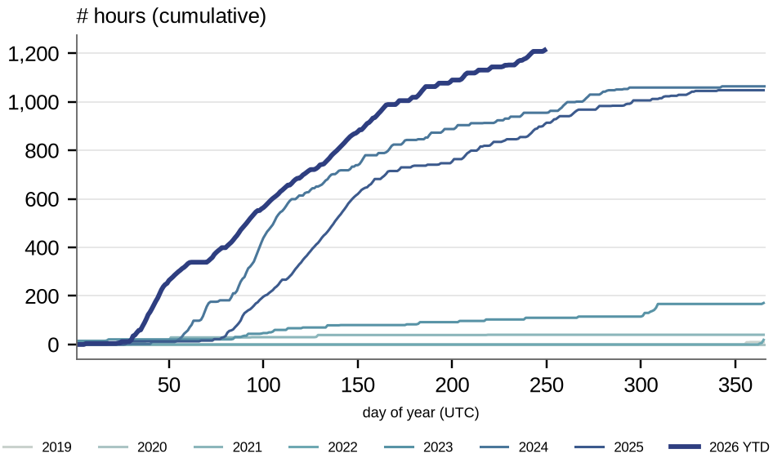
Capture prices & negative hours — country variants
Portugal's technology capture spreads, and the rise of negative-price hours in Spain
Portugal — capture price vs baseload by technology
Spain — cumulative near-negative-price hours through the year
Source: ENTSO-E Transparency Platform (hourly prices, generation, flows & capacity).

Slide 10
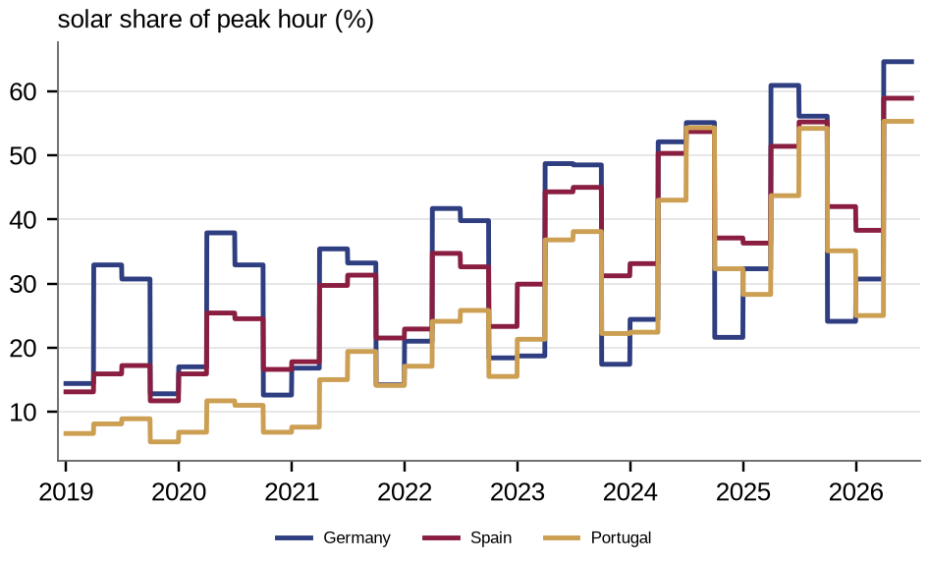
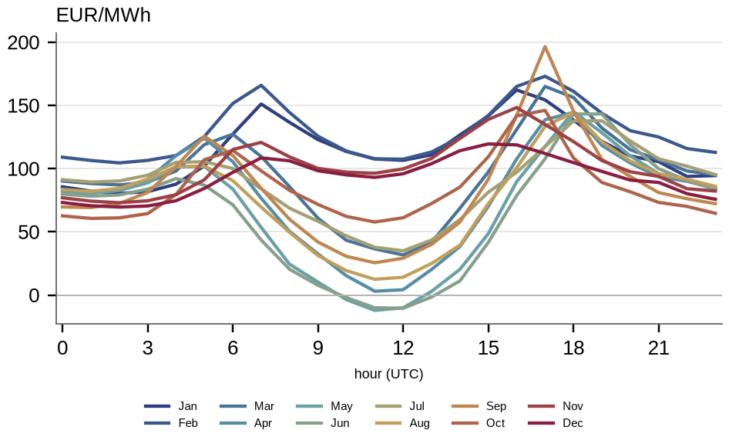
Solar's imprint on the intraday market
The share of solar in the peak hour, and how the price 'duck' deepens month by month
Solar share of the peak hour, by market (quarterly average)
Germany — intraday price by month (the monthly 'duck')
Source: ENTSO-E Transparency Platform (hourly prices, generation, flows & capacity).

Slide 11
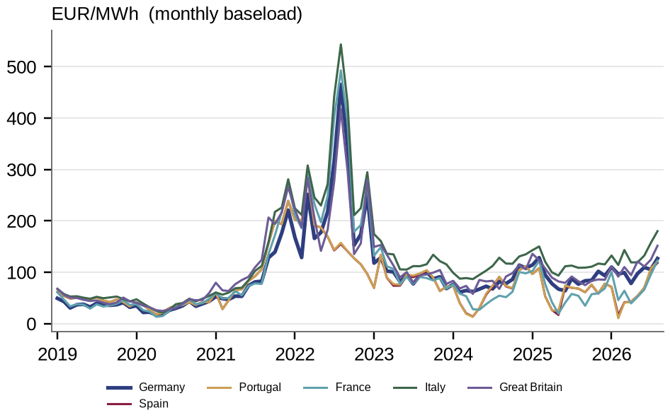
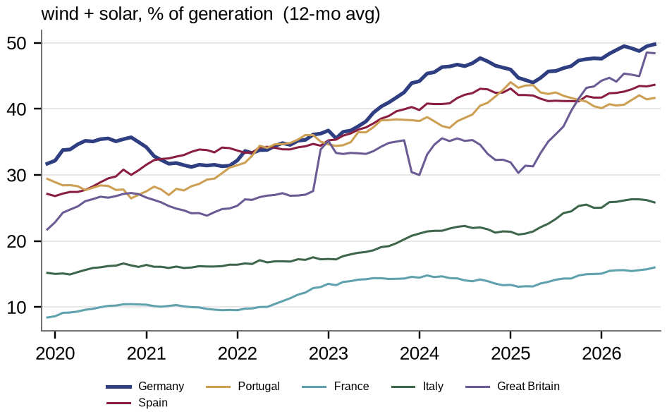
European power prices & renewables penetration
Monthly baseload price by market, and the rising share of wind & solar in generation
Monthly baseload power price by market (€/MWh). GB is the Elexon market index, not a day-ahead auction
Wind & solar share of generation, by market (12-month average)
Source: ENTSO-E Transparency Platform (hourly prices, generation, flows & capacity).

Slide 12
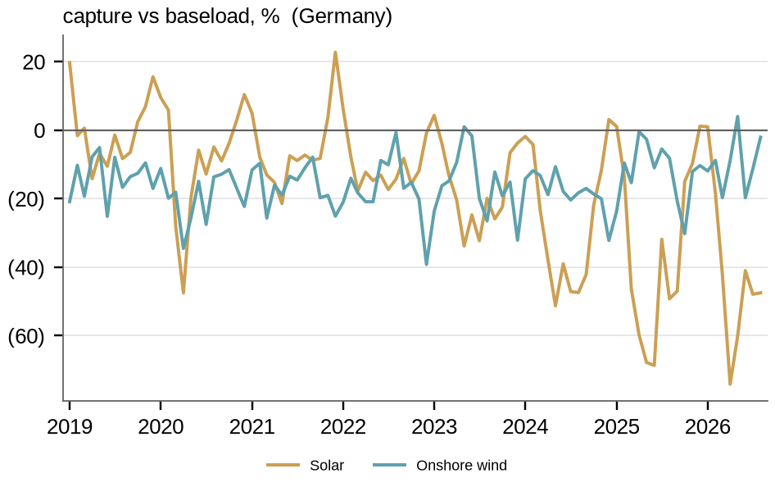
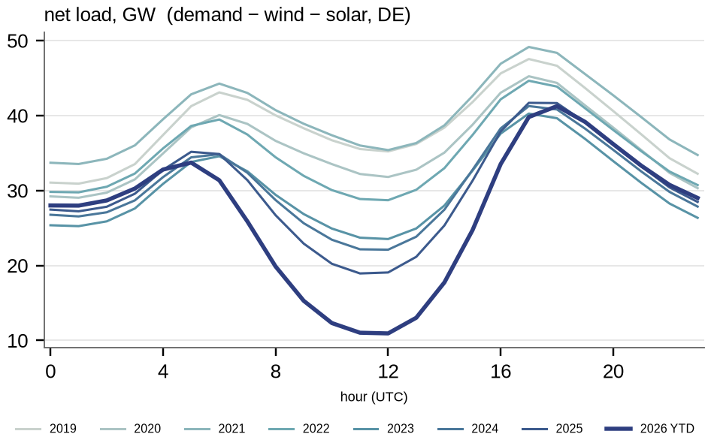
Renewable capture erosion & the net-load 'duck' (Germany)
How solar's realised price is eroded vs baseload, and how solar hollows out midday net load
Solar & wind capture price vs baseload (Germany)
Net-load 'duck': demand − wind − solar by hour, by year (Germany)
Source: ENTSO-E Transparency Platform (hourly prices, generation, flows & capacity).

Slide 13
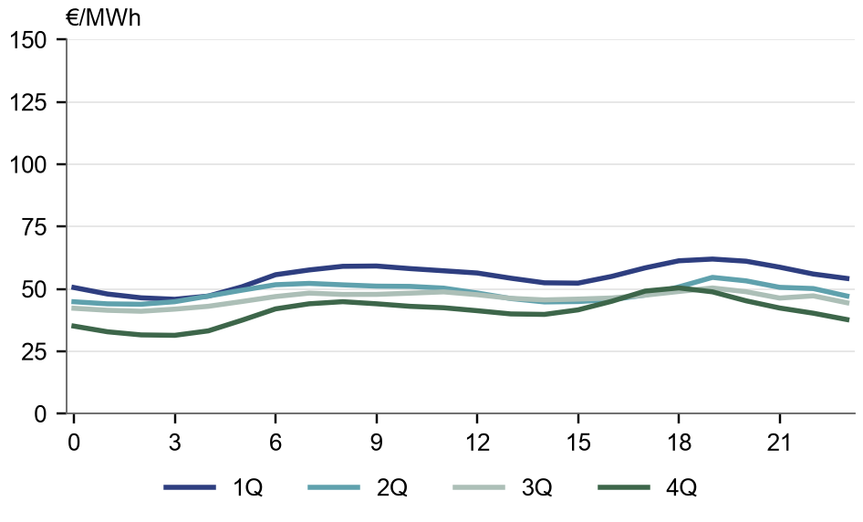
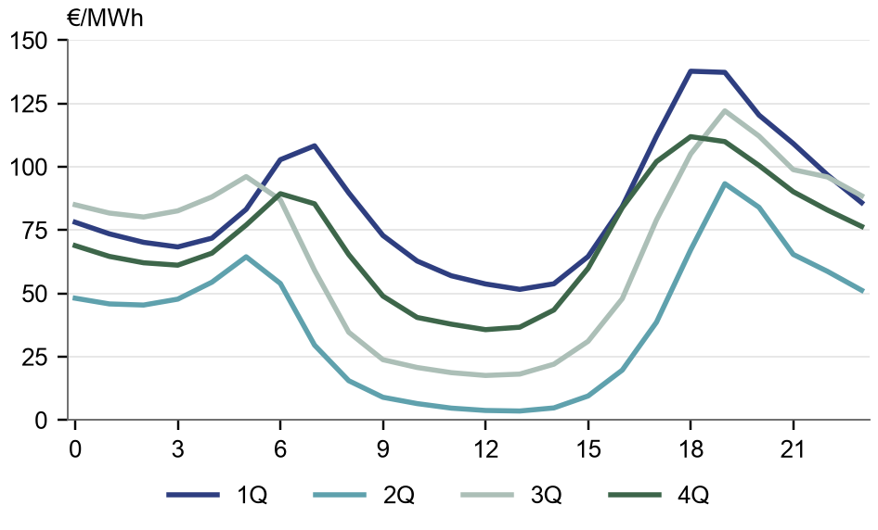
Spain intraday 'duck' — quarterly, 2019 vs 2025
Average intraday price by quarter (Spain day-ahead)
2019 — by quarter
2025 — by quarter
Source: ENTSO-E Transparency Platform (hourly prices, generation, flows & capacity).

Slide 14
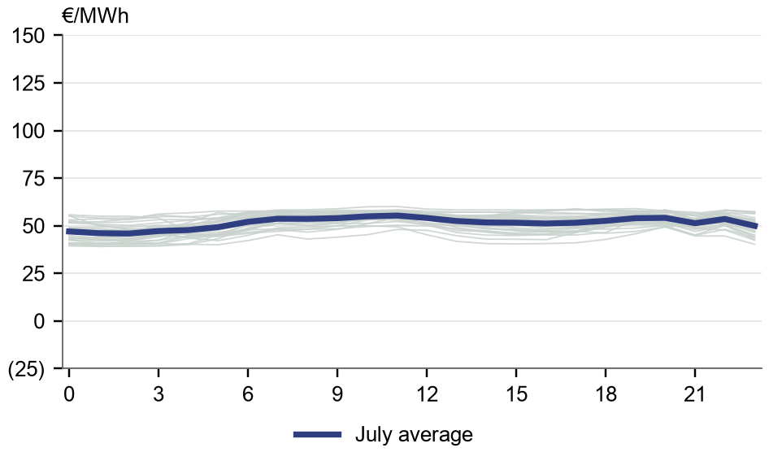
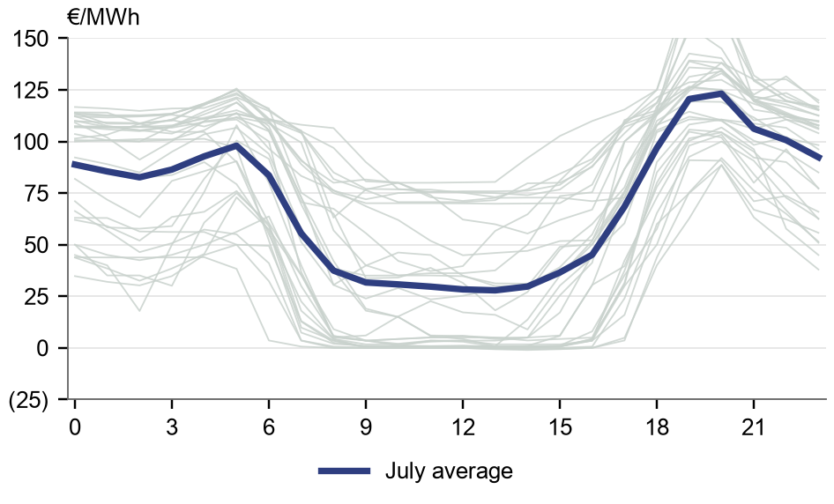
Spain July price 'spaghetti' — 2019 vs 2025
Every July day's intraday price shape; navy line = July average (Spain)
2019 — July, daily
2025 — July, daily
Source: ENTSO-E Transparency Platform (hourly prices, generation, flows & capacity).

