Slide 1
Project part 1
Geovisualization & Image processing
Fredrik Andersson, Simon Sundell nit10fan@student.hig.se ofk12ssl@student.hig.se

Slide 2
analysis
Main goal: Visualize flooding of Peace River in British Columbia, Canada
Data used: Landsat 7 satellite imagery (SLC-off)
From year 2004, 2005 & 2008 to 2014

Slide 3
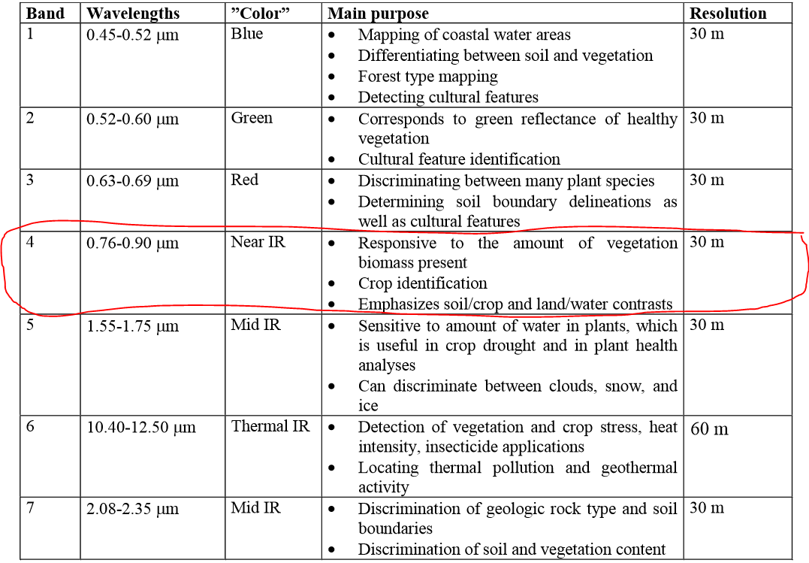
data
Band 4 was chosen for analysis, best for emphasizing shorelines
Source: Markku Pyykönen Lecture 1 – Remote sensing
Remote Sensing and GIS Analysis in Land Management

Slide 4
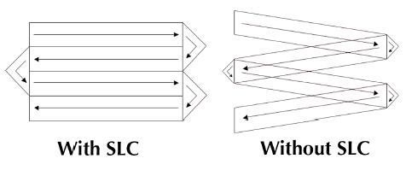
problems
SLC-off equals periodic noise
Diminished fairly well using Fast Fourier Transform (FFT) on full-size images.
Source: http://landsat.usgs.gov/products_slcoffbackground.php

Slide 5

problems
Original data example:
August 2008, band 4

Slide 6
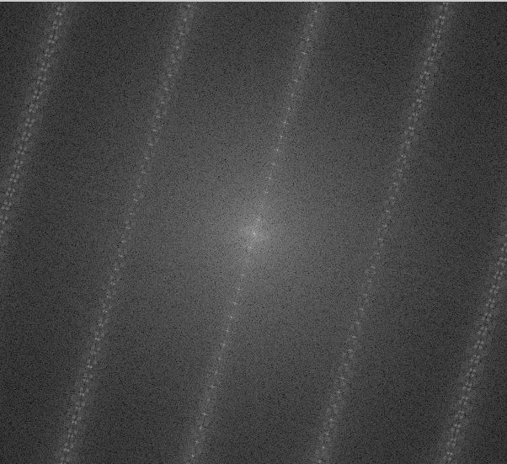
Fourier domain

Slide 7

Fourier domain – noise removed

Slide 8
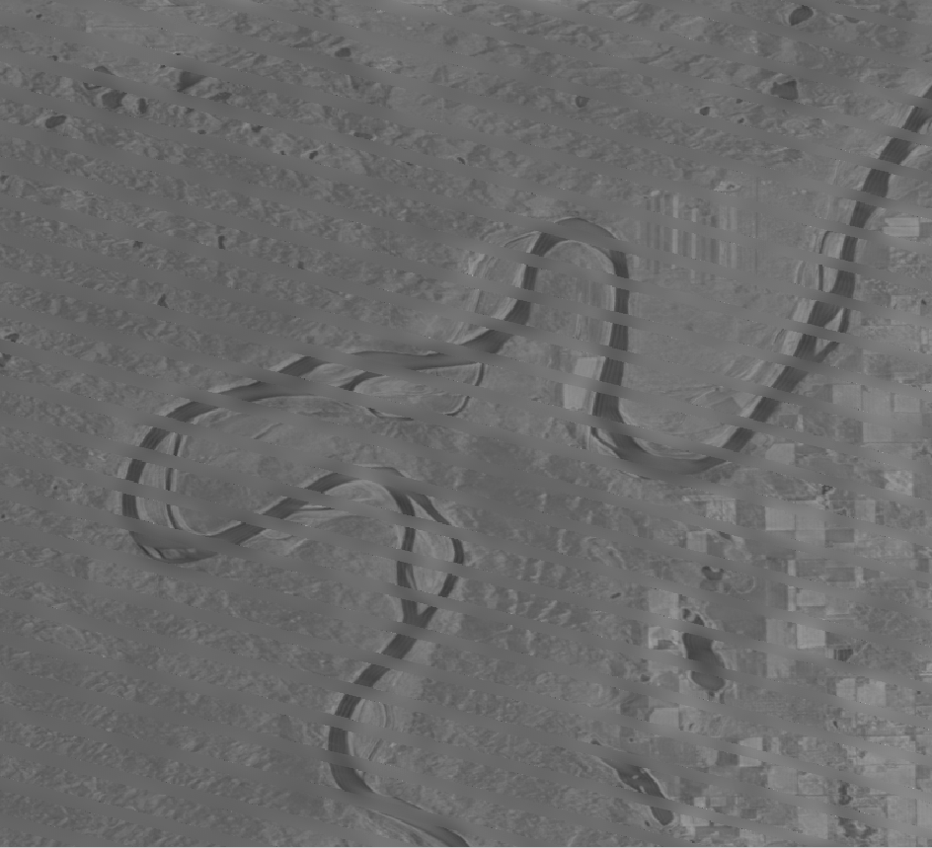
problems
Periodic noise diminished:
August 2008, band 4

Slide 9
Major problems:
Finding the right river pixel values
Search for values less than 90/255
Removing ”look-alike” river pixels
Removed using FFT polygon technique, by simply overlaying not known river with black (0 value) polygons.
problems

Slide 10
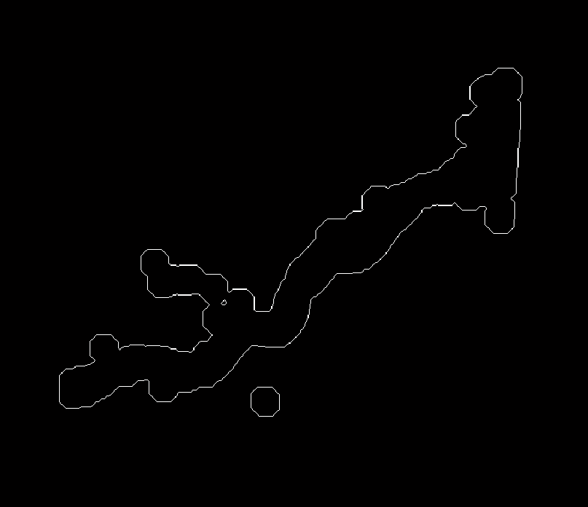
The river after Canny-op, Morph Ops and removal of (most) noise and wannabe river pixels
August 2008, band 4

Slide 11
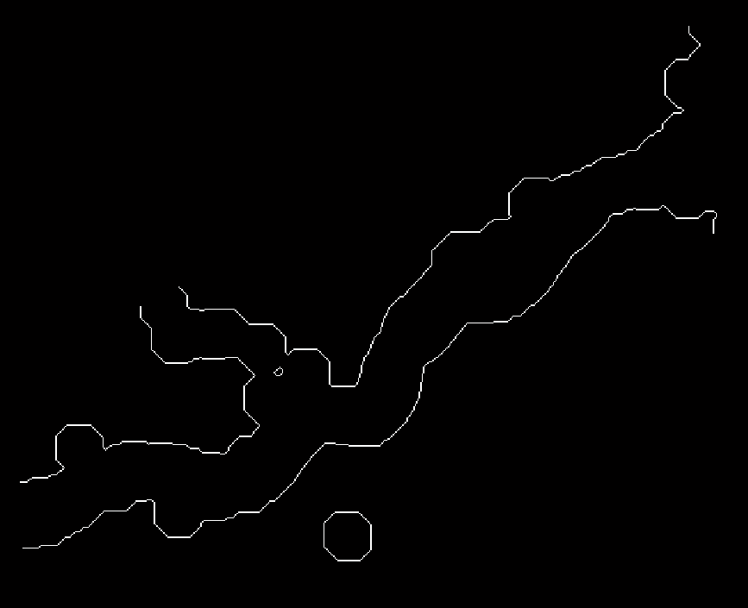
Removing edges of river, in order to lines not attached to each other
Also solved by overlaying polygons on each side of the river
August 2008, band 4

Slide 12
Sorting and saving the edges was executed with the provided functions - fairly easy process given you have good images/lines

Slide 13
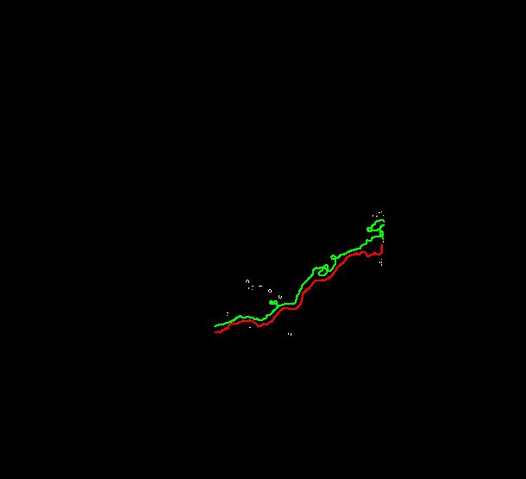
result
August 2008, band 4

Slide 14
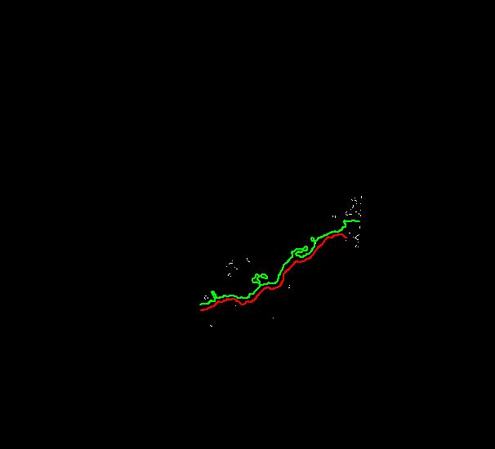
result
July 2009, band 4

Slide 15
Final problem
Does not work on all images!!
Seem to work on only Aug 2008, and July 2009
Needs more tinkering
Part 2 – work in progress

