Slide 1
Multiple Sequence Alignment Using Genetic Algorithms
Fred jones

Slide 2
Introduction
Multiple Sequence Alignment (MSA): Understanding evolutionary relationships between sequences
Traditional Methods: ClustalW, Clustal Omega, MAFFT, and MUSCLE
Challenge: Explore an alternative alignment (Genetic Algorithms) method/algorithm to compare to traditional methods

Slide 3
Problem Description
Objective: Implement a Genetic Algorithm (GA) to solve multiple sequence alignment problems
Approach: Compare GA results to cornerstone algorithm (ClustalW, MUSCLE) results
Key Tasks:
Generate initial population with random gaps.
Evaluate alignments using sum-of-pairs score with BLOSUM62.
Optimize alignments through selection, crossover, and mutation.

Slide 4
Methodology
Data Retrieval: Fetched 6 different sequences from the GenBank database using accession codes
GA Implementation:
Generate initial population – pad lengths by adding random gaps
Fitness function - Score of an alignment by summing the BLOSUM62 substitution matrix scores for all pairs of non-gap characters in each column, with penalties for gaps
Evolving Alignments - selection, crossover, and mutation, replacement with elitism
Population Size – 200
Generations - 2000
Traditional Methods: GA is compared to ClustalW and MUSCLE results

Slide 5
Results
Algorithm | Total Alignment Score (BLOSUM-62 Matrix)
ClustalW | 45,590.0
MUSCLE | 49,117.0
Genetic Algorithm | 39,876.0

Slide 6
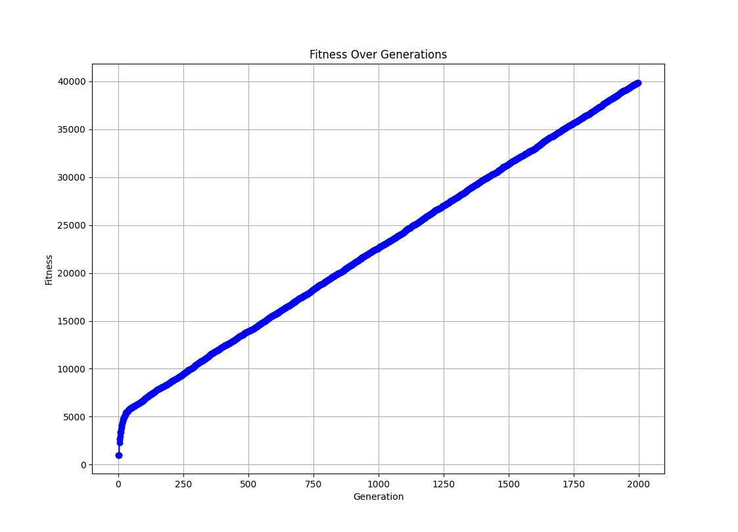
Fitness graph

Slide 7
Conclusion
Genetic Algorithm produced a decent alignment score comparatively
Graph showed more room for convergence
Computation time was far greater for the Genetic Algorithm (hours compares to minutes)
Areas for improvement:
Larger population size
Run for more generations
Efficiency improvement
Dynamic parameter tuning

