Slide 1
NonRelational Databases NoSQL
Created by
Fredj FATHIA

Slide 2
What is NoSQL ?
NoSQL stands for the non-relational database which is currently being used for storing and retrieving data. NoSQL is used for managing the large unstructured data sets where the information is not kept in a relational form or non-tabular form. Rather, the data is stored in the form of documents, graph or collection of key-value pairs.
A common misconception is that NoSQL databases don’t store relationship data well. In fact, when compared with SQL databases, many find modeling relationship data in NoSQL databases to be easier than in SQL databases, because related data doesn’t have to be split between tables.

Slide 3
Why NoSQL ?
Picking the right database technology is one of decisions that will drive how you architect your application. This slide will help you understand why and when should you choose a NoSQL database.
To make a choice, you first need to ask a few questions about the needs of your application. For example;
Can your application support your projected user volume growth?
To cope up with user demands/activities. Do you need to scale your applications?
How much money and time can be saved with 0% downtime?
Would your application benefit from rapid development cycles? (flexible data model)
Does your application generate huge amounts of data?
Answering these questions helps you identify the needs of your application and highlights areas where a NoSQL database truly shines in contrast to a relational database.

Slide 4
Why NoSQL ?
The traditional database languages were unable to deliver effective outcomes in case of:
Variable data i.e., regularly altering formation such as in unstructured, structured or semi-structured data.
Modern applications dealing with a huge number of people from multiple geographical locations which needs to run all the time serving data integrity in an effective way.
Distributed applications hosted over the cloud throwing a massive amount of data which needs to analyzed and accessed from the time to time. Since these data sets are available over various virtual servers, the NoSQL is needed to access them especially when they are unstructured.
NoSQL is developed to resolve the major associated issues such as scalability, performance, data integrity and modeling which are getting common in a relational database.

Slide 5
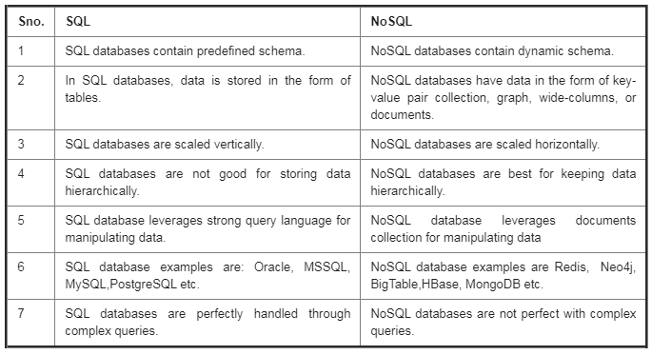
Difference between SQL and NoSQL
The SQL and NoSQL- both the databases are very famous across the industries. Let's understand the key differences among them:

Slide 6
NoSQL characteristics
Store and retrieve data from many formats.
It’s free of joins (extract your data using simple interfaces without joins).
It’s schema-free (allow you to drag-and-drop your data into a folder and then query it without creating an entity-relational model).
It works on many processors (store your database on multiple processors and maintain high-speed performance).
It uses shared-nothing commodity computers (most NoSQL systems leverage low-cost commodity processors that have separate RAM and disk).
It supports linear scalability .
It’s innovative (NoSQL offers options to a single way of storing, retrieving, and manipulating data).

Slide 7
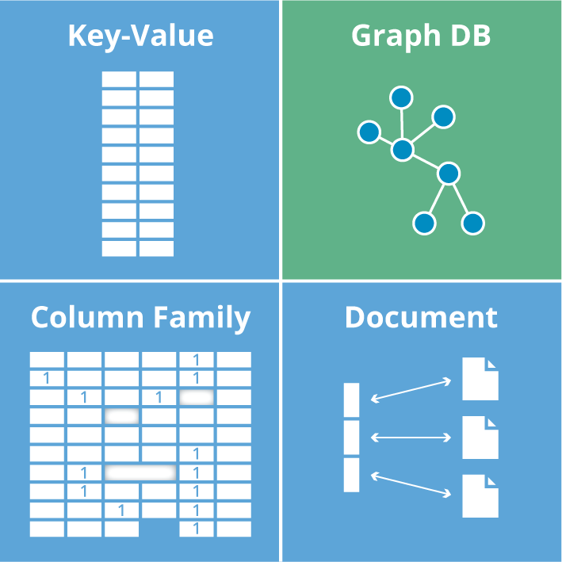
NoSQL databases types
A NoSQL database can be of four types:
key-value store: It contains a hash table which stores keys and its values such as Amazon Simple Storage Service (S3), (Dynamo).
Document-based store: It keeps the documents which are made up of tagged elements.
Column-based Store: All the storage blocks consist of information just from a single column, such as in Cassandra or HBase.
Graph-based store: It is a network database which leverages the nodes and their edges for keeping or showing data such as in Neo4J.

Slide 8
ACID theorem
The “ACID” rules were originally defined by Jim Gray in the 1970s; the acronym was popularized in the 1980s. ACID transactions solve many problems when implemented to the letter but have been engaged in a push-pull with performance trade-offs ever since. Still, simply understanding these rules can educate those who seek to bend them about the dragons they may encounter.
The system must provide ACID transactions, and must always present applications with consistent and correct data. Designing applications to cope with concurrency anomalies in their data is very error-prone, time-consuming, and ultimately not worth the performance gains.

Slide 9
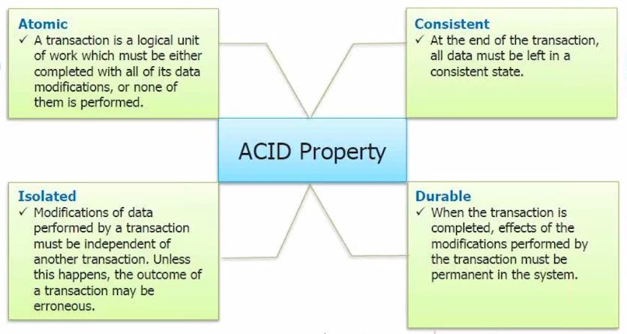
What does ACID stand for?

Slide 10
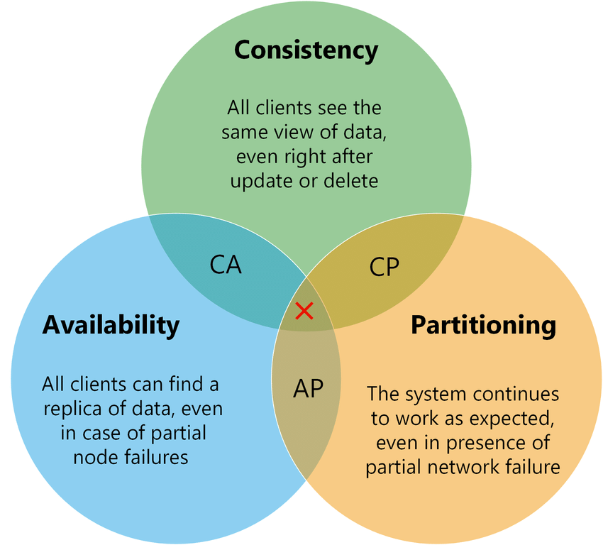
CAP theorem
CAP is a tool to explain trade-offs in distributed systems. It was presented as a conjecture by Eric Brewer at the 2000 Symposium on Principles of Distributed Computing and formalized and proven by Gilbert and Lynch in 2002.

Slide 11
NoSQL advantages
A few of the biggest advantages of NoSQL are:
They have big data abilities.
Zero downtime and not a single point of failure.
It can be easily replicated and is simple to implement.
You can use it as a main or analytic data source.
It can deal with all kinds of data: structured, semi-structured, unstructured.
Scalability is performed horizontally with quick performance.
It doesn't require any separate layer for the cache.
It leverages OOPs (Object Oriented Programming) making it flexible. For online applications, you can use it as the main data source.
They don't require expensive high-performance server for execution.
It has the ability to handle distributed database operations.

