Slide 1
Introduction to Databases
Created by
Fredj Fathia

Slide 2
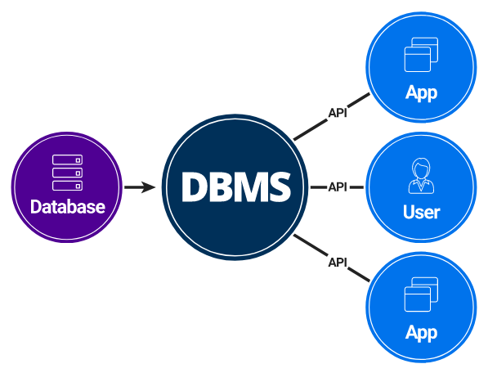
What does Database Management System (DBMS) mean?
A database management system (DBMS) is a software package designed to define, manipulate, retrieve and manage data in a database.
A DBMS generally manipulates the data itself, the data format, field names, record structure and file structure.
It also defines rules to validate and manipulate this data.

Slide 3
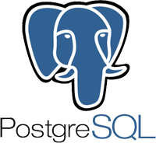
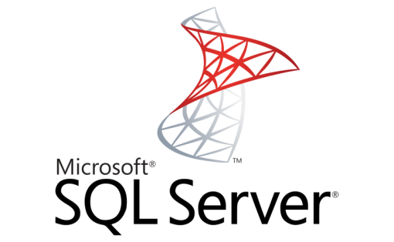
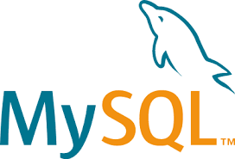
Exemples of DBMS

Slide 4
What is MySQL?
MySQL, the most popular Open Source SQL database management system, is developed, distributed, and supported by Oracle Corporation.
MySQL store Data in Tables. Tables further store Data in Rows and Columns.
MySQL is based on the structure query language(SQL), witch is used for adding, removing, and modifying information in the database.
MySQL is a freely available Database System.
MySQL can run on multiple Platforms such as Linux, Windows and Unix.
MySQL is highly Scalable Database System.

Slide 5
PostgreSQL
PostgreSQL is a powerful, open source object-relational database system that uses and extends the SQL language combined with many features that safely store and scale the most complicated data workloads.
PostgreSQL has earned a strong reputation for its proven architecture, reliability, data integrity, robust feature set, extensibility, and the dedication of the open source community behind the software to consistently deliver performing and innovative solutions.

Slide 6
PostgreSQL
PostgreSQL runs on all major operating systems, has been ACID-compliant since 2001, and has powerful add-ons such as the popular PostGis geospatial database extender.
Getting started with using PostgreSQL has never been easier - pick a project you want to build, and let PostgreSQL safely and robustly store your data.

Slide 7
SQL Server
SQL Server is a relational database management system, or RDBMS, developed and marketed by Microsoft.
SQL Server is built on top of SQL, a standard programming language for interacting with the relational databases.
SQL server is tied to Transact-SQL, or T-SQL, the Microsoft’s implementation of SQL that adds a set of proprietary programming constructs.
SQL Server works exclusively on Windows environment for more than 20 years. In 2016, Microsoft made it available on Linux. SQL Server 2017 became generally available in October 2016 that ran on both Windows and Linux.

Slide 8
What’s the difference?
PostgreSQL, MySQL, and SQL Server use very similar syntax, with some notable differences.
Microsoft SQL Server has the greatest contrast in SQL syntax, as well as a wide variety of functions not available in other platforms.

