Slide 1
User Journey Presentation
Sudoku Puzzle & Solver App
Student ID: FK18726
Reg Number: 1804162

Slide 2
User Story 1
“I have just downloaded the application for the first time, and wish to open it.”

Slide 3
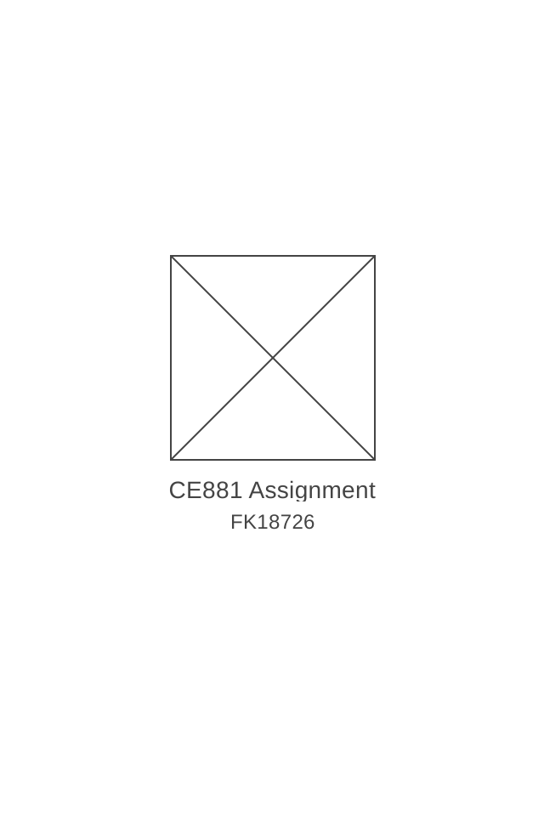
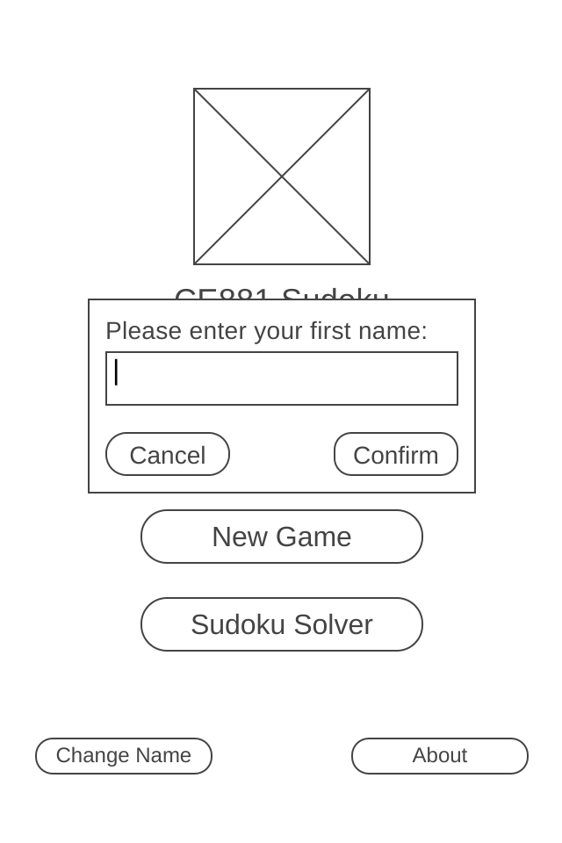
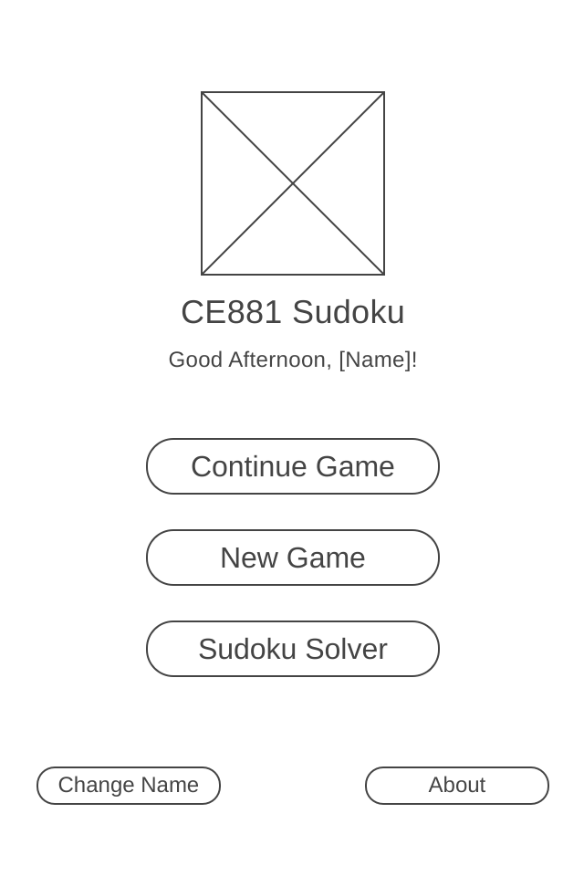
Upon opening the application, every user will be met with the splash screen. This will automatically disappear after a few seconds, and requires no input from the user.
The user will be met with a dialog box; prompting them to enter their name. Once their name is entered, they should press ‘Confirm’. If the user does not wish to provide a name, then they can press the ‘Cancel’ Button.
The dialog box will then disappear, with the user being able to access the full main menu. If they had entered a name and pressed ‘Confirm’ in the dialog box, a greeting would be displayed with the user’s name. If they pressed ‘Cancel’, a default name of ‘User’ will be given.

Slide 4
User Story 2
“I want to change my name in the app, as I do not like the current set name.”

Slide 5
In order to change their in-app name, the user should press the ‘Change Name’ button from the main menu.
The user will be met with a dialog box; prompting them to enter their name. Once their name is entered, they should press ‘Confirm’. If the user does not wish to provide a name, then they can press the ‘Cancel’ Button.
The dialog box will then disappear, with the user being able to access the full main menu. If they had entered a name and pressed ‘Confirm’ in the dialog box, a greeting would be displayed with the user’s name. If they pressed ‘Cancel’, their previously entered name will be given.

Slide 6
User Story 3
“I’m unsure about the rules of Sudoku, and want to know what the modes do within the app.”

Slide 7
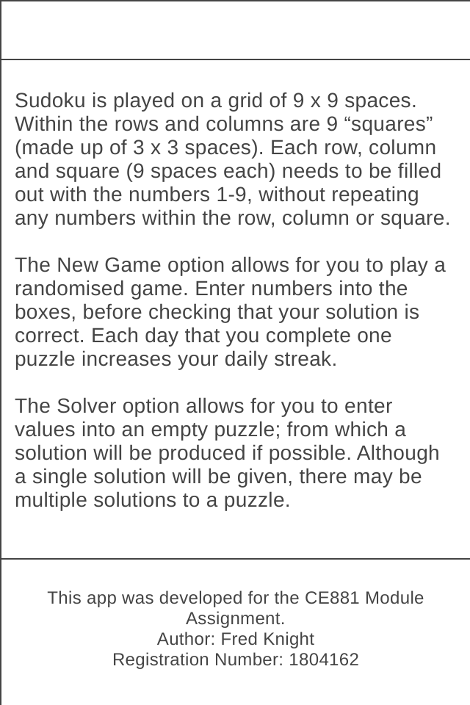
The details that the user is after are located within the about section. In order to access this section, the user should press the ‘About’ button from the main menu.
The about section contains a basic outline of how Sudoku puzzles are set out, as well as a brief explanation of what the two modes do within the app. This section also contains a small amount of information in regards to the project.

Slide 8
User Story 4
“I want to attempt a puzzle for the first time in this app.”

Slide 9
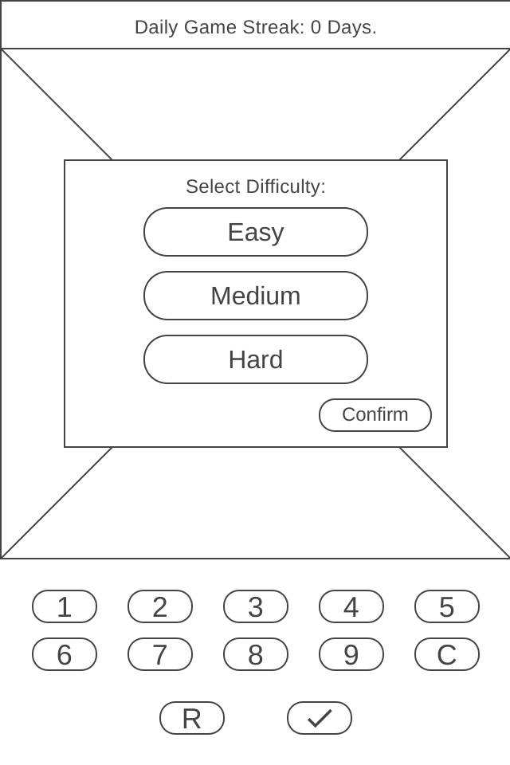
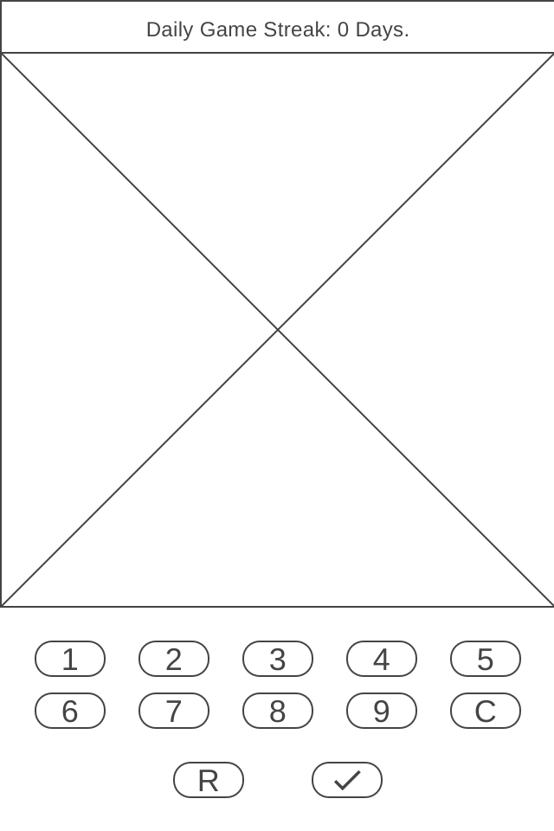
To start a new puzzle, the user should press the ‘New Game’ button from the main menu.
A dialog box will then appear to the user; prompting them to select a difficulty for the generated puzzle. Once they have selected the difficulty, they should press the ‘Confirm’ button.
This will then create the activity for the puzzle mode. Here, the user can select points on a grid that they wish to enter numbers into, before confirming their solution and having the app check to see if the solution is correct.

Slide 10
User Story 5
“I want to continue a puzzle that I had previously started, as I want to finish it.”

Slide 11
To continue from a previously unfinished puzzle, the user should press the ‘Continue Game’ button from the main menu.
This will then create the activity for the puzzle mode. It will load the user’s progress on their last puzzle.

Slide 12
User Story 6
“I want to start a new puzzle, as I do not wish to continue my current puzzle.”

Slide 13
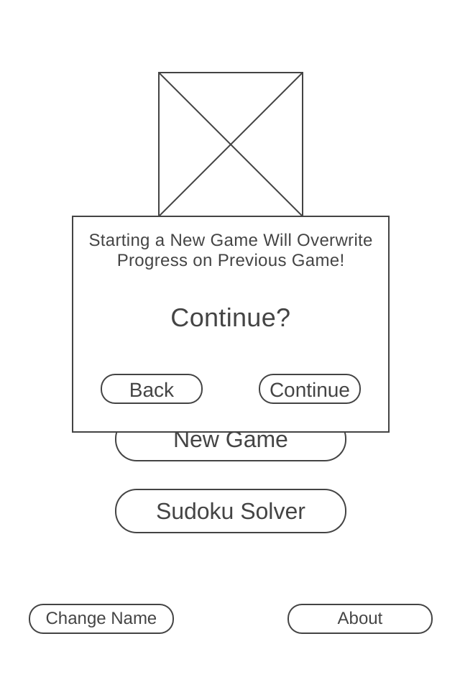
To start a new puzzle, the user should press the ‘New Game’ button from the main menu.
A dialog box then appears, asking the user to confirm if they wish to start a new game or not. If they wish to overwrite their previous puzzle, they should press the ‘Continue’ button. To cancel and return to the main menu, they should press the ‘Back’ button.
Another dialog box then appears, prompting the user to select a difficulty for the generated puzzle.

Slide 14
After selecting a difficulty, the user should press the ‘Confirm’ button in order to confirm the difficulty of their new puzzle.
This will then create the activity for the puzzle mode. Here, the user can select points on a grid that they wish to enter numbers into, before confirming their solution and having the app check to see if the solution is correct.

Slide 15
User Story 7
“I want to check my solution to an existing puzzle from an alternative source, as a solution wasn’t provided.”

Slide 16
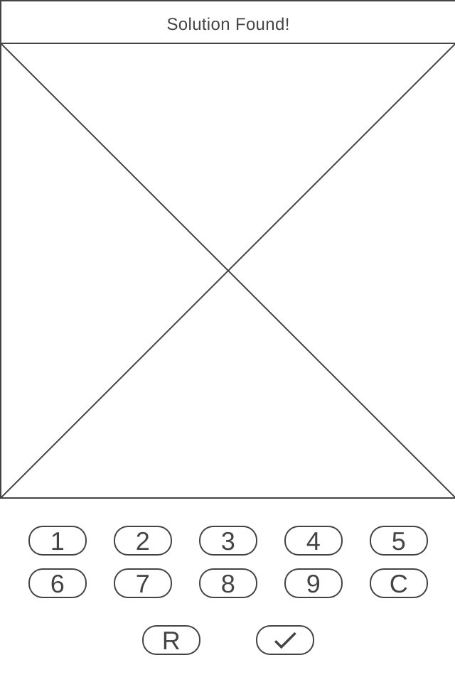
In order to access the solver mode of the app, the user should select the ‘Sudoku Solver’ button from the main menu.
This will then create the activity for the solver mode. Here, the user can select points on a grid that they wish to enter numbers into, before confirming their choice to have the app find a solution.

Slide 17
User Story 8
“I wish to leave the application, as I no longer have a need or want to use it at this time.”

Slide 18
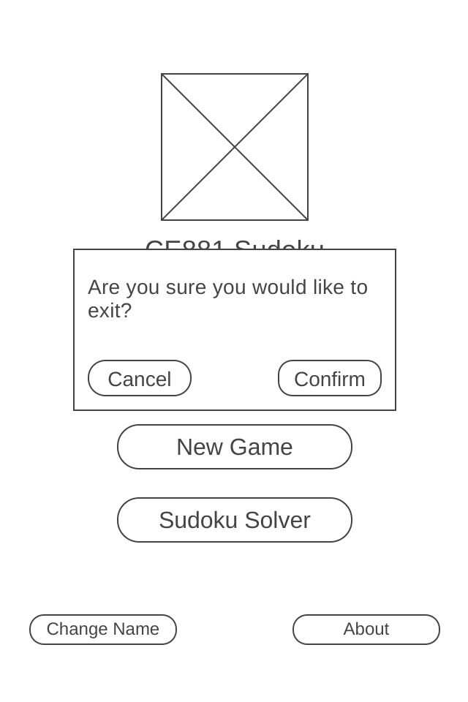
In order to leave the app, the user should press the ‘Back’ button on their device from the main menu.
The user will be met with a dialog box; prompting them to either press the ‘Confirm’ button if they wish to leave, or the ‘Cancel’ button if they do not yet wish to leave.

