Slide 1
CE881 Sudoku Sudoku Puzzle Generator & Solver
Student ID: FK18726
Reg Number: 1804162

Slide 2
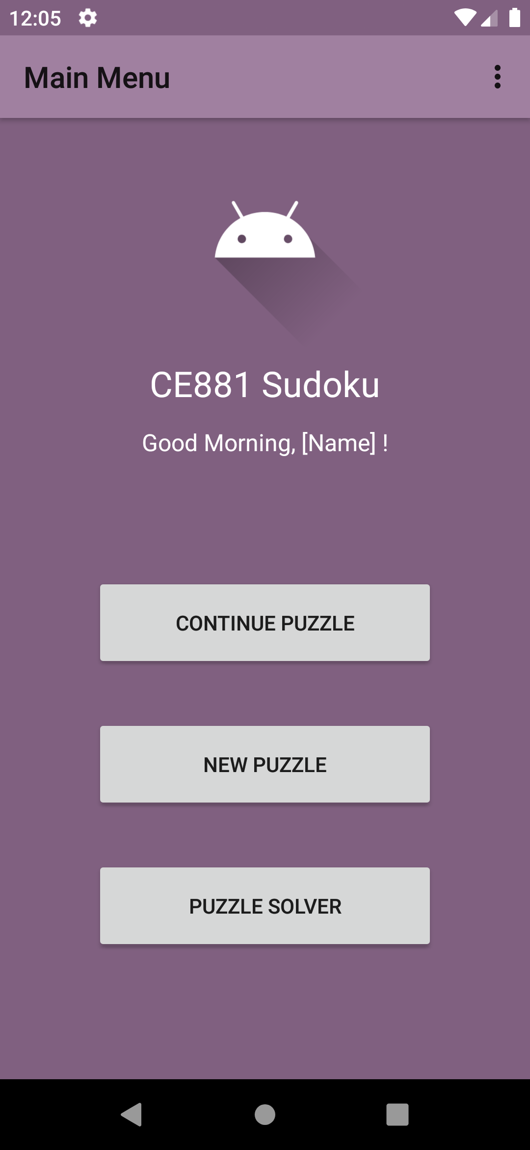
Features
Puzzle Generator and Solver in a single application
Difficulty options for puzzle generation
Puzzles are constantly saved
Allows for puzzles to be resumed after app exit
Many available competitors either focus on one or the other
Including both in a single app both provides convenience to the user
Reduces required storage due to having multiple apps installed to serve the same purpose
‘About’ section, for summary of Sudoku rules and menu option functions
Greets the user when app is opened
Prefix based on the current time of day
Name can be set and changed by the user

Slide 3
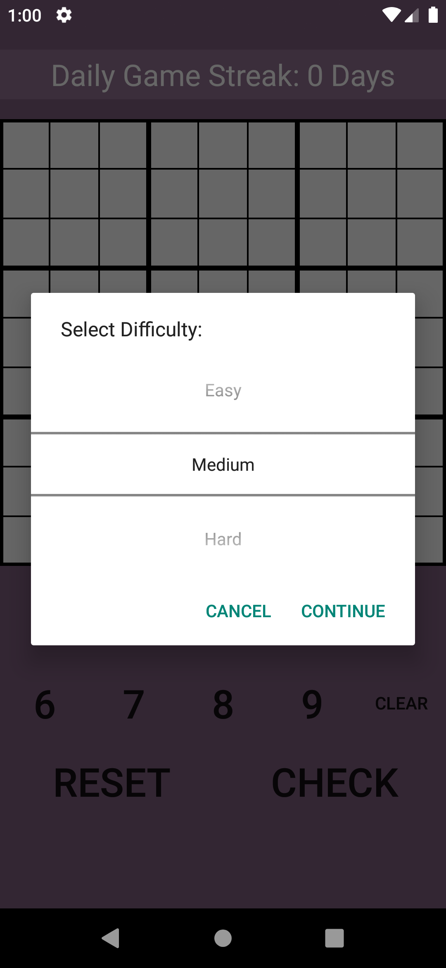
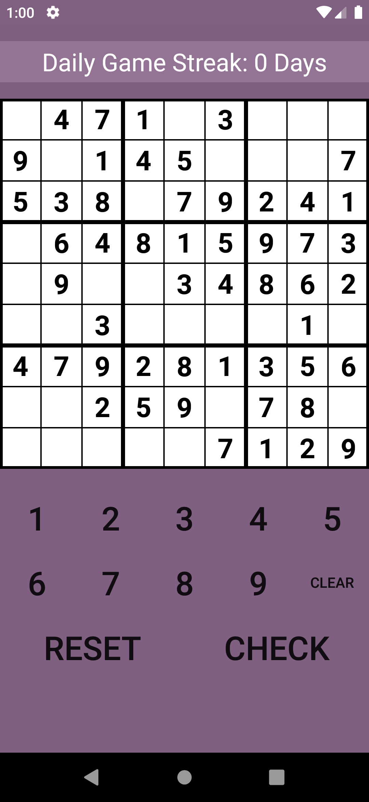
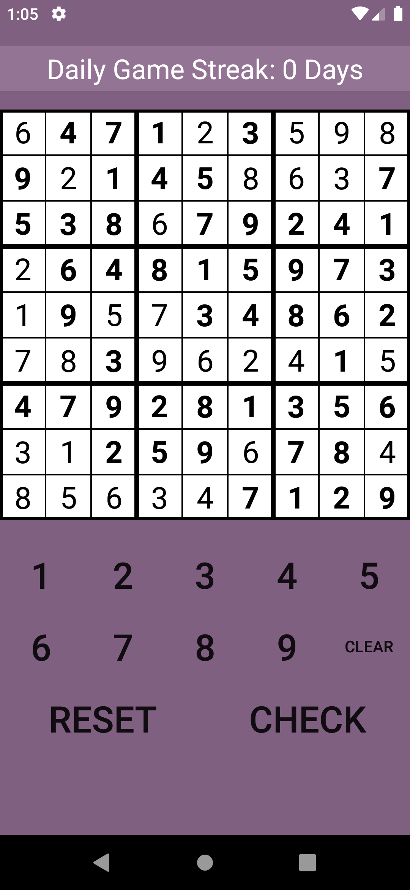
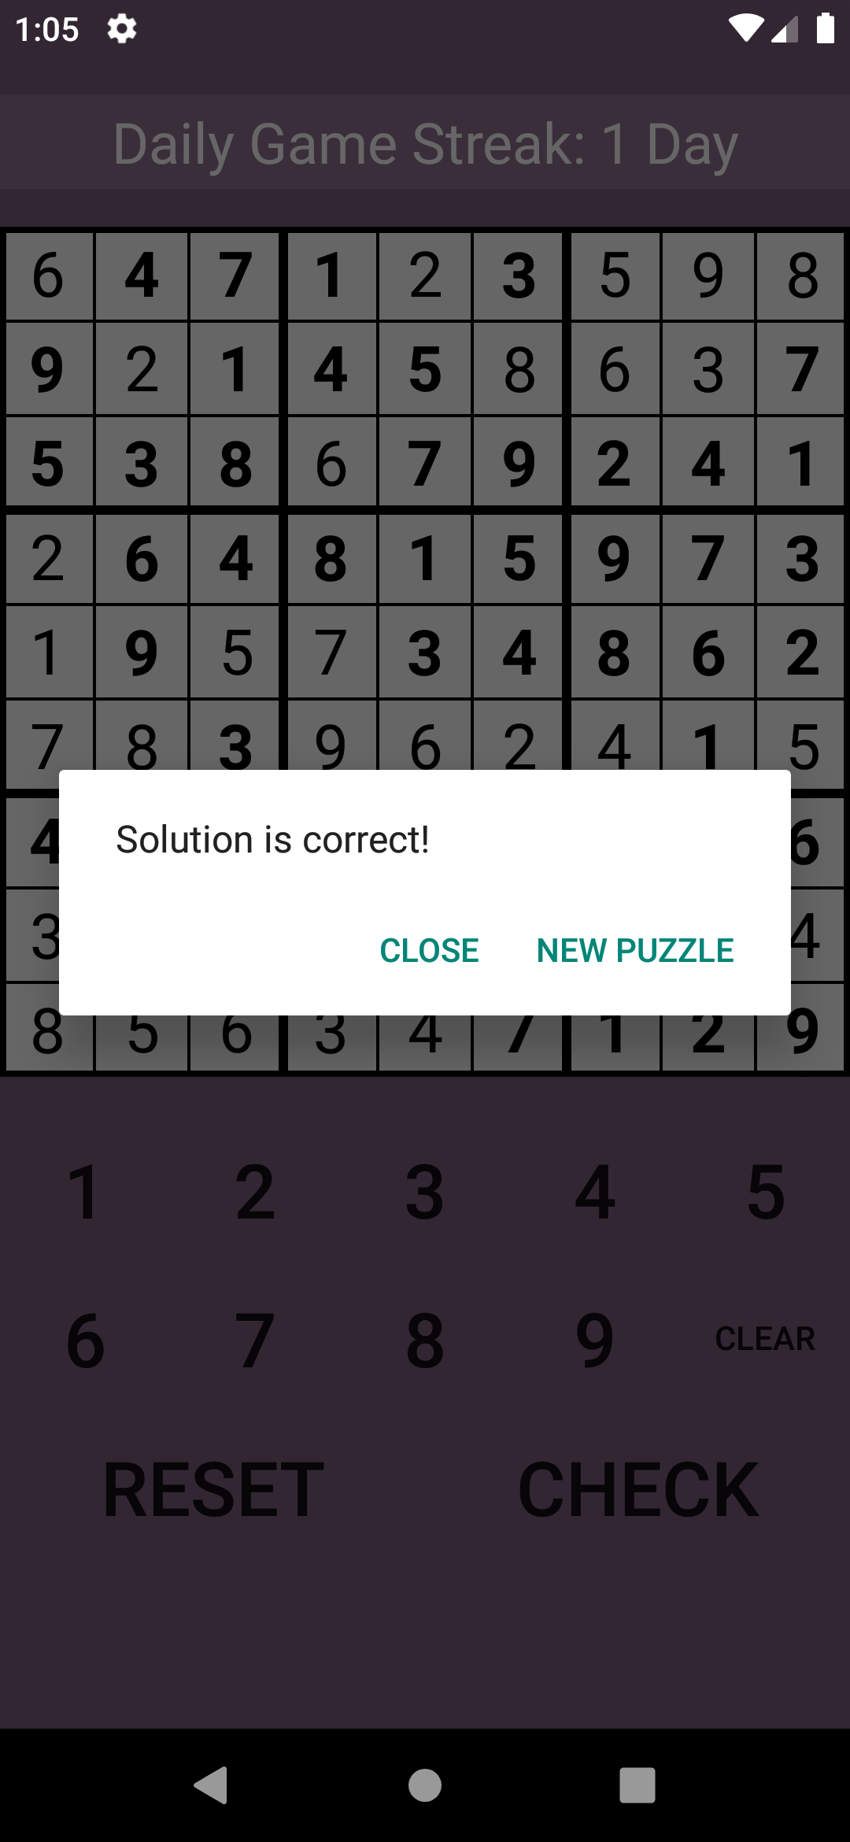
Sudoku Puzzle Generator
Selecting ‘New Game’ will prompt the user to select a difficulty
This difficulty decides on how many numbers will be made hidden to the user
If the user has not previously created a puzzle, the ‘Continue’ button will also give this prompt
The puzzle is the generated using the selected difficulty
If the user has selected ‘Continue’, then this will be skipped and instead the saved grid state will be loaded
Users enter numbers into the empty cells, before checking their solution
If the solution is correct and the user has not already completed a puzzle in the same day, then their daily streak will increment

Slide 4
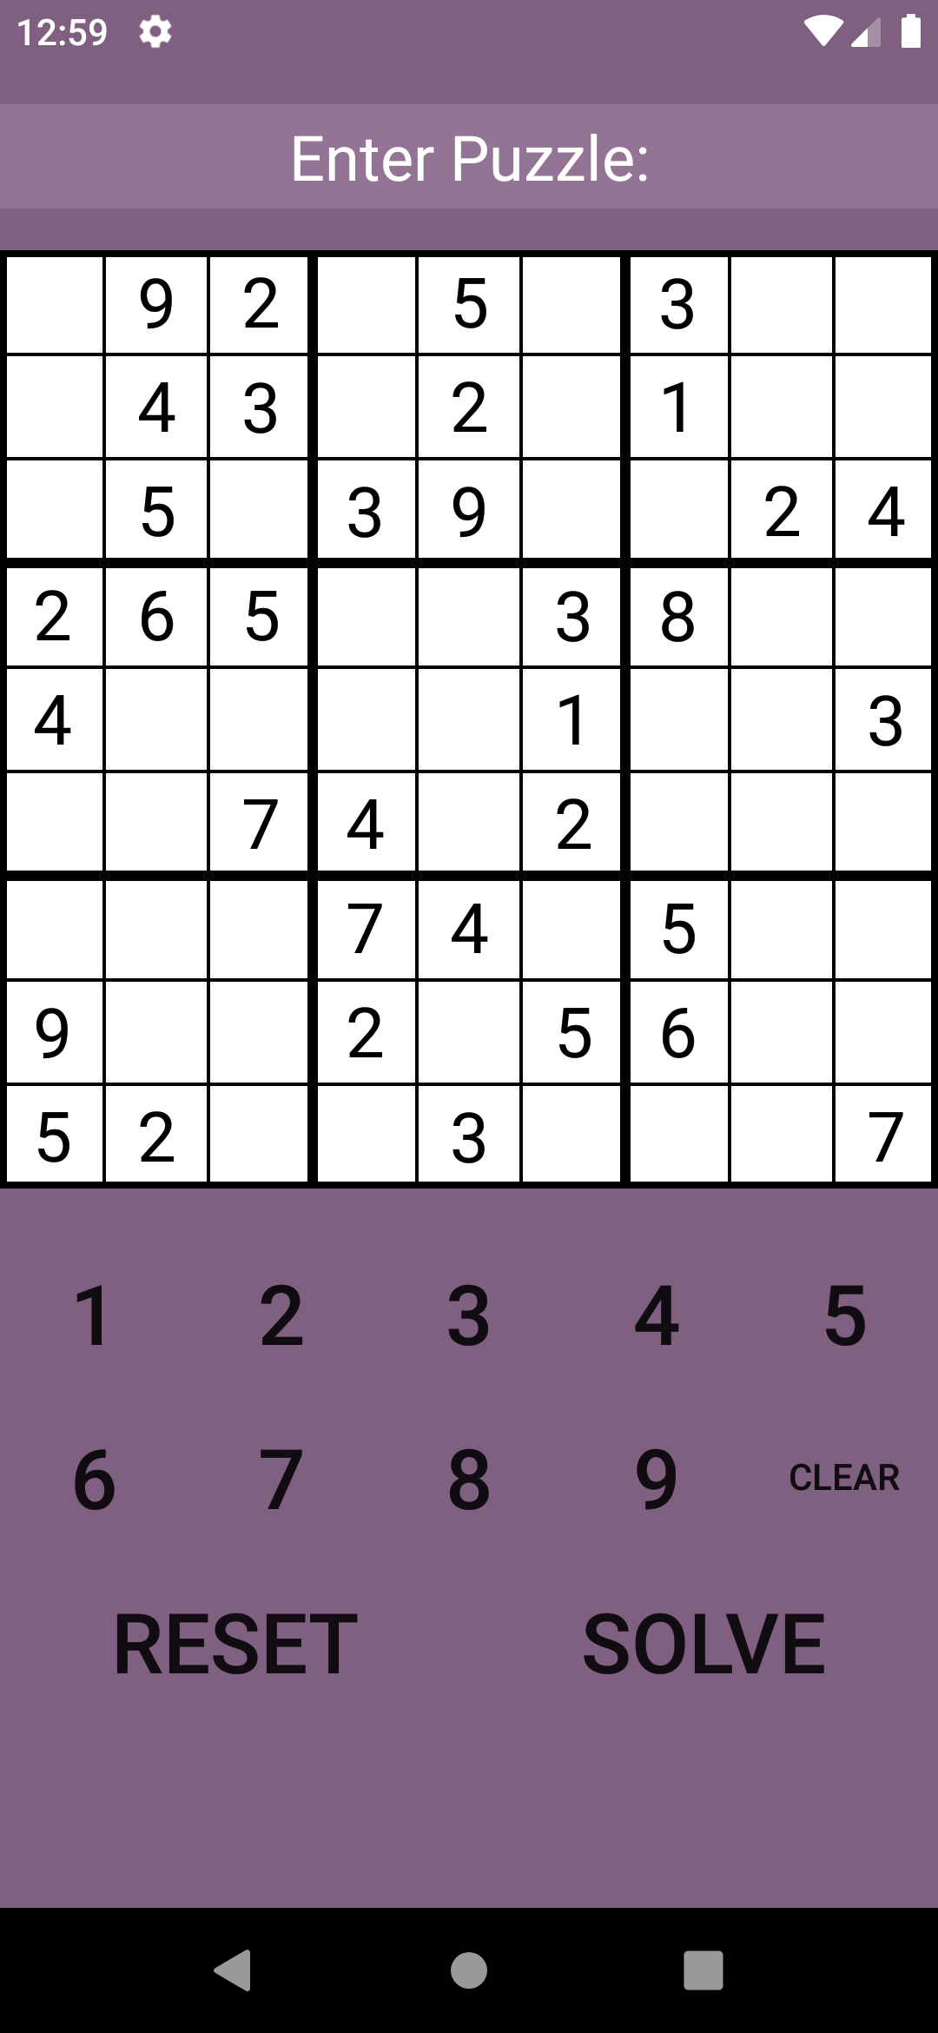
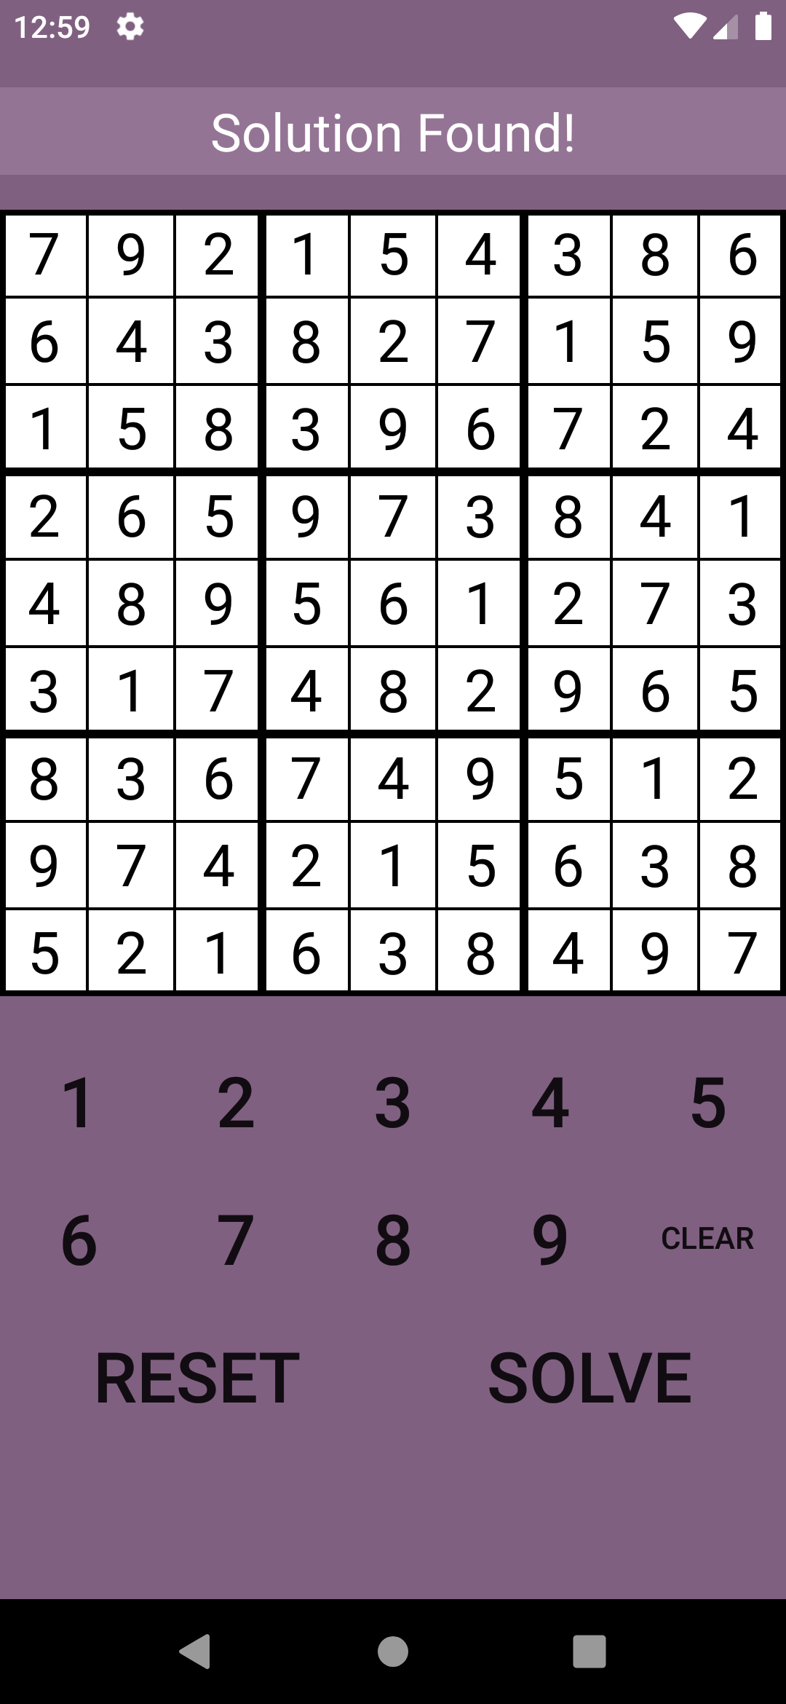
Sudoku Puzzle Solver
The user will be presented with an empty grid, and will be prompted to enter a puzzle
They can then enter valid numbers into selected cells
When the user has finished entering their puzzle, they can select to ‘Solve’ the puzzle
The app will then check each number in every cell until a solution is found
Many solutions for a specific puzzle may be possible, however only the first reached will be used
When a solution has been found, the full solution will be presented to the user

