Slide 1

Rigor and Reproducibility II
Experimental Reproducibility
Fred LaPolla MLS & Alisa Surkis PhD

Slide 2
Review

Slide 3


Which of the following is not an identified source of problems in reproducibility by the NIH:
ⓘ
Click Present with Slido or install our Chrome extension to activate this poll while presenting.
Notes:
📣 This is Slido interaction slide, please don't delete it. ✅ Click on 'Present with Slido' and the poll will launch automatically when you get to this slide.

Slide 4

Provide an example of a key biological variable and why we should report on it in our research:
ⓘ
Click Present with Slido or install our Chrome extension to activate this poll while presenting.
Notes:
📣 This is Slido interaction slide, please don't delete it. ✅ Click on 'Present with Slido' and the poll will launch automatically when you get to this slide.

Slide 5
Which of the following describes a way that publication bias contributes to the reproducibility crisis?
ⓘ
Click Present with Slido or install our Chrome extension to activate this poll while presenting.
Notes:
📣 This is Slido interaction slide, please don't delete it. ✅ Click on 'Present with Slido' and the poll will launch automatically when you get to this slide.

Slide 6
Agenda
Common statistical misunderstandings
Reporting and Reproducibility
Bias
Transparency of Reporting

Slide 7
Outcomes
Students will be able to define p values and power and discuss contemporary debates around “significance”
Students will be able to explain how methods reporting impacts reproducibility
Students will be able to explain the role of blinding and randomization in reproducibility and bias

Slide 8
Statistics

Slide 9
In your own words, explain what a p value is
ⓘ
Click Present with Slido or install our Chrome extension to activate this poll while presenting.
Notes:
📣 This is Slido interaction slide, please don't delete it. ✅ Click on 'Present with Slido' and the poll will launch automatically when you get to this slide.

Slide 10
P Values
The probability of obtaining a result as large or extreme (as mathematically “far”) in a comparison if the Null Hypothesis is true (i.e. if in two groups there is in fact no difference between them)
Alpha 𝛂 is the threshold for “significance”
If p = 0.05, we are saying that there is a 5% chance of seeing results as “far” from the Null Hypothesis

Slide 11
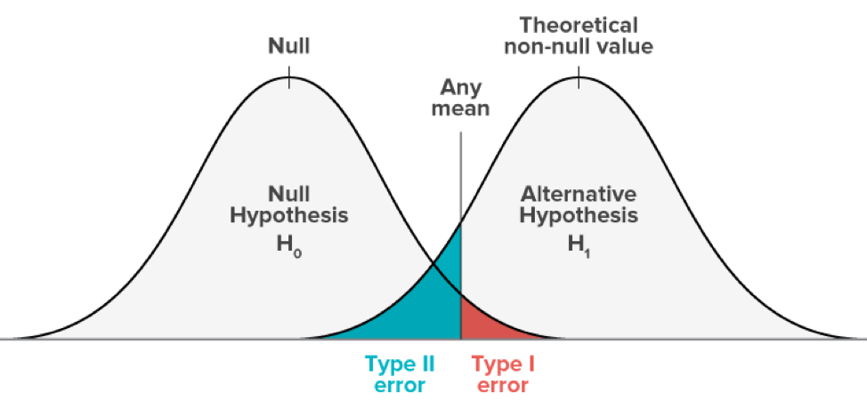
Visualized Example

Slide 12
P Values
Introduced as a general guideline in the 1920s by Ronald Fisher
Bayesian viewpoint is that the more implausible a hypothesis is, the greater the odds of a false positive regardless of p value

Slide 13
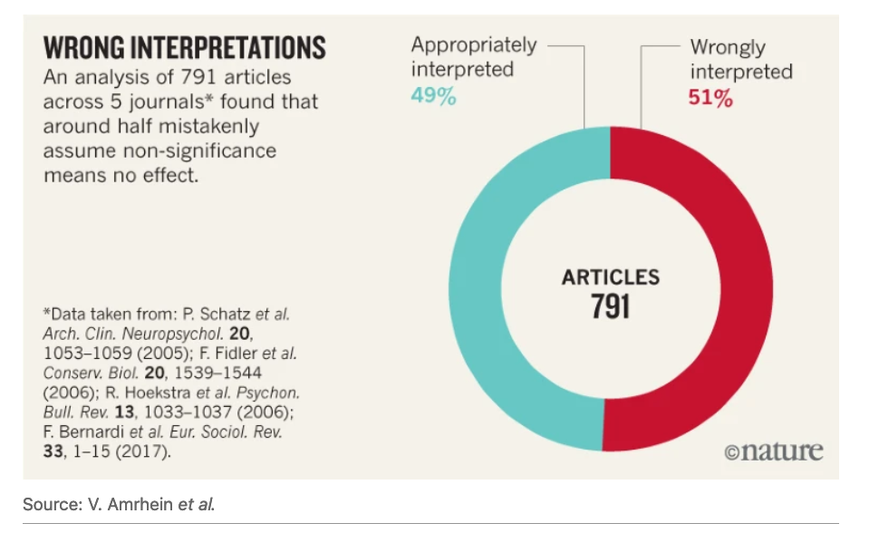
https://www-nature-com.ezproxy.med.nyu.edu/articles/d41586-019-00857-9

Slide 14
P Hacking
Because p values are a probability, if we run enough tests, eventually we will get a p value under .05 even though there is no difference (Type 1 error)
Other ways we may p hack include:
Non-transparent inclusion/exclusion criteria
Running tests on subsets until significance is found
Only reporting significant findings

Slide 15
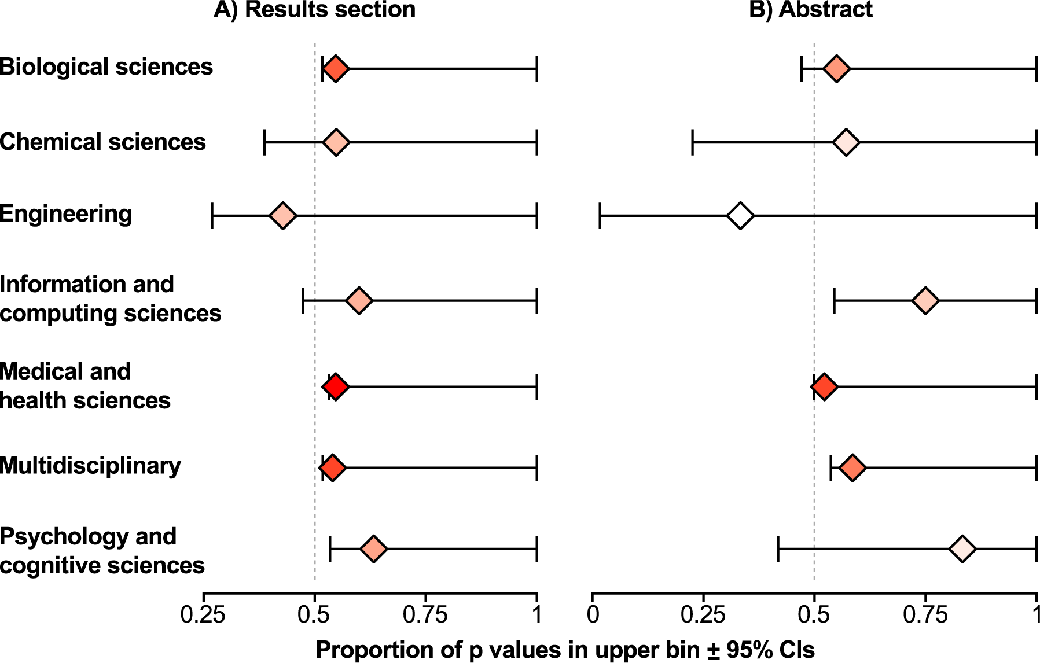
P Hacking Common
2015 study found p Hacking widespread in a text mining paper: https://journals.plos.org/plosbiology/article?id=10.1371/journal.pbio.1002106#sec010

Slide 16
To avoid issues around reporting significance
Report effect size
Report confidence intervals
Report number of tests run
When running multiple tests, conduct p value adjustments, such as FWER, FDR or Bonferroni

Slide 17
What do you feel are the benefits and drawbacks of reporting significance (e.g. p < .001) in research? How might the drawbacks be overcome?
ⓘ
Click Present with Slido or install our Chrome extension to activate this poll while presenting.
Notes:
📣 This is Slido interaction slide, please don't delete it. ✅ Click on 'Present with Slido' and the poll will launch automatically when you get to this slide.

Slide 18
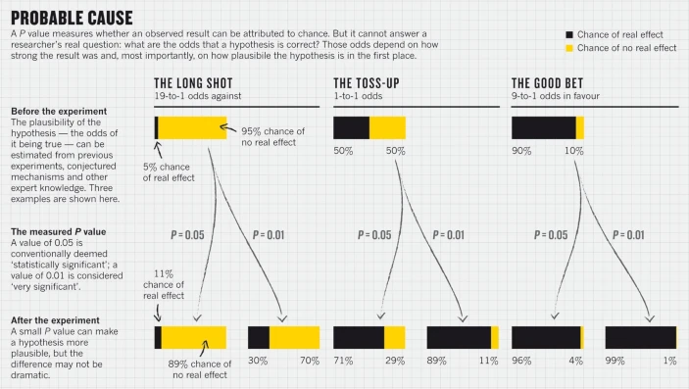
Nuzzo 2014
In Bayesian statistics, the prior probability of a result impacts the likelihood we should accept that finding.
Scientific method: Statistical errors | Nature

Slide 19
Power

Slide 20
Power
The power of a study refers to the probability of failing to reject the null hypothesis when a difference really exists (Type II Error)
So if power is 80% that means the magnitude of difference observed would be detected as a difference (i.e. the null hypothesis would be rejected in 8 out of 10 cases).
Beta 𝛃 is sometimes employed to describe the ideal power level.

Slide 21
Visualized Example

Slide 22
Power
Power is impacted by a) the sample size, b) the magnitude of effect being detected, c) the type of test being run, d) the significance or alpha level (often .05)
A larger study with more experimental units being examined can detect smaller effect sizes.

Slide 23
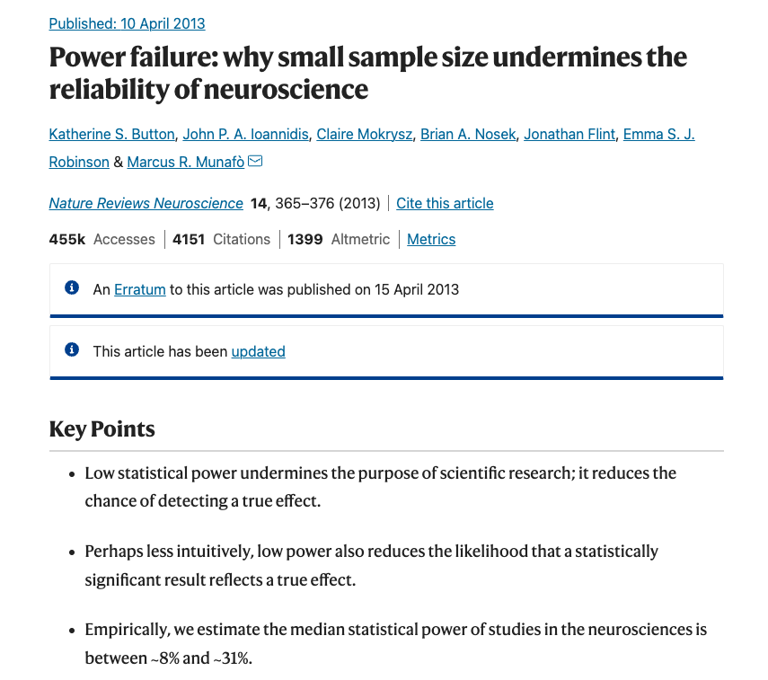
Power
Neuroscience review found median power of studies to be between 8% and 31%
https://www.nature.com/articles/nrn3475

Slide 24
In your view, what does a power of 8%-31% mean for the likelihood of discovery?
ⓘ
Click Present with Slido or install our Chrome extension to activate this poll while presenting.
Notes:
📣 This is Slido interaction slide, please don't delete it. ✅ Click on 'Present with Slido' and the poll will launch automatically when you get to this slide.

Slide 25
Power
For 8%-31% power, we would expect to reject the null hypothesis only 8%-31% of the time, greatly increasing the likelihood of type II error

Slide 26
Power and Winner’s Curse
Moreover, with smaller samples of experimental units (i.e. the N of a study), only larger magnitude effects will be detectable.
This means that it is more common for low powered studies that are published to demonstrate larger effects.
In these cases, replication often fails to demonstrate as large an effect.

Slide 27
Bias

Slide 28
In the context of scientific research, how would you define "bias?"
ⓘ
Click Present with Slido or install our Chrome extension to activate this poll while presenting.
Notes:
📣 This is Slido interaction slide, please don't delete it. ✅ Click on 'Present with Slido' and the poll will launch automatically when you get to this slide.

Slide 29
Error & Bias
Error:
The difference between true values and observed values
Bias: The systematic introduction of error

Slide 30
Can you name some areas where bias may be introduced into research?
ⓘ
Click Present with Slido or install our Chrome extension to activate this poll while presenting.
Notes:
📣 This is Slido interaction slide, please don't delete it. ✅ Click on 'Present with Slido' and the poll will launch automatically when you get to this slide.

Slide 31
Blinding Assessors
Blinding: Concealing membership of which treatment group to assessors.
2014 meta-analysis looked at 10 studies comprising 2450 animals
Found unblinded studies Odds Ratios were larger by 59%
https://www-sciencedirect-com.ezproxy.med.nyu.edu/science/article/pii/S0895435614001577

Slide 32
Randomization
Meta-analysis of meta-analyses on stroke research found randomized studies showed effects about ¼ smaller than non-randomized
https://journals.plos.org/plosone/article?id=10.1371/journal.pone.0098856

Slide 33

What do you perceive as barriers to and benefits of blinding and randomization?
ⓘ
Click Present with Slido or install our Chrome extension to activate this poll while presenting.
Notes:
📣 This is Slido interaction slide, please don't delete it. ✅ Click on 'Present with Slido' and the poll will launch automatically when you get to this slide.

Slide 34
Blinding and Randomization
2019 study of 574 papers found 56% reported randomization, and 31% reported blinding
Up from 25% and 24% in 2014
https://journals.plos.org/plosone/article?id=10.1371/journal.pone.0215221
https://journals.plos.org/plosone/article?id=10.1371/journal.pone.0089981

Slide 35
Transparent Reporting

Slide 36
Have you ever participated in research where any of the following were not reported (check all that apply)
ⓘ
Click Present with Slido or install our Chrome extension to activate this poll while presenting.
Notes:
📣 This is Slido interaction slide, please don't delete it. ✅ Click on 'Present with Slido' and the poll will launch automatically when you get to this slide.

Slide 37
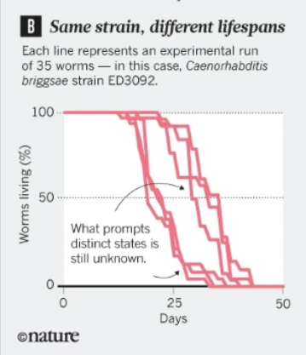
Kilkenny et. al. 2009
Systematic review of methods found very high proportions of studies lacking basic biological information such as numbers of animals, weight, age, and sex.
12% randomized and 14% blinded.
https://journals.plos.org/plosone/article?id=10.1371/journal.pone.0007824

Slide 38
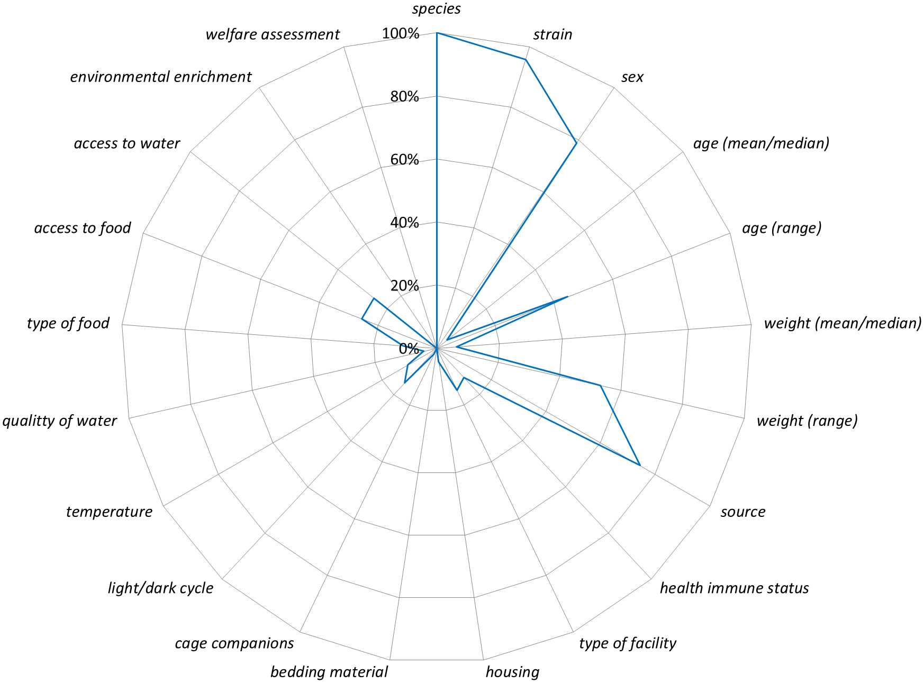
Avey et. al. 2016
Found key methods information often lacking
No difference found in high “impact” vs low.
https://journals.plos.org/plosone/article?id=10.1371/journal.pone.0166733

Slide 39
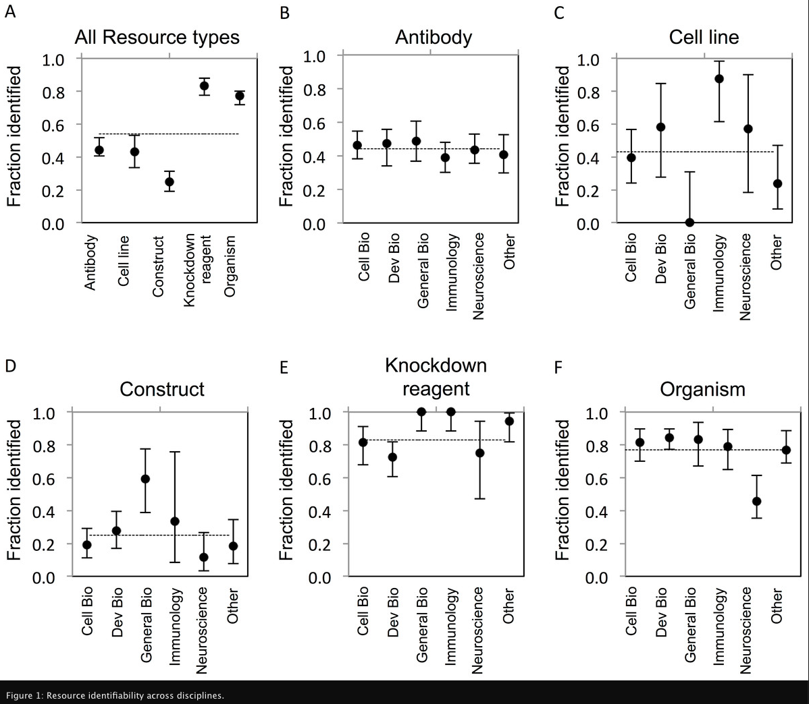
Vasilevsky et. al. 2013
54% (922/1703) of evaluated resources were uniquely identifiable

Slide 40
Checklists
Increasingly journals recommend that researchers use methods checklists, which are often framed around specific disciplines.
2018 survey found 49% of respondents felt checklists improve the quality of research
https://www.nature.com/articles/d41586-018-04590-7

Slide 41
Checklists
A few common checklists, Nature’s, Cell’s Star Methods and ARRIVE.
These are not exhaustive and I recommend checking out if there are any specific to your discipline.

Slide 42
Have you ever used a checklist in reporting your research?
ⓘ
Click Present with Slido or install our Chrome extension to activate this poll while presenting.
Notes:
📣 This is Slido interaction slide, please don't delete it. ✅ Click on 'Present with Slido' and the poll will launch automatically when you get to this slide.

Slide 43
Methods Reporting Resources

Slide 44
Methods Reporting Resources
Protocols.io: a repository for citing and reporting methods: https://www.protocols.io/
Created by a researcher after 1.5 replicability attempt

Slide 45
Methods Reporting Resources
Protocols publications:
Cold Spring Harbor Protocols
Nature Protocols
Journal of Visualized Experiments: JoVE
source: https://hslguides.med.nyu.edu/basicsciencetoolkit/sciencetoolkit/research-support

Slide 46
Group Exploration
Protocols publications:
In your group, look up a research method of your choosing, see if you can identify anything of use, and in 5 minutes we will report back (choose a speaker).
Cold Spring Harbor Protocols Group 1
Nature Protocols Group 2
Journal of Visualized Experiments: JoVE Group 3
https://www.protocols.io/ Group 4

Slide 47
Review

Slide 48
Which of the following is not true of p values
ⓘ
Click Present with Slido or install our Chrome extension to activate this poll while presenting.
Notes:
📣 This is Slido interaction slide, please don't delete it. ✅ Click on 'Present with Slido' and the poll will launch automatically when you get to this slide.

Slide 49
Which of the following is a benefit of blinding?
ⓘ
Click Present with Slido or install our Chrome extension to activate this poll while presenting.
Notes:
📣 This is Slido interaction slide, please don't delete it. ✅ Click on 'Present with Slido' and the poll will launch automatically when you get to this slide.

Slide 50
Choose the correct option: Checklists like ARRIVE help researchers to...
ⓘ
Click Present with Slido or install our Chrome extension to activate this poll while presenting.
Notes:
📣 This is Slido interaction slide, please don't delete it. ✅ Click on 'Present with Slido' and the poll will launch automatically when you get to this slide.

Slide 51

Homework
Review a publishing guideline of your choosing, for example, Cell’s Star Methods, https://www.cell.com/pb-assets/journals/research/cell/methods/Methods_Guide_general-1678470557763.pdf, Nature’s Checklist https://www.nature.com/documents/Reporting_checklist_new.doc the Arrive guidlelines
https://arriveguidelines.org/arrive-guidelines/inclusion-and-exclusion-criteria/3c or another of your choosing and write a 300 word reflection on a) how the guideline might help someone doing your specific research improve reproducibility and b) drawbacks or barriers to following the guideline for someone in your field. Be specific about how the guidelines relate to your area of work.

Slide 52

Have a great week!
fred.lapolla@nyulangone.org

Slide 53
References
Alawbathani S, Batool M, Fleckhaus J, Hamad S, Hassenrück F, Hou Y, et al. A teaching tool about the fickle p value and other statistical principles based on real-life data. Naunyn Schmiedebergs Arch Pharmacol [Internet]. 2021 Jan 14 [cited 2021 Jan 28]; Available from: https://doi.org/10.1007/s00210-020-02045-3
2. Chavalarias D, Wallach JD, Li AHT, Ioannidis JPA. Evolution of Reporting P Values in the Biomedical Literature, 1990-2015. JAMA. 2016 Mar 15;315(11):1141–8.
3. Amrhein V, Greenland S, McShane B. Scientists rise up against statistical significance. Nature. 2019 Mar;567(7748):305–7.
4. Head ML, Holman L, Lanfear R, Kahn AT, Jennions MD. The Extent and Consequences of P-Hacking in Science. PLOS Biol. 2015 Mar 13;13(3):e1002106.
5. Vasilevsky NA, Brush MH, Paddock H, Ponting L, Tripathy SJ, LaRocca GM, et al. On the reproducibility of science: unique identification of research resources in the biomedical literature. PeerJ. 2013 Sep 5;1:e148.
6. Scientific method: Statistical errors | Nature [Internet]. [cited 2023 Aug 21]. Available from: https://www.nature.com/articles/506150a
7. Button KS, Ioannidis JPA, Mokrysz C, Nosek BA, Flint J, Robinson ESJ, et al. Power failure: why small sample size undermines the reliability of neuroscience. Nat Rev Neurosci. 2013 May;14(5):365–76.
8. Bello S, Krogsbøll LT, Gruber J, Zhao ZJ, Fischer D, Hróbjartsson A. Lack of blinding of outcome assessors in animal model experiments implies risk of observer bias. J Clin Epidemiol. 2014 Sep 1;67(9):973–83.
9. Hirst JA, Howick J, Aronson JK, Roberts N, Perera R, Koshiaris C, et al. The Need for Randomization in Animal Trials: An Overview of Systematic Reviews. PLOS ONE. 2014 Jun 6;9(6):e98856.
10. Kilkenny C, Parsons N, Kadyszewski E, Festing MFW, Cuthill IC, Fry D, et al. Survey of the Quality of Experimental Design, Statistical Analysis and Reporting of Research Using Animals. PLOS ONE. 2009 Nov 30;4(11):e7824.
11. Fergusson DA, Avey MT, Barron CC, Bocock M, Biefer KE, Boet S, et al. Reporting preclinical anesthesia study (REPEAT): Evaluating the quality of reporting in the preclinical anesthesiology literature. PLOS ONE. 2019 May 23;14(5):e0215221.
12. The ARRIVE guidelines 2.0 | ARRIVE Guidelines [Internet]. [cited 2023 Aug 15]. Available from: https://arriveguidelines.org/arrive-guidelines
13. STAR Methods: Cell Press [Internet]. [cited 2023 Aug 15]. Available from: https://www.cell.com/star-authors-guide
14. Checklists work to improve science. Nature. 2018 Apr 18;556(7701):273–4.

