Slide 1
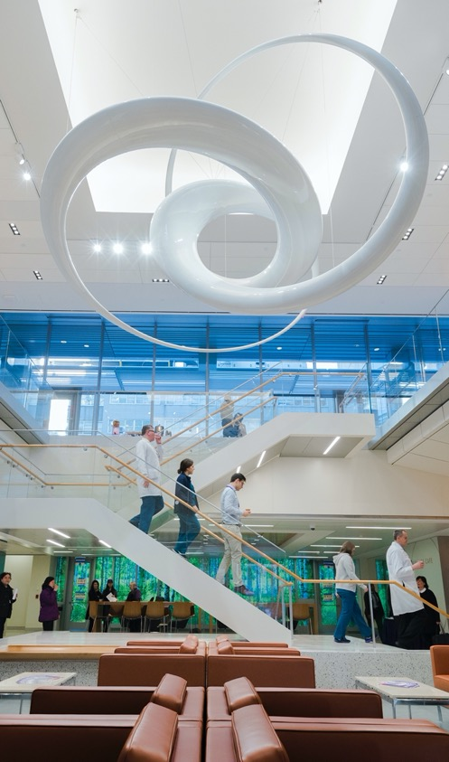
Rigor and Reproducibility:
Scientific Premise II
Fred LaPolla MLS

Slide 2
Review

Slide 3


If we want to narrow down our search results by including abstracts that include terms relating to both a population/problem and a specific exposure/intervention we would type:
ⓘ
Click Present with Slido or install our Chrome extension to activate this poll while presenting.
Notes:
📣 This is Slido interaction slide, please don't delete it. ✅ Click on 'Present with Slido' and the poll will launch automatically when you get to this slide.

Slide 4
Why at the current time is ChatGPT a poor literature finding tool
ⓘ
Click Present with Slido or install our Chrome extension to activate this poll while presenting.
Notes:
📣 This is Slido interaction slide, please don't delete it. ✅ Click on 'Present with Slido' and the poll will launch automatically when you get to this slide.

Slide 5
What is a good database for following citation chains (what papers cited a given paper, and what papers that paper cited)
ⓘ
Click Present with Slido or install our Chrome extension to activate this poll while presenting.
Notes:
📣 This is Slido interaction slide, please don't delete it. ✅ Click on 'Present with Slido' and the poll will launch automatically when you get to this slide.

Slide 6
What database has a similar biological/life science scope to PubMed but more international and pharmaceutical coverage?
ⓘ
Click Present with Slido or install our Chrome extension to activate this poll while presenting.
Notes:
📣 This is Slido interaction slide, please don't delete it. ✅ Click on 'Present with Slido' and the poll will launch automatically when you get to this slide.

Slide 7
Agenda
Literature reviewing for reproducibility
Employing LLM for appraisal

Slide 8
Outcomes
Students will be able to identify sources of bias and error in a methods section
Students will be able to employ new technologies to help in literature summaries
Students will be able to explain strengths and weaknesses of a research article

Slide 9
Key Items to Identify in Methods

Slide 10

What were some of the ways bias may be introduced in a study?
ⓘ
Click Present with Slido or install our Chrome extension to activate this poll while presenting.
Notes:
📣 This is Slido interaction slide, please don't delete it. ✅ Click on 'Present with Slido' and the poll will launch automatically when you get to this slide.

Slide 11
Common sources of Bias and Error
Bias
Lack of randomization
Lack of blinding
Population selection problems
Housing differences
Analysis flaws
Publication bias
Error
Accuracy of measurements
Imprecise measurements
Human error
Reporting errors

Slide 12
Thinking back to your memory of the various guidelines we saw, what are some things we want to report on in our methods to increase reproducibility and decrease bias?
ⓘ
Click Present with Slido or install our Chrome extension to activate this poll while presenting.
Notes:
📣 This is Slido interaction slide, please don't delete it. ✅ Click on 'Present with Slido' and the poll will launch automatically when you get to this slide.

Slide 13
Review the methods for this paper and evaluate strengths and weaknesses from a reproducibility standpoint
https://www-nature-com.ezproxy.med.nyu.edu/articles/s41417-023-00629-8

Slide 14

What were some strengths and weaknesses of the methods section?
ⓘ
Click Present with Slido or install our Chrome extension to activate this poll while presenting.
Notes:
📣 This is Slido interaction slide, please don't delete it. ✅ Click on 'Present with Slido' and the poll will launch automatically when you get to this slide.

Slide 15
Optimizing AI for Literature Review

Slide 16
Have you ever used an AI tool to summarize or appraise literature?
ⓘ
Click Present with Slido or install our Chrome extension to activate this poll while presenting.
Notes:
📣 This is Slido interaction slide, please don't delete it. ✅ Click on 'Present with Slido' and the poll will launch automatically when you get to this slide.

Slide 17
AI Tips
Do not upload proprietary information into a public AI interface.

Slide 18
AI Tips
Do not upload Private Health Information into a public AI interface.

Slide 19
AI Tips
Contact the AI team for proprietary cases: https://med.nyu.edu/centers-programs/healthcare-innovation-delivery-science/predictive-analytics-unit

Slide 20
AI Tips
Currently for summaries, Bing Chat may be more useful than chat.openai.com or Google Bard (in my experience as of August 2023).
This is because it can go to websites to search unlike chat.openai.com, and in my experience just did a better job than Bard.

Slide 21
AI Tips
Sample prompt (your mileage may vary):
Summarize strengths and weaknesses of the following methods section from a standpoint of following the Arrive guidelines, site: https://arriveguidelines.org/arrive-guidelines. Explain your reasoning at each step. Place results in a table. If you do not know, write "IDK": """ <text here>

Slide 22
AI Tips
Be specific in what you want the tool to do:
Summarize strengths and weaknesses of the following methods section from a standpoint of following the Arrive guidelines, site: https://arriveguidelines.org/arrive-guidelines. Explain your reasoning at each step. Place results in a table. If you do not know, write "IDK": """ <text here>

Slide 23
AI Tips
Refer to a source by which to summarize, in order to lower the odds of hallucination:
Summarize strengths and weaknesses of the following methods section from a standpoint of following the Arrive guidelines, site: https://arriveguidelines.org/arrive-guidelines. Explain your reasoning at each step. Place results in a table. If you do not know, write "IDK": """ <text here>

Slide 24
AI Tips
In Bing, site: <some url> is a way to refer to an external source
Summarize strengths and weaknesses of the following methods section from a standpoint of following the Arrive guidelines, site: https://arriveguidelines.org/arrive-guidelines. Explain your reasoning at each step. Place results in a table. If you do not know, write "IDK": """ <text here>

Slide 25
AI Tips
Having the AI walk through reasoning can help us ascertain if what it did makes sense and help us understand why.
Summarize strengths and weaknesses of the following methods section from a standpoint of following the Arrive guidelines, site: https://arriveguidelines.org/arrive-guidelines. Explain your reasoning at each step. Place results in a table. If you do not know, write "IDK": """ <text here>

Slide 26
AI Tips
Putting information in a table is my personal preference to make it easier to read
Summarize strengths and weaknesses of the following methods section from a standpoint of following the Arrive guidelines, site: https://arriveguidelines.org/arrive-guidelines. Explain your reasoning at each step. Place results in a table. If you do not know, write "IDK": """ <text here>

Slide 27
AI Tips
Offer the AI an “out” to avoid invented information
Summarize strengths and weaknesses of the following methods section from a standpoint of following the Arrive guidelines, site: https://arriveguidelines.org/arrive-guidelines. Explain your reasoning at each step. Place results in a table. If you do not know, write "IDK": """ <text here>

Slide 28
AI Tips
Demarcate text to analyze clearly
Summarize strengths and weaknesses of the following methods section from a standpoint of following the Arrive guidelines, site: https://arriveguidelines.org/arrive-guidelines. Explain your reasoning at each step. Place results in a table. If you do not know, write "IDK": """ <text here>

Slide 29
AI Tips
Break up the text since it will be too long for one exchange
Summarize strengths and weaknesses of the following methods section from a standpoint of following the Arrive guidelines, site: https://arriveguidelines.org/arrive-guidelines. Explain your reasoning at each step. Place results in a table. If you do not know, write "IDK": """ <text here>

Slide 30
AI Tips
Evaluate the Results

Slide 31
Try an AI tool, if you want, to review the methods for this paper and evaluate strengths and weaknesses from a reproducibility standpoint
https://www-nature-com.ezproxy.med.nyu.edu/articles/s41417-023-00629-8

Slide 32
How did your experience compare?
ⓘ
Click Present with Slido or install our Chrome extension to activate this poll while presenting.
Notes:
📣 This is Slido interaction slide, please don't delete it. ✅ Click on 'Present with Slido' and the poll will launch automatically when you get to this slide.

Slide 33
Review

Slide 34
Which of the following may hinder reproducibility of a research study
ⓘ
Click Present with Slido or install our Chrome extension to activate this poll while presenting.
Notes:
📣 This is Slido interaction slide, please don't delete it. ✅ Click on 'Present with Slido' and the poll will launch automatically when you get to this slide.

Slide 35
What are key details to look for when appraising literature?
ⓘ
Click Present with Slido or install our Chrome extension to activate this poll while presenting.
Notes:
📣 This is Slido interaction slide, please don't delete it. ✅ Click on 'Present with Slido' and the poll will launch automatically when you get to this slide.

Slide 36
Name ways you might avoid writing non-reproducible methods sections.
ⓘ
Click Present with Slido or install our Chrome extension to activate this poll while presenting.
Notes:
📣 This is Slido interaction slide, please don't delete it. ✅ Click on 'Present with Slido' and the poll will launch automatically when you get to this slide.

Slide 37
Homework
Identify an article of interest to you and provide a link in your submission. Using what we learned in class, briefly summarize two strength and two weakness with regards to reproducibility in bias, and refer to checklists relevant to your article’s domain.
Suggested articles:
Defining the proteomic landscape of cultured macrophages and their polarization continuum https://onlinelibrary-wiley-com.ezproxy.med.nyu.edu/doi/10.1111/imcb.12687
A Patient-Derived Glioblastoma Organoid Model and Biobank Recapitulates Inter- and Intra-tumoral Heterogeneity - PMC (nyu.edu)
Next
Write a reflection on why you believe researchers may choose to include or exclude the information that this paper provided. How could researchers set themselves up for success in reporting relevant information in their papers and what sorts of barriers make it a challenge?

Slide 38

Have a great week!
fred.lapolla@nyulangone.org

Slide 39
References
1. DeSimone D. Plovnick, C. Subject Guides: AI in Healthcare: Educational Resources [Internet]. [cited 2023 Aug 21]. Available from: https://hslguides.med.nyu.edu/aihsl/education

